Slide 1
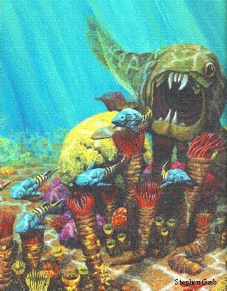
PLACODERMS:
Monsters of the Sea
Notes:
http://www.uky.edu/KGS/coal/webfossl/pages/placoderms.html

Slide 2
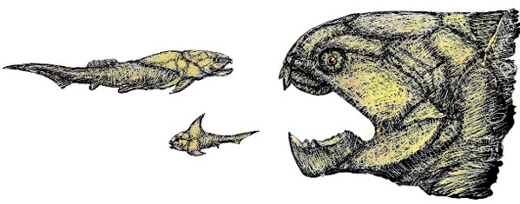
What are they?
Placoderms are an extinct group of jawed fishes.
They are best known for their heavy armored plates on their
head and body.
Notes:
http://www.mdgekko.com/devonian/neighborhood/Placoderms/placoderm.html

Slide 3
When did they live?
Placoderms evolved during the Silurian Period.
They reached their highest peak of diversity during the Devonian Period (“The Age of Fishes”)
During this time, they dominated marine and freshwaters.
Notes:
http://www.mdgekko.com/devonian/neighborhood/Placoderms/placoderm.html

Slide 4
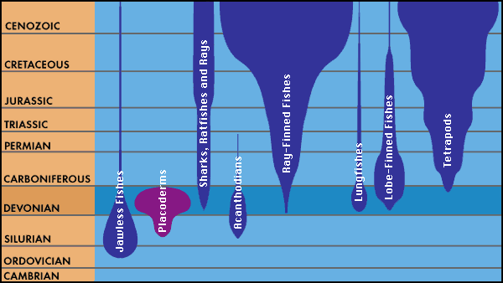
TIME LINE
Notes:
http://www.mdgekko.com/devonian/neighborhood/Placoderms/placoderm.html

Slide 5
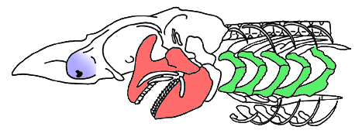
Class Placodermi
Placodermi is one of the earliest classes of gnathostomes, or jawed fishes
Notes:
http://tolweb.org/tree?group=Gnathostomata&contgroup=Vertebrata (picture)
http://www.ucmp.berkeley.edu/vertebrates/basalfish/placodermi.html

Slide 6
BONY ARMOR
Placoderms, whose name means plated skin, had large shields made of dermal bone covering their head and thorax.
The rest of their bodies contained small bony scales for further protection.
Notes:
http://www.mdgekko.com/devonian/neighborhood/Placoderms/placoderm.html

Slide 7
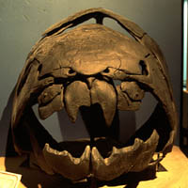
BONY Armor (cont.)
Placoderms lacked teeth, but instead had large dermal plates covering their mouths.
These plates, sometimes razor-sharp, were used for biting and chewing.
Notes:
http://www.mdgekko.com/devonian/neighborhood/Placoderms/placoderm.html
http://www.ucmp.berkeley.edu/vertebrates/basalfish/placodermi.html (picture and text)

Slide 8
PLACODERMS CAPTURED!
About 200 genera of placoderms have existed, most during the Devonian Period.
Several of fossils of these different types of Placodermi have been discovered and can be viewed at various museums around the world, such as Canada, Scotland, and Germany.
Notes:
http://www.mdgekko.com/devonian/neighborhood/Placoderms/placoderm.html
http://www.toyen.uio.no/palmus/galleri/montre/english/placoderms_liste_e.htm

Slide 9

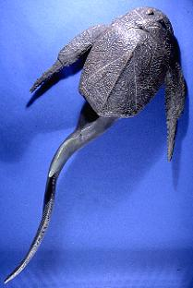
Bothriolepis
A fossil of Bothriolepis, a species of Placodermi, can be seen in Scaumenac Bay, Canada
It was common in fresh and brackish waters of the late Devonian Period.
Notes:
http://www.toyen.uio.no/palmus/galleri/montre/english/x18.htm

Slide 10
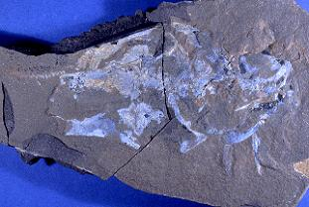
Coccosteus
Another example of a placoderm fossil, Coccosteus, which was prominent during the middle Devonian, is on display in Scotland.
This picture shows parts of the head and body armor.
Notes:
http://www.toyen.uio.no/palmus/galleri/montre/english/162_477.htm

