Slide 1

http://7thfloormedia.com/projects/safari/newsletter/wednesday/hagfish.html
Designed by: Jed Robinson

Slide 2
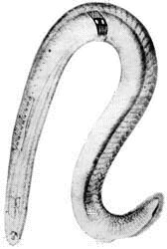
Introduction To Hagfish
Hagfish are a primitive jawless fish that live in deep marine environments1. They have a long, slender body resembling that of an eel or a lamprey2. They belong to the order Myxiniformes, which some regard as the sister group of all other craniates. There are 45 living species3 of hagfish divided into four genera: Myxine, Neomyxine, Paramyxine, and Eptatretus2.
http://oceanlink.island.net/oinfo/hagfish/hagfish.html

Slide 3
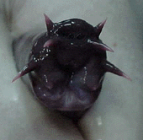
Body Structures
(or lack thereof)
http://oceanlink.island.net/oinfo/hagfish/hagfish.html
Hagfish are almost blind, yet they do have very good senses of smell and touch. They lack jaws but do have four pairs of sensory tentacles around the mouth. They have a tongue-like structure equipped with two pairs of tooth-like rasps which are used to tear away flesh. They lack a stomach and a cerebrum or cerebellum. The skeleton is composed completely of cartilage. They have a partial cranium and do not have vertebrae4. They do have a notochord which acts as their main axial support3.

Slide 4
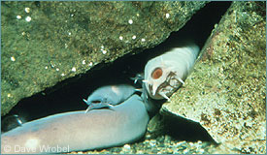
Where Do They Live?
http://www.mbayaq.org/efc/living_species/default.asp?hOri=1&inhab=198
Hagfish live in the cold waters of the antitroprical regions of the northern and southern hemispheres. They tend to live in very dense populations with up to 15,000 living in a small area. They live on the ocean floor scavenging on dead or dying fish and small invertebrates (i.e. polychaete worms). They have a slow metabolism allowing them to go up to seven months without eating4.

Slide 5
Diversity Within The Hagfish Genres
The Myxine and Neomyxine are considered to be more advanced than Paramyxine and Eptatretus for the following reasons2:
The first two have a single pair of external gill openings while the latter two have two small separate gill openings. Paramyxine’s openings are closer together than Eptatretus’ and is therefore more closely related to the first two2.
Myxine and Neomyxine have smaller eyes than the latter two groups, which is considered a less primitive condition2.

Slide 6


Relation To Other Vertebrates
:
Hagfish:http://www.hmsc.orst.edu/odfw/devfish/sp/hagfish.html
Lamprey:http://www.fisheries.vims.edu/lamprey.htm
There is some controversy in the classification of hagfish and how they are related to other vertebrates. Hagfish have been included in the clade Cyclostomi, along with lampreys. Cyclostomi were thought to be a sister-group to Gnathostomata (jawed-vertebrates). Recent evidence has suggested that cyclostomes are paraphyletic and that hagfishes are actually a sister-group to lampreys and gnathostomes. This means that hagfish are the sister-group to all other craniates, or to Vertebrates5.

Slide 7
What Is So Special About Hagfish?
Hagfish have many characteristics that are extremely unique:
They have a main heart along with three accessory hearts6.
They are born as hermaphrodites, meaning that they have gonads of both sexes. As an adult, they can change sex from season to season4.
They have large slime glands that line the length of their body. They produce huge amounts of slime as a form of defense mechanism2. Hence, they are sometimes called slime hags3.

Slide 8
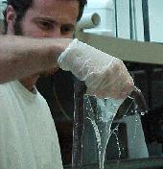
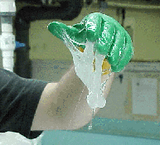
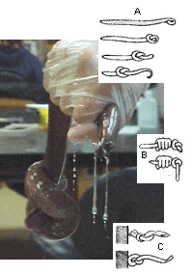
Special features cont’d
Slime produced by hagfish
http://oceanlink.island.net/oinfo/hagfish/hagfish.html
They can also “sneeze” when their nostrils become clogged by their own slime2.
They can tie themselves in knots to either2:
a.) clean slime off their body2
b.) escape from predators2
c.) tear off pieces of food2
http://oceanlink.island.net/oinfo/hagfish/hagfish.html

Slide 9
Sources
http://www.mbayaq.org/efc/living_species/default.asp?hOri=1&inhab=198
http://oceanlink.island.net/oinfo/hagfish/hagfish.html
Liem, Karel F., et al. Functional Anatomy of the Vertebrates. New York: Harcourt College Publishers, 2001. p. 53.
http://www.ucmp.berkeley.edu/vertebrates/basalfish/myxini.html
http://tolweb.org/tree?group=Hyperotreti&contgroup=Craniata
http://healthlink.mcw.edu/article/980877037.html

