Slide 1
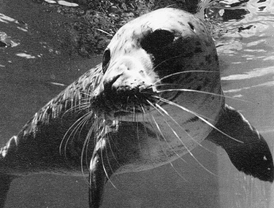
Vibrissae
By Lisa Komoroske
Source: Sea World

Slide 2
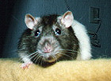
What are they??
Source: Salmon
“Vibrissae are stubble-like whiskers that Cetaceans have on their snouts. Vibrissae are used as tactile indicators - like a cat's whiskers”
Definition from: Enchanted Learning

Slide 3
More Detailed:
Vibrissae or whiskers are hairs that are usually long, straight, and stiff. Their bases are well-supplied with nerves, and vibrissae are very sensitive to touch. They provide the animal with information about its immediate surroundings. Vibrissae are usually restricted to certain parts of the body and are often found in tufts or clumps. Most commonly found on the faces of carnivorous/omnivorous mammals, they also are found on other parts of the body, for example, on the ankles of a squirrel or the rump of some crevice-roosting bats.
Source: Animal Diversity

Slide 4
How Do They Work??
Vibrissae have specialized nerve follicles that are deeply imbedded into the facial muscles where they are attached to a dense nerve network that connects them to the brain.
Vibrissae are the equivalent to human fingertips which use receptors to “feel” one’s surroundings through tactile sensory.
“Whiskers,” however, are much more sensitive. Vibrassae can keenly reflect minor irritation by catching vibrations of air. They do not have to touch an object, they just need to catch air currents which form as an animal approaches different objects. The minor vibration of the tip of the hair is transferred to the root where it is perceived by sensitive nerves endings and then they immediately inform brain.
Whiskers are more than twice as thick as ordinary hairs, and their roots are set three times deeper.

Slide 5
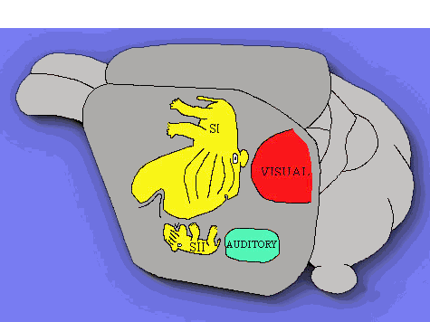
Source: Sissa
The sensory section of a rat’s brain is over double the size of its visual and auditory sections combined. This means that the rat and other like mammals rely more heavily on tactile vibrissae than any other sense.

Slide 6
Where Did Vibrissae
Come From??
“We do not know when hair evolved, as it is usually not preserved in fossils. Pits in the fossilized rostrum of the some Cretaceous therapsids may be an indirect indication of the presence of vibrissae (McLoughlin, 1980); if so, these provide the first direct evidence of hair. The small body size (i.e., high surface area to mass ratio and therefore propensity to loose heat) and possible endothermy of the earliest mammals and their immediate ancestors suggest that they could not have existed without a good covering of insulation. So it is likely that these animals had hair, and most reconstructions of them show their bodies covered with fur (e.g., Savage and Long, 1986). But was insulation the primitive function of hair, the reason why it originally evolved? Insulation is the most conspicuous and perhaps the most universal function of hair in modern mammals, but hair doesn't serve as effective insulation until it is fairly well developed as pelage. It may be that the first hairs evolved as sensory outgrowths between the scales of some ancestral therapsid, and only later took on the function of insulation.”
Source: Animal Diversity

Slide 7
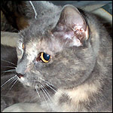
Who Has Vibrissae?
Since whiskers offer an alternative method to detecting one’s surroundings to vision and hearing, it makes sense that the animals that use them live in environments where conditions for the latter are less than ideal. Vibrissae are most commonly found on nocturnal or aquatic animals that live in murky water (where vision and echolocation are not viable).
Source: Pet Place

Slide 8
Whales have evolutionarily lost all body hair except vibrissae.
Vibrissae in dogs are served by the largest of the 12 pair of cranial nerves.
        Source: Bernese
Cats have about 24 moveable whiskers, twelve on either side of his nose, arranged in four rows in a pattern as individual as our fingerprints. The strongest and thickest are in the middle rows.
Source: Pet Place
  About 400-700 vibrissae make up the “mustache” of a walrus. Walruses use their mystacial vibrissae to feel for prey buried in the sea floor sediment.
  Source: Walrus Research

Slide 9
Special Adaptations for Aquatic Use:
Research with Manatees and Harbor Seals have found that the use of vibrissae is essential to navigation, food acquisition, and safety (i.e. avoiding speed boats, predators, etc.)
Sensory reception on these aquatic mammals with vibrissae is similar to the lateral line system adopted by many fishes.

Slide 10
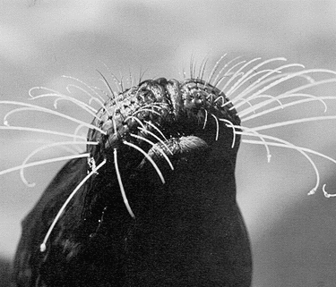
Experiments with Harbor Seals have found direct correlation between vibrissae capacity and water motion detection. Although the seals were able to detect the motion 80% of the time even when their eyes or ears were covered, when their vibrissae were covered they were NEVER able to detect the moving object.
Source: Washington
Source: Sea World

Slide 11
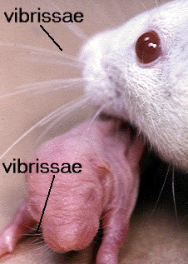
Although vibrissae are the first hair to form embryologically and are fully functional at birth while ears and eyes are not, newborns do not usually grow normal vibrissae until c. six months of age. Mother cats have been known to bite off vibrissae of young, believed to be a technique for keeping them from leaving the nest too soon.
Source: Greenfield
Source: Salmon

Slide 12
Vibrissae are deeply innervated and are not shed during molting.
Sometimes they come out one by one, replacing themselves through time.
Source: Greenfield
Length of vibrissae seems to correlate with the ecology of the animal:
e.g. -Burrowing mice have vibrissae that are shorter than arboreal species.
-Vibrissae of bears are considerably shorter than those of hunting canines and felines.
Source: Bernese

Slide 13
Final Random Facts:
Amputation of vibrissae in rats has been shown to affect locomotor activity, depth perception, swimming ability, shock-induced fighting, emotionality, tacticle maze learning, equilibrium and discrimination of surfaces.
Removal of vibrissae lowers general activity in cats.
Vibrissae of seals are sensitive to vibrations from 50 to 1000 Hz. Source: Bernese
Carpal vibrissae are most common in carnivores that grasp their prey with their forelegs.
Source: Pet Place
In the facial mimics whiskers play a very important role. Cat may move them forward during the pleasant wait for caress or press them to the muzzle during the angry grin.
Source: Greenfield

