Slide 1
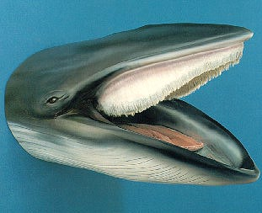
Baleen
An Adaptation of Marine Mammals for Filter Feeding
Photo courtesy of the Natural History Museum of Los Angeles County
Project By Stephen Miles

Slide 2
What is Baleen Anyway?
Baleen is a series of keratin sheets which have evolved in a number of whales to allow filter feeding. Suspended from the upper jaw of whales, baleen grows throughout their lifetime. In addition, the free end of the baleen is continually worn down. It is both a strong and a flexible material which has historically been used for many uses under the name “whalebone”. Baleen can grow up to 12 feet in some whales. Some whales have several hundred individual baleen plates in their mouths.

Slide 3
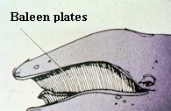
Baleen in more Detail
Baleen is actually a series of hundreds of small keratin sheets. Each sheet is suspended from the upper jaw and are very closely associated near the jaw. Distally the baleen becomes feathery and more loosely associated. The inside surface of baleen is frayed to help catch food while the outside edge is smooth.
Did you realize?
Baleen is made of keratin just like human fingernails and hair and similarly grows throughout the whales’ life.
Photo Courtesy of the National Marine Mammal Laboratory

Slide 4
Who has Baleen?
Baleen is a phenomenon found in suborder Mysticeti of the order Cetacea, commonly reffered to as baleen whales. They are eutherian mammals.
The whales of Mysticeti are the only marine mammals to have evolved filter feeding.
Suborder Mysticeti contains the largest organisms to ever live on Earth (blue whales)
There are four living families of baleen whales: right, pygmy right, gray, and rorqual whales.

Slide 5
When did Baleen evolve?
The first whales began to evolve between 53 and 54 MYA (Million Years Ago) from their land ancestors. Around 34 MYA the first toothed filter feeding whales began to swim in the oceans of the world. After 4 million years (30 MYA), baleen whales had become toothless filter feeders. Modern baleen whales diversified between 5-23 MYA.
53 MYA First Whales
34 MYA First Toothed Filter Feeders
30 MYA First Toothless Filter Feeders
5-23 MYA Modern Baleen Whales diversify

Slide 6
Where does Baleen come from?
The ancestors of modern baleen whales had teeth similar to most other mammals. However, when whales began filter feeding it was no longer necessary to have large teeth. Modern toothed whales use their teeth to aid in catching the prey which make up their diet. With the diet of most baleen whales consisting of organisms smaller than the average tooth, teeth are obviously unnecessary. The evidence that baleen whales come from toothed ancestors is present both in the fossil record and in the embryos of modern baleen whales. During embryonic development, baleen whales retain teeth buds. These buds, however, disappear before birth.

Slide 7
How is Baleen Used to Feed?
As already mentioned baleen is used by whales to filter feed. It is important to not only understand the physical way in which baleen whales feed but also why they feed the way they do. Baleen whales spend about 3-4 months a year feeding in the plankton rich waters of the high latitudes. The remainder of their year is spent migrating to and breeding in warmer low latitude waters. These migrations are often thousands of miles and many whales do not eat either while migrating or breeding. This lifestyle requires whales to eat tremendous amounts and store the food as blubber. Because of the high demand for food, baleen whales evolved an efficient way to consume massive quantities of food.

Slide 8
Why Filter Feeding?
Baleen whales dwarf most other organisms, both in the water and on land. Therefore the choice to eat a diet consisting of some of Earth’s smallest organisms may seem peculiar. However, one can begin to understand the advantages of filter feeding when the energetic requirements of active hunting are taken into account. Being so large, baleen whales can not exactly sneak up on other large organisms which might easily be able to swim away. In addition, chasing down enough food to supply not only the energetic needs of hunting and surviving while in the polar waters but also a lengthy migration and breeding might prove impossible. The solution then is to eat massive amounts of small organisms which cannot readily escape.

Slide 9
How exactly?
Now that we understand why filter feeding is effective, we can look at how these giants manage to capture their food. The different families of baleen whales have evolved slightly different derivations but the essential basics of baleen feeding is the same in all baleen whales.
Water and organisms enter an open mouth
The mouth is closed
Water is forced out of the mouth. Organisms are caught in the baleen and remain in the mouth. Some whales even use their teeth to help free any food caught in the baleen.
The organisms are swallowed and digested.

Slide 10
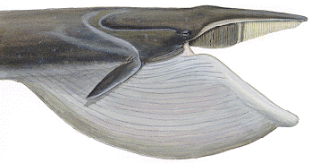
Different Families…Different Ways of Eating
As mentioned the different families of baleen whales have evolved specific methods of filter feeding coinciding with their specific diets. A brief overview of the different ways is offered here.
Photo Courtesy of the Center for Coastal Studies

Slide 11
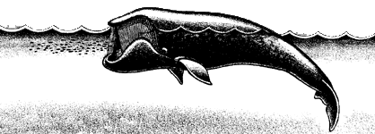
Right
Whales
Photo courtesy of http://www.seaworld.org/
Right whales swim along the surface continually straining zooplankton from the water. Because the straining is continuous, right whales do not exhibit the large throat grooves of other baleen whales. Water enters through the front of the mouth, food is caught on the fibers of the baleen plates, and the water then exits through the sides of the mouth. This process of surface feeding combined with the buoyancy of dead right whales (hence the name “right” given to them by whalers) made right whales a historically easy target for whalers. The large baleen developed to aid in this specific type of feeding was also a coveted commodity.

Slide 12
Gray Whales
Gray whales have developed a slightly different method of feeding to reflect their diet consisting primarily of bottom dwelling crustaceans. Gray whales swim down near the bottom of the ocean and take in large amounts of water and often sand and mud from the bottom not to mention of course the organisms that reside there. There are reports of gray whales seen swimming to the surface with a trail of mud behind them as well as reports of large amounts of sediment removed as a result of feeding.

Slide 13
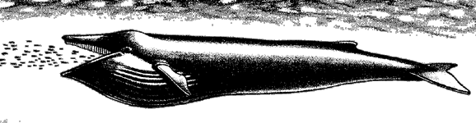
Rorqual Whales
Photo courtesy of http://www.seaworld.org/
Unlike right whales, Rorquals do not continuously filter water. Rather they take large gulps of water at a time and then force that water out through the baleen trapping their food inside their mouth. Rorquals use their numerous throat grooves as well as their tongues to help force the water out of their mouths.
Humpback whales demonstrate a slightly more specific method of feeding. They swim down deep and as they swim back up towards their food they create a “bubble net” which captures their food. They then simply swim up through this net and surface giving a wonderful demonstration of baleen use.
There are a series of pictures which provide a wonderful example of this at the Whale Center of New England’s Webpage

Slide 14
How have Humans Used Baleen?
The physical properties have made baleen a very useful commodity to humans. The strong yet flexible nature enabled baleen, or whalebone as it is commercially referred to, to serve as a sort of plastic before plastic had been invented. Whalebone has been utilized by several different groups of people for a number of different uses. Some of its uses are listed below:
Women’s corsets, buggy whips, umbrella ribs, and boats
The usefulness of baleen has in part led to the extensive whaling and subsequent endangerment of a number of the world’s species of whales.

Slide 15
Works Cited
Virtualology.com
National Marine Mammal Laboratory
Sea World
The Tree of Life Web Project
The Origins and Adaptations of Mysticetes
Enchanted Learning
The Natural History Museum of Los Angeles County Foundation
The Whale Center of New England
The Center for Coastal Studies

Slide 16
Credits
This webpage was created by Stephen Miles in partial fulfillment of the requirements for Vertebrate Morphology (EEOB 421), a course in the Department of Ecology and Evolutionary Biology at Tulane University. The course is taught by Dr. Hank Bart.
Questions or concerns may be emailed to Stephen Miles

