Slide 1
TRAIT EXTRACTION
Tulane Group
Henry L. Bart Jr.
Yasin Bakis
Bahadir Altintas
Xiaojun Wang

Slide 2
AIM

Slide 3
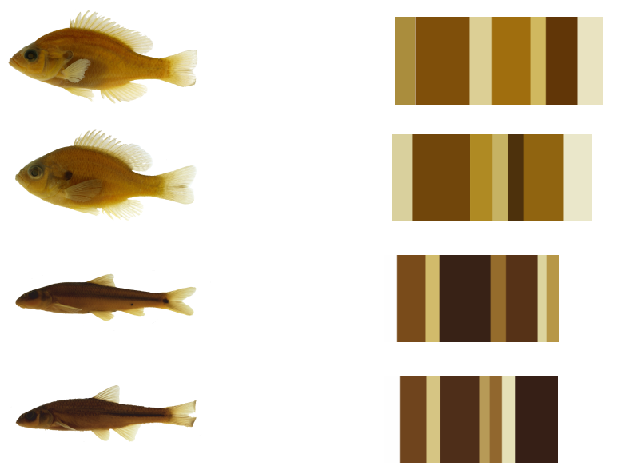
COLOR based data extraction

Slide 4
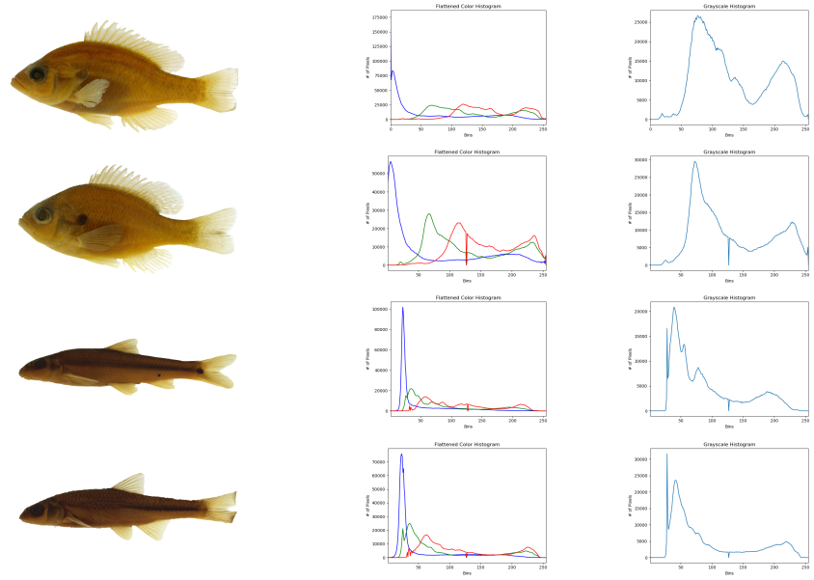
Histograms

Slide 5
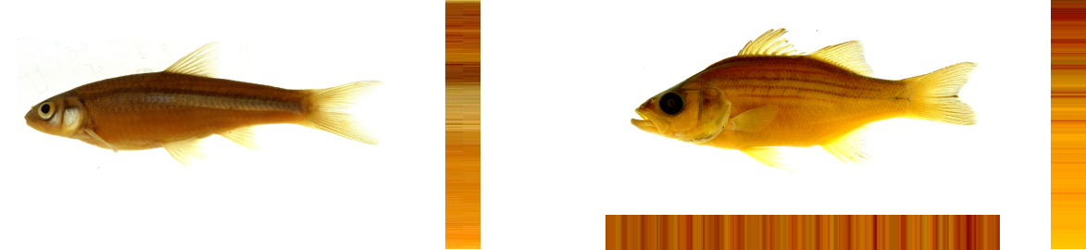
Color pattern ?????? should we add this

Slide 6
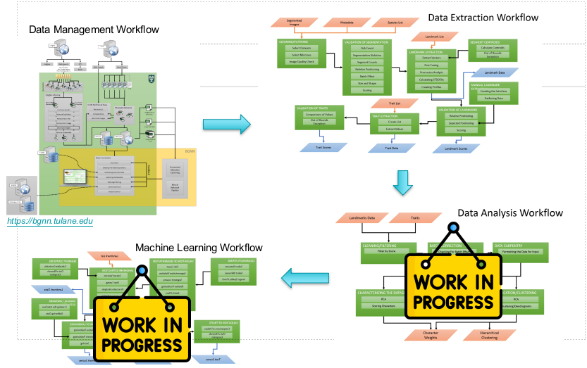
Workflow

Slide 7
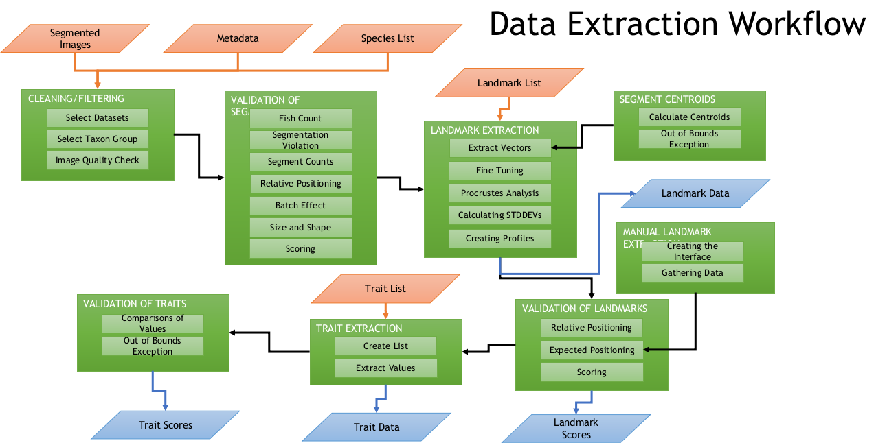
Our Workflow

Slide 8
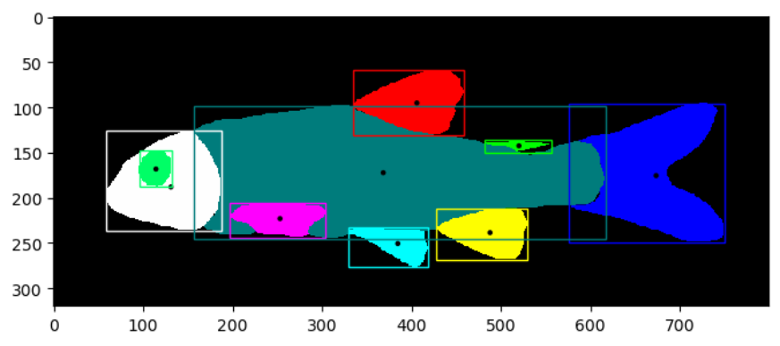
Centroids
*Bounding box & Segmentation images are provided by Karpatne Lab

Slide 9
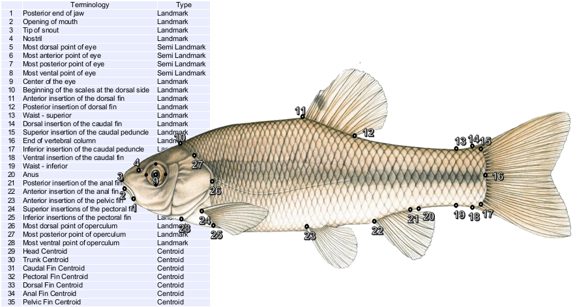
Landmarks

Slide 10
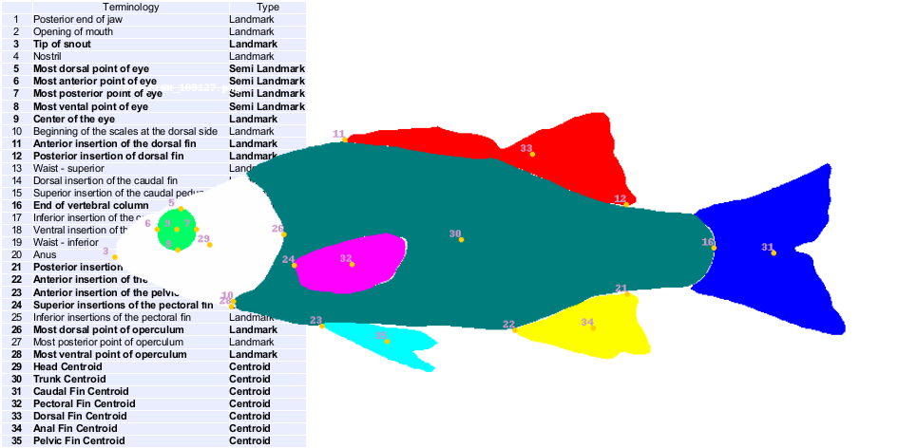
INHS Dataset
INHS : ~ 20K FMNH: ~2700 OSUM:~1500

Slide 11
POSSIBLE TRAITS
Total number of landmarks(including centroids),n: 35
Trait type | Landmarks needed(min) | Num. Of Traits
Distance | 2 | 595
Angle | 3 | 6545
Area | 3….n | ?????
Ratio

Slide 12
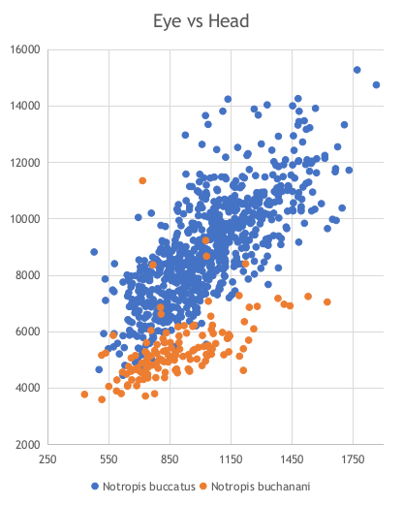
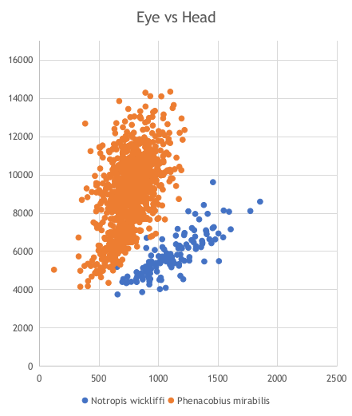
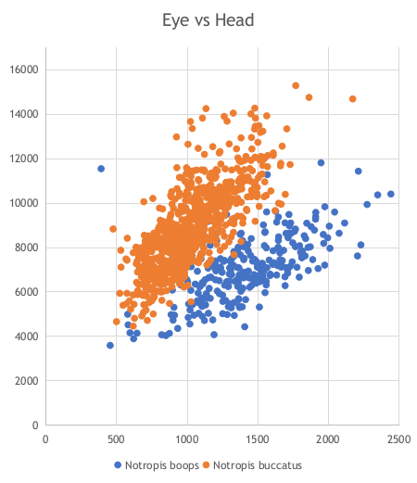
Area based trait discovery

Slide 13
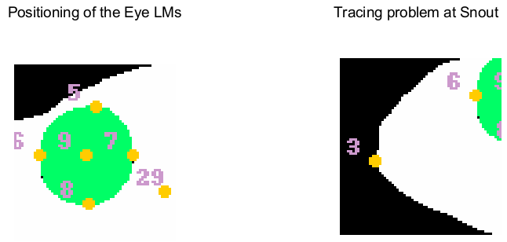
Problems with landmarking

Slide 14
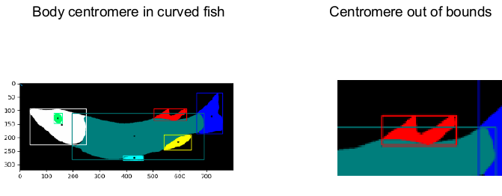
..more

Slide 15
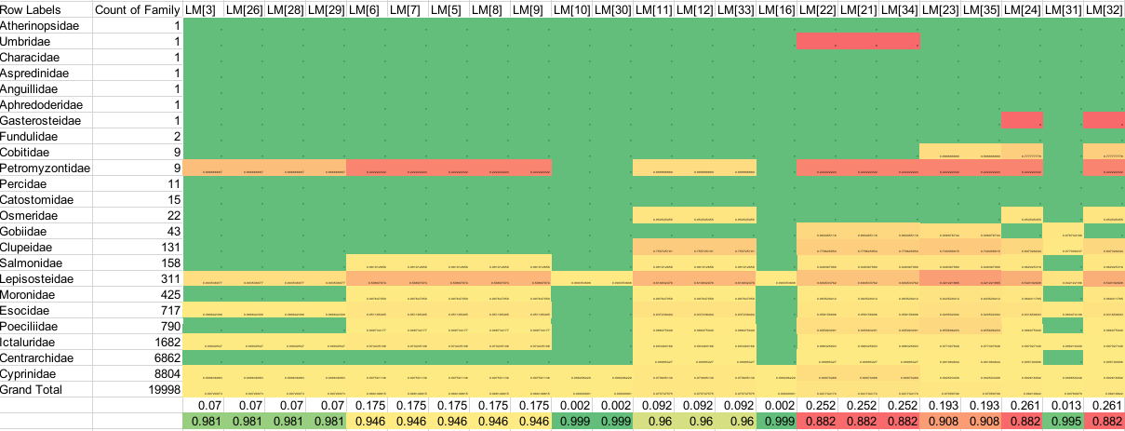
Result statistics

Slide 16

Credits
Credits & contributers will be here
https://github.com/tubri/bahadir_presentations/raw/main/11.07.20022_presentation_tubri.pptx

