Slide 1
TRAIT EXTRACTION
Tulane Group
Henry L. Bart Jr.
Yasin Bakis
Bahadir Altintas
Xiaojun wang

Slide 2
AIM

Slide 3
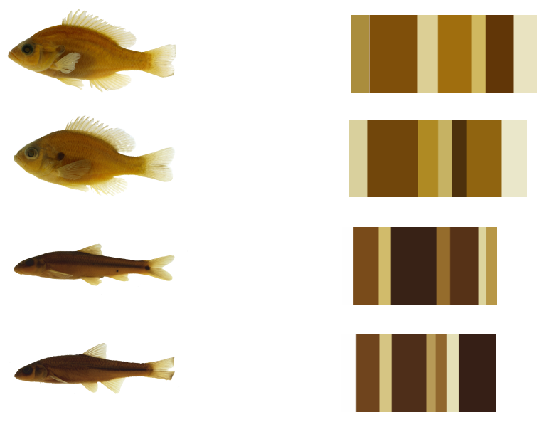
COLOR based data extraction

Slide 4
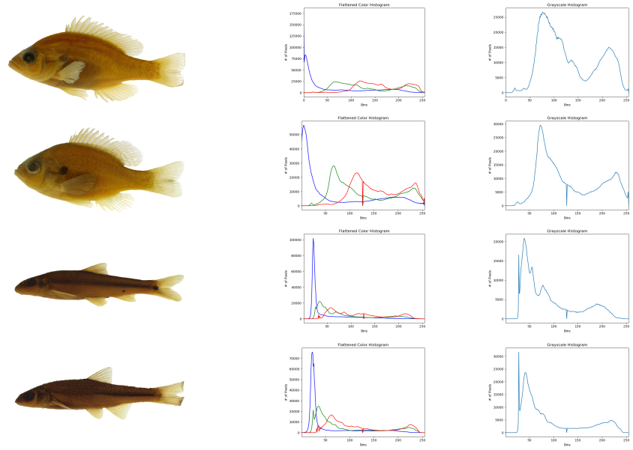
Histograms

Slide 5
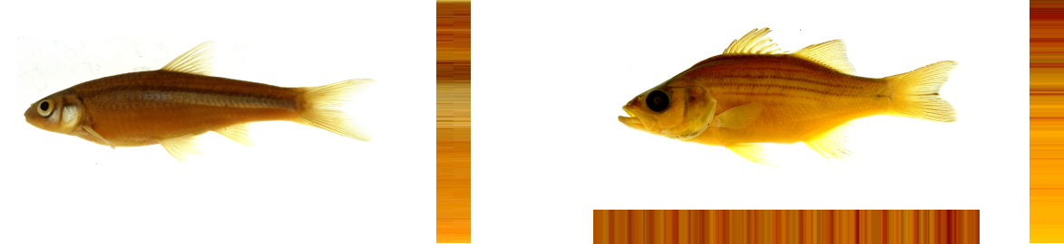
Color pattern

Slide 6
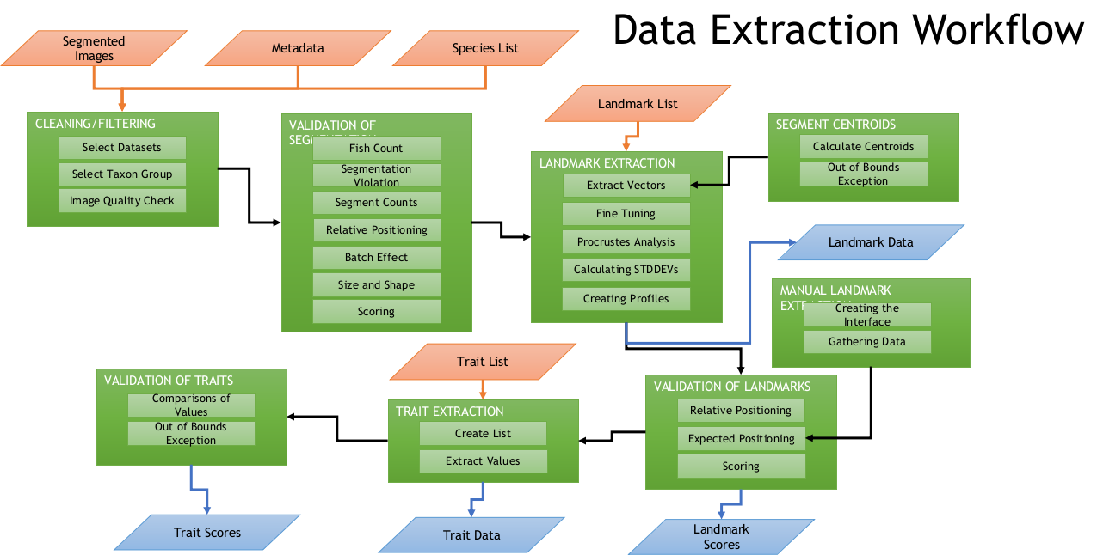
Our Workflow

Slide 7
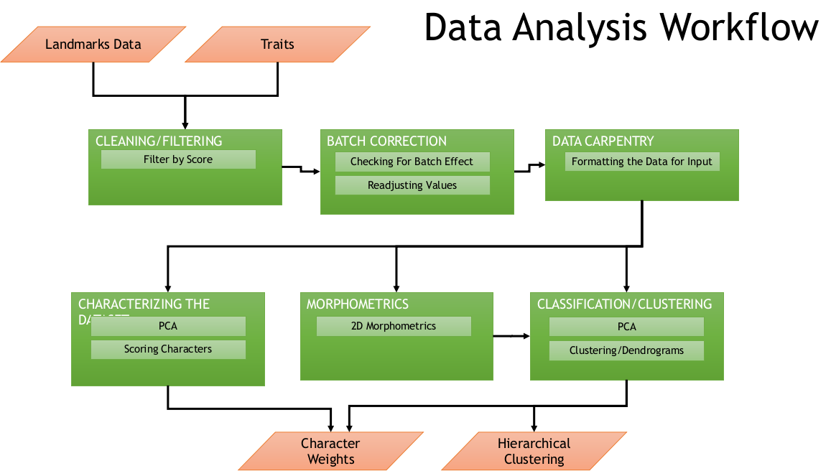

Our workflow

Slide 8
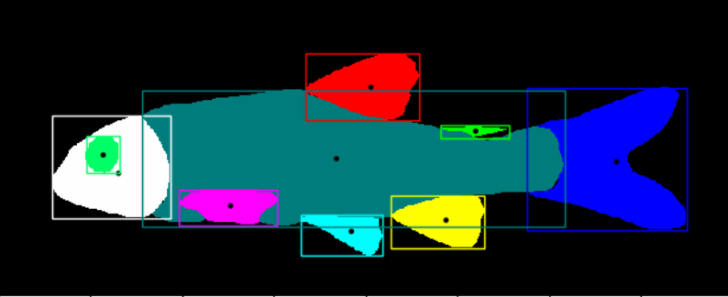
Centroids

Slide 9
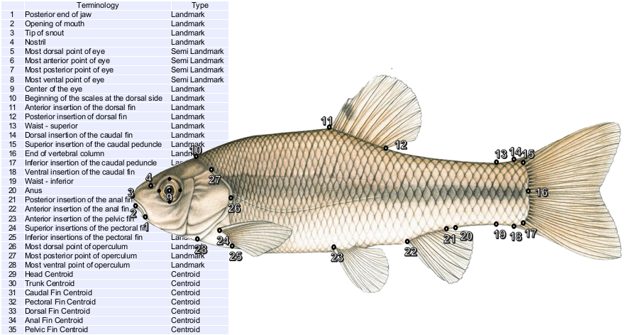
Landmarks

Slide 10
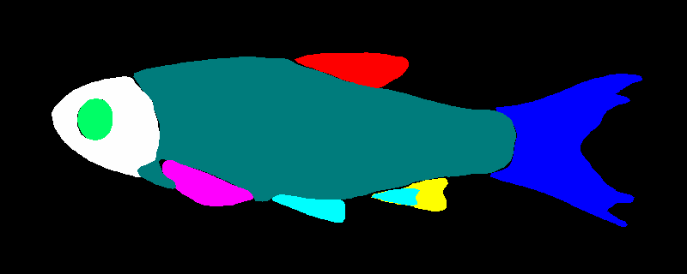

INHS Dataset
19999 images

Slide 11
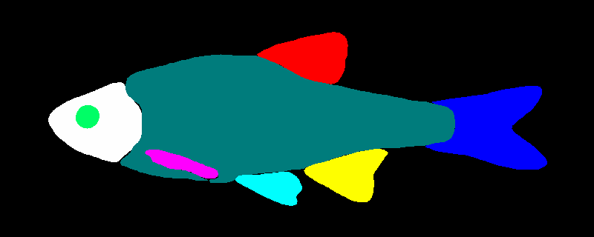
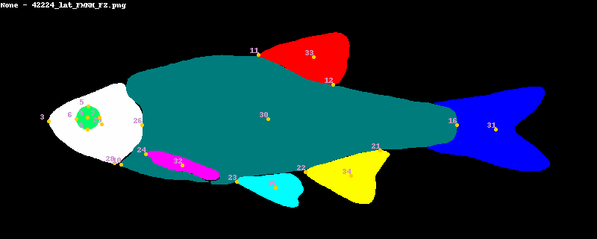
FNHM dataset
2698 images

Slide 12
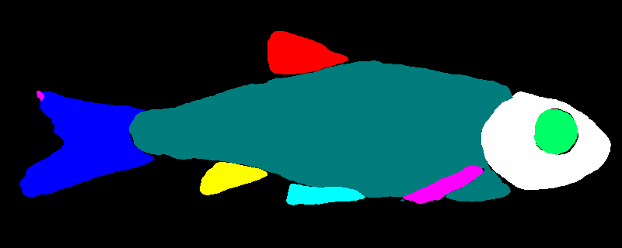
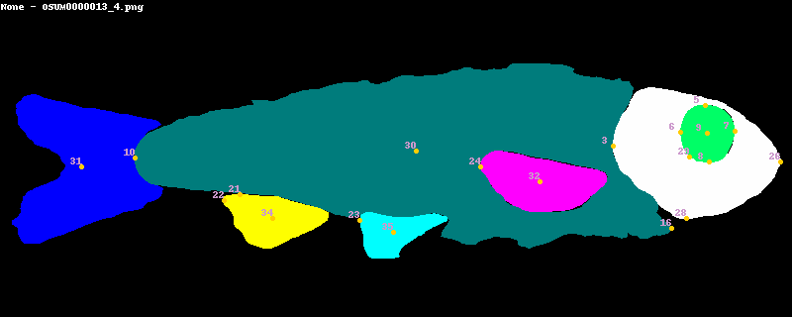
OSUM dataset
1429 images

Slide 13
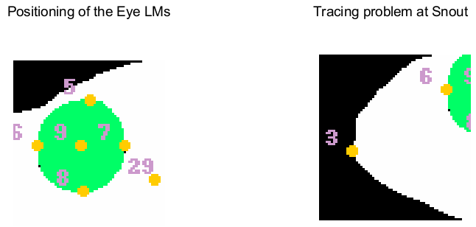
Problems with landmarking

Slide 14
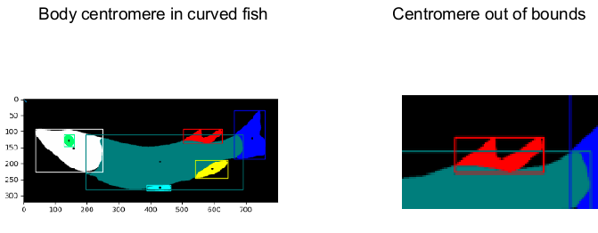
..more

Slide 15
Result statistics
Statistical fail and success results will here

Slide 16

Credits
Credits & contributers will be here
https://github.com/tubri/bahadir_presentations/raw/main/11.07.20022_presentation_tubri.pptx

