Slide 1
TRAIT EXTRACTION
Tulane Group
Henry L. Bart Jr.
Yasin Bakis
Bahadir Altintas
Xiaojun wang

Slide 2
AIM

Slide 3
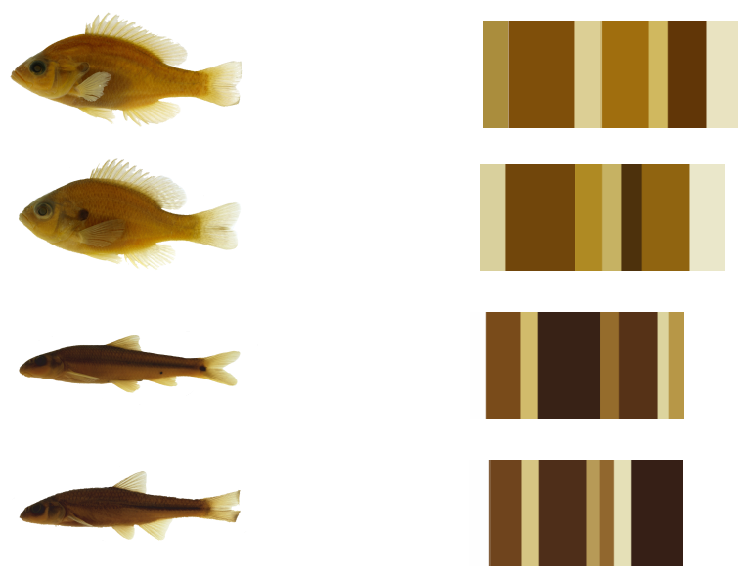
COLOR based data extraction

Slide 4
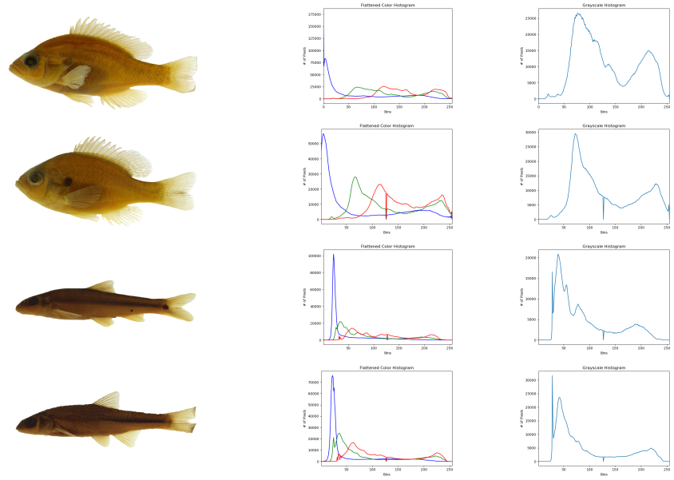
Histograms

Slide 5
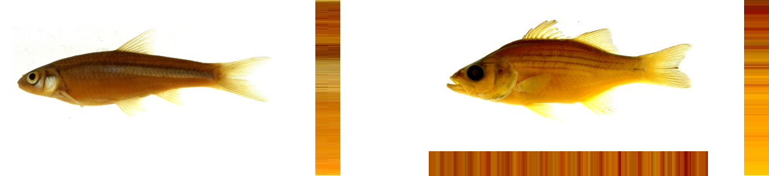
Color pattern

Slide 6
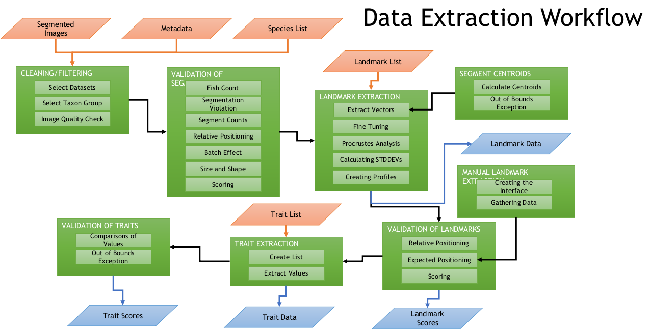
Our Workflow

Slide 7
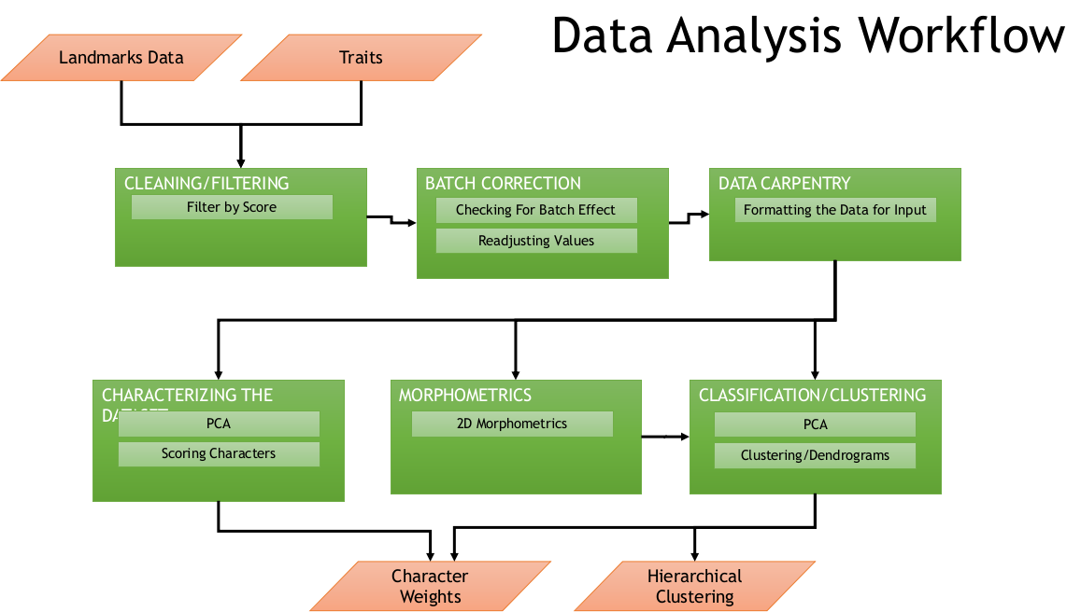

Our workflow

Slide 8
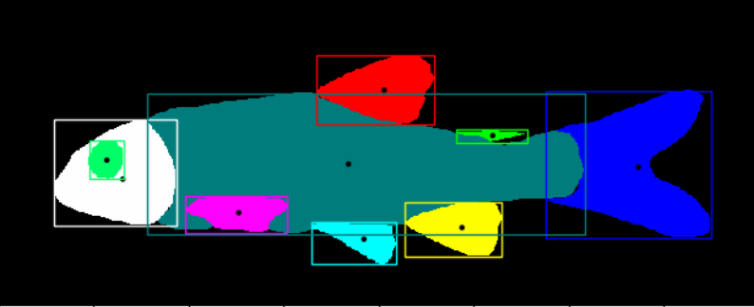
Centroids

Slide 9
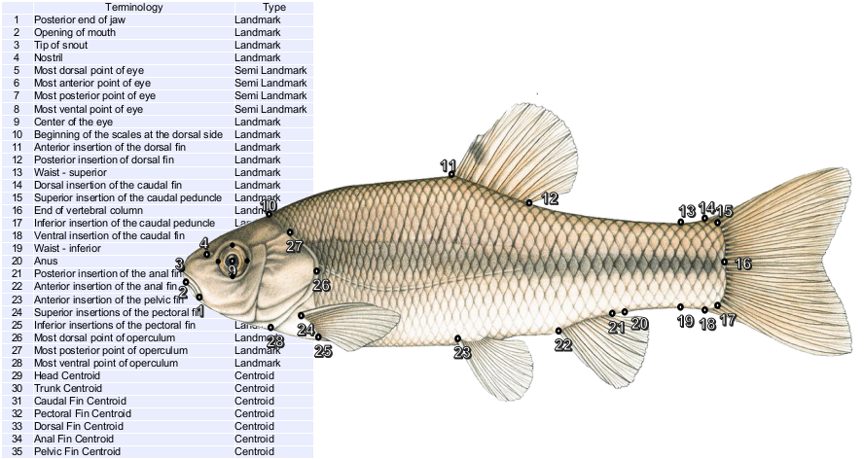
Landmarks

Slide 10
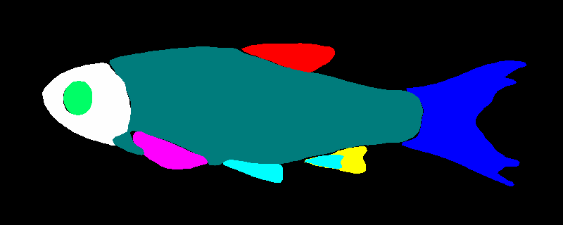

INHS Dataset
19999 images

Slide 11
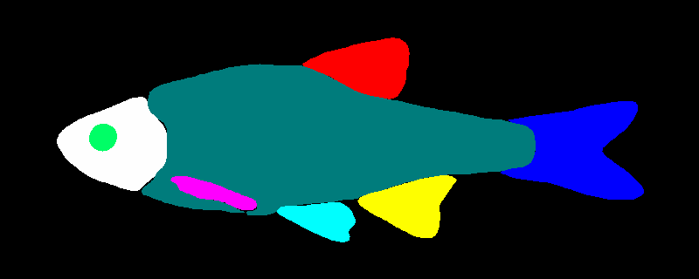
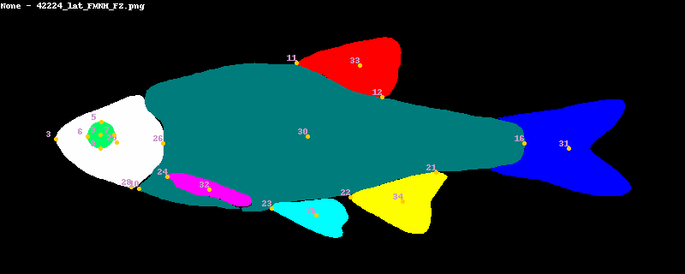
FNHM dataset
2698 images

Slide 12
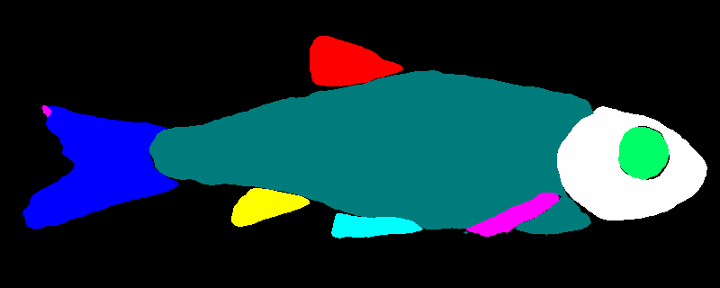
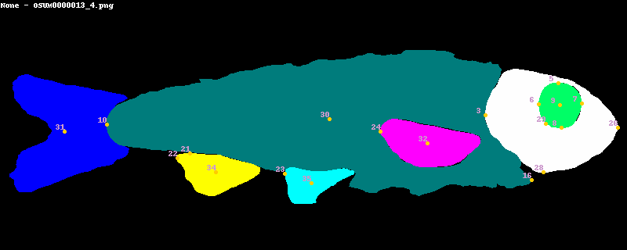
OSUM dataset
1429 images

