Slide 1
Locating a CID
Bailey Tucker
Begin
Portfolio version: organization details removed; system screens are mock-ups with fictional data.

Slide 2
Navigation
Use the arrows to navigate forward or backwards in a topic
Use the button to return to the Main Page
Use the button to complete the assessment after completing the course
To watch the videos, click on the image to have the video play
Main Menu
Post Test
Previous
Next
Slide 1 of 28

Slide 3
Main Menu
Navigation
Overview
Objectives
Topic 1
Topic 2
Topic 3
Topic 4
Topic 5
Post Test
Previous
Exit
Next
Slide 2 of 28

Slide 4
Overview
This course will provide the Course Identification number (CID) Checklist and two different scenarios the checklist can be applied: how to locate a CID using the Course Manager tool and how to locate a CID using a metadata report.
These skills will help save time and prevent working in an incorrect course. This course is intended for all curriculum alignment and content team members.
It is expected that learners of the course can navigate the system. This course should take about 15 -20 minutes to complete.
Previous
Main Menu
Exit
Next
Slide 3 of 28

Slide 5
Objectives
Objective 1: Given a list of characteristics, the learner will be able to identify the characteristics of the CID Checklist correctly.
Objective 2: Given a dataset of course characteristics and using the CID checklist, the learner will identify a CID with 100% accuracy when using a screenshot of the Course Manager Tool.
Objective 3: Given a screenshot of search results from the Course Manager Tool, the learner will determine base courses and linked courses with 100% accuracy.
Objective 4: Given a dataset of course characteristics and using the CID checklist, the learner will identify a CID with 100% accuracy when using a screenshot of a Course Metadata Report.
Objective 5: Given a screenshot of search results from a Course Metadata Report, the learner will determine base courses and linked courses with 100% accuracy.
Previous
Main Menu
Exit
Next
Slide 4 of 28

Slide 6
Course Progression
Topic 1: CID Checklist
1
Topic 2: Locate CID using the Course Manager Tool
2
Topic 3: Determine a base course vs. a linked course in the Course Manager Tool
3
Topic 4: Locate CID using a Course Metadata Report (CMR)
4
Topic 5: Determine a base course vs. a linked course from a CMR
5
Previous
Main Menu
Exit
Next
Slide 5 of 28

Slide 7
Topic 1
CID Checklist
Exit
Main Menu
Next

Slide 8
Topic 1: CID Checklist
Checklist:
    Determine the school year a course is needed
    Determine the content of a course
    Identify if a base Course or linked Course
      Note: Or state specific base courses
Previous
Main Menu
Exit
Next
Slide 7 of 28

Slide 9
Topic 1 Practice Question
Select the correct answer:
Which of the following lists of characteristics is the correct list for the CID checklist?
      a. School Year, Content, and New Course
      b. School Year, Content, and Retired Course
      c. School Year, Content, and Base/Link Course
      d. Imported, Content, and Base/Link Course
Previous
Main Menu
Exit
Next
Slide 8 of 28

Slide 10
Topic 2
Locate CID using the Course Manager Tool
Exit
Main Menu
Next

Slide 11
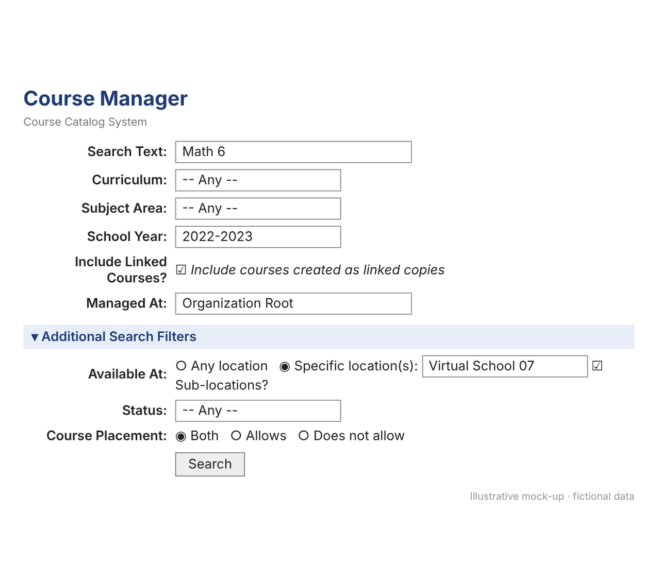
Topic 2: Locate CID using the Course Manager Tool
  Determine Search parameters for Course Manager:
    Search Text: enter all or part of a Course Name or Display Name
    Curriculum: leave as ‘Any’
    Subject Area: leave as ‘Any’
    School Year: as needed
    Include Linked Courses?: Select to return courses that are links from the base
    Managed at: leave at the organization root
    Additional Search filters:
      Available at: Select Any location or a Specific location
Previous
Main Menu
Exit
Next
Slide 10 of 28

Slide 12
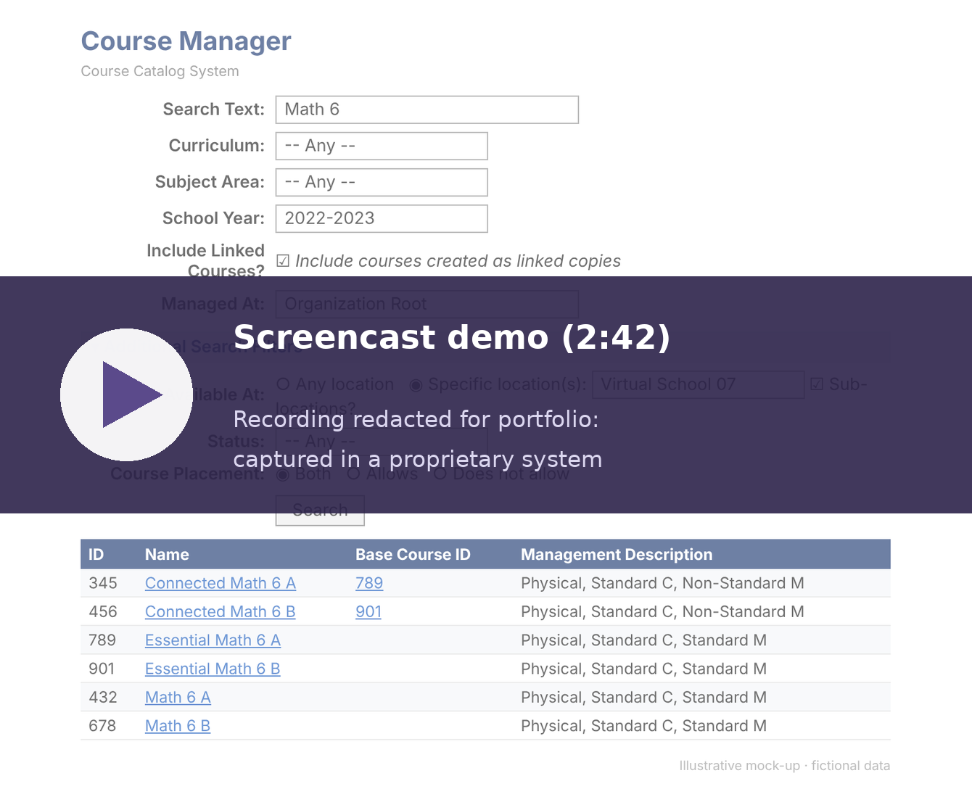
Click the video to play
Previous
Main Menu
Exit
Next
Slide 11 of 28

Slide 13
Topic 2 Practice Question
Now it is your turn!
Using the Course Manager Tool, which CID is correct for the following criteria: The 23/24 School Year American Government course for Nevada locations?
a. 140998
b. 141123
c. 156743
d. 121311
Main Menu
Exit
Previous
Next
Slide 12 of 28

Slide 14
Topic 3
Determine a base course vs. a linked course in the Course Manager Tool
Exit
Main Menu
Next

Slide 15
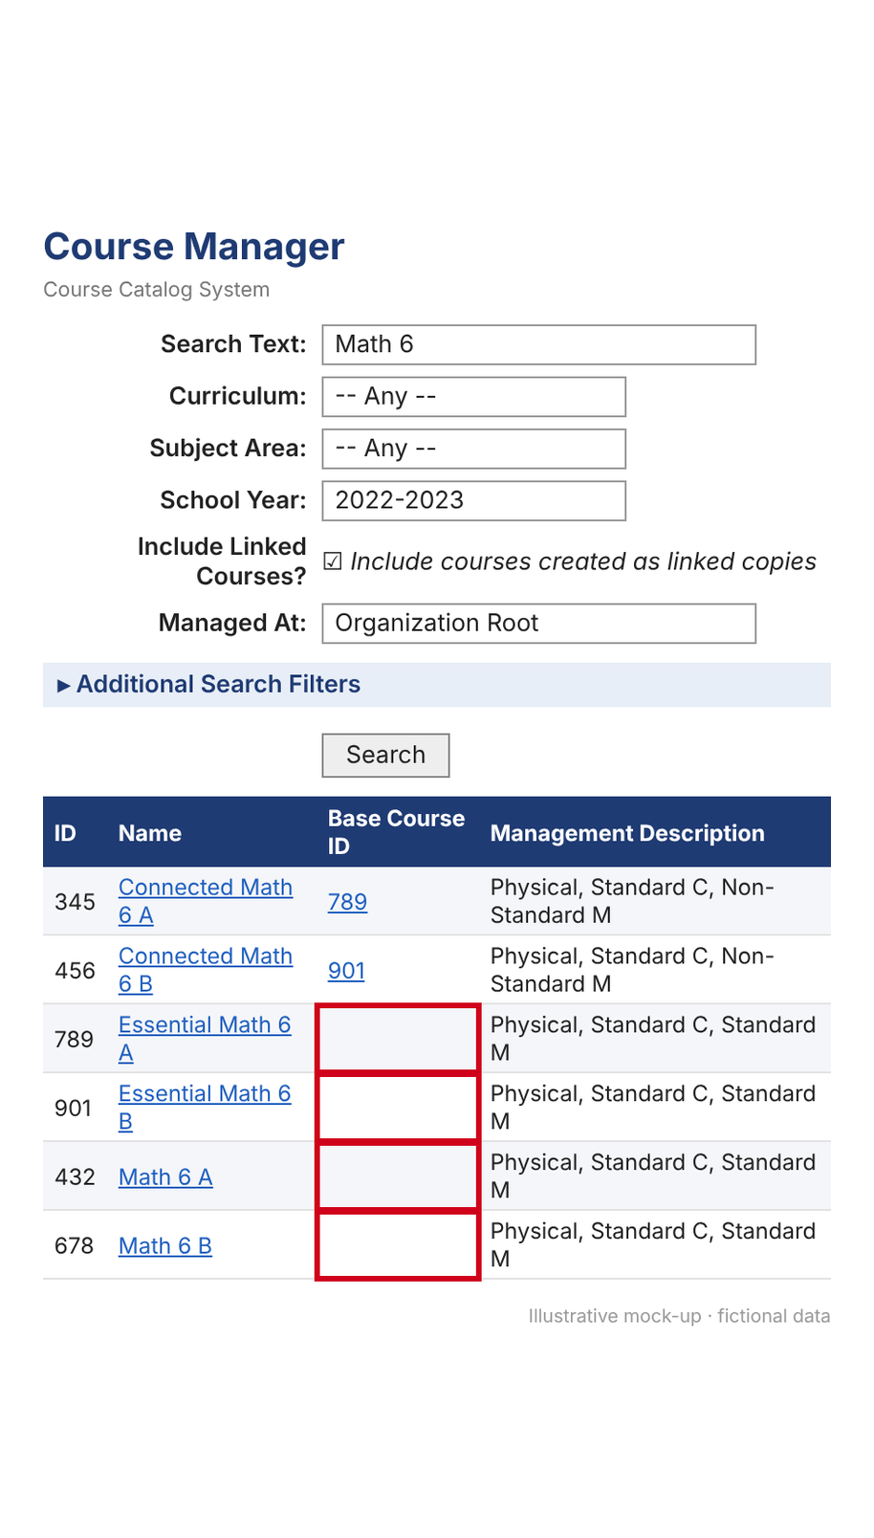
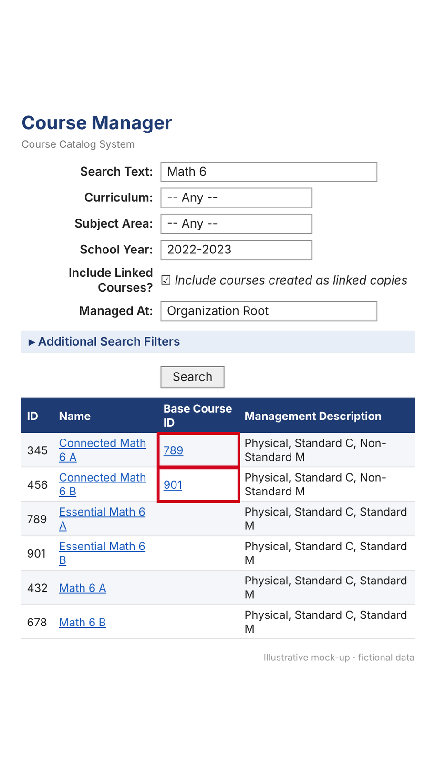
Topic 3: Determine a base course vs. a linked course in the Course Manager Tool
Base Course vs. Linked Course
  On the Course Manager, if no Base Course ID is listed in the ‘Base Course ID’ column, then it is a base course
  On the Course Manager, if a course is a linked course, then it will have a CID listed in the ‘Base Course ID’ column
Base Courses
Linked Courses
Previous
Main Menu
Exit
Next
Slide 14 of 28

Slide 16
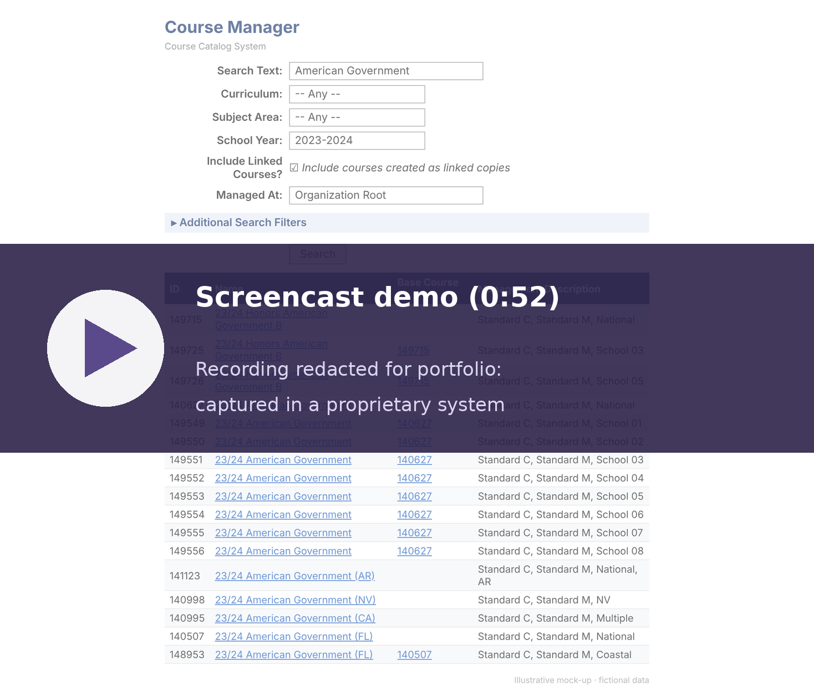
Click the video to play
Previous
Exit
Main Menu
Next
Slide 15 of 28

Slide 17
Topic 3 Practice Question
Now it is your turn!
Using the Course Manager Tool, which CID is the national base course for the 23/24 American Government course?
a. 140627
b. 141123
c. 156743
d. 121311
Previous
Main Menu
Exit
Next
Slide 16 of 28

Slide 18
Topic 4
Locate CID using a Course Metadata Report (CMR)
Exit
Main Menu
Next

Slide 19
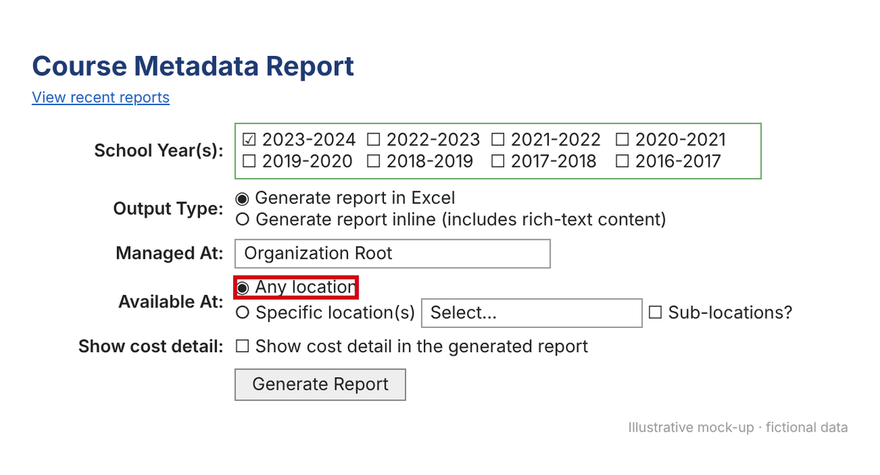
Topic 4: Locate CID using a Course Metadata Report (CMR)
There are two types of reports that can be used:
  Full (any and all locations)
  Specific Location
Previous
Main Menu
Exit
Next
Slide 18 of 28

Slide 20
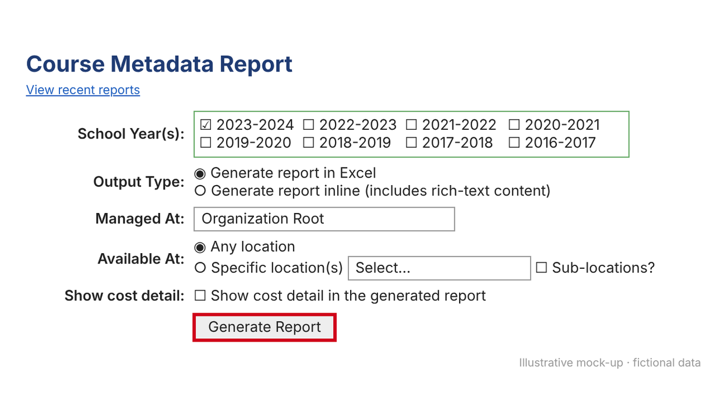
Steps to Run a Course Metadata Report (CMR)
On the Courses Metadata Report (Beta) screen select data as needed:
  School Year(s): Select SY needed
  Output Type: leave as ‘Generate report in Excel’
  Managed at: leave at the organization root
  Available at: Any location or Specific location
Click Generate Report
Main Menu
Exit
Next
Previous
Slide 19 of 28

Slide 21
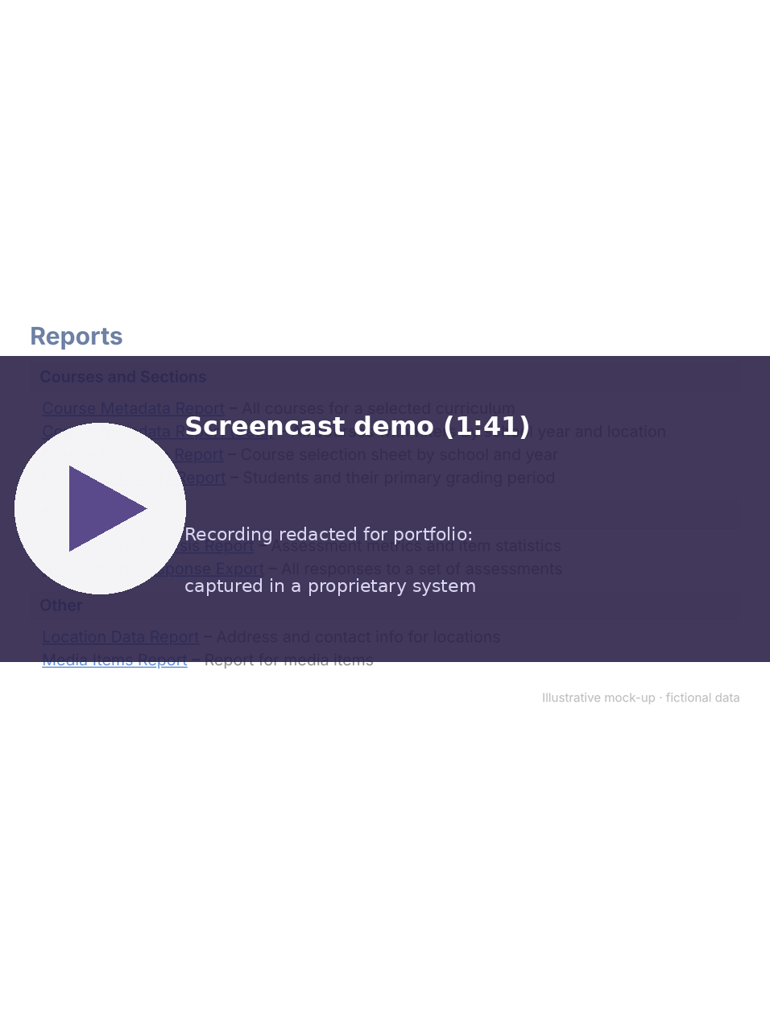
Click the video to play
Previous
Exit
Main Menu
Next
Slide 20 of 28

Slide 22
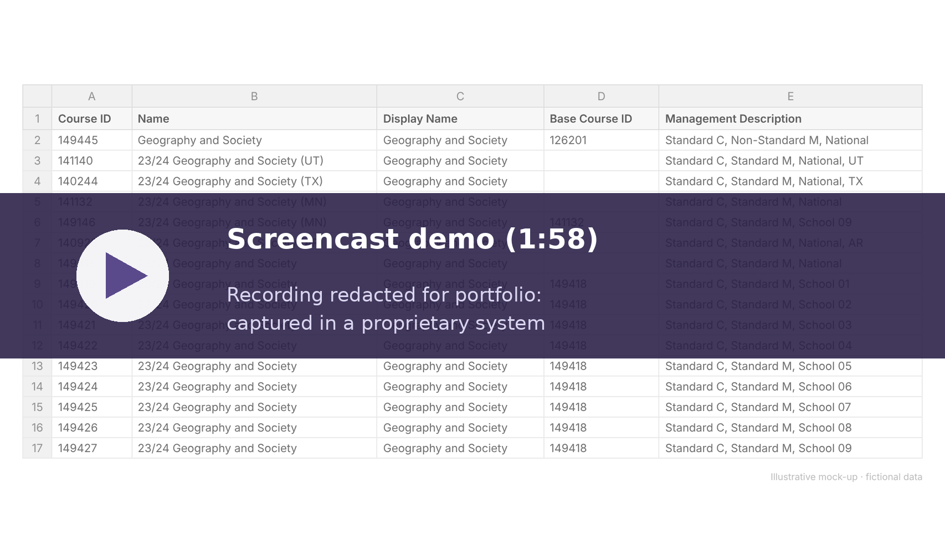
Items to filter on a CMR
Location
School Year
Subject
Grade
Previous
Next
Exit
Main Menu
Slide 21 of 28

Slide 23
Topic 4 Practice Question
Select the correct answer:
Using the Course Metadata Report, which CID is correct for the following criteria: The 23/24 School Year Economics course for Colorado locations?
a. 110998
b. 117486
c. 116743
d. 121311
Previous
Main Menu
Exit
Next
Slide 22 of 28

Slide 24
Topic 5
Determine a base course vs. a linked course from a CMR
Exit
Main Menu
Next

Slide 25

Topic 5: Determine a base course vs. a linked course from a CMR
On a CMR, if no Base Course ID is listed in the ‘Base Course ID’ column, then it is a base course
On a CMR, if a course is a linked course, then it will have a CID listed in the ‘Base Course ID’ column
Previous
Main Menu
Exit
Next
Slide 24 of 28

Slide 26
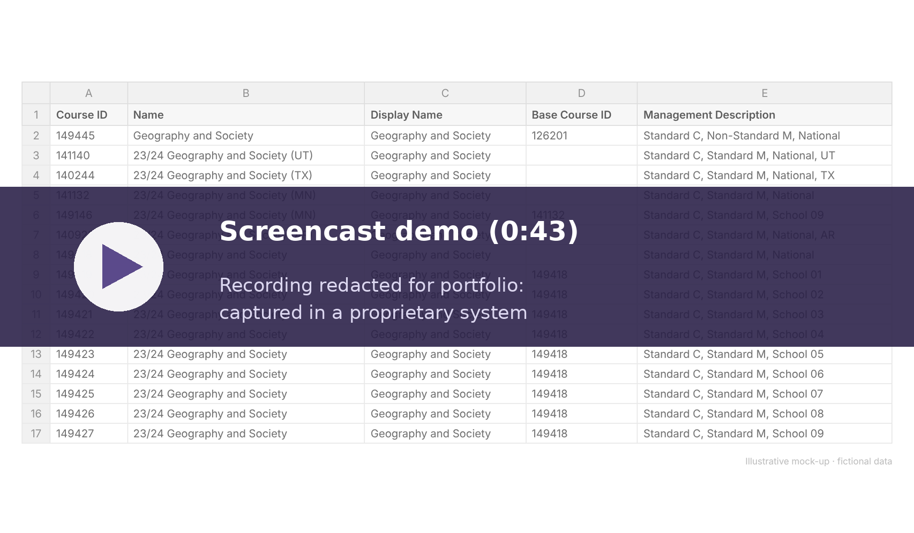
Click the video to play
Previous
Next
Main Menu
Exit
Slide 25 of 28

Slide 27
Topic 5 Practice Question
Select the correct answer:
Using a Course Metadata Report, which CID is the national base course for the 23/24 Geography and Society course?
a. 121311
b. 141123
c. 156743
d. 149418
Previous
Main Menu
Exit
Next
Slide 26 of 28

Slide 28
Correct!
That is correct!
Main Menu
Exit
Next
Previous

Slide 29
Correct!
That is the correct CID!
Main Menu
Exit
Next
Previous

Slide 30
Correct!
That is the correct CID!
Previous
Main Menu
Exit
Next

Slide 31
Correct!
That is the correct CID!
Main Menu
Exit
Next
Previous

Slide 32
Correct!
That is the correct CID!
Previous
Main Menu
Exit
Next

Slide 33
Incorrect
Try Again
Previous
Main Menu
Exit
Next

Slide 34
Incorrect
Try Again
Previous
Main Menu
Exit
Next

Slide 35
Incorrect
Try Again
Previous
Main Menu
Exit
Next

Slide 36
Incorrect
Try Again
Previous
Main Menu
Exit
Next

Slide 37
Incorrect
Try Again
Previous
Main Menu
Exit
Next

Slide 38


Summary
In this course, you learned the CID Checklist and two different scenarios the checklist can be applied: how to locate a CID using the Course Manager tool and how to locate a CID using a metadata report.
Now show what you know, take the Post Test.
Previous
Main Menu
Post Test
Exit
Next
Slide 27 of 28

Slide 39
Thank you!
This course has ended
Bailey Tucker
Instructional Design Portfolio
Exit
Slide 28 of 28

