Slide 1
Lieutenant Commander Database

Slide 2
Datasets
Primary Dataset
U.S. Department of Agriculture
Lists commodities exported by week and country from 2000-2005
Secondary Dataset
Collected from the United Nations
Lists commodities traded between U.N. nations from 2000-2005 missing 2003

Slide 3
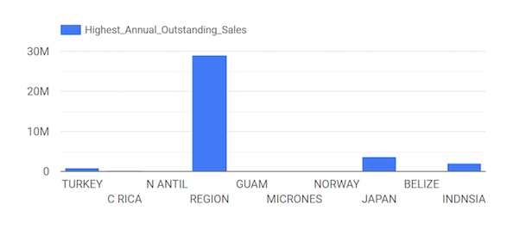
Questions
We were interested in looking at trends in exports of U.S. agricultural products
We would have liked to analyze outstanding sales in our dataset, but the data was incomplete and difficult to interpret

Slide 4
SQL Queries
Our initial and secondary dataset consisted of multiple .csv files for each year. We UNIONED these files into two tables. One for each dataset
We used a query to create another table for the entity ‘Country’ in our dataset using the ‘country_code’, ‘country_name’, and ‘region_code’ columns
We used a another query to reduce the dimensionality of our dataset by removing unnecessary columns
We CAST the ‘week_ending’ column as a DATE data type

Slide 5
SQL Queries
create table workflow.Exports_temp as select * from Aggriculture.Exports_2000
union all select * from Aggriculture.Exports_2001
union all select * from Aggriculture.Exports_2002
union all select * from Aggriculture.Exports_2003
union all select * from Aggriculture.Export_2004
union all select * from Aggriculture.Exports_2005
create table workflow.Exports_Temp2 as select * except(week_ending_date) cast(week_ending_date AS DATE) as Date from workflow.Exports_Temp
create table workflow.Exports_2000-2005 select * except(serialid, sort_code, net_sales_for_week_next_year, outstanding_sales_next_year,region_code,country_name) from workflow.Exports_Temp2
create table workflow.Countries as
select distinct country_code, country_name, region_code
from Aggriculture.Exports_2000_to_2005
where country_code is not null
order by country_code

Slide 6
Beam Transforms
We performed three beam transformations. One for our Exports table and one for our Countries table and one for our Imports table
Exports: Our beam transform for the Exports table standardized our country_code column by converting all numeric country codes to string abbreviations
Countries: Our beam transform for the Countries table removed the country_code column now that that it no longer corresponds to our Exports table
Imports: For the imports table, we used beam to remove unnecessary columns and replace all null values with 0

Slide 7
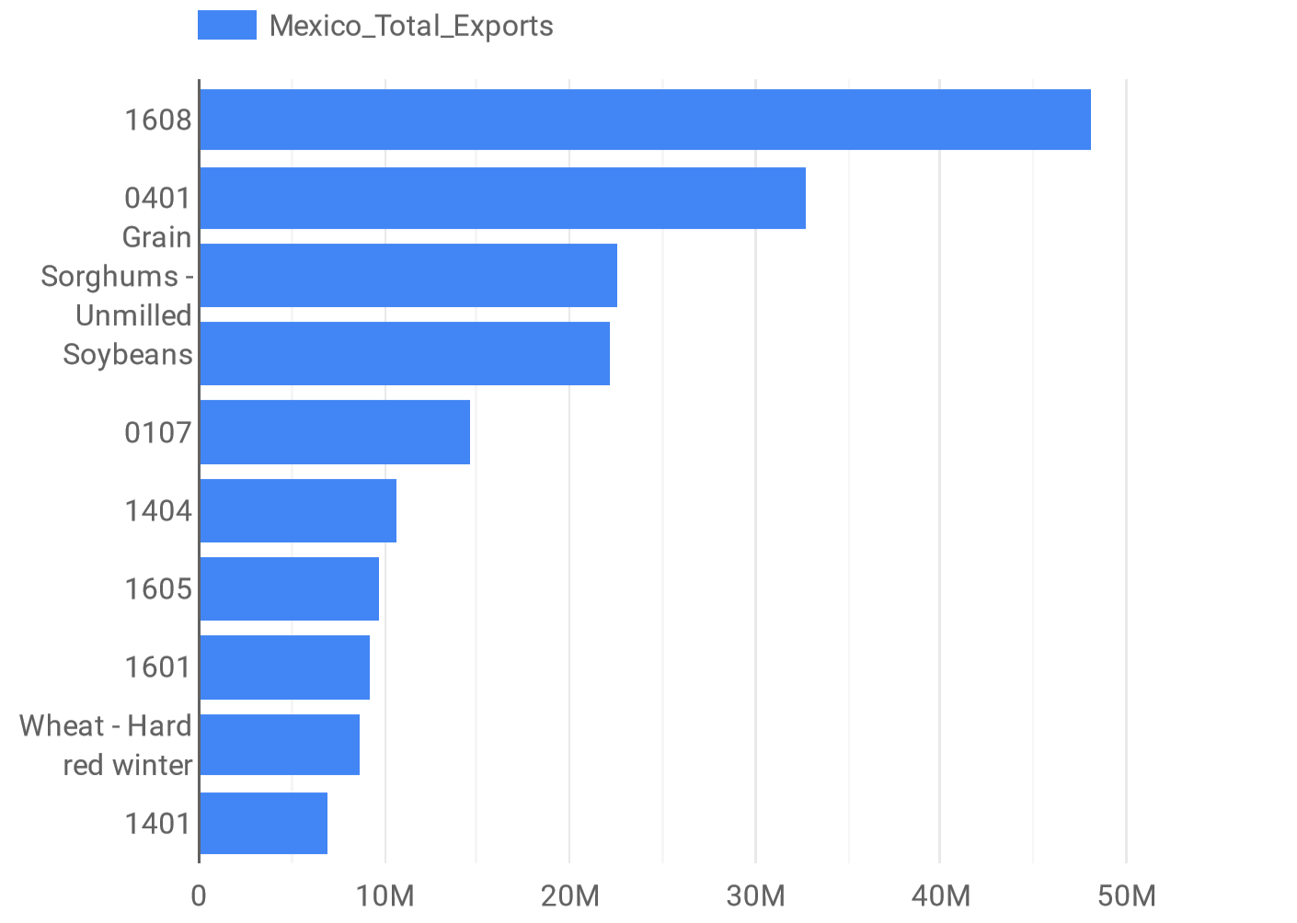
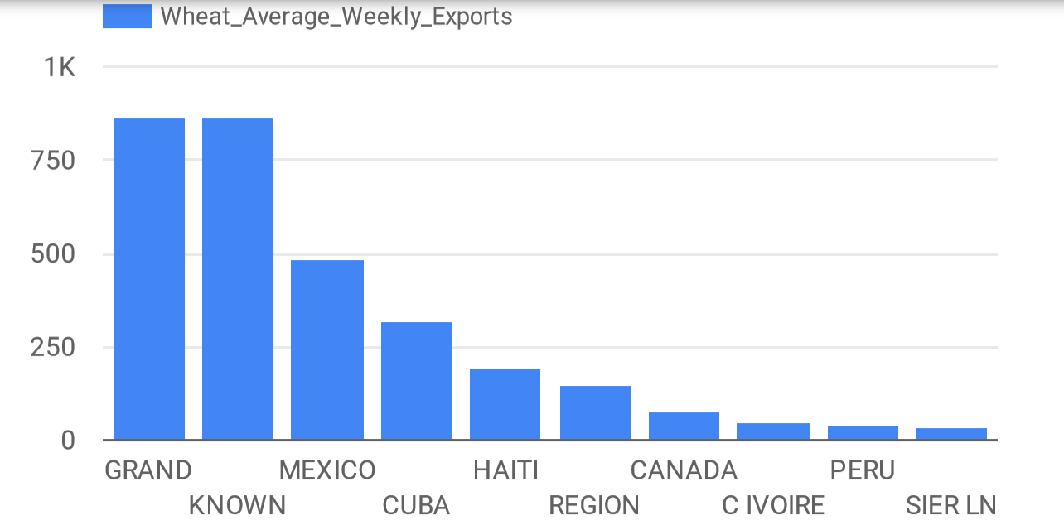
Visualizations (Exports)
All Exports US -> Mexico
Average Weekly Export of Wheat, by country
Challenge: Unknown commodity names
Success: Clear representation of which countries are purchasing wheat

Slide 8
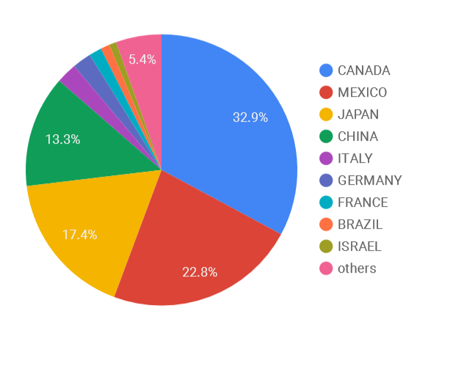
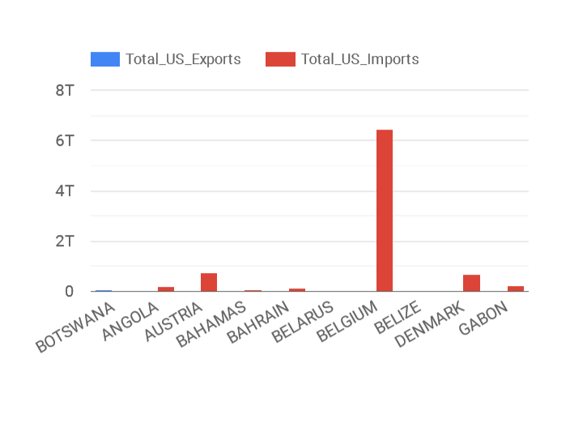
Visualizations (Imports/Exports)
US Imports/Exports 2001
Total Trade Value
Striking visual representation of trade imbalance
Effective display of who the US trades with (sum of imports and exports)

Slide 9
Workflow
Air workflow executed the our queries and Beam transformation in the following order.
Union tables
Cast date, create Countries table
Remove columns from Exports table
Exports beam transforms, Countries beam transforms

Slide 10
Improvements
One thing we would have liked to have done would be find data that corresponded with our commodity_code column so that we would have more data about what commodities were being exported
Building a second table that aggregated our data by year would have made it easier for us to compare our two datasets
We had trouble finding compatible datasets for comparison. An improvement would be finding more data that might provide us with more compatibility across datasets

