Slide 1
Has WAR Changed MLB MVP Voting?
A preliminary analysis of MVP voting from 1980–2025
Tucker Bright | Applied Statistics | Purdue University

Slide 2
Research question
Testing whether MVP results have become more aligned with comprehensive player value
How has the rise of WAR changed MLB MVP voting?
• Hypothesis: as WAR became more prominent in baseball analysis, MVP voting became more consistent with WAR.
• Important limitation: the analysis can show alignment over time, but it cannot by itself prove that WAR caused voters to change.
• 2020 is excluded from season-comparison analyses because the MLB regular season was shortened.
2

Slide 3
Data and approach
1980–2025
MVP voting seasons
AL + NL
Separate league races
Vote Share
Voting outcome
WAR + 4
WAR, HR, RBI, BA, OPS
• Historical MVP voting tables were collected into one player-level dataset.
• For each league-season, I calculated the correlation between each statistic and MVP vote share.
• I also compared the MVP winner's WAR with the highest WAR among players receiving MVP votes.
3

Slide 4
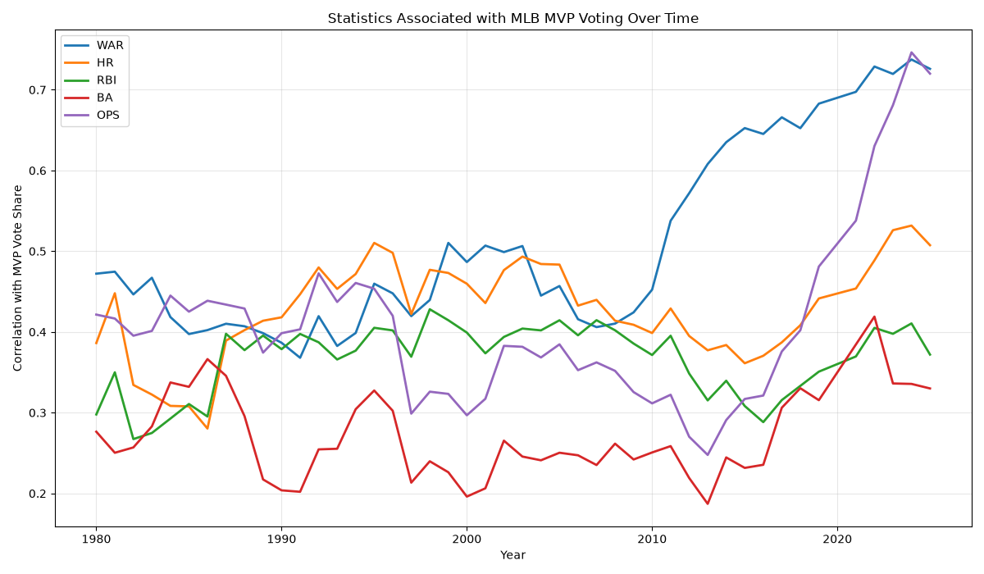
WAR alignment rises sharply in the modern era
5-year rolling average of within-race correlations with MVP vote share
4

Slide 5
Era comparison: WAR shows the largest shift
0.441 → 0.681
WAR / vote-share correlation
Pre-2008 to 2013–2025
• HR is nearly unchanged overall.
• RBI and BA show little long-run movement.
• OPS also rises in the modern era, suggesting a broader shift toward comprehensive performance measures.
5

Slide 6
MVP winners are much closer to the WAR leader
28.6%
1980–2007
MVP had highest WAR
58.3%
2013–2025
MVP had highest WAR
• Average MVP-to-highest-WAR gap fell from 1.91 WAR to 0.46 WAR.
• Modern voters do not always select the WAR leader, but their winner is usually much closer in WAR.
6

Slide 7
Historical races show how large the gaps once were
Race | MVP winner | WAR | Highest-WAR vote-getter | WAR | Gap
1996 AL | Juan González | 3.8 | Ken Griffey Jr. | 9.7 | 5.9
1987 NL | Andre Dawson | 4.0 | Tony Gwynn | 8.6 | 4.6
1998 AL | Juan González | 4.9 | Alex Rodriguez | 8.5 | 3.6
2012 AL | Miguel Cabrera | 7.1 | Mike Trout | 10.5 | 3.4
All 15 largest WAR gaps in the current analysis occurred by 2012.
2012 is a notable outlier: Miguel Cabrera won the Triple Crown, an exceptionally rare achievement that provided important context surrounding the MVP vote.
7

Slide 8
Preliminary conclusion and next steps
What the data suggests
• MVP voting has become substantially more aligned
with WAR.
• The strongest shift appears after the early 2010s.
• Traditional stats such as HR, RBI, and BA do not show
a comparable increase.
• These patterns show association, not proof that WAR
caused the change.
Next steps
• Repeat key analyses using position players only.
• Test whether era differences are statistically
significant.
• Use full league WAR leaderboards, not only MVP
vote-getters.
• Add historical context on when WAR became
prominent in MVP discussion.
8

