Slide 1
Interactive Data Visualization: Kate Furbish
Project 2: Final Project

Slide 2
Dataset
Our dataset
Who was Kate Furbish?
Information held in each sample
Notes:
Our dataset was created based on information regarding Bowdoin's collection of Kate Furbish's botanical drawings
Who was Kate Furbish?
Kate Furbish was an extremely prolific botanist from Brunswick, Maine.
She lived from 1834 to 1931, where she traveled around Maine collecting samples and cataloging hundreds of the flora in Maine.
Her dilligent, prolific cataloging of the flora of Maine while defying gender norms of her time marks Furbish as one of the unsung heros of botany.
Her work is now largely curated at Bowdoin College, and can be seen on dipslay in Hawthorne-Longfellow Library.
Our project uses a dataset that holds information on each sample in her catalogues, such as:
Location of where the sample was found
Year that the sample was found
Common and scientific labels (current and at time of discovery)
Where in her books each flora sample can be found

Slide 3
Data Sample
Volume | Page | KF Scientific Name | KF Scientific Name | AH Scientific Name | AH Common Name | Dimensions (hxw, cm) | Place Name-1 | Year-1
1 | 37 | Actaea rubra Willd | Actaea spicata L | Actaea rubra (Ait) Willd | red baneberry | 32.4 x 24.8 | Brunswick | 1870
Notes:
This is an example of what a line in our dataset would look like
Our dataset was given to us with some, though not significant, amount of formatting necessary, as some lines would hold multiple samples and there was some inconsistency in formatting (such as hidden characters in town names)
As you can see, there is a guide to where in the collection the flora is represented, along with the various scientific names the flora has held over time, its current common name, the size of the drawing in the collection, and the year and location the sample was taken

Slide 4
Goals
Determine where Kate Furbish went and when.
Identify where certain flora are located in Maine.
Identify where in her collections each of the flora are documented.
Determine where she found the most flora.
Determine which were her most active years
Notes:
These were the primary questions we set out to answer, which we will discuss the success of later on in our presentation
They are:
Determining where Kate Furbish went and when
We discovered early on this would be limited by the fact that she mainly recorded the year in which she took a sample, so we could not determine her general travel pattern
Identifying where certain flora are located in Maine
Identifying where in her collections each of the flora are documented
Determining where she found the most flora
Determining which were her most active years

Slide 5
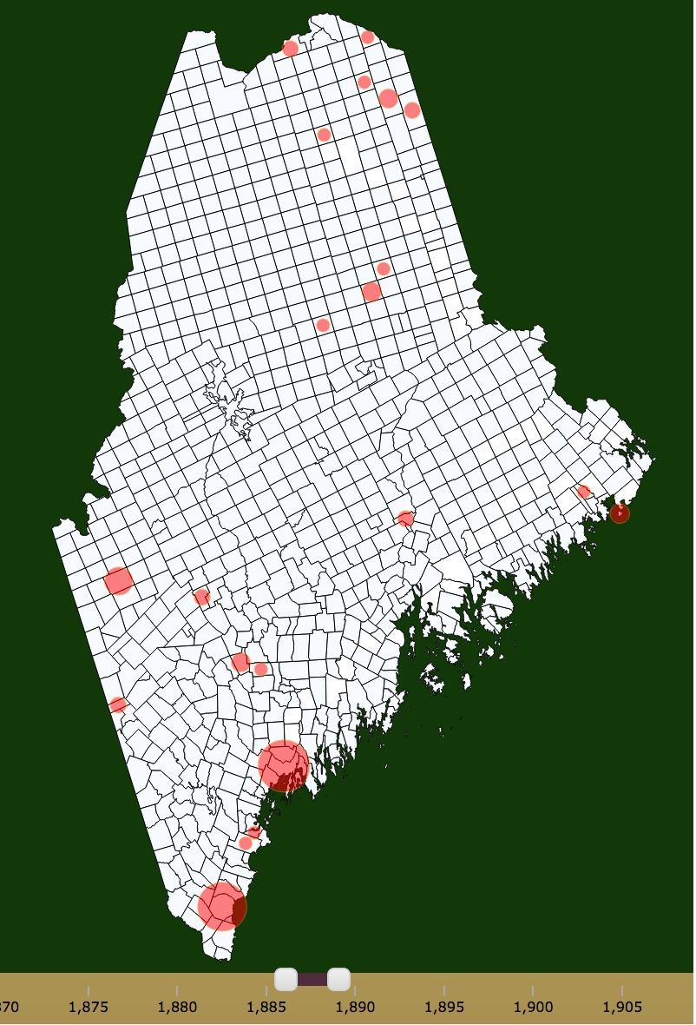
Implemented Interactions & Associated Visual Effects
Interactive Scaled Dots:
Click to show relevant data
Size reflects number of samples
Future zoom capabilities
Search Box
Allows searching for flora by AH Scientific name and by common name
Enables clicking to see specific flora on map
Enables deselect to remove specific flora from map
Notes:
We employed an integrated set of tools to make one super visualization that we will demo at the end of this presentation. We used a variety of interactions and visual effects these would cause
Interactive scaled dots:
The dots appeared on the map and changed in size based on where the current user selection of samples were taken
When clicked, relevant information is shown in the town inspector box, which will be discussed momentarily
In the next week, we hope to implement a zoom feature triggered by clicking on the dots, which will show more detail
Search box:
Allows searching by current scientific name and common name
Clicking on specific flora adds to the current selection displayed on map. The user can do this by individual flora, or select all at once. The same process is available for removing flora from the current selection.

Slide 6
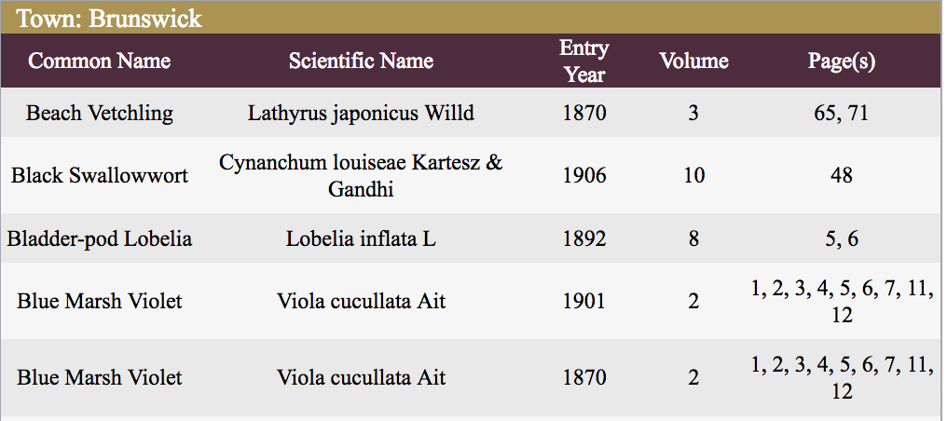
Implemented Interactions & Associated Visual Effects
Towns
Mouse-over → tooltip
Click → shown in town inspector
Town Inspector
Displays relevant and important information for selected town
Notes:
Towns:
On our map, we broke up the state of Maine by town
Towns have similar capabilities as dots, where moussing over shows a tooltip that displays the town name and a click leads to relevant information being shown in the town inspector
Town Inspector:
The town inspector shows information about the currently selected town that is relevant to the current selection of flora
It is a modified version of our initial spread sheet, showing information we deemed most relevant to answering the questions we decided to answer
You can see on the example in this slide that we show each sample individually, instead of breaking up rows by flora, so that the user can see samples of the same species that were taken in separate years

Slide 7
Implemented Interactions & Associated Visual Effects (Future)
Year Slider
Enables user to determine which year range they are interested in
Information passing
Animate to show time-lapse
Sample distribution doughnut chart
When zoomed in, show donut chart displaying distribution
Debugging
Notes:
This slide is our ideas for future work, along with work we plan on implementing in the next week
Year Slider:
Enables user to determine time range of samples they view
This will alter the display on the map and the town inspector, as samples of flora that are selected but are not within the range will not be included
While we do not believe that we can do this in the next week, we believe it would helpful to user to implement an animated time lapse so that they can watch how sampling changed annually without having to manually alter the settings each time they want to increase the year
Sample distribution doughnut char:
When zoomed in due to a click on a dot, the dots will disappear and the selected town will show a doughnut chart showing the relative number of samples taken within the town
Debugging
Of course, our code is not perfect and we still have to work out some bugs

Slide 8
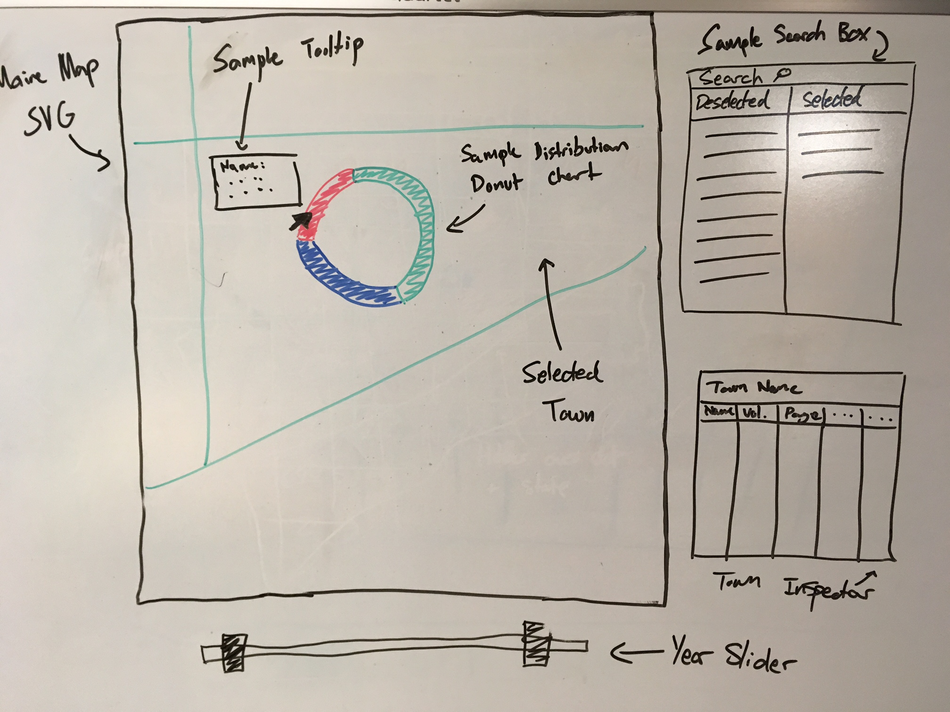
Future Work
Notes:
This is what we hope to make our zoomed in view look like in the next week

Slide 9
Degree of Success
Where did she go and when?
Where are certain flora located?
Where in the collection is this flora (regarding page and volume number)?
Where did she find the most flora?
What were her most active years?
Notes:
We believe that we answered each of these primary questions with our visualization
Determining where Kate Furbish went and when
By selecting all flora and changing the selected year, users can see where samples were collected, how many were taken, and when they were collected, and compare these over time
Identifying where certain flora are located in Maine
We believe this is afforded by allowing the user to select any flora, which will automatically be visualized on the map in the location where samples were taken
Identifying where in her collections each of the flora are documented
By selecting flora then examining the results in the town inspector, the user can see where to look up a species in the collections
Determining where she found the most flora
This can again be addressed by selecting all flora then examining the map
Determining which were her most active years
By altering the time slider, the user will be able to see how many samples were taken year by year and compare relative amounts

Slide 10
New skills that we learned!
Searching / filtering
GeoJSON
Projection
Zooming
GitHub
Message Passing (between visualizations)
Range Slider
Notes:
Searching/ filtering
Go Tucker go
GeoJSON
We spent a lot of time learning how to take shape files provided by state governments, converting them appropriately, and then using these to visually represent the state of Maine by town
We are also in the process of learning how to take this data and increase the image accurately and consistently
GitHub
Before this project, Sophie and Tucker were very unfamiliar with the use of GitHub, especially through the terminal, for version control and collaboration
Message Passing
Go Tucker Go
Range Slider
Go Marcus Go

Slide 11
Demo

