Slide 1
Interactive Data Visualization: Kate Furbish
Project 2: Final Project

Slide 2
Dataset
Dataset created from Bowdoin's collection of Kate Furbish's botanitcal drawings
Kate Furbish was a botanist from Brunswick, Maine.
She lived from 1834 to 1931, where she traveled around Maine collecting samples and cataloging hundreds of the flora in Maine.
Our project uses a dataset that holds information on each sample in her catalogues, such as:
Location of where the sample was found
Year that the sample was found
Common and scientific labels (current and at time of discovery)
Where in her books each flora sample can be found
Notes:
Our project focuses on the dataset created from Bowdoin's collection of Kate Furbish's botanitcal drawings
Kate Furbish was a botanist from Brunswick, Maine.
She lived from 1834 to 1931, where she traveled around Maine collecting samples and cataloging hundreds of the flora in Maine.
Her dilligent, prolific cataloging of the flora of Maine while defying gender norms of her time marks Furbish as one of the unsung heros of botany.
Her work is now largely curated at Bowdoin College, and can be seen on dipslay in Hawthorne-Longfellow Library. Our project uses a dataset that holds information on each sample in her catalogues, such as:
Location of where the sample was found
Year that the sample was found
Common and scientific labels (current and at time of discovery)
Where in her books each flora sample can be found

Slide 3
Data Sample
Volume | Page | KF Scientific Name | KF Scientific Name | AH Scientific Name | AH Common Name | Dimensions (hxw, cm) | Place Name-1 | Year-1
1 | 37 | Actaea rubra Willd | Actaea spicata L | Actaea rubra (Ait) Willd | red baneberry | 32.4 x 24.8 | Brunswick | 1870

Slide 4
Goals
Determine where Kate Furbish went and when.
Identify where certain flora are located in Maine.
Identify where in her collections each of the flora are documented.
Determine where she found the most flora.
Determine which were her most active years
Determine if we can evaluate for genus instead of species

Slide 5
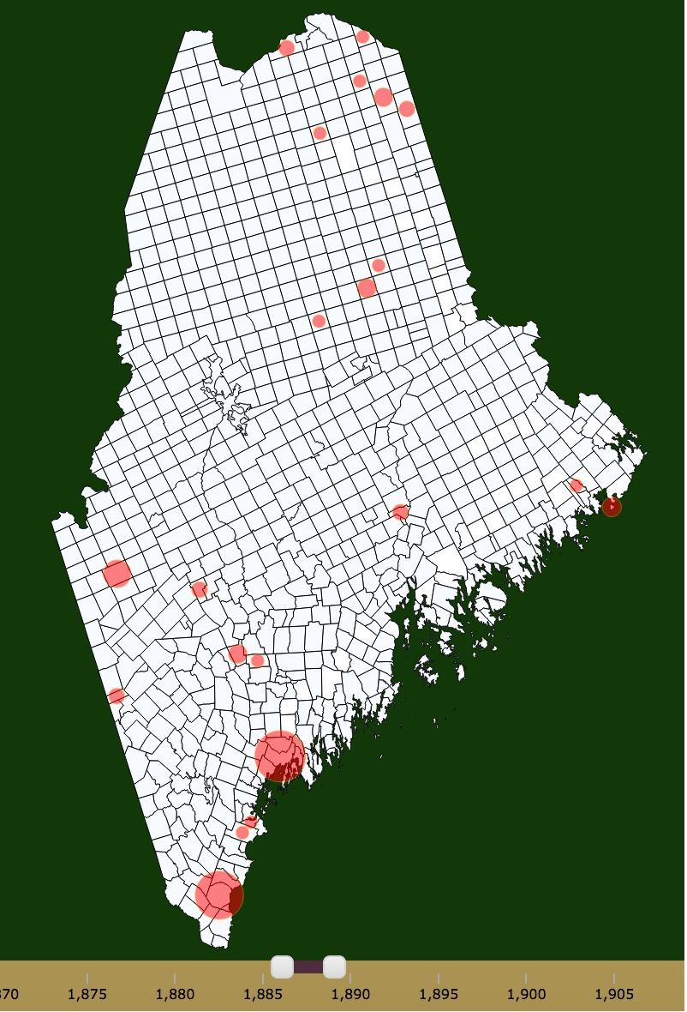
Implemented Interactions & Associated Visual Effects
Interactive Scaled Dots:
Click to show relevant data
Size reflects number of samples
Zoom in on state to display distribution + further detail (future)
Search Box
Allows searching for flora by AH Scientific name and by common name
Enables clicking to see specific flora (select individually & select all)
Enables deselect to remove specific flora (deselect individually & deselect all)

Slide 6
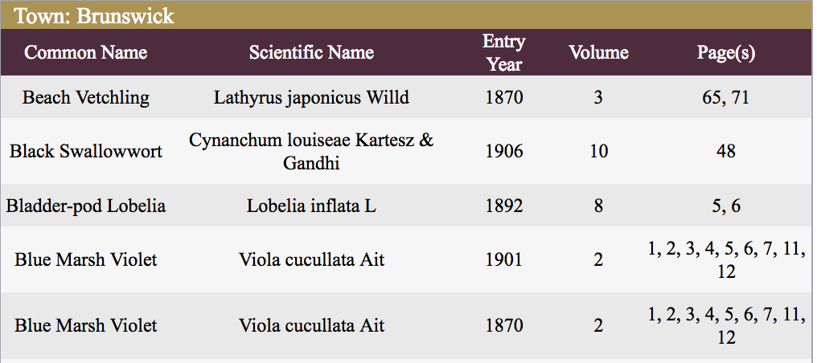
Implemented Interactions & Associated Visual Effects
Towns
Mouse-over → tooltip
Click → shown in town inspector
Town Inspector
Displays relevant and important information for selected town

Slide 7
Implemented Interactions & Associated Visual Effects (Future)
Year Slider
Enables user to determine which year range they are interested in
Information passing
Sample distribution doughnut chart
When zoomed in (due to click), show donut chart displaying distribution

Slide 8
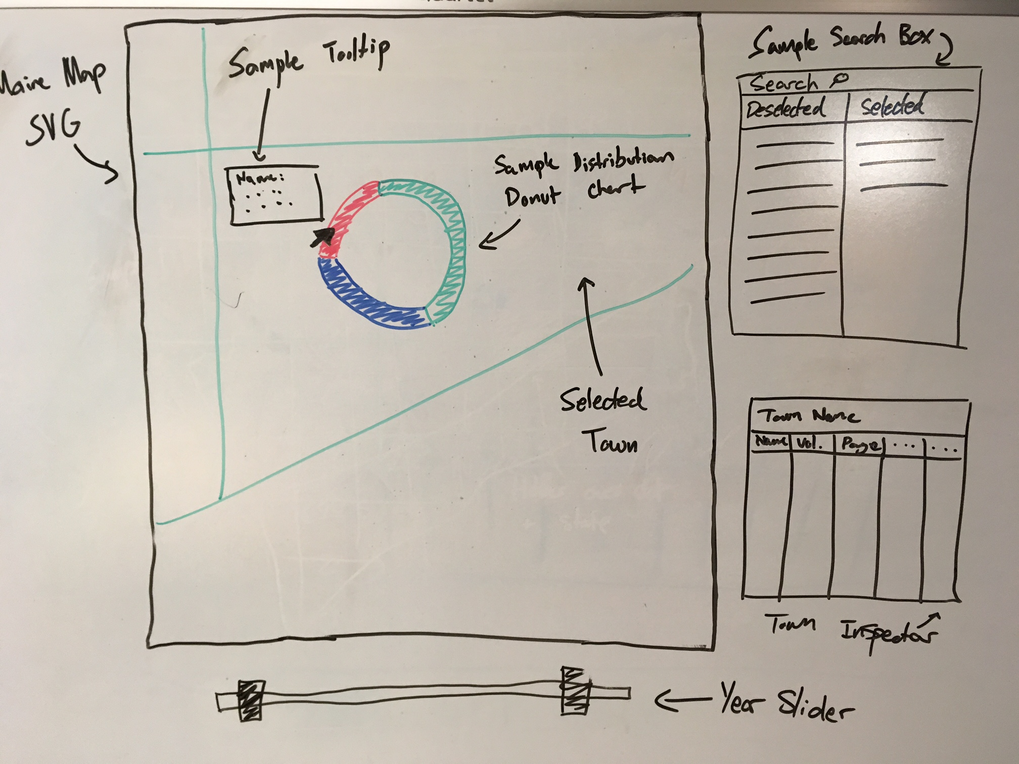
Future Work

Slide 9
Degree of Success
Where did she go and when?
Where are certain flora located?
Where in the collection is this flora (regarding page and volume number)?
Where did she find the most flora?
What were her most active years?
Is there a way we can evaluate for genus instead of species?

Slide 10
New things that we learned!
Searching / filtering
GeoJSON
Projection
Zooming
GitHub
Message Passing (between visualizations)
Range Slider

