Slide 1
Improving TCP/IP Performance Over Wireless Networks
Authors: Hari Balakrishnan, Srinivasan Seshan, Elan Amir and Randy H. Katz
Presented by
Sampoorani Deivasigamani

Slide 2
The Problem
In TCP
Packet Loss => Congestion
But in Mobile Networks
Packet Loss => disconnections, handoffs,
high bit error rates

Slide 3
Snoop TCP
Design Goals
Improved Performance
No change to TCP at fixed hosts
No violation of end-to-end TCP semantics
No recompiling/relinking of existing applications

Slide 4
Components
Snoop Module
To recover from wireless losses
Routing Protocol
Eliminate losses during handoff

Slide 5
Snoop : Basic Idea
Data from FH -> MH
Cache unacknowledged TCP data
Perform local retransmissions
Data from MH -> FH
Detect missing packets
Perform negative acknowledgements

Slide 6
FH -> MH : Snoop_data() – 1
New Packet in normal TCP sequence
Normal case
Add to snoop cache
Forward to MH
Out of sequence packet cached earlier
Fast Retransmission/timeout at sender due to
A)Loss in wireless link (if last ACK is < current seq.no.): Forward to MH
B) Loss of previous ACK (if last ACK > current seq.no.): Send ACK to FH (similar to last one seen) with MH address and port

Slide 7
FH -> MH: Snoop_data() – 2
Out of sequence packet not cached earlier
A) Congestion in fixed n/w (if seq. no is more than 1/2 packets away from last one seen):
Forward to MH
Mark it as retransmitted by sender
B) Out Of Order Delivery

Slide 8
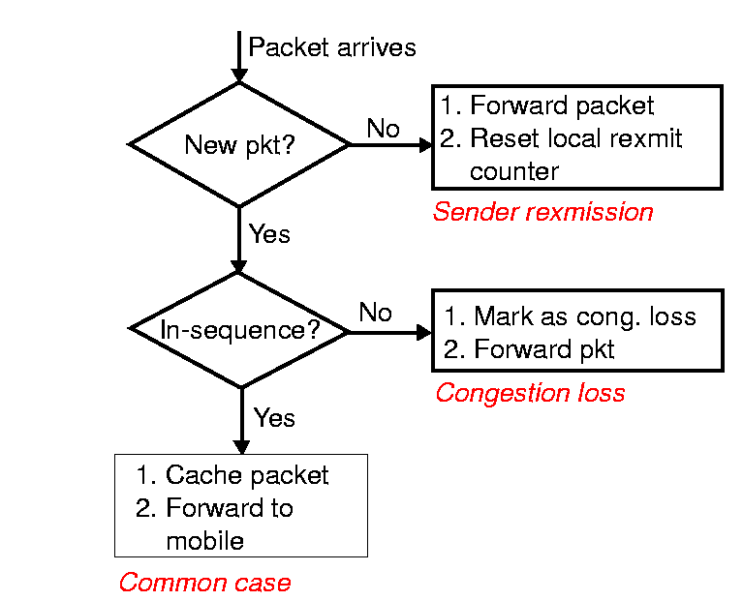
Snoop: FH -> MH
Data Processing

Slide 9
FH -> MH: Snoop_ack() - 1
New ACK
Common case
Cleaning of snoop cache
Update round trip estimate
Forward ACK to FH
Spurious ACK
Discard it

Slide 10
FH -> MH: Snoop_ack() - 2
Duplicate ACK (DUPACK) – Identical to last received highest cumulative ACK, MH generates DUPACK for every packet received out-of-sequence
A) Packet not in snoop cache
Lost in fixed n/w
Forward to FH
B) Packet marked as sender retransmitted
Forward to FH – TCP keeps track of no. of dupacks received when it retransmits

Slide 11
FH -> MH: Snoop_ack() - 3
C) Unexpected DUPACK – first DUPACK after a packet loss
Lost packet on wireless link
Retransmit at higher priority (reduces no. of DUPACKS, improves throughput)
Estimate max. of DUPACKS
D) Expect DUPACK
Subsequent packets after the lost one reaching MH
Discard it

Slide 12
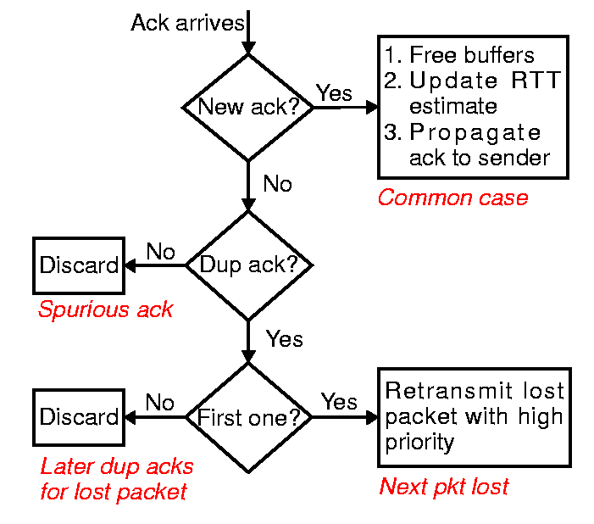
Snoop: ACK Processing

Slide 13
Data Transfer from MH -> FH
Why? MH timeouts for packets lost in first link will happen much later than they should.
NACKs* sent from BS to MH when
A) threshold no. of packets from a single window have reached
B) No new packets from MH for certain time
*- Based on TCP SACK.

Slide 14
Routing Protocol
Why? In mobile IP, packets in transit during handoff are lost/experience long delays.
Goals
Low latency handoff
Reduce packet loss and delay variation
Solution?
Use Multicast and intelligent buffering in nearby BSs

Slide 15
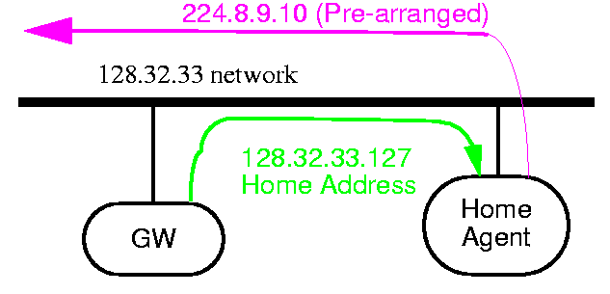
Routing Protocol – Basics
Each MH has home address and agent
Each MH is also mapped to a temporary IP multicast group consisting of BS in vicinity of MH

Slide 16
Routing Protocol - Beaconing
Each BS periodically broadcasts beacons
MH keeps track of these to determine current location and motion
MH identifies nearby BSs, determines which cell to join and handoff (based on signal strength, communication quality)

Slide 17
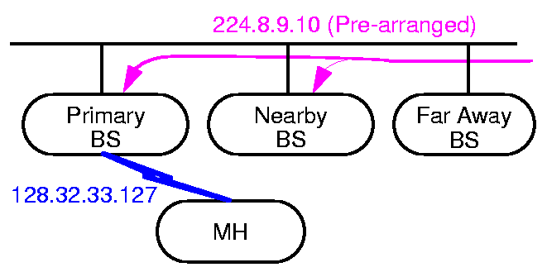
Routing Protocol
Primary BS : delivers data
Other neighbor BSs : Buffer data (minimizes data loss and delays during handoff)

Slide 18
Handoffs : Low latency, light weight
Snoop cache proportional to window size
When handoff requested or anticipated, nearby BSs cache packets
Nearby BSs cannot snoop on ACKs, so use FIFO scheme for cache
Holes in state of new BS -> slight performance degradation
Notes:
Refer to add notes

Slide 19
Implementation
Platform: IBM Thinkpad laptops, PC base stations,BSD/OS 2.0
2 Mbps AT&T wavelan
Snoop Cache
Circular buffer of pointers to kernel mbufs
Beyond “high watermark”, only out of order and earlier in sequence packets buffered

Slide 20
Timer based retransmissions
Smoothed round trip time
srtt = (1- a)*old_srtt + a * curr_rtt
If no ACK in 2 * srtt -> retransmit
Persist Timer
If there are unacknowledged packets and no activity either from sender or receiver for 200ms
Also sets no. of expected DUPACKS to zero and updates next expected ACK

Slide 21
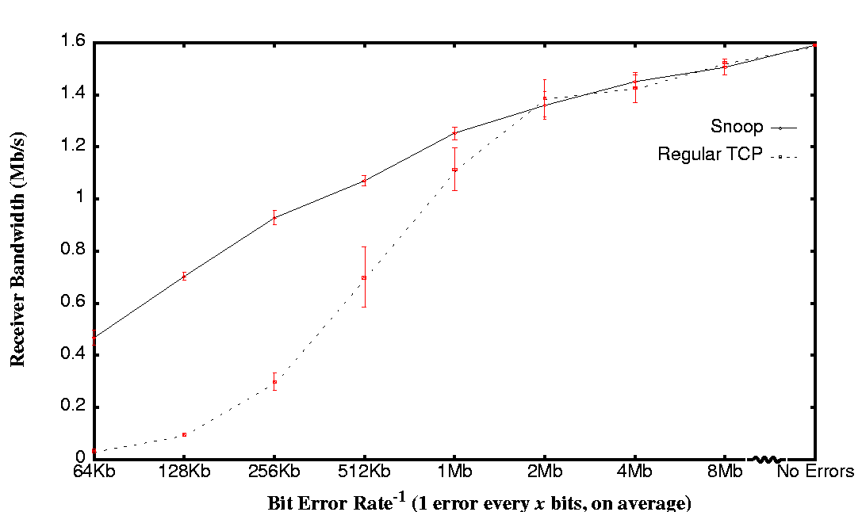
Performance – Effect of Bit Errors

Slide 22
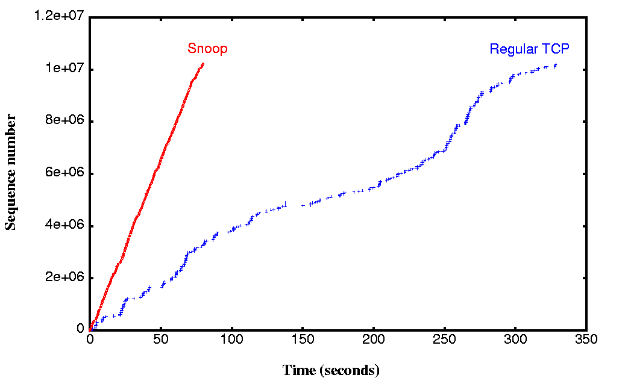
Connection Behavior – Effect of Bit Errors
Error rate: 3.9x10⁻⁶
Snoop – 1Mbps,TCP – 0.25 Mbps

Slide 23
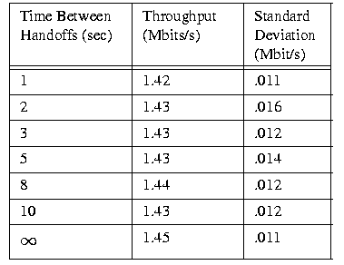
Performance: Effect of handoffs

Slide 24
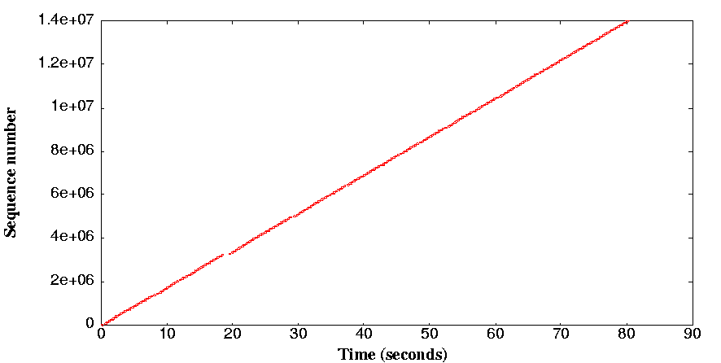
Connection Behavior – Effect of Handoffs
Handoff Frequency – 10s
Throughput – 1.4Mbps

Slide 25
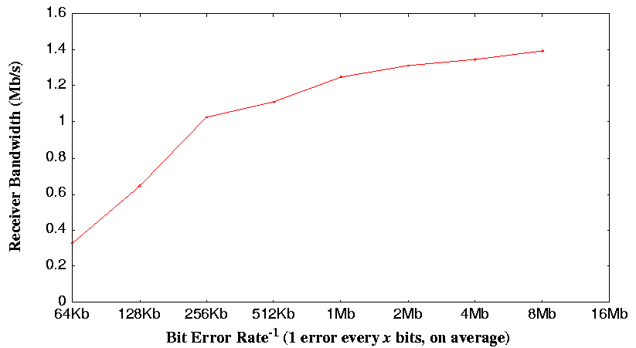
Performance: Handoffs, Bit Errors
Handoffs – 5s

Slide 26
Performance Summary
For BER > 5x10⁻⁷, throughput increases upto 20 times than regular TCP
For lower error rates, similar performance => negligible overhead due to snoop
Handoffs complete in 5-70ms (compared to 265-1400ms in I-TCP)

Slide 27
Alternative Approaches
I-TCP [A.Bakre, B.R.Badrinath]
Violation of end-to-end semantics
Significant state transfer during handoffs
Link level retransmissions
Interferes with TCP retransmissions
Retransmissions even for unreliable protocols
Fast Retransmit [R.Caceres, L.Iftode]
Doesn’t address wireless link errors
Need to transmit packets lost in handoff
Sender shrinks window before fast retransmit

Slide 28
Summary
Snoop Agent for better end-to-end TCP performance
Local caching and retransmissions by snoop agent
Caching and multicasting to minimize handoff latency and losses
Bandwidth improvement between 1 and 20 across different BERs
No.of redundant wireless retransmissions -> 0

Slide 29
References
[1] Hari Balakrishnan, Srinivasan Seshan and Randy H.Katz, “Improving Reliable Transport and Handoff Performance in Cellular Wireless Networks”, ACM Wireless Networks, May 1995
[2] Hari Balakrishnan, Venkata N. Padmanabhan, Srinivasan Seshan and Randy H.Katz, “A Comparison of Mechanisms for Improving TCP Performance over Wireless Links”, ACM SIGCOMM 1996.

