Slide 1
Simple NS Tutorial
CS 556 – Computer Networks II
Professor Ibrahim Matta
Presented by Karim Mattar
January 27, 2005

Slide 2

Overview (1 of 2)
NS is an event driven simulator
  World is modeled as a list of events
  Take one event, process it until it is completed
  Uses simulated virtual time rather than real time
  Single threaded

Slide 3

Overview (2 of 2)
NS contains functionalities and support for:
  Protocols: TCP, UDP
  Traffic Behavior: FTP, Telnet, Web, CBR, VBR
  Queue Mgmt: Drop Tail, RED, CBQ
  Routing Algorithms: LS, DV, Dijkstra’s Algorithm
  Multicast, MAC protocols
  Animation (NAM)
  Tracing

Slide 4

NS Goals
Support networking research & education
  Protocol design, traffic studies
  Protocol comparison
Collaborative environment
  Free
Multiple levels of detail in one simulator

Slide 5
NS Current Status
Platform Support
  FreeBSD, Linux, Solaris, Windows & MAC
Latest Release
  ns-2.27

Slide 6
OTcl and C++: The Duality
Pure C++
objects
Pure OTcl
objects
C++/OTcl split objects
C++
OTcl
ns

Slide 7
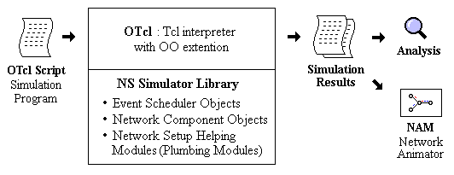
NS input & output

Slide 8
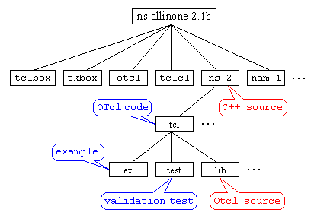
NS Directory map

Slide 9
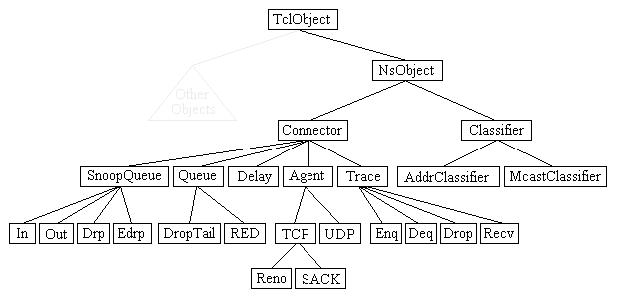
NS Class Hierarchy

Slide 10
Basic Tcl
Defining a variable.
set var1 1
set var2 “Hello“
Variable Reference
puts "var1=$var1, var2=$var2"
Assign the results of a function
set var3 [expr 5*10]

Slide 11
Basic Tcl
For Loop
  for {set i 0} {$i < 100} {incr i} {
  puts “I = $i "
  }
While Loop
  set i 0
  while {$i < 10} {
  set n($i) [new Node]
  incr i
  }
Procedure
  proc proc1 {} {
  puts "in procedure proc1"
  }
  proc1

Slide 12
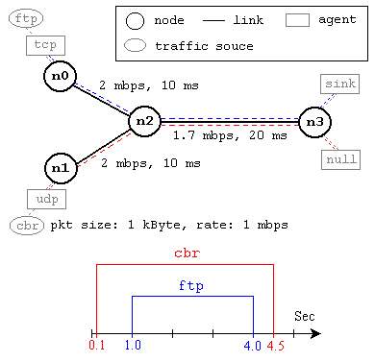
Simple Simulation Example

Slide 13
Creating Event Scheduler
Create event scheduler
  set ns [new Simulator]
Schedule events
  $ns at <time> <event>
  <event>: any legitimate ns/tcl commands
Start scheduler
  $ns run

Slide 14
Creating Network
Nodes
  set n0 [$ns node]
  set n1 [$ns node]
Links and queuing
  $ns duplex-link $n0 $n1 <bandwidth> <delay> <queue_type>
  <queue_type>: DropTail, RED, CBQ, FQ, SFQ, DRR

Slide 15
Creating Connection: UDP
UDP
  set udp [new Agent/UDP]
  set null [new Agent/Null]
  $ns attach-agent $n0 $udp
  $ns attach-agent $n1 $null
  $ns connect $udp $null

Slide 16
Creating Traffic: On Top of UDP
CBR
  set src [new Application/Traffic/CBR]
Exponential or Pareto on-off
  set src [new Application/Traffic/Exponential]
  set src [new Application/Traffic/Pareto]

Slide 17
Creating Connection: TCP
TCP
  set tcp [new Agent/TCP]
  set tcpsink [new Agent/TCPSink]
  $ns attach-agent $n0 $tcp
  $ns attach-agent $n1 $tcpsink
  $ns connect $tcp $tcpsink

Slide 18
Creating Traffic: On Top of TCP
FTP
  set ftp [new Application/FTP]
  $ftp attach-agent $tcp
Telnet
  set telnet [new Application/Telnet]
  $telnet attach-agent $tcp

Slide 19
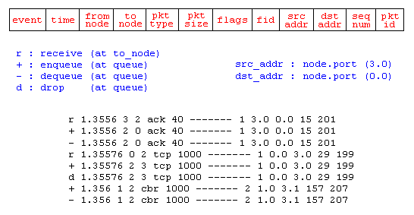
Tracing
Trace packets on all links
  $ns trace-all [open out.tr w]

Slide 20
Summary: Generic Script Structure
set ns [new Simulator]
# [Turn on tracing]
# Create topology
# Setup packet loss, link dynamics
# Create:
# - protocol agents
# - application and/or setup traffic sources
# Post-processing procedures
# Start simulation

Slide 21
Simple Simulation Example 1

Slide 22
TCL Script Step 1
#Create a simulator object
set ns [new Simulator]
#Open the All trace file
Set f [open out.tr w]
$ns trace-all $f

Slide 23
TCL Script Step 2
#Create four nodes
set n0 [$ns node]
set n1 [$ns node]
set n2 [$ns node]
set n3 [$ns node]
#Create links between the nodes
$ns duplex-link $n0 $n2 2Mb 10ms DropTail
$ns duplex-link $n1 $n2 2Mb 10ms DropTail
$ns duplex-link $n2 $n3 1.7Mb 20ms DropTail

Slide 24
TCL Script Step 3
#Set Queue Size of link (n2-n3) to 10
$ns queue-limit $n2 $n3 10

Slide 25
TCL Script Step 4
#Setup a TCP connection
set tcp [new Agent/TCP]
$ns attach-agent $n0 $tcp
set sink [new Agent/TCPSink]
$ns attach-agent $n3 $sink
$ns connect $tcp $sink
$tcp set fid_ 1
#Setup a FTP over TCP connection
set ftp [new Application/FTP]
$ftp attach-agent $tcp

Slide 26
TCL Script Step 5
#Setup a UDP connection
set udp [new Agent/UDP]
$ns attach-agent $n1 $udp
set null [new Agent/Null]
$ns attach-agent $n3 $null
$ns connect $udp $null
$udp set fid_ 2
#Setup a CBR over UDP connection
set cbr [new Application/Traffic/CBR]
$cbr attach-agent $udp
$cbr set packet_size_ 1000
$cbr set rate_ 1mb

Slide 27
TCL Script Step 6
#Schedule events for the CBR and FTP agents
$ns at 0.1 "$cbr start"
$ns at 1.0 "$ftp start"
$ns at 4.0 "$ftp stop"
$ns at 4.5 "$cbr stop"
#Call the finish procedure after 5 seconds of simulation time
$ns at 5.0 "finish"
#Print CBR packet size and interval
puts "CBR packet size = [$cbr set packet_size_]"
puts "CBR interval = [$cbr set interval_]"

Slide 28
TCL Script Step 7
#Define a 'finish' procedure
proc finish {} {
global ns f
$ns flush-trace
#Close the trace file
close $f
exit 0
}

Slide 29
TCL Script Step 8
# Trace Congestion Window and RTT
set file [open cwnd_rtt.tr w]
$tcp attach $file
$tcp trace cwnd_
$tcp trace rtt_
#Run the simulation
$ns run

Slide 30
Additional Tools
NAM-1 (Network AniMator Version 1)
  Packet-level animation
  Well supported by ns
Scripting language for processing trace files
  Perl
  Awk
Plotting graphs
  xgraph
  GNUPLOT
  MATLAB

Slide 31
Awk: Processing Trace File (out.tr)
Event Time From-Node To-Node Pkt-Type Pkt-Size Flags Fid Src-addr Dest-addr Seq-num Pkt-id
- 1.06 0 2 tcp 1040 ------- 1 0.0 3.0 2 124
r 1.07 1 2 cbr 1000 ------- 2 1.0 3.1 120 122
+ 1.07 2 3 cbr 1000 ------- 2 1.0 3.1 120 122
- 1.07 2 3 cbr 1000 ------- 2 1.0 3.1 120 122
r 1.08 2 3 cbr 1000 ------- 2 1.0 3.1 117 119
+ 1.09 1 2 cbr 1000 ------- 2 1.0 3.1 122 126
- 1.09 1 2 cbr 1000 ------- 2 1.0 3.1 122 126
r 1.10 0 2 tcp 1040 ------- 1 0.0 3.0 1 123

Slide 32
Awk: Calculating Throughput (1 of 2)
Do “man awk” on csa/csb to know more
awk ‘{if(($3==“0”)&&($4==“2”)&&($1==“r”)) print $2, $6}’ out.tr > Temp
What is in the Temp file?

Slide 33
Awk: Temp File
1.01016 40
1.07890 1040
1.14567 1040
1.23544 1040
1.34467 1040
1.45278 1040
1.55278 1040
1.65278 1040
1.75278 1040
1.85278 1040

Slide 34
Awk: Calculating Throughput (2 of 2)
awk -f throughput.awk Temp > File_Throughput
xgraph File_Throughput
gnuplot
  plot “File_Throughput” with lines

Slide 35
Awk: throughput.awk script file
BEGIN{
sum = 0;
}
{
if ($1>0)
printf(“%lg\t%lg\n”,$1,sum/$1);
sum = sum + $2;
}
END{
puts “Done”
}

Slide 36
GNUPLOT
#simple.gnu
set xrange [0:200]
set yrange [0:0.4]
set xlabel 'Time (sec)'
set ylabel 'Throughput (bps)'
plot ’out.data' title ’Tcp' with lines
set term postscript
set output “tcp.ps”
%gnuplot simple.gnu

Slide 37
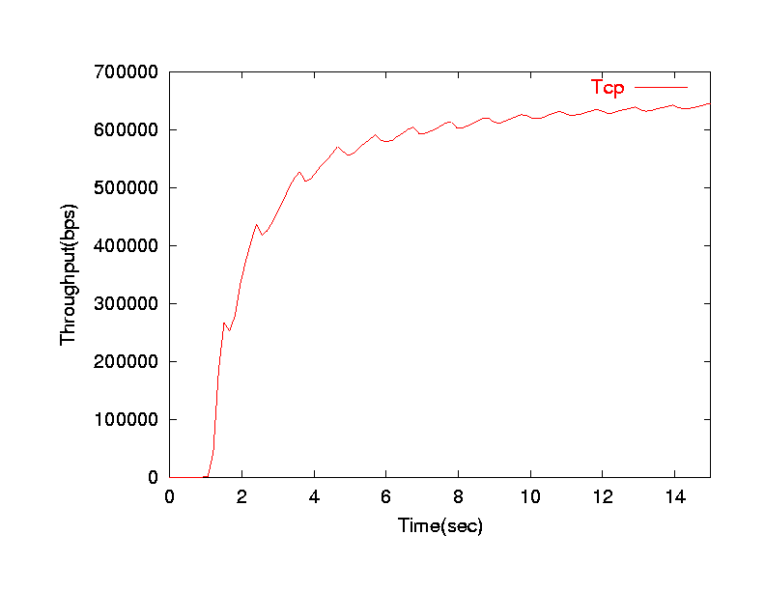
Throughput vs Time

Slide 38
Awk script (Congestion Wnd)
awk ‘{if($6==“cwnd_”) print $1,$7}’ cwnd_rtt.tr > cwnd.data
gnuplot
  plot “cwnd.data” with lines

Slide 39
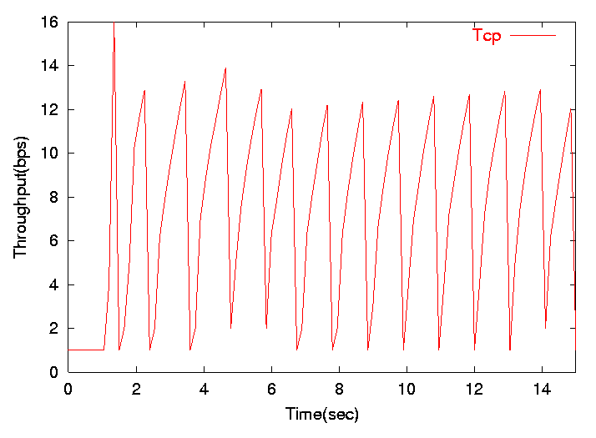
Congestion Window vs Time
cwnd(pkts)

Slide 40
Simple Simulation Example 2
ftp
Traffic Source
Tcp
TcpSink
Agent
n0
n4
1Mb, 10ms
10Mb, 2ms
10Mb, 2ms
n2
n3
10Mb, 2ms
Link
10Mb, 2ms
n1
n4
Node
Tcp
TcpSink
ftp

Slide 41
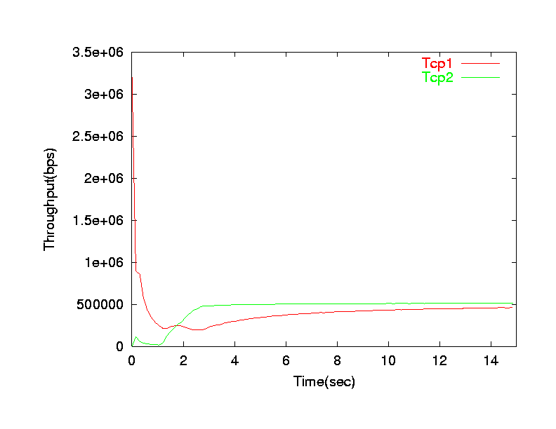
Throughput vs Time

Slide 42
Random Variables in NS
Seeds and Generators
  (Seed = 0) results in the generation of a new random variable each time we run the simulation
  (Seed != 0) results in the generation of the same sequence of random variables each time we run the simulation
Creating Random Variables
  Create a new generator and assign it a seed
  Set MyRng [new RNG]
  $MyRng seed 2
Distribution Types
  Example: Uniform distribution
  Set r1 [new RandomVariable/Uniform]
  $r1 use-rng $MyRng
  $r1 set min_ 0.0
  $r1 set max_ 10.0
  Other distribution types: Pareto, constant & exponential

Slide 43
Useful Links
NS web page (Download & Build NS)
  http://isi.edu/nsnam/ns/
NAM web page
  http://www.isi.edu/nsnam/nam
NS tutorials (Simplest tutorial first)
  http://www-sop.inria.fr/maestro/personnel/Eitan.Altman/COURS-NS/n3.pdf
  http://www.isi.edu/nsnam/ns/tutorial/index.html
  http://nile.wpi.edu/NS/
NS Manual (Complete Reference)
  http://www.isi.edu/nsnam/ns/ns-documentation.html
GNUPLOT Tutorial
  http://www.duke.edu/~hpgavin/gnuplot.html
Perl Tutorial
  http://docs.rinet.ru/P7/

