Slide 1
An Open Source Software
Suite for Air and Ocean Vehicles
NTNU 2014-11-17
Ricardo Martins <rasm@lsts.pt>
Paulo Dias <pdias@lsts.pt>
Underwater Systems and Technology Laboratory (LSTS)

Slide 2
Tutorial Overview
Background
GLUED
  Minimal GNU/Linux distribution
IMC
  Inter-Module Communication API
DUNE
  On-board Software
Neptus
  Command and Control Unit

Slide 3
Background

Slide 4
What is It ?
Complete software solution for autonomous vehicles
Operating system (Linux distribution)
API for interaction between software modules
On-board software for sensor interaction, Control, Guidance, Navigation
GUI Command & Control Unit
Mission Review and Analysis (Log Analysis)

Slide 5
Brief Timeline
1997 – LSTS was created
1997 – First AUV was purchased (WHOI REMUS AUV)
2004 – Neptus was created
2005 – First ROV built from scratch
2006 – DUNE and IMC were created
2006 – First AUV built from scratch (LAUV)
2007 – Projects and MoU with the PO Ministry of Defence
...
2014 – 7 operational LAUVs, 1 ROV, 1 ASV, 20 UAVs, 10 LAUVs sold, toolchain used by external entities (NTNU, HTWG, EvoLogics GmbH, ...)

Slide 6
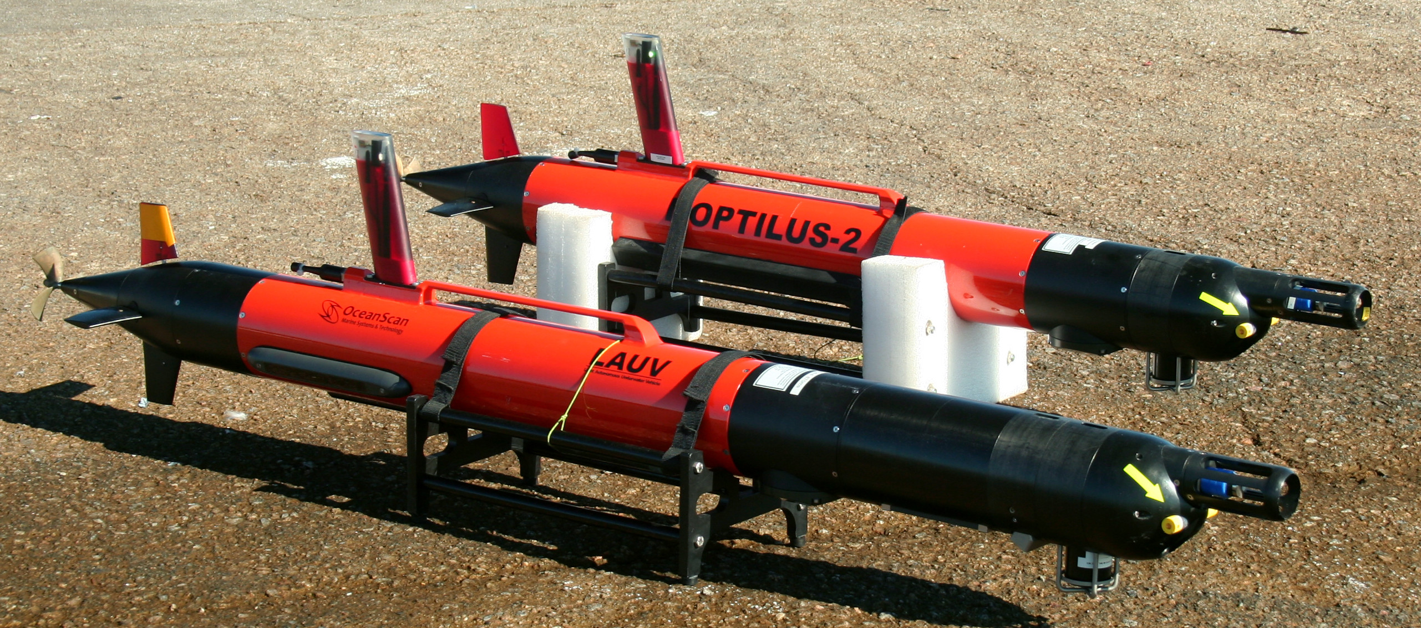
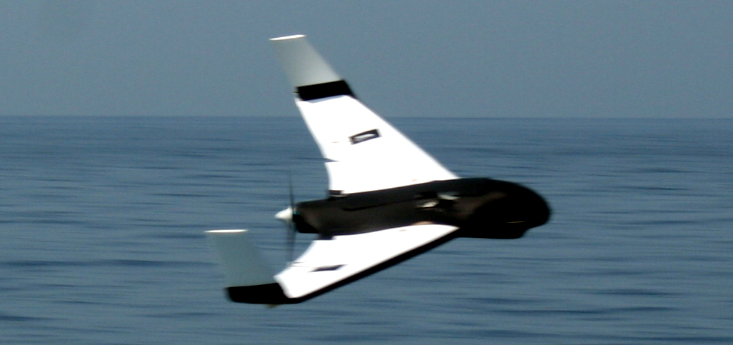
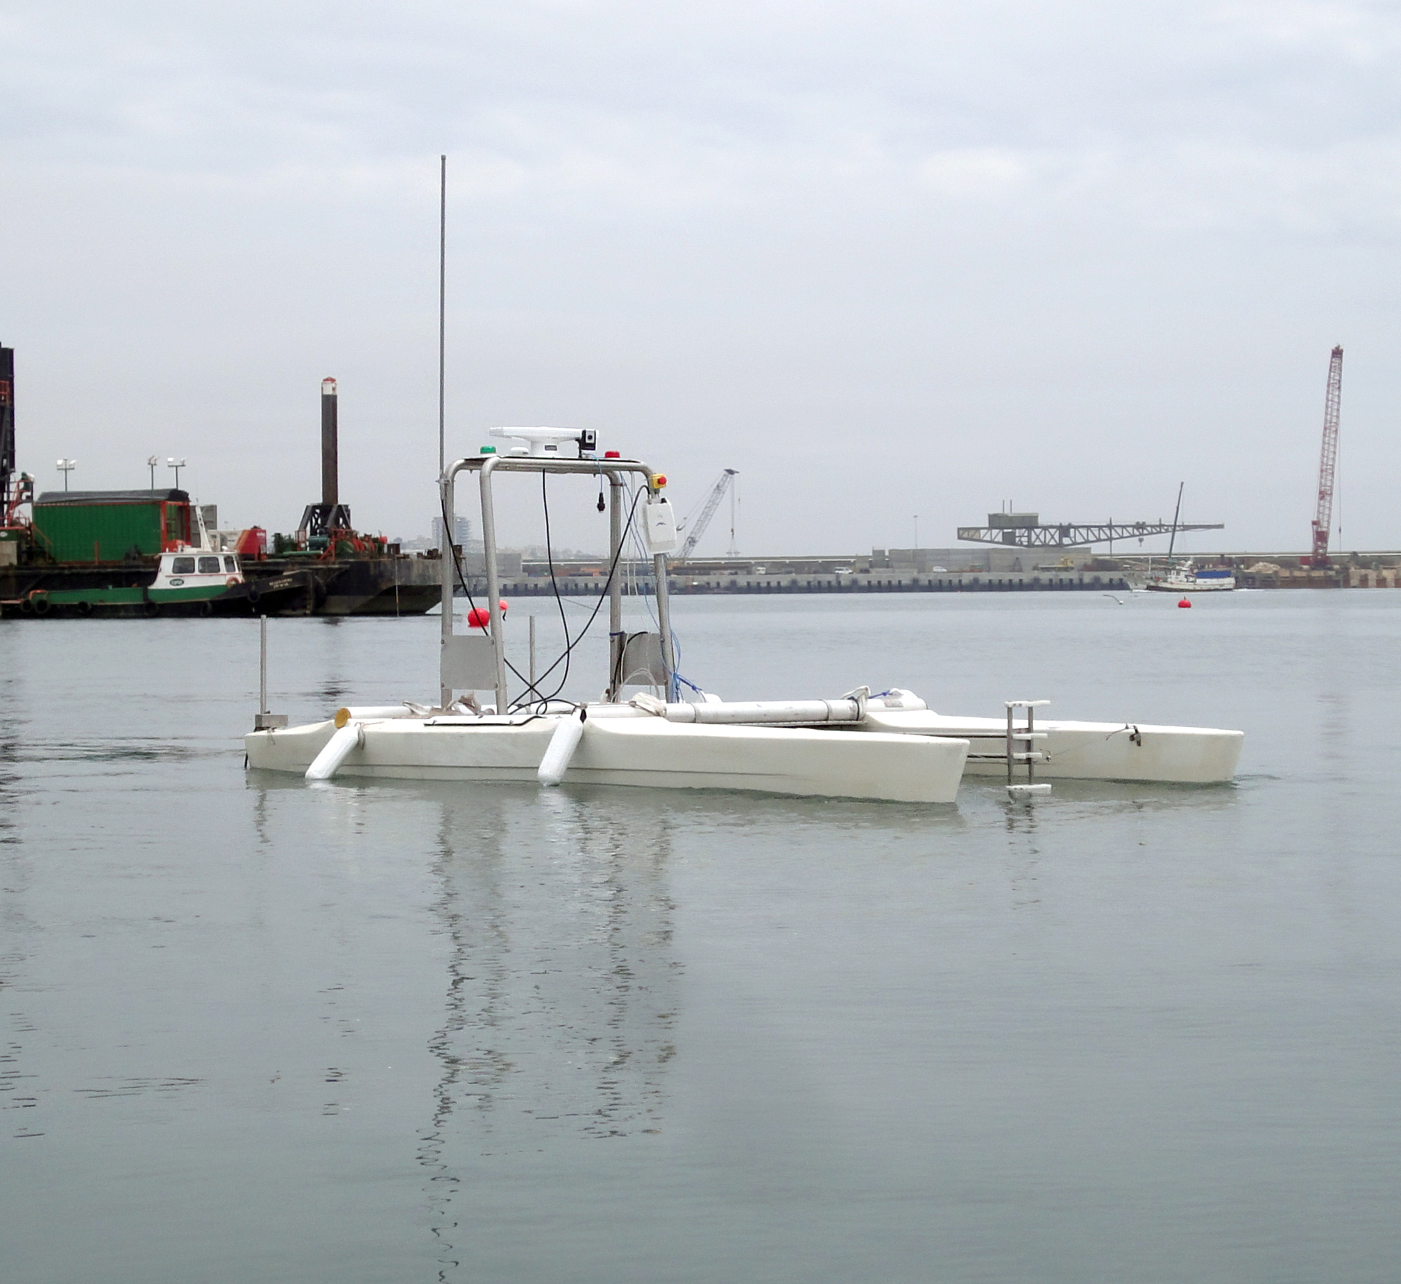
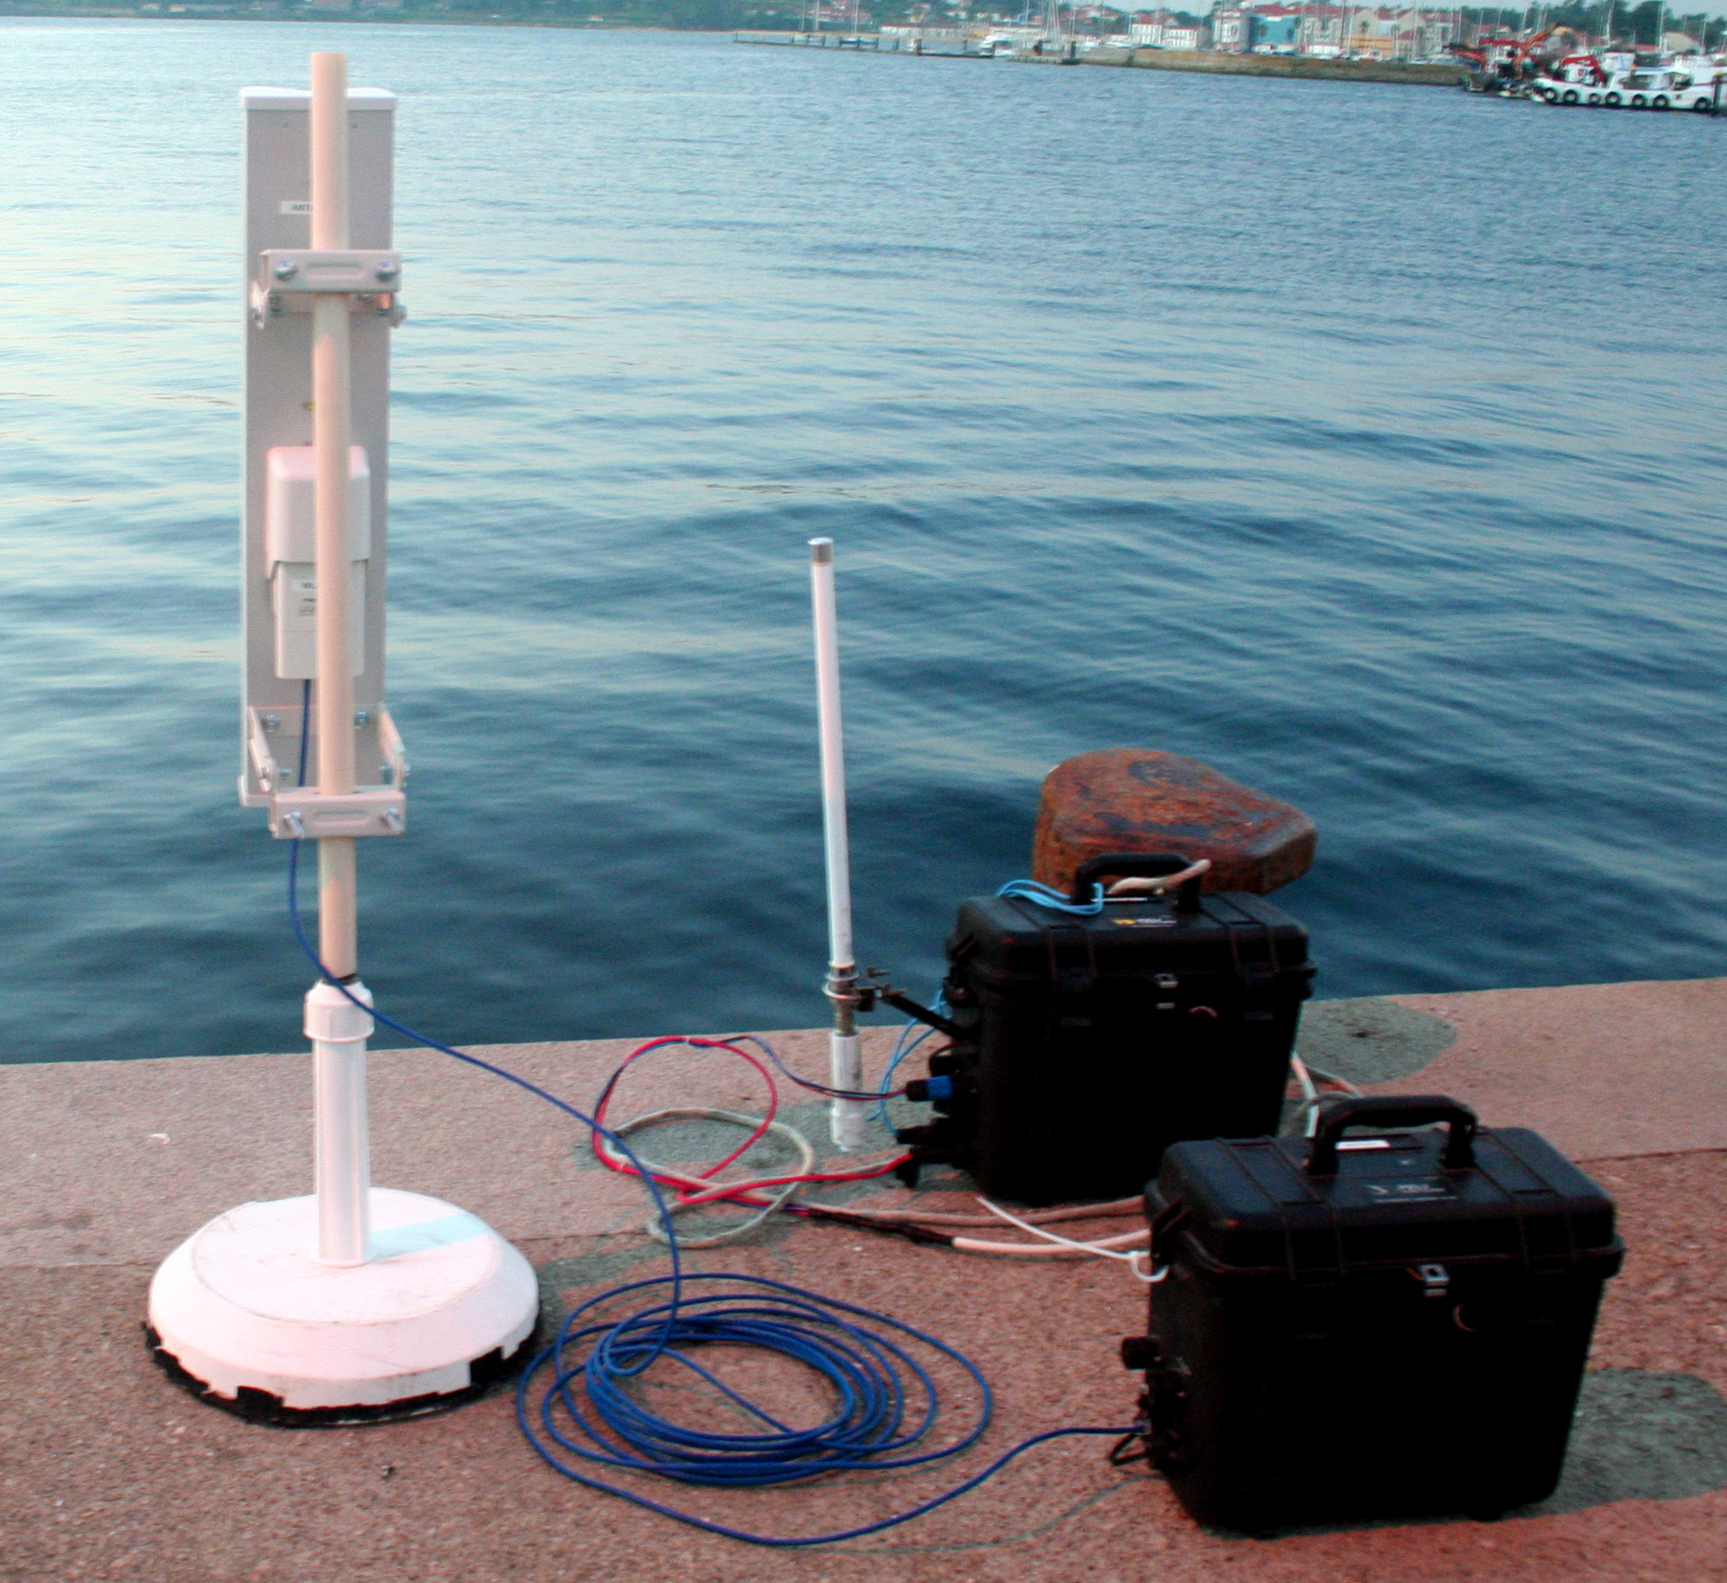
Systems

Slide 7
Why start from scratch ?
The REMUS on-board software was starting to show its age (based on QNX4 and Pre ISO C++ 98)
The code-base was developed and maintained poorly
Freely available software had a few shortcomings:
  Highly experimental
  Cumbersome or impossible to use in embedded systems
  Command & Control software was primitive
  We disagreed with the architecture/design choices

Slide 8
Further motivation
To avoid things like this:
// Created by John Doe (1996)
// Updated by John Smith (1999)
// Updated by Tommy Toe (2001)
// Vandalized by Joe Bloggs (2005)
From common/abstraction/shared/whoi_mboard.h
(Fictitious names)

Slide 9
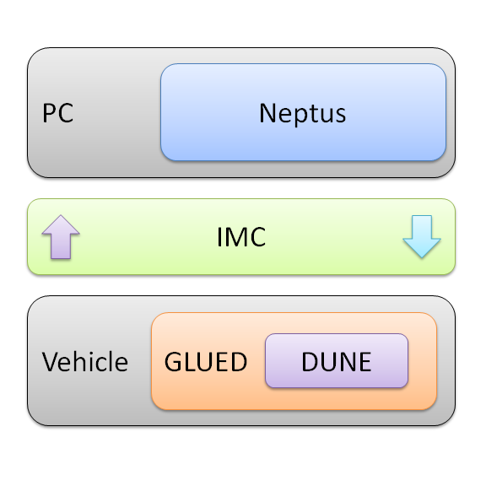
Toolchain Overview

Slide 10
GLUED
GNU/Linux Uniform Environment Distribution
https://github.com/LSTS/glued

Slide 11
Overview
Minimal GNU/Linux distribution focused on embedded systems
Small footprint
  around 10 MiB
Fast boot time
  2 to 5 seconds depending on target machine and peripherals
Target machine binaries are cross compiled (i.e., built for a platform other than the one on which the compiler is running)
Creates a reproducible root filesystem for a given target
Supports several x86, ARM, and MIPS targets

Slide 12
Motivation
Time to build large software projects in embedded systems is almost unbearable
  several hours vs a few minutes in modern PCs
Embedded systems usually require bootloader and kernel customization
The longer the system takes to boot the longer it is uncontrollable
Upgrading the operating system should be an unattended process with a predictable outcome
The root filesystem and target binaries should be easily replicated and traceable

Slide 13
Supported Hardware
ARM
  BeagleBone White & Black (TI AM3359 @ 1 GHz)
  ISEE IGEPv2 (TI DM3730 @ 1 GHz)
x86
  IEI PM-LX 800 (AMD Geode LX @ 500 MHz)
  IEI PM-LX2 800 (AMD Geode LX @ 500 MHz)
  Kontron pITX (Intel Atom Z510 @ 1.6 GHz)
MIPS
  Ubiquiti RouterStation (Atheros AR7161 MIPS 24K @ 680 MHz)

Slide 14
IMC: Inter-Module Communication
API

Slide 15
Overview
Message Oriented Protocol
One XML document defines all messages
Generators for documentation, C++ and Java code
Serialization/deserialization to/from:
  JSON
  XML
  Binary
Serialized messages are used for logging and communication
Binary serialization format can be translated to human-readable format (LLF)

Slide 16
Interaction Layers
Plan control
Vehicle control
Maneuvering
Guidance
Navigation
Sensing
Actuation
Networking
Storage

Slide 17
Addressing
Addresses are partitioned in classes (AUV, UAV, ROV, CCU, etc)
Each system has a unique address (i.e., unique number)
Subsystems/submodules of a system are called entities
Each entity has a unique local number used to further qualify a message (e.g., disambiguate messages of the same type but different sources, temperature from a CTD vs CPU temperature)

Slide 18
Anatomy of a message
Synchronization Number
  Marks the beginning of a message
  Identifies protocol version
  Allows for endianess detection
Message Identification Number
  Uniquely identifies a message type
Message size
Timestamp

Slide 19
Anatomy of a message
Source Address
Source Entity
Destination Address
Destination Entity
Message Specific Fields
CRC16

Slide 20
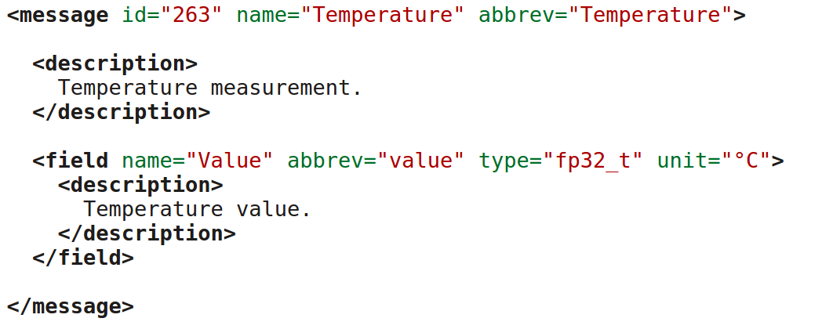
Example

Slide 21
DUNE: Uniform Navigational Environment

Slide 22
Overview
Designed for embedded systems
Written in C++
Used in AUVs, UAVs, ROVs, ASVs, data-loggers and communication gateways
Related logical operations are isolated from each other in tasks, usually running in a separate thread of execution
Communication between tasks and communication with external software is performed exclusively by using the set of messages described in the IMC API

Slide 23
Overview
Communication
  TCP, UDP, Acoustic modem, Iridium, GSM
Logging
Interaction with sensors, actuators, and power devices
Controllers for attitude, speed, manual operation, etc
Guidance algorithms
Maneuvers (way-point following, area coverage, follow reference, loiter, station keeping, etc)

Slide 24
Supported Platforms
Architectures
  x86, ARM, PowerPC, SPARC, MIPS, AVR32
Operating Systems
  Linux v2.6+/Android, QNX v6.x, Oracle Solaris, Mac OS X, eCos, RTEMS, OpenBSD, FreeBSD, NetBSD, Microsoft Windows
Hardware Interfaces
  Serial Port, I²C, I/O port, CAN

Slide 25
Required Software
Mandatory
  Git
  CMake
  C/C++ Compiler
  Python Interpreter
Optional
  Eclipse
  Microsoft Visual Studio

Slide 26
Required Software
Ubuntu/Debian
  sudo apt-get install cmake git g++ make python
Microsoft Windows
  http://www.cmake.org/download/
  http://git-scm.com/downloads/
  http://sf.net/projects/mingw/files/Installer/mingw-get-inst/
  http://www.microsoft.com/express
Apple Mac OS X
  http://www.cmake.org/download/
  https://developer.apple.com/xcode/

Slide 27
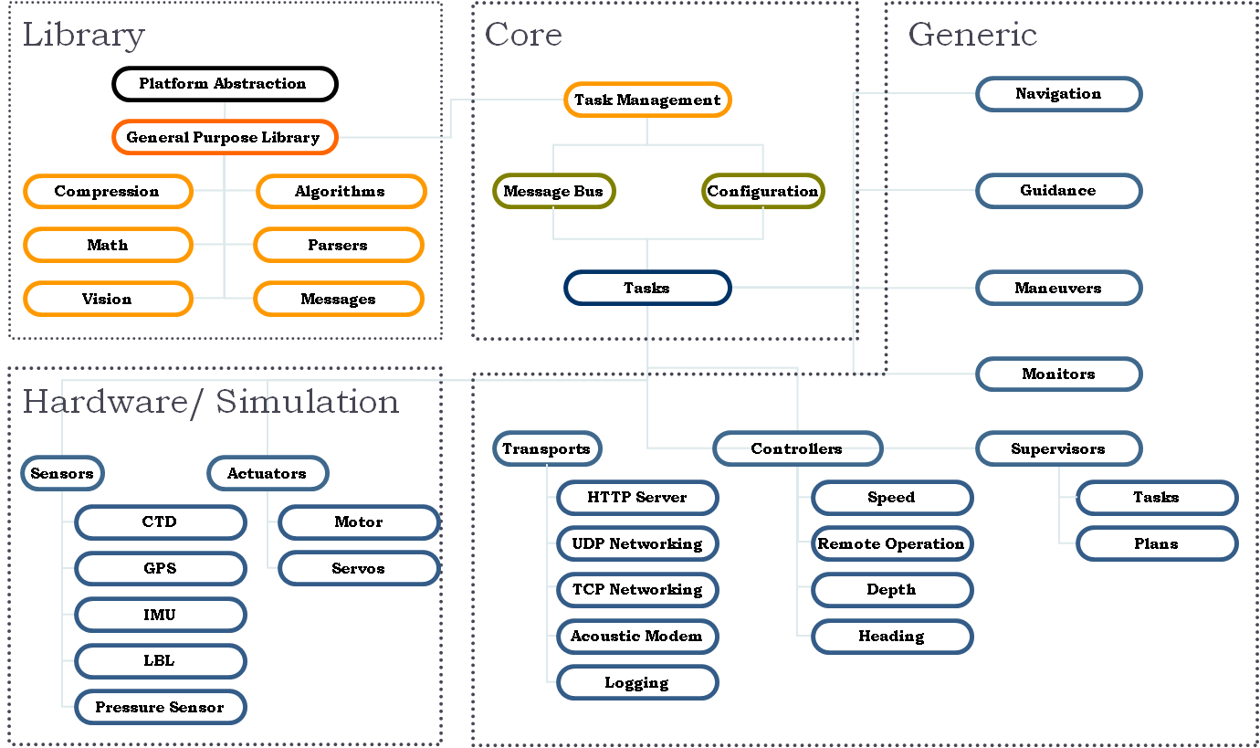
Example System

Slide 28
Resources
Source Code
  https://github.com/LSTS/dune
Documentation
  http://lsts.pt/docs
  https://github.com/LSTS/dune/wiki
Mailing List
  https://groups.google.com/forum/#!forum/lsts-toolchain
  lsts-toolchain@googlegroups.com
Nightly Builds
  http://www.lsts.pt/cdash/index.php?project=DUNE

Slide 29
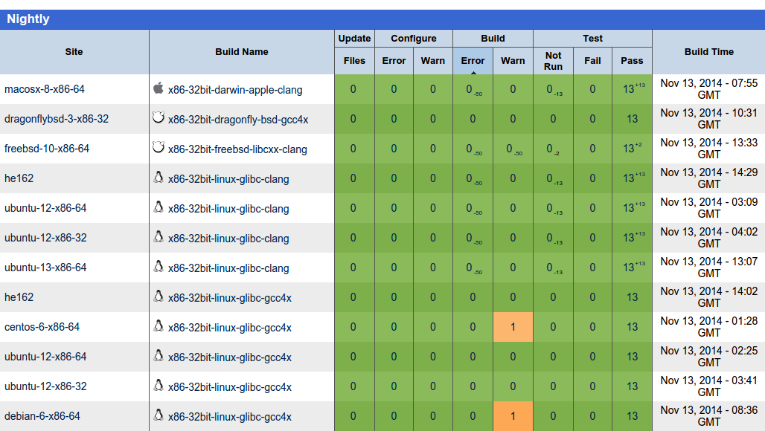
Nightly Builds

Slide 30
Source Code Organization
cmake
  CMake related files
vendor
  3rd party libraries
firmware
  Microcontroller firmware
www
  HTTP server files

Slide 31
Source Code Organization
programs
  Standalone programs, utilities and scripts
src/Main
  Daemon/launcher main functions (executable entry point)
src/DUNE
  Core library
src/Actuators
  Device driver tasks for actuator or actuator-like devices

Slide 32
Source Code Organization
src/Maneuver
  Maneuvering related tasks. Waypoint following and more complex compound maneuvers
src/Monitors
  Safety monitors (CPU, Clock, Fuel, Operational Limits, etc)
src/Navigation
  Position estimators, dead reckoning, etc
src/Plan
  Plan execution and storage

Slide 33
Source Code Organization
src/Power
  Device driver tasks for power supplies and related devices
src/Sensors
  Device driver tasks for sensors (IMUs, Sonars, GPS, ADCs)
src/Simulators
  Simulation engines and simulation based tasks
src/Supervisors
  Tasks responsible for supervising global states
src/Transports
  Communication and logging tasks (UDP, TCP, HTTP, GSM, etc)

Slide 34
Source Code Organization
src/UserInterfaces
  Tasks that control LEDs, LCDs, buttons and instrument panels
src/Vision
  Video acquisition and processing
etc
  Configuration files

Slide 35
Bootstrapping
mkdir $HOME/tutorial && cd $HOME/tutorial
git clone https://github.com/LSTS/dune.git dune
mkdir build && cd build
cmake ../dune
make
./dune -c lauv-seacon-1 -p Simulation

Slide 36
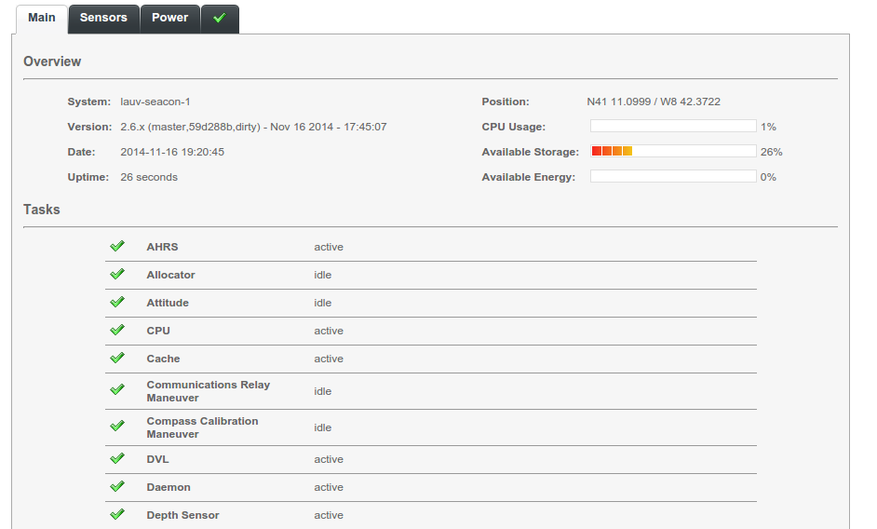
Web Interface
http://127.0.0.1:8080

Slide 37
Anatomy of a Task
Runs concurrently with other tasks
Communicates with other tasks using IMC messages
Does one job (and does it right)
Can be event-driven or periodic

Slide 38
Basic Functions
Task(const std::string& name, Tasks::Context& ctx)
  Task constructor
  Never fails, doesn't throw exceptions
  Declares configuration parameters
  Allocates resources that do not depend on configuration parameters
void onUpdateParameters(void)
  Called when configuration parameters change
void onEntityReservation(void)
  Called when the task can reserve entities

Slide 39
Basic Functions
void onEntityResolution(void)
  Called when the task can resolve entities
void onResourceAcquisition(void)
  Called when the task can acquire resources (open serial ports, sockets, etc)
void onResourceInitialization(void)
  Called when the task can initialize previously acquired resources
void onResourceRelease(void)
  Releases all acquired resources
void onMain(void) / void task(void)
  Main task loop

Slide 40
Example Task: Producer
http://goo.gl/FUezwX
Task produces random temperature values and dispatches them to the message bus
Scaffold created using the command:
  python ../dune/programs/scripts/dune-create-task.py ../dune 'Ricardo Martins' 'Workshop/Producer'
  make rebuild_cache
Source code resides in src/Workshop/Producer
Task entry point is src/Workshop/Producer/Task.cpp
Build: make

Slide 41
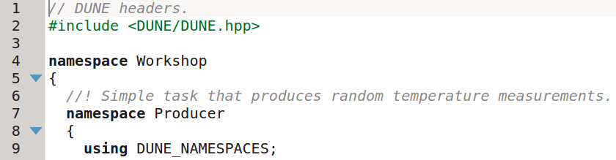
Example Task: Producer

Slide 42
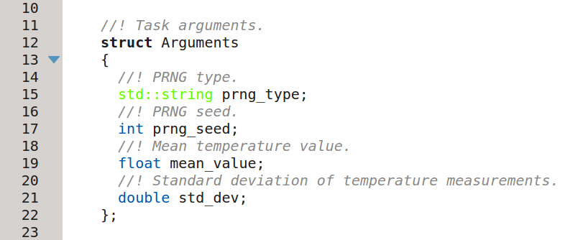
Example Task: Producer

Slide 43
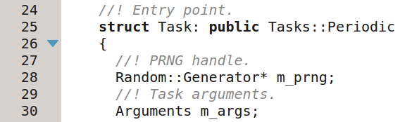
Example Task: Producer

Slide 44
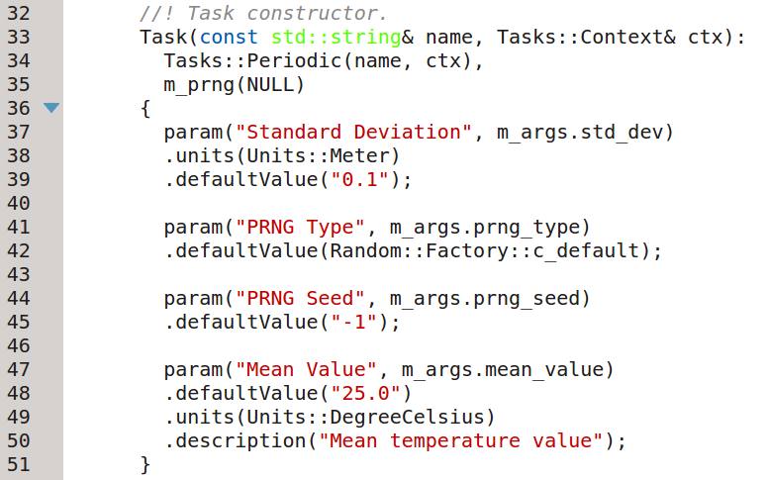
Example Task: Producer

Slide 45
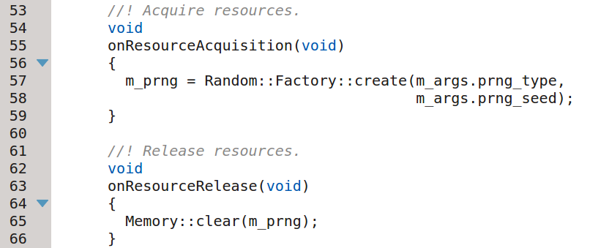
Example Task: Producer

Slide 46
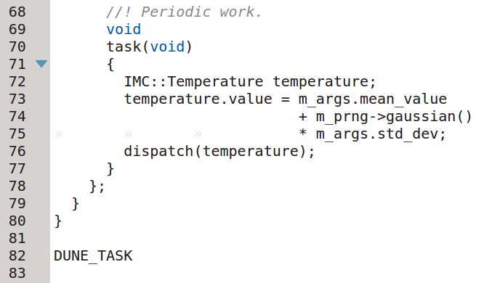
Example Task: Producer

Slide 47
Example Task: Consumer
http://goo.gl/1n2Cpk
Task consumes temperature messages and prints them to the output (console)
Scaffold created using the command:
  python ../dune/programs/scripts/dune-create-task.py ../dune 'Ricardo Martins' 'Workshop/Consumer'
  make rebuild_cache
Source code resides in src/Workshop/Consumer
Task entry point is src/Workshop/Consumer/Task.cpp
Build: make

Slide 48
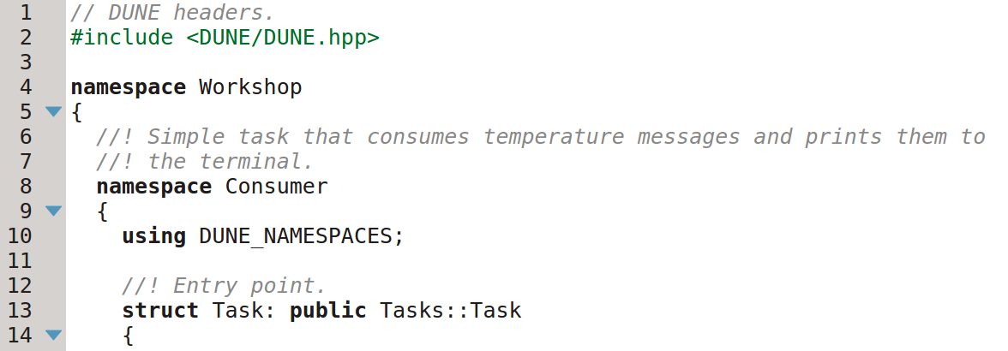
Example Task: Consumer

Slide 49
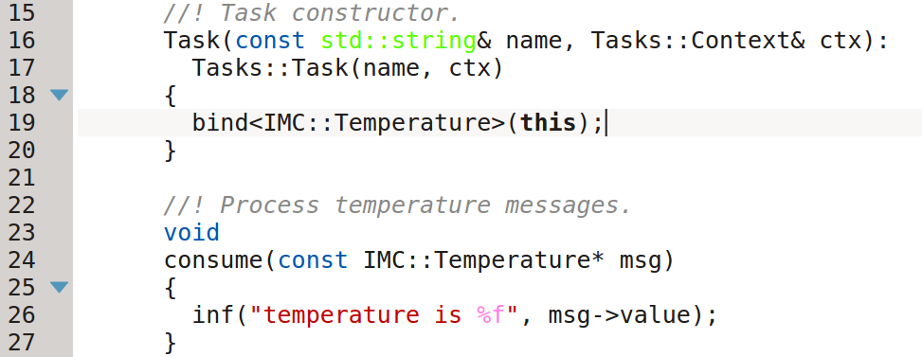
Example Task: Consumer

Slide 50
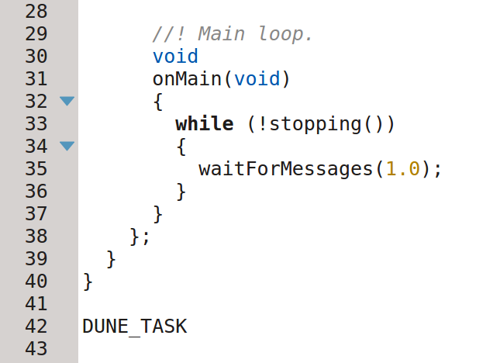
Example Task: Consumer

Slide 51
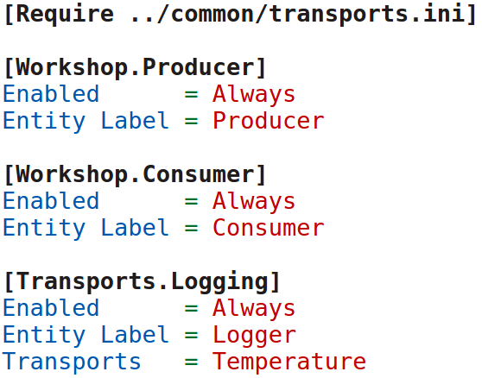
Configuration File
http://goo.gl/n4nli4
Configuration file etc/development/workshop.ini:

Slide 52
Runtime Output
Command: ./dune -c development/workshop
[2014/11/16 19:51:26] - MSG [Daemon] >> system name: 'unknown' (65535)
[2014/11/16 19:51:26] - MSG [Daemon] >> registered tasks: 160
[2014/11/16 19:51:26] - MSG [Daemon] >> base folder: '/home/rasm/tutorial/build'
[2014/11/16 19:51:26] - MSG [Daemon] >> configuration folder: '/home/rasm/tutorial/dune/etc'
[2014/11/16 19:51:26] - MSG [Daemon] >> web server folder: '/home/rasm/tutorial/dune/www'
[2014/11/16 19:51:26] - MSG [Daemon] >> log folder: '/home/rasm/tutorial/build/log/unknown'
[2014/11/16 19:51:26] - MSG [Daemon] >> library folder: '/home/rasm/tutorial/build'
[2014/11/16 19:51:26] - MSG [Daemon] >> firmware folder: '/home/rasm/tutorial/dune/firmware'
[2014/11/16 19:51:26] - MSG [Transports.Cache] >> starting
[2014/11/16 19:51:26] - MSG [Transports.FTP] >> starting
[2014/11/16 19:51:26] - MSG [Transports.Fragments] >> starting
[2014/11/16 19:51:26] - MSG [Transports.HTTP] >> starting
[2014/11/16 19:51:26] - MSG [Transports.LogBook] >> starting
[2014/11/16 19:51:26] - MSG [Transports.Logging] >> starting
[2014/11/16 19:51:26] - MSG [Workshop.Consumer] >> starting
[2014/11/16 19:51:26] - MSG [Workshop.Producer] >> starting

Slide 53
Runtime Output
[2014/11/16 19:51:26] - MSG [Transports.HTTP] >> listening on 0.0.0.0:8080
[2014/11/16 19:51:26] - MSG [Transports.Logging] >> log started '20141116/195126'
[2014/11/16 19:51:26] - MSG [Transports.FTP] >> listening on 127.0.0.1:30021
[2014/11/16 19:51:26] - MSG [Transports.FTP] >> listening on 192.168.1.178:30021
[2014/11/16 19:51:26] - MSG [Transports.FTP] >> listening on 10.0.254.1:30021
[2014/11/16 19:51:27] - MSG [Workshop.Consumer] >> temperature is 25.068323
[2014/11/16 19:51:28] - MSG [Workshop.Consumer] >> temperature is 24.957678
[2014/11/16 19:51:29] - MSG [Workshop.Consumer] >> temperature is 25.030371
[2014/11/16 19:51:30] - MSG [Workshop.Consumer] >> temperature is 24.979784
[2014/11/16 19:51:31] - MSG [Workshop.Consumer] >> temperature is 25.037634
[2014/11/16 19:51:32] - MSG [Workshop.Consumer] >> temperature is 24.971085
[2014/11/16 19:51:33] - MSG [Workshop.Consumer] >> temperature is 24.974072
[2014/11/16 19:51:34] - MSG [Workshop.Consumer] >> temperature is 24.877298

Slide 54
Log Files
DUNE stores log files in the IMC serialization format:
  Binary format
  1 file for all messages and message types (Data.lsf)
  Messages are stored roughly in the same order as they were created
  Supports Gzip and Bzip2 compression (Data.lsf.gz, Data.lsf.bz2)

Slide 55
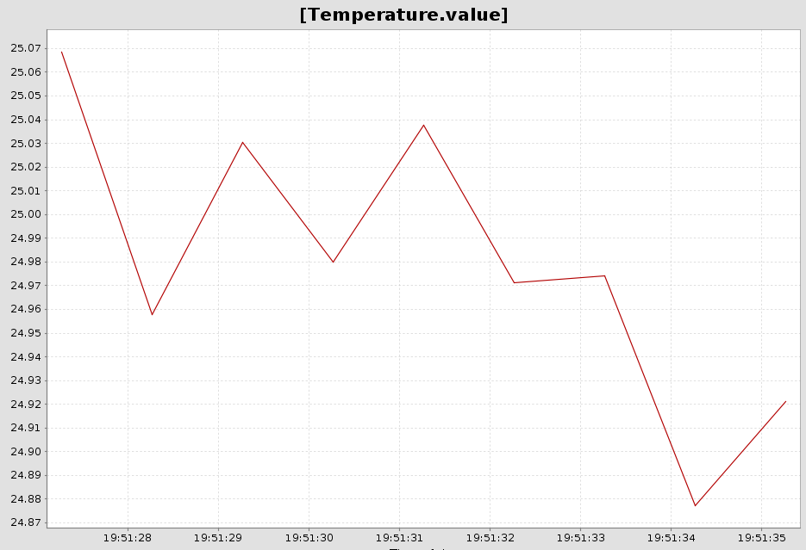
Log File (Neptus MRA)

Slide 56
Neptus
Command & Control Unit

