Slide 1
MIA Lab Final Presentation:
Hypothesis 1: Preprocessing
Project Group 7: Chanae Smith, Tudorita Zaharia, Isabella Torres

Slide 2

NOISE REDUCTION
High quality images Customized 3T scanner & pulse sequences Denoising could help
RESAMPLING
Images in native subject space. Resampling would ensure consistent resolution & voxel dims across images
BACKGROUND REMOVAL
The dataset has non-skull stripped T1w and T2w images.
NORMALIZATION
Dataset has consistent acquisition parameters and imaging devices across subjects. Sanity check confirmed this
Notes:
To develop the hypothesis, we started by exploring the material that was provided to us. We found that preprocessing for medical image analysis typically comes in 4 flavours, so we considered those with respect to our dataset
The first is background removal, where you remove irrelevant areas. In our case, that would be like the skull since the images are non-skull-stripped. So this would definitely feasible for isolating the brain region before further processing.
Next is noise reduction. The HCP uses advanced MRI acquisition techniques that yield high-quality images with reduced noise due to hardware improvements like customized 3T scanners. But, additional denoising techniques could still be beneficial to enhance the clarity of structures, especially for segmentation tasks.
Thirdly, normalization. We took a look at the research paper detailing the acquisition parameters for the images and found that they standardized the data collection protocol by enforcing consistent acquisition parameters and imaging devices across subjects from all sites. So histogram matching or similar intensity normalization methods across the dataset might not be very helpful due to the already existing uniformity. While negative results in research are still results, we would like to focus on something that might be a bit more insightful
Lastly, there are resampling methods. We know that the dataset images are in native subject space. This means that the images are in the original anatomical orientation and resolution as they were acquired from each subject, without being transformed or aligned to a standard template or atlas space. So resampling the images could help with downstream tasks like registration
So based on this, we wanted to develop a hypothesis that would target one or multiple of these 3 types of preprocessing
Resampling is the process of interpolating and adjusting an image to a new grid or voxel size, often to match a different spatial resolution or align with a standard reference space. It involves changing the voxel dimensions, orientation, or resolution to ensure consistency across images or compatibility with a template.

Slide 3
Hypothesis
We investigate the combined effects of multiple pre-processing steps on the final evaluation of brain tissue segmentation, and hypothesize that:
Combining denoising and resampling methods leads to additive improvements in segmentation performance over using each method individually.

Slide 4
Method

Slide 5
Experiments
Baseline
Experiment 1: Denoising Only - Wiener Filter
The Wiener filter was applied to investigate how varying the kernel size (3, 5, 7, 9) affects segmentation quality across several brain structures.
Experiment 2: Resampling Only - Linear Interpolation
Images were resampled linearly by different scaling factors (e.g., upsampling by 1.1, 1.2, or downsampling by 0.8, 0.9) to see how adjusting voxel sizes affects segmentation quality across various brain structures
Experiment 3: Combination of Denoising & Resampling - Wiener Filter & Linear Interpolation

Slide 6
Pipeline
Baseline: GT registration -> Mask registration -> T1/T2 registration -> T1/T2 Skull Stripping -> T1/T2 normalization
Experiment 1 (denoising): GT registration - Mask registration - T1/T2 registration - T1/T2 skull stripping - T1/T2 denoising - T1/T2 normalization
Experiment 2 (resampling): GT registration - GT resampling - Mask registration - Mask resampling - T1/T2 registration - T1/T2 skull stripping - T1/T2 resampling - T1/T2 normalization
Experiment 3 (both): Mask registration - Mask resampling - GT registration - GT resampling - T1/T2 registration - T1/T2 skull stripping - T1/T2 denoising - T1/T2 resampling - T1/T2 normalization

Slide 7
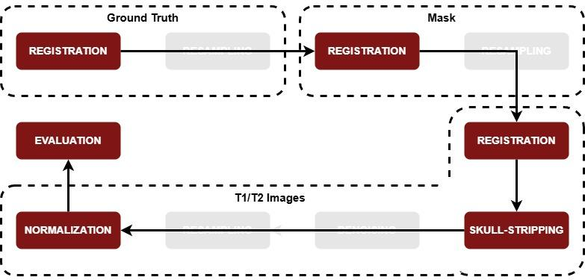
Pipeline - Baseline

Slide 8
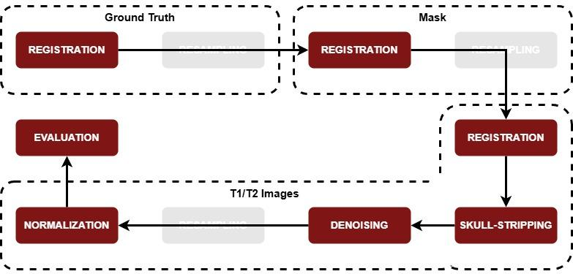
Pipeline - Experiment 1

Slide 9
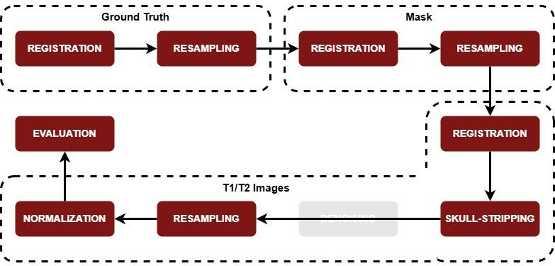
Pipeline - Experiment 2

Slide 10
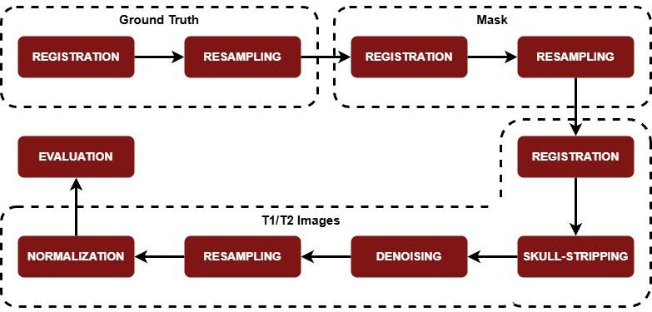
Pipeline - Experiment 3

Slide 11
Results & Inference

Slide 12
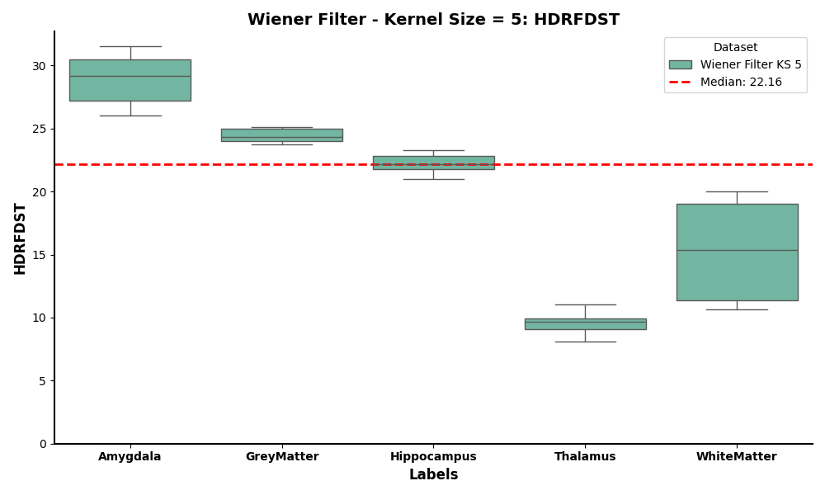
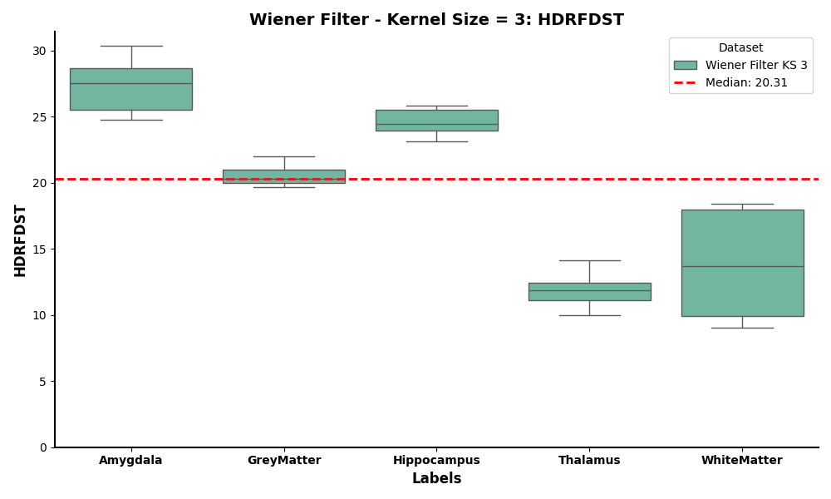
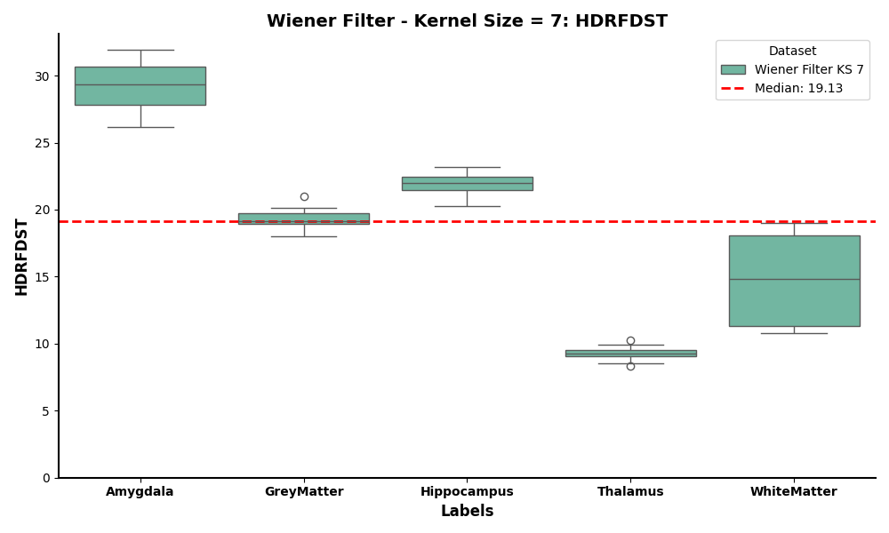
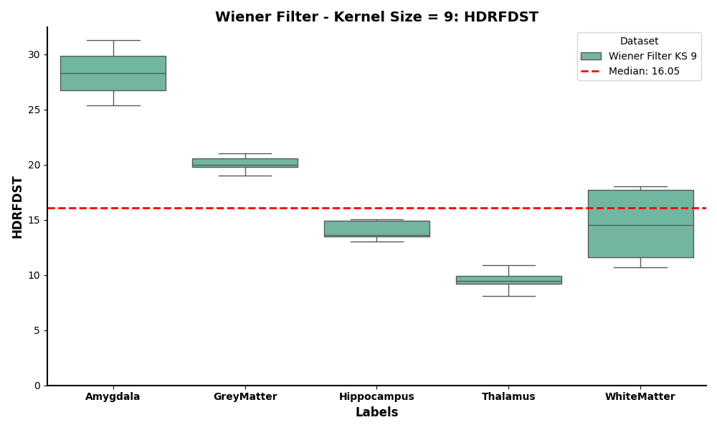
Experiment 1: Denoising
Hausdorff - Kernel Size vs. Anatomical Area
Notes:
The Wiener filter in MRI image processing is used to reduce Gaussian noise while preserving anatomical structures. It works by adaptively smoothing the image based on the signal-to-noise ratio (SNR) in local regions, balancing noise suppression and detail preservation.
It suppresses high-frequency noise, which is common in MRI images due to low signal acquisition or hardware limitations.
Detail Preservation
It gives cleaner MRI images, enhancing the performance of tasks like brain segmentation by improving contrast and boundary clarity.
Hausdorff Distance (HD): Measures the maximum distance between the boundary of the segmented region and the ground truth.
The global median is calculated from all HDRFDST values across the different brain structures. It serves as a benchmark for comparison.
Amygdala:
HDRFDST values are relatively high compared to other structures
Median HDRFDST is around 27-28, well above the global median
This suggests that the segmentation for the amygdala has poorer boundary alignment with the ground truth
GreyMatter:
HDRFDST values are low and tightly distributed
The median is approximately 20, very close to the global median
The small spread indicates consistent segmentation performance with minimal boundary misalignment
Hippocampus:
HDRFDST values are slightly higher but still consistent
Thalamus:
HDRFDST values are the lowest among all structures
Median is around 12
The small spread suggests highly consistent and accurate boundary alignment for this structure
WhiteMatter:
HDRFDST values have the largest spread which indicates high variability in segmentation accuracy for WhiteMatter
Values range from approximately 9 to 18
Conclusions
The Wiener filter with kernel size = 9 provides better results for three out of 5 structures but struggles with the Amygdala and shows poor performance for GreyMatter.

Slide 13
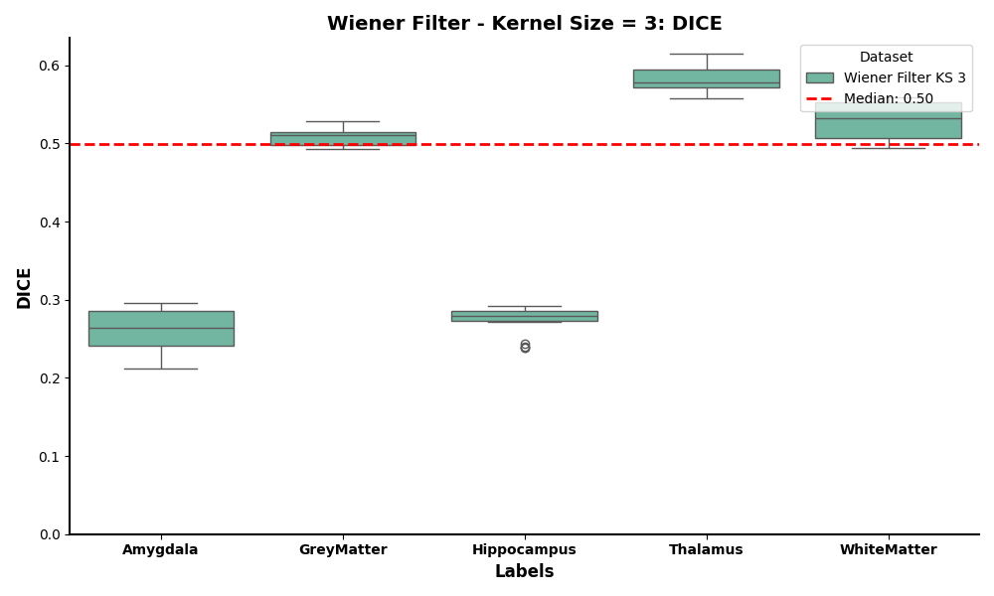
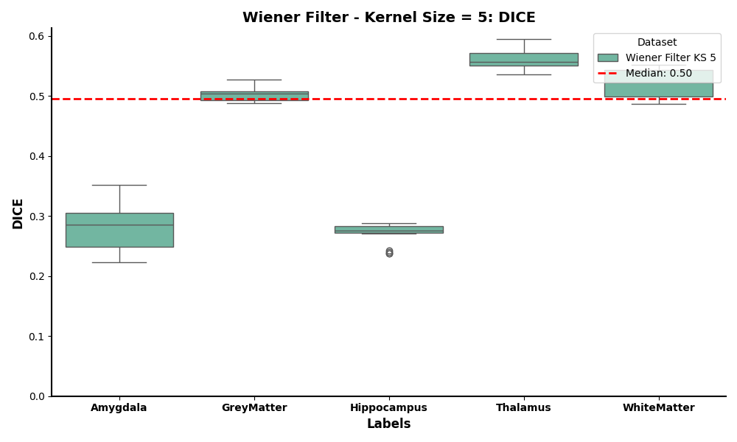
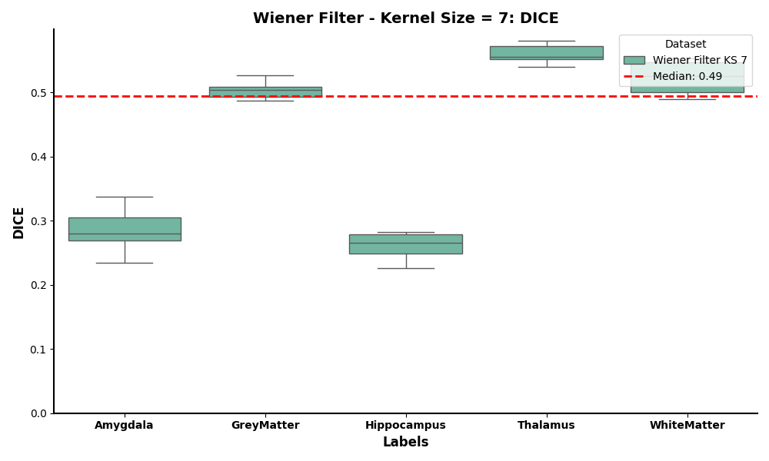
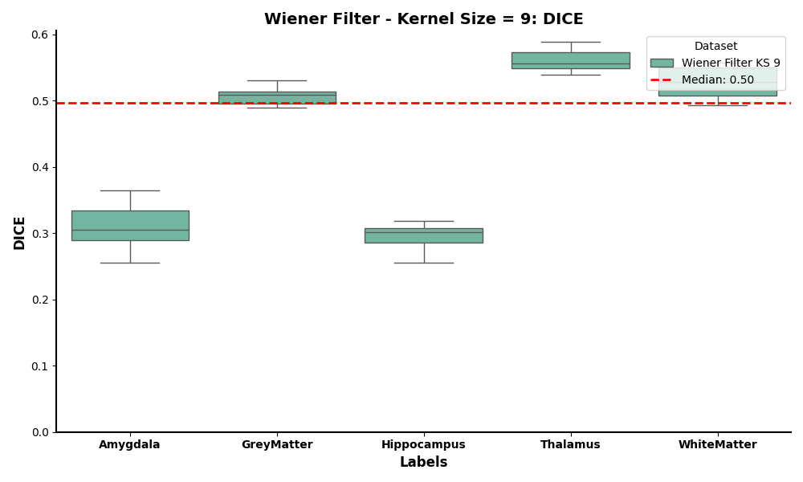
Experiment 1: Denoising
DICE - Kernel Size vs. Anatomical Area
Notes:
DICE measures the overlap between the predicted segmentation and the ground truth.

Slide 14
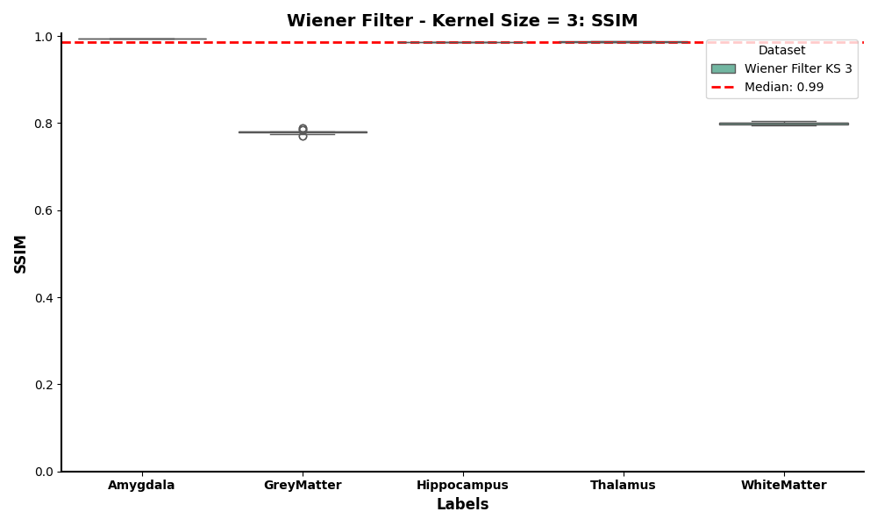
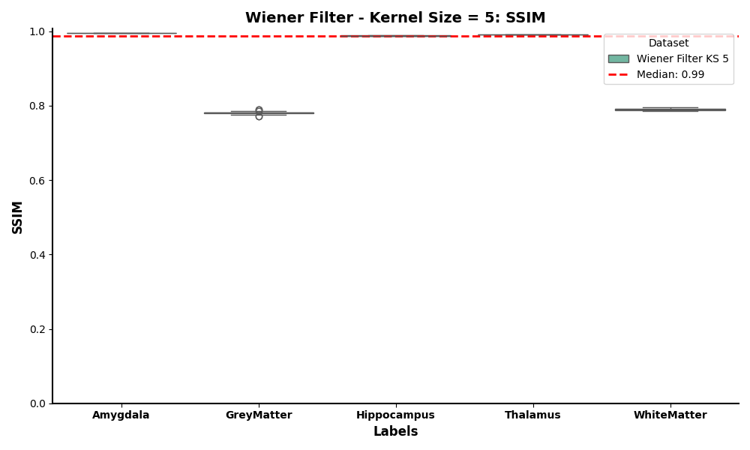
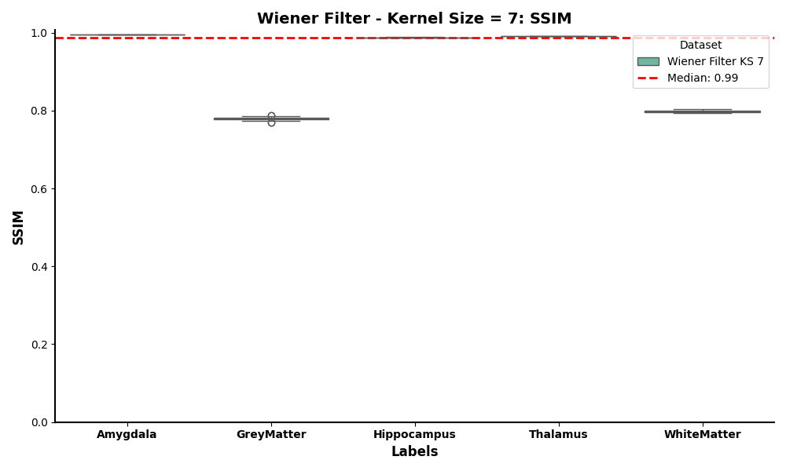

Experiment 1: Denoising
SSIM - Kernel Size vs. Anatomical Area
Notes:
SSIM (Structural Similarity Index) measures the perceptual similarity between two images.
1 indicates perfect similarity
SSIM is useful for evaluating the quality of denoised images while preserving structures and details.

Slide 15
Experiment 1: Denoising
Interpretation of Results
Hausdorff Distance:
Lowest score was for kernel size 9, with median ≈16
The median HD decreases as the kernel size increases from 3 -> 9.
Lower HD means tighter correspondence between the predicted segmentation boundaries & the ground truth. As the kernel size gets larger, the filter removes more high‐frequency noise, resulting in smoother boundaries and less shape irregularity (& so consistently lower HD).

Slide 16
Experiment 1: Denoising
Interpretation of Results
Hausdorff Distance:
Lowest score was for kernel size 9, with median ≈16
The median HD decreases as the kernel size increases from 3 -> 9.
Lower HD means tighter correspondence between the predicted segmentation boundaries & the ground truth. As the kernel size gets larger, the filter removes more high‐frequency noise, resulting in smoother boundaries and less shape irregularity (& so consistently lower HD).
DICE
All kernel sizes hover around a median Dice of 0.49–0.50.
Small structures (like the Amygdala) show lower Dice scores (≤ 0.35) - difficulty in segmenting very small or low‐contrast regions.

Slide 17
Experiment 1: Denoising
Interpretation of Results
Hausdorff Distance:
Lowest score was for kernel size 9, with median ≈16
The median HD decreases as the kernel size increases from 3 -> 9.
Lower HD means tighter correspondence between the predicted segmentation boundaries & the ground truth. As the kernel size gets larger, the filter removes more high‐frequency noise, resulting in smoother boundaries and less shape irregularity (& so consistently lower HD).
DICE
All kernel sizes hover around a median Dice of 0.49–0.50.
Small structures (like the Amygdala) show lower Dice scores (≤ 0.35) - difficulty in segmenting very small or low‐contrast regions.
SSIM
Median SSIM is ~0.99 for all kernel sizes - minimal structural distortion.
Because SSIM measures the per‐voxel structural similarity to the original images, all kernel sizes produce relatively high SSIM.
Selected Kernel Size: 9

Slide 18
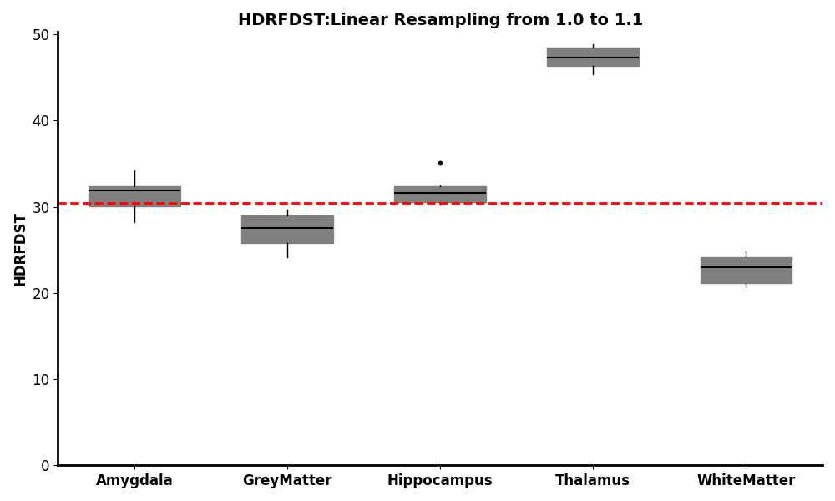
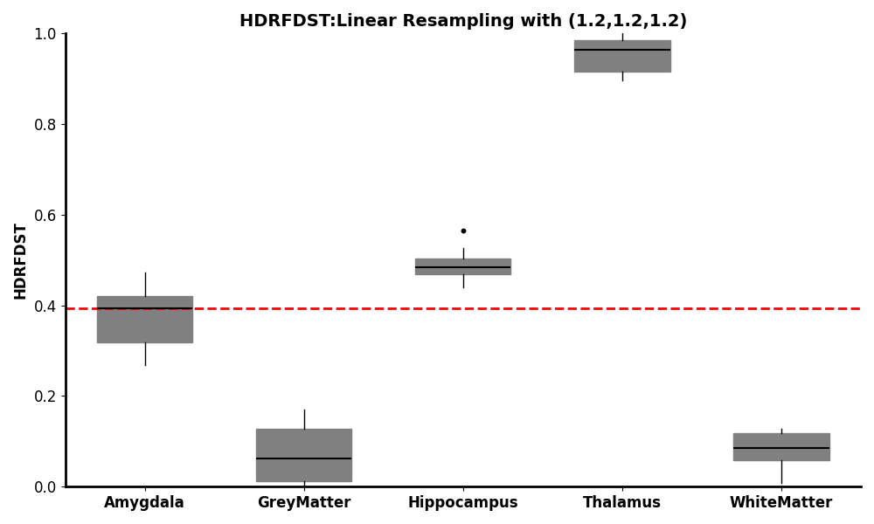
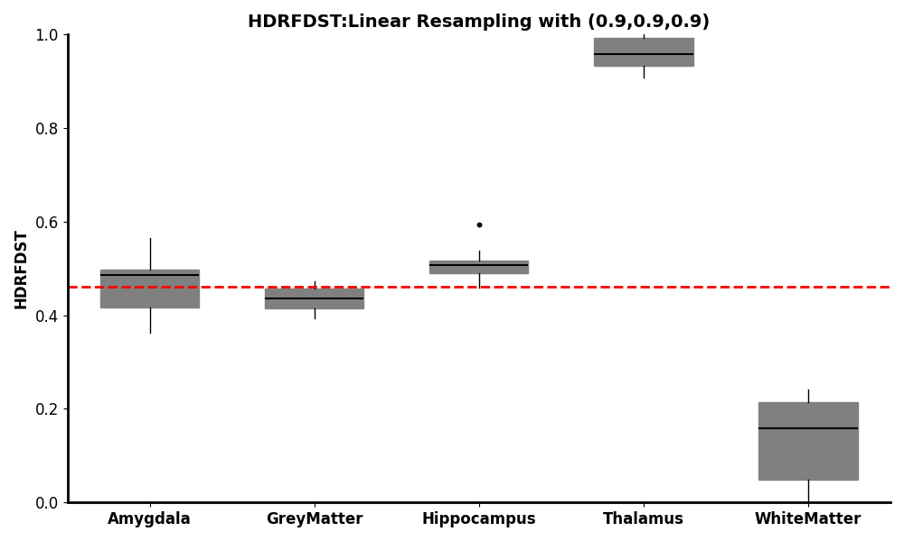
Experiment 2: Resampling
Hausdorff - Scaling Factor vs. Anatomical Area

Slide 19
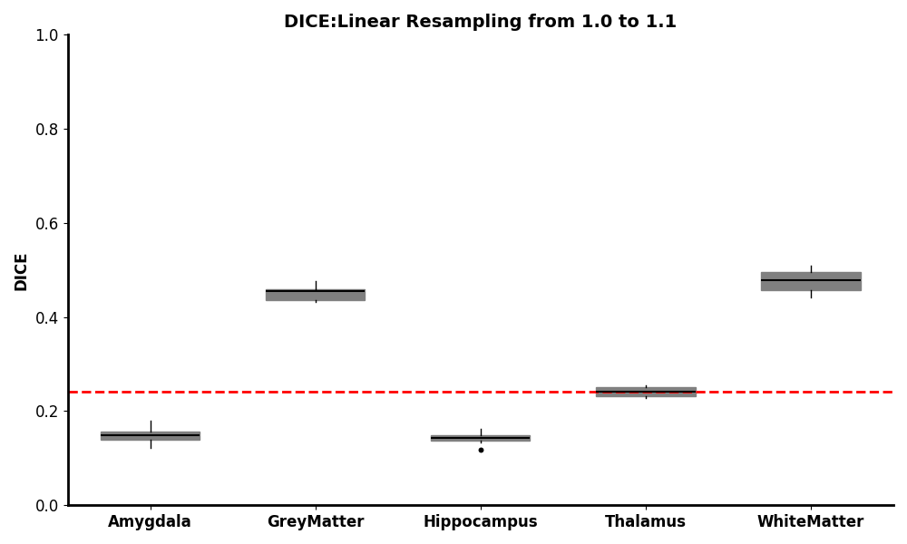
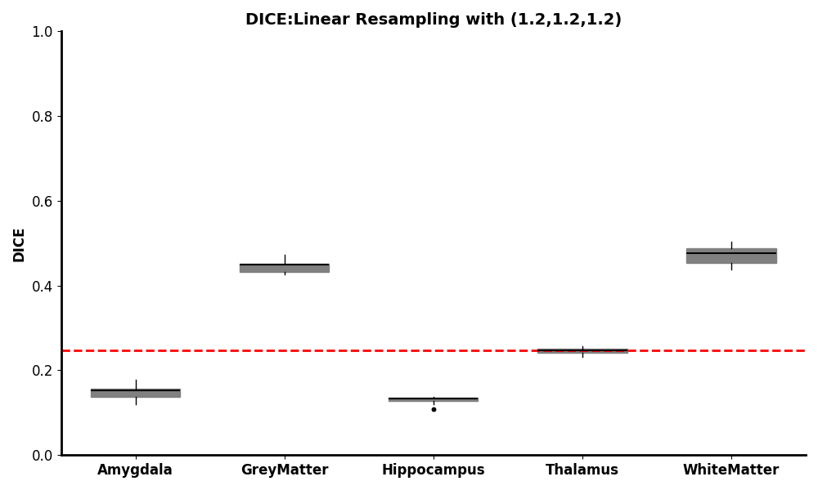

Experiment 2: Resampling
DICE - Scaling Factor vs. Anatomical Area

Slide 20
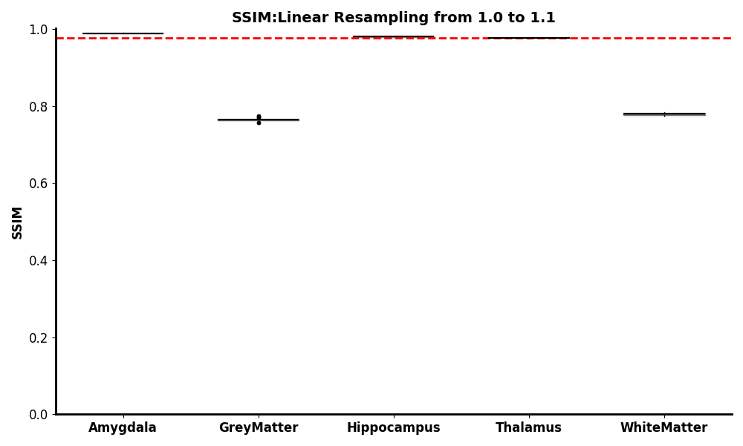
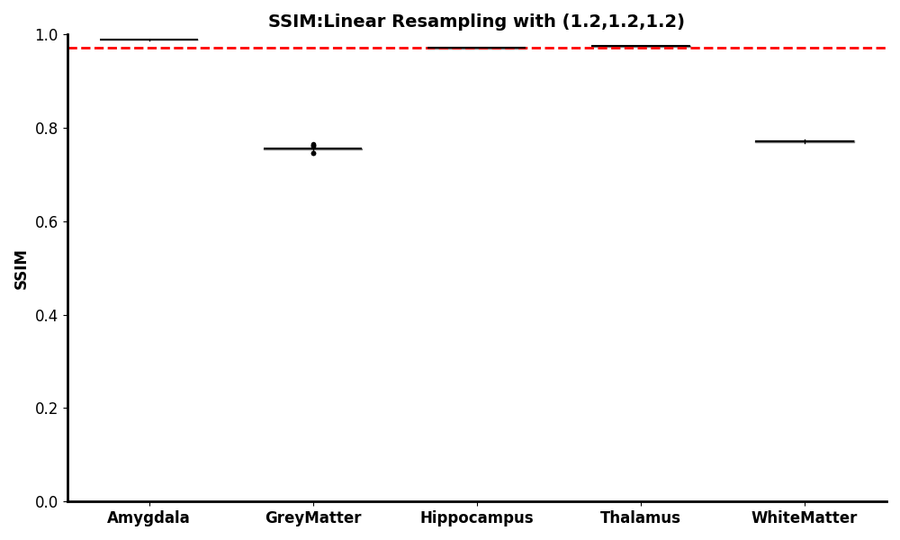
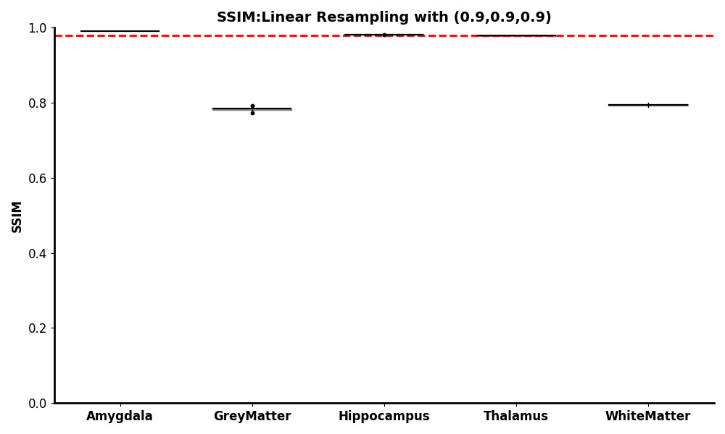
Experiment 2: Resampling
SSIM - Scaling Factor vs. Anatomical Area

Slide 21
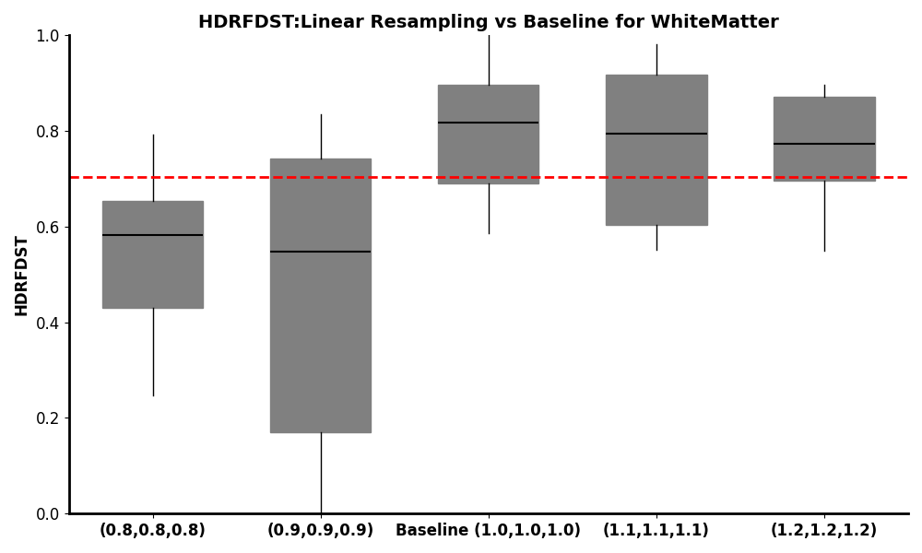
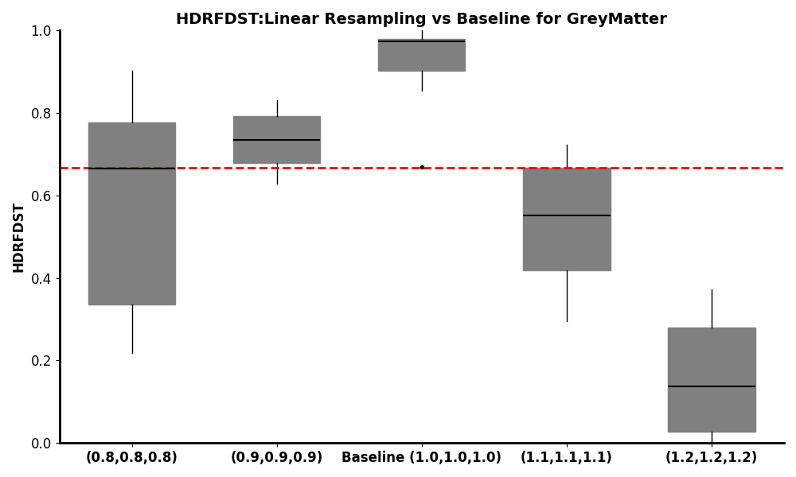
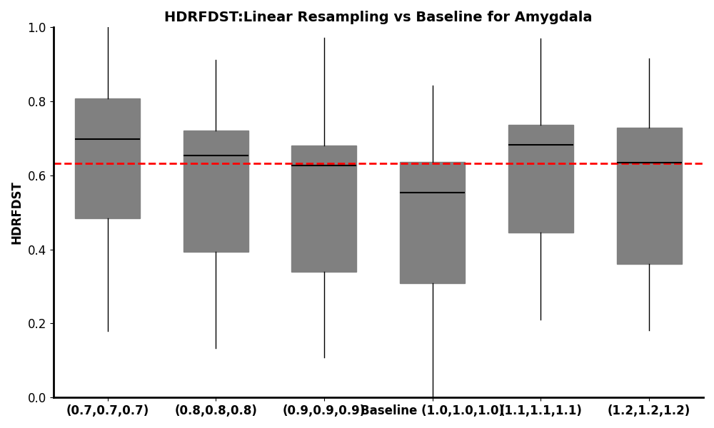
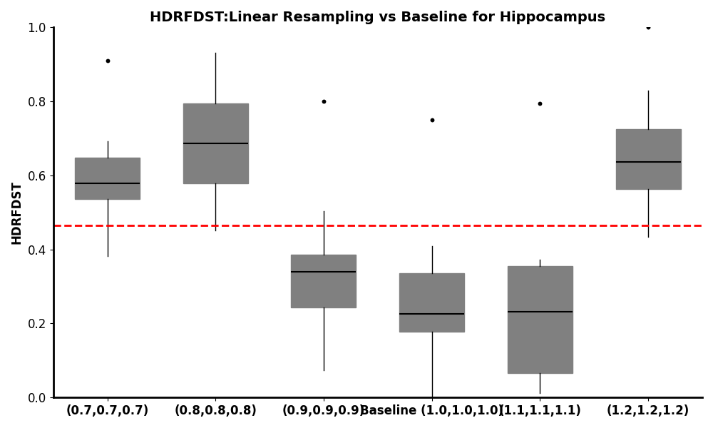
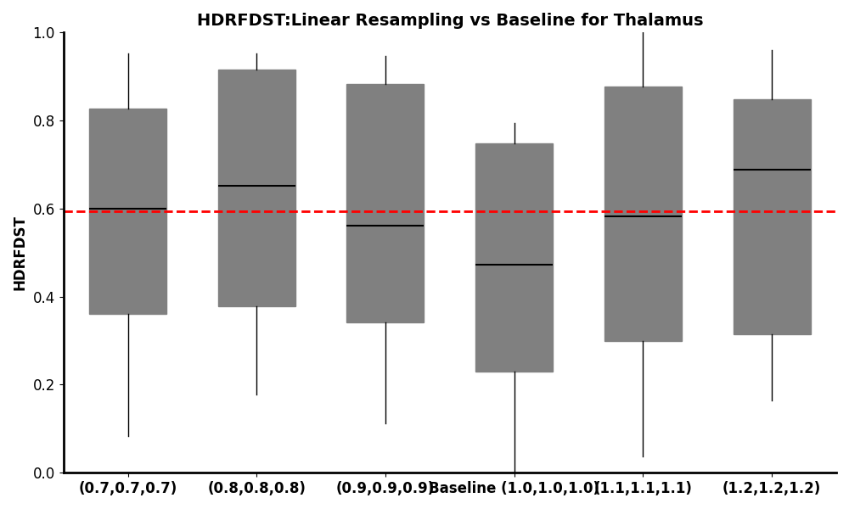
Experiment 2: Resampling
Hausdorff - Scaling Factor vs. Anatomical Area
Notes:
In experiment 2, we tried three methods, nearest neighbour, linear being the one with some promising results.
The resampling was fine-tuned by defining the pixel size on x,y,z axis. The values takes were from 0.7 until 1.2, we could take smaller sizes than 0.7 since our RAM memory wouldn’t allow.
The first metric we observed was Hausdorff, which didn’t display any patterns.

Slide 22
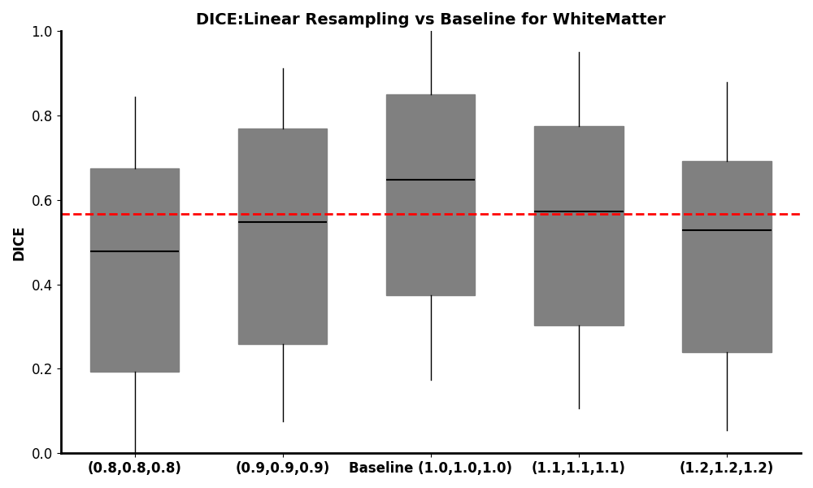
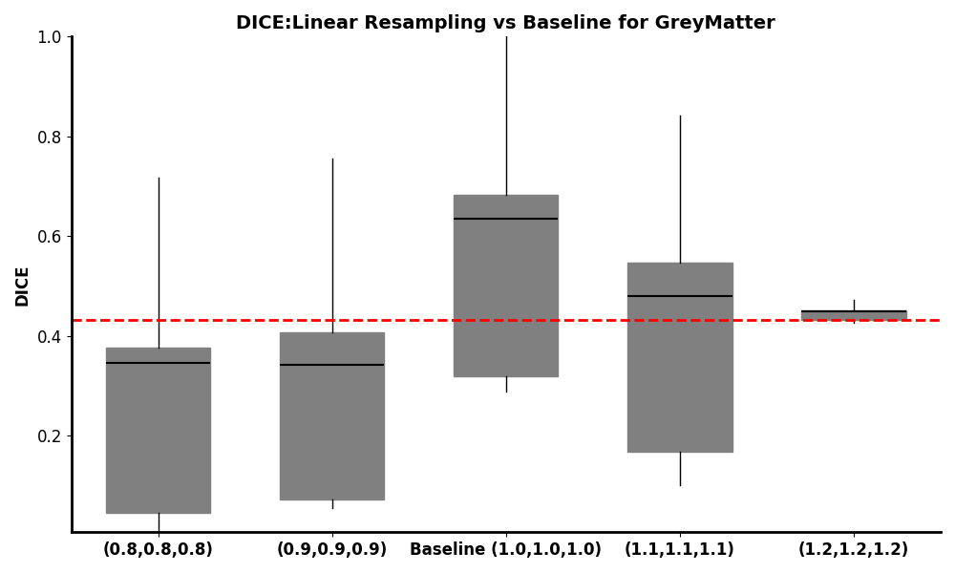
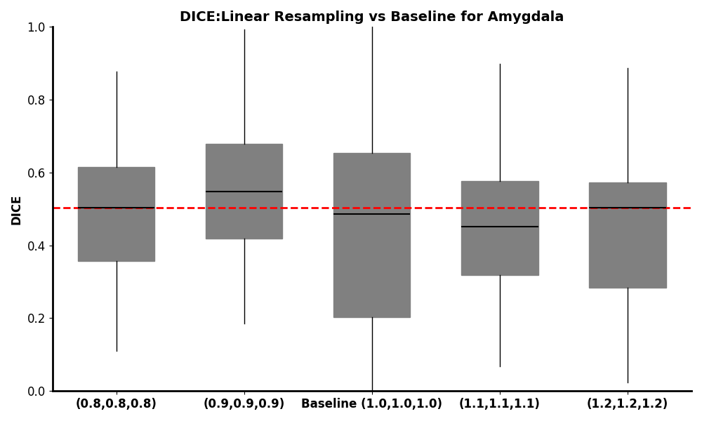
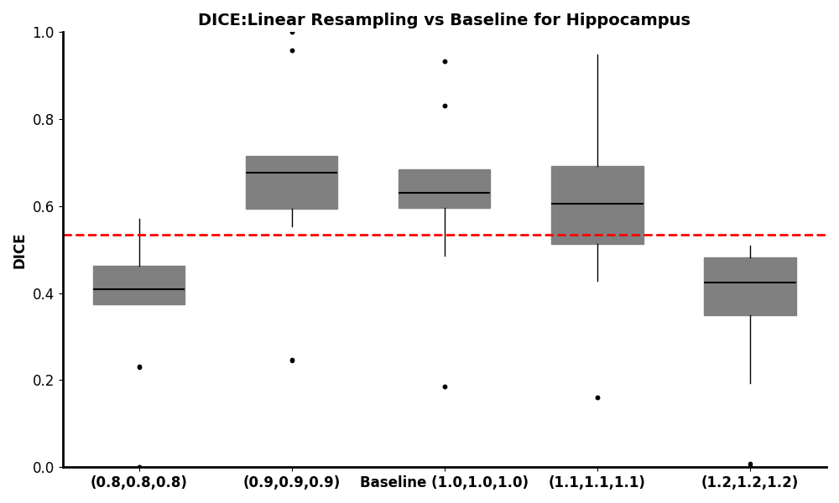
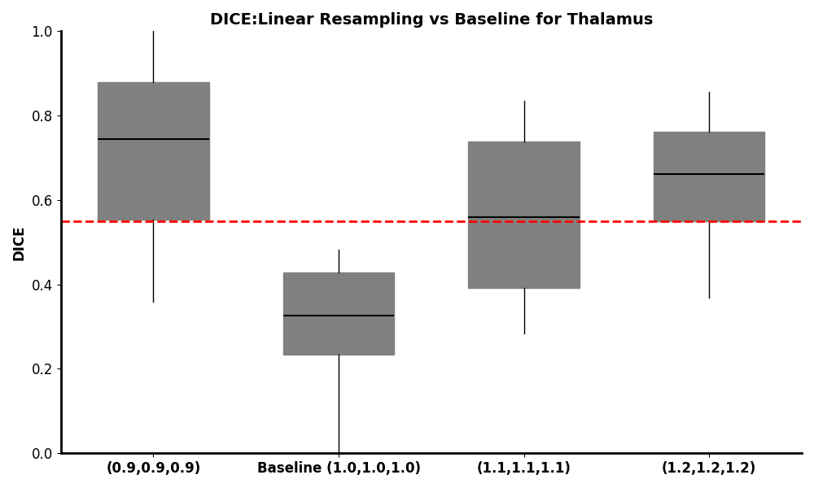
Experiment 2: Resampling
DICE - Scaling Factor vs. Anatomical Area
Notes:
The same happened for the Dice, which makes me think whether resampling is even necessary.

Slide 23
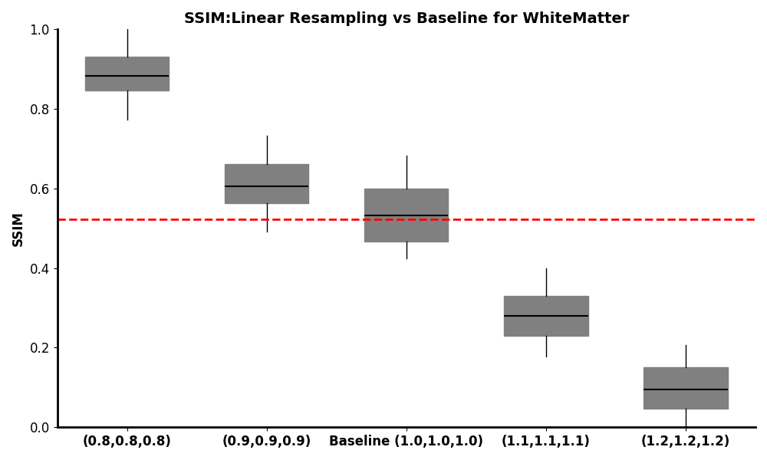
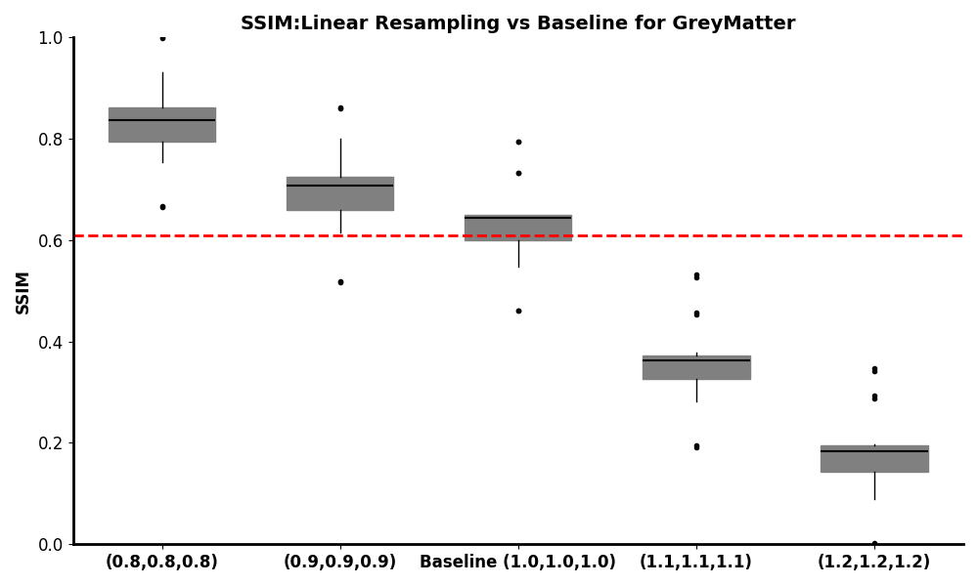
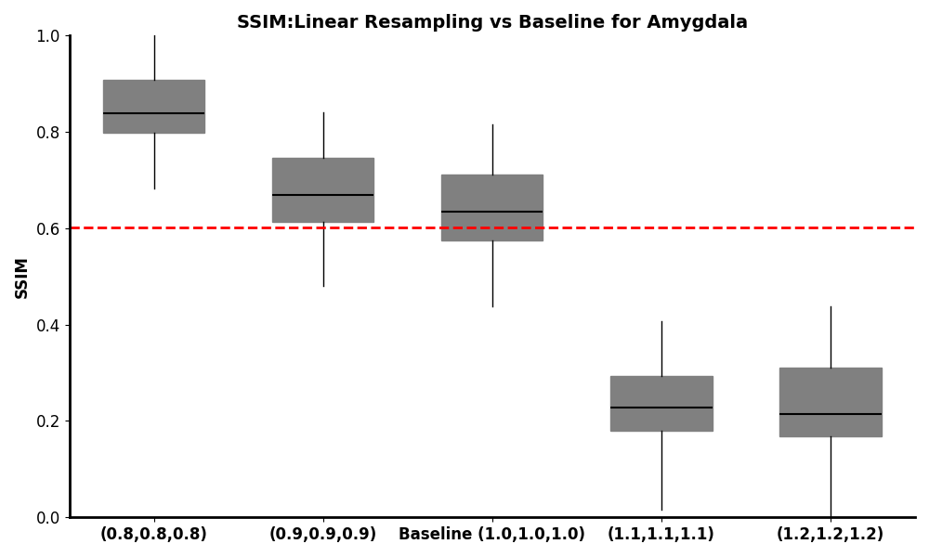
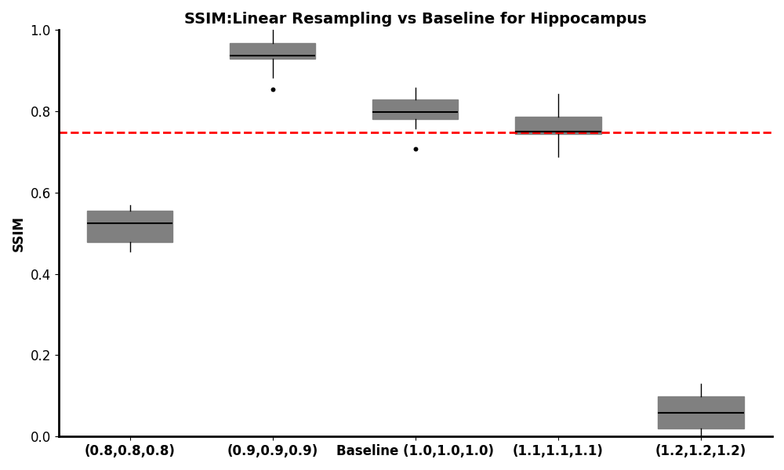
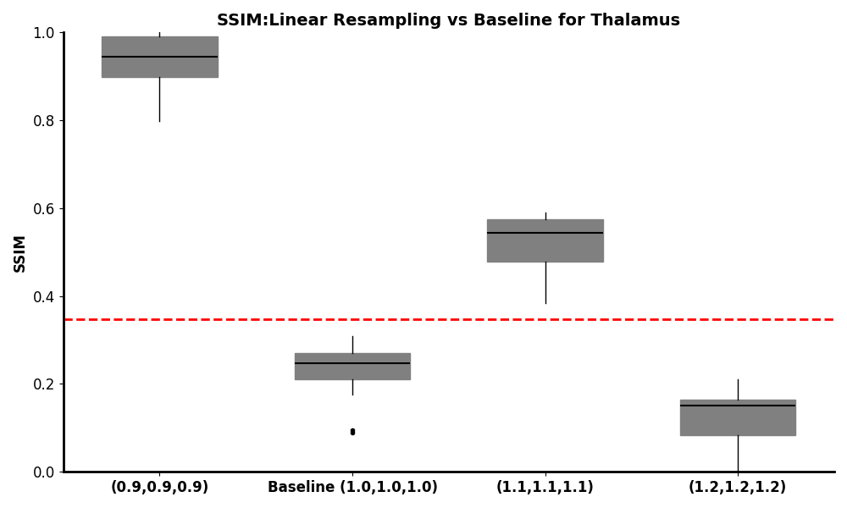
Experiment 2: Resampling
SSIM - Scaling Factor vs. Anatomical Area
Notes:
Then by introducing our new metric Structural Similarity index, there was a visible change that the smaller the pixel size becomes, the more changes happens inside the image.

Slide 24
Experiment 2: Resampling
Interpretation of Results
The effect of resampling on segmentation quality is highly structure‐dependent and often not uniformly beneficial.
Resampling by linear interpolation alone doesn’t reliably boost overall segmentation accuracy, and sometimes degrades performance.
Selected Scaling Factor: 0.9

Slide 25
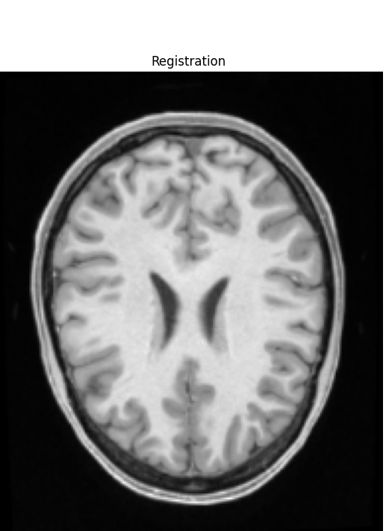
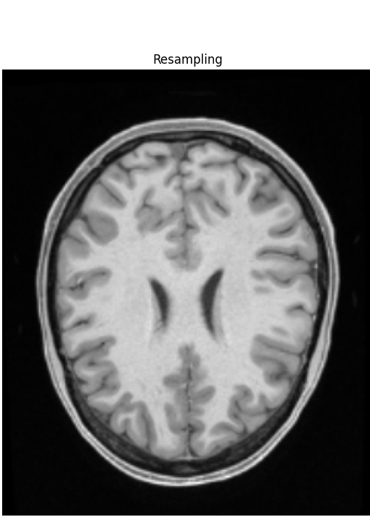
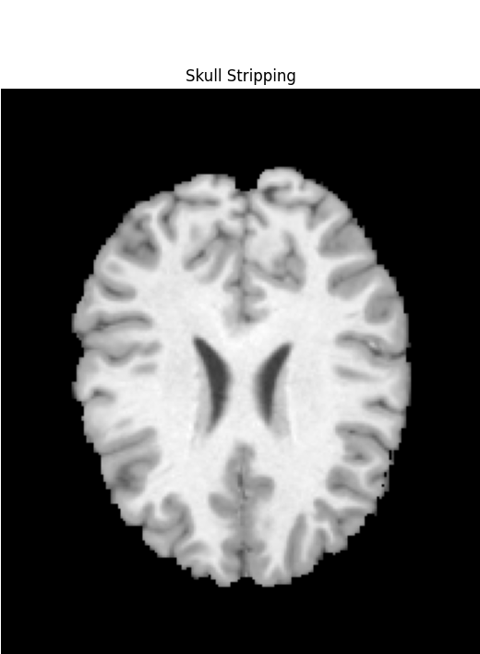
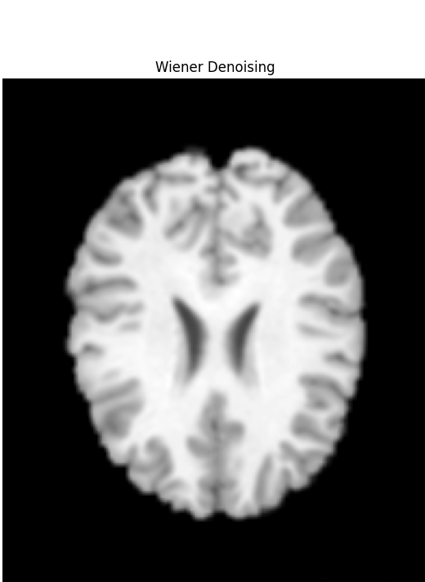

Experiment 3: Combination
T1 Example

Slide 26
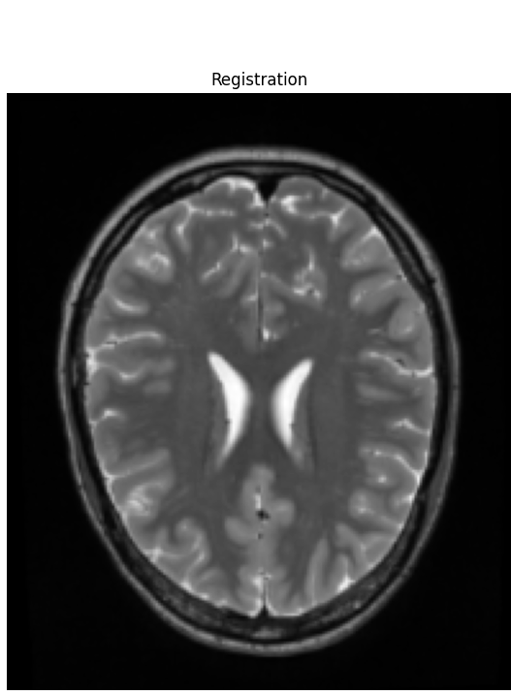
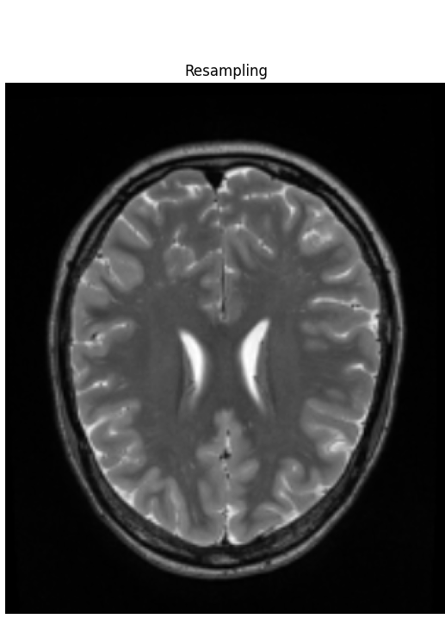
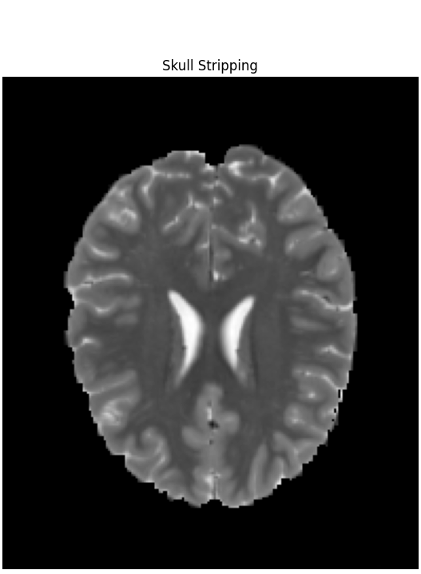
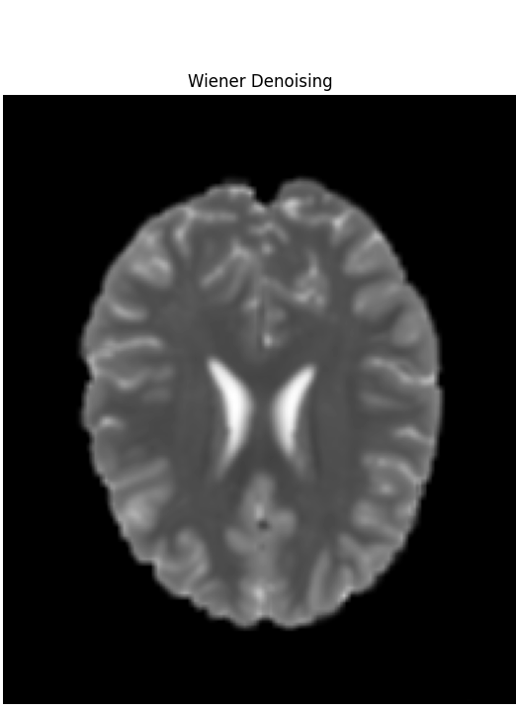

Experiment 3: Combination
T2 Example

Slide 27
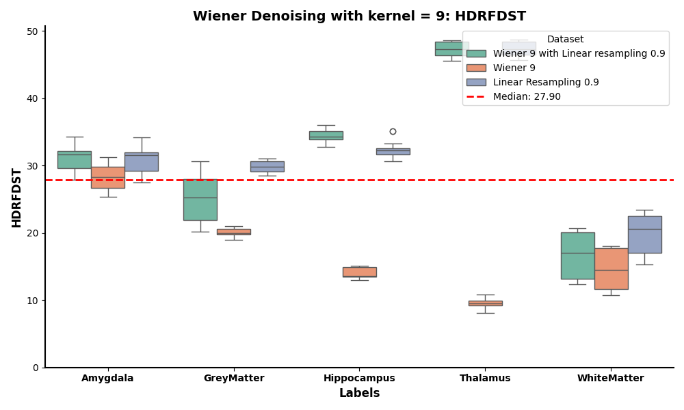
Experiment 3: Combination
Denoising (Wiener) and Resampling (Linear)

Slide 28
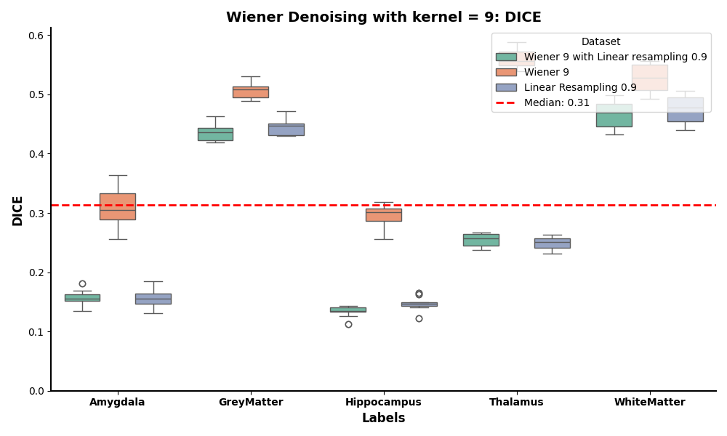
Experiment 3: Combination
Denoising (Wiener) and Resampling (Linear)

Slide 29
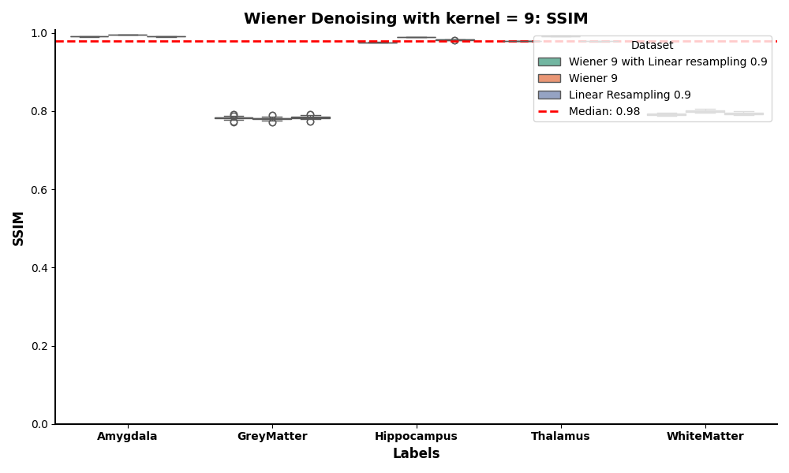
Experiment 3: Combination
Denoising (Wiener) and Resampling (Linear)

Slide 30
Discussion & Conclusion

Slide 31
Open Questions
Why didn’t combining Wiener filtering with linear interpolation (Experiment 3) enhance segmentation performance beyond Wiener filtering alone (Experiment 1)?
Impact of Linear Interpolation on Image Quality:
Introduction of artifacts
Alteration of noise characteristics
Interaction between denoising & resampling
Sequence sensitivity
Non-additive effects
Notes:
- Introduction of Artifacts: Linear interpolation estimates new pixel values based on adjacent pixels, which can lead to blurring, especially around edges and fine details. This blurring may obscure critical anatomical boundaries, making accurate segmentation more challenging.
- Alteration of Noise Characteristics: Resampling through linear interpolation can modify the spatial distribution of noise. Instead of reducing noise, it may spread noise across pixels, potentially complicating the segmentation process.
2. Interaction Between Denoising and Resampling:
- Sequence Sensitivity: The order in which preprocessing steps are applied can significantly influence outcomes. Applying Wiener filtering before resampling might denoise the image effectively, but subsequent resampling could reintroduce artifacts or alter the noise structure, negating the benefits of denoising.
- Non-Additive Effects: The combination of denoising and resampling does not guarantee cumulative benefits. In some cases, the processes may interfere with each other, leading to diminished or neutral effects on segmentation performance.

Slide 32
Open Questions
Why didn’t combining Wiener filtering with linear interpolation (Experiment 3) enhance segmentation performance beyond Wiener filtering alone (Experiment 1)?
Structure dependent responses
Different brain structures may respond uniquely to preprocessing.
Limitations of linear interpolation
Assumes a straightforward linear change between pixels
Potential loss of high frequency info
Both methods can attenuate high frequency components of the image.
Notes:
- Variable Impact on Anatomical Structures: Different brain structures, varying in size and contrast, may respond uniquely to preprocessing. Linear interpolation might adversely affect smaller or low-contrast structures by blurring their boundaries, thereby reducing segmentation accuracy for these regions.
Limitations of Linear Interpolation:
Linear interpolation assumes a straightforward linear change between pixels, which may not capture the complex intensity variations present in medical images. This limitation can result in loss of important image details crucial for accurate segmentation.
Both Wiener filtering and linear interpolation can attenuate high-frequency components of the image, which include essential details and edges. Excessive smoothing may lead to the loss of features vital for distinguishing between different tissue types during segmentation.

Slide 33
Conclusion
Hypothesis: Combining denoising and resampling methods leads to additive improvements in segmentation performance over using each method individually.
Summary of Findings:
Dice Scores: Denoising alone produced the highest Dice across all brain structures.
Hausdorff Distances: The Wiener denoised dataset shows lower (i.e., better) Hausdorff distance compared to the other two datasets.
Conclusion:
The data do not support the hypothesis of additive improvements.
The best segmentation performance (highest Dice, lowest Hausdorff) was achieved by Wiener denoising alone
Hypothesis currently disproved.
Main takeaway: Careful consideration must be given to the sequence and combination of preprocessing steps in medical image analysis pipelines.

Slide 34


Slide 35
Supplementary Deck
Discussion Questions

Slide 36
Selection of Preprocessing Techniques
What is the Wiener Filter?
The Wiener filter is a statistical approach used to reduce noise in images by minimizing the mean square error between the estimated and true signal.
It operates by adapting to the local image variance:
In areas with high variance (e.g., edges), the filter performs less smoothing to preserve details.
In regions with low variance (e.g., smooth areas), it applies more smoothing to effectively suppress noise.
This adaptability makes the Wiener filter particularly effective in maintaining image clarity while reducing noise

Slide 37
Selection of Preprocessing Techniques
Why did we choose Wiener filtering for denoising?
We selected the Wiener filter due to its effectiveness in reducing noise while preserving important image details.
The Wiener filter adapts to the local image variance, performing more smoothing in areas with low variance (i.e., less detail) and less smoothing in areas with high variance (i.e., edges and details).
This adaptability makes it suitable for medical images, which require noise reduction without compromising critical anatomical structures.

Slide 38
Selection of Preprocessing Techniques
What is linear interpolation?
It is a method used to estimate new pixel values when resizing images.
It calculates the value of a new pixel based on a weighted average of the nearest neighboring pixels.
Specifically, for a point between two known pixel values, linear interpolation assumes that the point lies on the straight line connecting the two known values.
This method is computationally efficient and provides smoother transitions compared to nearest-neighbor interpolation, making it suitable for tasks like image scaling and rotation

Slide 39
Selection of Preprocessing Techniques
Why did we choose linear interpolation for resampling?
Linear interpolation was chosen for resampling because it is a straightforward and computationally efficient method that maintains image continuity.
While more complex interpolation methods exist, linear interpolation offers a balance between performance and computational demand, making it a practical choice for our study.

Slide 40
Selection of Preprocessing Techniques
Were alternative denoising methods considered?
Gaussian Smoothing: Applies a Gaussian filter to the image, averaging pixel values with a Gaussian kernel to reduce noise while preserving edges.
Median Filtering: Replaces each pixel's value with the median value of the neighboring pixels within a defined window, effectively removing impulsive noise such as salt-and-pepper noise while preserving edges.

Slide 41
Selection of Preprocessing Techniques
Were alternative resampling methods considered?
Nearest Neighbor Interpolation: Assigns the value of the nearest pixel to the new pixel location, resulting in a piecewise constant image.
Bilinear Interpolation: Calculates the new pixel value as a weighted average of the four nearest pixels, producing a smoother image than nearest neighbor interpolation.
Bicubic Interpolation: Determines the new pixel value using a weighted average of the 16 nearest pixels, offering smoother and more visually appealing results compared to bilinear interpolation.
Spline Interpolation: Utilizes piecewise polynomials, specifically splines, to interpolate the image, providing smooth and continuous transitions between pixel values.

Slide 42
Parameter Optimization
How was the optimal kernel size for the Wiener filter determined?
We experimented with various kernel sizes (3, 5, 7, 9) to observe their impact on segmentation quality across different brain structures.
The selection was guided by evaluating performance metrics such as the Dice coefficient, Hausdorff distance, and SSIM, aiming to identify the kernel size that provided optimal noise reduction while preserving structural integrity.

Slide 43
Parameter Optimization
How was the optimal scaling factor for the linear interpolator determined?
We tested different scaling factors (e.g., upsampling by 1.1, 1.2, or downsampling by 0.8, 0.9) to assess their effect on segmentation performance.
Difficult choice.

Slide 44
Structure-Specific Effects
Our results indicate varying effects of preprocessing on different anatomical structures. How can we account for these differences, and what implications do they have for the generalizability of our preprocessing pipeline?
The varying effects can be attributed to factors such as size, contrast, and the inherent variability of these structures.
For example, smaller structures like the amygdala showed lower Dice scores, indicating difficulty in segmenting very small or low-contrast regions.
These differences imply that preprocessing techniques may need to be tailored to specific structures to achieve optimal results, affecting the generalizability of a one-size-fits-all preprocessing pipeline.

Slide 45
Combination of Preprocessing Steps
Given that combining denoising and resampling did not yield additive improvements, what insights have we gained about the interaction between these preprocessing steps?
The lack of additive improvements when combining the 2 methods suggests that these preprocessing steps may interact in complex ways.
It's possible that resampling after denoising alters the noise characteristics or spatial resolution in a manner that negates the benefits of denoising.
This insight highlights the importance of carefully considering the sequence and combination of preprocessing steps in medical image analysis pipelines.

Slide 46
Evaluation Metrics
Why did we choose Dice coefficient, Hausdorff distance, and SSIM as our primary evaluation metrics?
Dice Coefficient: Chosen for its ability to measure the overlap between the predicted segmentation and the ground truth, providing a straightforward metric for segmentation accuracy.
Hausdorff Distance: Selected to assess the maximum boundary distance between the segmentation and the ground truth, offering insight into the spatial accuracy of the segmentation boundaries.
SSIM (Structural Similarity Index Measure): Used to evaluate the structural similarity between the original and processed images, ensuring that preprocessing steps do not distort the underlying anatomical structures.

Slide 47
Future Directions
Based on our findings, what future research directions do we propose for enhancing preprocessing techniques in medical image analysis? Are there emerging methods or technologies we believe hold promise?
Future research could explore adaptive preprocessing techniques that adjust parameters based on the characteristics of individual images or structures, potentially improving generalizability across datasets.
Additionally, investigating advanced denoising methods, such as those based on machine learning, and their integration with resampling techniques could provide further insights.

