Slide 1

The TU Dortmund Compression Framework
Version: Oct 26, 2016

Slide 2
What is tudocomp?
A C++11 framework for
modular development & analysis of
text compression algorithms

Slide 3
Core Features
Template-based interface for
modular compressors
Input
Compressor
Output

Slide 4
Core Features
Template-based interface for
modular compressors
Compressor
Input
Factorizer
Encoder
Output

Slide 5
Core Features
Template-based interface for
modular compressors
Compressor
Input
…
…
…
…
Output

Slide 6
Core Features
Input & Output abstractions
Buffer
Buffer
File
Input
…
Output
File
Stream
Stream

Slide 7
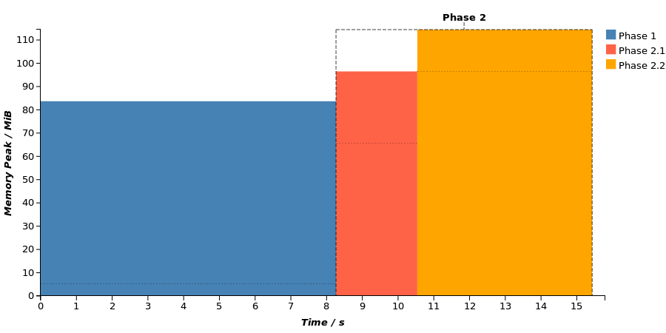
Core Features
Runtime and heap allocation measurement
+ web application for visualization

Slide 8
TODO: What does the framework feature?
  Integer types with arbitrary bit width
  Efficient basic text data structure implementations
  (e.g. Suffix Array, LCP Array, …) (→ SDSL)
  Efficient integer alphabet encoding (e.g. Huffman)
  Modular baseline implementations of various compression
  algorithms (e.g. LZ77, LZ78, …)
  Unit test helpers

Slide 9
TODO: Compression cycle “data flow” figure

Slide 10
TODO: Modularity of compressors

Slide 11
TODO: Implementation overview

Slide 12
TODO: Command-line application (live demo)

Slide 13
TODO: Documentation & API Reference

Slide 14
TODO: Feature showcase on RLE example
  Input and Output
  Compressor interface (live demo)
  Run-length encoding example (live demo)
  Unit tests (live demo)
  Runtime and heap memory allocation tracking (live demo)
  Charter web application (live demo)
  Modularity (templated RLE example) (live demo)

