Slide 1
Vodafone challenge
Tudor Manoleasa

Slide 2
Short introduction
In the next following slides, I will be presenting an analysis of different Machine Learning models that I have tried in order to achieve the target of the project. I will give short explanations regarding my intuition behind specific techniques and at the end, I am going to compare the algorithms in terms of metrics such as balanced accuracy, sensitivity, precision and so on. Bear in mind that the pictures and scores you shall see are taken directly from my notebook. The entire analysis is based on a dataset (CSV file) that I have received from the data engineering team at Vodafone. Speaking of this dataset, I will jump straight into it!

Slide 3

Why is the dataset "good"?
It has a large amount of samples to work on and this is ideal since ML models require much data
There are not that many missing values (empty cells) that could potentially create problems (such as the reduction of the dataset size). In other words, the dataset is quite consistent and can be easily manipulated
It has both numerical and categorical columns, which is a big plus because it adds diversity and a larger pool of options when it comes to the models I can fit (certain ML algorithms work with numerical data, others work with categorical data and some more advanced ones with both)
The heterogeneity of the data allows me to do lots of statistical experiments (t-tests, ANOVA tests, Chi-Square tests) that give me useful insights

Slide 4

Why is the dataset "bad"?
Probably the biggest downside is the fact that it is unbalanced (there are way more customers who don't want to switch off (churn) the services than those who want)
Some values of certain categorical features (such as 'service area') are present in the training dataset, but not in the testing set and vice-versa; this is unfortunate because specific ML models might be drastically altered if they don't see the same domain of values for each categorical column
The labels of a few categorical features might suggest missing values when in fact, they could just be badly named (such as 'Unknown')
It's worth saying that all of these inconveniences were solved while doing the data preparation, hence no con was left untreated!

Slide 5
Exploratory data analysis
After "cleaning" my data, I thought that it is a good idea to do some sort of exploration through charts and statistical analysis. Some of the findings were useful information for my ML models. There are lots of insights that can be extracted from boxplots or correlation matrices for example. With that in mind, in the next following slides, I will present a few visualisations that I found to be relevant enough when taking decisions regarding my models!

Slide 6
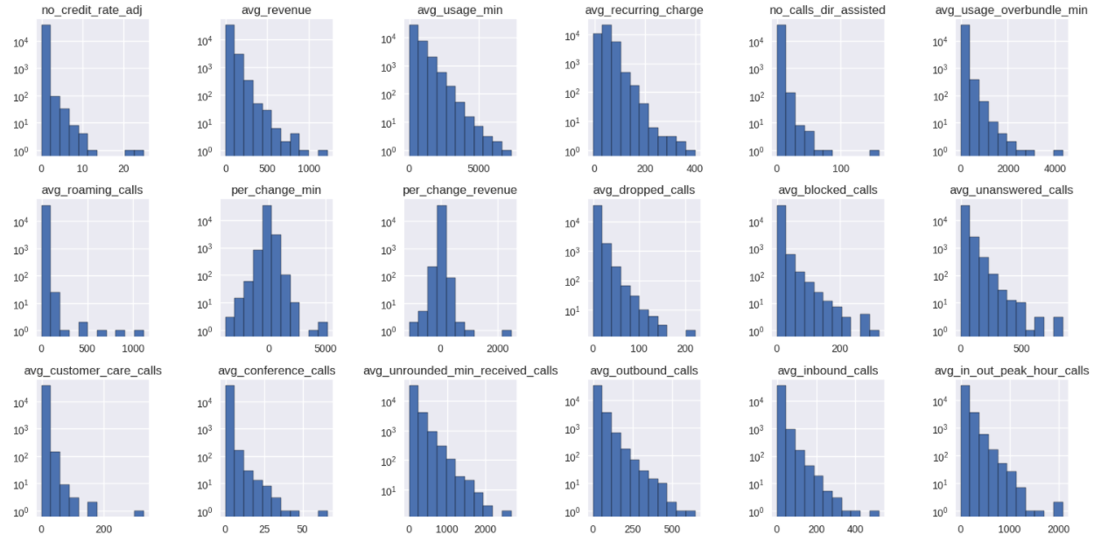
A few Histograms
Done on my numerical columns
Please notice the Exponential Distribution of the data
In an ideal scenario, I would have liked the histograms to have bell shapes (Gaussian Distributions)

Slide 7
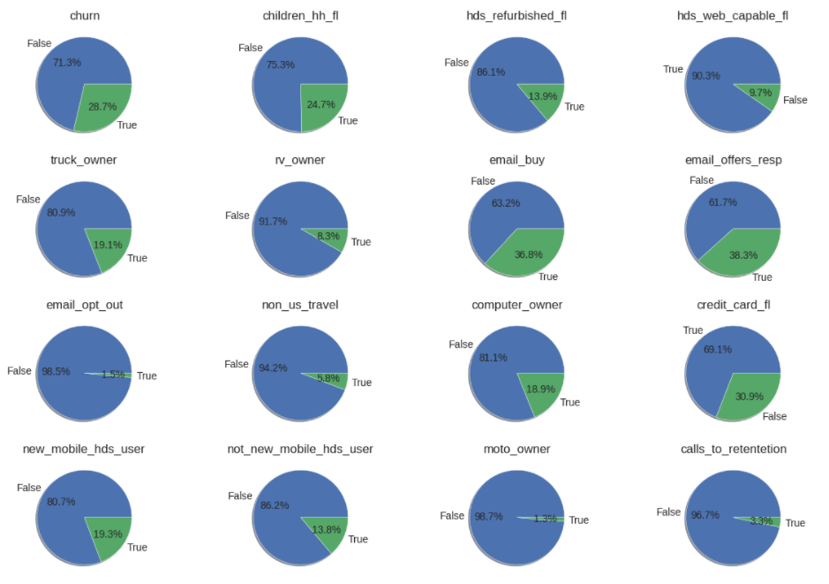
A few pie charts
Done on my boolean columns
Each pie chart has one dominating label that is widely associated with customers who did not switch off the services
Notice that the unbalanced character of the dataset can be seen in the 'churn' pie chart

Slide 8
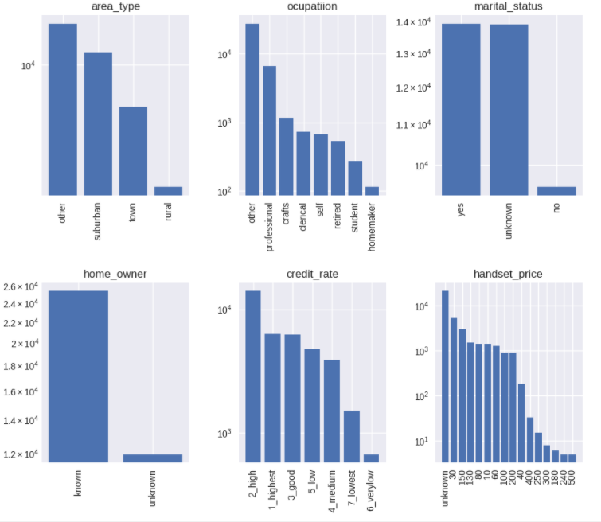
A few bar charts
Done on my categorical columns
Interesting that for a large proportion of the customers, the marital status is unknown; a question could arise: is it really unknown for valid reasons or did the people choose not to specify it?
Also, looking at the 'area_type', what could the 'other' label represent? Why is it dominant?

Slide 9
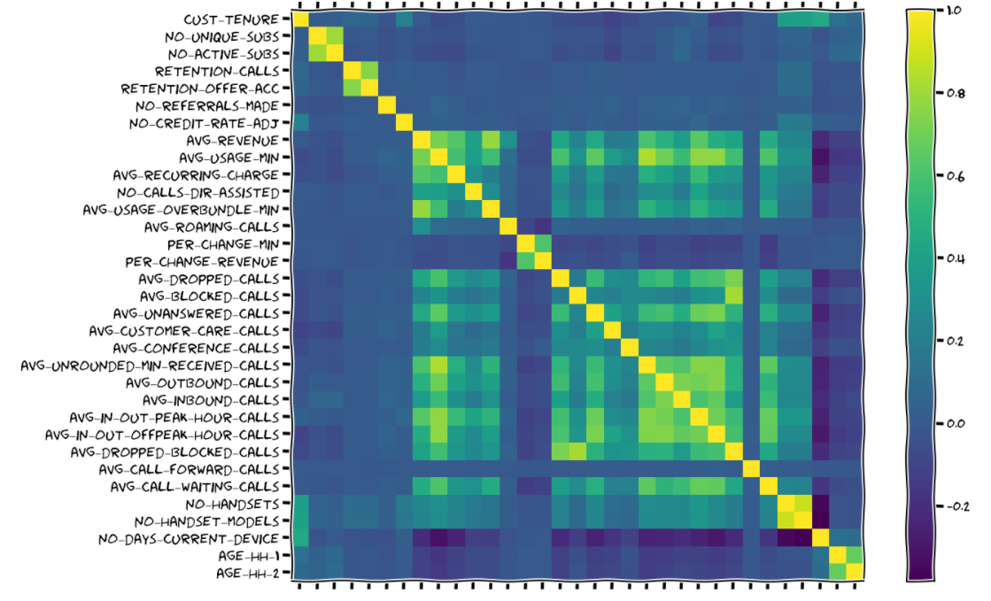
Correlation matrix
Done on my numerical columns
Checking the correlations between pairs of columns help me in deciding which features are redundant
If the correlation of 2 variables is greater than 0.8 it means that when one INCREASES in value, the other expands as well
If the correlation of 2 variables is smaller than -0.8 it means that when one DECREASES in value, the other expands
In both of the above cases, one variable has to be dropped or not taken into consideration when training a model because it might badly influence the results
Looking at the graph on the right side, above the main diagonal, you can see that there are only a few correlated features in the dataset, hence I won't drop to many things

Slide 10
Chi-square test of independence
A statistical test that tells me if 2 categorical variables are independent or not
Luckily, I got lots of categorical features that I can test against the output column 'churn'
I am especially interested in those features that are NOT INDEPENDENT from the output since that means a relationship between the predictor and the target
I will create subsets of different not-independent features and I will feed my ML models with them
The best subset shall win!

Slide 11
T-tests
A statistical test that tells me if 2 means (μ) are equal
For each numerical column, I will take each boolean column and I'll test the equality of the means in the 2 cases (True and False); for example, I might want to check if the mean of the 'avg_revenue' feature when 'churn' is True equals the mean of the 'avg_revenue' when 'churn' is False
I am especially interested in those features that DON'T HAVE EQUAL MEANS when partitioned by the 'churn' column since that could mean a relationship between the predictor and the target
I will create subsets of different features such as as those described at the previous bullet point and I will feed my ML models with them
The best subset shall win!

Slide 12
Feature engineering & solving the unbalance problem
The dataset I received may not be left intact. The boolean and categorical columns must be tweaked a bit while the numerical features should be made more Gaussian-like. Moreover, let's not forget about the unbalance problem. I would like the number of customers who had churned to be equal to those who had not. I will briefly talk about a few solutions that I found when it comes to the numerical columns and the unbalance character of my data, while the rest is left to be read by the data science team in my Jupyter notebook.

Slide 13
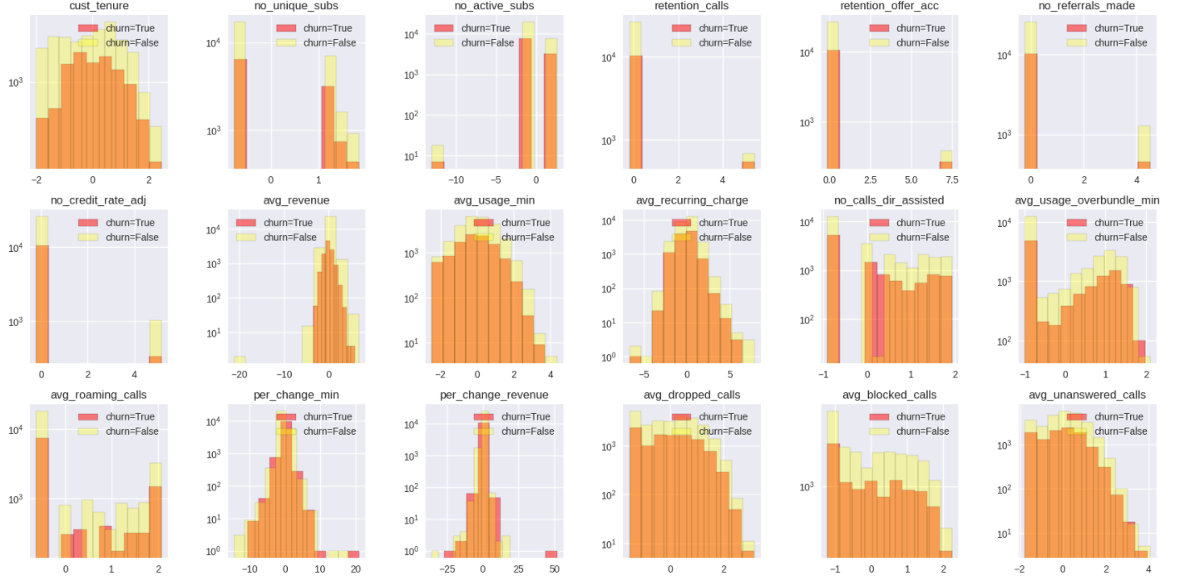
Numerical columns transformation
I applied a transformation to my numerical columns in order to force them to be more Gaussian-like
Notice that each histogram is a an overlapped histogram containing the distributions of a numerical feature when the output column 'churn' is True and False
Of course, the results are not the best, but at least some of the mapped features can be properly utilized in a few ML models

Slide 14
Oversampling
There are 27252 customers who want to churn and 11033 who don't want to do it (unbalanced)
Oversampling refers to the process of randomly extracting samples from the under represented output label and putting them in the dataset until each label is represented equally!
By doing this artificial trick, I no longer have to worry about my models being biased towards the majority label

Slide 15
Classification
There are 4 techniques I tried on this project, namely: tree based models, naïve bayes variants, Support Vector Machines (SVMs) and an Artificial Neural Network (ANN). Out of these 4, the Artificial Neural Network produced the best results (but on the negative label :( ) ! I will briefly discuss each model and why I chose to try it in the following slides.

Slide 16
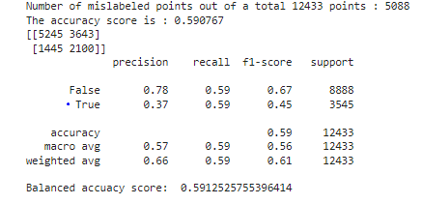
TRee based models
They require no data preparation, hence they could work beautiful even if the dataset would have not been stylized
They can handle numerical, categorical and boolean features with ease; this is a big plus because it imposes no constraints on what kind of data you need to gather
They work for both classification and regression so you can easily extend your usecases
They are very easy to understand, visualise and interpret
These are the testing results of the best tree based model I have. As you can see, the outcome is not the best. Both the accuracy and balanced accuracy are pretty low and the confusion matrix is not looking good either. The main line of interest is the one with a blue dot before "True". There you can find the scores associated with customers who want to churn. The recall is at 0.59 meaning that out of all the clients who TRULY want to churn, 59% have been correctly classified as positive. The precision stands at 0.37, meaning that out of all the clients who have been CLASSIFIED as customers who will churn, only 37% will TRULY churn. Keeping in mind that only 10% of the positive classified customers will be contacted, I want a model with HIGHER PRECISION

Slide 17
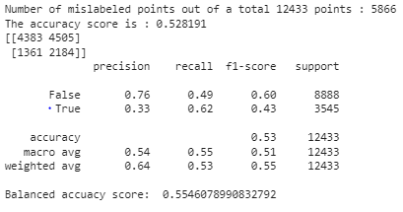
GAUSSIAN naïve BAyes (GNB)
A perfect fit since I have mapped my numerical columns to gaussian distributions
I can also use the findings of my t-tests and correlation matrix in order to feed the best features subset to the model
GNB is one of the easiest, fastest and most scalable models out there
A downside may be the fact that it makes some extreme statistical assumptions, but the behavior is still good
These are the testing results of the best GNB model I have. As you can see, the outcome is even worse than the previous tree based model. Both the accuracy and balanced accuracy are very low and the confusion matrix is not looking good either. The main line of interest is the one with a blue dot before "True". There you can find the scores associated with customers who want to churn. The recall is at 0.62 meaning that out of all the clients who TRULY want to churn, 62% have been correctly classified as positive. The precision stands at 0.33, meaning that out of all the clients who have been CLASSIFIED as customers who will churn, only 33% will TRULY churn. Keeping in mind that only 10% of the positive classified customers will be contacted, having such a low precision is unacceptable.

Slide 18
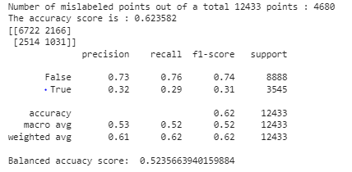
Bernoulli naïve bayes (bNB)
Another variant of Naïve Bayes that works with boolean features
I can also use the findings of my Chi-square tests of independence in order to feed the best features subset to the model
Again, BNB is one of the easiest, fastest and most scalable models out there
A downside may be the fact that it makes some extreme statistical assumptions, but the behavior is still good
These are the testing results of the best BNB model I have. As you can see, the outcome is comparable with the tree based model. The accuracy is a bit higher, but that is not very relevant since the testing set is unbalanced. However, one interesting thing to notice here is that on the negative label, the recall and the precision are quite good! Regardless of that, the main line of interest is the one with a blue dot before "True". There you can find the scores associated with customers who want to churn. The recall is at 0.29 (extremely low)meaning that out of all the clients who TRULY want to churn, 29% have been correctly classified as positive. The precision stands at 0.32 (extremely low), meaning that out of all the clients who have been CLASSIFIED as customers who will churn, only 32% will TRULY churn. Keeping in mind that only 10% of the positive classified customers will be contacted, having such a low precision is unacceptable again...

Slide 19
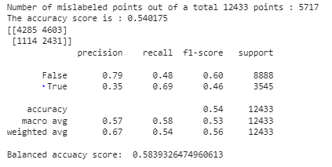
SUPPORT vector machines
A model that will behave good if the data is linearly separable in the space made out of the input features; in other words, when plotting the samples and their specific output label, you should be able to separate the positive 'churn' ones from the negatives
It has a strong mathematical background that is very hard to understand, but the constructed SVM is easy to visualise and fast when it comes to predicting new instances.
The overall model is stable. Adding new training samples won't really change the decision surface unless the distribution of the data changes dramatically
It benefits from the so called "kernel trick", a mathematical observation that allows you to find separating hyper-planes by mapping the data to higher dimensions
These are the testing results of the best SVM model I have. As you can see, the outcome is comparable with the tree based model. The main line of interest is the one with a blue dot before "True". There you can find the scores associated with customers who want to churn. The recall is at 0.69 (the highest until now)meaning that out of all the clients who TRULY want to churn, 69% have been correctly classified as positive. The precision stands at 0.35 (extremely low), meaning that out of all the clients who have been CLASSIFIED as customers who will churn, only 35% will TRULY churn. Keeping in mind that only 10% of the positive classified customers will be contacted, having such a low precision is unacceptable again...

Slide 20
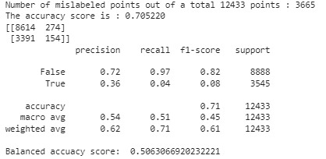
ARTificial neural network
The go-to solution when classical machine learning fails!
Extremely powerful when having a large dataset (as in our case)
Accepts numerical and categorical + boolean inputs (but it requires some tweaking)
More added data will just make it better, hence scalable
Works very well on heterogenous data (as in our case)
The only downside is the amount of parameters it has to learn, hence very costly
These are the testing results of the best ANN model I have. As you can see, the outcome is EXTREMLY WEAK ON THE POSITIVE LABEL. The main line of interest is the one with a blue dot before "True". There you can find the scores associated with customers who want to churn. The recall is at 0.04 (ALMOST 0) meaning that out of all the clients who TRULY want to churn, 4% have been correctly classified as positive. The precision stands at 0.36 (extremely low), meaning that out of all the clients who have been CLASSIFIED as customers who will churn, only 36% will TRULY churn. Keeping in mind that only 10% of the positive classified customers will be contacted, having such a low precision is unacceptable, BUT WITH THE HELP OF THIS ANN WE CAN REJECT WITH A LOT OF CERTAINTY THE CUSTOMERS WHO DON'T WANT TO CHURN. The rest of the customers who have been WRONGLY CLASSIFIED AS NEGATIVE CAN BE FED TO ANOTHER MODEL.

Slide 21
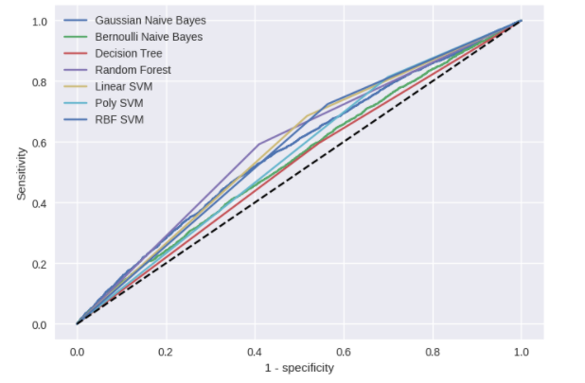
Roc graph
Theoretically speaking, the curve on the ROC graph that gives the highest area under the curve should tell you the best classifier. In this case, there is a close battle between the RBF kernel SVM, Linear kernel SVM and the Random Forest

