Slide 1
Mean Reversion
Observation: Spreads of metals cointegrated at different confidence levels
Normalize spreads and aggregate against all combinations, weighting for cointegration levels
Perform Mean Reversion with EMA Crossovers and thresholds.
Comprehensive Backtesting Tool
Obtained four stationary timeseries
Optimization of EMA and threshold choice – minimize T-Cost and maximize PnL per trade
Aggregation of positions + apply weighting of cointegration levels

Slide 2
Sentiment Analysis – Natural Language Processing
Idea: Obtain daily sentiment of Commodities market
Used NLP & Web Scraping to match keywords with Company description - get confidence level of its relation to Commodities
Comprehensive Backtesting Tool
Combine daily signals with Mean Reversion Model, producing more informed signals and reducing number of overall trades, reducing risk
Define simple trading strategy based on sentiment data obtained by NLP, weighted by root number of keyword matches

Slide 3
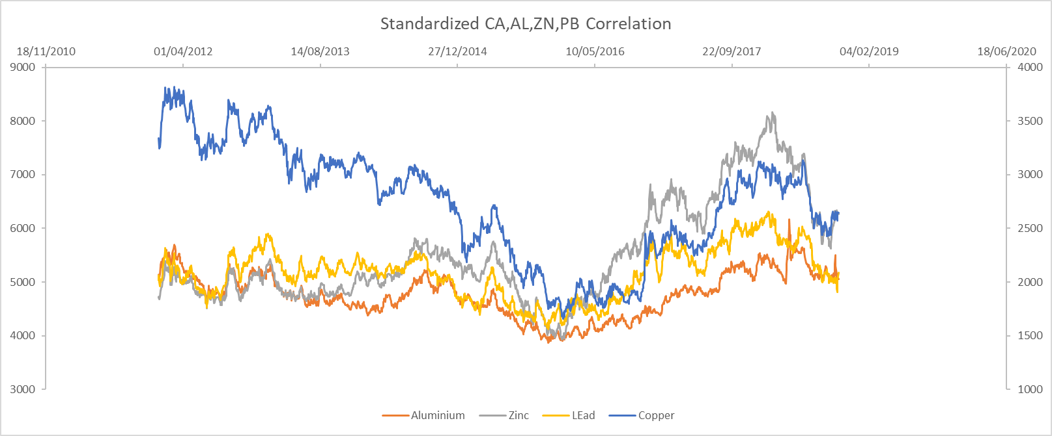

Slide 6
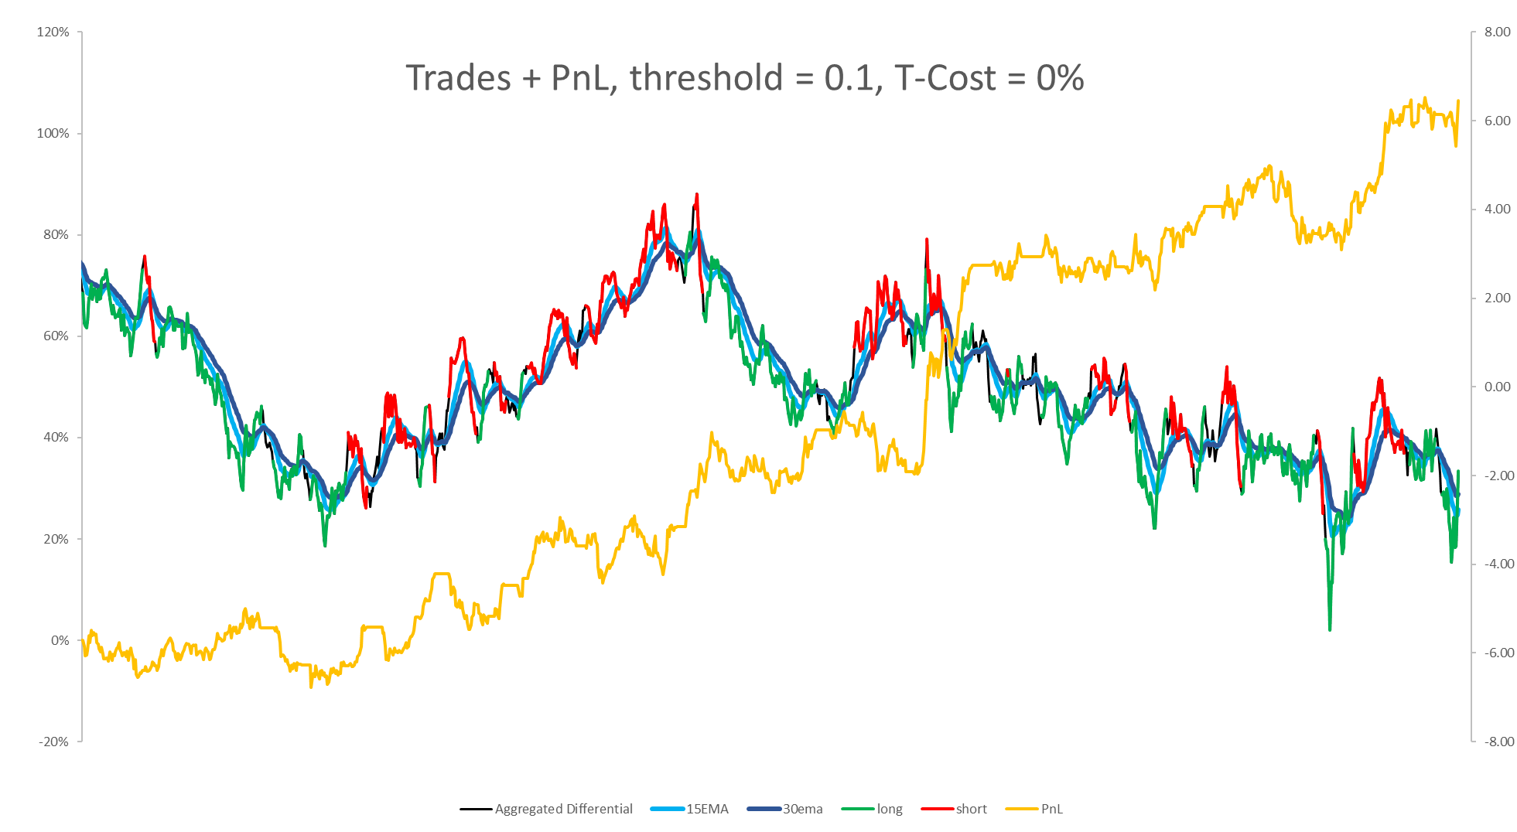

Slide 7
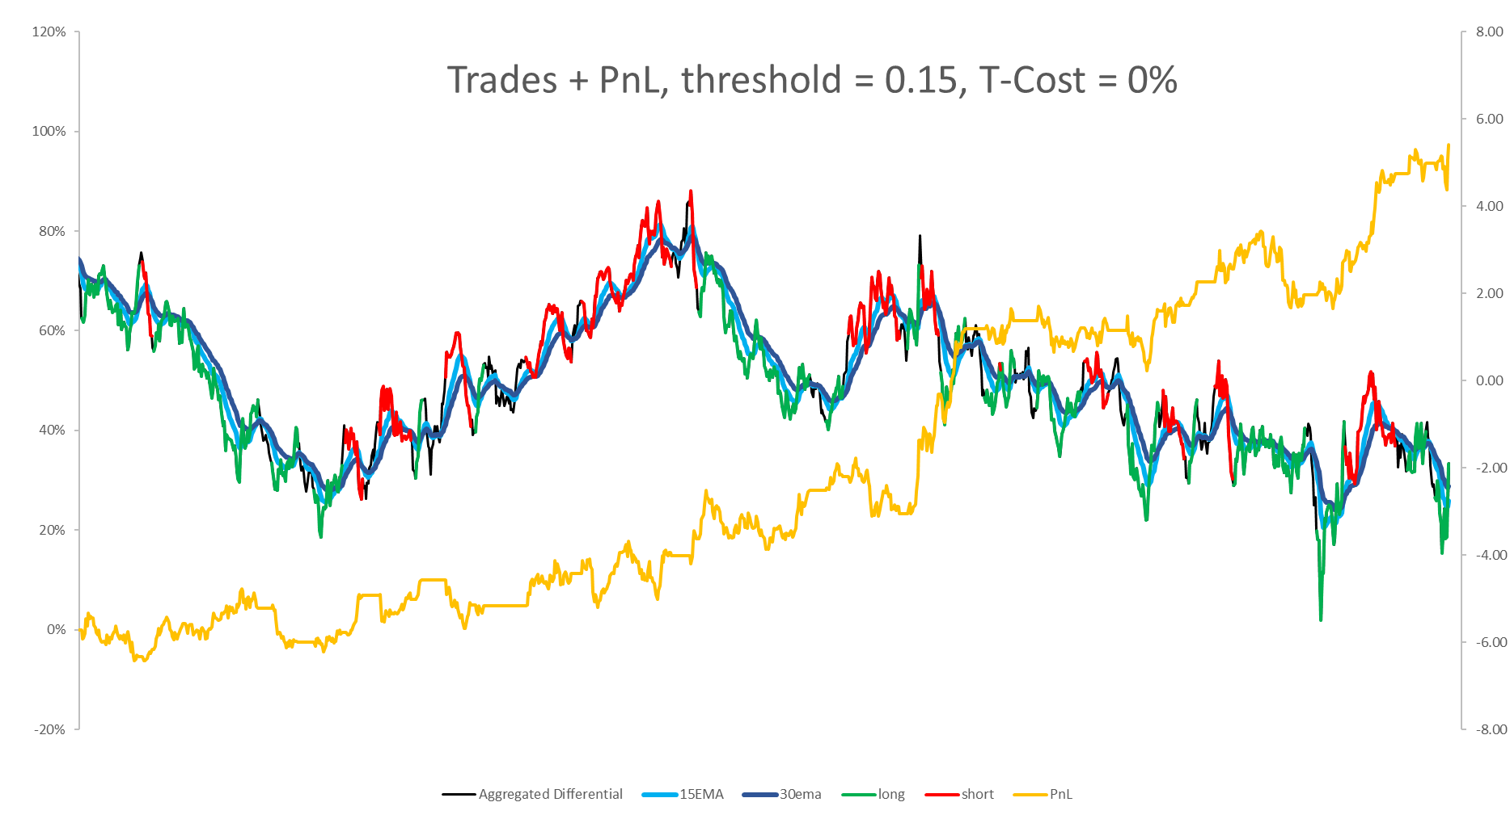

Slide 9
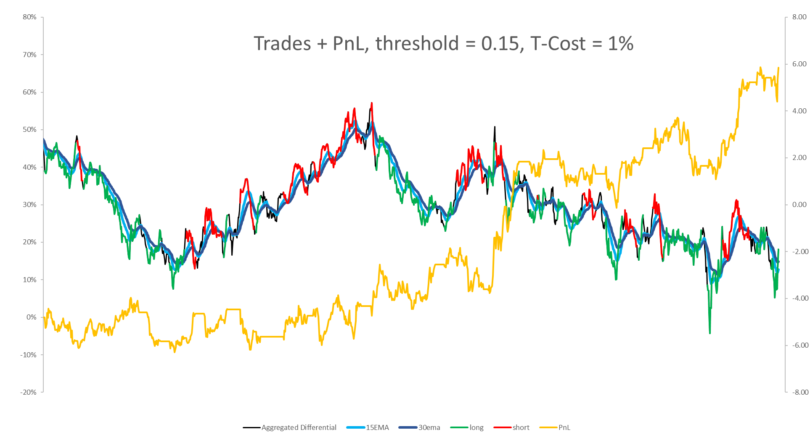

Slide 10
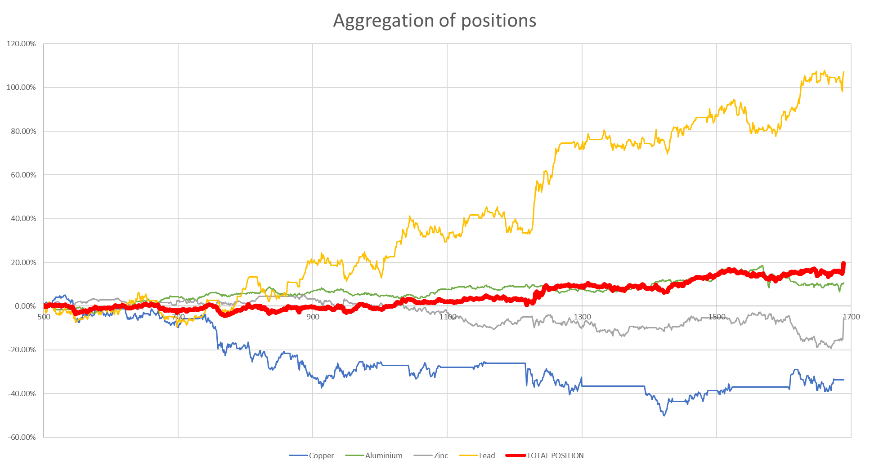

Slide 11
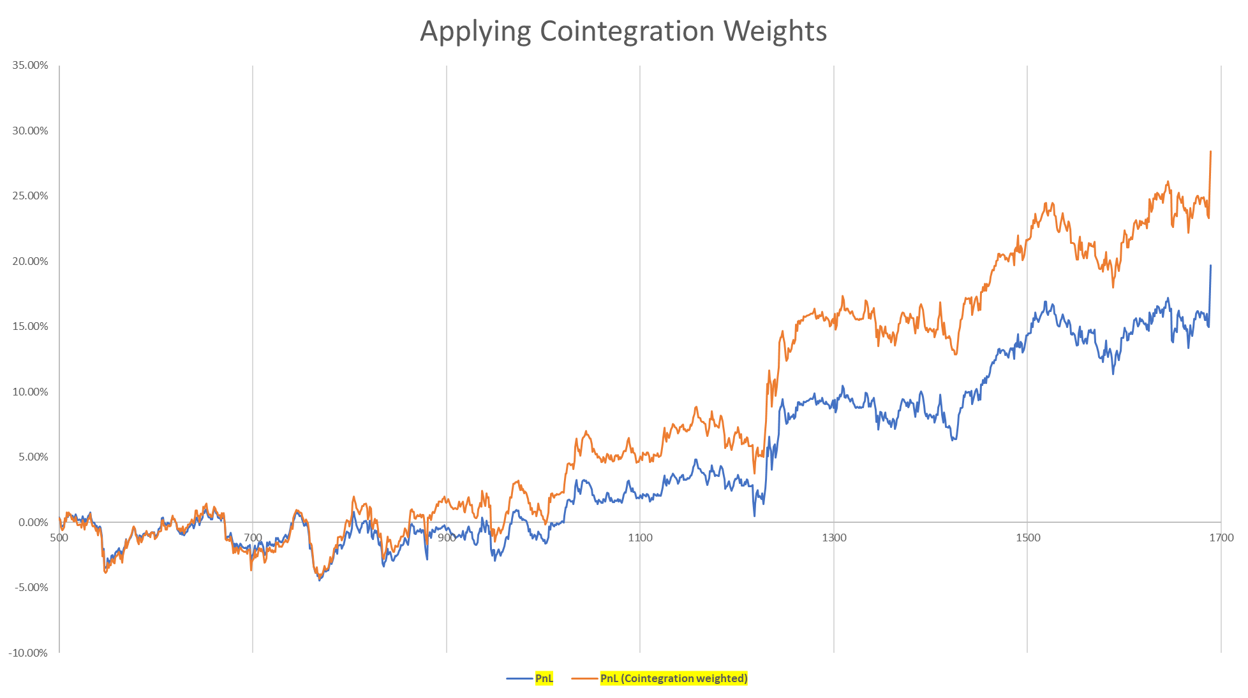

Slide 14
Next steps: Importantly, we want to combine the signals for the two strategies, so that we have fewer trades, reducing T-Cost and increasing average PnL per trade.

