Slide 1
Final Project DSD 2025 - Summer
Comprehensive Analysis Pipeline for Arterial Stiffness Estimation from Wrist Pulse Signals
Student: Dinh Bach Tue Advisor: PhD Researcher Bahmani Nima

Slide 2
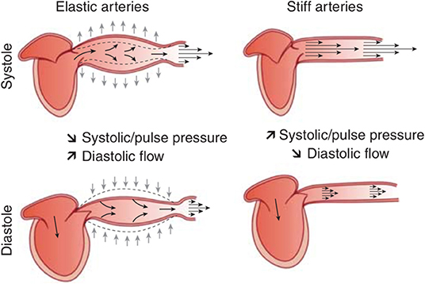
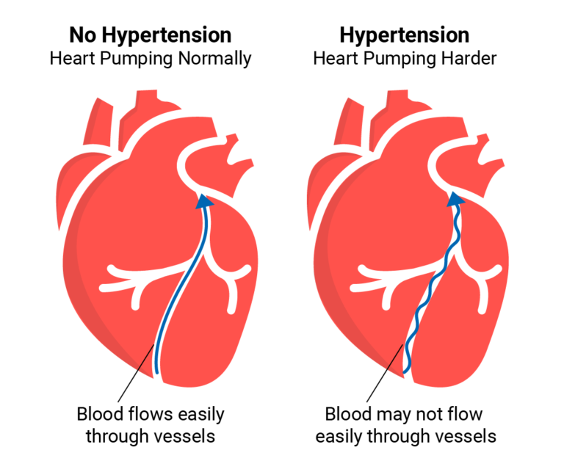
Background
Arterial stiffness is the gold standard biomarker for vascular aging and cardiovascular risk.
Arterial stiffness is the reduced elasticity and increased rigidity of artery walls. This increases the speed of pressure waves, which raises cardiac workload and damages microcirculation in organs.
Over time, this contributes to hypertension, left ventricular hypertrophy, stroke, kidney disease, and other cardiovascular complications.

Slide 3
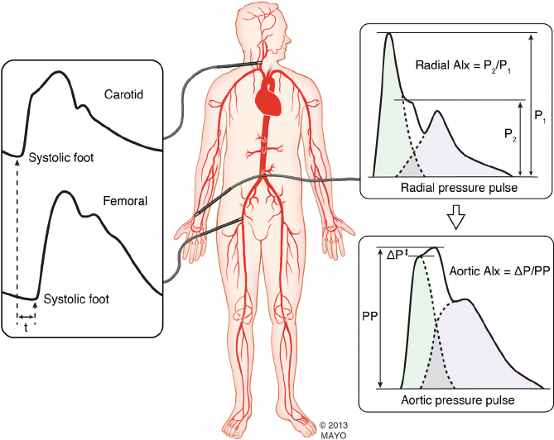
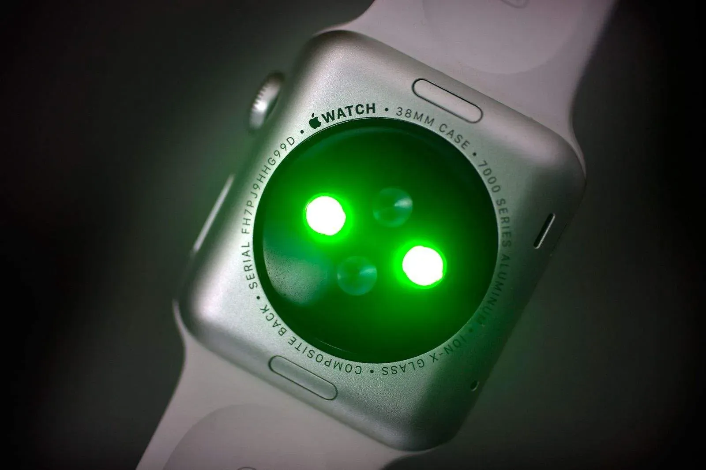
Motivation
Carotid–femoral Pulse Wave Velocity (cfPWV) is the gold-standard measure of arterial stiffness
Expensive (specialized devices)
Inconvenient (clinical setting)
Not wearable-friendly
Wrist PPG signal from PPG sensor
Wrist Area signal from mmWave sensor

Slide 4
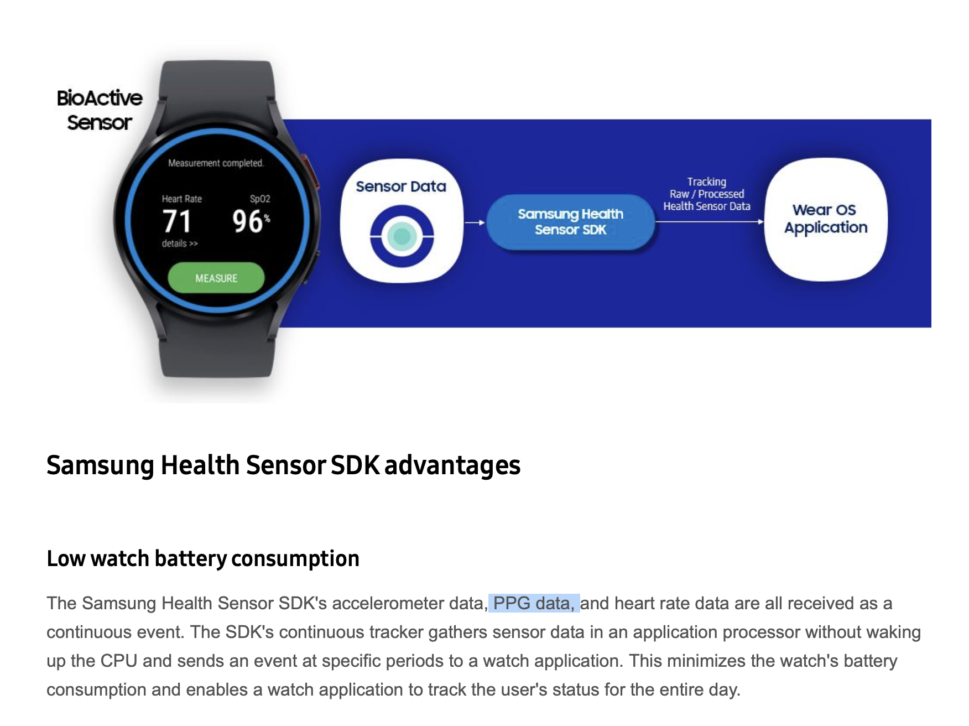
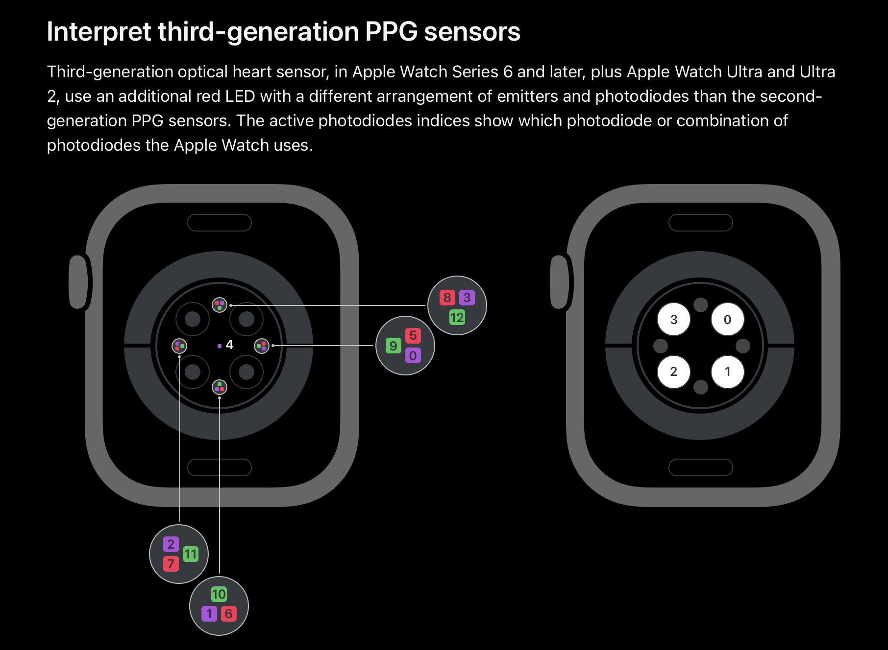
Commercial devices with same technology
Samsung Galaxy Watch
Apple Watch series

Slide 5
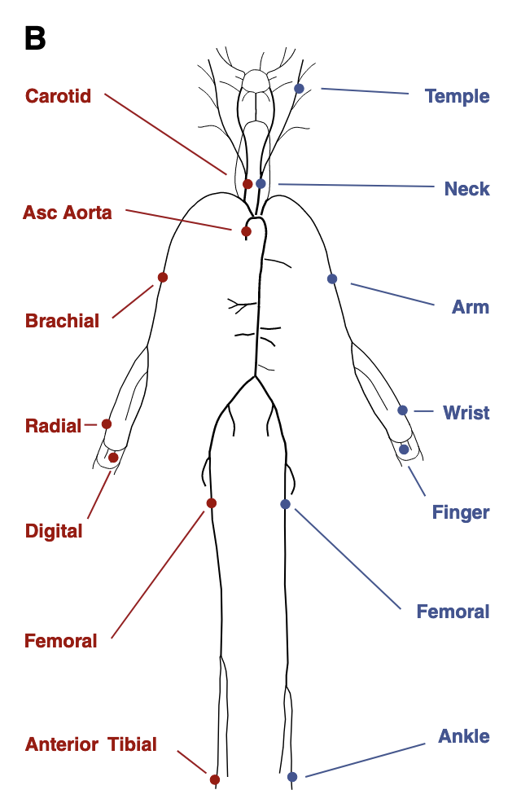
Objective of The Project
Develop a robust foundation for transferring knowledge from synthetic waveform data to real wearable device data for non-invasive cardiovascular health monitoring.
Dataset
Based on Silico Database (Charlton et al., 2019)
4,374 virtual subjects with simulated P (pressure), U (flow), A (area), and PPG waveforms
Each subject has simulated cardiovascular properties and hemodynamic parameters
Multi-site measurements including radial artery (wrist focus)
Target variable: Carotid-femoral PWV for arterial stiffness

Slide 6
Workflow
Classical Machine Learning (Feature-based)
Signal Processing
Data Visualization
Deep Learning (Time-series-based)
Data Augmentation
Benchmark
Interpretability
Final Model

Slide 7
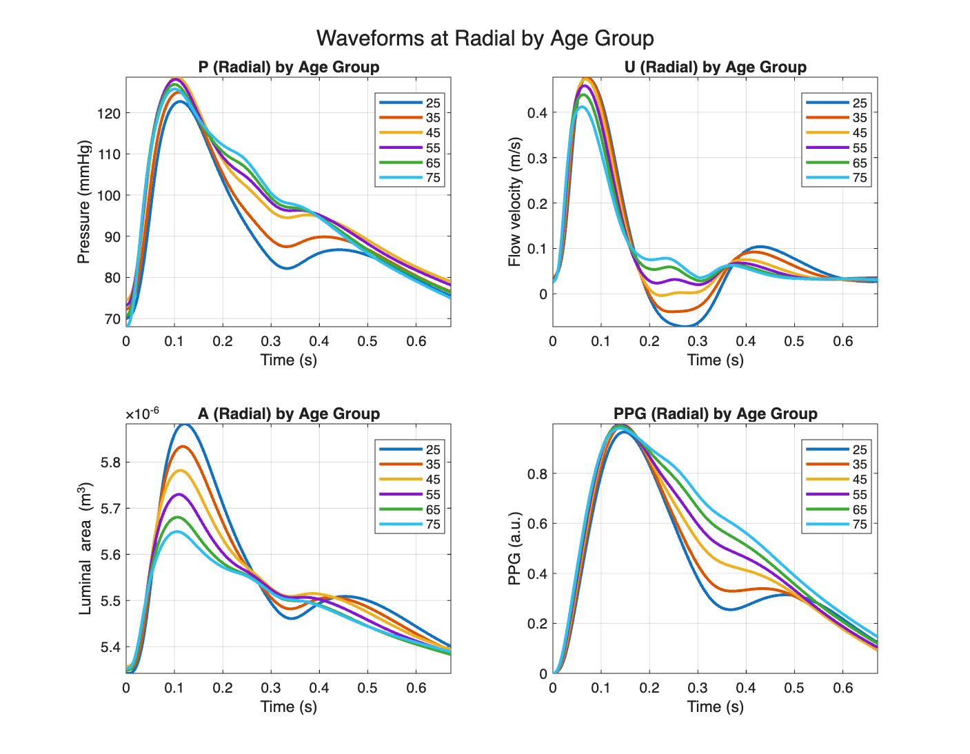
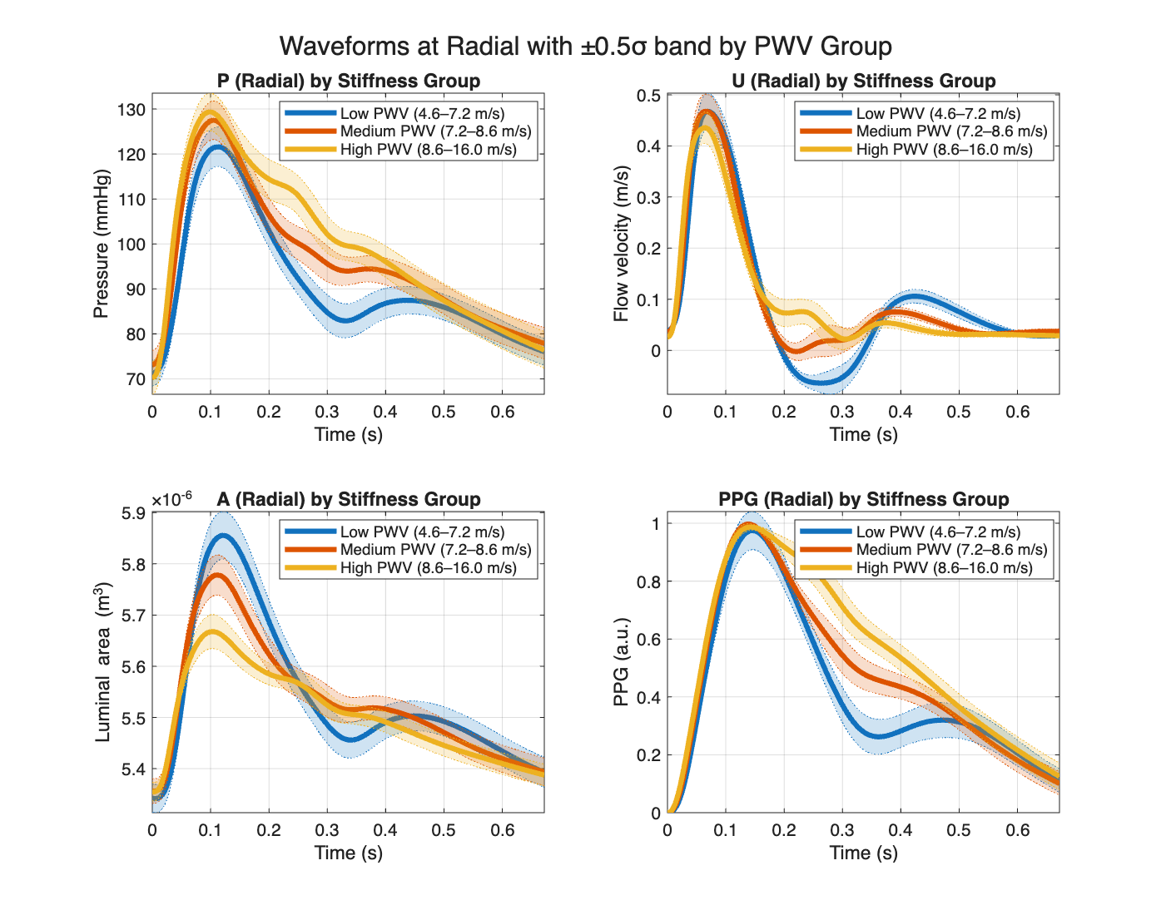
Data Visualization

Slide 8
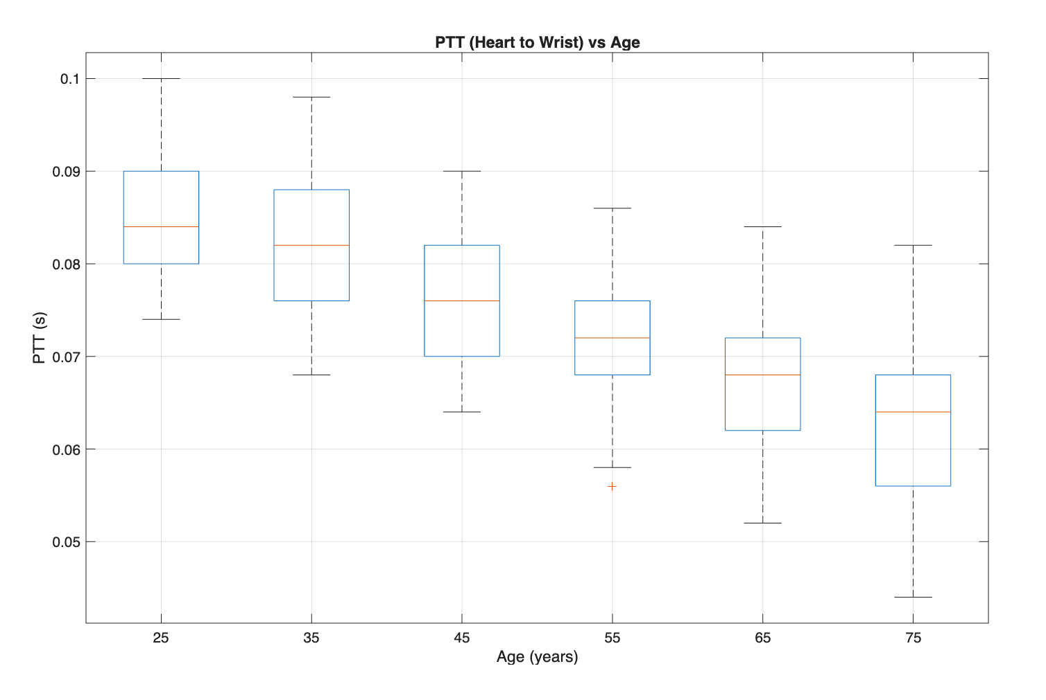
Data Visualization
Box plot of Pulse Transit Time (PTT) correlation with ages

Slide 9
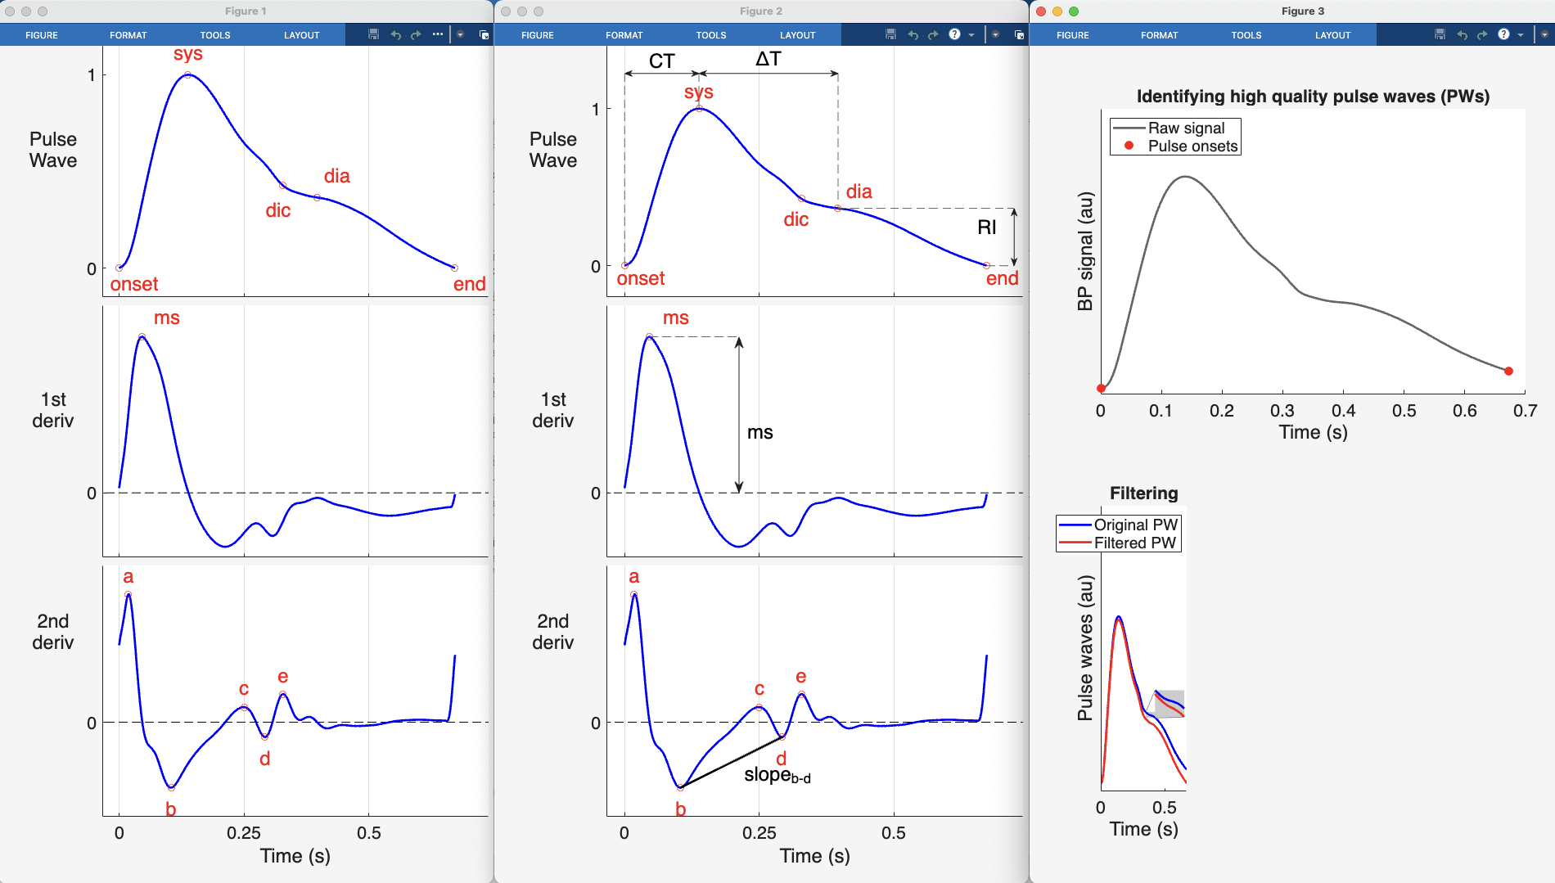
Signal Processing
Plots from built-in signal processing tools from Peter H Charlton

Slide 10
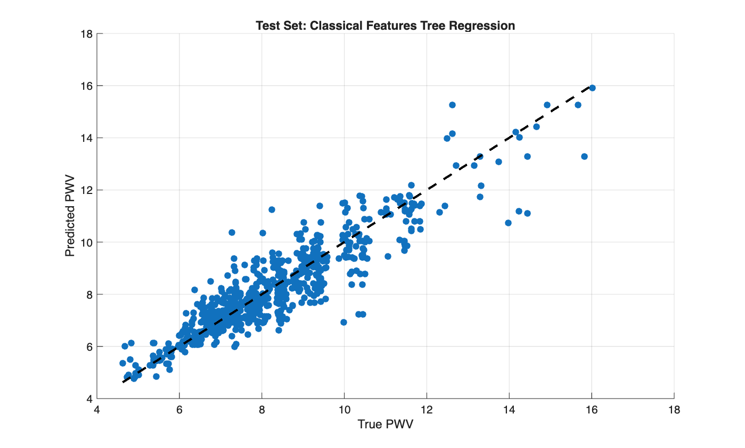
Feature-based Machine Learning
Tree regression with classical PPG feature-based , R^2 = 0.92

Slide 11
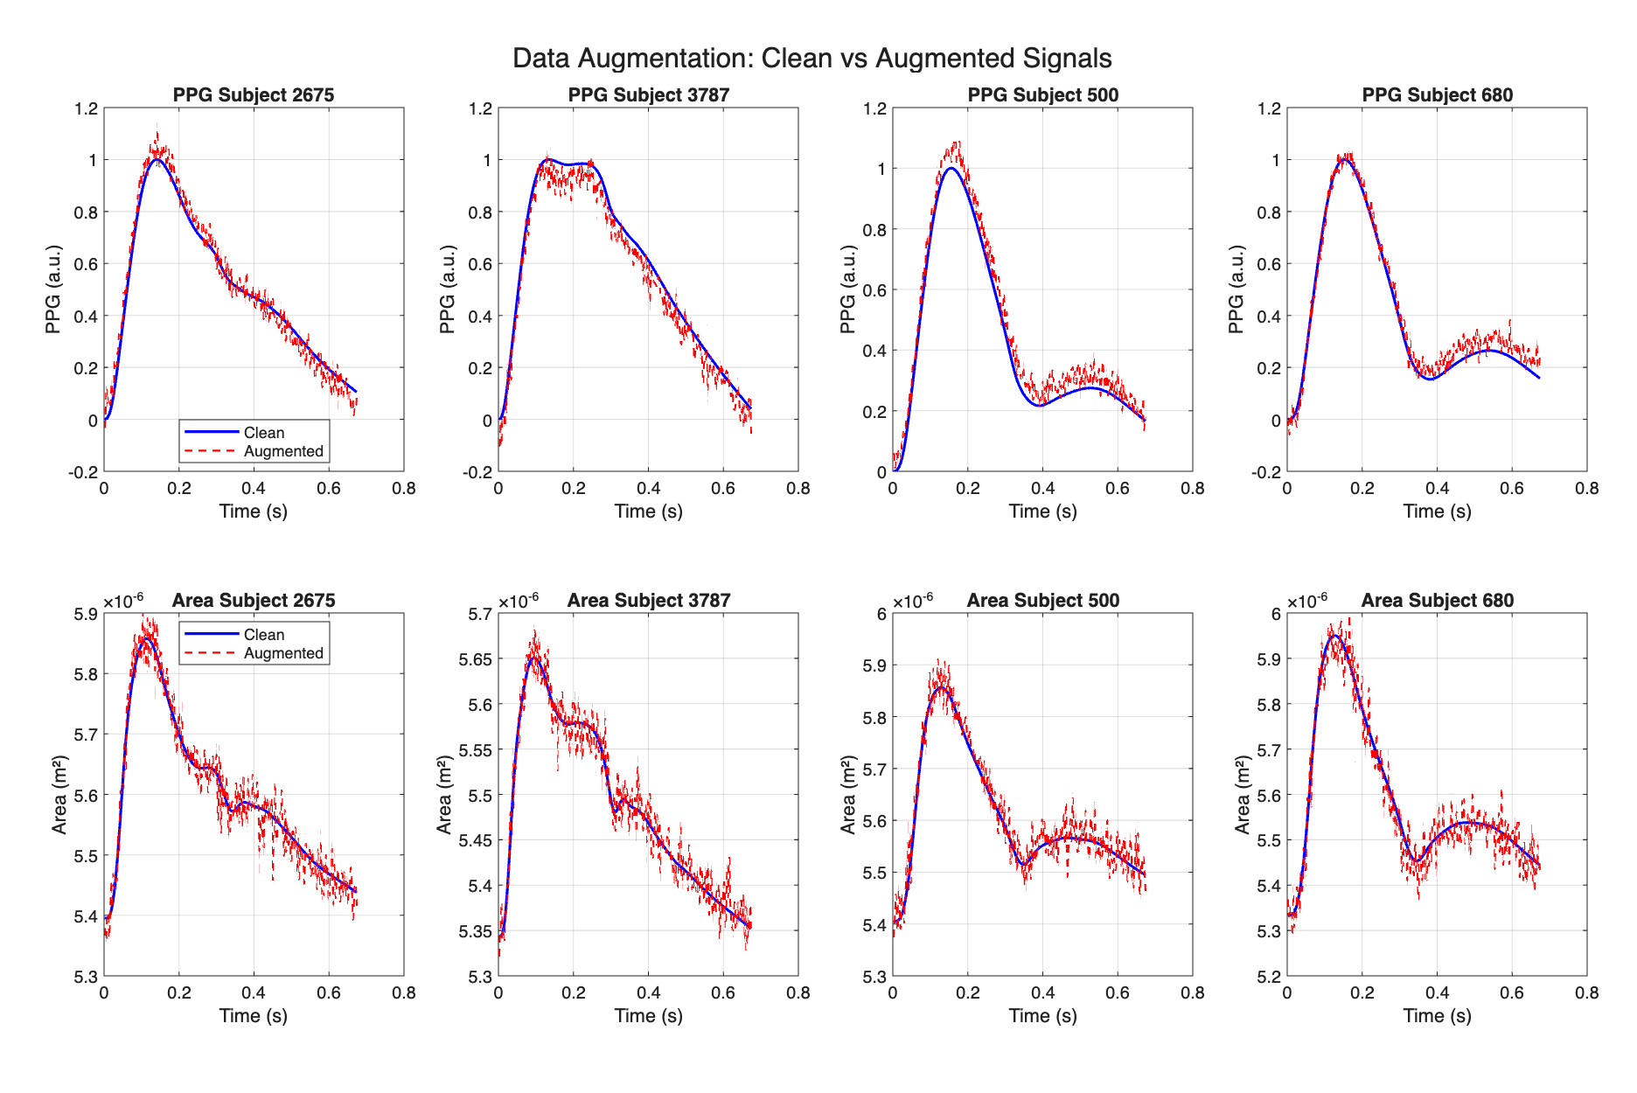
Data Augmentation
Methods:
Adding Gaussian noise, baseline drift, motion artifacts
Benefits:
- Add generalization to the models, increase accuracy, robustness.
- Shape model’s attention to more important parts of the waveform

Slide 12
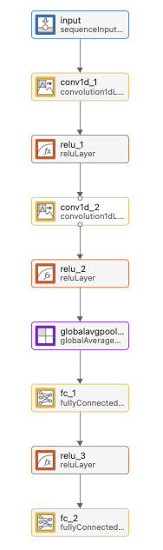
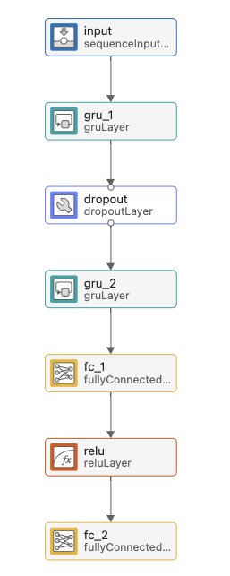
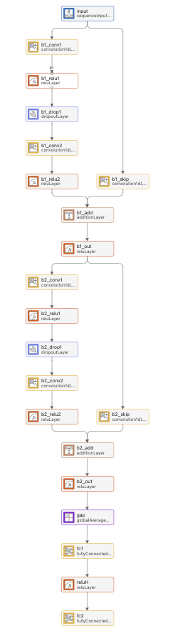
Deep Learning Models
CNN
(Convolutional Neural Network)
GRU
(Gated Recurrent Unit)
TCN
(Temporal Convolutional Network)

Slide 13
Training
Clean
(PPG + Area)
Augmented
(PPG + Area)
Clean PPG
Clean Area
Augmented PPG
Augmented Area
CNN
GRU
TCN
18 models

Slide 14
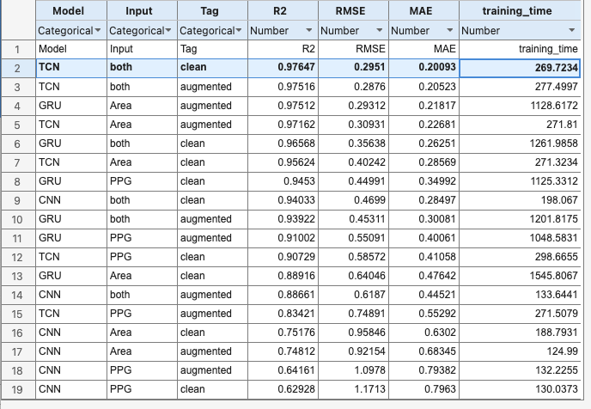
Benchmark
- Same experimental settings:
+ Input data (PPG/Area signals, preprocessing, train/test split)
+ Target variable (cfPWV)
+ Evaluation metrics (MAE, RMSE, R²)
+ Parameters (~50k parameters)
+ Training protocols (epochs, batch size, optimization, cross-validation)
+ Testing protocols (clean data)
Benchmarking 18 model results

Slide 15
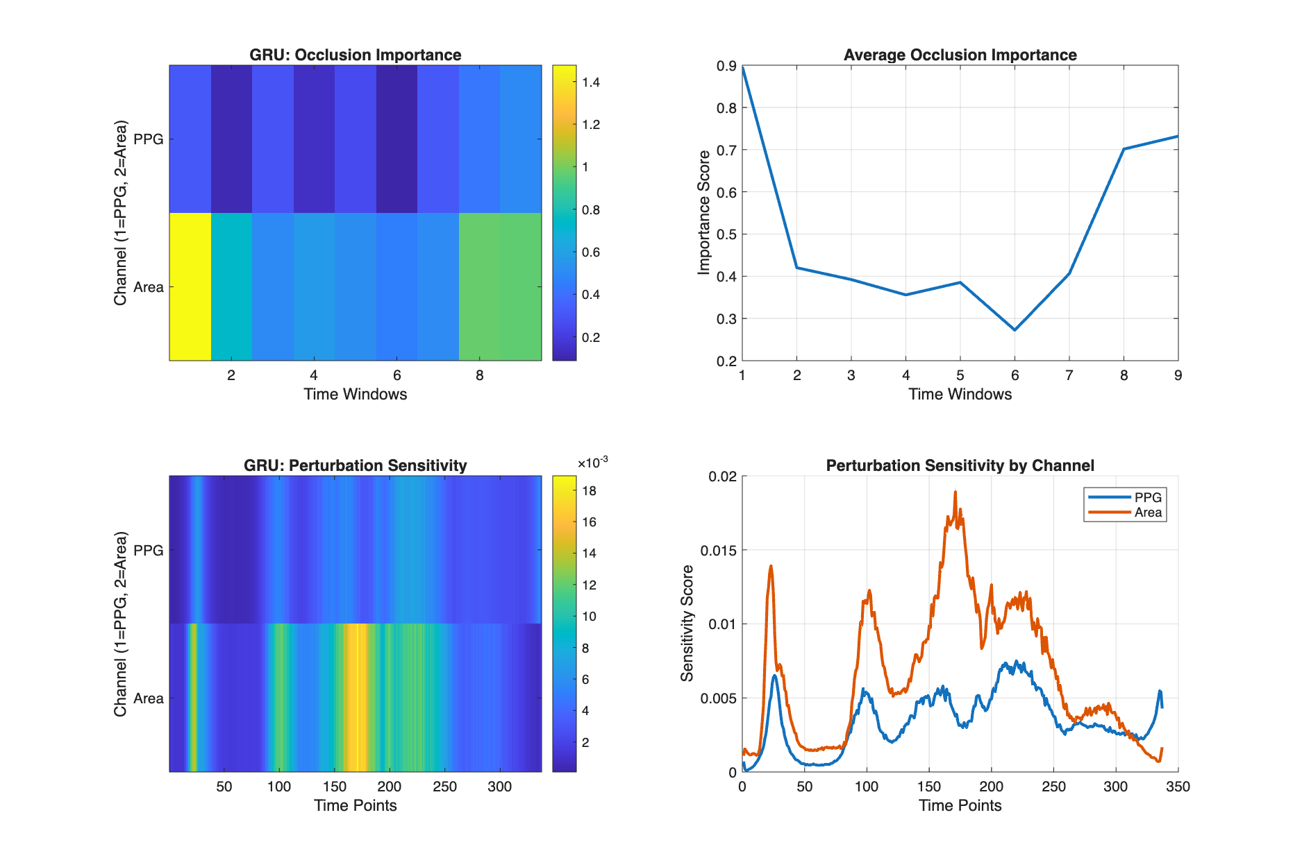
Interpretability (Occlusion and Perturbation Sensitivy)
Occlusion Analysis: Systematically masks input regions with zero to measure how much the output change (9 windows)
Perturbation Analysis: SHAP-like sensitivity analysis with noise injection into each timepoint (337 windows)
Interpretability of GRU model trained with augmented data

Slide 16
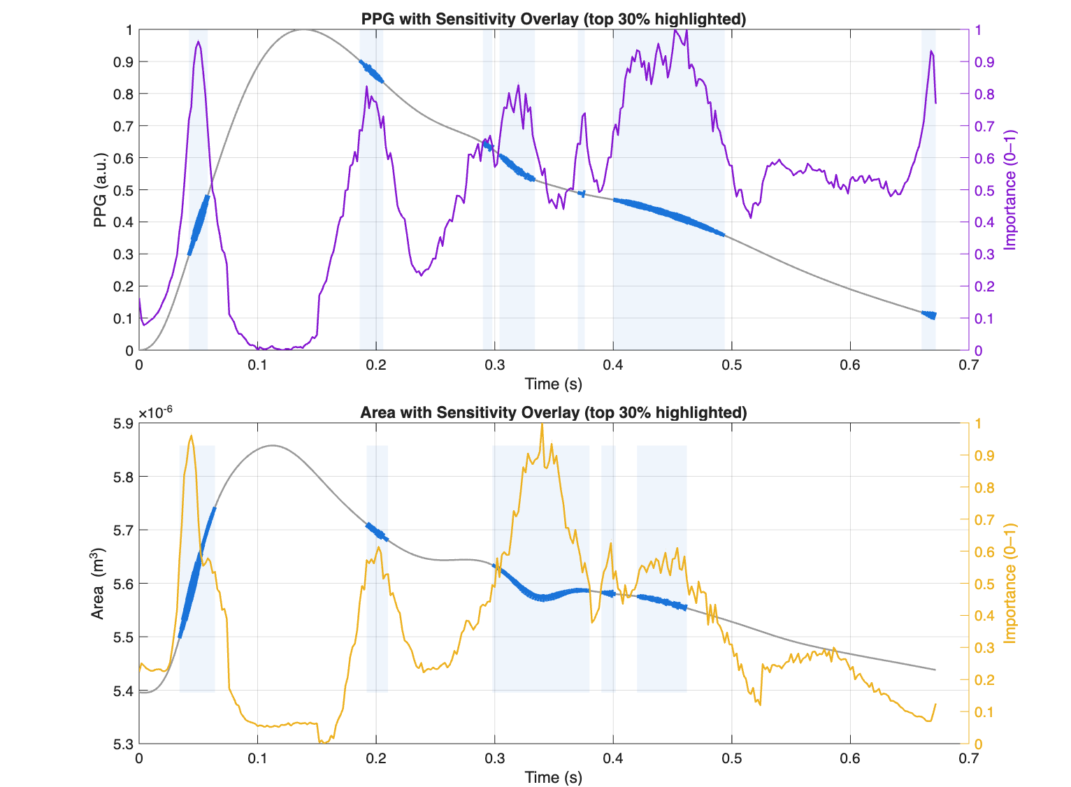
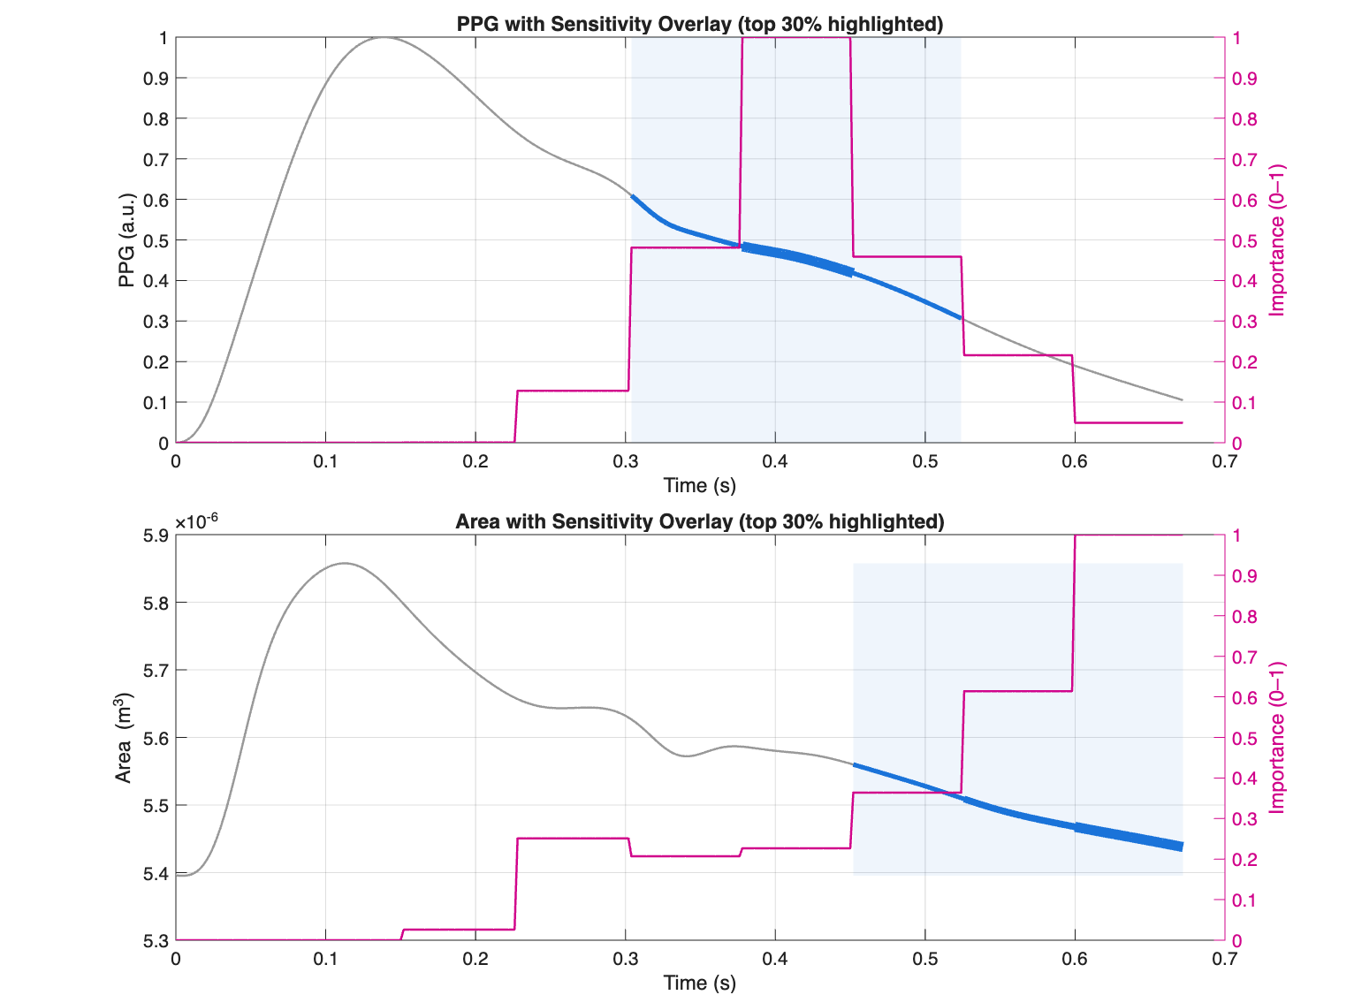
Interpretability (Waveform Sensitivity Overlay)
Overlay Interpretability of GRU model trained with augmented data on a sample subject waveform
Overlay Interpretability of GRU model trained with clean data on a sample subject waveform

Slide 17
Conclusion
Final Model
- Data augmentation helps to generalize the model, add robustness, shape model’s attention to informative places
- TCN (Temporal Convolutional Network) achieves the best performance among the three
- Combining PPG and Area helps to increase the performance of the models (More relied on Area)
TCN architecture with clean PPG, clean Area, augmented PPG and augmented Area as inputs

Slide 18
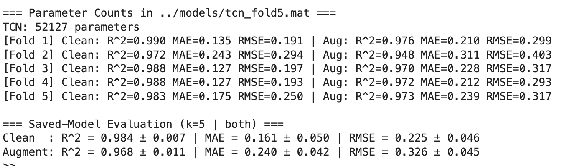
Results
=> Best R2, MAE and RMSE score

Slide 19
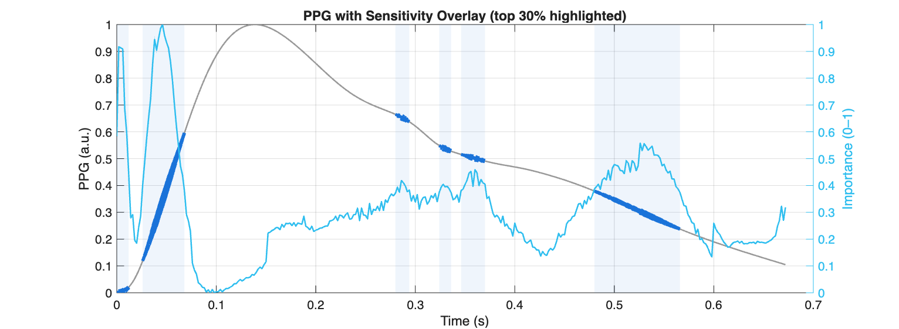
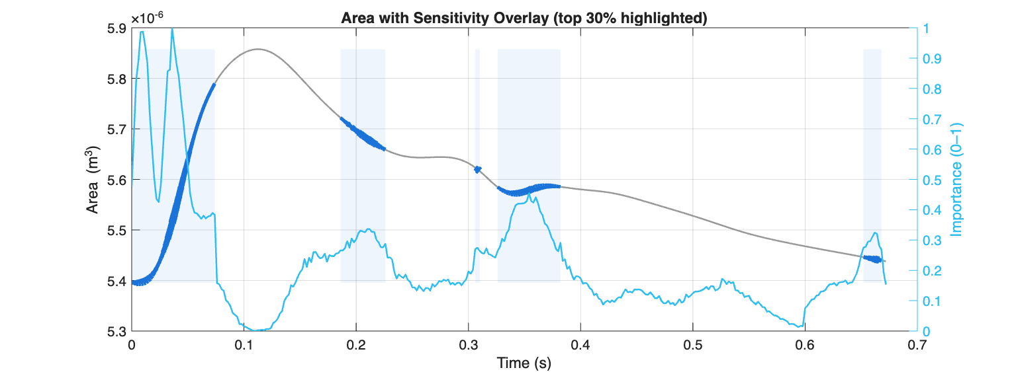
Results
Diversify the attention to other part that also provides useful physiological information such as upstroke/downstroke phase, dicrotic notch, etc.

Slide 20
Future Directions
Multi-sensor integration: Extend models to fuse PPG, mmWave, and other wrist-based signals.
Transfer learning & domain adaptation: Apply fine-tuning and adaptation strategies to bridge the gap between synthetic and real data.
Data augmentation: Investigate how different augmentation strategies affect model robustness, particularly in noisy or low-quality signals.
Model interpretability: Explore the effect of window resolution in occlusion and perturbation analyses to better understand which waveform segments drive predictions.
Architectural exploration: Benchmark additional architectures such as Transformers and hybrid models
Ultimately, the goal is to create a pipeline that is not only accurate on synthetic datasets but also generalizes effectively to wearable-collected signals for practical, non-invasive cardiovascular health monitoring.

