Slide 1
Volunteer Matching System: Group 1
Xuan Loc Le
Tue Bach Dinh
Nam Khanh Thieu

Slide 2
Overview
UML Diagram
Relational Data Model
Functional Dependencies
SQL Implementation

Slide 3
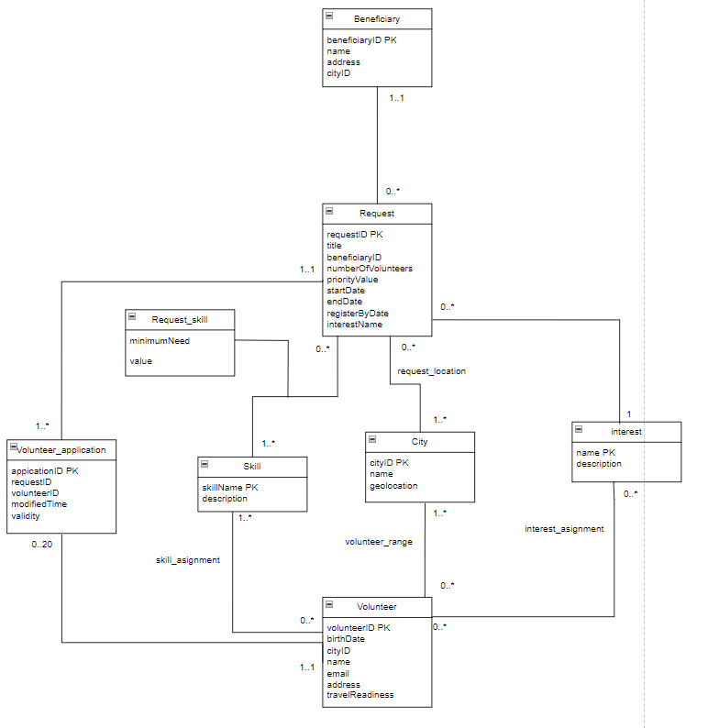
1. UML diagram

Slide 4
2. Relational Data Model
Relations based on classes:
Beneficiary (beneficiaryID, name, address, cityID)
Request (requestID, title, beneficiaryID, numberOfVolunteers, priorityValue, startDate, endDate, registerByDate, interestName)
Skill (skillName, description)
City (cityID, name, geolocation)
Interest (name, description)
Volunteer_application (applicationID, requestID, volunteerID, modifiedTime, validity)
Volunteer (volunteerID, birthdate, cityID, name, email, address, travel_readiness)
Request_skill (skillName, requestID, minimumNeed, value)

Slide 5
2. Relational Data Model
Association classes:
RequestLocation(requestID, cityID)
A many-to-many association RequestLocation from classes Request and City.
VolunteerRange (volunteerID, cityID)
A many-to-many association VolunteerRange is from classes Volunteer and City.
InterestAssignment (interestName, volunteerID)
A many-to-many association InterestAssignment from classes Volunteer and Interest.
SkillAssignment(volunteerID, skillName)
A many-to-many association SkillAssignment from classes Volunteer and Skill.

Slide 6
3. Functional Dependency
Relations and their non-trivial functional dependencies
Beneficiary
beneficiaryID → name, address, cityID
Request
requestID → requestID, title, beneficiaryID, numberOfVolunteers, priorityValue, startDate, endDate, registerByDate, interestName
Skill
skillName → description
City
cityID → name, geolocation
Volunteer_application
applicationID → requestID, volunteerID, modifiedTime, validity
Volunteer
volunteerID → birthDate, cityID, name, email, address, travelReadiness
Interest
name → description
Request_skill
skillName, requestID → minimumNeed, value

Slide 7
4. SQL implementation
Part A. Basic
Part B. Advanced
View
Trigger and function
Transaction
Analysis

Slide 8
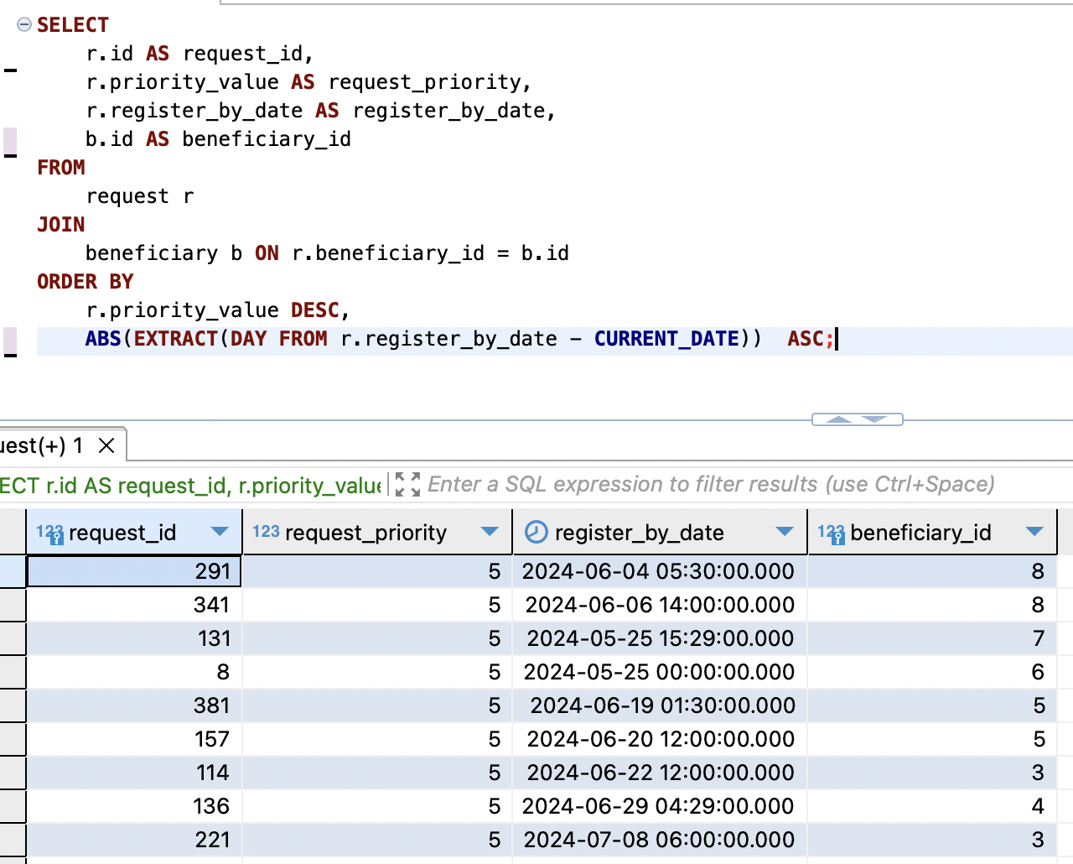
Part A
Sort requests and the beneficiaries who made them by the highest number of priority (request’s priority value) and the closest 'register by date'.

Slide 9
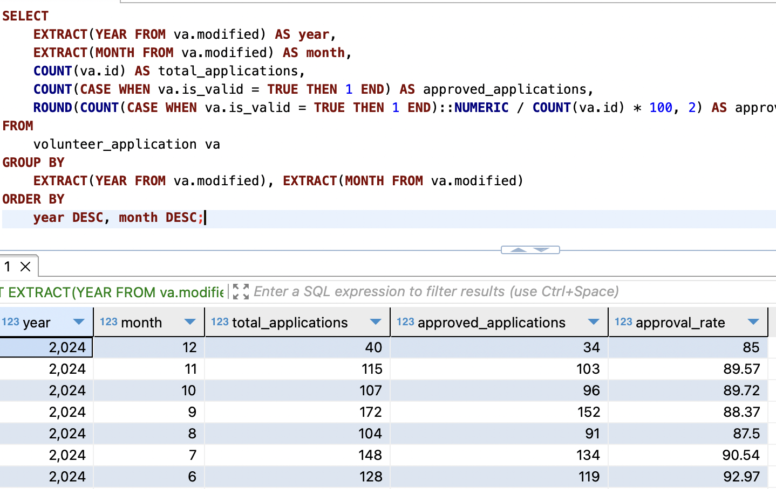
Free choice: Query to Track Volunteer Application and Approval Rates Over Time

Slide 10
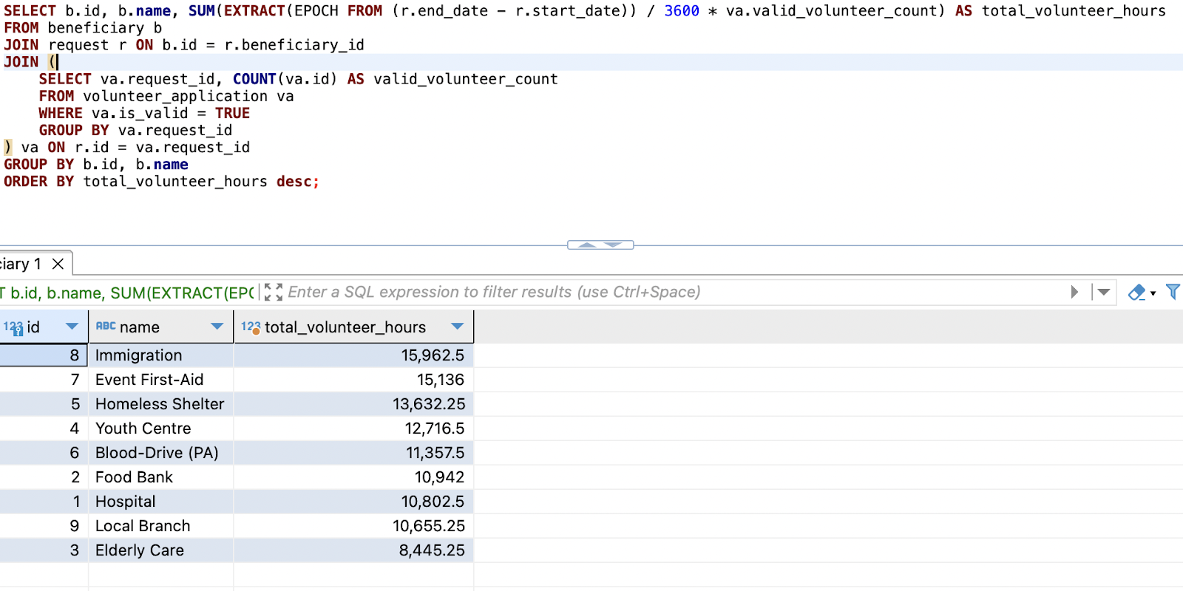
Free choice: List of Beneficiaries and Their Total Volunteer Hours

Slide 11
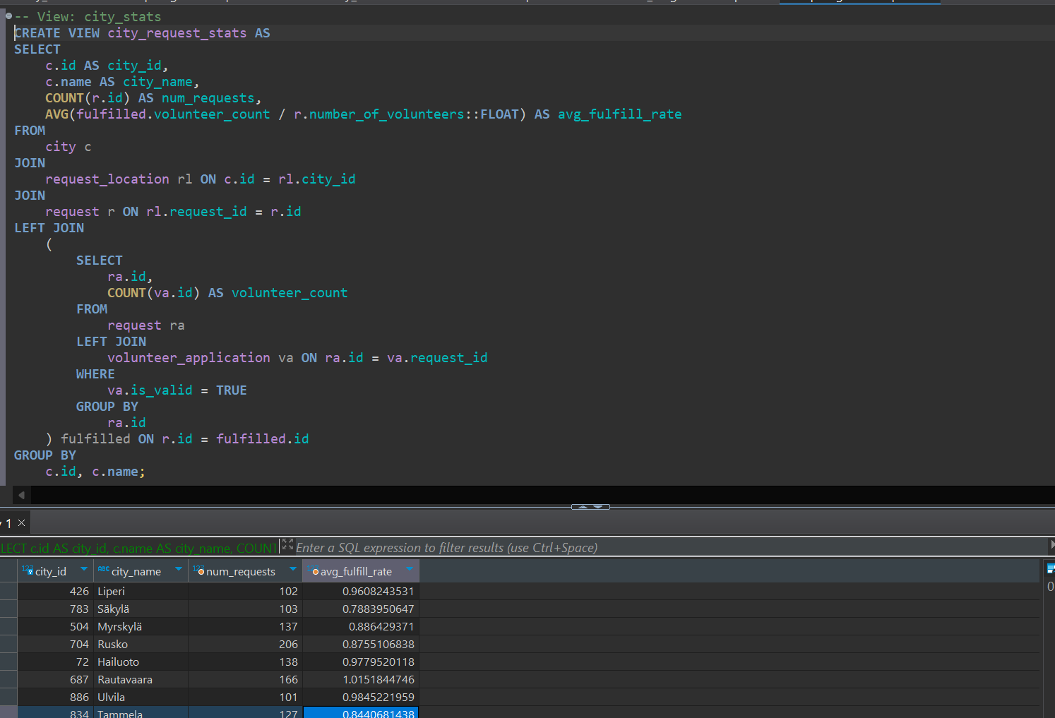
Part B
View (free choice): Write a query that creates a view containing: location ID, city name, number of requests, avg_fulfill_rate. avg_fulfill_rate is the fraction between the number of satisfied volunteers for the application and the total needed.

Slide 12
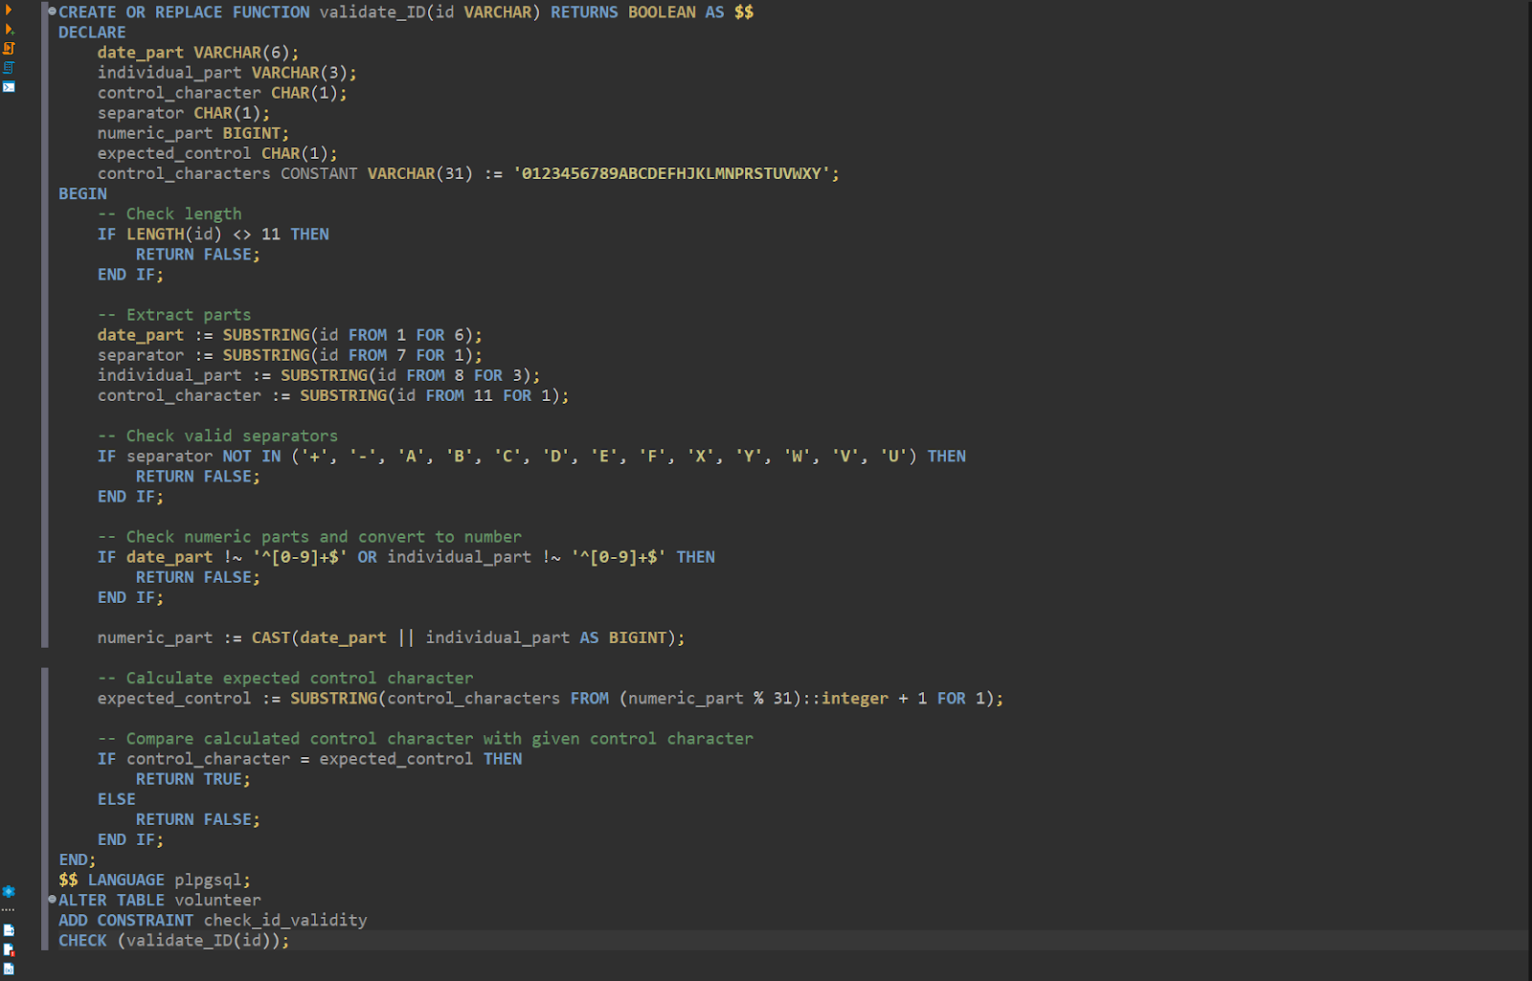
Trigger and Function: Create a check constraint for the volunteer table with a function that validates a volunteer ID when a new volunteer is inserted

Slide 13
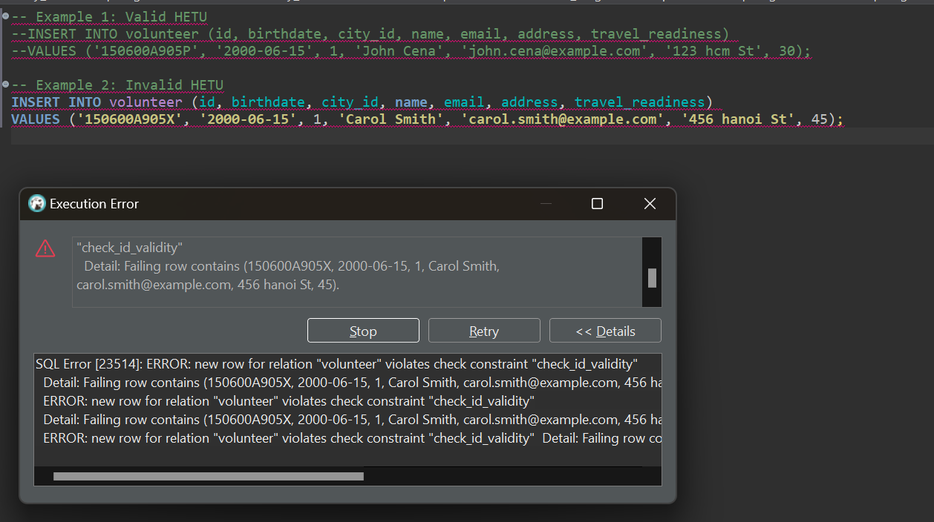
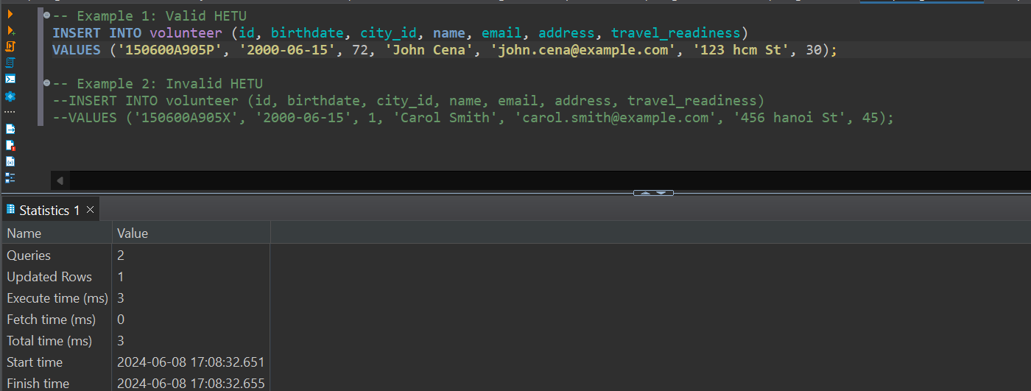
Sample run

Slide 14
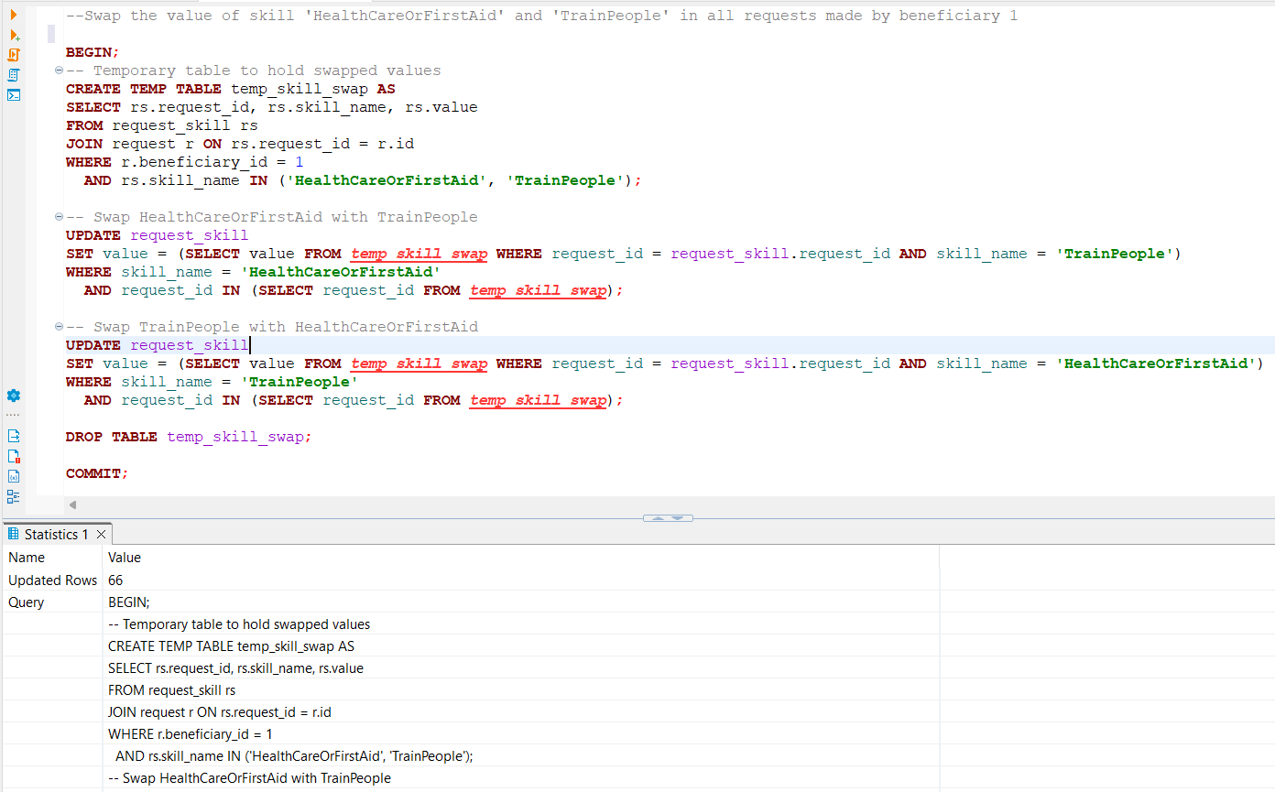
Transaction (free choice): Create a transaction to swap the value of skill ‘HealthcareOrFirstAid’ and ‘TrainPeople’ in all requests made by beneficiary 1.

Slide 15
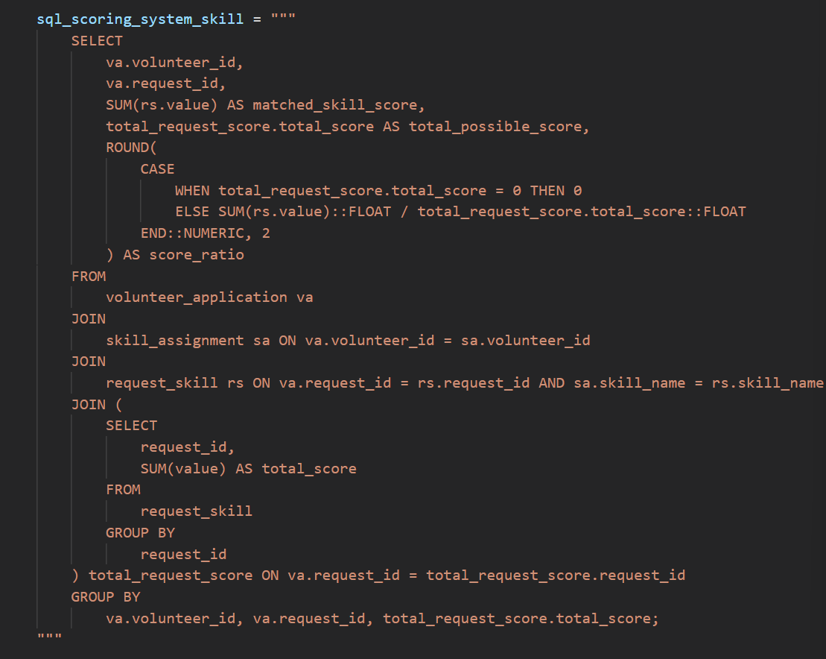
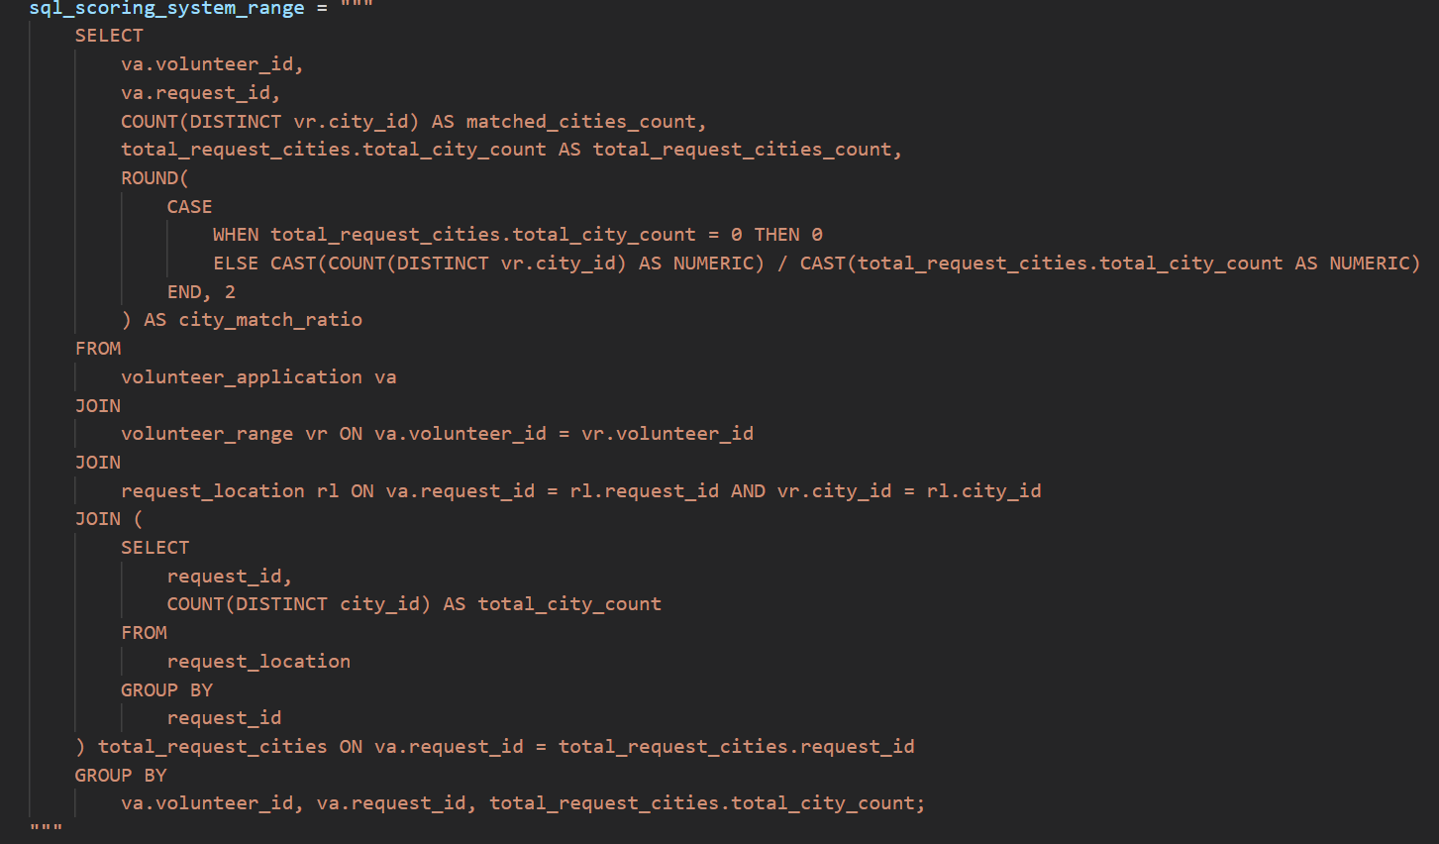
Analysis: Our scoring matching system
We takes into consideration all aspects of the volunteer, and also the assessment of the request to those aspects. We consider the importance of the categories in the order: skill = range > interest > travelReadiness.
The weight of each category contributes respectively 35%, 35%, 20%, 10% to the final score.
Our SQL implementation:

Slide 16
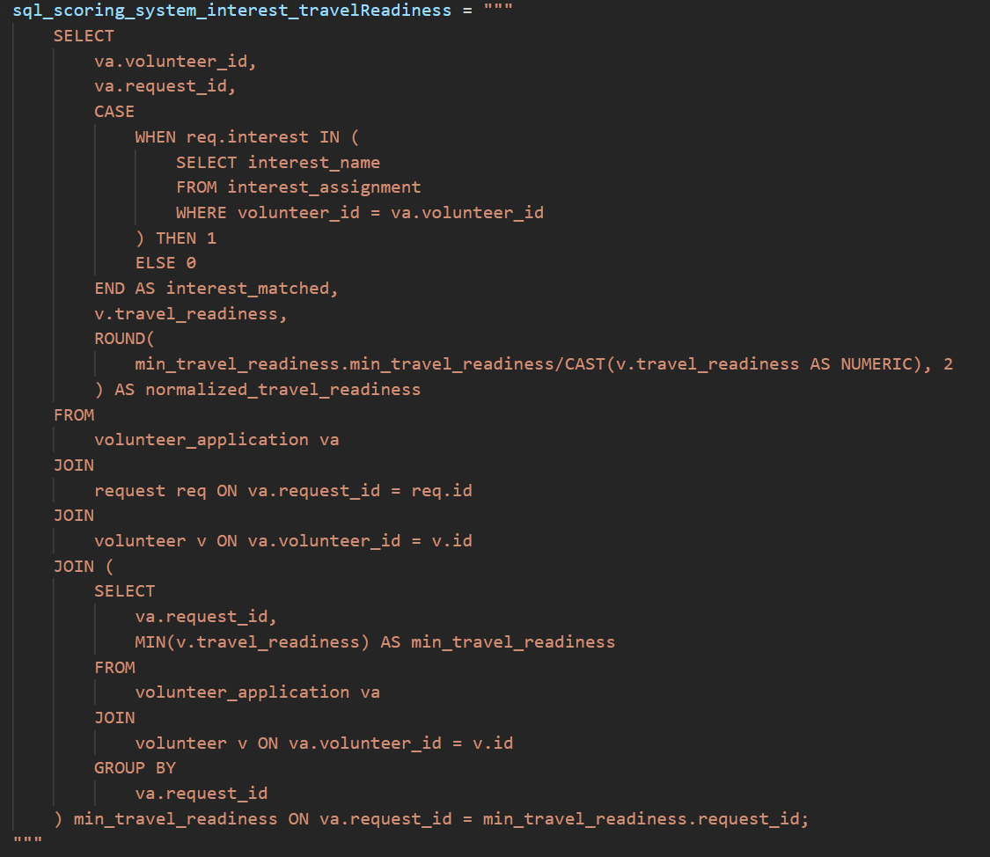
Analysis: Our scoring matching system
We takes into consideration all aspects of the volunteer, and also the assessment of the request to those aspects. We consider the importance of the categories in the order: skill = range > interest > travelReadiness.
The weight of each category contributes respectively 35%, 35%, 20%, 10% to the final score.
Our SQL implementation:

Slide 17
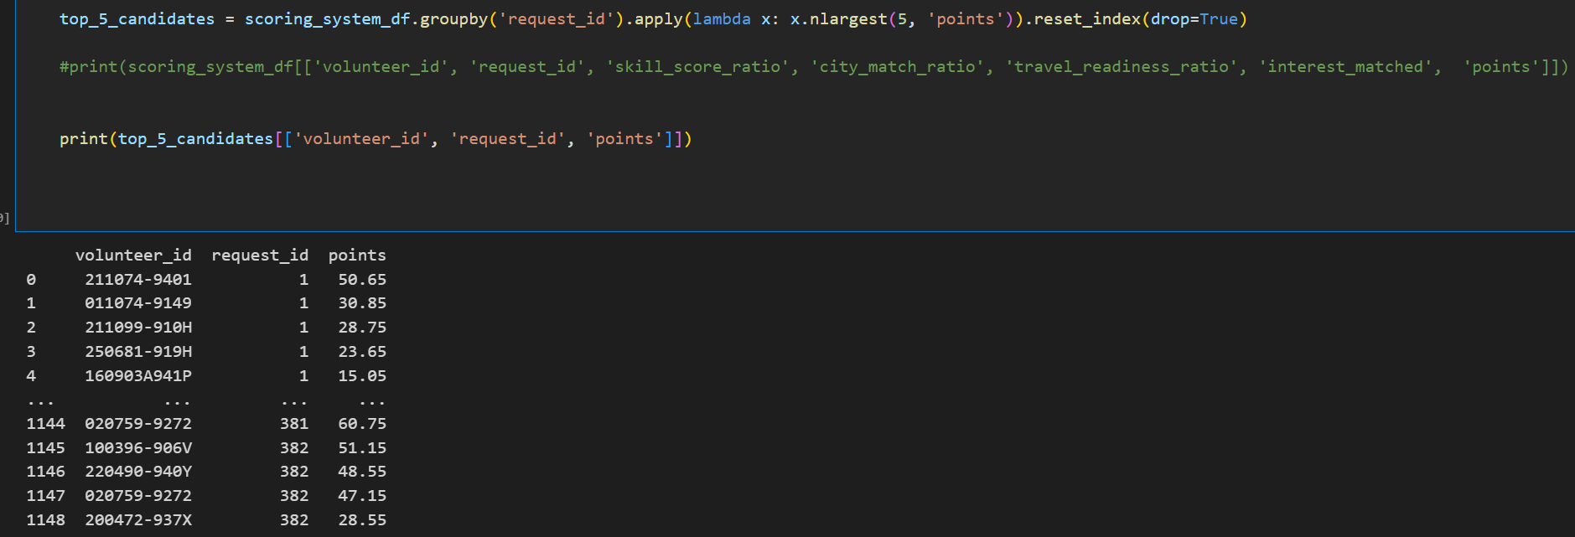
Analysis: Our scoring matching system
Sample run:
The query returns the matching score for each pair of request-volunteer, which can be selectively extract for different needs.

Slide 18
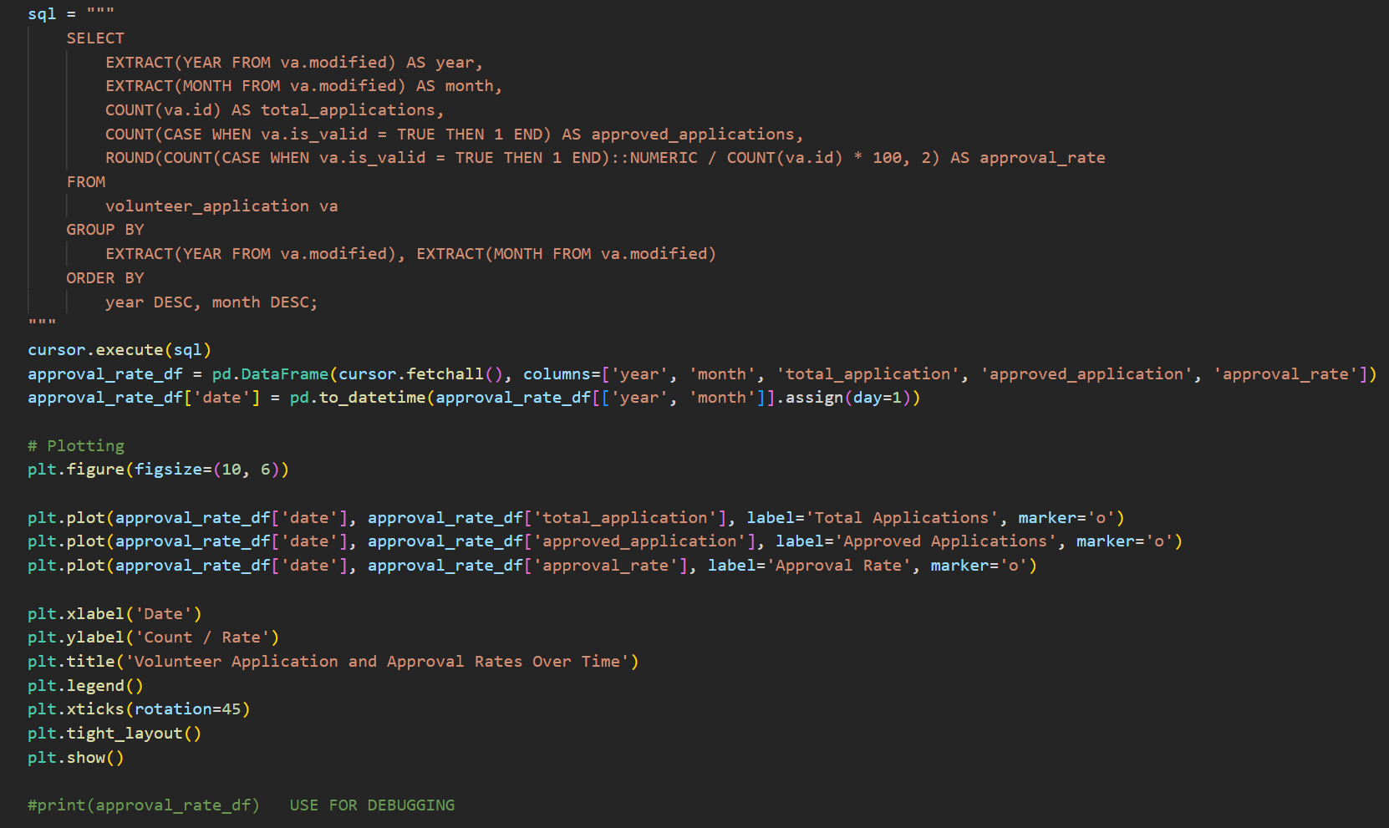
Analysis (free choice): Analyse the number of volunteer applications and approval rates over time
We tracks the number of volunteer applications and approval rates over time, providing insights into trends and the efficiency of the approval process. Monitoring these rates helps identify periods of high volunteer interest and ensures that applications are processed promptly, maintaining volunteer engagement.

Slide 19
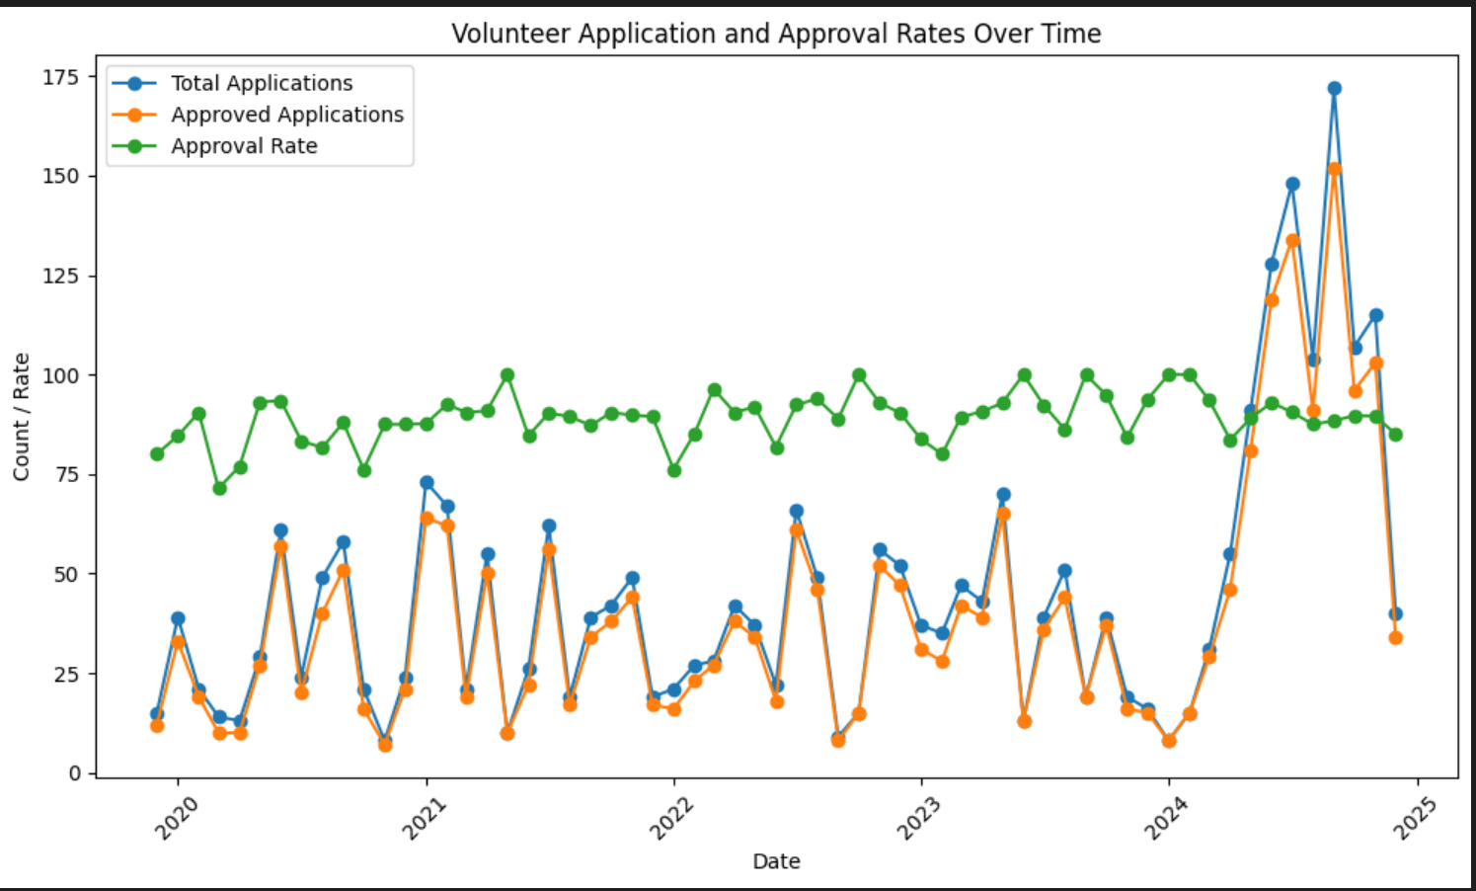
Analysis (free choice): Analyse the number of volunteer applications and approval rates over time
The approval rate seems to be stable with high rate between 75% to 100%. This suggests that the approval policy is reasonable, thus encouraging new volunteer to participate in.
In general, this shows that we might need to expand and recruit a huge amount of volunteer for the upcoming requests. The approve policy seems to be reasonable and do not need to be modified now.

Slide 20
THE END
THANK YOU FOR LISTENING

