Slide 1







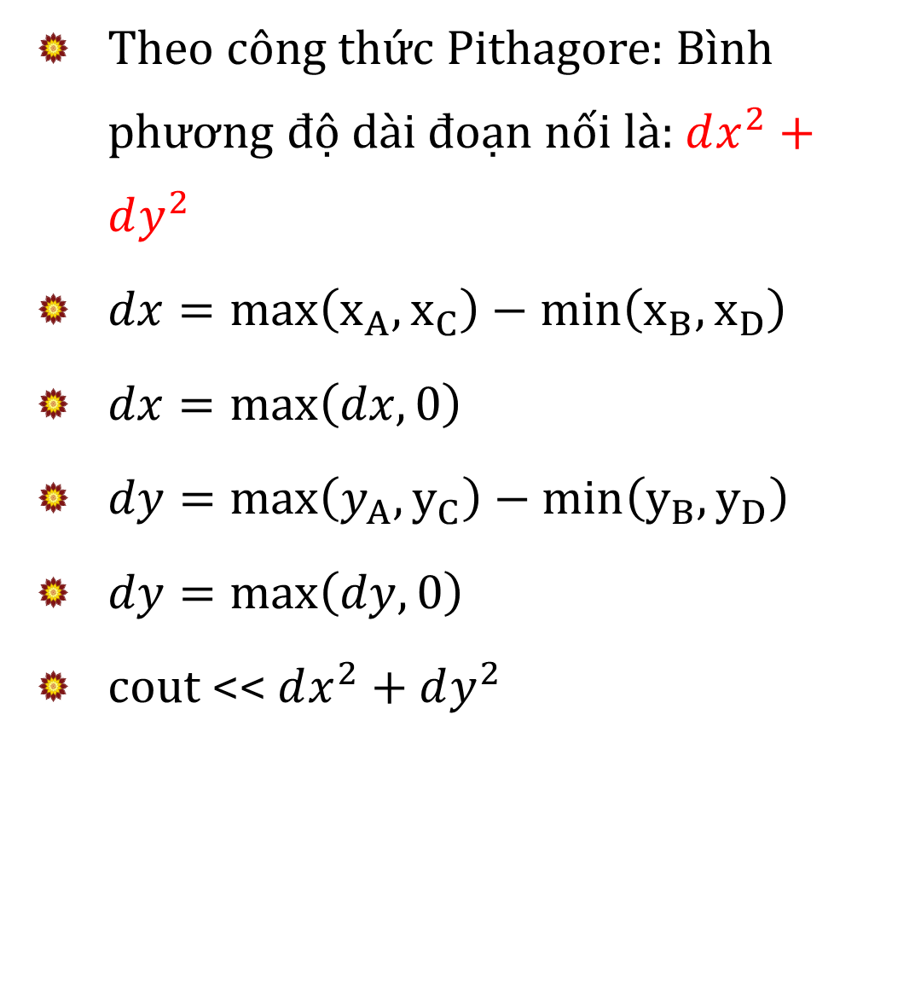









Theo công thức Pithagore: Bình phương độ dài đoạn nối là: $dx^{2}+dy^{2}$
$dx=max\left(x_{A},x_{C}\right)−min\left(x_{B},x_{D}\right)$
$dx=\max\left(dx,0\right)$
$dy=max\left(y_{A},y_{C}\right)−min\left(y_{B},y_{D}\right)$
$dy=\max\left(dy,0\right)$
cout << $dx^{2}+dy^{2}$
$$y_{D}$$
$$D$$
$$C$$
$$y_{C}$$
$$dy$$
$$y_{B}$$
$$B$$
$$A$$
$$y_{A}$$
$$x_{A}$$
$$x_{B}$$
$$x_{C}$$
$$x_{D}$$
$$dx$$
$$\max\left(x_{A},x_{C}\right)$$
$$\min\left(x_{B},x_{D}\right)$$

