Slide 1





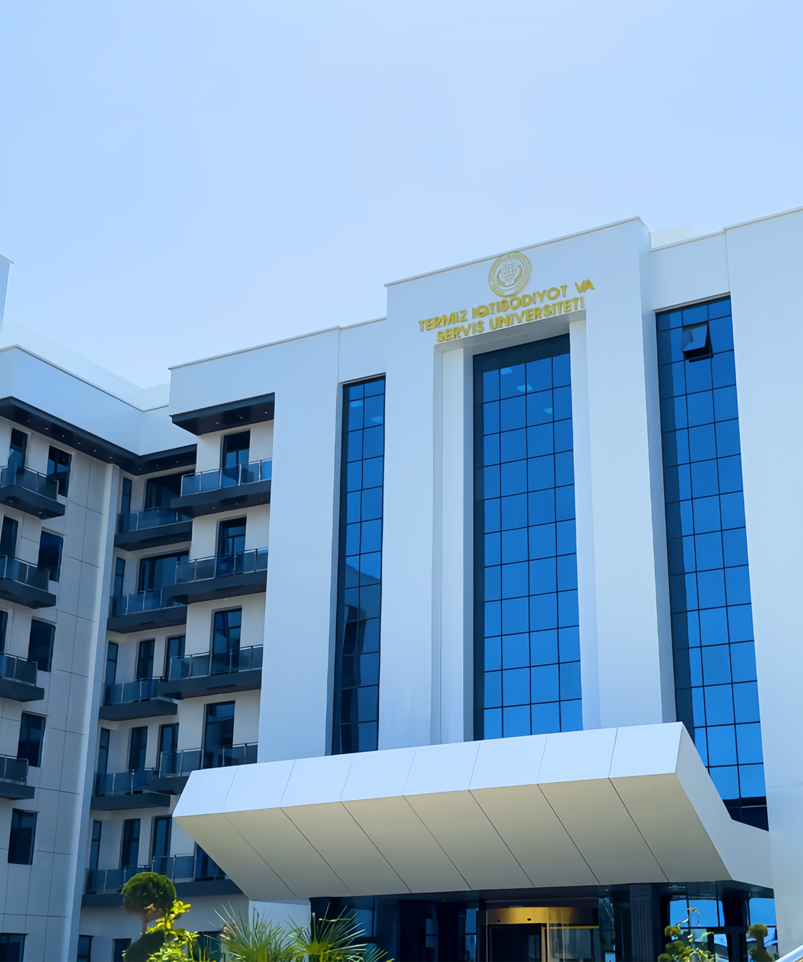
TUES
IN NUMBERS

Slide 2






STRATEGY FOR DEVELOPING THE MATERIAL AND TECHNICAL BASE"
“Implementation of advanced technology aimed at increasing the effectiveness of spiritual and educational activities and enhancing the impact of educational affairs.”
"AVAILABILITY OF EDUCATIONAL BUILDINGS AND DORMITORY FOR STUDENTS.“
THE AREA OF UNIVERSITY CAMPUS
DORMITORY FOR STUDENTS.
Student contingent
2023
2024
2025
2026
2027
2022-23
2023-24
2024-25
2025-26
1000
2000
250
500
30669
The persisting demand for student accommodation
"Change in the capacity of educational buildings"
23669
+7000
200
2024
2026
2027
2023
2026
+1500
+6901
+250
+500
750
1650
+50
The persisting demand for student accommodation
16768
50
250
"Educational areas of buildings."
200
2023
2024
2026
2026
2027
8872
+7896
University Building Capacity
200
Name of objects | number | Area m²
Educational buildings | 4 | 32687,3
Auditories | 148 | 31791,4
Laboratories | 9 | 435,7
Computer cabinets | 10 | 460,2
Supplementary training buildings | 2 | 1482,8
200
50
250
250
350
Useful area 45 650,2
TRAINING COURSES ESTABLISHED AT UNIVERSITY ACADEMIC BUILDINGS
Educational area 32 687,3
For a student 4.2 m²
Shift coefficient 2
№ | Training Name | Specialization | Number of Participants | Time of Establishment
1 | Language Teaching Center | English, Turkish, Russian languages. | 800 | 2024
2 | Vocational Training Center | Nursing and dental technician | 100 | 2025
NEWLY CREATED STUDENT SEATS
CONSTRUCTION OF ADDITIONAL INFRASTRUCTURE FACILITIES
2023
2024
2022 -2023-yy
2027 -2030-yy
UNIVERSITY RENTED EDUCATIONAL BUILDINGS
Medical faculty building
7500-seat educational building
2025-30
Improving service delivery and digital marketing services
2000-seat student dormitory building
Establishing medical diagnostic centre
№ | Rented building name | The number of rented rooms | The rented area m²
1 | Law College Building | 11 | 606,6
2 | Sports college building | 5 | 876,2
2026 -2027-yy
2025-26
2027-30
Establishing a center for language training, IT education, and medical courses
Construction of 68-apartment houses for professors and teachers
Outdoor and indoor sport facilities

Slide 3
PROSPECTS FOR THE DEVELOPMENT OF SCIENTIFIC ACTIVITY
01
ACADEMIC AND SCIENTIFIC LABORATORY RENEWAL IN 2022-2025
SCIENTIFIC SCHOOLS
TRAINING LABORATORIES (FUNDED BY THE UNIVERSITY)
Prospects for the extraction and medical use of chemical substances from plants growing in Uzbekistan
Thermostat TSO-1/80 SPU | Medical and biological physics
Magnetic stirrerMS7-H550-Pro
High-speed centrifugeD2012 plus
Digital pH meterPHS-3E | Biochemistry
Urine analyzerMS7-H550-Pro | Medicinal and biological chemistry
Laboratory electric furnace SNOL 8.2
Operating room organization | Physiology
Sevtsev table. To determine visual acuity
Laboratory equipment set for blood typing and blood analysis | Pathological physiology
Dinamometr
Sevtsev table. To determine visual acuity
Neurological hammer | Clinical Anatomy
Autoclave-sterilizer GR85DF (automatic)
Centrifuge | OXTA
Picoflow meter | Histology
Spirometer
Microton Polyautomatic | Pathological anatomy
ECG machine
Autoclave (for sterilization)
Establishing an animal vivarium | Microbiology
To create IT laboratory consisting of following network deoartments such asRoboto technology, Compyuter graphics, Mobile Apps, Web development, Desktop software | Information Technology
Chemistry
2022
Urine analyzer MS7-H550-Pro | Studies on the extraction of alkaloids and other chemicals from the composition of medicinal plants
Laboratory electric furnace SNOL 8.2
AquadistillatorADEa-4-С3МО
High speed centrifuge D2012 plus
Saxlet oil analyzer
Digital stationary pH-metr PHS-3E
For the preservation of experimental animals | Based on scientific research, the study of the pathogenesis of moldelization and rejection of diseases, as well as the experimental study of ustivor treatment methodsri
Biochemical analyzer
IFA analyzer
Urine analyzer
Blood analyzer
Thermostat
Autoclave-sterilizer
Department building cutlets for vivarium
Cutlets
Set of large and small surgical instruments
Biophysics
2023
Studying biochemical processes in the body using physical methods
Biology
2024
Population of medicinal plants in Surkhandarya
Areas of scientific schools
Analysis of anthropometric ,and morphological indicators in diseases of organisms living in the warm climates
Anatomy
2025
Physiology
2025
Studying physiological processes in the body using physiological methods
Histology
2025
Study of physiological processes in the body using histochemical and immunohistochemical methods
History
2025
Introducing digital technologies and artificial intelligence into the educational process of history
Ethnography
2025
The main directions and schools of modern ethnography, priority theoretical and methodological views related to the theory of ethnos
Biochemistry
2026
Biochemical analysis of blood, urine and lymph
PARTICIPATION OF STUDENTS AND DOCTORAL STUDENTS IN SCIENTIFIC SCHOOL PROJECTS
EDUCATIONAL AND SCIENTIFIC LABORATORIES
Faculty name | 2023 |  |  |  | 2024 |  |  | 2025 |  |  | 2026
 | Training laboratory / upgraded leveli | Scientific laboratory / updated leveli | Virtual lab fill level | Training laboratory / upgraded level |  | Scientific laboratory / refreshed rate | Virtual lab fill level | Training laboratory / upgraded level | Scientific laboratory / refreshed rate | Virtual lab fill level | Training laboratory / upgraded level | Scientific laboratory / refreshed rate | Virtual lab fill level
Medicine | 12% | 9% | 5% | 16% |  | 13% | 8% | 23% | 17% | 12% | 28% | 21% | 18%
Economics and Information Technology | 10% | 7% | 4% | 12% |  | 11% | 6% | 15% | 14% | 9% | 20% | 13% | 12%
Pedagogy and social and humanities sciences | 8% | 6% | 4% | 9% |  | 10% | 9% | 11% | 15% | 16% | 17% | 14% | 13%

Slide 4


















YOUTH ENGAGEMENT STRATEGY AT TERMEZ UNIVERSITY OF ECONOMICS AND SERVICE
INTEGRATING ADVANCED TECHNOLOGIES TO IMPROVE THE EFFICIENCY OF BOTH SPIRITUAL AND EDUCATIONAL ACTIVITIES AND THE IMPACT OF UPBRINGING EFFORTS
SPIRITUAL AND EDUCATIONAL AFFAIRS
1. ENHANCING THE EFFECTIVENESS OF YOUTH AFFAIRS AND SPIRITUAL-EDUCATIONAL ACTIVITIES.
5. DEVELOPING A UNIVERSITY PROGRAM TO PROMOTE NATIONAL SPORTS AMONG STUDENTS AND NURTURE CHAMPIONS FOR NATIONAL, ASIAN, WORLD, AND OLYMPIC GAMES
CLUBS AND CIRCLES ORGANIZED WITHIN THE FRAMEWORK OF THE 'DEVELOPMENT STRATEGY CLUSTER
Establishing an interdepartmental lab for sociological and psychological analysis within the spiritual, educational, and disciplinary management system of university. Implementing systematic training for leaders and staff in the field.
TUES chess club
№ | Target Indicators | 2025 | 2026 | 2027 | 2028 | 2029 | 2030
1 | Circles and Clubs | 14 | 15 | 16 | 17 | 19 | 20
2 | Uzbekistan, Asian, World, and Olympic Champions | 10 | 15 | 18 | 22 | 25 | 30
3 | Rooms of 5 important initiatives | 3 | 4 | 5 | 6 | 7 | 8
4 | Winners of Competitions and Contests | 5 | 8 | 12 | 15 | 18 | 20
5 | Winners of Competitions and Contests | 1 | 3 | 4 | 5 | 6 | 7
“Bookworm student” circle
2. ORGANIZING MEANINGFUL ACTIVITIES AND ENSURING STUDENT ENGAGEMENT DURING FREE TIME.
“'Development strategy cluster”
Socio-Psychological Service Center
Establishing a creative students' park, “Book-café”, and “Student tech zone” for talented and creative students at the university. Launching the “Student media center” and implementing a “Modern technologies and unified interactive cluster center” for student engagement.
Student media center
Student volunteering center
3. ENHANCING THE STUDENT SELF-MANAGEMENT SYSTEM AND OPTIMIZING THE EFFECTIVENESS OF THEIR ACTIVITIES.
ENHANCING THE ENGAGEMENT OF FEMALE STUDENTS
Exploring the practices of prestigious higher education institutions abroad and establishing the “Student council” at the university.
“Student ensemble ”
6. INTEGRATING DIGITAL TECHNOLOGIES WIDELY FOR SYSTEMATIC MONITORING OF ACTIVITIES IN THE SPIRITUAL AND EDUCATIONAL SECTOR.
“University honor” Introducing a special breast insignia
“"Embroidery and Design" club
4. PROMOTING THE SOCIAL ENGAGEMENT OF FEMALE STUDENTS AND ORGANIZING SYSTEMATIC EFFORTS TO PREPARE THEM AS PRACTICAL PROFESSIONALS.
-organizing various contests and events through mobile applications;
-digitizing the allocation of student dormitory spaces;
-creating a secure student mobile app to maintain public order;
-developing an effective system to support students with disabilities at the university.
“Establishing the activities of the 'Zulfiyaxonim Followers’
club
Establishing the activities of the 'Student Media Center'
Launching the “Zulfiyaxonim izdoshlari” club for talented and creative female students at the university, and offering systematic support to female students in need of social protection, including those listed in the ‘Temir daftar' and “Yoshlar daftari” to help them gain vocational skills free of charge.
Student press club
Telestudio
Mobile photography
Graphic design
Mediapult
Social Media
Marketing Manager

Slide 5



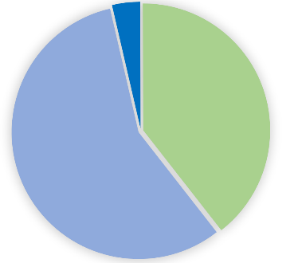

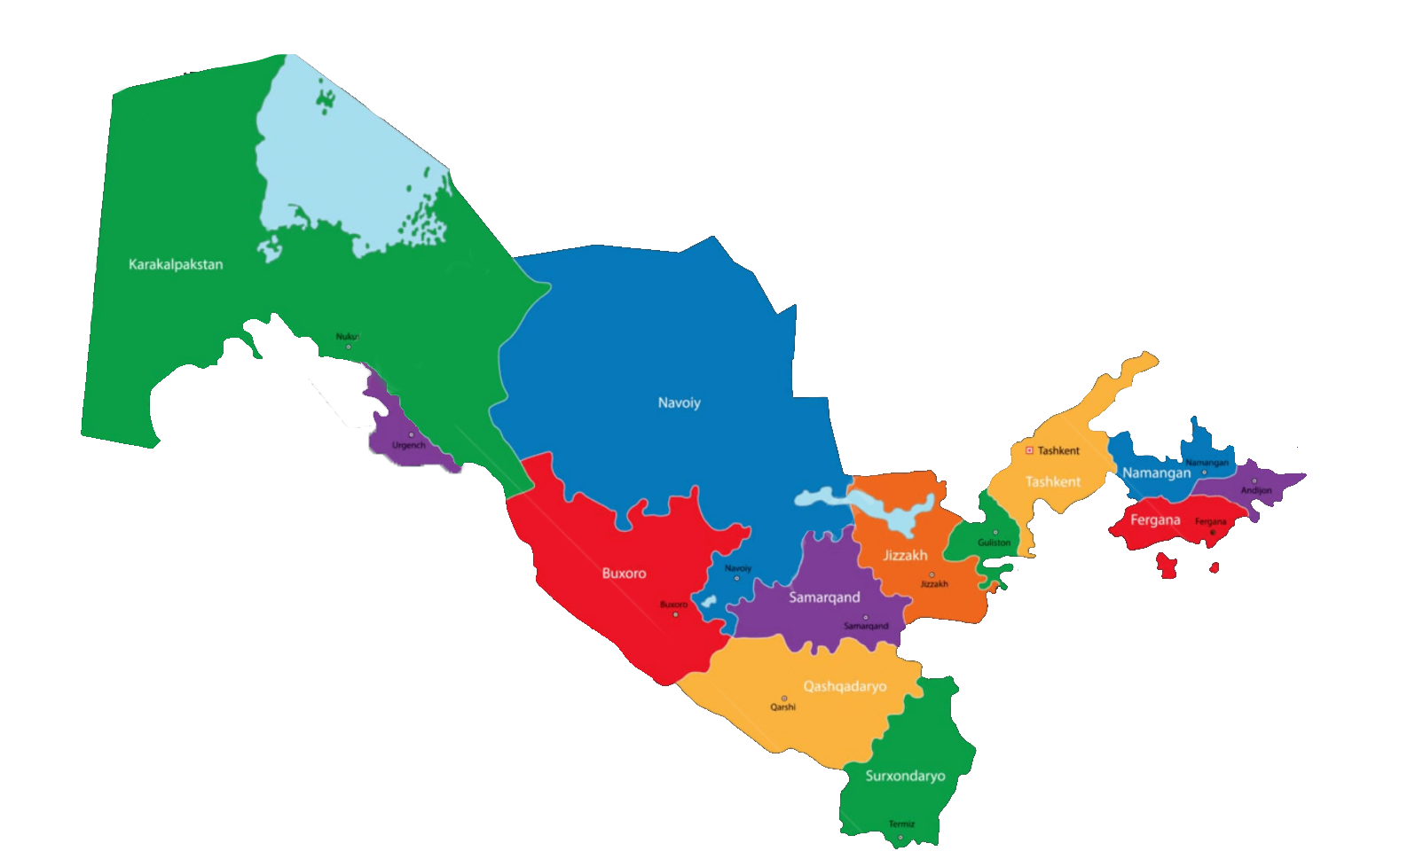


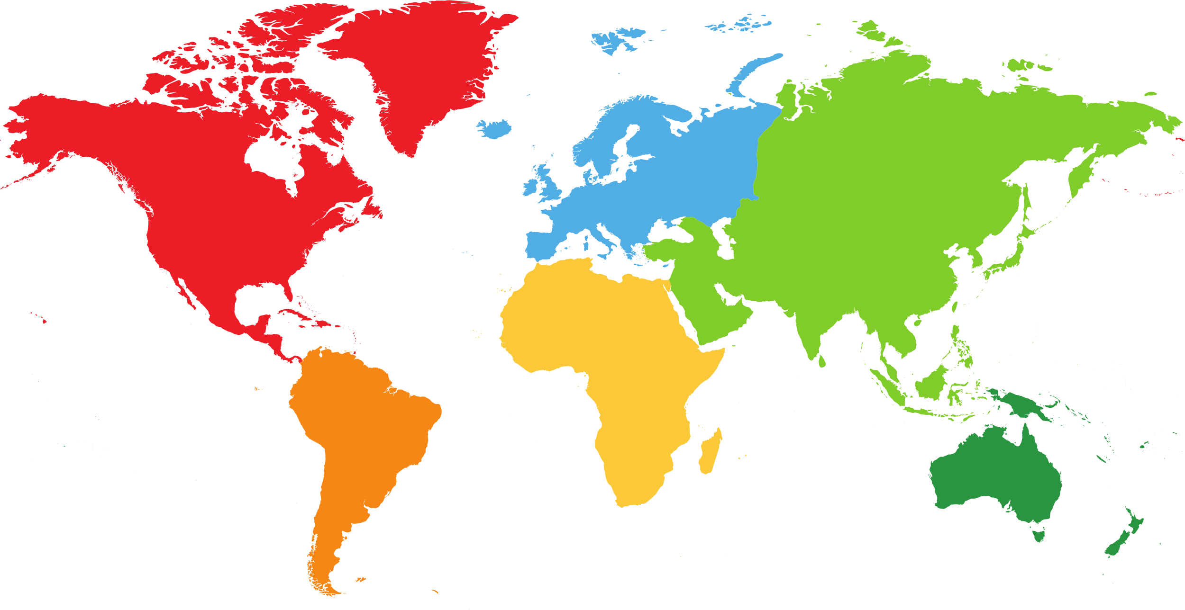














OVERALL INDICATORS
EDUCATIONAL-METHODOLOGICAL SUPPORT
BASIC INDICATORS
THE CONTENT AND SCIENTIFIC POTENTIAL OF PROFESSORS AND STUDENTS
The number of faculties
3
26
14
3,6%
Methodological manual
Textbook
The number of departments
16 ta
42,6%
Scientific potential
The total number of teachers
281
Bachelor’s degree specialties
28 ta
39,5%
Doctors of science (DSc)
10
Monography
56,9%
Doctors of philosophy (PhD)
111
Master’s degree specialties
13 ta
Education guidance
Teachers without scientific degree
160
62
55
3,55%
37
148
133
3,55%
Average age
Doctors of science, DSc
52,67%
47,33%
STUDENTS’ CONTINGENCY ACCORDING TO REGIONS
39,5%
Doctors of philosophy PhD
Scientific potential
39,5%
42,6%
7
UNIVERSITY’S INTERNATIONAL PARTNERSHIP RELATIONS
13
9
126
47
38
63
15
32
29
Kazakhstan
Turkey
THE TOTAL NUMBER OF STUDENTS
20
23684
50
MASTERS
467
Tajikistan
BACHELORS
23217
66
Russia
BOYS
7475
22702
GIRLS
16209
Tajikistan
Japany
Chine
India
Czechia

Slide 6





STRATEGY FOR DEVELOPMENT OF EDUCATIONAL AND METHODOLOGICAL SUPPORT
ORGANIZATION OF CONTINUOUS PROFESSIONAL DEVELOPMENT OF STAFF
IMPLEMENTATION OF A NEW MODEL OF PEDAGOGICAL EDUCATION AND SCIENTIFIC DIRECTIONS
Advanced training courses abroad for basic professional competencies of teaching staff
Develop and launch a "Young Personnel Reserve" program (competitive grants, projects, retraining, internships, research assistance packages, etc.)
Assessing the
outcome of the
educational
process based
on the level of
practical
skills and
professional competence
To teach students to independently acquire knowledge and propose innovations in the classroom
Working on
real-world
issues in
training
sessions
Working on
real-world
issues in
training
sessions
DEVELOPMENT OF THE ACTIVITIES OF THE "LANGUAGE CENTER" AT THE UNIVERSITY
Advance delivery of learning materials
Engish
Russan
METHODOLOGICAL AND TECHNICAL SUPPORT
German
Turkish
 | Year | Amount (mln., soums)
 | 2022
 | 2026
Financing
CONTINUOUS ATTRACTION OF PROFESSORS AND STUDENTS TO THE LANGUAGE CENTER
Measures
"Professor Teacher Rating" at the end of the academic year
Encouragement of students with certificates (Foreign internship)
Providing the information resource center with a modern bibliographic information system
Establishment of a university printing house
Expanding other foreign language courses (Chinese, Japanese, Korean, Spanish, French)
SELECTION OF TALENTS. WORKING WITH SCHOOL
Establishing a language proficiency level and issuing a certificate
Literature and Mother tongue
TUES Olympiad
Biology
Chemistry
Mathematics
Physics
Computer science
English
Russian
Starting from the 2023-2024 academic year
The Olympiad will cover all schools in Surkhandarya region
Educational-methodological, pedagogical support.
Implementation of training seminars for students of regional
schools

Slide 7

COMPETITIVENESS IN THE INTERNATIONAL EDUCATION MARKET
Units for Internationalization and Transformation of the University
International Relations and Academic mobility
Innovation in Education and Digital Transformation Center
International Certification and Qualification Center
Centre for Language and Culture
Ratings and Management Office
Strategic Development Monitoring Department
International Summer Schools
INCREASING INTERNATIONAL SCIENTIFIC PUBLICATIONS
EXTERNAL AND INTERNAL INTERNATIONALIZATION
Overseas and Fields to undergo International Accreditation( Total)
№ |  | 2025 | 2026 | 2027 | 2028 | 2029 | 2030
1 | Professional Development abroad(teachers/staff) | 20 | 30 | 45 | 60 | 70 | 80
2 | Professional development abroad (students) | 50 | 100 | 200 | 250 | 300 | 400
3 | Seminar- training courses (for teachers) | 25 | 25 | 25 | 25 | 25 | 25
4 | Seminar- training courses (for students) | 25 | 30 | 30 | 35 | 35 | 35
Indexing of University Journals in International Scientific Databases
Establishment of a University Scientific Proofreading Center

Slide 8



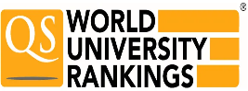


**COMPETITIVENESS IN THE INTERNATIONAL EDUCATION MARKET**
**ENSURING THE INTEGRATION OF EDUCATION, SCIENCE, INNOVATION, AND SCIENTIFIC RESEARCH & SUPPORTING YOUTH SCIENTIFIC ACTIVITIES*
Here is the translation of your text into English:
**ESTABLISHING JOINT SCIENTIFIC LABORATORIES IN PRODUCTION**
- Regional Medicinal Plants Research Laboratory (2027)
- Establishment of Sultan Hospital Modern Diagnostic Center (2026)
**INTERFEDERAL SCIENTIFIC LABORATORIES OPENING**
- Pharmacology Research Laboratory (2026-2030)
- Natural Sciences Research Laboratory (2026-2030)
- Software and Artificial Intelligence Laboratory (2027-2030)
- Regional Research Center (2026-2030)
**ESTABLISHING AN INNOVATIVE STARTUP AND TECHNOLOGY TRANSFER CENTER FOR TALENTED STUDENTS AND YOUNG SCIENTISTS** (2027)
**INCREASE THE UNIVERSITY'S SCIENTIFIC CAPACITY TO 75%**
IMPLEMENTATION OF MODERN EDUCATIONAL TECHNOLOGIES AND DIRECTIONS
"MODERN TEACHER" QUALIFICATION IMPROVEMENT PROGRAMS
Expanding the use of AI and digital pedagogy tools in education.
**EXPANDING DIGITAL EDUCATION PLATFORMS**
Placing all lesson materials on an online platform through the "Smart Campus" system.
Developing adaptive learning materials for virtual reality based on AR/VR technologies.
**TRANSITION TO INTERNATIONAL EDUCATION STANDARDS**
- Implementing "Double Degree" joint programs with prestigious universities worldwide.
- Expanding student exchange programs within the framework of academic mobility and sending them to prestigious universities for qualification improvement.
Organizing training courses to help students obtain international certifications.
**PROMOTING INNOVATIVE PEDAGOGICAL METHODS AND ESTABLISHING A "EDUCATIONAL INNOVATIONS" CENTER AT THE UNIVERSITY**
DEVELOPING THE MATERIAL-TECHNICAL BASE Current Educational
Area of the University 3 educational buildings148 classrooms with a total capacity of 24,000 seats
NEWLY BUILT EDUCATIONAL BUILDINGS Construction of a modern 5,000-seat educational building (2028)
IN EXISTING EDUCATIONAL BUILDINGS:
"Smart Campus" project (Equipping all buildings with a digital management system) 2027-2030Green Campus project (Expanding solar panel energy production)
CONSTRUCTION OF A 2,000-SEAT STUDENT DORMITORY (2025-2026)
CONSTRUCTION OF 68 APARTMENTS FOR UNIVERSITY PROFESSORS AND TEACHERS (2026-2027)
CREATING TREES, FLOWER GARDENS, AND REST AREAS ON CAMPUS.ENSURING AN ECOLOGICALLY CLEAN ENVIRONMENT (2025-2030)
 | Information Technology | Economic | Biology
Medicine | History | Education | Psychology
2027 | 2028 | 2029 | 2030
 | 1000+ | 800+ | 600+
 | 1200+ | 1000+ | 800+
 | 1000+ | 800+ | 600+
 | 1000+ | 800+ | 600+
Rating categories | 2026 | 2028 | 2023

