Slide 1
FINAL PROJECT · VIBE CODING CEDIA 2026
Interactive Subnetting and VLSM Tutor
Guided IP addressing practice for networking students
Wilson Fernando Guerrero Álvarez · UTE · Engineering Sciences and Industries
Tuesman Daniel Castillo Calvas · UTPL · Engineering and Architecture
Project guide 18 · Interactive learning activity or simulation
Narration generated with an AI voice (ElevenLabs) and reviewed by the authors.
Vibe Coding CEDIA 2026 · Universidad UTE · UTPL
1 / 10
Notes:
COVER
We present the Interactive Subnetting and V L S M Tutor.
We are Wilson Guerrero and Tuesman Castillo, from U T E and U T P L in Ecuador.
It helps students understand I P addressing through guided practice.

Slide 2
FINAL PROJECT · VIBE CODING CEDIA 2026
The problem
Students learn subnetting and VLSM as isolated rules, without a model that connects them.
A CONCRETE EXAMPLE
192.168.10.130 /26: why is the network .128?
Vibe Coding CEDIA 2026 · Universidad UTE · UTPL
2 / 10
Notes:
PART A · PRESENTATION (3 min in total)
In our networking courses we see the same problem every semester.
Students learn subnetting and V L S M as a list of isolated rules and calculations.
They memorize steps but do not connect binary, the prefix, the mask, the network and the broadcast.
Here is a simple example.
An address ends in one hundred thirty with a slash twenty six prefix.
Many students cannot explain why the network ends in one hundred twenty eight.
Without that mental model, allocating subnets of different sizes becomes trial and error.

Slide 3
FINAL PROJECT · VIBE CODING CEDIA 2026
The tool
WHO USES IT
WHAT GOES IN
WHAT COMES OUT
Networking students and instructors
Base network, prefix and hosts
Table, map and explained steps
Vibe Coding CEDIA 2026 · Universidad UTE · UTPL
3 / 10
Notes:
THE TOOL · NARRATION · ≈30 s · 70–80 words
The tutor is designed for networking students and their teachers.
It follows project guide eighteen of the course, interactive learning activity or simulation.
The student enters a base network, the prefix and the number of hosts each subnet needs.
The tutor returns the addressing table and a visual map of the allocated space.
It also explains every result step by step, with hints and immediate feedback.
It runs as a web page in any browser.

Slide 4
FINAL PROJECT · VIBE CODING CEDIA 2026
How it works
1 · INPUT
2 · AI
3 · REVIEW
4 · RESULT
Network, prefix and hosts
Claude coded our rules
We verified by hand
Table and feedback
The instructor always decides.
Vibe Coding CEDIA 2026 · Universidad UTE · UTPL
4 / 10
Notes:
HOW IT WORKS · NARRATION · ≈40 s · 95–105 words
The tutor has three parts.
In Concepts, a bit explorer shows live how the network and the broadcast change when the prefix moves.
In the Calculator, the student solves subnetting and V L S M cases with a step by step explanation.
In Practice, the student solves exercises at three levels of difficulty and gets feedback on every field.
A I was part of the build.
Claude wrote the code from the procedure and the examples that we provided.
We then checked every calculation by hand.
Teachers always decide what is taught and how it is assessed.

Slide 5
FINAL PROJECT · VIBE CODING CEDIA 2026
Evidence that it works
10/10
50/50
8/8
exercises match the manual calculation
cases in the automated check
correct answers from two students
Reference: Python ipaddress. Small pilot.
Vibe Coding CEDIA 2026 · Universidad UTE · UTPL
5 / 10
Notes:
EVIDENCE · NARRATION · ≈35 s · 80–90 words
We tested the tutor in three ways.
Each of us solved five exercises by hand, and all ten matched the tutor.
Then an automated check compared fifty cases against an independent calculation with the standard library of Python.
All fifty matched.
Finally in a pilot session two students solved eight exercises with the tutor and got all eight right.
This is a small pilot and it does not allow us to generalize.
The review also found three feedback errors that we have already fixed.

Slide 6
FINAL PROJECT · VIBE CODING CEDIA 2026
Limits and responsible use
WHAT IT DOES NOT DO
DATA AND PRIVACY
NEXT STEP
Does not replace assessment
No data leaves the browser
Assessment in Canvas
Vibe Coding CEDIA 2026 · Universidad UTE · UTPL
6 / 10
Notes:
LIMITS AND RESPONSIBLE USE · NARRATION · ≈25 s · 55–65 words
The tutor has clear limits.
It does not replace a formal assessment.
It does not configure devices or design a complete network.
Outside a S C O R M package it does not send grades to Canvas.
No data leaves the browser.
The next step is to add an assessment in Canvas and then connect student progress to the L M S.

Slide 7
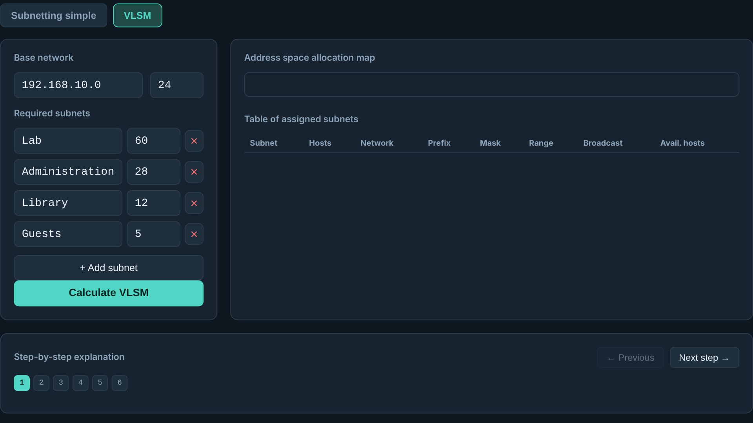
FINAL PROJECT · VIBE CODING CEDIA 2026
Demo · Input
VLSM calculator: network 192.168.10.0/24 and four sample subnets
Vibe Coding CEDIA 2026 · Universidad UTE · UTPL
7 / 10
Notes:
PART B · DEMO (2 min in total)
Now let us see the tutor on screen.
This is the V L S M calculator.
The student types the base network and the prefix, in this case slash twenty four.
Then the student adds the required subnets.
Lab with sixty hosts, Administration with twenty eight, Library with twelve and Guests with five.
These are sample data, not real network records.
When the student presses Calculate, the tutor does the rest.

Slide 8
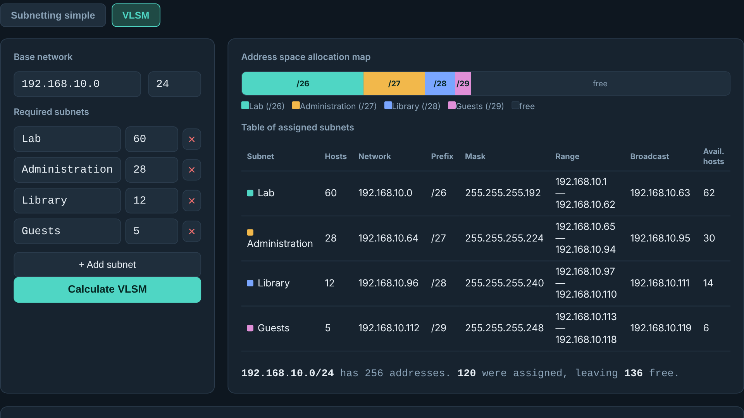
FINAL PROJECT · VIBE CODING CEDIA 2026
Demo · Result
Map and table: 120 addresses allocated and 136 free
Vibe Coding CEDIA 2026 · Universidad UTE · UTPL
8 / 10
Notes:
NARRATION · ≈35 s · 80–90 words in English
This is the main result.
At the top, the map shows how the address space is divided and how much remains free.
Below it, the table gives the network, prefix, mask, range and broadcast for each subnet.
The tutor allocated Lab first because it is the largest subnet.
It received a slash twenty six.
That way the space does not fragment.
Out of two hundred fifty six addresses, one hundred twenty were used and one hundred thirty six remain free.

Slide 9
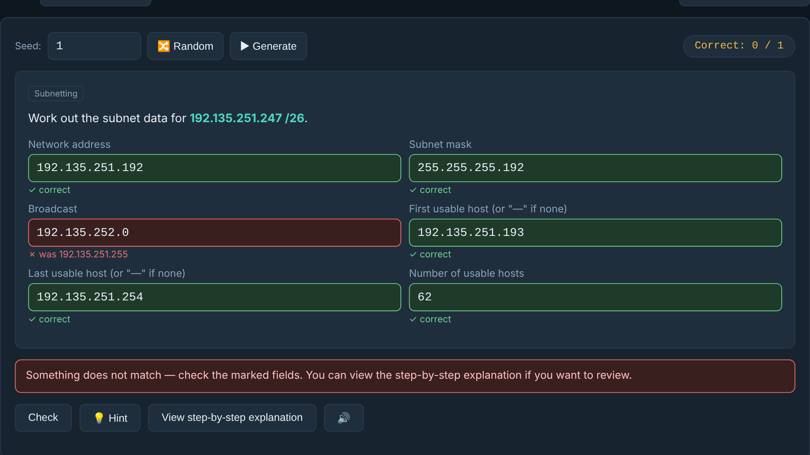
FINAL PROJECT · VIBE CODING CEDIA 2026
Demo · Review and delivery
Practice: field-by-field feedback with the expected value
Vibe Coding CEDIA 2026 · Universidad UTE · UTPL
9 / 10
Notes:
NARRATION · ≈30 s · 70–80 words in English
Here is the review and feedback step.
In Practice the student solves an exercise and presses Check.
Each correct field turns green.
A wrong field turns red and shows the expected value.
In this case the broadcast was wrong.
The student can ask for a hint or open the step by step explanation.
A seed number lets the student repeat exactly the same exercise later and review it with the teacher.

Slide 10
FINAL PROJECT · VIBE CODING CEDIA 2026
Practice at your own pace, understand every calculation
Next step: assessment in Canvas.
tuesman.github.io/tutor-vlsm
Wilson Guerrero Álvarez (UTE) · Tuesman Castillo Calvas (UTPL)
Vibe Coding CEDIA 2026 · Universidad UTE · UTPL
10 / 10
Notes:
CLOSE · NARRATION · ≈25 s · 55–65 words
With this tutor, students practice at their own pace and see how each calculation works.
As teachers, we hope to spend less time correcting arithmetic and more time discussing network design.
The next step is to connect it with an assessment in Canvas.
We invite you to try it at the link on screen.
Thank you for your attention.

