Slide 1
Rental Bike Prediction

Slide 2
Objective :
The objective it to predict the number of bike will be ranted in a given day by providing some features about the day.
Benefits:
1) Able to make prediction of the numbers of bike ranted so the organization can plan ahead.
2)Can see if the company is need upscaling or not .

Slide 3
Data Sharing Agreement
Sample file name
Number of columns
Columns datatype
Columns name
Length of data stamp
Length of time stamp

Slide 4
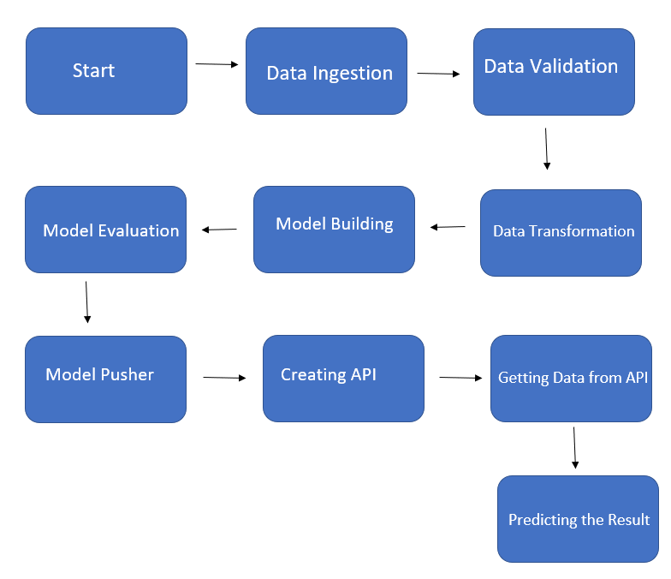
Architecture

Slide 5
Data Validation and Data Transformation
Name of Columns : The name of columns of should be validated and should be same as per the schema
Number of Columns : The number of columns should be same.
Distribution : The data should have the same distribution as original data that the model was trained with.
Same Data Type : All columns should have the same data type as original data had.
Missing values : Missing values should be removed with the same criteria used in the original data.
Categorical columns : All categorical columns should be handled.
Split : Split the data into train and test data.

Slide 6
Model Training
The accumulated data should be exported to a csv format.
The data is pre-processed. i.e. handling the outliers, handling the missing values, dropping not required columns, handling the categorical columns.
The data is split into train and test files.
Selecting the correct model.
Training the model with train data.
Evaluating the model with test data.

Slide 7
Prediction
Test data is used form prediction.
Same pre-processing technique is used in test data as used in train data.
Model is given in test data for prediction.
Ones the prediction is done the result is saved.

