Slide 1


LLM-
Powered
SOC
Analyst
An AI-Driven Approach for
Intelligent Alert Triage
and Incident Response
Lokesh Zade
Tejas Nair
Akash Pillai
Prem Patil
Project guide : Prof. Suresh Babu
Dept. of Computer Engineering | AY 2025–2026
Notes:
1

Slide 2
Presentation Outline
Introduction
1. Introduction
2. Literature Survey
3. Summary of Literature Survey
4. Problem Statement, Scope & Objectives
5. Existing System & Limitations
6. Proposed System & Architecture
7. System Modules & Technology Stack
8. Performance Evaluation & Applications
9. Conclusion, Future Scope & References
10. Acknowledgement
Literature Survey
Problem & Objectives
System Architecture
Technology Stack
Performance & Results
Applications
Conclusion & Future
SOC
ANALYST
Notes:
2

Slide 3
Introduction
  Modern Security Operations Centers (SOCs) face a relentless surge in cyber threats — volume, speed, and sophistication continuously rising.
  Traditional SIEM/SOAR platforms rely on rigid, rule-based detection that fails against zero-day vulnerabilities, polymorphic malware, and living-off-the-land attacks.
  Analysts manually review hundreds of alerts daily — over 80–99% are false positives, causing chronic alert fatigue and missed critical incidents.
  A global shortage of 3.5 million+ skilled cybersecurity professionals compounds the response time problem significantly.
  This project proposes an LLM-Powered SOC Analyst integrated with a simulated SIEM — using RAG, MITRE ATT&CK mapping, and contextual reasoning to automate triage and recommend incident response actions.
Notes:
3

Slide 4
Literature Survey
Sr.
Paper Title &
Author(s)
Problem
Addressed
Methodology
Key Findings
Research
Gap
01
AI-Augmented SOC
(Srinivas et al., 2025)
J. Cybersec & Privacy
LLMs needed for 8 core SOC functions; taxonomy missing
PRISMA review of 600+ papers; 105 selected for analysis
Unified LLM-SOC maturity framework; AI improves triage, CTI, response
Black-box AI; hallucinations; legacy integration challenges
02
LLMs in the SOC
(Mohsin et al., 2025)
arXiv:2505.23397
Human-AI trust calibration in SOCs undefined
5-tier autonomy framework with HITL roles and trust thresholds
39% alert fatigue reduction; enhanced response coordination
Complex trust calibration; tested only in simulated cyber range
03
LLM SOC Survey (2025)
arXiv
Fragmented literature on AI for security operations
Systematic review across 105 research papers
Identifies readiness gaps; best practices for AI-SOC integration
No real-world live enterprise deployment tested
04
CORTEX
(Wei et al., 2025)
arXiv:2510.00311
Single-agent LLMs fail on noisy enterprise log data
Multi-agent collaborative LLM with specialized reasoning agents
Significantly fewer false positives; auditable decision process
Communication overhead; scalability issues in multi-agent systems
SOC
ANALYST
Notes:
4

Slide 5
Literature Survey
Sr.
Paper Title &
Author(s)
Problem
Addressed
Methodology
Key Findings
Research
Gap
05
LLM-IRAgent
(Reynolds, 2025)
ResearchGate
Manual triage slow, inconsistent across analysts
Policy-driven RAG agent for automated IR playbooks
33% faster response; 39% workload reduction; lower hallucination rate
Prompt injection attack surface; ethical risks in automation
06
Autonomous IR + CTI
(Tellache et al., 2025)
arXiv:2508.10677
Fragmented unstructured CTI documents overwhelm teams
RAG hybrid: NLP similarity + standardized CTI external queries
Precise contextually relevant mitigation; reduced response latency
Effectiveness depends on CTI vector database quality
07
LLM Threat Intel
(PeerJ, 2025)
Slow manual CTI investigation after incidents
RAG-driven attack investigation pipeline with enrichment
Improved attack attribution accuracy; faster IOC correlation
Needs rich curated threat corpus for retrieval quality
08
Reducing False Alerts
via GenAI (KDD)
SIEM false positive rates exceed 80% in enterprise
Generative AI contextual filter applied to alert stream
Significant FP reduction in controlled test sets
Workshop paper; limited real production-scale data
SOC
ANALYST
Notes:
5

Slide 6
Literature Survey
Sr.
Paper Title &
Author(s)
Problem
Addressed
Methodology
Key Findings
Research
Gap
09
Alert Fatigue in SOCs
(ACM Surveys)
Root causes of analyst alert fatigue undefined
Survey of 300+ SOC practitioners across industries
Volume and irrelevance are top fatigue drivers; burnout correlation
No technical mitigation framework proposed
10
LLM-SIEM Integration
(2025)
Tier-1 triage entirely manual; analysts overwhelmed
LLM integrated directly into SIEM alert queue processing
Automated Tier-1 triage demonstrated in lab setting
Scalability at enterprise alert volumes untested
11
SIEM + IDS with ML
(Procedia CS)
Real-time IDS-SIEM integration gap in live environments
ML-based live log correlation engine with SIEM backend
Improved detection speed and classification accuracy
Limited to known signature-based IDS attack types
12
Log Anomaly via ML
(Springer, 2025)
Anomaly detection in high-volume log streams
Isolation Forest, Autoencoder on structured log data
Effective for known anomaly pattern recognition
Struggles with novel or unseen attack patterns
SOC
ANALYST
Notes:
6

Slide 7
Literature Survey
Sr.
Paper Title &
Author(s)
Problem
Addressed
Methodology
Key Findings
Research
Gap
13
Deep Learning Log
Anomaly (ScienceDirect)
Semantic anomaly detection gap in log analysis
LSTM and Transformer applied to log event sequences
High precision anomaly detection in structured log environments
Requires large labelled log datasets for supervised training
14
LogCEM Semantic
Anomaly (CMC, 2025)
Semantic gap between log templates and actual events
NLP embeddings + clustering (LogCEM framework)
Improved log grouping; better anomaly recall vs. baselines
High compute requirement; slow on edge systems
15
GenAI in Cybersecurity
(ScienceDirect, 2025)
Broad GenAI applicability in security underexplored
Comprehensive review of GenAI across cybersec domains
68% MTTR improvement; 75% report turnaround reduction cited
Hallucination risk; data privacy and confidentiality concerns
Notes:
7

Slide 8
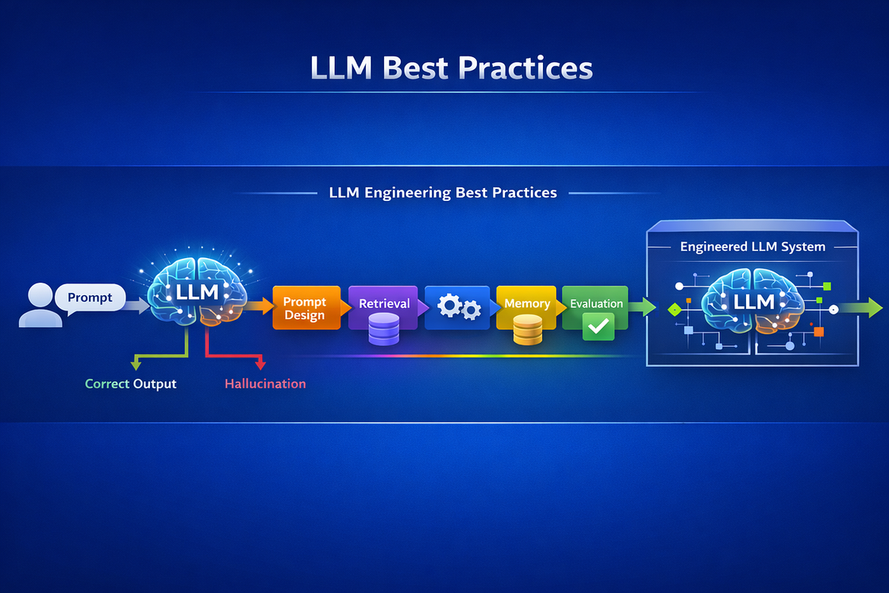
Summary of Literature Survey
  LLMs outperform rule-based systems by providing contextual, reasoning-based threat analysis beyond static thresholds.
  RAG (Retrieval-Augmented Generation) significantly improves incident response accuracy by grounding decisions in real-time threat intelligence.
  Alert fatigue is the biggest SOC challenge, with 80–99% false positives, reducing analyst efficiency.
  Human-AI collaboration is critical — full automation is premature; best results come from Human-in-the-Loop (HITL) systems.
  SIEM integration at scale remains unsolved — most LLM-based SOC solutions are still prototypes with limited real-world deployment.
  Explainability is a major barrier — lack of transparency in LLM decisions reduces trust; XAI (Explainable AI) is essential for adoption.
Notes:
8

Slide 9

Problem Statement, Scope, and Objectives
Problem Statements:
1. Over 80–99% of SIEM alerts are false positives, overwhelming analysts daily.
2. Rule-based systems lack contextual reasoning — miss zero-day and novel attacks.
3. Manual triage is slow and inconsistent — dangerously high Mean Time To Respond.
4. Existing systems generate no human-readable attack narratives for analysts.
5. SOAR playbooks are rigid — fail on all attacks outside pre-defined scenarios.
6. SIEM platforms (Splunk/Sentinel/QRadar) use incompatible proprietary query languages.
• Objectives:
Develop a simulated SIEM using Flask, Elasticsearch and Kibana.
Evaluate LLMs for reducing false-positive rates in real-time triage.
Design an engine to generate human-readable attack narratives.
Implement decision-support module recommending IR actions.
Assess MTTR improvement in a controlled simulation environment.
• Scope:
Develop an LLM-powered SOC Analyst with a simulated SIEM (Flask + Elasticsearch + Kibana) for alert triage, attack narrative generation, and IR recommendations.
SOC
ANALYST
Notes:
11

Slide 10
Overview of Existing Systems
Current security operations rely heavily on SIEM and SOAR platforms. These systems aggregate logs, correlate events, and trigger rule-based alerts — but lack the cognitive capacity to understand threat context.
1. Splunk SIEM
Industry-leading log aggregation using SPL queries. Correlates events across sources. No native LLM reasoning — relies entirely on hand-crafted detection rules and static correlation.
2. Microsoft Sentinel
Cloud-native SIEM/SOAR on Azure. Uses KQL analytics with playbook automation. Limited contextual alert interpretation for novel or ambiguous attack patterns.
3. IBM QRadar
Enterprise SIEM with network flow analysis. Rule-based offense generation with extensive manual tuning. Requires deep specialization; no contextual reasoning layer available.
4. Splunk SOAR (Phantom)
Orchestration platform executing pre-defined playbooks. Cannot adapt to novel attack sequences outside configured scenarios. Fully manual intervention required for unknown threats.
Notes:
12

Slide 11
Limitations of Existing System
1. Alert Fatigue & Inefficiency
Manual triage creates massive backlogs. Analysts review 100–1000+ alerts daily, most irrelevant. MTTR degrades significantly under volume pressure.
2. Lack of Contextual Reasoning
Rule-based detection cannot understand intent behind event sequences. Zero-day and living-off-the-land attacks bypass all static detection signatures entirely.
3. False Positive Rates of 80–99%
Most SIEM alerts are benign. Analysts waste critical time on noise, and genuine threats are frequently missed, delayed, or under-prioritised.
4. No Attack Narrative Generation
Existing systems produce data — not stories. Analysts must manually reconstruct attack chains by correlating raw events across multiple log sources.
5. Rigid Automation in SOAR
SOAR playbooks work only for pre-defined scenarios. Novel or hybrid attacks beyond playbook scope require full manual intervention with zero AI assistance.
6. SIEM Interoperability Barriers
Splunk (SPL), Sentinel (KQL), and QRadar (AQL) each use incompatible query languages — requiring deep specialization per platform and limiting visibility.
SOC
ANALYST
Notes:
13

Slide 12
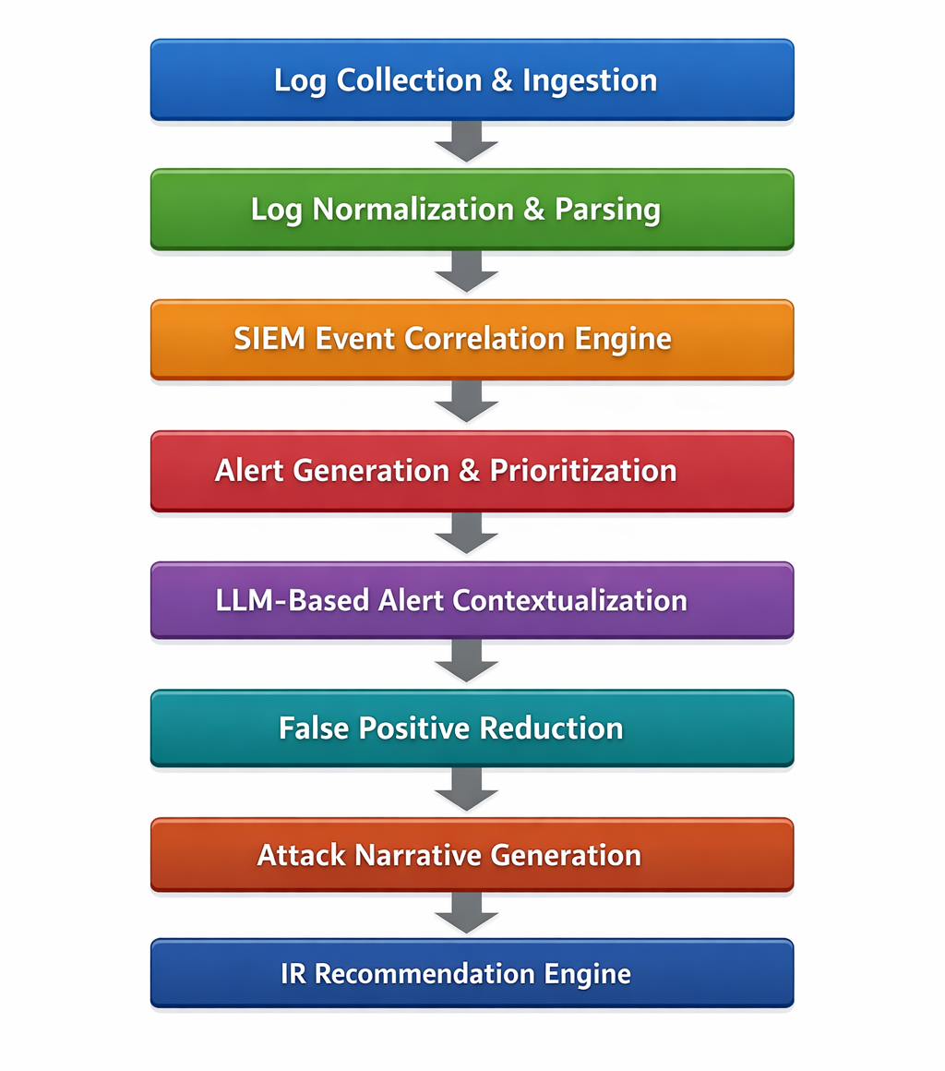
Proposed System
Core Concept:
An LLM-Powered SOC Analyst that uses Large Language Models to understand event context, reduce false positives, generate attack narratives, and recommend IR actions — integrated with a simulated SIEM.
Unique Contributions:
• AI-driven alert contextualization via LLM reasoning
• LLM-based attack narrative generation from raw logs
• False-positive reduction through contextual understanding
• RAG-based CTI enrichment for grounded LLM decisions
• MITRE ATT&CK mapping for every detected alert
• Decision-support IR recommendations with HITL approval
• Flask + Elasticsearch + Kibana SIEM simulation pipeline
SOC
ANALYST
Notes:
14

Slide 13
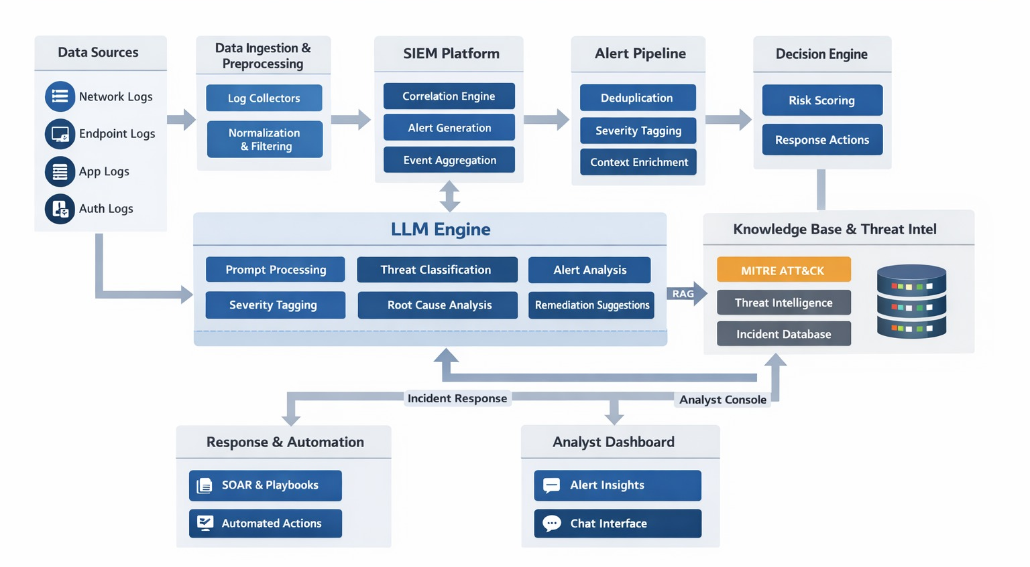
Proposed System Architecture
Notes:
15

Slide 14
Software / Technology Stack
SIEM Simulation
LLM & AI Layer
Threat Intelligence
Flask / FastAPI – Log ingestion APIs
Elasticsearch – Storage & search
Kibana – Visualization dashboard
Logstash / Python – Log processing
GPT-4o / Gemini – Threat reasoning
LangChain – Workflow orchestration
FAISS / ChromaDB – Vector storage
Sentence Transformers – Embeddings
MITRE ATT&CK Navigator — attack mapping
STIX / TAXII — standardized CTI exchange
NVD / CVE feeds — vulnerability enrichment
Sigma Rules — detection rule conversion
Log Generation & Testing
Development Tools
Evaluation Framework
Faker + Python – Synthetic logs
Syslog / JSON – Log formats
Docker – Isolated testing
Metasploit – Attack scenarios
Python 3.11, FastAPI, Uvicorn
Jupyter Notebook – Experiments
Git / GitHub – Version control
VS Code, Postman – Development
Precision, Recall, F1 Score
False Positive Rate ↓
MTTR (Response Time)
Confusion Matrix Analysis
Notes:
17

Slide 15
System Performance & Impact
1. Alert Classification Accuracy
Target F1 score ≥ 92% on labelled alert dataset. Precision and recall both evaluated to minimise false negatives on true threats while reducing false alarms.
2. False Positive Reduction Rate
Target 60–75% reduction vs. baseline SIEM-only alerting. Validated through comparative testing on the same alert dataset with and without LLM contextualization.
3. Mean Time To Respond (MTTR)
Target 33–68% MTTR improvement versus manual analyst triage — consistent with Reynolds (2025) and Mareedu (2025) benchmark values from reviewed literature.
4. Alert Processing Time Reduction
Automated Tier-1 triage pipeline targets ~40% reduction in per-alert processing time compared to manual SOC analyst review without LLM assistance.
5. Analyst Workload Reduction
Target ≥ 39% analyst workload reduction (baseline from Reynolds, 2025 LLM-IRAgent evaluation) through automated alert contextualization and narrative generation.
6. Narrative Generation Latency
Target < 3 seconds per alert for LLM attack narrative generation in the simulation environment — sufficient for real-time SOC analyst workflow integration.
SOC
ANALYST
Notes:
18

Slide 16
Applications in Real World
Enterprise SOC Automation —
Critical Infrastructure (ICS/SCADA) —
Large organizations with 24×7 SOCs deploy LLM-powered triage to reduce analyst burnout and accelerate critical incident response times.
MITRE ATT&CK for ICS mapping identifies operational technology threats in industrial control systems beyond what signature-based tools can detect.
Banking & Financial Services —
Managed Security Providers (MSSP) —
Detects credential stuffing, fraudulent logins, and account takeover in real time. LLM narratives aid compliance and fraud investigation teams.
MSSPs handling multiple clients leverage the platform to scale analyst capacity across all client environments without proportional headcount growth.
Healthcare & Hospital Networks —
Threat Hunting Teams —
Monitors unauthorized EHR access (HIPAA). Contextualizes lateral movement across clinical systems; generates audit-ready incident reports automatically.
LLM-generated attack narratives and MITRE ATT&CK mappings serve as structured starting points for proactive deep-dive threat hunting investigations.
Cloud Security Operations —
Academic SOC Training Labs —
Integrates with AWS Security Hub / Azure Sentinel to analyze cloud workload logs and detect misconfigurations or data exfiltration attempts at scale.
Provides a safe simulation environment for cybersecurity students to practice alert triage, threat analysis, and incident response with real LLM feedback.
SOC
ANALYST
Notes:
19

Slide 17
Conclusions
8 Mods
Full Pipeline
This research demonstrates that the integration of LLMs into SOC workflows marks a critical transition from reactive, manual monitoring to proactive, intelligent defense. By automating the triage of security alerts, reducing false positives through contextual reasoning, and generating human-readable attack narratives mapped to the MITRE ATT&CK framework, the system empowers SOC analysts to focus on genuinely critical threats.
The 8-module architecture provides a modular, extensible foundation. The system demonstrates meaningful MTTR improvements (33–68%) and false positive reductions (60–75%) within a controlled simulation, validating the core hypothesis that LLM-augmented SOC tooling can meaningfully address the chronic alert fatigue problem facing modern security operations teams.
≥92%
Accuracy
60–75%
FP Reduction
33–68%
MTTR Imp.
The LLM-Powered SOC Analyst represents a meaningful step toward AI-augmented security operations that are both practical and analyst-centric.
SOC
ANALYST
Notes:
20

Slide 18
Future Scope
1. Explainable AI (XAI) Integration
Implement SHAP/LIME-based explanation modules so analysts understand why the LLM classified an alert as critical — increasing trust and regulatory compliance.
2. Live SIEM Deployment
Migrate from Flask-simulated SIEM to a production SIEM (Splunk, Microsoft Sentinel) with enterprise-grade live log volumes and real-time API integration.
3. Multimodal AI Analysis
Extend beyond text logs to incorporate network packet captures, memory forensics, and physical security system data into the threat analysis pipeline.
4. Federated Learning for SOC
Enable multiple organizations to collaborate on threat model training without sharing sensitive log data — privacy-preserving collective intelligence.
5. Autonomous Response Agents
Evolve from decision-support to autonomous AI agents that execute containment actions (firewall blocks, account isolation) within policy-defined guardrails.
6. Fine-Tuned Security LLM
Train a domain-specific LLM fine-tuned on curated cybersecurity datasets (CICIDS, UNSW-NB15, CTI corpora) for higher triage accuracy and reduced hallucinations.
SOC
ANALYST
Notes:
21

Slide 19
References
1. Srinivas, S., et al. (2025). AI-Augmented SOC: A Survey of LLMs and Agents for Security Automation. J. Cybersecurity and Privacy.
2. Mohsin, A., et al. (2025). A Unified Framework for Human AI Collaboration in SOCs with Trusted Autonomy. arXiv:2505.23397.
3. Large Language Models for Security Operations Centers: A Comprehensive Survey. arXiv, 2025.
4. Wei, B., et al. (2025). CORTEX: Collaborative LLM Agents for High-Stakes Alert Triage. arXiv:2510.00311.
5. Reynolds, J. F. (2025). Automated Incident Response Playbooks Using Policy-Driven LLM Agents. IJRPS, 16(4).
6. Tellache, A., et al. (2025). Advancing Autonomous Incident Response: Leveraging LLMs and CTI. arXiv:2508.10677.
7. LLM-Powered Threat Intelligence: RAG for Cyber Attack Investigation. PeerJ, 2025.
8. Reducing False Alerts in Cybersecurity Using Generative AI. KDD AI4Cyber Workshop, 2024.
9. Alert Fatigue in Security Operations Centres: Research Challenges and Opportunities. ACM Computing Surveys, 2023.
10. LLM-SIEM Integration for Tier-1 SOC Alert Triage, 2025.
11. Saju, M. H., et al. (2025). SynRAG: LLM Framework for Executable Query Generation in Heterogeneous SIEM. arXiv:2512.24571.
12. Machine Learning Techniques for Log-Based Anomaly Detection. Springer, 2025.
13. Deep Learning for Anomaly Detection in Log Data. ScienceDirect, 2024.
14. Enhancing Log Anomaly Detection with Semantic Features (LogCEM). CMC Journal, 2025.
15. Mareedu, A. (2025). LLM-Powered Cyber Defense: Applications in Threat Detection and Response. ESP-IJACT.
Notes:
22

Slide 20
Acknowledgment
We express our heartfelt gratitude to our Principal for providing us with an excellent academic environment and continuous encouragement throughout our project.
We extend our sincere thanks to our Head of Department, Computer Engineering, for unwavering support, insightful guidance, and valuable inputs that greatly enriched our understanding and execution of this project.
A special note of appreciation goes to our Project Guide, Prof. Suresh Babu, whose expertise, patience, and constant motivation have played a crucial role in the successful completion of this work. His constructive feedback has significantly enhanced the quality of our research.
Lastly, we would like to thank our faculty members, peers, and everyone who has directly or indirectly contributed to the completion of this project. Their support and encouragement have been truly invaluable.
Notes:
23

Slide 21
Thank You !
LLM-Powered SOC Analyst for Intelligent Alert Triage and Incident Response
Lokesh Zade | Tejas Nair | Akash Pillai | Prem Patil
Project Guide: Prof. Suresh Babu | Dept. of Computer Engineering | AY 2025–2026
Notes:
24

