Slide 1
FastQC

Slide 2



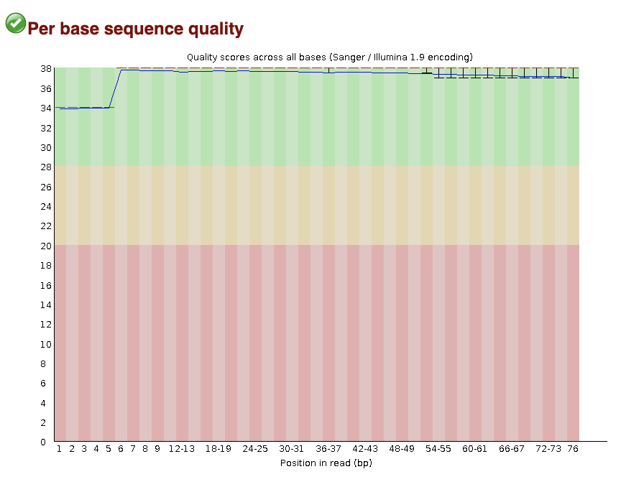
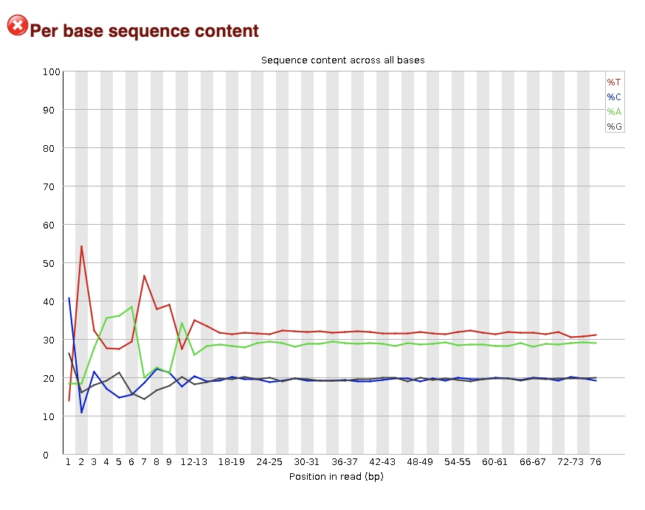
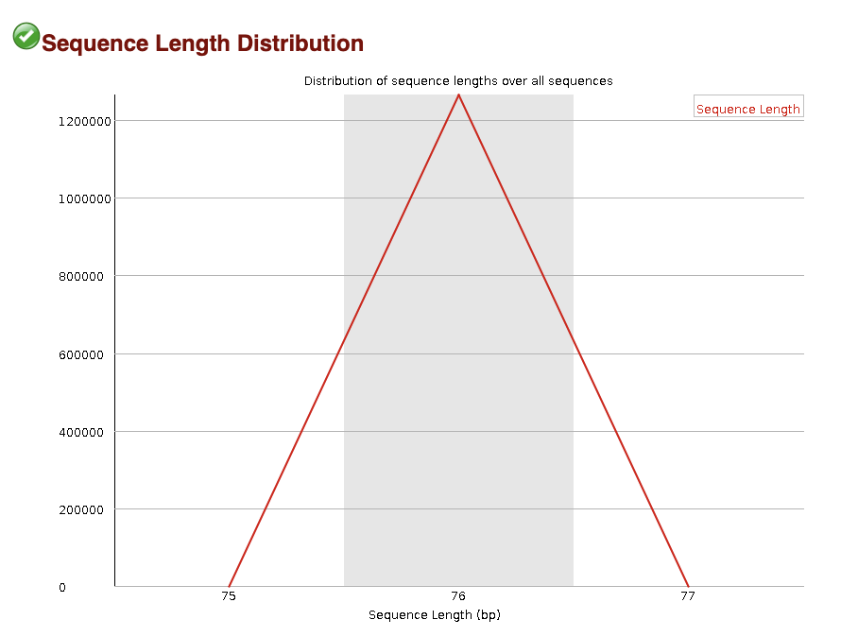

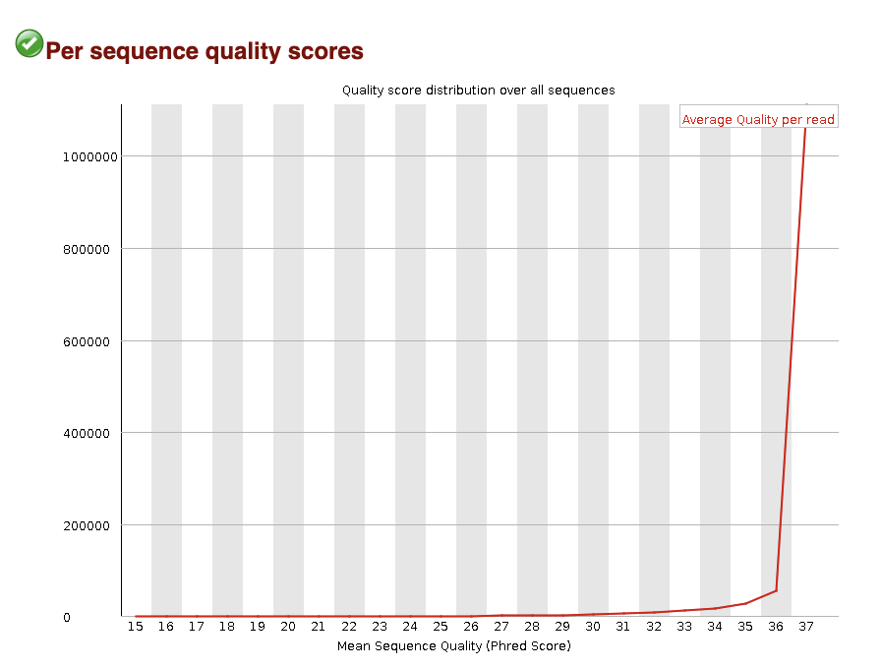

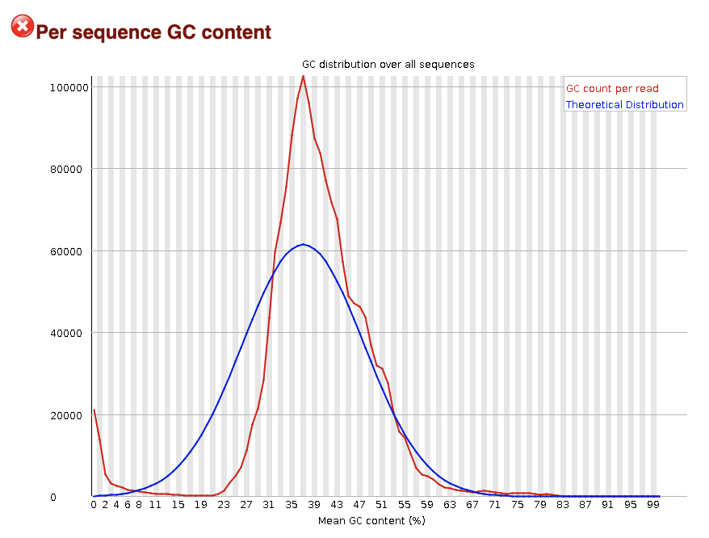

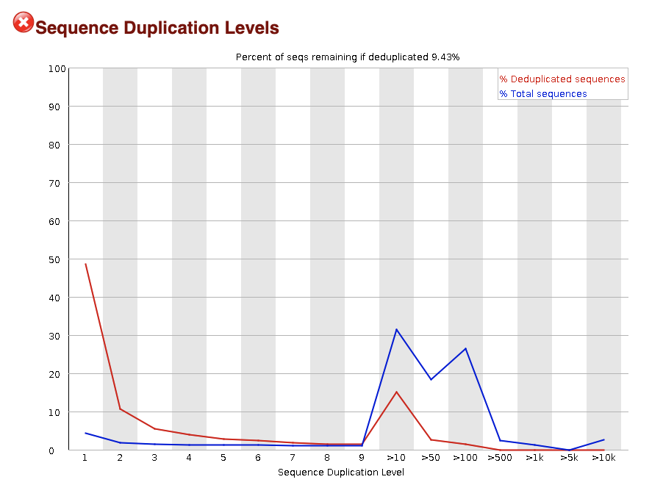

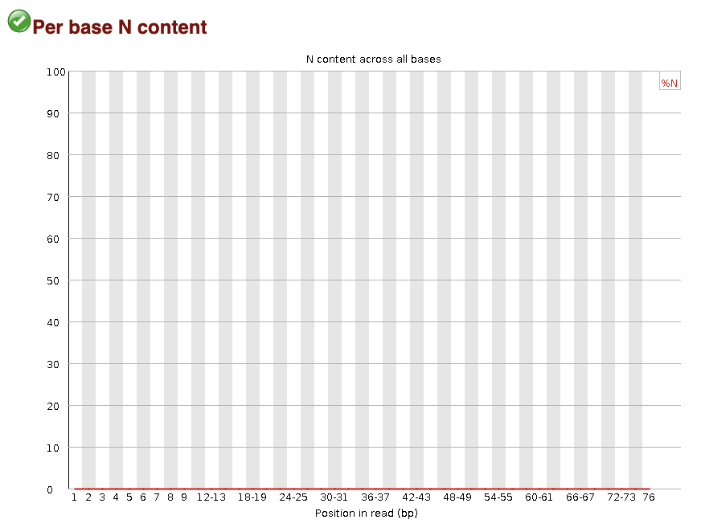
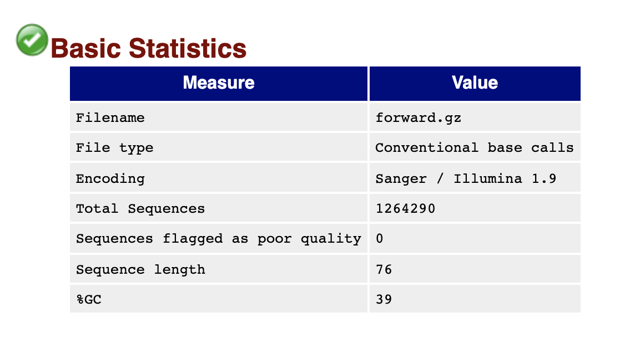
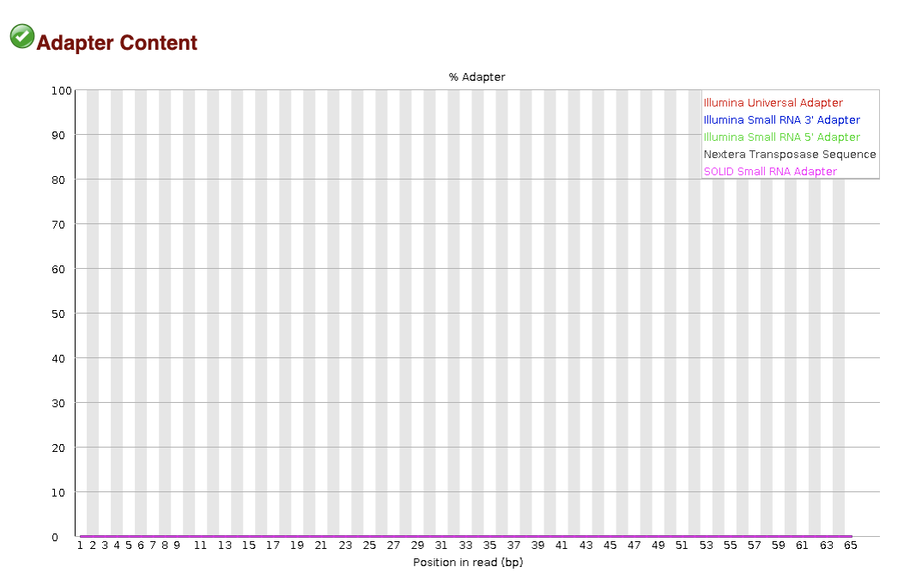

FastQC
Quality
Characteristics

Slide 3
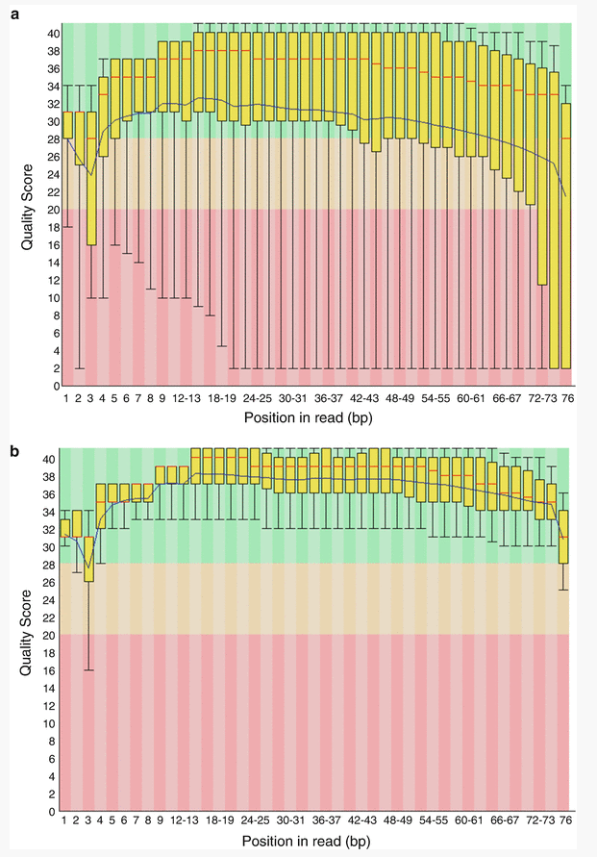
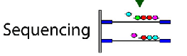
FastQC: Sequence Quality Histogram
Quality Score
Position in read (bp)
Position in read (bp)
GOOD
High quality over the length of the read
BAD
Read quality drops at the beginning and end

Slide 4
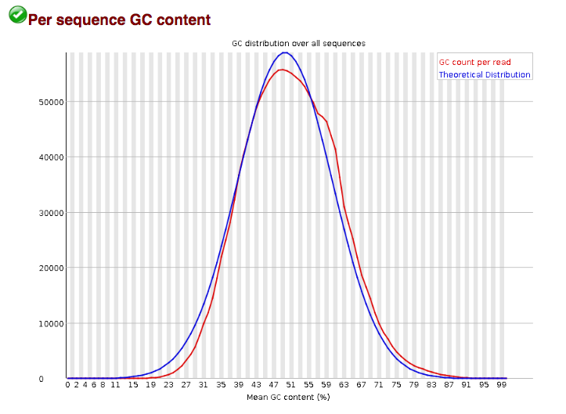
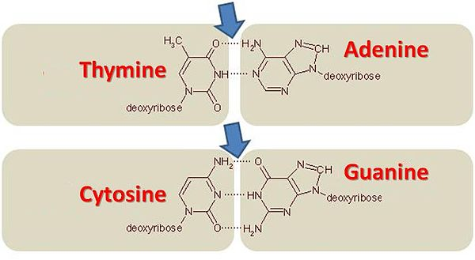
FastQC: Per sequence GC content
Number of Reads
Mean GC content (%)
Notes:
GC-content (or guanine-cytosine content) is the percentage of bases in a DNA or RNA molecule that are either G or C out of an implied four total bases.
The FastQC plot is a histogram of the number of reads on the y axis, and the mean GC % of the reads in that bin.
So this peaks around 50%, so most reads have between 40-60% of GC%

Slide 5
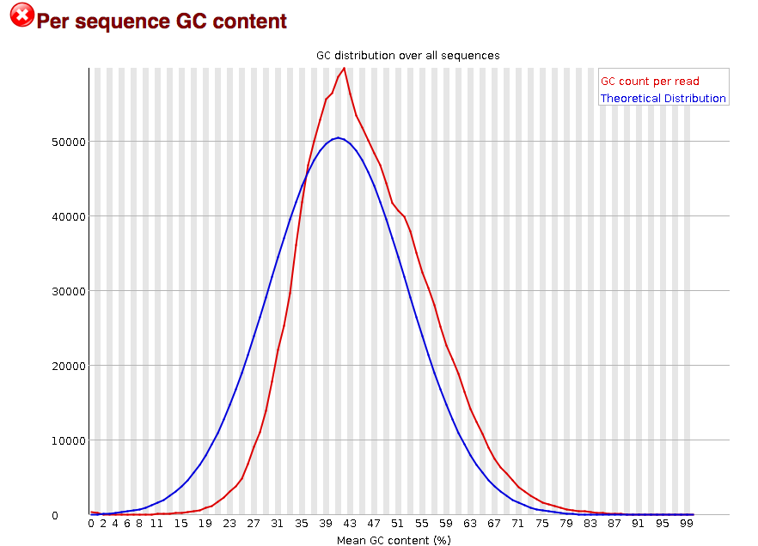
FastQC: Per sequence GC content
Number of Reads
Mean GC content (%)
Mean GC content (%)
Mean GC content (%)
GOOD: follows normal distribution (sum of deviations is < 15% of reads)
BAD: can indicate contamination with adapter dimers, or another species
Notes:
In a normal random library you would expect to see a roughly normal distribution of GC content where the central peak corresponds to the overall GC content of the underlying genome.
Since we don't know the the GC content of the genome, a theoretical distribution (blue) is created based on observed distribution.
An unusually shaped distribution could indicate a contaminated library or some other kinds of biased subset of reads mixed in.
Sharp peaks on an otherwise smooth distribution are normally the result of a specific contaminant (adapter dimers for example), which may well be picked up by the overrepresented sequences module. Broader peaks may represent contamination with a different species.

Slide 6
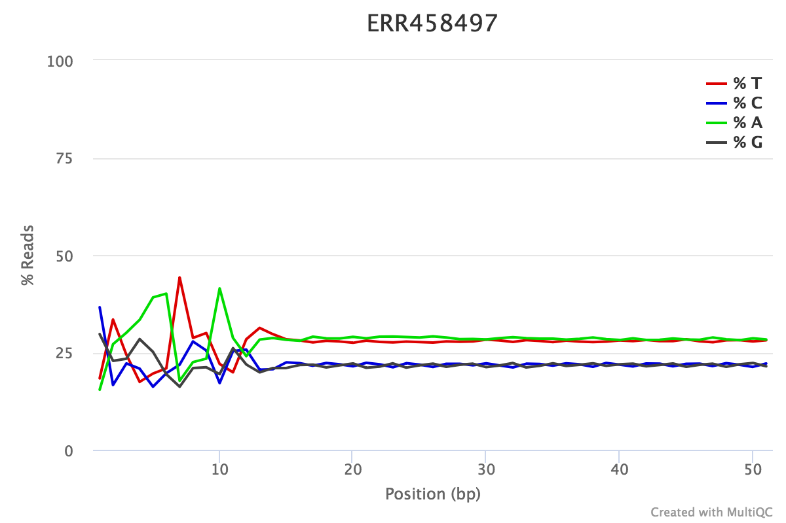
FastQC: Per Base Sequence Content
% Reads
Position (bp)
Proportion of each position for which each DNA base has been called
RNAseq data tends to show a positional sequence bias in the first ~12 bases
The "random" priming step during library construction is not truly random and certain hexamers are more prevalent than others
sequencing.qcfail.com
Notes:
This plot shows the position along the read ( x axis) and the proportion of all reads for which each DNA base has been called (y axis)
RNAseq data tends to show a positional sequence bias in the first ~12 bases
The "random" priming step during library construction is not truly random and certain hexamers are more prevalent than others
Studies have shown that this does NOT cause mis-called bases or drastic bias in sequenced fragments Read quality drops at the beginning and end
This biased distribution is expected for RNAseq

Slide 7
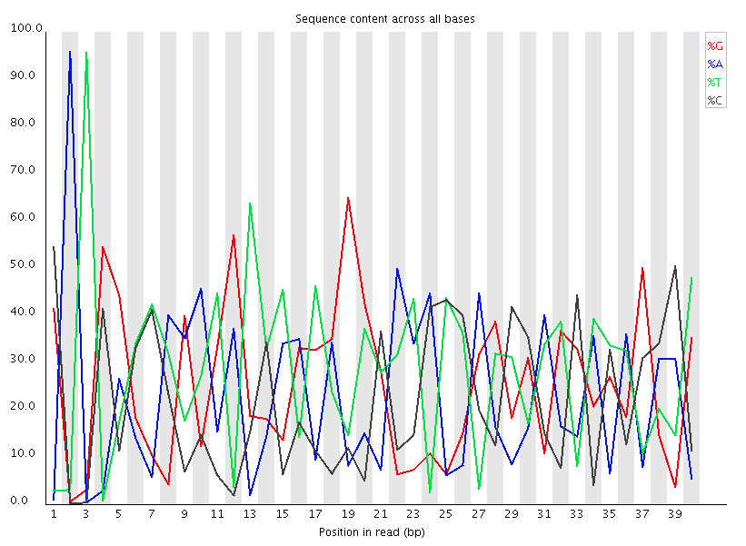
FastQC: Per Base Sequence Content
EXPECTED for RNAseq
BAD:
Shows a strong positional bias throughout the reads, which in this case is due to the library having a certain sequence that is overrepresented
Notes:
Could be adapter-dimer contamination or other

Slide 8
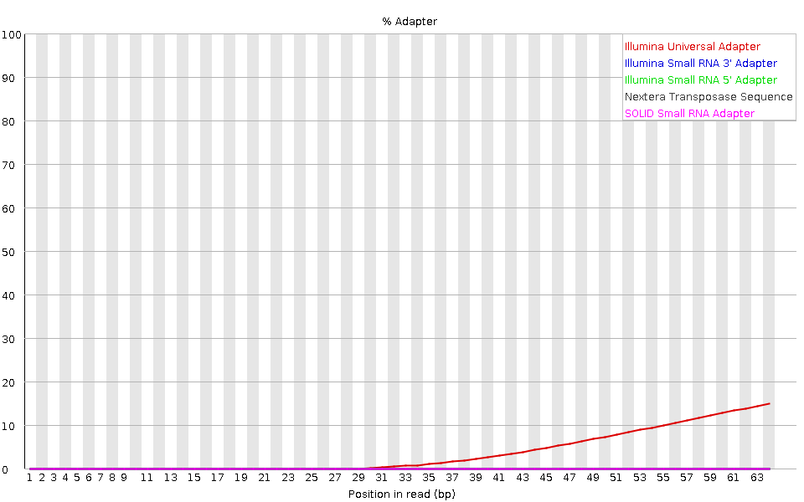
FastQC: Adapter content
Adapters
FastQC will scan each read for the presence of known adapter sequences
The plot shows that the adapter content rises over the course of the read
Solution – Adapter trimming!
Position in read (bp)
sequencing.qcfail.com

