Slide 1

What makes a musical sound?
Pitch
n Hz * 2 = n + an octave
n Hz *
(1.05946309436…)
= n + a semitone
The 12-note equal-tempered chromatic scale is customary, but not absolutely necessary.
Scales can be built with different divisions per octave, or with non-equal intervals.
Standard Western tuning defines
A above middle C as 440 Hz.
The human hearing range is about
20 Hz-20 kHz or 10 octaves.

Slide 2
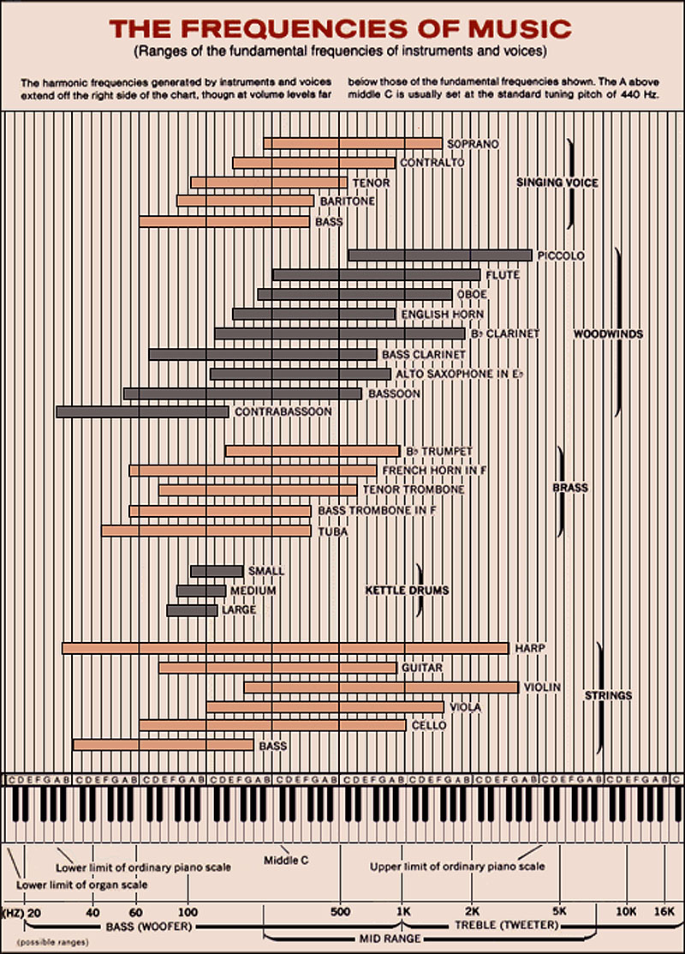

Slide 3
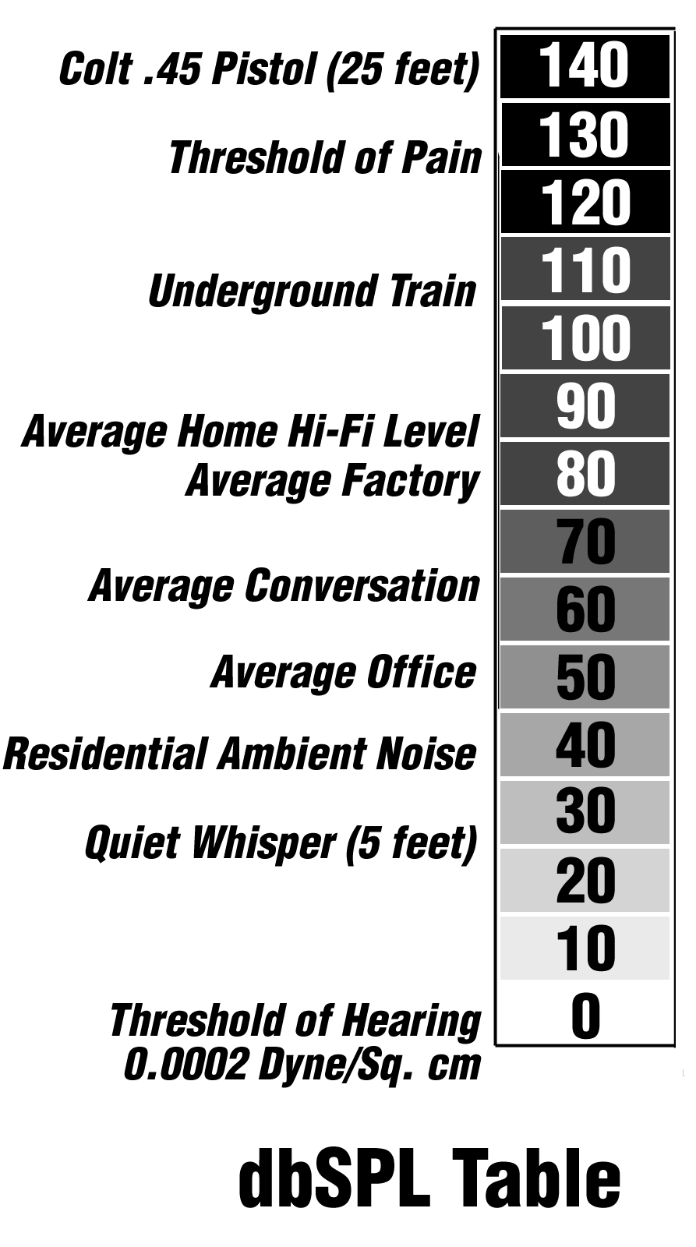
What makes a musical sound?
Amplitude (Volume)
measured in dB (a ratio)
1 dB = minimum perceivable change in loudness
10 dB = twice as loud
125 dB = dynamic range of human hearing
Absolute sound levels are measured in dB SPL
= dB above threshold of hearing

Slide 4
What makes a musical sound?
Duration
Location
Environment/Ambience

Slide 5
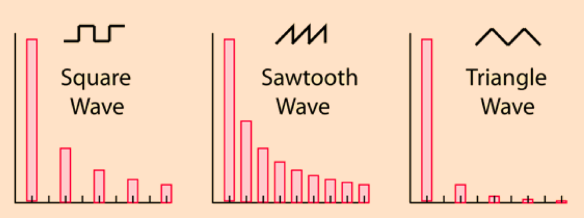
What makes a musical sound?
Timbre or tone
Determined by harmonic content.
Harmonics=integer multiples of the fundamental frequency;
present in all natural sounds.
Different waveforms have different harmonic structures.

Slide 6
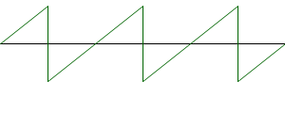
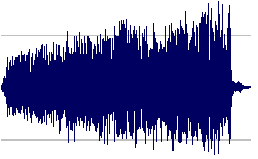
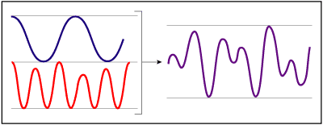
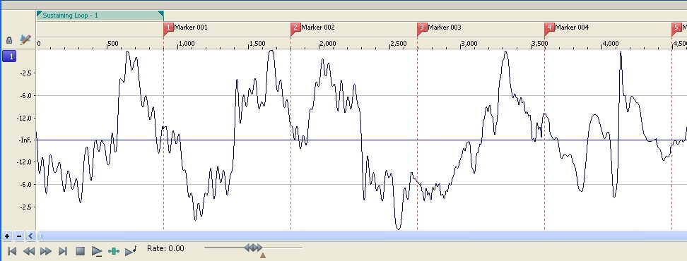
What makes a musical sound?
Timbre or tone
A synthesizer can use static waveforms, singly or layered;
or short digital recordings of real sounds (samples);
or dynamically addressable wavetables.

Slide 7
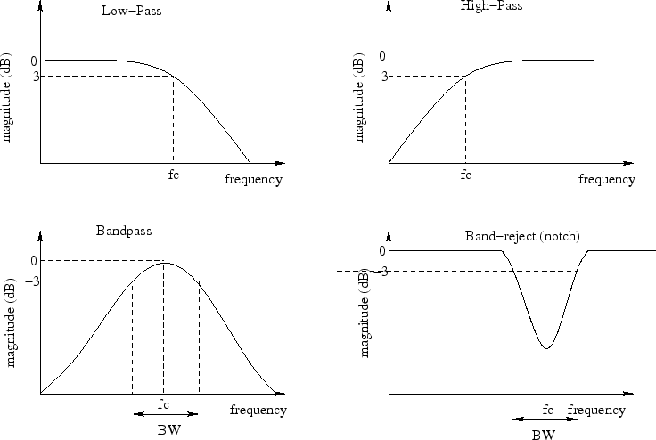
The easiest way to change timbre: apply a filter

Slide 8
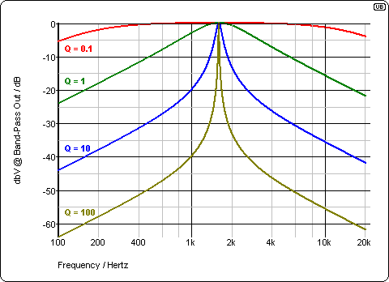
A filter has four characteristics:
type, center or cutoff frequency, gain (+ or -), and Q or bandwidth

Slide 9
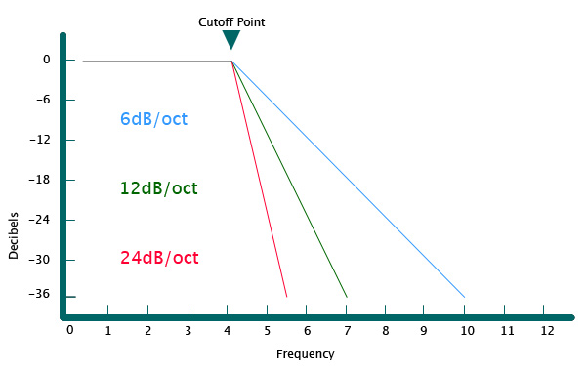
The most common filter is the Low-Pass (or high-cut). It allows control over the brightness of the sound.
A low-pass filter has a slope, in dB/octave above the cutoff frequency. Sharper slopes mean more radical alteration of the sound, but sometimes the difference is subtle.

Slide 10
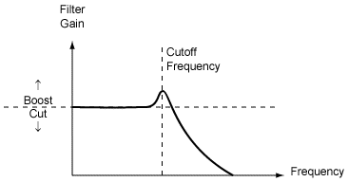
A low-pass filter with a high Q can exhibit resonance: a bump in the frequency response right at the cutoff frequency, exaggerating the filter action.

Slide 11
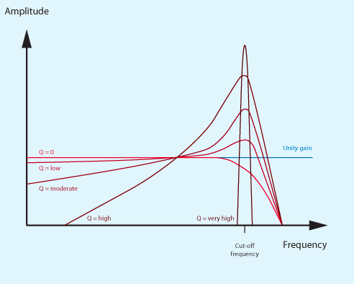
If the Q or resonance is high enough, the filter can go into self-oscillation, and generate a pitch by itself.

Slide 12
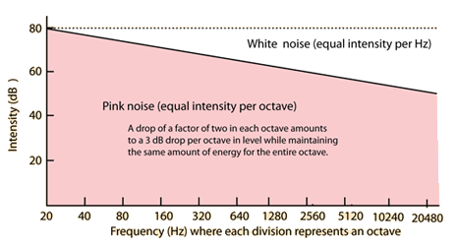
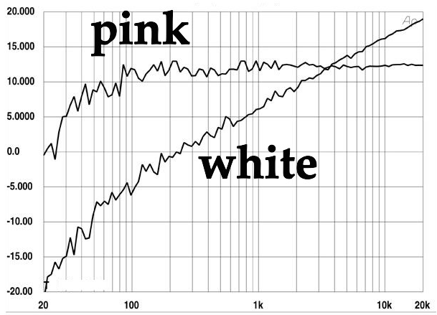
Another source of sound is noise. Different “colors” of noise sound different. Pink noise sounds more natural since it follows our logarithmic response to frequencies.
Filtered noise is an effective tool in sound design.

Slide 13
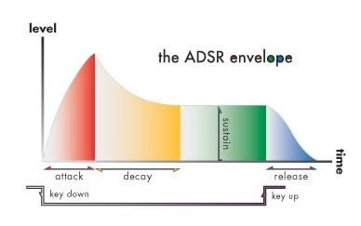
duration or gate time
Envelope: a change in any parameter over time:
Gives sound motion or “life”.
Can be applied to:
• amplitude • timbre (filter freq) • pan (stereo position)
• modulation (vibrato, etc.) • anything else!

Slide 14
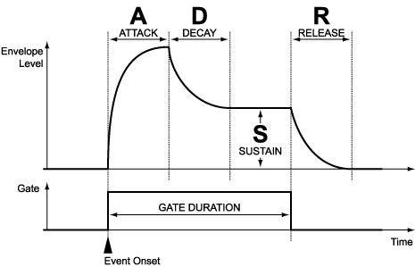
Attack: time from onset to initial peak volume
Decay: time from peak to sustain level
Sustain: level of sound as long as the gate is open
Release: time from closing of gate to zero level

Slide 15
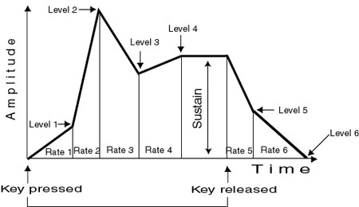
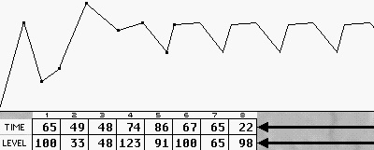
ADSR is just an approximation, designed for ease of build and use in the analog era.
Envelopes can be much more complex than that.

Slide 16
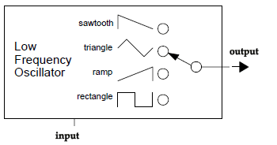
LFO: Oscillator at < 20 Hz, modulates some sound parameter: frequency, amplitude, filter frequency, pan position, etc.
LFO can have an envelope, so it changes over time: increase/decrease in intensity and/or frequency

Slide 17
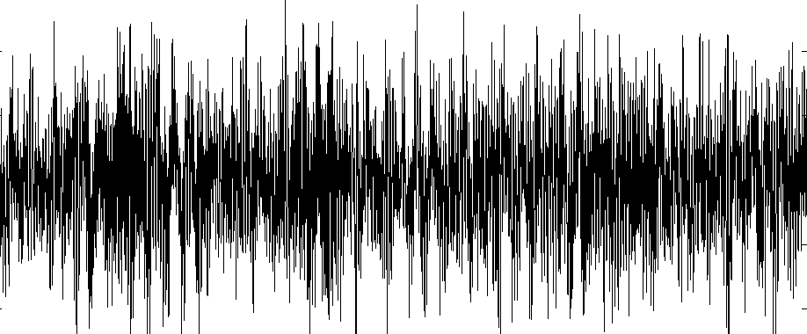
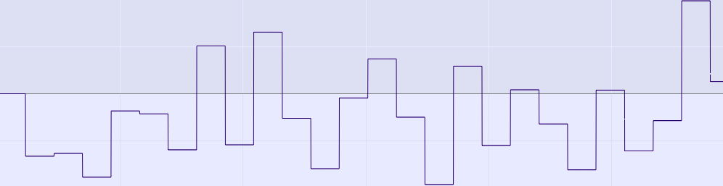
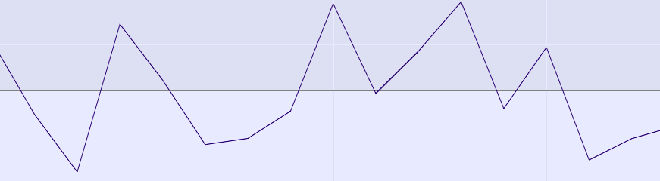
Noise as LFO: random number generator
Sample-and-Hold or Interpolated Sample-and-Hold

Slide 18
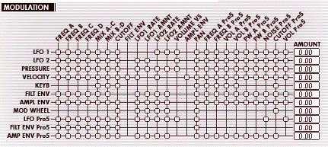
Real-time control inputs:
Keys • Sliders • Buttons • Knobs • Graphics • Camera
Multi-touch (expand/contract/reshape)
Audio input • Breath • Motion/rotation
Modulation matrix assigns sources to destinations

Slide 19
Other types of synthesis:
Additive: build up sounds one harmonic at a time
FM: two or more waves modulate each other at audio frequencies, creating complex sidebands.
Granular: extracting short pieces of samples and playing them back in different order or rate, interpolating between them.
Physical modeling/waveguide: uses mathematical models of physical objects to generats sound waves and to modify them as they pass through.

Slide 20
