Slide 1

BILKENT UNIVERSITY SPRING 2023 - CS 484
Neural Style Transfer Project
Tugberk Dikmen - 21802480

Slide 2
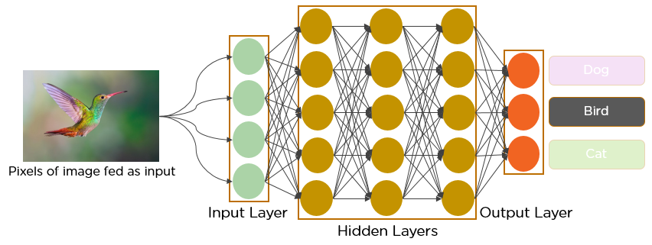
What is Convolutional Neural Networks ?
Figure 1: CNN[4]

Slide 3
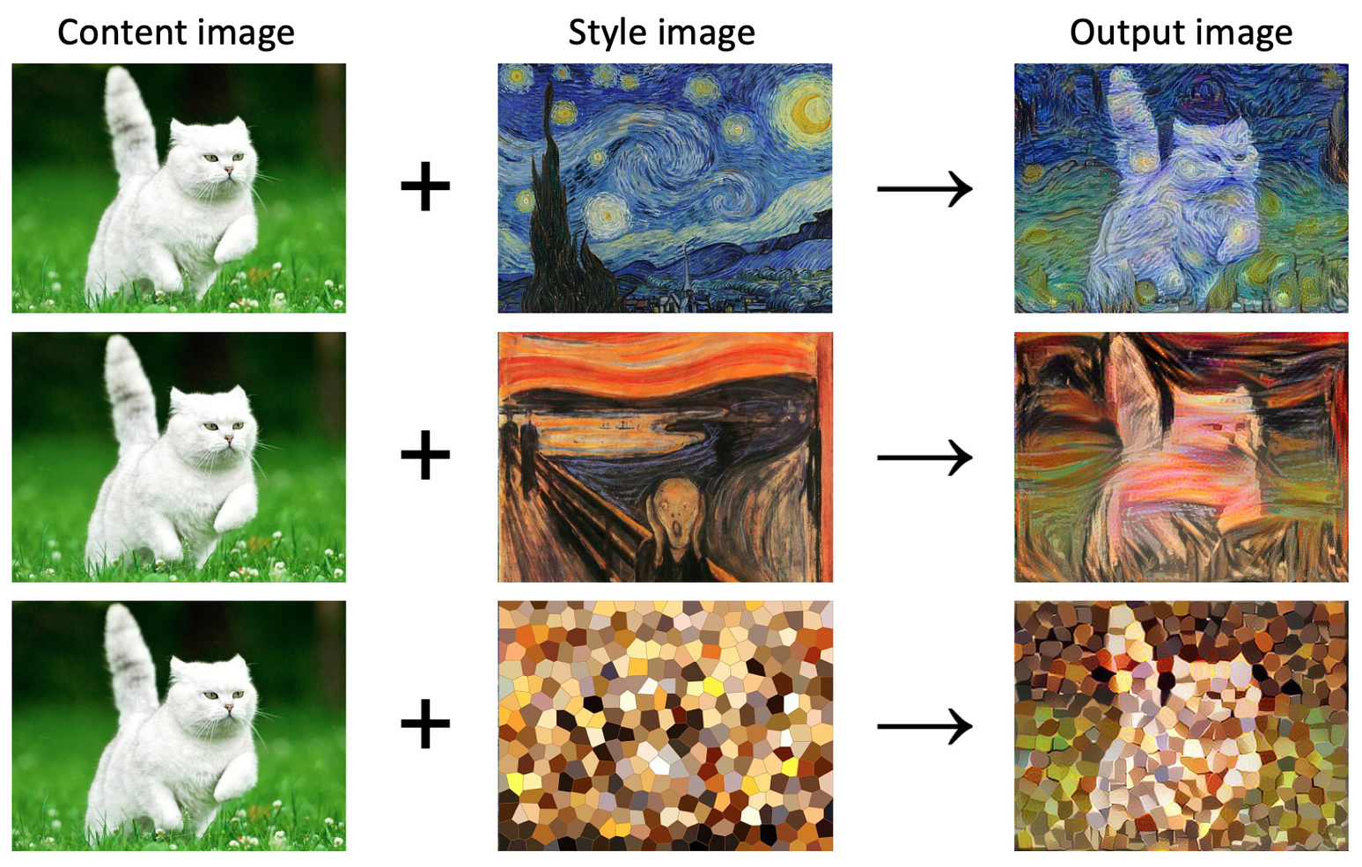
What is Neural Style Transfer ?
Figure 2: NST[3]

Slide 4
How to Implement a NST Program ?
1. Step
2. Step
3. Step
4. Step
5. Step
Understanding what NST is.
Choosing a deep learning model.
Creating a dataset and training the model.
Parameter tuning.
Taking the results.

Slide 5
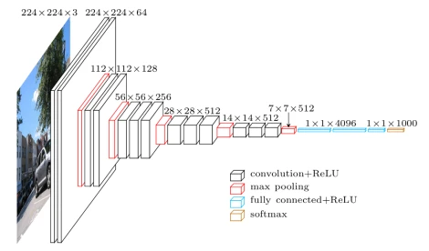
VGG-19 Deep Learning Model
Figure 3: VGG-19[8]

Slide 6


Training VGG-19 Model With Specific Dataset
Using ImageNet Pretrained VGG-19 Model
Trained for content and style images, 1000 each.
Trained on a large and diverse dataset.
The hyperparameters and architecture should be adjusted and optimized.
Already learned to extract low-level features from the images.
Allows to capture the specific characteristics of the content and style images
Not always suitable for the specific task may require fine-tuning or re-training

Slide 7
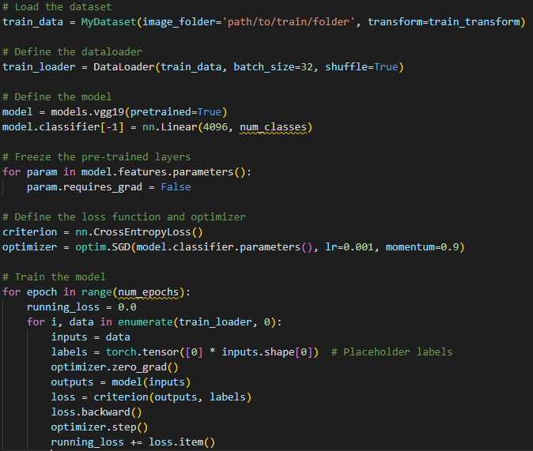
Parameter Tuning for Training Deep Learning Model

Slide 8
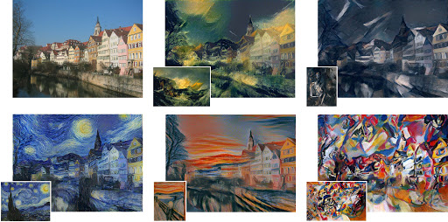
Results and Conclusion
Figure 4: Example Outputs[5]

Slide 9
References
[1] Computer vision: Algorithms and applications, 2nd ed. [Online]. Available: http://szeliski.org/Book/. [Accessed: 07-Apr-2023].
[2] L. A. Gatys, A. S. Ecker, and M. Bethge, “A neural algorithm of artistic style,” arXiv.org, 02-Sep-2015. [Online]. Available: https://arxiv.org/abs/1508.06576. [Accessed: 07-Apr-2023].
[3] “How to style transfer your own images,” GoDataDriven, https://godatadriven.com/blog/how-to-style-transfer-your-own-images/ (accessed May 8, 2023).
[4] [1] M. Mandal, “Introduction to convolutional neural networks (CNN),” Analytics Vidhya, https://www.analyticsvidhya.com/blog/2021/05/convolutional-neural-networks-cnn/ (accessed May 9, 2023).
[5] A. Sharma, “Introduction and implementation to neural style transfer - deep learning,” Analytics Vidhya, https://www.analyticsvidhya.com/blog/2020/10/introduction-and-implementation-to-neural-style-transfer-deep-learning/ (accessed May 8, 2023).
[6] “Neural style transfer tutorial with tensorflow and python in 10 minutes,” YouTube, 07-Jan-2021. [Online]. Available: https://www.youtube.com/watch?v=bFeltWvzZpQ. [Accessed: 07-Apr-2023].
[7] “Pytorch Neural Style Transfer tutorial,” YouTube, 02-Jul-2020. [Online]. Available: https://www.youtube.com/watch?v=imX4kSKDY7s. [Accessed: 07-Apr-2023].
[8] G. Boesch, “VGG very deep convolutional networks (vggnet) - what you need to know,” viso.ai, https://viso.ai/deep-learning/vgg-very-deep-convolutional-networks/ (accessed May 8, 2023).
[9] “Welcome to pytorch tutorials¶,” Welcome to PyTorch Tutorials - PyTorch Tutorials 2.0.0+cu117 documentation. [Online]. Available: https://pytorch.org/tutorials/. [Accessed: 07-Apr-2023].

