Slide 1
Factory Method Pattern

Slide 2

Concepts
Doesn’t expose instantiation logic
Defer to subclasses
Common interface
Specified by architecture, implemented by user
Examples:
Calendar
ResourceBundle
NumberFormat

Slide 3
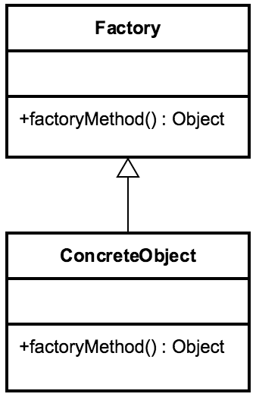
Design
Factory is responsible for lifecycle Common Interface
Concrete Classes Parameterized create method

Slide 4
Everyday Example - Calendar
Calendar cal = Calendar.getInstance();
System.out.println(cal); System.out.println(cal.get(Calendar.DAY_OF_MONTH));

Slide 5

Exercise Factory
Create Pages Create Website
Create Concrete Classes Create Factory
Enum

Slide 6

Pitfalls
▪
▪
▪
Complexity Creation in subclass Refactoring

Slide 7
Contrast
Singleton
Returns same instance
One constructor method - no args
No Interface
No Subclasses
Factory
Returns various instances
Multiple constructors
Interface driven
Subclasses
Adaptable to environment more easily

Slide 8

Factory Summary
Parameter Driven
Solves complex creation
A little complex
Opposite of a Singleton

