Slide 1
Singleton Pattern

Slide 2

Concepts
Only one instance created
Guarantees control of a resource
Lazily loaded
Examples:
Runtime
Logger
Spring Beans
Graphic Managers
Drag picture to placeholder or click icon to add a graphic

Slide 3
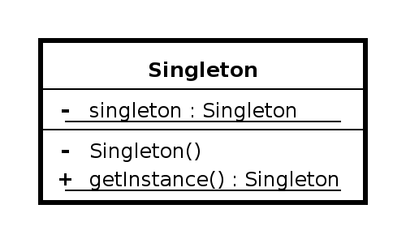
Design
Class is responsible for lifecycle Static in nature
Needs to be thread safe Private instance
Private constructor
No parameters required for construction

Slide 4
Everyday Example - Runtime Env
Runtime singletonRuntime = Runtime.getRuntime();
singletonRuntime.gc(); System.out.println(singletonRuntime);
Runtime anotherInstance = Runtime.getRuntime(); System.out.println(anotherInstance); if(singletonRuntime == anotherInstance) {
System.out.println(“They are the same instance”);
}

Slide 5

Exercise Singleton
Create Singleton
Demonstrate only one instance created
Lazy Loaded
Thread safe operation

Slide 6

Pitfalls
▪
▪
▪
▪
▪
Often overused Difficult to unit test
If not careful, not thread-safe Sometimes confused for Factory java.util.Calendar is NOT a Singleton
Prototype

Slide 7
Contrast
Singleton
Returns same instance
One constructor method - no args
No Interface
Factory
Returns various instances
Multiple constructors
Interface driven
Adaptable to environment more easily

Slide 8

Singleton Summary
Guarantee one instance
Easy to implement
Solves a well defined problem
Don’t abuse it

