Slide 1
Builder Pattern

Slide 2

Concepts
Handles complex constructors
Large number of parameters
Immutability
Examples:
StringBuilder
DocumentBuilder
Locale.Builder

Slide 3
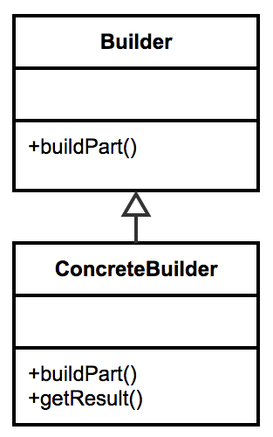
Design
Flexibility over telescoping constructors Static inner class
Calls appropriate constructor Negates the need for exposed setters
Java 1.5+ can take advantage of Generics

Slide 4
Everyday Example - StringBuilder
StringBuilder builder = new StringBuilder();
builder.append("This is an example "); builder.append("of the builder pattern. "); builder.append("It has methods to append "); builder.append("almost anything we want to a String. "); builder.append(42);

Slide 5

Exercise Builder
Demonstrate Exposed Setters Demonstrate Telescoping Constructors Create Builder
Build Out Example

Slide 6

Pitfalls
▪
▪
▪
▪
▪
Immutable Inner static class Designed first Complexity
Method returns object

Slide 7
Contrast
Builder
Handles complex constructors
No interface required
Can be a separate class
Works with legacy code
Prototype
Implemented around a clone
Avoids calling complex constructors
Diﬃcult to implement in legacy code

Slide 8

Builder Summary
Creative way to deal with complexity
Easy to implement
Few drawbacks
Can refactor in with separate class

