Slide 1
AbstractFactory Pattern

Slide 2

Concepts
Factory of Factories
Factory of related objects
Common Interface
Defer to Subclasses
Examples:
DocumentBuilder
Frameworks

Slide 3
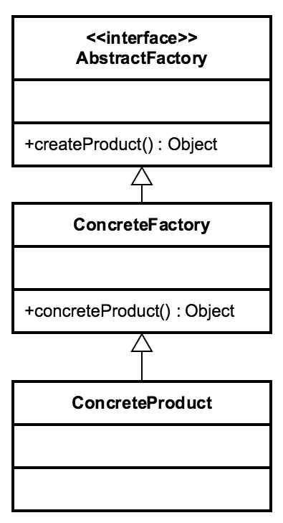
Design
Groups Factories together Factory is responsible for lifecycle Common Interface
Concrete Classes Parameterized create method Composition

Slide 4
Everyday Example - DocumentBuilderFactory
DocumentBuilderFactory abstractFactory = DocumentBuilderFactory.newInstance();
DocumentBuilder factory = abstractFactory.newDocumentBuilder(); Document doc = factory.parse(bais);

Slide 5

Exercise AbstractFactory
Code Walkthrough AbstractFactory Factory
Product

Slide 6

Pitfalls
▪
▪
▪
▪
▪
Complexity Runtime switch
Pattern within a pattern Problem specific
Starts as a Factory

Slide 7
Contrast
Factory
Returns various instances
Multiple constructors
Interface driven
Adaptable to environment more easily
AbstractFactory
Implemented with a Factory
Hides the Factory
Abstracts Environment
Built through Composition

Slide 8

AbstractFactory Summary
Group of similar Factories
Complex
Heavy abstraction
Framework pattern

