Slide 1

CSE 472 Machine Learning
LLM - Detect AI Generated Text
Presented by
Abdullah Al Fahad
Student ID: 1805033
Section: A2
Level: 4 Term: 2
Siam Al Mujadded
Student ID: 1805051
Section: A2
Level: 4 Term: 2

Slide 2
Based on: AI Generated Text detection
Competition Link: LLM - Detect AI Generated Text | Kaggle
Problem: This competition challenges participants to develop a machine learning model that can accurately detect whether an essay was written by a student or an LLM. The competition dataset comprises a mix of student-written essays and essays generated by a variety of LLMs.

Slide 3
Overview: LLMs are trained on a massive dataset of text and code, which means that they are able to generate text that is very similar to human-written text. For example, students could use LLMs to generate essays that are not their own, missing crucial learning keystones. We want to build a model to identify which essay was written by middle and high school students, and which was written using a large language model.

Slide 4
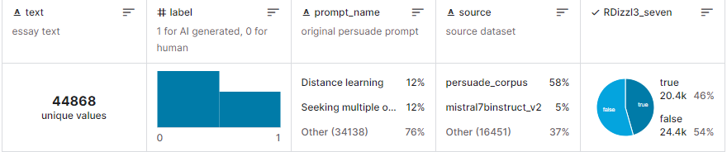
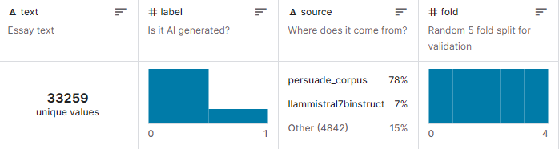
Datasets used:
DAIGT V2 Train Dataset
Details
22. DAIGT Proper Train Dataset
Details

Slide 5

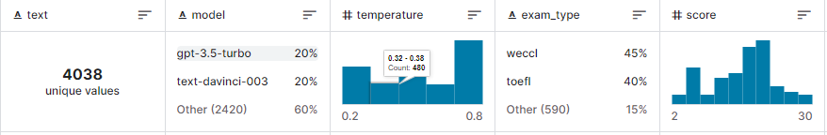
3. DAIGT | External Dataset
Details
All the texts are human generated.
4. ArguGPT
Details
ArguGPT is a balanced corpus of 4,038 argumentative essays generated by 7 GPT models in response to essay prompts from three sources: (1) in-class or homework exercises, (2) TOEFL and (3) GRE writing tasks.

Slide 6
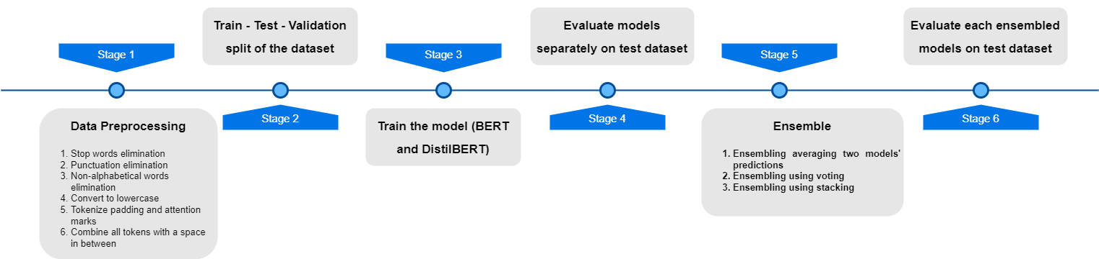
Methodology:

Slide 7
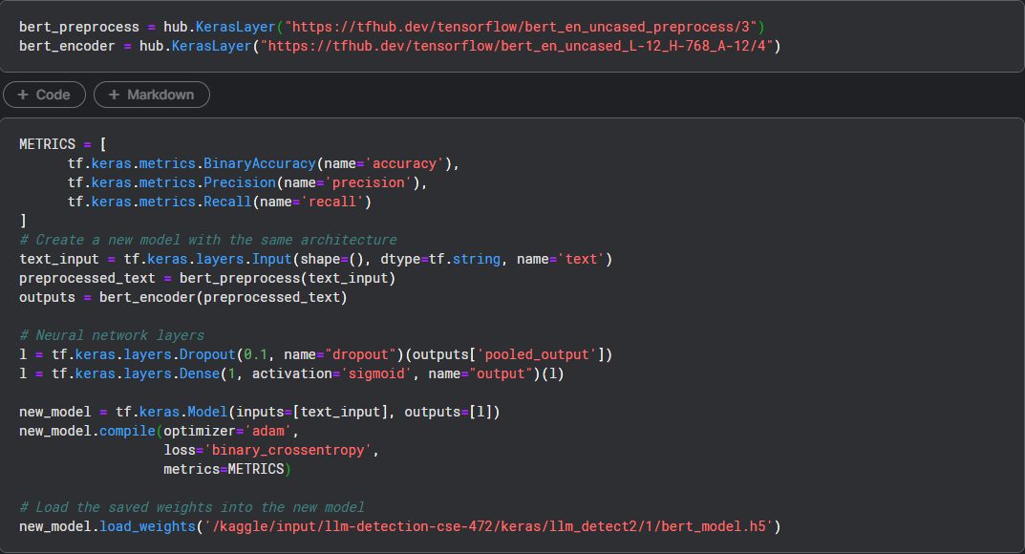
BERT

Slide 8
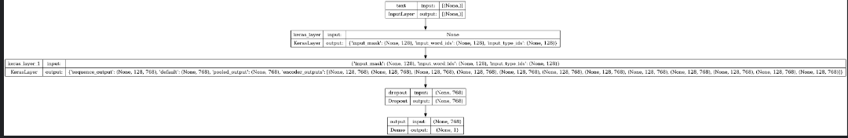
Generated using tensorflow.keras.utils.plot_model

Slide 10
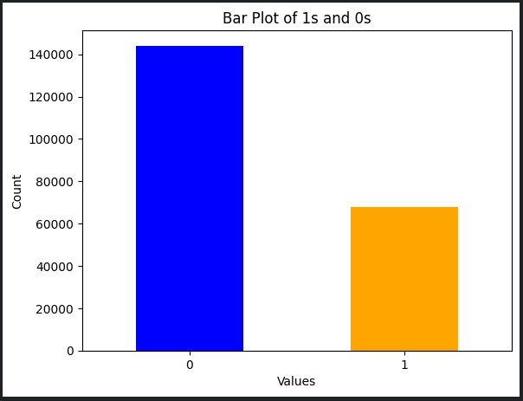
Dataset bar plot

Slide 11
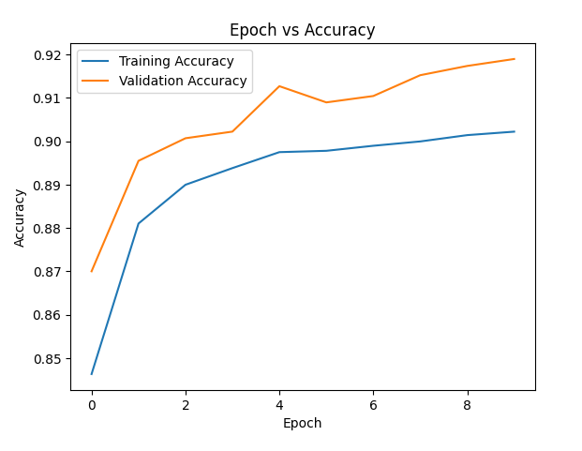
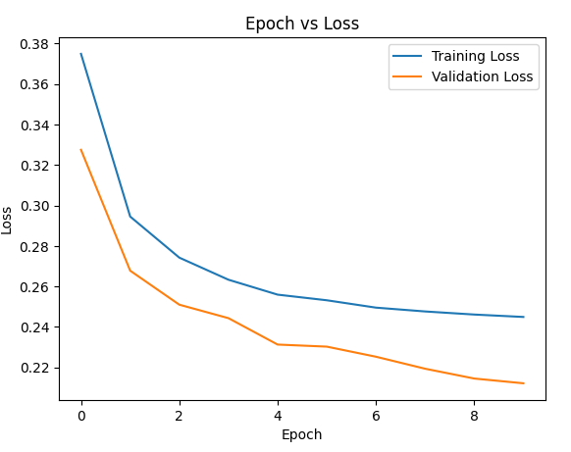
Results and graphs

Slide 12
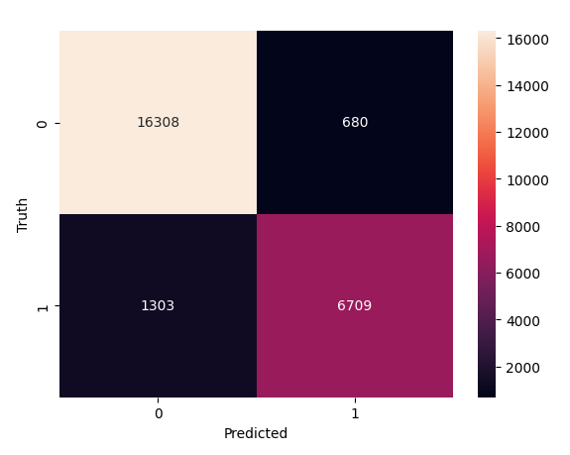
 | Loss | Accuracy | Validation loss | Validation Accuracy
Train | 0.2449 | 0.90 | 0.21 | 0.92
Test | 0.2123 | 0.9207

Slide 13
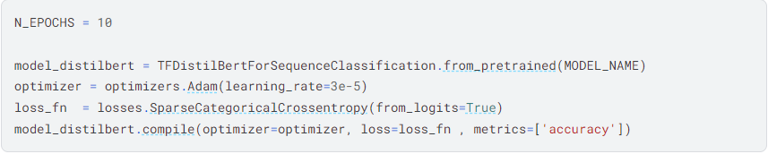
DistilBERT
notebook
def construct_encodings(x, tkzr, trucation=True, padding=True):
return tkzr(x, truncation=trucation, padding=padding)
def construct_tfdataset(encodings, y=None):
if y:
return tf.data.Dataset.from_tensor_slices((dict(encodings),y))
else:
# this case is used when making predictions on unseen samples after training
return tf.data.Dataset.from_tensor_slices(dict(encodings))

Slide 14
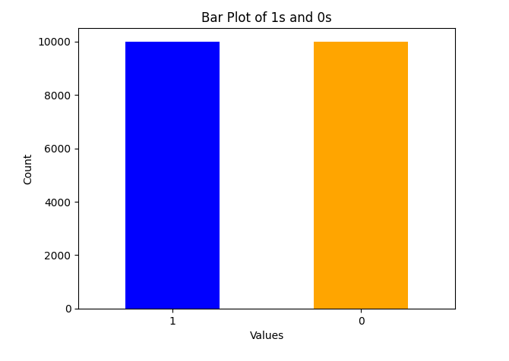
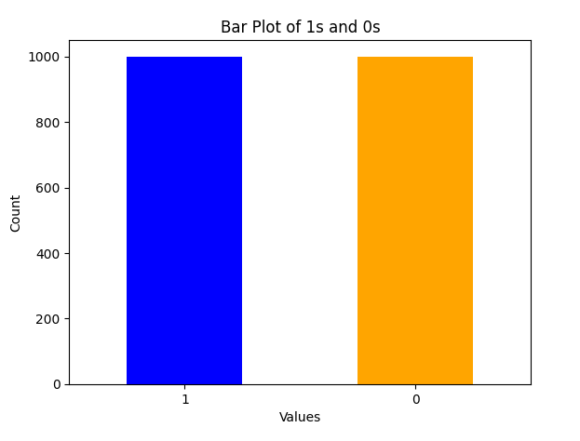
Train test dataset stat
For train test For Validation data

Slide 15
0.005 | Loss | Accuracy | Validation loss | Validation Accuracy
Train | 0.6935 | 0.4994 | 0.6939 | 0.5000
Test | 0.69 | 0.50
3e-5 | Loss | Accuracy | Validation loss | Validation Accuracy
Train | 0.0016 | 0.99 | 0.14 | 0.85
Test | 0.0152 | 0.99

Slide 16
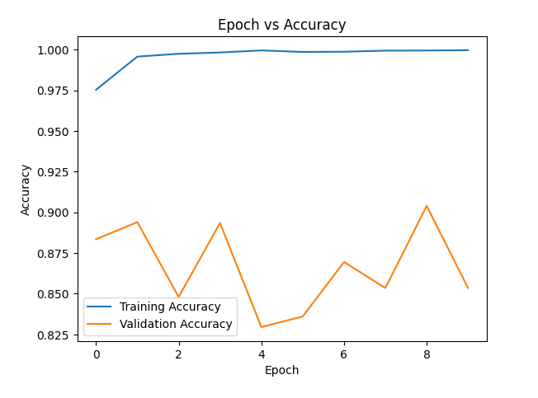
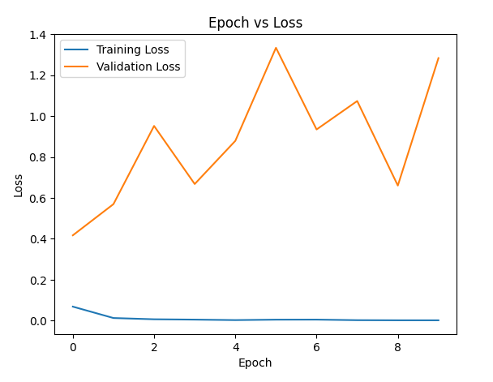
Results and Graphs

Slide 17
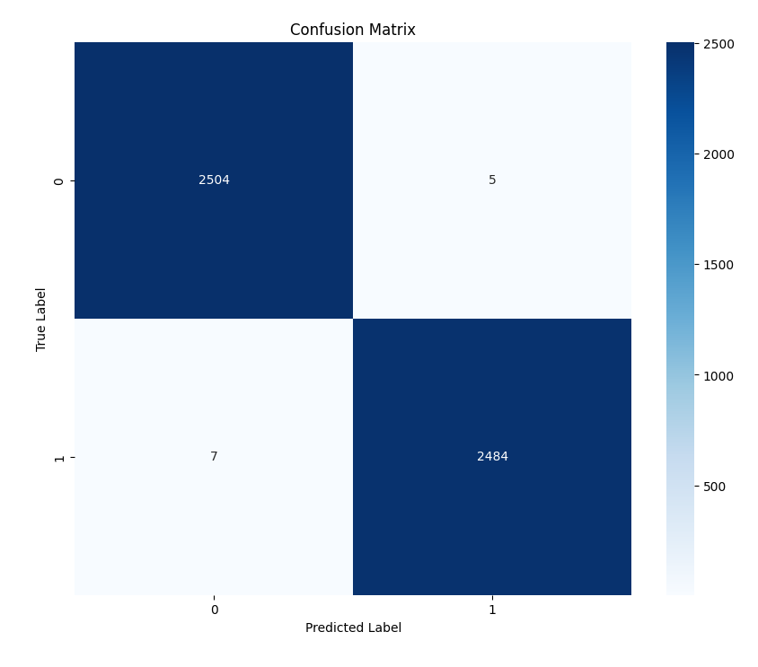

Slide 18
Ensembling
notebook
Three methods are used
1.Ensembling averaging two models' predictions
2.Ensembling using voting
3.Ensembling using stacking

Slide 19
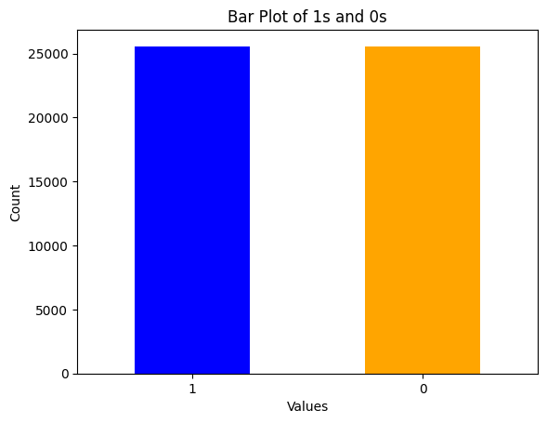
Dataset in Ensemble
25567
25567

Slide 20
Method-1
Averaging two models' predictions
BERT
DistilBERT
Average
Final Output

Slide 21
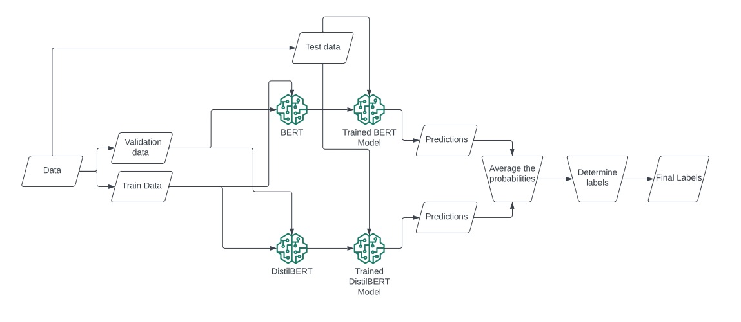
Method-1
Averaging two models' predictions

Slide 22
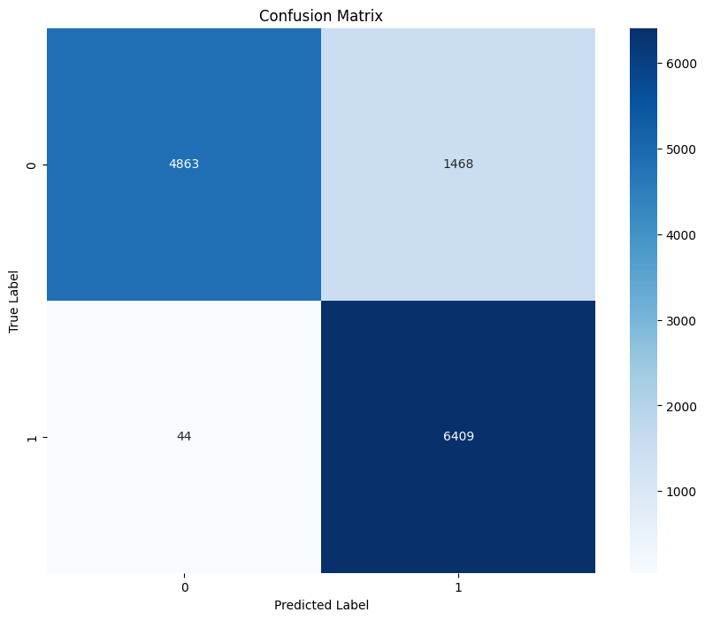
Method-1
Accuracy: 88.17%

Slide 23
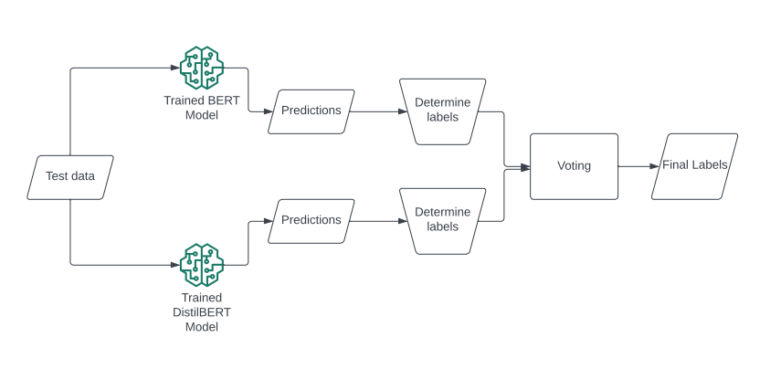
Method-2
Voting Technique

Slide 24
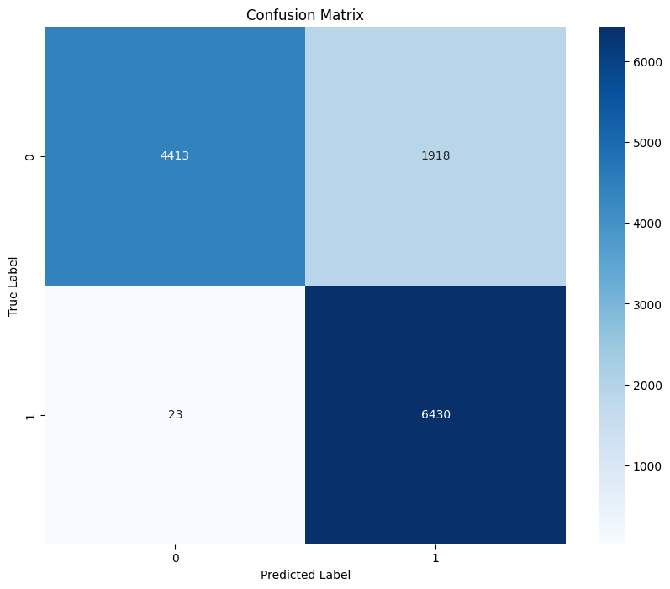
Method-2
Accuracy: 84.82%

Slide 25
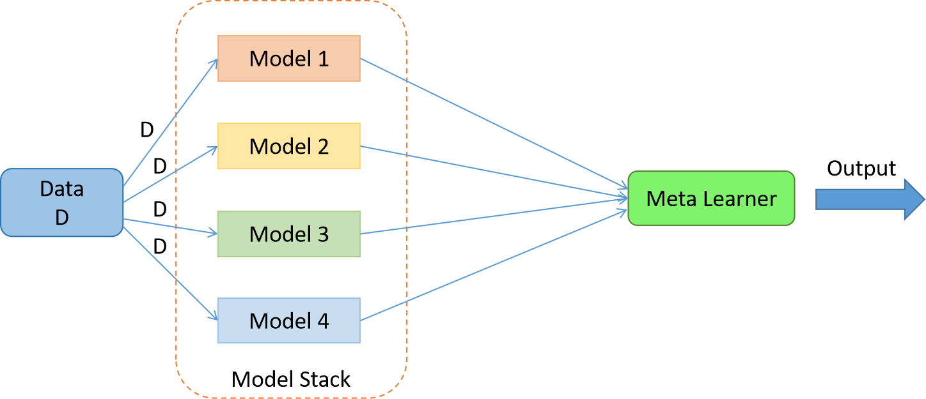
Method-3
Stacking Technique

Slide 26
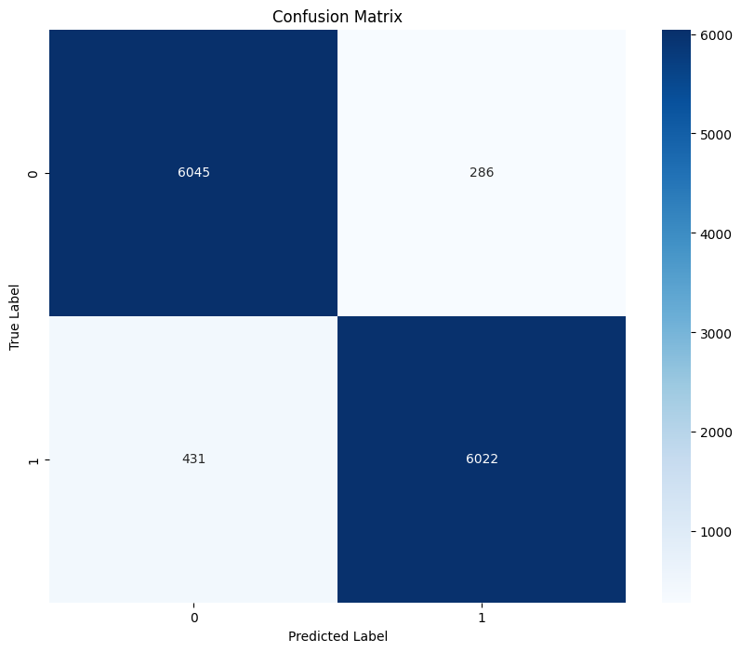
Method-3
Accuracy: 94.39%

Slide 27
Final Result
Average | Voting | Stack
88.17% | 84.82% | 94.39%

