Slide 1
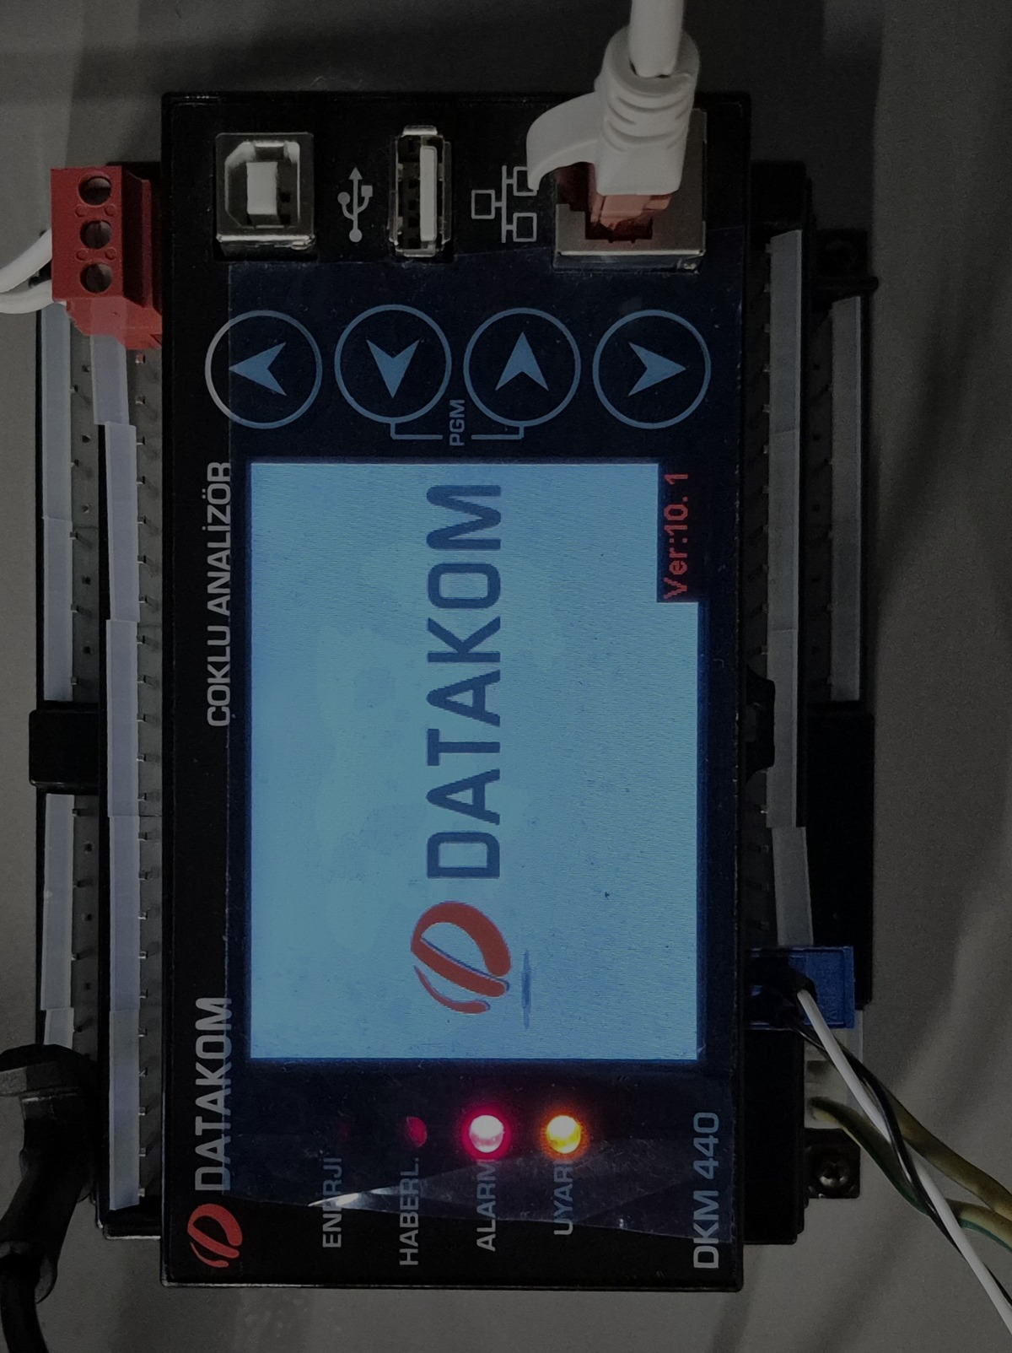
IKOM · STAJ TESLİMİ · 2026-08-06
Reading a power
analyser from a phone
A DATAKOM DKM-440 is read over Modbus TCP, republished as JSON over
MQTT/TLS, and displayed on an Android phone — where a from-scratch
C++ neural network turns a hand-drawn symbol into a gateway command.
Industrial telemetry is taught in slices; this bench is the whole path, on one desk.
DKM-440
ESP8266
EMQX / TLS 1.3
Android
C++17 MLP
Every figure in this deck is a measured value from the bench, or it is labelled as unproven.

Slide 2
VERIFIED END TO END · 2026-07-28
What runs today
METER
GATEWAY
BROKER
PHONE
NET
DKM-440
Modbus
TCP
ESP8266
MQTT
TLS
EMQX
MQTT
sub
osos-hmi
192.169.10.74:502
Modbus TCP · unit 1
192.169.10.75
Wi-Fi · gateway
…emqxsl.com:8883
TLS 1.3 · retained + LWT
Android · Kotlin
live tiles · alarms
22 / 22
5 s
TLS 1.3
97.65 %
REGISTERS PER CYCLE
REPORT INTERVAL
TO THE BROKER
MNIST TEST ACCURACY
15 consecutive cycles
fixed read budget
DigiCert G2 verified
784-128-10, from scratch
— Cross-checked, not self-reported. A PC-side Modbus client read the same value the gateway published, in the same second.
— The meter cannot move. Its address is a DHCP reservation on MAC 00-00-36-7F-04-55, because CFG_METER_HOST is a compile-time constant.
OSOS · DKM-440 remote meter reading
01

Slide 3
THE BRIEF BEHIND THE BENCH
Why build it at all
METER
GATEWAY
BROKER
PHONE
NET
Because there is nowhere
to practise this.
WHAT A NEWCOMER MEETS HERE
A device that punishes impatience
the DKM-440 stops answering a master that fires back to back
Industrial telemetry is taught in slices — a serial lecture here, a protocol chapter there, a cloud broker in a different course entirely. Nobody hands a newcomer the whole path from a physical register to a pixel on a phone and says: make it work.
This bench is that path, compressed onto one desk, with real hardware that misbehaves in real ways. It is an emulation ground for someone starting in this field — including the person who built it.
A protocol with no self-description
Modbus gives you a number; the meaning lives in a PDF
A network that lies quietly
a DHCP lease moved four times and blinded the gateway each time
A chip with one UART
the constraint that chose the entire architecture
A model that is only probably right
Every one of those is a lesson that does not survive a simulator. That is the argument for hardware.
and sits in front of an industrial actuator
OSOS · DKM-440 remote meter reading
02

Slide 4
PART ONE
The bench
Three instruments, one subnet, and a supply whose dial is the only thing on the bench that can move.
METER
GATEWAY
BROKER
PHONE
NET
OSOS · DKM-440 remote meter reading
03

Slide 5
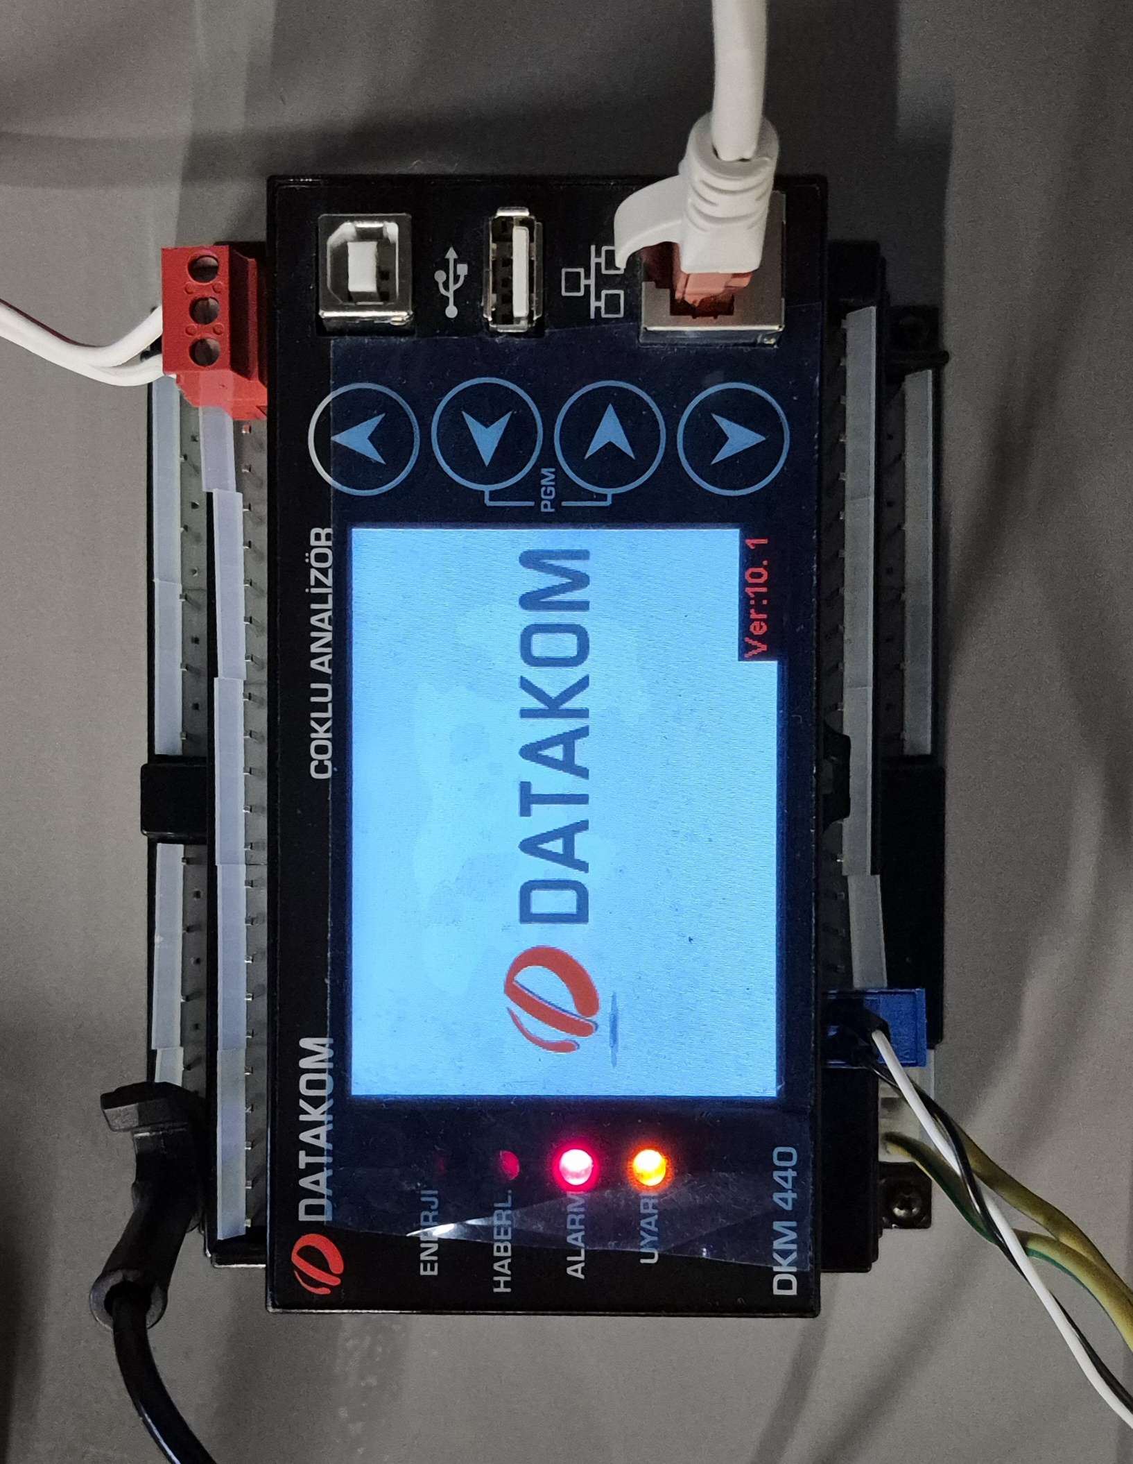
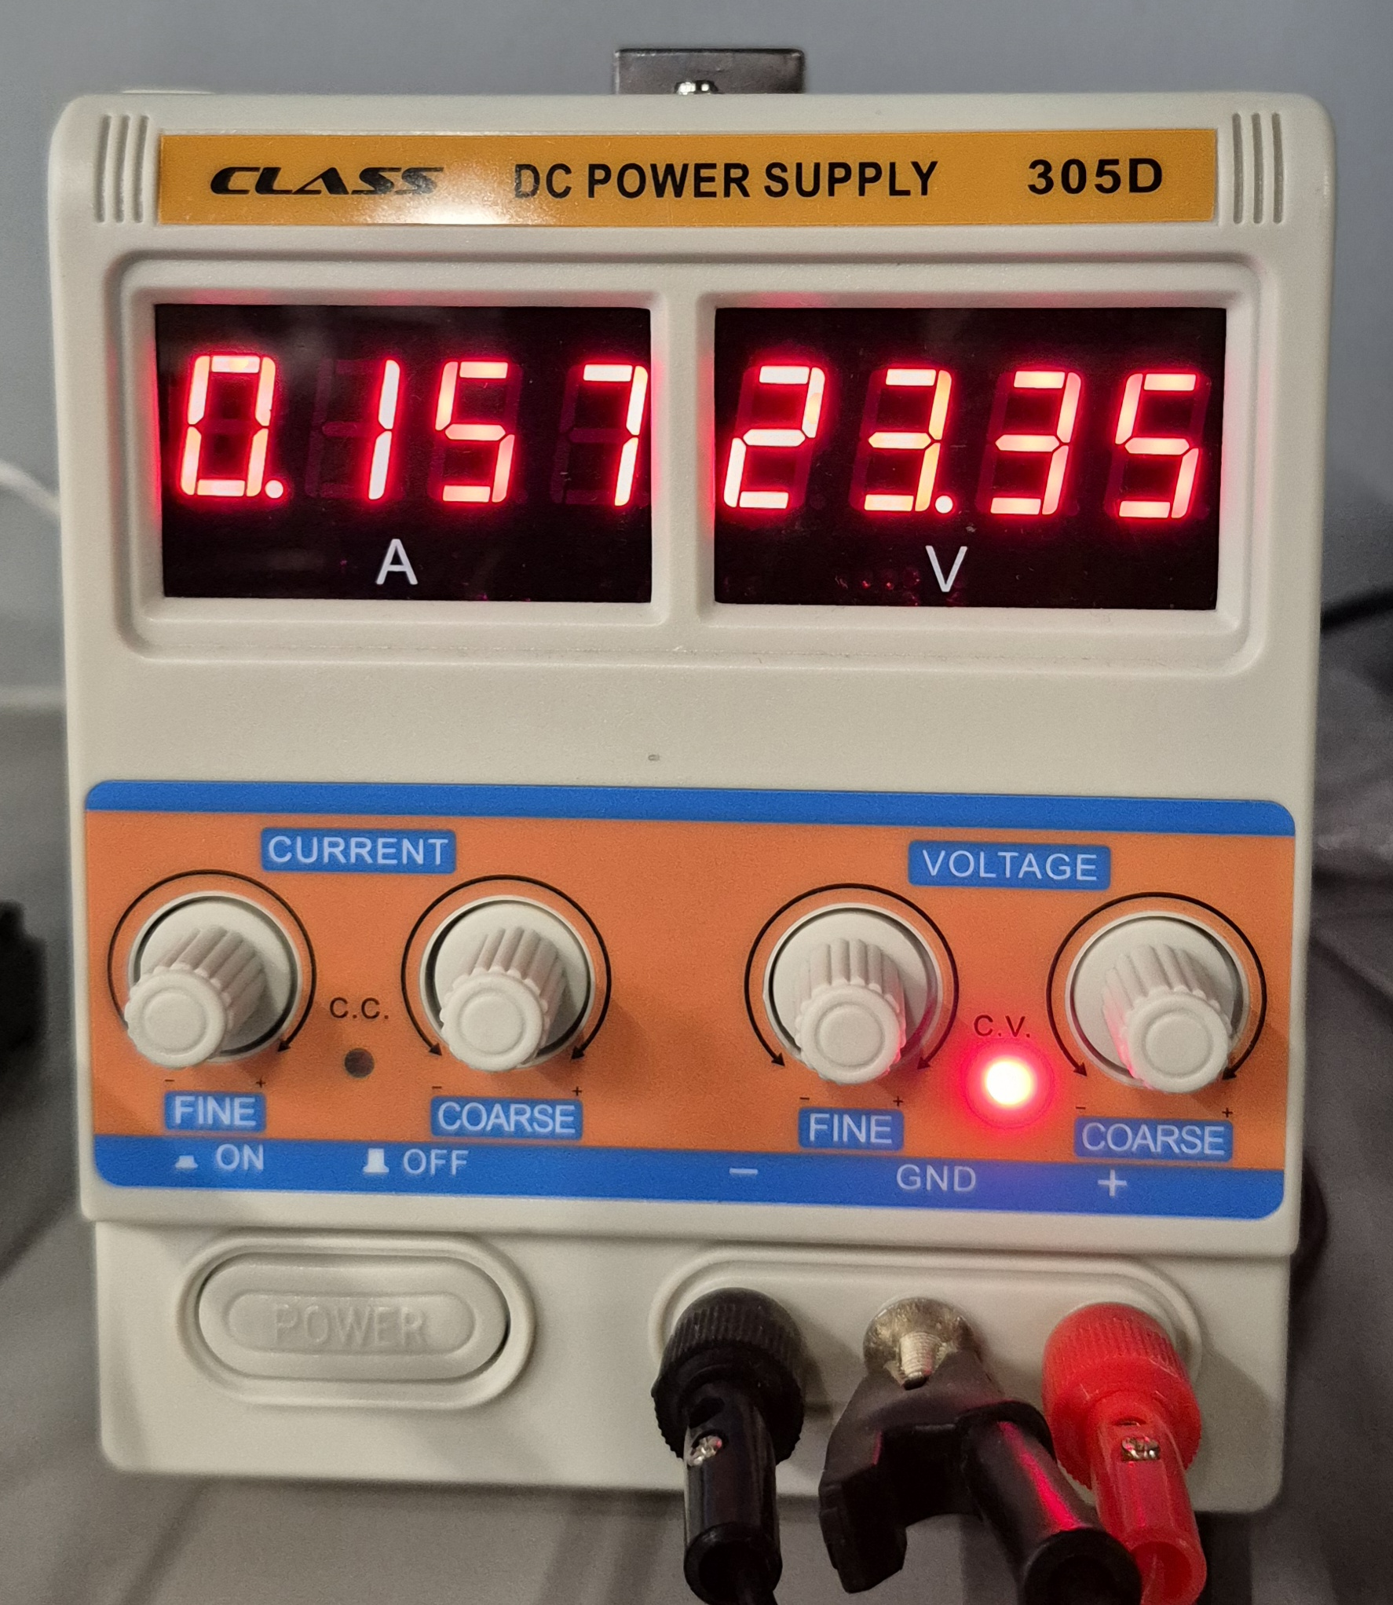
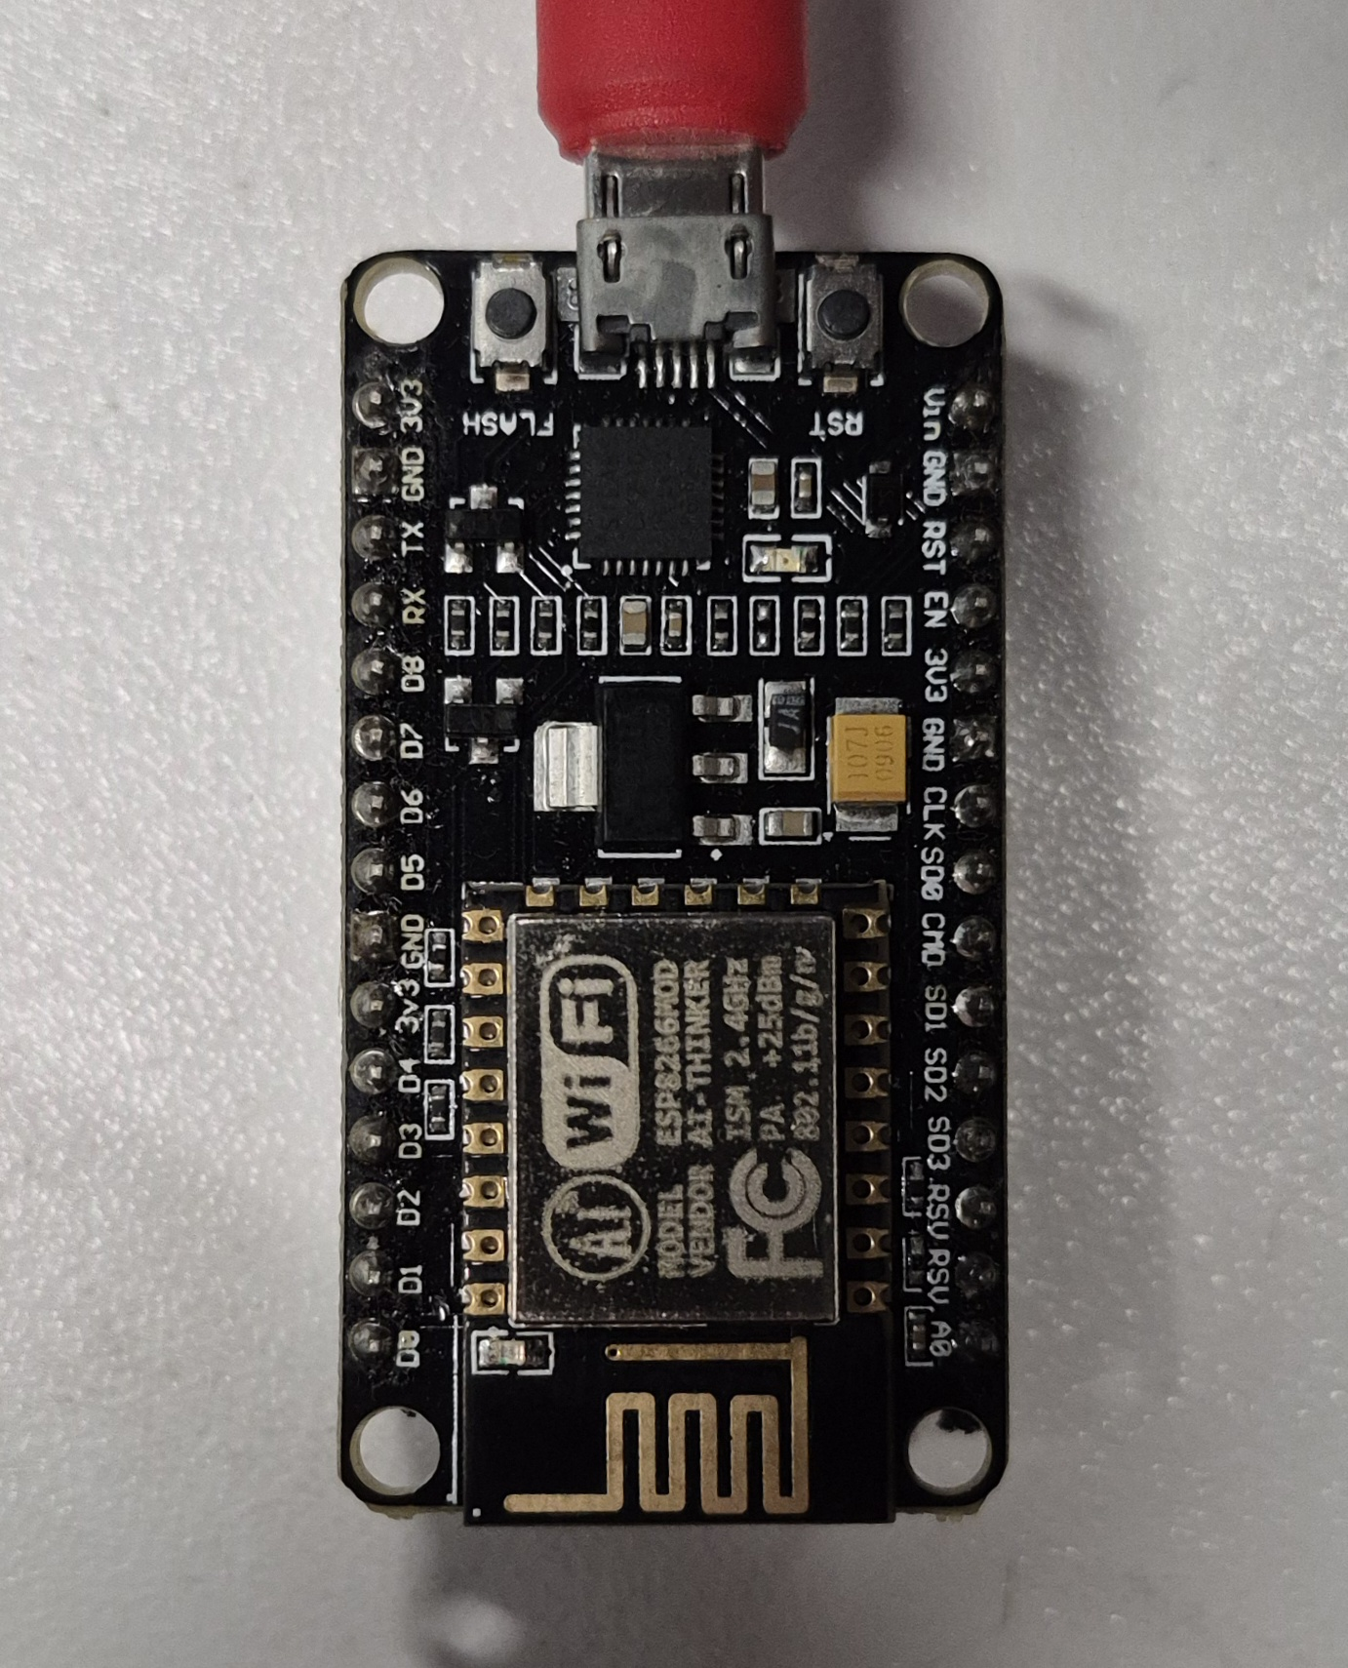
PHOTOGRAPHED 2026-07-28
The hardware
METER
GATEWAY
BROKER
PHONE
NET
THE SUBNET
router
192.169.10.1
bench PC
.72 DHCP
DKM-440
.74 reserved
ESP8266
.75 DHCP
SSID IKOM_Bilisim
RSSI −46 dBm
192.169.x.x is not private address space — 192.168 was meant. It only shadows real hosts inside that block, so it stays. Recorded so nobody rediscovers it.
DATAKOM DKM-440 · Ver 10.1
RJ45 top edge — Modbus TCP :502
CLASS 305D · 23.35 V @ 0.157 A
variable — the dial is not a constant
Ai-Thinker ESP-8266MOD · COM11
802.11 b/g/n — the WAN bridge
The meter is LAN-only and has no business on the internet. The ESP8266 is the one controlled egress point: it translates registers into JSON and speaks outward to a broker, so nothing on the internet ever addresses the meter.
OSOS · DKM-440 remote meter reading
04

Slide 6
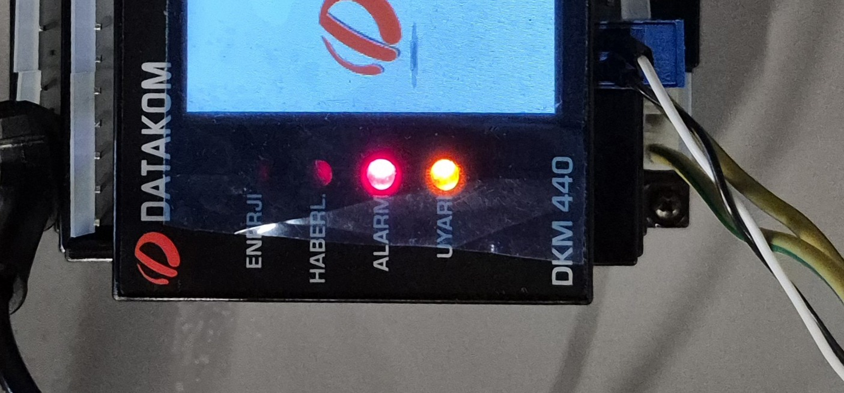
WHY TWO ALARM LAMPS ARE LIT AND NOTHING IS WRONG
Reading the panel honestly
METER
GATEWAY
BROKER
PHONE
NET
THE FOUR LAMPS
ENERJİ
off
energy accumulation
HABERL.
off
communications
ALARM
LIT
an AC meter with no AC connected
UYARI
LIT
warning — absent phases
the status LEDs, bottom edge of the panel
0.000 is not null
EVERY AC REGISTER READS ZERO — CORRECTLY
A zero means “read correctly, genuinely zero”. A null means the register could not be read at all. The gateway publishes the key either way, so a consumer can always tell the two apart — that distinction is requirement FW-12.
It matters because the meter is a True-RMS AC analyser with nothing on its voltage or current inputs. The lamps are not a fault; they are the device correctly complaining about absent phases.
MainBus_Voltage_L1 100 = 0.000
MainBus_Current_L1 180 = 0.000
MainBus_Freq_L1 266 = 0.000
OSOS · DKM-440 remote meter reading
05

Slide 7
SUPPLY_VOLTAGE · REGISTER 40260 · BESLEME GERİLİMİ
The most misread number on the bench
METER
GATEWAY
BROKER
PHONE
NET
Three different values have been recorded for this register.
All three were correct at the time.
USE THIS INSTEAD
22 / 22
WHEN
VALUE
The register count proves the Modbus path is healthy. The voltage only proves the dial position.
2026-07-23
26.5 V
2026-07-28 gateway + PC client
13.2 V
2026-07-28 photographed dial
23.35 V
It is a live readback of whatever the bench supply is dialled to — not a characteristic of the meter. It is the one channel on this bench that can move, which makes it useful as a staleness canary and useless as a regression reference.
OPEN — AND MORE URGENT
The app reads ≈2 % above the supply's own display, always in the same direction.
Cable loss has the wrong sign, so it is excluded: either the PSU display under-reads or the DKM's housekeeping ADC over-reads. One DMM across the meter's own terminals settles it, and nobody has taken that measurement yet.
OSOS · DKM-440 remote meter reading
06

Slide 8
PART TWO
The path a value takes
From a resistive divider inside the meter to a JSON string in a phone's memory, one layer at a time.
METER
GATEWAY
BROKER
PHONE
NET
OSOS · DKM-440 remote meter reading
07

Slide 9
TWO HOPS, SEVEN LAYERS, ONE PAYLOAD
The whole system, on the OSI model
METER
GATEWAY
BROKER
PHONE
NET
LAYER
HOP 1 METER → GATEWAY
HOP 2 GATEWAY → BROKER → PHONE
7
Application
Modbus FC03 read holding registers
MQTT 3.1.1 PUBLISH / SUBSCRIBE
L7
6
Presentation
IEEE-754 float32, big-endian word order
JSON UTF-8 · weights as base64 LE float32
L6
5
Session
MBAP transaction id pairs reply to request
MQTT session, keepalive, retained status + LWT
L5
4
Transport
TCP port 502
TCP port 8883, wrapped in TLS 1.3
L4
3
Network
IPv4 192.169.10.75 → 192.169.10.74
IPv4 → …ala.eu-central-1.emqxsl.com
L3
2
Data link
Ethernet II MAC 00-00-36-7F-04-55
802.11 b/g/n CSMA/CA, SSID IKOM_Bilisim
L2
1
Physical
Cat5e twisted pair, RJ45
2.4 GHz ISM RSSI −46 dBm at the bench
L1
TLS sits between 4 and 7 — it is why the payload can cross the public internet at all, and it is the only layer here that a leaked credential would still walk straight through.
OSOS · DKM-440 remote meter reading
08

Slide 10
23.35 V LEAVING THE METER AND ARRIVING AT THE PHONE
Four bytes, wrapped twice
METER
GATEWAY
BROKER
PHONE
NET
HOP 1 — WHAT THE METER SENDS
HOP 2 — WHAT THE PHONE RECEIVES
Ethernet II header
14 B
802.11 frame
~34 B
IPv4 header
20 B
IPv4 + TCP
40 B
TCP header
20 B
ESP8266
TLS 1.3 record AEAD sealed
~22 B
MBAP header tid · pid · len · unit
7 B
decode
+ re-wrap
MQTT PUBLISH osos/{gw}/telemetry
~28 B
FC03 reply fn + byte count
2 B
"Supply_Voltage": 23.350
~26 B
41 BA CC CD ← the value
4 B
the full 22-register frame is under 1 KB (NF-2, still unmeasured)
67 bytes on the wire to carry 4 bytes of measurement
— The number changes representation twice, and value never. Binary float32 on the meter side, decimal text on the broker side. String(v, 3) is the only transformation, and it is lossy in the third decimal by design — nothing scales, offsets or corrects the reading anywhere in the chain.
OSOS · DKM-440 remote meter reading
09

Slide 11
FUNCTION CODE 03 · BIG-ENDIAN FLOAT32 ACROSS TWO REGISTERS
One register read, byte for byte
METER
GATEWAY
BROKER
PHONE
NET
ESP8266 → 192.169.10.74:502
192.169.10.74:502 → ESP8266
REQUEST 12 bytes
00 01 transaction id
00 00 protocol id (0 = Modbus)
00 06 length of what follows
01 unit id
03 FC03 read holding registers
01 04 start address 260
00 02 quantity: 2 registers
RESPONSE 13 bytes
00 01 transaction id — pairs the reply
00 00 protocol id
00 07 length
01 unit id
03 FC03 echoed
04 byte count
41 BA CC CD → 23.350 V
THE DEVICE'S TEMPER
IT APPLIES TO CONCURRENT MASTERS TOO
The DKM-440 stops answering a master that fires requests back to back. It is a property of the device, not the transport — it survived the move from RS-485 to TCP unchanged.
gateway polling alone
22 / 22 ×15
one PC client opened alongside
21 / 22
kReadGapMs = 30 READ_RETRIES = 1
Close QModMaster, server.py and every PC client before an acceptance run.
remove the gap and reads start failing intermittently
OSOS · DKM-440 remote meter reading
10

Slide 12
ONE CONSTRAINT CHOSE THE WHOLE ARCHITECTURE
Why this board reads Ethernet, not RS-485
METER
GATEWAY
BROKER
PHONE
NET
The ESP8266 has exactly one usable hardware UART.
AND THE PART THAT ACTUALLY MATTERED
The serial console stays usable while the gateway runs.
UART1 can transmit but has no receive line, so any Modbus RTU implementation must take UART0 — which is the programming and console port. Reading the meter over its own Ethernet port sidesteps the problem entirely.
That is not a convenience. Every diagnosis in this project — the dead meter, the register counts, the TLS handshake — was read off that console. A gateway you cannot watch is a gateway you cannot debug.
WHAT GOING OVER TCP DELETES
×
a MAX3485 transceiver
×
A/B wiring and bus termination
COM11 · 115200 BAUD
×
DE/RE direction toggling
tls: broker supports MFLN(1024) - using small buffers
mqtt: connecting to nba17802...emqxsl.com:8883 ... ok
seq=15 22/22 regs besleme=23.350 heap=18432
×
3.5-character frame timing
OSOS · DKM-440 remote meter reading
11

Slide 13
MODBUS/DKM_440_MAPPING/METHOD.MD
Finding a register nobody documented
METER
GATEWAY
BROKER
PHONE
NET
A measurement register holds raw = scale × value. Drive the value to several known points; the register whose raw plots a straight line against them is that measurement, and the slope is the scale.
1
2
3
4
Move one thing
Record 3–5 points
Least-squares every register
Rank, then verify
On a bench a single source feeds every input, so a static dump shows the same number in a dozen registers. Motion is the discriminator.
Two points pin a line; three to five across a wide range give a meaningful R² and expose non-linearity.
Fit raw = m·V + b. The true register scores R² ≈ 1.000; noise and drift score low. Constant registers are skipped — no line to fit.
R² first, swing second, so a perfectly-fitting-but-barely-moving artefact cannot win. Then cross-check the winner against the TEDAŞ table.
find_register.py OUTPUT
STANDING CONSTRAINT C-4
addr R^2 slope(raw/V) intercept scale swing
20480 1.0000 10.000 0.00 10 500
20500 0.7500 -0.020 2624.17 1 1
never touch 16385–16406
Neither read nor write. The scan scripts exclude the block explicitly.
top row: R²=1.0000, big swing → that is the register, scale ÷10
OSOS · DKM-440 remote meter reading
12

Slide 14
MQTT OVER TLS 1.3 TO EMQX SERVERLESS
Getting it off the bench
METER
GATEWAY
BROKER
PHONE
NET
TOPICS
WHY TLS FITS ON THIS CHIP
osos/m/{mid}/a/{aid}/telemetry
every 5 s · the 22 values
The broker negotiates Maximum Fragment Length, so BearSSL runs with 1 KB receive buffers instead of the default 16 KB. That headroom is the only reason TLS coexists with the JSON encoder here.
osos/m/{mid}/registry
retained · which analyzers exist
osos/m/{mid}/state
retained · sleep, interval, loads
osos/m/{mid}/status
retained · online/offline + LWT
FOOTPRINT
V0.4, CFG_USE_TLS=1
osos/m/{mid}/cmd
phone → modem
RAM
33,920 / 80,192 42 %
osos/m/{mid}/ack
modem → phone
IRAM
60,799 / 65,536 92 %
osos/m/{mid}/labels
retained · APP-owned names
flash
388,320 / 1,048,576 37 %
92 % IRAM is the tight constraint on this board — not flash.
osos/{gw}/telemetry
legacy v1 · still rendered
Protocol v2. Every modem-published payload carries "v": 2; the legacy topics carry none and are v1 by definition, so the old gateway still renders with no special case.
Server verified
Credentials out of git
No role separation
CFG_TLS_INSECURE=0, against a DigiCert Global Root G2 anchor compiled into config.h. Handshake confirmed on hardware.
config.h is gitignored; only config.h.example is committed. Losing it loses the Wi-Fi and broker passwords.
Gateway and head-end share one credential. A leaked gateway password grants publish rights on every topic — the weakest point in the system.
OSOS · DKM-440 remote meter reading
13

Slide 15
ONE FIVE-SECOND CYCLE, START TO FINISH
What the operation actually does
METER
GATEWAY
BROKER
PHONE
NET
22 register reads
idle
0 ms
~730 ms
~1.0 s
5 000 ms
22 × (request + 30 ms gap) ≈ 730 ms
The remaining ~4 s is idle by design. You cannot poll faster to evaluate an alarm without breaking the polite-master rule — which is exactly why alarm rules live on the phone, over the telemetry stream the gateway already publishes.
encode · ArduinoJson 7
publish · one TLS record
osos/dkm440-gw1/telemetry
THREE FIELDS THAT ARE NOT DECORATION
{ "ts": "2026-08-03T11:20:05Z",
"seq": 4127,
"buffered": false,
"meter_ok": true,
"values": {
"Supply_Voltage": 23.350,
"MainBus_Voltage_L1": 0.000,
"MainBus_Current_N": null,
… 22 keys total
} }
— seq monotonic per boot, independent of connectivity — a consumer can detect a gap even if timestamps look fine.
— buffered honestly false on this build. Store-and-forward did not fit in 36 KB of free heap, and it is reported as absent rather than faked.
— null vs 0.000 not read, versus read as genuinely zero. Losing that distinction would make a dead meter look like an idle one.
OSOS · DKM-440 remote meter reading
14

Slide 16
PART THREE
The neural network
Written from scratch in C++17 — no framework, no library, every derivative by hand.
METER
GATEWAY
BROKER
PHONE
NET
OSOS · DKM-440 remote meter reading
15

Slide 17
NEURAL_NET_C/EXPLANATION.MD §1–§2
What a neural network is
METER
GATEWAY
BROKER
PHONE
NET
1 · A NEURON IS A WEIGHTED SUM
2 · WHY THERE MUST BE A HIDDEN LAYER
zⱼ = Σᵢ ( Wⱼᵢ · inᵢ ) + bⱼ
No single straight line separates XOR's ones from its zeros. A hidden layer fixes it: each hidden neuron draws its own line, turning the input into a representation in which the classes are separable. The output neuron then draws one line in that new space.
1
0
Take the inputs, multiply each by its own weight, add a bias, produce one number. That is the entire neuron. Everything else in the project is bookkeeping: running many of these in parallel is a layer, running layers in sequence is a network, and choosing good W and b automatically is training.
0
1
XOR
The smallest possible demonstration of why depth works at all: layers build coordinates in which the problem becomes easy.
3 · WHY THE ACTIVATION MUST BE NON-LINEAR
A linear function of a linear function is still linear, so without a non-linear f any depth collapses into a single matrix. Stacking layers would buy nothing at all.
sigmoid
ReLU
softmax
1 / (1 + e⁻ᶻ)
max(0, z)
eᶻʲ / Σ eᶻᵏ
s′ = s(1−s)
r′ = 1 if z>0
vector-valued
derivative peaks at 0.25
does not vanish — trains faster
max subtracted to stop overflow
OSOS · DKM-440 remote meter reading
16

Slide 18
FORWARD, LOSS, BACKWARD, STEP
How it learns
METER
GATEWAY
BROKER
PHONE
NET
FORWARD
LOSS
BACKWARD
STEP
a^0 = x
z^l = W^l·a^(l-1) + b^l
a^l = f(z^l)
L = −Σ y_j log a_j
δ^L = a − y
δ^l = (W^(l+1))^T·δ^(l+1)
⊙ f′(z^l)
W ← W − η·(1/n)·Σ δ·a^T
Each layer caches z and a — not an optimisation. Backprop needs both.
Cross-entropy over a softmax output punishes a confident wrong answer far harder than MSE does.
The chain rule, written out. With softmax + cross-entropy the output term collapses to a − y.
Mini-batch SGD: shuffle, accumulate gradients over 64 samples, take one averaged step.
HYPERPARAMETERS — main_mnist.cpp
HOW WE KNOW THE DERIVATIVES ARE RIGHT
EPOCHS
10
max |analytic − numeric| < 1e-9
BATCH
64
gradcheck.cpp perturbs every weight by ±ε and compares the finite difference against backprop's gradient. It is the one test that makes hand-written calculus trustworthy — and it is why the maths above is not just decoration on a slide.
ETA (learning rate)
0.1
shuffle
Fisher–Yates, per epoch
weight init
scaled by fan-in
OSOS · DKM-440 remote meter reading
17

Slide 19

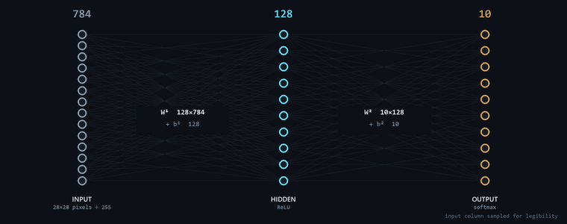
70 000 HANDWRITTEN DIGITS · 60 K TRAIN / 10 K TEST
MNIST — the standard first problem
METER
GATEWAY
BROKER
PHONE
NET
TEST ACCURACY
97.65 %
10 000 unseen
real samples, read straight out of data/t10k-images-idx3-ubyte
WHY THIS SHAPE
— 784 in 28 × 28 pixels flattened and divided by 255. No convolution, no augmentation at train time.
— 128 hidden, ReLU wide enough to learn stroke parts, small enough that the whole weight file is 407 KB and fits in a phone asset.
— 10 out, softmax ten probabilities that sum to one — which is what makes a confidence gate meaningful later.
Written from scratch: no TensorFlow, no PyTorch, no BLAS. Roughly 900 lines of C++17, every derivative derived by hand and checked numerically.
OSOS · DKM-440 remote meter reading
18

Slide 20
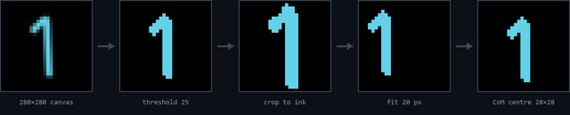
MX-1 AND MX-2 — THE SEAM BETWEEN THE TWO SPECS
From the trainer to the phone
METER
GATEWAY
BROKER
PHONE
NET
ONE STROKE, EIGHT STEPS — AND TWO INDEPENDENT IMPLEMENTATIONS OF IT
MX-1 WEIGHT PARITY
w.bin exports to nnc-json-1 (base64 LE float32) and loads bit-identically in both runtimes — www/nn.js and Android Weights.kt. One trained artifact, two consumers, zero re-training.
280×280 canvas · stroke 20 round cap · R-channel · threshold 25 · ink ≥ 30 · fit 20 px block-average · centre-of-mass in 28×28
MX-2 IS THE ONE REAL PIECE OF TECHNICAL DEBT
MX-5 ROUND TRIP
draw.js and Preprocess.kt must produce byte-identical 784-vectors from the same stroke. Two hand-ported implementations of an eight-step pixel pipeline — and no test pinning them together.
label,p0..p783
Symbols drawn on the phone export in exactly the CSV format data_mnist.cpp already ingests, so the full network can be retrained on personal symbols with a wider output layer.
A divergence would not crash anything. It would silently change which command fires. One golden-vector fixture — a single stroke and its expected 784 bytes, asserted in both runtimes — closes it.
OSOS · DKM-440 remote meter reading
19

Slide 21
PART FOUR
The phone is the head-end
Live values, alarm rules, and a drawing pad that turns a symbol into a command — with a gate in front of it.
METER
GATEWAY
BROKER
PHONE
NET
OSOS · DKM-440 remote meter reading
20

Slide 22
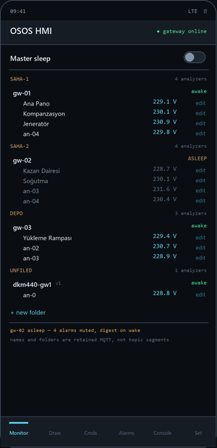
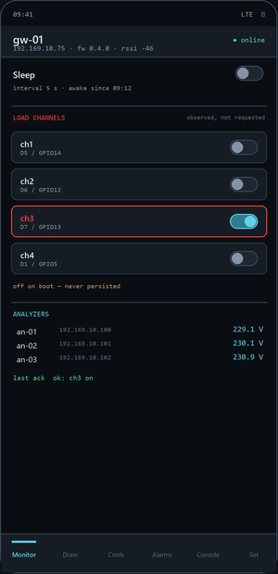
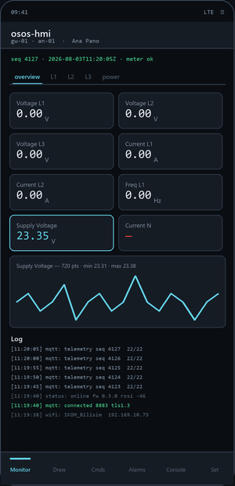
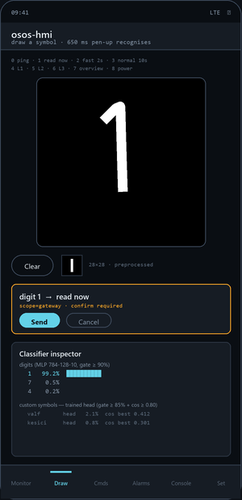
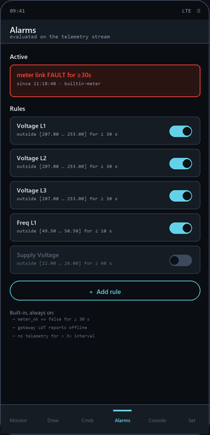
KOTLIN · JETPACK COMPOSE · HIVEMQ MQTT CLIENT
osos-hmi
METER
GATEWAY
BROKER
PHONE
NET
FLEET
MODEM
MONITOR
DRAW
ALARMS
Every modem and analyzer, in the operator's own folders. Asleep modems dim. One master sleep switch.
One modem's observed state: sleep, interval, and four load channels switched from the phone.
Five tile views for the selected analyzer; tap a tile for its sparkline over the last 720 frames.
650 ms of pen-up idle triggers recognition, so multi-stroke symbols still work. Every result opens the inspector.
Rules on the telemetry stream. Muted while asleep — still recorded, and returned as a digest on wake.
osos-hmi 0.3.0 · screens redrawn from the Compose source, not photographed
21

Slide 23
PROTOCOL V2 · MANY MODEMS × MANY ANALYZERS
From one meter to a fleet
METER
GATEWAY
BROKER
PHONE
NET
The machine owns the addresses. The operator owns the names.
A modem announces what it actually polls on a retained registry topic; the app annotates it with names and folders on a separate retained topic it alone owns. Two writers, two topics, no shared field — so a rename can never corrupt a Modbus address, and neither can win a race with the other.
Multiple analyzers
Sleep mode
Modem energy
Load control
FLAT IDS, FOLDERS AS METADATA
MUTE, NEVER DEAF
NEVER DEEP SLEEP
FOUR CHANNELS, OFF ON BOOT
an-01 stays an-01 for life. Names and folders live in MQTT, not in the topic, so a rename moves no data and breaks no history. The simulator runs 25 per modem; the ESP8266 is capped at 8 by its buffer.
Alarms keep evaluating while asleep — only the notification is suppressed, and everything suppressed comes back as a digest on wake. Per-modem, plus one master switch. The overnight record survives the quiet.
Sleep means a 5 s → 300 s interval and a lower radio duty cycle, with the broker connection intact. Deep sleep would drop the very link the wake command arrives on, and fire the LWT — reporting the modem dead while it merely rested.
Relay channels on the modem's own GPIO — not a meter register, so the DKM-440 command block stays untouched. Loads are never persisted: re-closing a contactor after a power cut has to be a decision, not a default.
AND THE ONE THAT COSTS NOTHING
Versioned
Backward compatible
Free rollback
every v2 payload carries "v": 2 — the legacy topics carry none and are v1 by definition
the old gateway still renders, tagged v1, with no special case in the reducer
if the flash goes wrong the demo degrades to v1 rather than dying
OSOS · DKM-440 remote meter reading
22

Slide 24
ONE JSON FILE IS THE SINGLE SOURCE OF TRUTH
Adding a command
METER
GATEWAY
BROKER
PHONE
NET
config/commands.json
HOW TO ADD ONE
{
"digits": {
"0": { "scope": "gateway", "action": "ping" },
"1": { "scope": "gateway", "action": "read_now" },
"2": { "scope": "gateway", "action": "set_interval",
"args": { "seconds": 2 } },
"4": { "scope": "local", "action": "view",
"args": { "page": "L1" } },
"9": { "scope": "none", "action": "unassigned" }
}
}
— Pick a free digit. 9 is reserved and unassigned; that is the cheapest slot.
— Choose a scope. gateway means it leaves the phone. local means it only changes what the phone shows.
— Name an existing action. ping, read_now, set_interval, view — the firmware and BOUND_ACTIONS both key off these strings.
— Regenerate the assets. the same file is bundled into the app and served to the browser HMI, so they cannot disagree.
TWO SCOPES, TWO RISK PROFILES
scope = local
scope = gateway
Fires instantly from the prediction. A misread switches to the wrong tile view — harmless, and instantly obvious.
Leaves the phone and reaches an industrial device. Requires confidence ≥ 0.90 and an explicit Send tap. Never fires on recognition alone.
OSOS · DKM-440 remote meter reading
23

Slide 25
MX-3 — THE REQUIREMENT THAT EXISTS BECAUSE OF THAT ASYMMETRY
A guess in front of an actuator
METER
GATEWAY
BROKER
PHONE
NET
Recognition never actuates. It only ever proposes.
1
Confidence gate
softmax ≥ 0.90 for digits · head ≥ 0.85 with a cosine ≥ 0.80 sanity check for custom symbols
2
Human gate
a gateway command arms a confirm bar and is published only after an explicit Send tap
3
Structural gate
relay and dkm_write are absent from the firmware source — not flag-disabled, not commented out, absent
The third gate is the one that matters. The first two are policy and can be changed by a settings screen; the third cannot be reached by any configuration, because there is no code to reach.
OSOS · DKM-440 remote meter reading
24

Slide 26
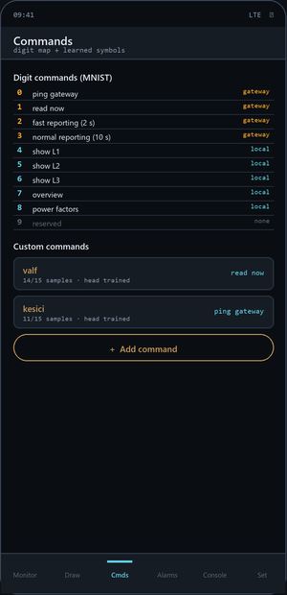
A LOGISTIC HEAD TRAINED ON-DEVICE OVER A FROZEN EMBEDDING
Teaching it your own symbol
METER
GATEWAY
BROKER
PHONE
NET
WHAT HAPPENS WHEN YOU SAVE 10 SAMPLES
1
Freeze the MLP
The 784-128-10 network is not retrained. Its 128-unit ReLU hidden layer is reused as an embedding — a compact description of what was drawn.
2
Augment ×5
Each stored 28×28 is shifted by ±1 and ±2 px, turning 10–15 samples into 50–75 training vectors for free.
3
Train a head
A logistic regression head, 128 → N, by SGD with L2. N is however many custom commands exist. Training finishes in milliseconds and reruns automatically whenever samples change.
4
Gate twice
The head's softmax must clear 0.85 and the best stored sample's cosine must clear 0.80. While a class has under 10 samples the head is not trusted at all — it falls back to pure cosine ≥ 0.93.
The inspector shows head softmax, per-class cosine and the digit MLP's top-3 after every recognition — a match is never a black box.
OSOS · DKM-440 remote meter reading
25

Slide 27
AND WHY THE RULES CANNOT LIVE IN THE FIRMWARE
Adding an alarm
METER
GATEWAY
BROKER
PHONE
NET
THE CONSTRAINT THAT DECIDED THIS
The Modbus read budget is fixed by the report interval. You cannot poll faster to evaluate a threshold without breaking the polite-master rule — so alarms are evaluated on the telemetry stream the gateway already publishes, and cost zero extra reads.
A RULE IS FOUR FIELDS
key
which telemetry value
MainBus_Voltage_L1
min / max
the acceptable band
207.00 … 253.00
holdSec
how long it must stay out
30
enabled
armed or not
true
The hold timer is what makes it usable: a single noisy frame will not wake anyone at 3 a.m.
THREE RULES YOU DO NOT HAVE TO WRITE
meter_ok == false
gateway LWT
telemetry silence
for ≥ 30 s
retained status says offline
no frame for > 3× the interval
OSOS · DKM-440 remote meter reading
26

Slide 28
EVIDENCE-BASED · NOTHING HERE IS ROUNDED UP
Where it actually stands
METER
GATEWAY
BROKER
PHONE
NET
PROVEN ON HARDWARE
CODE COMPLETE, UNPROVEN
OPEN, AND SAID SO
22/22 registers, 15 consecutive cycles
cmd/ack on the ESP8266 — compiles, not flashed
sleep current never measured on a meter (F-6)
PC client read the same value, same second
sleep and 4 load channels — same
no broker role separation or ACLs (BR-2)
TLS 1.3 handshake, server verified (BR-1)
power-pull → retained offline (A2)
store-and-forward: buffered is always false
meter address survives a power cycle
< 2 s command latency (NF-1)
no golden-vector test for MX-2 parity
fleet tree renders 2 modems + a v1 gateway
RS-485 gateway — never run on hardware
supply channel reads ≈2 % high, uninvestigated
gradient check 1e-9 · MNIST 97.65 % (SRS-02)
overnight soak — not yet attempted
mains accuracy never verified against a DMM
credentials out of version control
The PC head-end was superseded, not skipped. HE-1…HE-5 were written before the Android app existed. The phone is the head-end now, and those five requirements should be rewritten to say so rather than left looking failed.
OSOS · DKM-440 remote meter reading
27

Slide 29
DOCS/IKOM_APPLICATIONS.MD · 2026-07-31
What this is worth to IKOM
METER
GATEWAY
BROKER
PHONE
NET
The valuable line in the repository is the architecture, not the register map.
Three of the four pieces built here are vendor-neutral. Any Modbus field device can go behind this gateway in about a day once its map is known — and the method for deriving an unknown map is itself written down.
Submetering
Power quality
OSOS as a service
Street lighting
RECOMMENDED FIRST
BEST MARGIN
SHORTEST PATH TO REVENUE
One DKM-440 covers 30 single-phase feeders — an entire distribution panel at one Modbus address. Apartment blocks, shopping centres, organised industrial zones. One meter, one gateway, thirty billable circuits.
The meter measures harmonics to the 17th, THD-V/I and imbalance — none of it currently exposed. Instrument a plant for a fortnight, produce a report, recommend filters. Sells expertise, not boxes.
Automatic meter reading is regulated and recurring in Turkey. This is already most of a compliant reader; the gap is data integrity, history and a reporting front end — not new hardware.
An astronomical time relay plus two remotely drivable relays, in the same box as the measurement. Municipal lighting maps onto it almost exactly.
BEFORE ANY OF THEM
Store-and-forward
A historian
Per-device credentials
a reader that silently drops data during a network blip cannot be a system of record
720 frames in RAM is monitoring; billing and compliance need durable history
cheap to fix now, expensive after the first customer site
OSOS · DKM-440 remote meter reading
28

Slide 30
FOUR STEPS · DOCS/BROKER_ACL.MD CARRIES THE DETAIL
Putting it into production
METER
GATEWAY
BROKER
PHONE
NET
ADDING A METER IS ONE LINE
1 · Per-modem credentials
// firmware8266/osos_gw8266/config.h
static const AnalyzerCfg CFG_ANALYZERS[] = {
{ "an-01", "192.169.10.74", 502, 1, 5 },
{ "an-02", "192.169.10.75", 502, 1, 5 }, // <- new
};
#define CFG_MODEM_ID "gw-01" // per modem
One broker user per modem, plus one head-end user, with the ACLs in docs/BROKER_ACL.md. This is the one item still open (BR-2) and the only one that is a security issue rather than a feature.
2 · Point it at your broker
CFG_MQTT_HOST in config.h, and the app's Settings screen. Nothing else is broker-specific — no EMQX API, no vendor extension.
No topic changes, no app rebuild, no migration. The analyzer appears in the tree the moment the modem republishes its registry, named an-02 until someone names it properly from the phone.
3 · Own the metadata
osos/m/+/labels and osos/tree are retained JSON the app writes. A bridge into IKOM Data Manager subscribes to those two topics and the fleet is in your database, named.
WHAT IS ALREADY VENDOR-NEUTRAL
The topic grammar
The gateway
The app
4 · Store-and-forward first
one file per language, three implementations that must agree
any Modbus TCP device, once its register map is known
subscribes fleet-wide; it has no idea what a DKM-440 is
buffered is always false today. A reader that silently drops data during a network blip cannot be a system of record — this is the gate before any billing use.
The register map is the part that is specific to this meter. Everything above it moves.
OSOS · DKM-440 remote meter reading
29

Slide 31
IN ONE SENTENCE
A register inside an industrial meter
now reaches a phone in five seconds,
and a drawing sends one back.
Everything between those two ends — the polite-master pacing, the one-UART constraint, the least-squares register hunt, the TLS buffer negotiation, the confidence gate — is the actual work. The demo is the receipt.
STILL OWED
flashing v0.4 to the ESP8266 — it compiles, it has not run
broker role separation and ACLs
the awake-vs-asleep current, measured not assumed
a DMM across the meter's own supply terminals
METER
GATEWAY
BROKER
PHONE
NET
SRS-00 · SRS-01 · SRS-02 · delivery 2026-08-06

