Slide 1
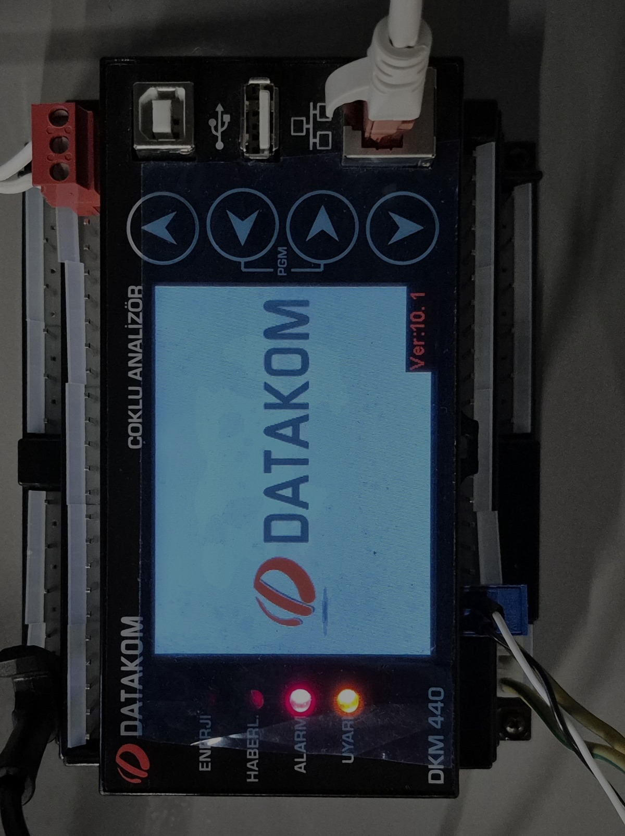
IKOM · STAJ TESLİMİ · 2026-08-06
Reading a power
analyser from a phone
A DATAKOM DKM-440 is read over Modbus TCP, republished as JSON over
MQTT/TLS, and displayed on an Android phone — where a from-scratch
C++ neural network turns a hand-drawn symbol into a gateway command.
Industrial telemetry is taught in slices; this bench is the whole path, on one desk.
DKM-440
ESP8266
EMQX / TLS 1.3
Android
C++17 MLP
Every figure in this deck is a measured value from the bench, or it is labelled as unproven.

Slide 2
VERIFIED END TO END · 2026-07-28
What runs today
METER
GATEWAY
BROKER
PHONE
NET
DKM-440
Modbus
TCP
ESP8266
MQTT
TLS
EMQX
MQTT
sub
osos-hmi
192.169.10.74:502
Modbus TCP · unit 1
192.169.10.75
Wi-Fi · gateway
…emqxsl.com:8883
TLS 1.3 · retained + LWT
Android · Kotlin
live tiles · alarms
22 / 22
5 s
TLS 1.3
97.65 %
REGISTERS PER CYCLE
REPORT INTERVAL
TO THE BROKER
MNIST TEST ACCURACY
15 consecutive cycles
fixed read budget
DigiCert G2 verified
784-128-10, from scratch
— Cross-checked, not self-reported. A PC-side Modbus client read the same value the gateway published, in the same second.
— The meter cannot move. Its address is a DHCP reservation on MAC 00-00-36-7F-04-55, because CFG_METER_HOST is a compile-time constant.
OSOS · DKM-440 remote meter reading
01

Slide 3
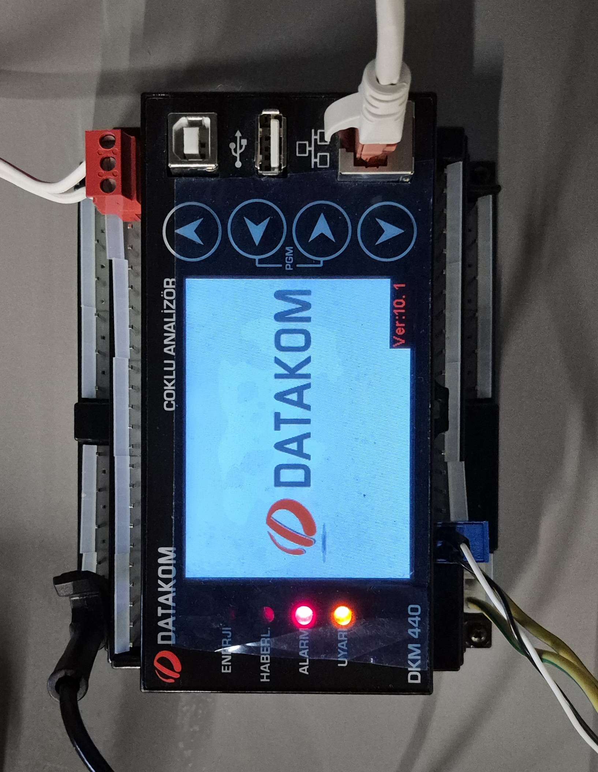
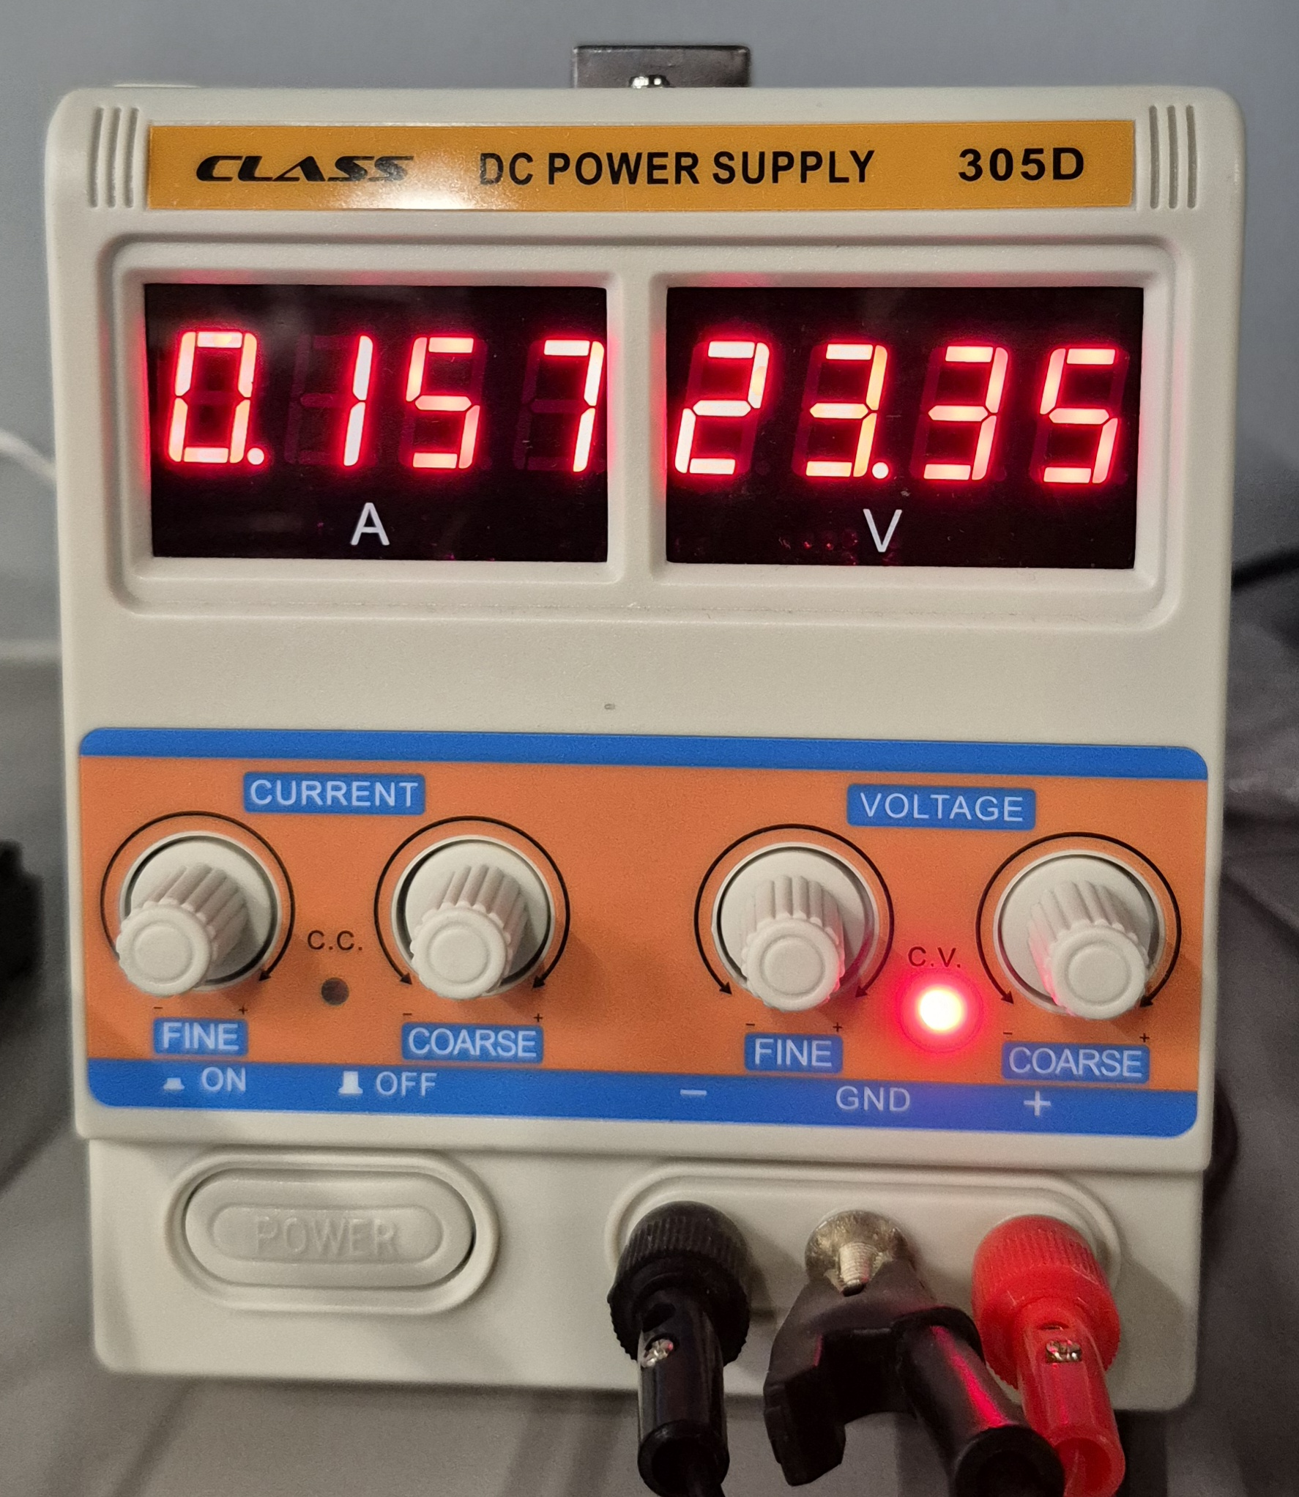
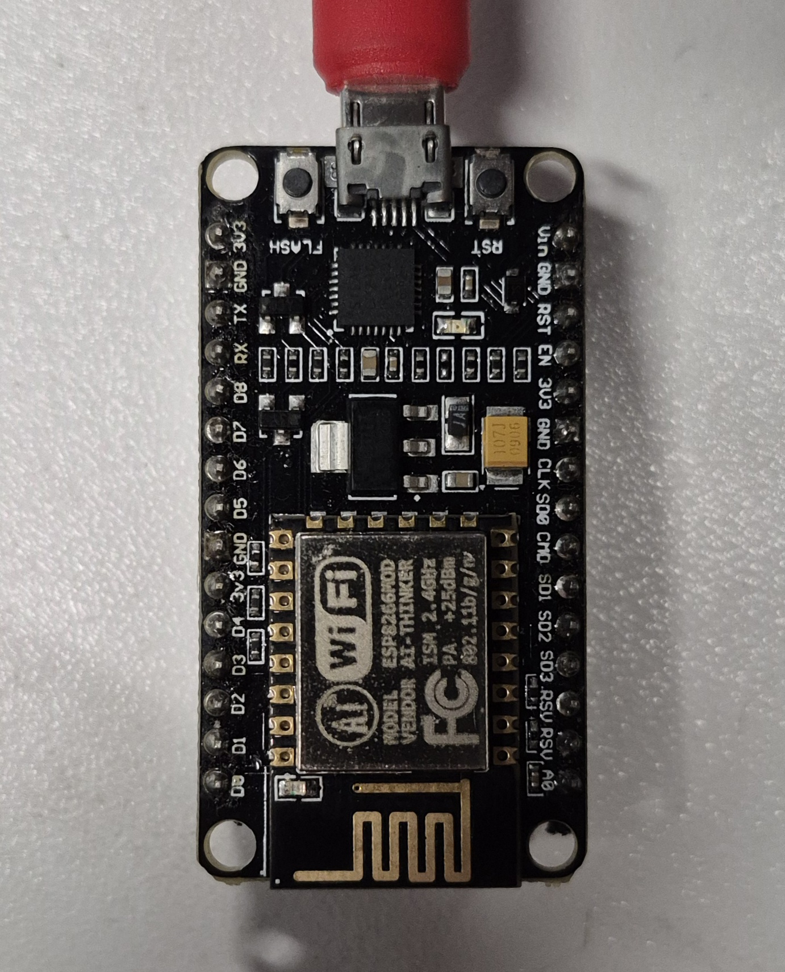
PHOTOGRAPHED 2026-07-28
The hardware
METER
GATEWAY
BROKER
PHONE
NET
THE SUBNET
router
192.169.10.1
bench PC
.72 DHCP
DKM-440
.74 reserved
ESP8266
.75 DHCP
SSID IKOM_Bilisim
RSSI −46 dBm
192.169.x.x is not private address space — 192.168 was meant. It only shadows real hosts inside that block, so it stays. Recorded so nobody rediscovers it.
DATAKOM DKM-440 · Ver 10.1
RJ45 top edge — Modbus TCP :502
CLASS 305D · 23.35 V @ 0.157 A
variable — the dial is not a constant
Ai-Thinker ESP-8266MOD · COM11
802.11 b/g/n — the WAN bridge
The meter is LAN-only and has no business on the internet. The ESP8266 is the one controlled egress point: it translates registers into JSON and speaks outward to a broker, so nothing on the internet ever addresses the meter.
OSOS · DKM-440 remote meter reading
02

Slide 4
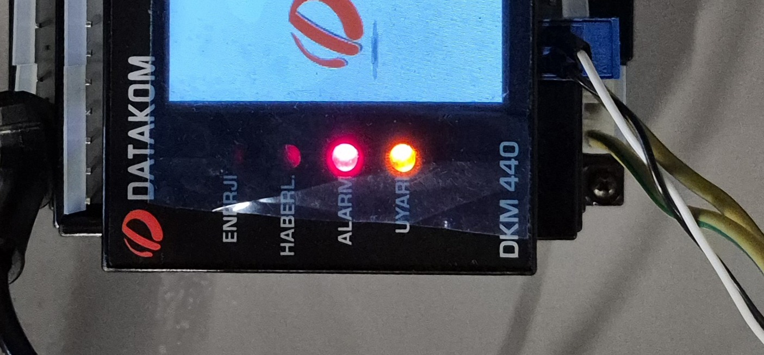
TWO ALARM LAMPS LIT, AND ONE NUMBER THAT KEEPS MOVING
Reading the panel honestly
METER
GATEWAY
BROKER
PHONE
NET
THE FOUR LAMPS
ENERJİ
off
energy accumulation
HABERL.
off
communications
ALARM
LIT
an AC meter with no AC connected
UYARI
LIT
warning — absent phases
the status LEDs, bottom edge of the panel
EVERY AC REGISTER READS ZERO — CORRECTLY
0.000 is not null
MainBus_Voltage_L1 100 = 0.000
MainBus_Current_L1 180 = 0.000
MainBus_Freq_L1 266 = 0.000
A zero means read correctly, genuinely zero. A null means the register could not be read at all. The gateway publishes the key either way — requirement FW-12 — so the two never merge.
It matters because this is a True-RMS AC analyser with nothing on its voltage or current inputs. The lamps are not a fault; they are the device correctly complaining about absent phases.
SUPPLY_VOLTAGE · REGISTER 40260
26.5 V
13.2 V
23.35 V
2026-07-23
07-28 · gw + PC
07-28 · dial
All three correct when recorded: a live readback of the bench dial, not a property of the meter — a staleness canary, never a reference.
OPEN · the app reads ≈2 % above the supply's own display, always the same way. Cable loss has the wrong sign; one DMM across the meter's own terminals settles it.
OSOS · DKM-440 remote meter reading
03

Slide 5
TWO HOPS, SEVEN LAYERS, ONE PAYLOAD
The whole system, on the OSI model
METER
GATEWAY
BROKER
PHONE
NET
LAYER
HOP 1 METER → GATEWAY
HOP 2 GATEWAY → BROKER → PHONE
7
Application
Modbus FC03 read holding registers
MQTT 3.1.1 PUBLISH / SUBSCRIBE
L7
6
Presentation
IEEE-754 float32, big-endian word order
JSON UTF-8 · weights as base64 LE float32
L6
5
Session
MBAP transaction id pairs reply to request
MQTT session, keepalive, retained status + LWT
L5
4
Transport
TCP port 502
TCP port 8883, wrapped in TLS 1.3
L4
3
Network
IPv4 192.169.10.75 → 192.169.10.74
IPv4 → …ala.eu-central-1.emqxsl.com
L3
2
Data link
Ethernet II MAC 00-00-36-7F-04-55
802.11 b/g/n CSMA/CA, SSID IKOM_Bilisim
L2
1
Physical
Cat5e twisted pair, RJ45
2.4 GHz ISM RSSI −46 dBm at the bench
L1
HOP 1 — 67 BYTES TO CARRY 4
HOP 2 — ≈150 BYTES TO CARRY ONE VALUE
eth 14 · ip 20 · tcp 20 · mbap 7 · fc03 2 · float32 4
802.11 34 · ip+tcp 40 · tls 22 · publish 28 · json 26
Representation changes twice; the value never. float32 on the meter side, decimal text on the broker side — String(v, 3) is the only transformation in the chain, and nothing scales, offsets or corrects the reading anywhere.
OSOS · DKM-440 remote meter reading
04

Slide 6
23.35 V LEAVING THE METER AND ARRIVING AT THE PHONE
Four bytes, wrapped twice
METER
GATEWAY
BROKER
PHONE
NET
HOP 1 — WHAT THE METER SENDS
HOP 2 — WHAT THE PHONE RECEIVES
Ethernet II header
14 B
802.11 frame
~34 B
IPv4 header
20 B
IPv4 + TCP
40 B
TCP header
20 B
ESP8266
TLS 1.3 record AEAD sealed
~22 B
MBAP header tid · pid · len · unit
7 B
decode
+ re-wrap
MQTT PUBLISH osos/{gw}/telemetry
~28 B
FC03 reply fn + byte count
2 B
"Supply_Voltage": 23.350
~26 B
41 BA CC CD ← the value
4 B
the full 22-register frame is under 1 KB (NF-2, still unmeasured)
67 bytes on the wire to carry 4 bytes of measurement
— The number changes representation twice, and value never. Binary float32 on the meter side, decimal text on the broker side. String(v, 3) is the only transformation, and it is lossy in the third decimal by design — nothing scales, offsets or corrects the reading anywhere in the chain.
OSOS · DKM-440 remote meter reading
05

Slide 7
FUNCTION CODE 03 · BIG-ENDIAN FLOAT32 ACROSS TWO REGISTERS
One register read, byte for byte
METER
GATEWAY
BROKER
PHONE
NET
ESP8266 → 192.169.10.74:502
192.169.10.74:502 → ESP8266
REQUEST 12 bytes
00 01 transaction id
00 00 protocol id (0 = Modbus)
00 06 length of what follows
01 unit id
03 FC03 read holding registers
01 04 start address 260
00 02 quantity: 2 registers
RESPONSE 13 bytes
00 01 transaction id — pairs the reply
00 00 protocol id
00 07 length
01 unit id
03 FC03 echoed
04 byte count
41 BA CC CD → 23.350 V
THE DEVICE'S TEMPER
AND TO CONCURRENT MASTERS
WHY ETHERNET, NOT RS-485
The DKM-440 stops answering a master that fires requests back to back. A property of the device, not the transport — it survived the move from RS-485 to TCP unchanged.
gateway alone
22/22 ×15
The ESP8266 has one usable UART: UART1 cannot receive, so Modbus RTU would have to take the console port. Over TCP the serial console stays usable — and every diagnosis in this project was read off it.
+ one PC client
21/22
kReadGapMs = 30
Close QModMaster, server.py and every PC client before an acceptance run.
READ_RETRIES = 1
seq=15 22/22 regs besleme=23.350
OSOS · DKM-440 remote meter reading
06

Slide 8
MODBUS/DKM_440_MAPPING/METHOD.MD
Finding a register nobody documented
METER
GATEWAY
BROKER
PHONE
NET
A measurement register holds raw = scale × value. Drive the value to several known points; the register whose raw plots a straight line against them is that measurement, and the slope is the scale.
1
2
3
4
Move one thing
Record 3–5 points
Least-squares every register
Rank, then verify
On a bench a single source feeds every input, so a static dump shows the same number in a dozen registers. Motion is the discriminator.
Two points pin a line; three to five across a wide range give a meaningful R² and expose non-linearity.
Fit raw = m·V + b. The true register scores R² ≈ 1.000; noise and drift score low. Constant registers are skipped — no line to fit.
R² first, swing second, so a perfectly-fitting-but-barely-moving artefact cannot win. Then cross-check the winner against the TEDAŞ table.
find_register.py OUTPUT
STANDING CONSTRAINT C-4
addr R^2 slope(raw/V) intercept scale swing
20480 1.0000 10.000 0.00 10 500
20500 0.7500 -0.020 2624.17 1 1
never touch 16385–16406
Neither read nor write. The scan scripts exclude the block explicitly.
top row: R²=1.0000, big swing → that is the register, scale ÷10
OSOS · DKM-440 remote meter reading
07

Slide 9
MQTT OVER TLS 1.3 TO EMQX SERVERLESS · ONE FIVE-SECOND CYCLE
Getting it off the bench
METER
GATEWAY
BROKER
PHONE
NET
22 register reads
idle
0 ms
~730 ms
~1.0 s
5 000 ms
22 × (request + 30 ms gap) ≈ 730 ms
encode · ArduinoJson 7
publish · one TLS record
The remaining ≈4 s is idle by design — alarm rules therefore live on the phone, over the stream the gateway already publishes.
osos/dkm440-gw1/telemetry
TOPICS
{ "ts": "2026-08-03T11:20:05Z",
"seq": 4127,
"buffered": false,
"meter_ok": true,
"values": {
"Supply_Voltage": 23.350,
"MainBus_Voltage_L1": 0.000,
"MainBus_Current_N": null,
… 22 keys total
} }
osos/{gw}/telemetry
every 5 s · the 22 values
osos/{gw}/status
retained · online/offline + LWT
osos/{gw}/event
link loss, recovery, boot
osos/{gw}/cmd
phone → gateway
osos/{gw}/ack
gateway → phone
cmd/ack are implemented on the phone, the ESP32-S3 build and now the ESP8266 v0.4 firmware — which compiles but has not been flashed.
TLS 1.3 — AND WHERE IT STOPS
seq · monotonic per boot — a gap is detectable
buffered · honestly false; store-and-forward did not fit in 36 KB
null vs 0.000 · not read, versus read as genuinely zero
MFLN lets BearSSL run 1 KB receive buffers instead of 16 KB — the only reason TLS coexists with the JSON encoder at 92 % IRAM. Server verified against a DigiCert G2 anchor, config.h gitignored. Gateway and head-end still share one credential.
OSOS · DKM-440 remote meter reading
08

Slide 10
NEURAL_NET_C/EXPLANATION.MD · EVERY DERIVATIVE BY HAND
The network, from one neuron to training
METER
GATEWAY
BROKER
PHONE
NET
A NEURON IS A WEIGHTED SUM
WHY THERE MUST BE A HIDDEN LAYER
zⱼ = Σᵢ ( Wⱼᵢ · inᵢ ) + bⱼ
No straight line separates XOR's ones from its zeros. Each hidden neuron draws its own line, building coordinates in which the classes become separable — and f must be non-linear, or any depth collapses back into a single matrix.
1
0
Multiply each input by its own weight, add a bias, produce one number. Many in parallel is a layer, layers in sequence are a network, and choosing W and b automatically is training.
0
1
XOR
FORWARD
LOSS
BACKWARD
STEP
a^0 = x
z^l = W^l·a^(l-1) + b^l
a^l = f(z^l)
L = −Σ y_j log a_j
δ^L = a − y
δ^l = (W^(l+1))^T·δ^(l+1)
⊙ f′(z^l)
W ← W − η·(1/n)·Σ δ·a^T
Each layer caches z and a — not an optimisation. Backprop needs both.
Cross-entropy over softmax punishes a confident wrong answer far harder than MSE.
The chain rule written out. With softmax + cross-entropy the output term collapses to a − y.
Mini-batch SGD: shuffle, accumulate over 64 samples, take one averaged step.
THE REST OF IT — main_mnist.cpp
HOW WE KNOW THE DERIVATIVES ARE RIGHT
max |analytic − numeric| < 1e-9
EPOCHS 10 · BATCH 64 · ETA 0.1 · Fisher–Yates shuffle per epoch
gradcheck.cpp perturbs every weight by ±ε and compares the finite difference against backprop.
weights scaled by fan-in · softmax with max subtracted
sigmoid s′ = s(1−s) peaks at 0.25 · ReLU r′ = 1 does not vanish
OSOS · DKM-440 remote meter reading
09

Slide 11

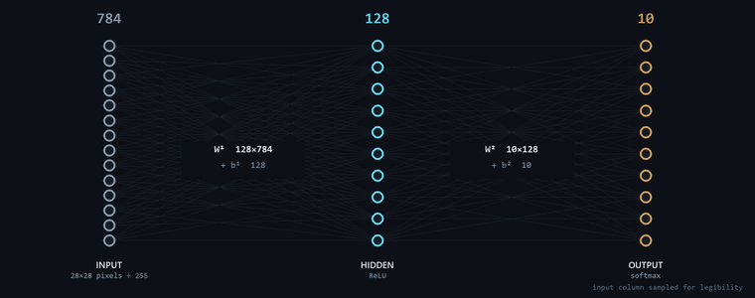
70 000 HANDWRITTEN DIGITS · 60 K TRAIN / 10 K TEST
MNIST — the standard first problem
METER
GATEWAY
BROKER
PHONE
NET
TEST ACCURACY
97.65 %
10 000 unseen
real samples, read straight out of data/t10k-images-idx3-ubyte
WHY THIS SHAPE
— 784 in 28 × 28 pixels flattened and divided by 255. No convolution, no augmentation at train time.
— 128 hidden, ReLU wide enough to learn stroke parts, small enough that the whole weight file is 407 KB and fits in a phone asset.
— 10 out, softmax ten probabilities that sum to one — which is what makes a confidence gate meaningful later.
Written from scratch: no TensorFlow, no PyTorch, no BLAS. Roughly 900 lines of C++17, every derivative derived by hand and checked numerically.
OSOS · DKM-440 remote meter reading
18

Slide 12
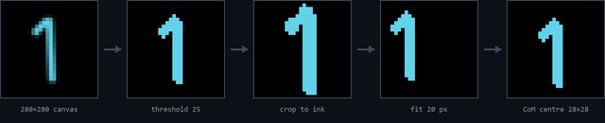
70 000 HANDWRITTEN DIGITS · 60 K TRAIN / 10 K TEST
MNIST, and the seam to the phone
METER
GATEWAY
BROKER
PHONE
NET
TEST ACCURACY
97.65 %
10 000 unseen
real samples, read straight out of data/t10k-images-idx3-ubyte
ONE STROKE, EIGHT STEPS — AND TWO INDEPENDENT IMPLEMENTATIONS OF IT
WHY THIS SHAPE
— 784 in 28 × 28 pixels flattened and divided by 255. No convolution, no augmentation at train time.
— 128 hidden, ReLU wide enough for stroke parts, small enough that the whole weight file is 407 KB and fits in a phone asset.
— 10 out, softmax ten probabilities summing to one — which is what makes a confidence gate meaningful.
280×280 canvas · stroke 20 round cap · R-channel · threshold 25 · ink ≥ 30 · fit 20 px block-average · centre-of-mass in 28×28
MX-2 IS THE ONE REAL PIECE OF TECHNICAL DEBT
MX-1 WEIGHT PARITY
draw.js and Preprocess.kt must produce byte-identical 784-vectors from the same stroke — two hand-ported implementations of that eight-step pipeline, with no test pinning them together. A divergence would not crash anything; it would silently change which command fires.
w.bin exports to nnc-json-1 and loads bit-identically in www/nn.js and Android Weights.kt. One trained artifact, two consumers, zero re-training.
no TensorFlow, no PyTorch, no BLAS · ~900 lines of C++17, every derivative derived by hand
10

Slide 13
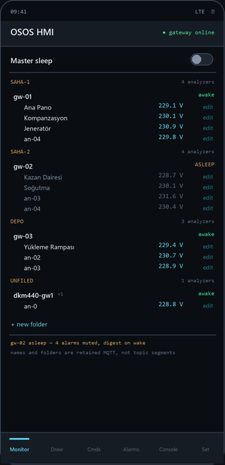
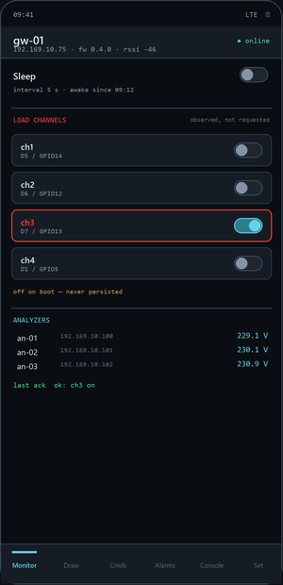
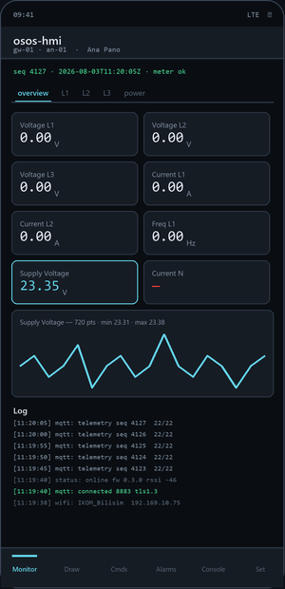
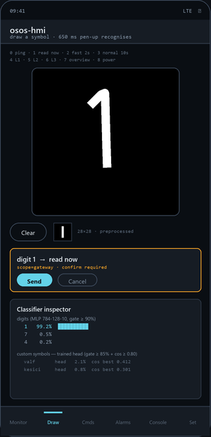
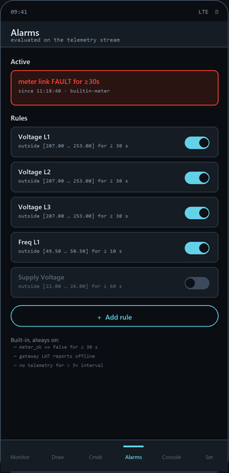
KOTLIN · JETPACK COMPOSE · HIVEMQ MQTT CLIENT
osos-hmi
METER
GATEWAY
BROKER
PHONE
NET
FLEET
MODEM
MONITOR
DRAW
ALARMS
Every modem and analyzer, in the operator's own folders. Asleep modems dim. One master sleep switch.
One modem's observed state: sleep, interval, and four load channels switched from the phone.
Five tile views for the selected analyzer; tap a tile for its sparkline over the last 720 frames.
650 ms of pen-up idle triggers recognition, so multi-stroke symbols still work. Every result opens the inspector.
Rules on the telemetry stream. Muted while asleep — still recorded, and returned as a digest on wake.
osos-hmi 0.3.0 · screens redrawn from the Compose source, not photographed
11

Slide 14
PROTOCOL V2 · MANY MODEMS × MANY ANALYZERS
From one meter to a fleet
METER
GATEWAY
BROKER
PHONE
NET
The machine owns the addresses. The operator owns the names.
A modem announces what it actually polls on a retained registry topic; the app annotates it with names and folders on a separate retained topic it alone owns. Two writers, two topics, no shared field — so a rename can never corrupt a Modbus address, and neither can win a race with the other.
Multiple analyzers
Sleep mode
Modem energy
Load control
FLAT IDS, FOLDERS AS METADATA
MUTE, NEVER DEAF
NEVER DEEP SLEEP
FOUR CHANNELS, OFF ON BOOT
an-01 stays an-01 for life. Names and folders live in MQTT, not in the topic, so a rename moves no data and breaks no history. The simulator runs 25 per modem; the ESP8266 is capped at 8 by its buffer.
Alarms keep evaluating while asleep — only the notification is suppressed, and everything suppressed comes back as a digest on wake. Per-modem, plus one master switch. The overnight record survives the quiet.
Sleep means a 5 s → 300 s interval and a lower radio duty cycle, with the broker connection intact. Deep sleep would drop the very link the wake command arrives on, and fire the LWT — reporting the modem dead while it merely rested.
Relay channels on the modem's own GPIO — not a meter register, so the DKM-440 command block stays untouched. Loads are never persisted: re-closing a contactor after a power cut has to be a decision, not a default.
AND THE ONE THAT COSTS NOTHING
Versioned
Backward compatible
Free rollback
every v2 payload carries "v": 2 — the legacy topics carry none and are v1 by definition
the old gateway still renders, tagged v1, with no special case in the reducer
if the flash goes wrong the demo degrades to v1 rather than dying
OSOS · DKM-440 remote meter reading
12

Slide 15
CONFIG/COMMANDS.JSON IS THE SINGLE SOURCE OF TRUTH
A drawing becomes a command
METER
GATEWAY
BROKER
PHONE
NET
config/commands.json
Recognition never actuates.
It only ever proposes.
{
"digits": {
"0": { "scope": "gateway", "action": "ping" },
"1": { "scope": "gateway", "action": "read_now" },
"2": { "scope": "gateway", "action": "set_interval",
"args": { "seconds": 2 } },
"4": { "scope": "local", "action": "view",
"args": { "page": "L1" } },
"9": { "scope": "none", "action": "unassigned" }
}
}
1
Confidence gate
softmax ≥ 0.90 for digits · head ≥ 0.85 with a cosine ≥ 0.80 check for custom symbols
2
Human gate
a gateway command arms a confirm bar and is published only after an explicit Send tap
To add one: pick a free digit — 9 is reserved and unassigned — choose a scope, name an action the firmware already keys off, and regenerate the assets. The same file is bundled into the app and served to the browser HMI, so the two cannot disagree.
3
Structural gate
scope = local
scope = gateway
relay and dkm_write are absent from the firmware source — not flag-disabled, not commented out, absent
Fires straight from the prediction. A misread switches to the wrong tile — harmless, and obvious.
Leaves the phone and reaches an industrial device. Never fires on recognition alone.
The first two gates are policy; the third cannot be reached by any configuration.
OSOS · DKM-440 remote meter reading
13

Slide 16
ON-DEVICE LEARNING AND ALARM RULES · BOTH SIT HERE BECAUSE OF A GATEWAY CONSTRAINT
What the phone does that the gateway cannot
METER
GATEWAY
BROKER
PHONE
NET
TEACHING IT YOUR OWN SYMBOL
ADDING AN ALARM
There is no headroom on an ESP8266 for a model, so learning happens where the samples are drawn.
The Modbus read budget is fixed by the report interval, so a threshold cannot be polled faster without breaking the polite-master rule. Rules are evaluated on the telemetry stream instead, and cost zero extra reads.
1
Freeze the MLP
the 784-128-10 network is not retrained; its 128-unit ReLU layer is reused as an embedding
A RULE IS FOUR FIELDS
2
Augment ×5
key
which telemetry value
MainBus_Voltage_L1
±1 and ±2 px shifts turn 10–15 samples into 50–75 training vectors for free
min / max
the acceptable band
207.00…253.00
3
Train a head
holdSec
how long it must stay out
30
logistic regression 128 → N by SGD with L2, finishing in milliseconds and rerunning whenever samples change
enabled
armed or not
true
The hold timer is what makes it usable: one noisy frame will not wake anyone at 3 a.m.
4
Gate twice
head softmax ≥ 0.85 and best-sample cosine ≥ 0.80; under 10 samples the head is not trusted at all
THREE RULES YOU DO NOT HAVE TO WRITE
meter_ok == false
for ≥ 30 s
The inspector shows head softmax, per-class cosine and the digit MLP's top-3 after every recognition — a match is never a black box.
gateway LWT
retained status says offline
telemetry silence
no frame for > 3× the interval
OSOS · DKM-440 remote meter reading
14

Slide 17
EVIDENCE-BASED · NOTHING HERE IS ROUNDED UP
Where it actually stands
METER
GATEWAY
BROKER
PHONE
NET
PROVEN ON HARDWARE
CODE COMPLETE, UNPROVEN
OPEN, AND SAID SO
22/22 registers, 15 consecutive cycles
cmd/ack on the ESP8266 — compiles, not flashed
sleep current never measured on a meter (F-6)
PC client read the same value, same second
sleep and 4 load channels — same
no broker role separation or ACLs (BR-2)
TLS 1.3 handshake, server verified (BR-1)
power-pull → retained offline (A2)
store-and-forward: buffered is always false
meter address survives a power cycle
< 2 s command latency (NF-1)
no golden-vector test for MX-2 parity
fleet tree renders 2 modems + a v1 gateway
RS-485 gateway — never run on hardware
supply channel reads ≈2 % high, uninvestigated
gradient check 1e-9 · MNIST 97.65 % (SRS-02)
overnight soak — not yet attempted
mains accuracy never verified against a DMM
credentials out of version control
The PC head-end was superseded, not skipped. HE-1…HE-5 were written before the Android app existed. The phone is the head-end now, and those five requirements should be rewritten to say so rather than left looking failed.
OSOS · DKM-440 remote meter reading
15

Slide 18
DOCS/IKOM_APPLICATIONS.MD · 2026-07-31
What this is worth to IKOM
METER
GATEWAY
BROKER
PHONE
NET
The valuable line in the repository is the architecture, not the register map.
Three of the four pieces built here are vendor-neutral. Any Modbus field device can go behind this gateway in about a day once its map is known — and the method for deriving an unknown map is itself written down.
Submetering
Power quality
OSOS as a service
Street lighting
RECOMMENDED FIRST
BEST MARGIN
SHORTEST PATH TO REVENUE
One DKM-440 covers 30 single-phase feeders — an entire distribution panel at one Modbus address. Apartment blocks, shopping centres, organised industrial zones. One meter, one gateway, thirty billable circuits.
The meter measures harmonics to the 17th, THD-V/I and imbalance — none of it currently exposed. Instrument a plant for a fortnight, produce a report, recommend filters. Sells expertise, not boxes.
Automatic meter reading is regulated and recurring in Turkey. This is already most of a compliant reader; the gap is data integrity, history and a reporting front end — not new hardware.
An astronomical time relay plus two remotely drivable relays, in the same box as the measurement. Municipal lighting maps onto it almost exactly.
BEFORE ANY OF THEM
Store-and-forward
A historian
Per-device credentials
a reader that silently drops data during a network blip cannot be a system of record
720 frames in RAM is monitoring; billing and compliance need durable history
cheap to fix now, expensive after the first customer site
OSOS · DKM-440 remote meter reading
16

Slide 19
FOUR STEPS · DOCS/BROKER_ACL.MD CARRIES THE DETAIL
Putting it into production
METER
GATEWAY
BROKER
PHONE
NET
ADDING A METER IS ONE LINE
1 · Per-modem credentials
// firmware8266/osos_gw8266/config.h
static const AnalyzerCfg CFG_ANALYZERS[] = {
{ "an-01", "192.169.10.74", 502, 1, 5 },
{ "an-02", "192.169.10.75", 502, 1, 5 }, // <- new
};
#define CFG_MODEM_ID "gw-01" // per modem
One broker user per modem, plus one head-end user, with the ACLs in docs/BROKER_ACL.md. This is the one item still open (BR-2) and the only one that is a security issue rather than a feature.
2 · Point it at your broker
CFG_MQTT_HOST in config.h, and the app's Settings screen. Nothing else is broker-specific — no EMQX API, no vendor extension.
No topic changes, no app rebuild, no migration. The analyzer appears in the tree the moment the modem republishes its registry, named an-02 until someone names it properly from the phone.
3 · Own the metadata
osos/m/+/labels and osos/tree are retained JSON the app writes. A bridge into IKOM Data Manager subscribes to those two topics and the fleet is in your database, named.
WHAT IS ALREADY VENDOR-NEUTRAL
The topic grammar
The gateway
The app
4 · Store-and-forward first
one file per language, three implementations that must agree
any Modbus TCP device, once its
register map is known
subscribes fleet-wide; it has no idea what a DKM-440 is
buffered is always false today. A reader that silently drops data during a network blip cannot be a system of record — this is the gate before any billing use.
The register map is the part that is specific to this meter. Everything above it moves.
OSOS · DKM-440 remote meter reading
17

Slide 20
IN ONE SENTENCE
A register inside an industrial meter
now reaches a phone in five seconds,
and a drawing sends one back.
Everything between those two ends — the polite-master pacing, the one-UART constraint, the least-squares register hunt, the TLS buffer negotiation, the confidence gate — is the actual work. The demo is the receipt.
STILL OWED
flashing v0.4 to the ESP8266 — it compiles, it has not run
broker role separation and ACLs
the awake-vs-asleep current, measured not assumed
a DMM across the meter's own supply terminals
METER
GATEWAY
BROKER
PHONE
NET
SRS-00 · SRS-01 · SRS-02 · delivery 2026-08-06

