Slide 1
Performance Evaluation of LoRa Networks
in a Smart City Scenario
Davide Magrin , Marco Centenaro and Lorenzo Vangelista
http://dx.doi.org/10.3390/s16091466
Review by Tugrul Yatagan
yatagan@itu.edu.tr

Slide 2
OUTLINE
Introduction
LoRa Technology
Link-level Assumptions
System-level Assumptions
Performance Evaluation
Conclusion

Slide 3
Introduction
LoRa technology
Link-level Assumptions
System-level Assumptions
Performance Evaluation
Conclusion
Introduction
LoRa
Star topology
Long range transmission in the License-free sub-GHz frequency
Higher receiver sensitivity (PHY)
These technologies trade data rate for coverage (data rate vs coverage)
Paper
A new ns-3 module to study the performance of a LoRa-based IoT network in a typical urban scenario
Results show that a LoRa network can scale well, achieving packet success rates above 95% in presence of a number of end devices in the order of 10⁴
LoRa networks that consider a number of end devices which are deployed in a realistic urban propagation scenario

Slide 4
Introduction
LoRa technology
Link-level Assumptions
System-level Assumptions
Performance Evaluation
Conclusion
LoRa technology
The LoRa Modulation
LoRa is a proprietary PHY modulation designed and patented by Semtech Corporation
Spreading Factor (SF), which can take values 7,8,9,10,11,12.
The higher the SF is, the longer in time the packet and the more reliable its reception will be

Slide 5
Introduction
LoRa technology
Link-level Assumptions
System-level Assumptions
Performance Evaluation
Conclusion
LoRa technology
LoRaWAN
LoRaWAN is open and described by the LoRa Alliance.
Three main roles;
The end device (or end node), that generates UL and/or receives downlink (DL) traffic.
Gateways, which are devices that collect/send the packets coming from/sent to the end devices and forward/receive them to/from.
The Network Server (NS), which plays the role of central coordinator and controller of the LoRa network.

Slide 6
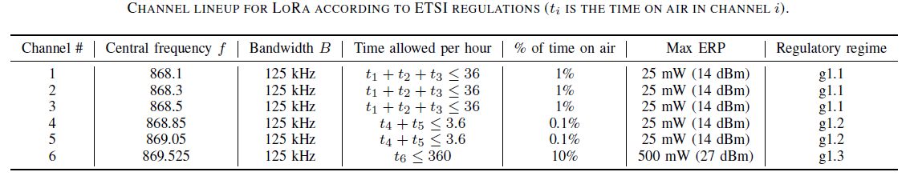
Introduction
LoRa technology
Link-level Assumptions
System-level Assumptions
Performance Evaluation
Conclusion
LoRa technology
Frequency Bands and European Regulations
LoRaWANs operate on the Industrial, Scientific, and Medical (ISM) frequency bands
902 - 928 MHz band in the US and in the 863 - 870 MHz band in Europe
Radios are required to adopt either a Listen-Before-Talk (LBT) policy or a duty cycled transmission to limit the rate.
Three different categories of ISM sub-bands
g1 line with maximum 36 seconds per hour Time on Air (ToA), 1% duty cycle to be shared between all sub-channels in each sub-band
g1.2 with maximum 3.6 seconds per hour ToA, 0.1% duty cycle
g1.3 with maximum 360 seconds per hour ToA, 10% duty cycle

Slide 7
Introduction
LoRa technology
Link-level Assumptions
System-level Assumptions
Performance Evaluation
Conclusion
Link-level Assumptions
System-level simulations are based on two models
The link measurement model, used to abstract the effects of propagation on signal strength, fading and similar effects.
The link performance model, which determines the probability of correctly receiving a packet at reduced complexity, the amount of interferers and other system-level effects

Slide 8


Introduction
LoRa technology
Link-level Assumptions
System-level Assumptions
Performance Evaluation
Conclusion
Link-level Assumptions
Link Measurement Model
Given a transmitter-receiver pair, the link measurement model aims at estimating the strength of the signal at the receiver side.
Receiver antenna gain with G_{tx} and G_{rc}, respectively, and the transmit power with P_{tx}, L is the path loss. Then, the received power is expressed as;
L^{dB} consists of two contributions: the propagation loss, which depends on the distance between transmitter and receiver, and the building penetration loss, due to the wall attenuation.

Slide 9

Introduction
LoRa technology
Link-level Assumptions
System-level Assumptions
Performance Evaluation
Conclusion
Link-level Assumptions
Link Measurement Model
The most common correlation model is a decaying exponential of distance.
The distance between end nodes i and j with d_{i,j} , the shadowing correlation is;
Assuming a shadowing decorrelation distance d₀ = 110 m
Regular grid in which each square has a side length of d₀ (decorrelation distance) and draw an independent Gaussian random variable at each vertex of the grid.

Slide 10
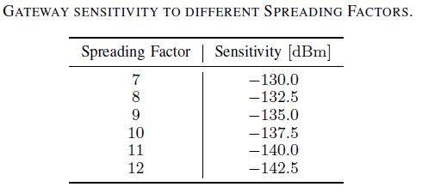
Introduction
LoRa technology
Link-level Assumptions
System-level Assumptions
Performance Evaluation
Conclusion
Link-level Assumptions
Link Performance Model
Abstracting the real implementation of the physical layer transmission chain and at making interference computations more manageable.
Model of the gateway receiver and a pair of look-up tables that are used to model the aspects of sensitivity and interference.
S_{i} the sensitivity of the gateway receiver for SF = i.
Increase of SF yields a better sensitivity.
Any received packet with SF = i whose power is below the threshold S_{i} cannot be detected by the gateway.

Slide 11
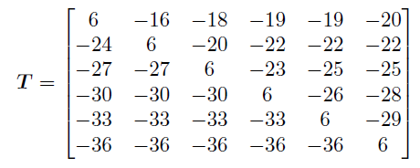
Introduction
LoRa technology
Link-level Assumptions
System-level Assumptions
Performance Evaluation
Conclusion
Link-level Assumptions
Link Performance Model
Paper assume that interference only comes from other LoRa transmissions
Different SFs to model whether a packet survives interference from other LoRa transmissions or not.
(relative) Signal-to-Interference-plus-Noise-Ratio (SINR) threshold matrix;
SINR margin (in dB units) that a packet sent with SF = i must have in order to be decoded if the interfering packet has SF = j.

Slide 12
Introduction
LoRa technology
Link-level Assumptions
System-level Assumptions
Performance Evaluation
Conclusion
System-level Assumptions
This paper explicitly refer to a LoRa Class A network, where transmissions are always initiated by the end devices
Every end device is assigned a random initial reporting delay (T seconds)
No DL transmissions, messages from the gateways to the end devices, are considered.
DL transmissions is future work

Slide 13
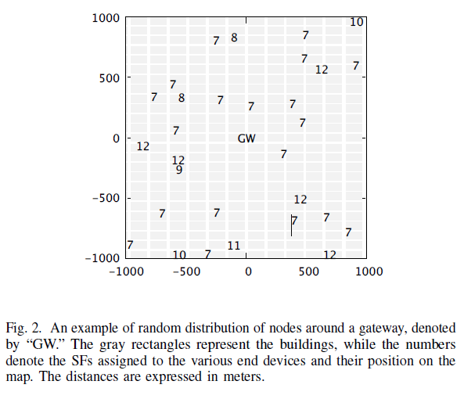
Introduction
LoRa technology
Link-level Assumptions
System-level Assumptions
Performance Evaluation
Conclusion
System-level Assumptions
Spreading Factor Assignment
At the beginning of the simulation, each device is assigned a SF as follows.
Calculate the power level that each gateway would receive from the end device
Pick the gateway with the highest received power and set the SF based on that value
Assign the end device the lowest SF that would still be above the gateway sensitivity,
Since we are interested, in general, in minimizing the ToA
Note that, due to the shadowing and the presence of buildings, the closest gateway to a device may not always be the one that receives the highest power

Slide 14


Introduction
LoRa technology
Link-level Assumptions
System-level Assumptions
Performance Evaluation
Conclusion
Performance Evaluation
Several tests were conducted in order to estimate throughput, packet error probability, and gateway coverage.
Throughput S as a function of the offered traffic G
A single central gateway and N end devices, uniformly distributed in a circular space around it of radius r = 7500 m (7500 is the maximum distance at which the gateway and an end device using SF = 12 are able to communicate)
For the throughput computation, the device i = 1, . . ,N generates every T_{i} seconds a packet which occupies the channel for t_{p,i} seconds in order to be transmitted. Network offered traffic;
Given value of G, throughput S;
The probability of success of a given packet P_{succ} is the ratio between the number of successfully received packets and the total number of sent packets

Slide 15
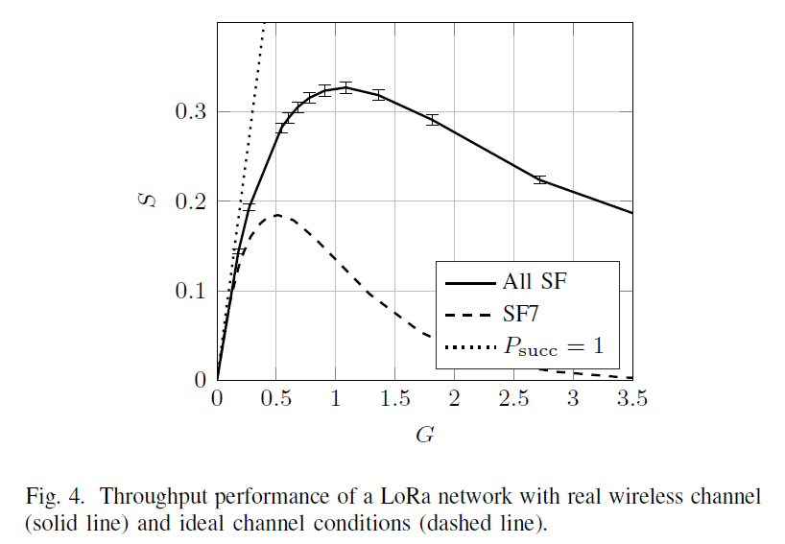
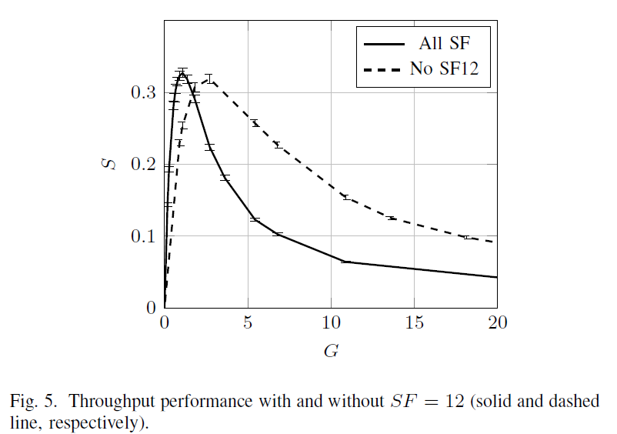
Introduction
LoRa technology
Link-level Assumptions
System-level Assumptions
Performance Evaluation
Conclusion
Performance Evaluation
Throughput Performance (SF)

Slide 16
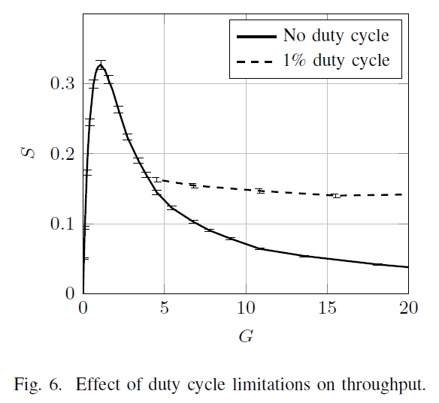
Introduction
LoRa technology
Link-level Assumptions
System-level Assumptions
Performance Evaluation
Conclusion
Performance Evaluation
Throughput Performance (Duty Cycle)

Slide 17
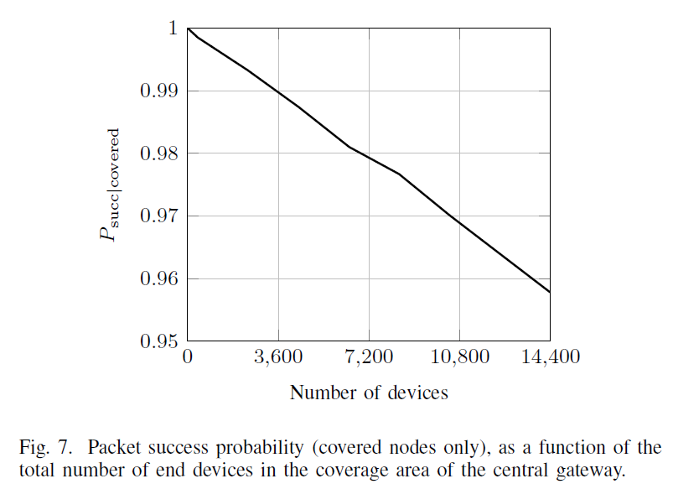
Introduction
LoRa technology
Link-level Assumptions
System-level Assumptions
Performance Evaluation
Conclusion
Performance Evaluation
Success Probability Performance
The trend appears to be linear with the number of devices in the network, with a success probability around 97% for a network with 10⁴ end devices

Slide 18
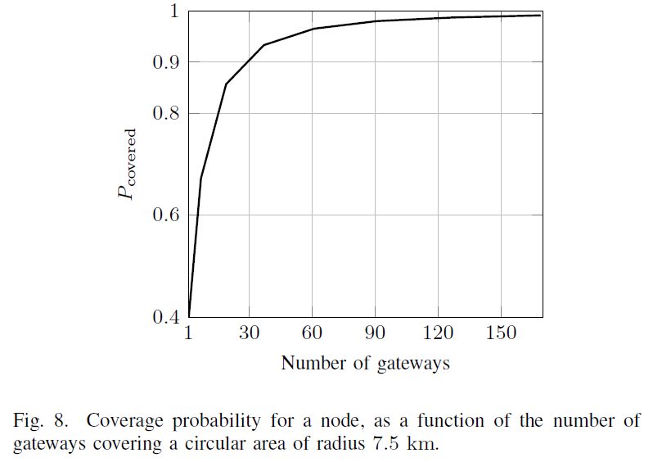
Introduction
LoRa technology
Link-level Assumptions
System-level Assumptions
Performance Evaluation
Conclusion
Performance Evaluation
Gateway Coverage Assessment
In order to achieve a reliability above 90%, we should deploy gateways in such a way that every gateway covers 6 km2 or, equivalently, a radius of 1200 m around it.

Slide 19
Introduction
LoRa technology
Link-level Assumptions
System-level Assumptions
Performance Evaluation
Conclusion
Conclusion
Simulation results show that;
The LoRaWAN access scheme provides a higher throughput with respect to a basic ALOHA scheme, thanks to the partial orthogonality between its spreading factors.
The LoRaWAN architecture can scale well, mainly due to the fact that an increase in the number of gateways enhances the coverage and reliability of the uplink as well.
A network featuring multiple gateways and a realistic traffic model resulted in a packet success rate above 95% for a gateway serving approximately 15000 end devices.
Future work;
The effectiveness of different ADR (Adaptive Data Rate) schemes
Investigate optimal gateway placement
Frequency planning and co-existence with other networks working in the unlicensed spectrum

Slide 20
Thank you for your time.
Any questions?

