Slide 1
Low Power Wide Area Networks: An Overview
U. Raza, P. Kulkarni and M. Sooriyabandara, "Low Power Wide Area Networks: An Overview," in IEEE Communications Surveys & Tutorials, vol. 19, no. 2, pp. 855-873, Secondquarter 2017. doi: 10.1109/COMST.2017.2652320
Review by Ahmet Arış
arisahmet@itu.edu.tr

Slide 2
OUTLINE
Introduction
How Low Power Wide Area (LPWA) Technologies Achieve Their Objectives?
LPWA Technologies
Proprietary Tecnologies
Standards
Challenges and Open Research Directions

Slide 3
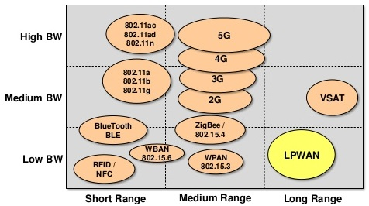
Introduction
How LPWA Technologies Achieve Their Objectives?
LPWA Technologies
Challenges and Open Research Directions
Introduction to LPWA Networks – I
How to provide connectivity for
low power devices
which are distributed over large geographical areas?
Technology gap:
Short range wireless technologies cannot address,
Very costly to deploy massive # of devices to route messages.
Cellular is optimized for voice and data,
Complex and expensive,
NB-IoT is still being developed.
Figure 1: Wireless Technologies With Respect to Range and Bandwidth Properties¹
1. Image Source: https://www.slideshare.net/PeterREgli/lpwan

Slide 4
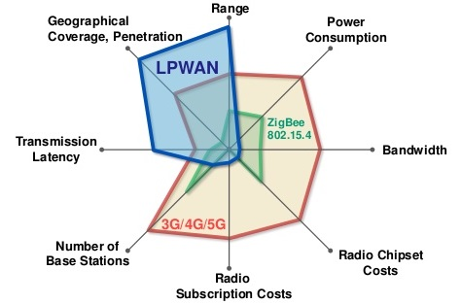
Introduction
How LPWA Technologies Achieve Their Objectives?
LPWA Technologies
Challenges and Open Research Directions
Introduction to LPWA Networks – II
Solution:
Low Power Wide Area (LPWA) technologies,
Low power,
Long range,
Low cost,
Low data rate,
High latency.
Not every use-case is applicable for LPWA technologies,
Delay tolerant applications,
Applications with low data rates,
Low power consumption needs and low cost.
Figure 2: Wireless Technologies With Respect to Various Properties¹
1. Image Source: https://www.slideshare.net/PeterREgli/lpwan

Slide 5
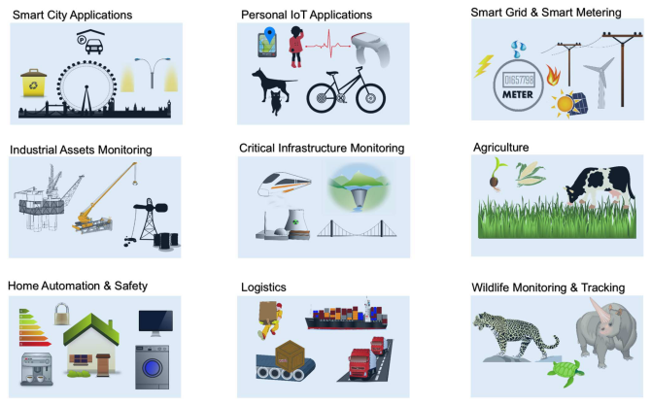
Introduction
How LPWA Technologies Achieve Their Objectives?
LPWA Technologies
Challenges and Open Research Directions
Introduction to LPWA Networks – IV
Figure 3: Applications of LPWA Technologies

Slide 6
Introduction
How LPWA Technologies Achieve Their Objectives?
LPWA Technologies
Challenges and Open Research Directions
How LWPA Technologies Achieve Their Objectives?
Key objectives of LPWA technologies: long range + low power + low cost,
How LPWA technologies achieve them?
Sub-GHz bands and special modulation techniques,
Simple network topology,
Duty-cycling,
Lightweight Medium Access,
Offloading complexity from end devices to base stations,
Multiplexing, densification, adaptive communication.

Slide 7
Introduction
How LPWA Technologies Achieve Their Objectives?
LPWA Technologies
Challenges and Open Research Directions
How LWPA Technologies Achieve Their Objectives: Long Range
LPWA technologies intend to:
Cover large areas (i.e., a few to tens of kms),
Propagate signals successfully to hard to reach places.
Sub-GHz bands + modulation techniques => long range,
Modulation techniques:
Narrowband and spread-spectrum modulations,
Narrowband and ultra narrow band:
Reduce noise,
Increase # of devices supported,
Decrease data rate,
Increase the amount of time radio needs to be kept on.
Spread-spectrum:
Resilient to interference and jamming,
Chirp Spread Spectrum (LoRa),
Direct Sequence Spread Spectrum.
Sub-GHz bands:
Robust and reliable communication at low power,
Lower frequency signals => less attenuation, less multi-path fading,
Sub-GHz is less congested than 2.4 GHz ISM.

Slide 8
Introduction
How LPWA Technologies Achieve Their Objectives?
LPWA Technologies
Challenges and Open Research Directions
How LWPA Technologies Achieve Their Objectives: Low Power Consumption – I
LPWA technologies intend to consume low power:
Up to ten years of battery life time.
Star topology+ duty cycling + lightweight MACs + complexity offloading => ultra low power consumption.
Duty cycling:
Application type, power source and traffic pattern affect duty cycling mechanism:
Application with only uplink transfers: end devices sleep until they need to transmit,
Application with downlink needs: end devices have to schedule listening.
Duty cycling in LPWA is a legislative requirement:
Regulations limit how much time a single transmitter can occupy the channel.
Topology:
Mesh topology:
Extends coverage of short-range wireless technologies,
Deployment cost to connect large geographical areas,
Reduced network lifetime due to more congested nodes and forwarding & listening.
Star topology:
Direct connection to base station,
Huge energy savings: no forwarding, no waiting for others’ messages to arrive.

Slide 9
Introduction
How LPWA Technologies Achieve Their Objectives?
LPWA Technologies
Challenges and Open Research Directions
How LWPA Technologies Achieve Their Objectives: Low Power Consumption – II
LPWA technologies intend to consume low power:
Up to ten years of battery life time.
Star topology+ duty cycling + lightweight MACs + complexity offloading => ultra low power consumption.
Complexity-offloading:
Complexity is offloaded to base stations:
Simple and cheap end devices,
Base stations can listen and transmit simultaneously from and to multiple devices,
Thus end devices can send data using any channel without the need of expensive signaling to initiate communication.
In LoRaWAN:
Base stations adapt communication parameters (i.e., data rate, modulation parameters),
Base stations support mobility of devices and handover mechanisms.
How much complexity to offload?
Network lifetime vs. Cost of end devices,
Should we process data first and send less data or should we send all data to base stations?.
Lightweight Medium Access:
Most existing MAC protocols are too complex for LPWA,
CSMA/CA:
# of devices per base station is limited
As # of devices grow, carrier sensing becomes less effective and expensive in reliably detecing ongoing transmissions,
RTS/CTS brings extra overhead.
LPWA technologies use ALOHA schemes:
Simple and keeps the transceiver design cheap and simple,
As # of devices grow, performance becomes less efficient.

Slide 10
Introduction
How LPWA Technologies Achieve Their Objectives?
LPWA Technologies
Challenges and Open Research Directions
How LWPA Technologies Achieve Their Objectives: Scalability
Support for massive # of devices sending low traffic volumes,
LPWA technologies should scale well with increasing number and density of devices,
Diversity techniques + densification + Adaptive channel selection and data rate => scalable LPWA networks
Diversity techniques:
Diversity in:
Channel,
Time,
Space,
Hardware.
Densification techniques:
Dense deployment of base stations:
More interference between end devices and base stations,
Coordinated radio resource management is needed.
Adaptive channel and data rate selection:
What can be adapted:
Modulation schemes,
Better channels,
Transmission power.
What is needed:
Efficient monitoring of link qualities,
Coordination between end devices and network.
Link asymmetry and regulations on duty cycling may affect adaption!
Trade-off between scalability and end device simplification!

Slide 11
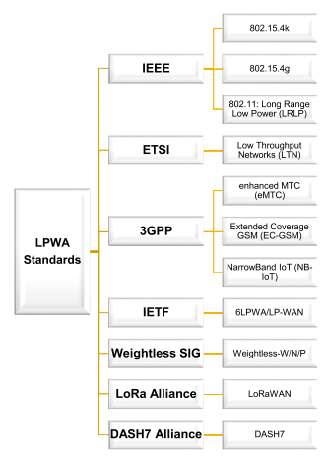
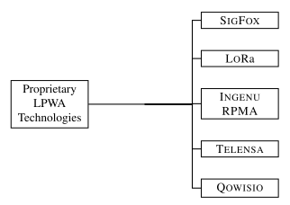
Introduction
How LPWA Technologies Achieve Their Objectives?
LPWA Technologies
Challenges and Open Research Directions
LWPA Technologies: Standards and Proprietary Technologies
Figure 5: Proprietary LPWA Technologies
Figure 4: Standards for LPWA Networks

Slide 12
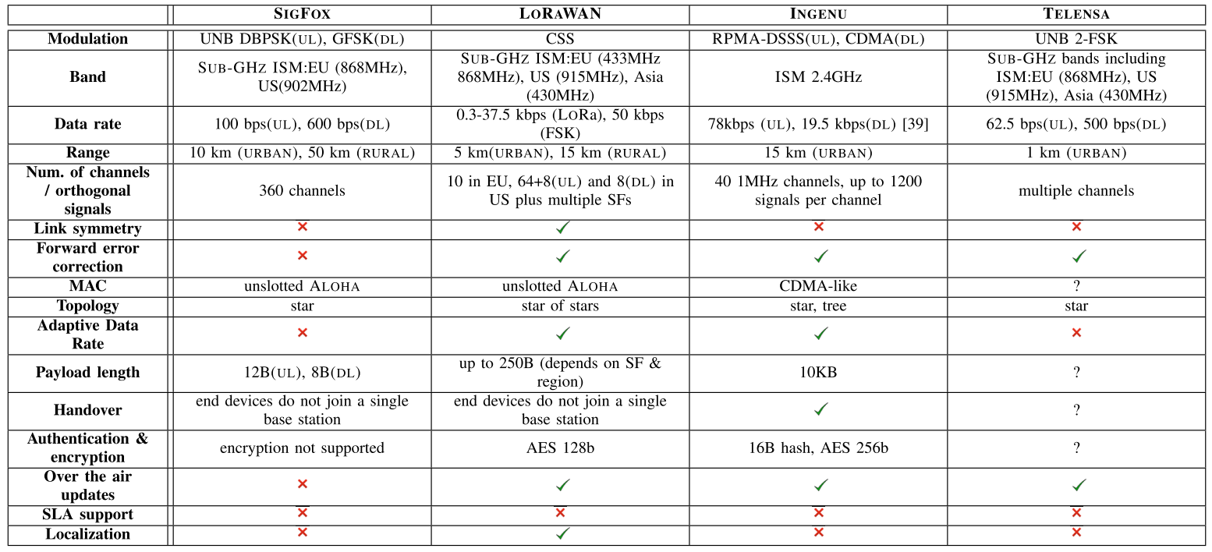
Introduction
How LPWA Technologies Achieve Their Objectives?
LPWA Technologies
Challenges and Open Research Directions
LWPA Technologies: Proprietary Technologies
Table 1: Technical Specifications of Proprietary LPWA Technologies

Slide 13
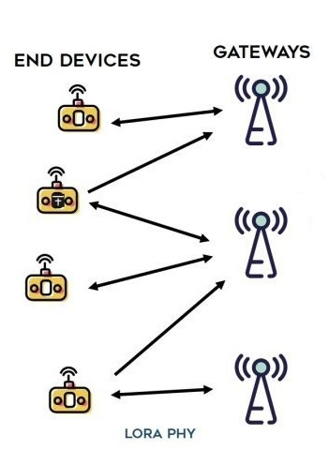
Introduction
How LPWA Technologies Achieve Their Objectives?
LPWA Technologies
Challenges and Open Research Directions
LWPA Technologies: Proprietary Technologies: LoRa
LoRa:
PHY layer technology,
Developed and commercialized by Semtech Corporation,
Modulates signals in Sub-GHz ISM band,
Uses a proprietary spread spectrum technique (Chirp Spread Spectrum),
Multiple devices can communicate at the same time using different channels/or orthogonal codes,
Supports multiple spreading factors (i.e., between 7-12),
Spreading factors affect data rate and range,
Higher spreading factors => longer range, lower data rates!
Data rate ranges from 300bps to 37.5 Kbps,
Figure 6: LoRa Network Architecture¹
Transmitted messages are received by all the base stations in range => star of stars topology,
Multiple receptions of the same message by different base stations => localization of the end device,
Time difference of arrival based localization technique supported by very accurate time synchronization between base stations is used.
1. Image Source: https://i1.wp.com/www.zerynth.com/wp-content/uploads/2017/05/lorawan-architecture.jpg?resize=1024%2C561&ssl=1

Slide 14
Introduction
How LPWA Technologies Achieve Their Objectives?
LPWA Technologies
Challenges and Open Research Directions
LWPA Technologies: Proprietary Technologies: LoRa
LoRa:
PHY layer technology,
Developed and commercialized by Semtech Corporation,
Modulates signals in Sub-GHz ISM band,
Uses a proprietary spread spectrum technique (Chirp Spread Spectrum),
Multiple devices can communicate at the same time using different channels/or orthogonal codes,
Supports multiple spreading factors (i.e., between 7-12),
Spreading factors affect data rate and range,
Higher spreading factors => longer range, lower data rates!
Data rate ranges from 300bps to 37.5 Kbps,
Longer range, less congested bands
Adaptability
Figure 6: LoRa Network Architecture¹
Transmitted messages are received by all the base stations in range => star of stars topology,
Multiple receptions of the same message by different base stations => localization of the end device,
Time difference of arrival based localization technique supported by very accurate time synchronization between base stations is used.
Localization
1. Image Source: https://i1.wp.com/www.zerynth.com/wp-content/uploads/2017/05/lorawan-architecture.jpg?resize=1024%2C561&ssl=1

Slide 15
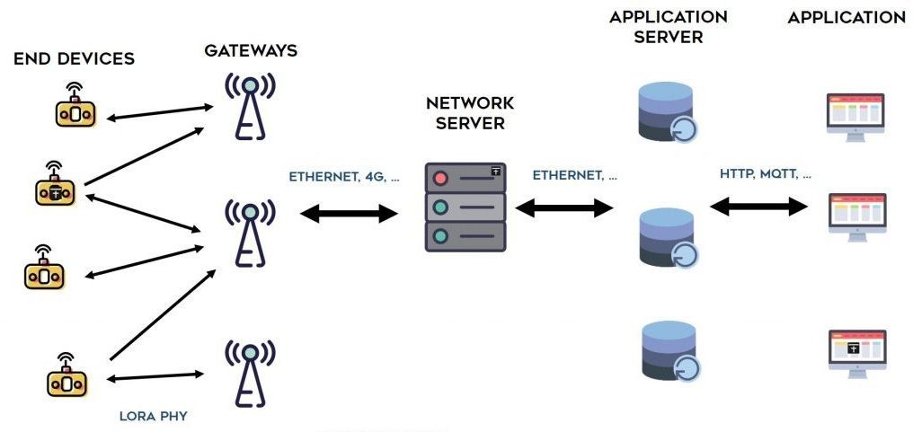
Introduction
How LPWA Technologies Achieve Their Objectives?
LPWA Technologies
Challenges and Open Research Directions
LWPA Technologies: Proprietary Technologies: LoRaWAN
LoRaWAN: Upper layers and system arch. defined by LoRa alliance on top of LoRa PHY,
Simple ALOHA scheme is used at the MAC layer,
End Devices can hop to any base station without extra signaling overhead,
Base stations connect End Devices to Network Server,
Brain of the LoRaWAN system,
Suppresses duplicate receptions,
Adapts radio access links,
Forwards data to suitable Application Servers.
LoRaWAN defines three classes of End Devices:
All devices support bidirectional communication,
Have different downlink latency and power requirements.
Figure 6: LoRaWAN Network Architecture¹
Class A:
Longest life time, highest latency,
Listens for a downlink communication only short after its uplink transmission.
Class B:
In addition to A,
Can schedule downlink receptions from base stations,
Only on scheduled slots, applications can send messages to Class B devices.
Class C:
Mains-powered,
Can continuously listen and receive downlink transmissions,
Shortest latency.
1. Image Source: https://i1.wp.com/www.zerynth.com/wp-content/uploads/2017/05/lorawan-architecture.jpg?resize=1024%2C561&ssl=1

Slide 16
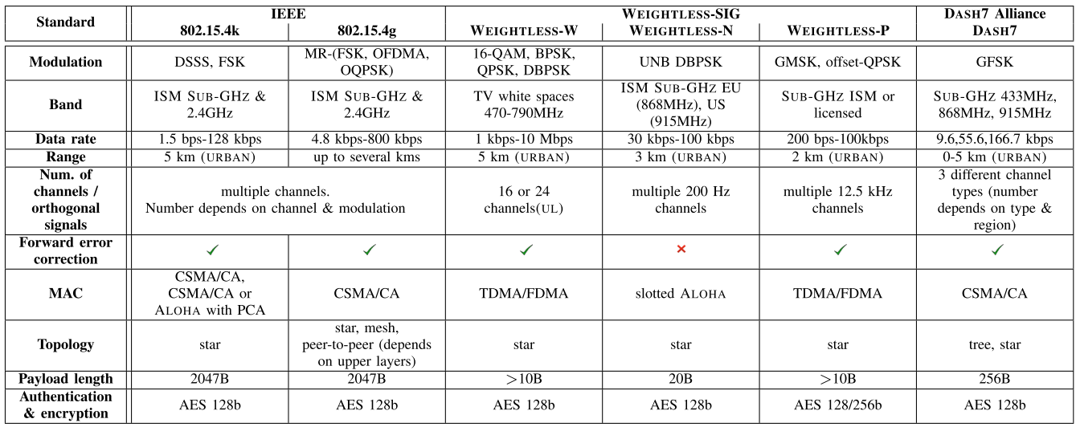
Introduction
How LPWA Technologies Achieve Their Objectives?
LPWA Technologies
Challenges and Open Research Directions
LWPA Technologies: Standards
Table 2: Technical Specifications of LPWA Standards

Slide 17
Introduction
How LPWA Technologies Achieve Their Objectives?
LPWA Technologies
Challenges and Open Research Directions
Challenges and Open Research Directions
Challenges of LPWA networks:
Scalability,
Interference control and mitigation,
Localization,
Link optimization and adaptability,
Co-existence of LPWA technologies with other wireless networks.

Slide 18
Introduction
How LPWA Technologies Achieve Their Objectives?
LPWA Technologies
Challenges and Open Research Directions
Challenges and Open Research Directions: Scalability
Millions of devices transmitting data over limited and shared radio resources,
Things to consider:
Different device densities across different geographical areas: hot-spot problem,
Interference caused by different LPWA technologies,
Employed simple MAC schemes (e.g., ALOHA, CSMA/CA) do not scale well.
Research directions:
Use of channel diversity,
Opportunistic spectrum access,
Adaptive transmission strategies with the help of base stations.

Slide 19
Introduction
How LPWA Technologies Achieve Their Objectives?
LPWA Technologies
Challenges and Open Research Directions
Challenges and Open Research Directions: Interference Control and Mitigation
Millions of connected devices will cause higher levels of interference,
Types of interference: cross-technology, self-technology,
Simple ALOHA schemes cause more interference when # of devices increase,
Densification of base stations to serve more devices cause interference across cells,
Research directions:
Use of channel diversity,
Opportunistic spectrum access,
Adaptive transmission strategies with the help of base stations.

Slide 20
Introduction
How LPWA Technologies Achieve Their Objectives?
LPWA Technologies
Challenges and Open Research Directions
Challenges and Open Research Directions: Localization
LPWA technologies target logistics, supply chain management and personal IoT applications,
Location of mobile objects, vehicles, humans, animals may be crucial.
Typical localization mechanisms:
Properties of received signals,
Time of flight based measurements.
LPWA technologies:
Have limited channel bandwidth,
Often don’t have a direct path between end devices and base stations,
Simple and cheap end device designs.
Require
Accurate time synchronization,
Sufficient deployment of base stations,
Careful network deployment and planning.
Cause
Great localization errors.

Slide 21
Introduction
How LPWA Technologies Achieve Their Objectives?
LPWA Technologies
Challenges and Open Research Directions
Challenges and Open Research Directions: Link Optimization and Adaptability
Adaptive techniques which can:
Monitor link quality,
Re-adjust its parameters (i.e., data rate, time on air, area coverage) for better performance.
End devices are very simple,
Adaptive techniques may require a feedback from base stations (network server),
Challenges:
Varying downlink properties of end devices,
Downlink has lower capacity than uplink due to link asymmetry,
Extreme duty cycling of devices,
Regulations.

Slide 22
Introduction
How LPWA Technologies Achieve Their Objectives?
LPWA Technologies
Challenges and Open Research Directions
Challenges and Open Research Directions: Co-Existence with Other Wireless Technologies
If End Devices have multiple wireless antennas,
How to benefit from multiple wireless technologies to achieve:
Energy efficiency,
High throughput,
Low latency,
Wide area coverage.
LWPA-IEEE 802.11.ah internetworking, LPWA-LTE internetworking...

Slide 23
LoRa Testbed and Simulator
Testbed: Ireland Pervasive Nation Testbed
Simulator: LoRaSim,
«LoRaSim is a discrete-event simulator based on SimPy for simulating collisions in LoRa networks and to analyse scalability»

Slide 24
Thank you for your time.
Any questions?

