Slide 1
LoRaWAN End Node Spreading Factor Assignment Suggestion
Tugrul Yatagan
yatagan@itu.edu.tr

Slide 2
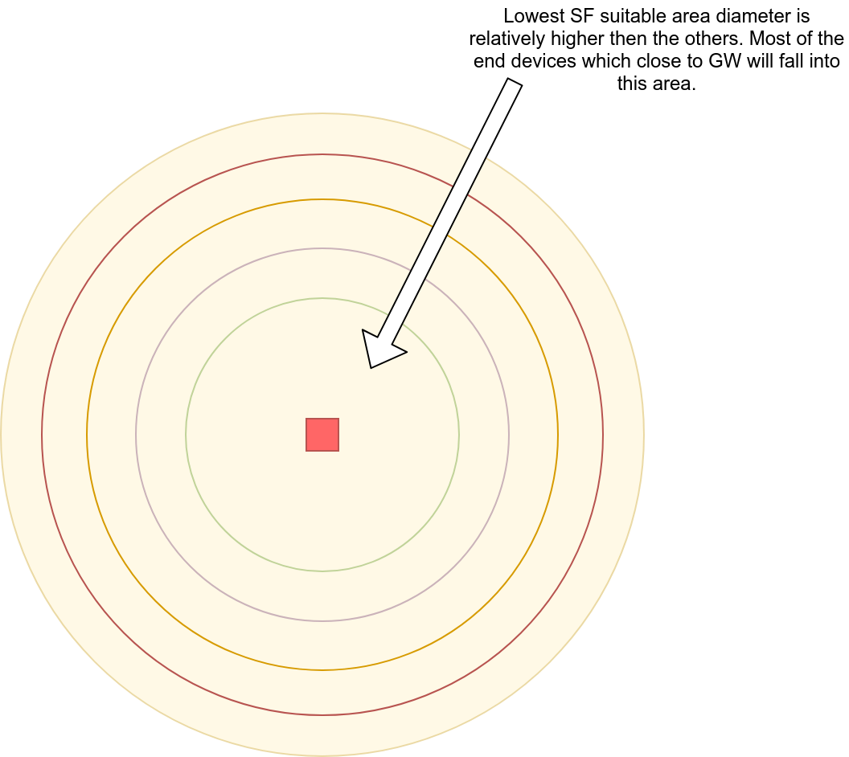
Introduction
Problem & Suggestion
Multiple GW Suggestion
Introduction
LoRaWAN uses Spreading Factors (SFs) for rate adaptation. In the specification of LoRa, the SF can be selected from SF7 to SF12.
A lower SF leads to a higher transmission rate and shorter transmission time, but requires a higher SNR.
SFs are orthogonal (not 100%), packets with different SFs in same channel can be received simultaneously.
Less collisions occur if more SFs used. However, more SFs could result in longer messages and more energy consumption.
End nodes choose SF according to their GW transmission signal strength.
Most of the end devices which close to GW will choose lowest SF which increases collisions.

Slide 3
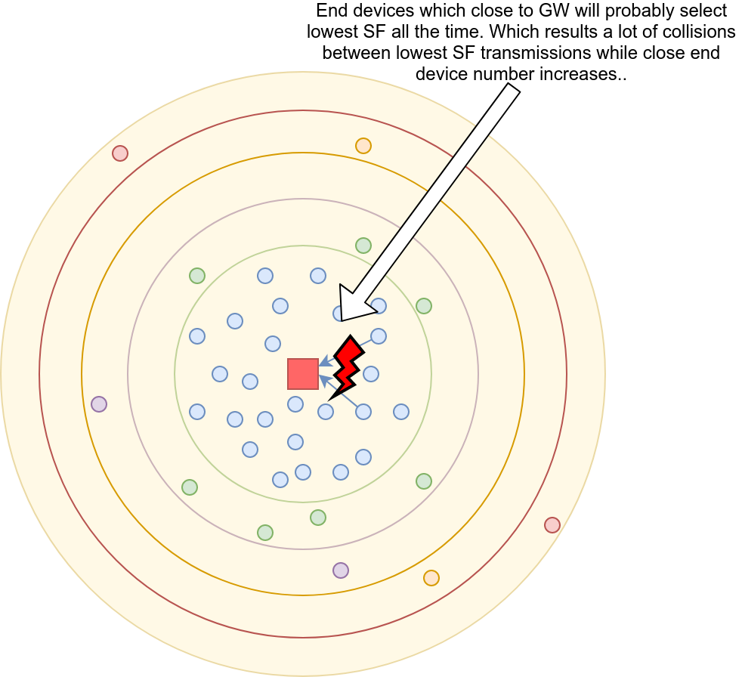
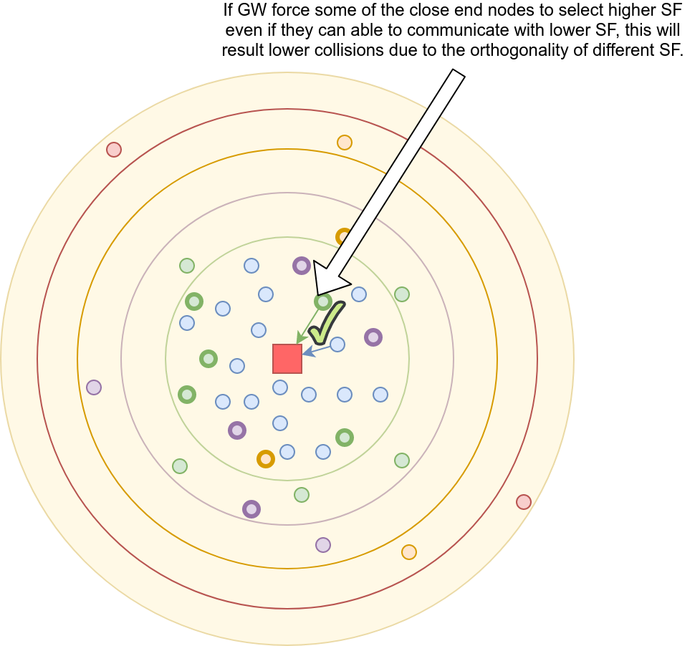
Introduction
Problem & Suggestion
Multiple GW Suggestion
Problem & Suggestion

Slide 4
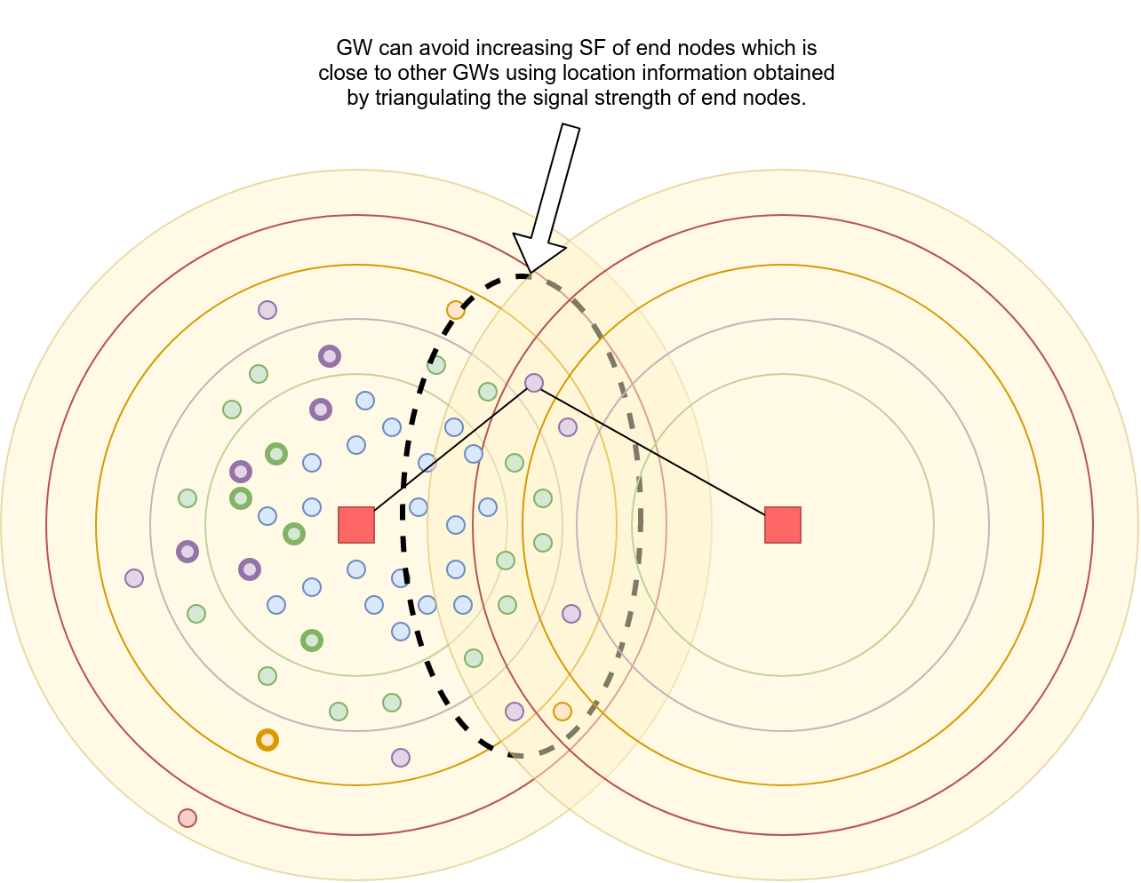
Introduction
Problem & Suggestion
Multiple GW Suggestion
Multiple GW Suggestion

Slide 5
Thank you for your time.
Any questions?

