Slide 1
Low Power Wide Area Networks: LoRa
Tugrul Yatagan
yatagan@itu.edu.tr

Slide 2
Outline
LPWAN Overview
LPWAN Design Goals and Techniques
LoRa
Research

Slide 3
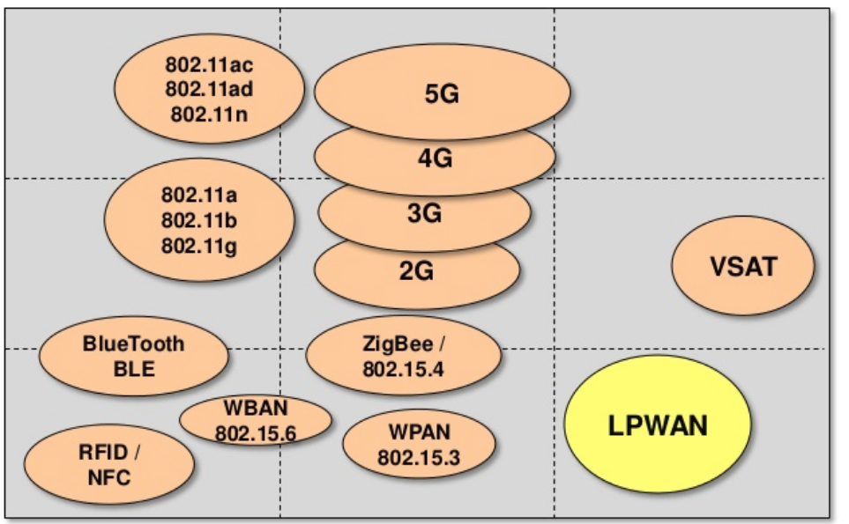
LPWAN Overview
LPWAN Design Goals and Techniques
LoRa
Research
LPWAN Overview: Introduction
Number of connected M2M devices and consumer electronics will surpass the number of human subscribers by 2020 ^{[2]}
IoT industry is expected to generate a revenue of 4.3 trillion dollars by 2024 ^{[3]}
How to provide connectivity for low power devices distributed over large geographical areas?
LPWA application areas;
Smart city
Personal IoT
Smart grid metering
Agriculture
Industrial assets monitoring
Home automation
Logistics
Wildfire monitoring
LPWAN fills the technology gap between;
Short range wireless technologies (ZigBee, Bluetooth, Wi-Fi)
Very costly to deploy massive/dense # of devices
Cellular (2G, 3G, 4G)
Optimized for voice and data
Complex and expensive
High power consumption
DATA RATE
RANGE
Figure 1: Wireless technologies with respect to range and data rate¹
1. Image Source: https://www.slideshare.net/PeterREgli/lpwan
Notes:
The range of short range wireless technologies is limited to a few hundred meters at best. Dense deployment needed. Multihop, mesh

Slide 4
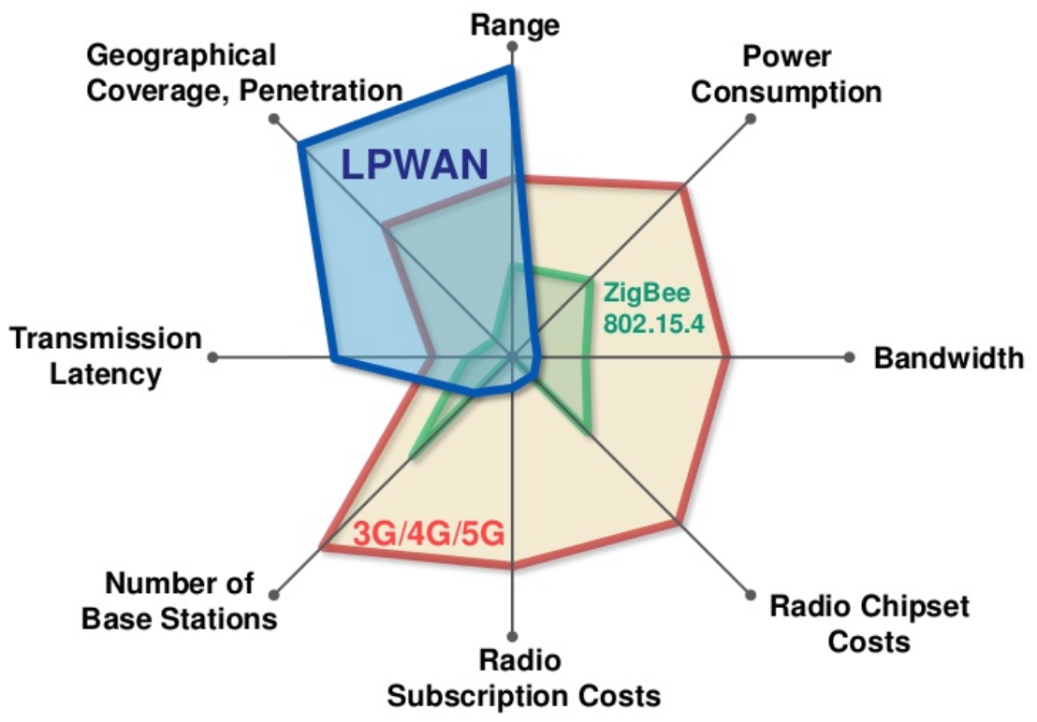
LPWAN Overview
LPWAN Design Goals and Techniques
LoRa
Research
LPWAN Overview: Key Features
Low Power Wide Area (LPWA) networks;
Low power (ten years and beyond)
Long range (a few to tens of kilometers)
Low cost
High scalability
Low data rate (in orders of tens of kilobits per seconds)
High latency (in orders of seconds or minutes)
LPWAN applicable applications;
Delay tolerant
Low data rates
Low power consumption
Low cost
Several competing technologies and alliances;
LoRa
Sigfox
NB-IoT
Weightless SIG
Figure 2: Wireless technologies with respect to various properties¹
1. Image Source: https://www.slideshare.net/PeterREgli/lpwan
Notes:
LPWAN is not suitable for many industrial IoT, vehicle to vehicle (V2V), and vehicle to infrastructure (V2I) applications

Slide 5
LPWAN Overview
LPWAN Design Goals and Techniques
LoRa
Research
LPWAN Design Goals and Techniques
Key objectives of LPWAN technologies; long range + low power + low cost
Long range
Sub-GHz band
Lower frequency signals experience less attenuation and multipath fading
Special modulation techniques
Designed to achieve range of a few km and tens of km
Two classes of main modulation techniques;
Narrowband; encoding the signal in low bandwidth (usually less than 25kHz)
Reduce noise, decrease data rate
Spread spectrum; spread signal over a wider frequency band but with the same power density
Resilient to interference, harder to decode
Low cost
Cost of hardware should below $10 and connectivity subscription per unit should low as $1
Reduction in hardware complexity
Minimum infrastructure
Using license-free or already owned licensed bands
Notes:
Key objectives are conflicting each other.
Narrowband share the overall spectrum very efficiently between multiple links. NB-IoT, WEIGHTLESS-P and SIgFox (100Hz)
Compared to the cellular and the short range wireless technologies
dense and therefore an expensive deployment

Slide 6
LPWAN Overview
LPWAN Design Goals and Techniques
LoRa
Research
LPWAN Design Goals and Techniques
Ultra low power operation
Simple topology
No mesh, direct connection from end devices to base stations
Duty cycling
End devices to turn off their transceivers when not required
Lightweight medium access control
Widely used MAC protocols (cellular, WLAN) are too complex. Mostly ALOHA is used
Offloading complexity from end devices
Simplify the design of end devices, move complexity to base stations and backend system
Scalability
Diversity; channel, time, space, and hardware
Densification
Adaptive channel selection and data rate
Quality of service
Limited or no QoS
Notes:
Huge energy savings: no forwarding, no waiting for others’ messages to arrive.
Application with only uplink transfers: end devices sleep until they need to transmit
not to waste precious energy in busy-listening to other devices
No CSMA/CA
Backend system adapts communication parameters (such as data rate/ modulation parameters)

Slide 7
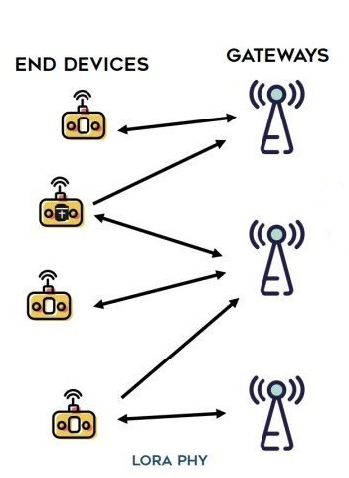
LPWAN Overview
LPWAN Design Goals and Techniques
LoRa
Research
LoRa: Medium Access Control
Multiple spreading factors (between 7-12) to decide the tradeoff between range and data rate
Data rate ranges from 300 bps to 37.5 kbps depending on spreading factor
The messages transmitted by the end devices are received by all the base stations in the range
Star of stars
Pure ALOHA
No CSMA/CA
LoRaWAN is open standard MAC layer protocol for LoRa physical layer
Battery Powered – Class A
Low Latency – Class B
No Latency – Class C
Base stations can adapt communication parameters
Data rate
Modulation parameters
Base stations support mobility of devices and handover mechanisms
Base stations are stateless
Figure 3: LoRa Topology¹
1. Image Source: https://i1.wp.com/www.zerynth.com/wp-content/uploads/2017/05/lorawan-architecture.jpg?resize=1024%2C561&ssl=1
Notes:
Higher spreading factors delivers long range at an expense of lower data rates and vice versa

Slide 8
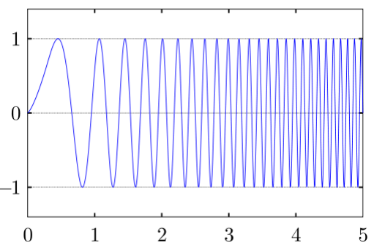
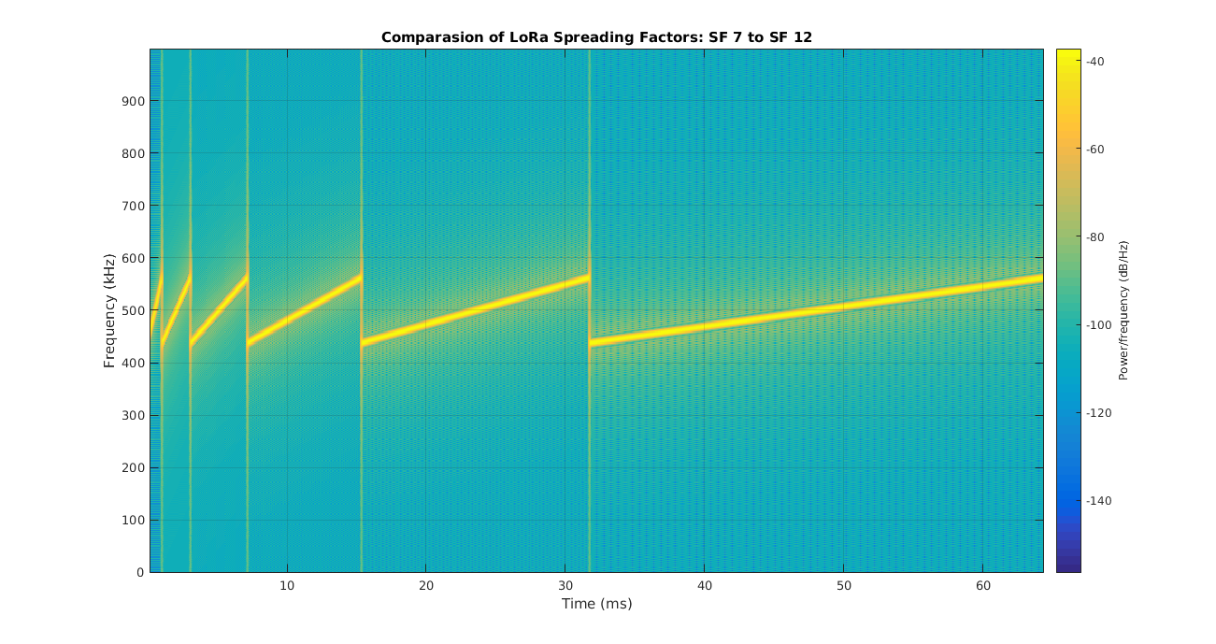
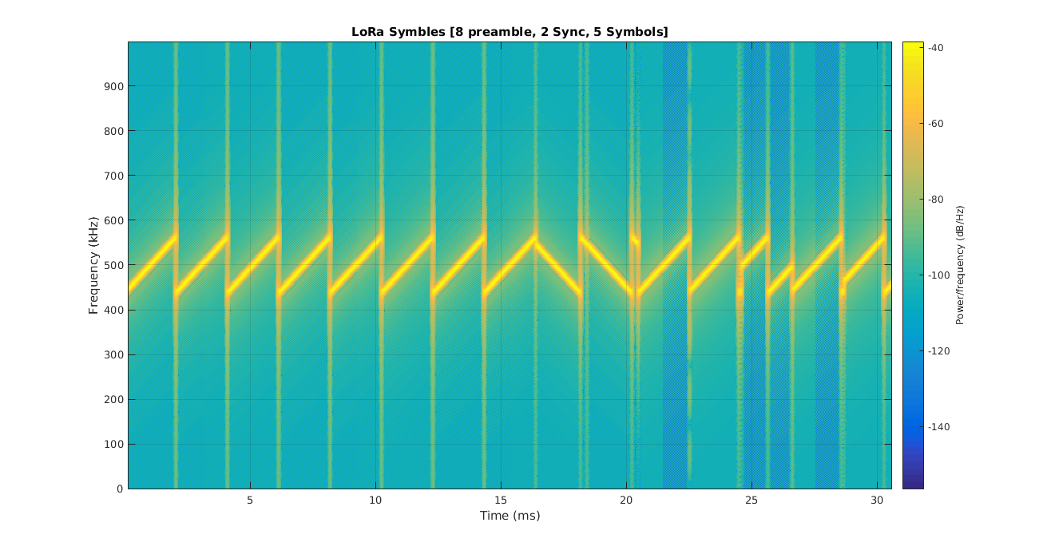
LPWAN Overview
LPWAN Design Goals and Techniques
LoRa
Research
LoRa: Modulation
LoRa modulates the signals in Sub-GHz ISM band using a proprietary modulation technique Chirp Spread Spectrum (CSS)
Chirp is a sinusoidal signal of frequency increase or decrease over time
Resilient to interference and noise
Figure 4: Chirp¹
Figure 5: LoRa CSS modulation SF 7 to 12¹
Figure 6: LoRa CSS modulation¹
1. Image Source: http://www.sghoslya.com/p/lora-is-chirp-spread-spectrum.html
Notes:
Higher spreading factors delivers long range at an expense of lower data rates and vice versa
It is easy to decode in freq. domain
FFT

Slide 9
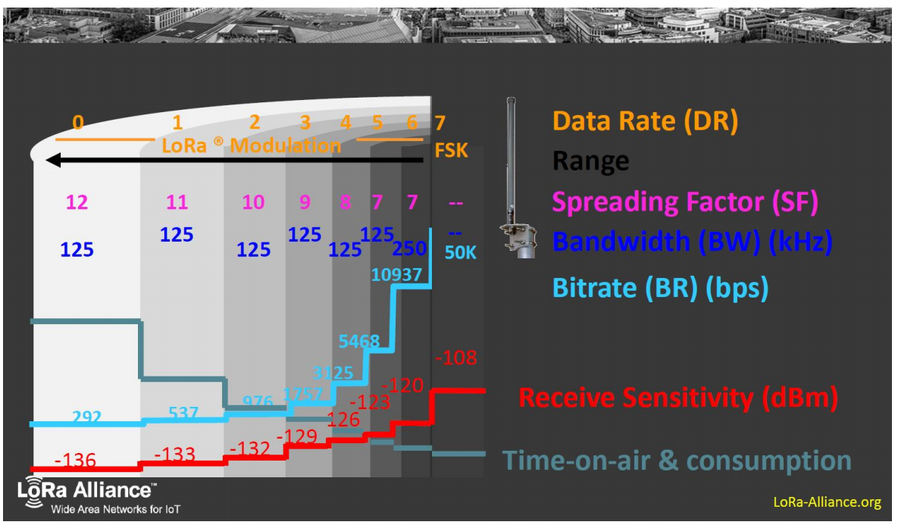
LPWAN Overview
LPWAN Design Goals and Techniques
LoRa
Research
LoRa: Spreading Factor
LoRa uses Spreading Factors for rate adaptation
SF can be SF7 to SF12
Lower SF leads to:
Higher transmission rate
Shorter transmission time
But requires a higher SNR
Lower sensitivity
SFs are orthogonal (not 100%):
Packets with different SFs in same channel can be received simultaneously
Figure 7: LoRa CSS modulation SF, data rate, time-on-air comparision¹
1. Image Source: https://home.zhaw.ch/~rumc/wcom2/unterlagen/wcom2chap3CSS.pdf
Notes:
Higher spreading factors delivers long range at an expense of lower data rates and vice versa

Slide 10
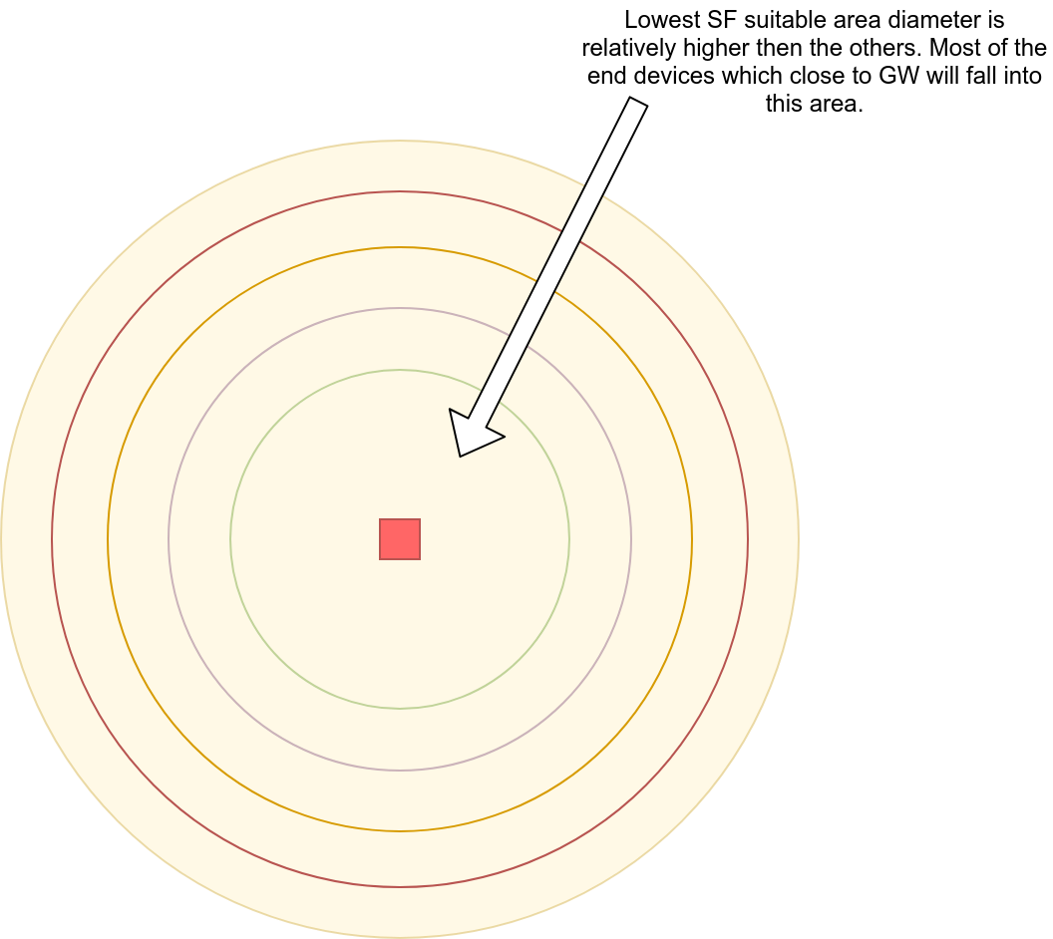
LPWAN Overview
LPWAN Design Goals and Techniques
LoRa
Research
Research: Problem
Less collisions occur if more SFs used:
More SFs could result in longer messages and more energy consumption
End nodes choose SF according to their GW transmission signal strength
Most of the end devices which close to GW will choose lowest SF which increases collisions
Figure 8: SF assignment issue on single gateway

Slide 11
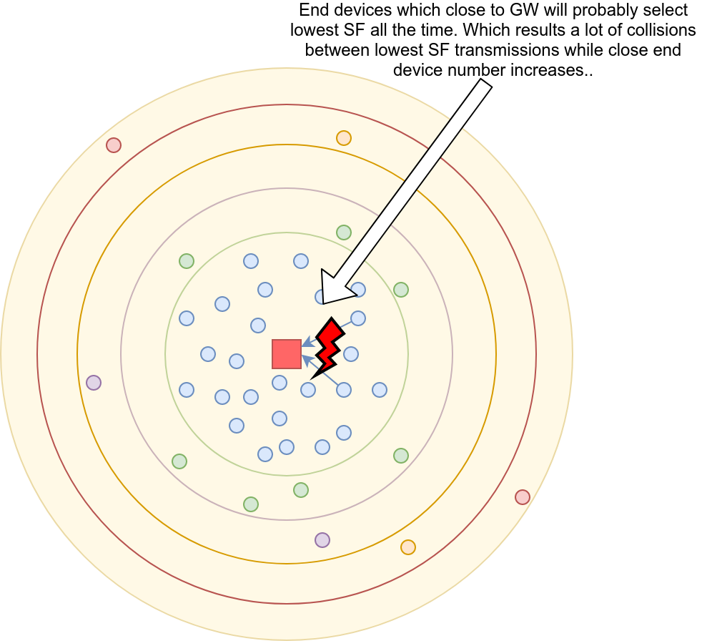
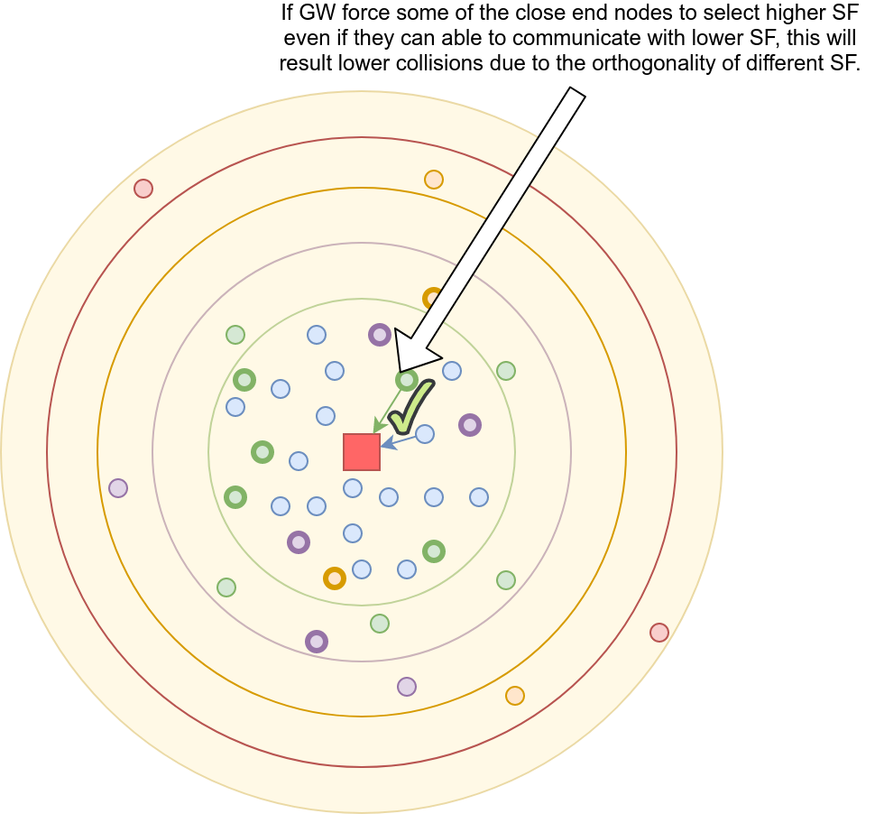
LPWAN Overview
LPWAN Design Goals and Techniques
LoRa
Research
Research: Problem & Proposal
Figure 9: SF assignment issue and proposal

Slide 12
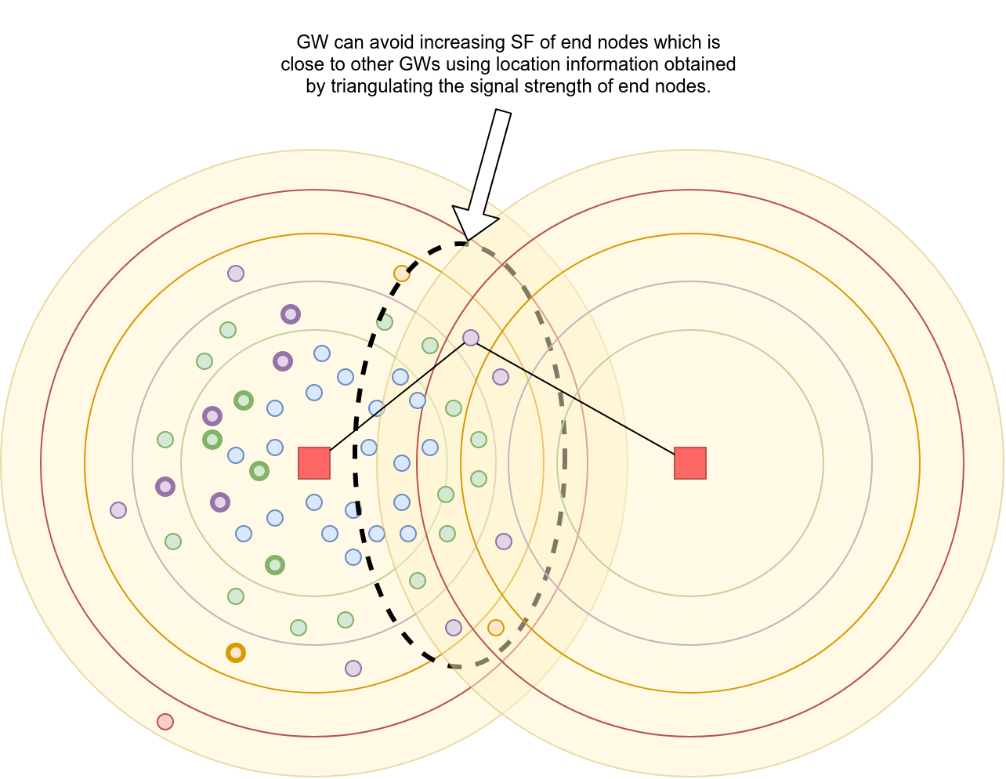
LPWAN Overview
LPWAN Design Goals and Techniques
LoRa
Research
Research: Problem & Proposal
Figure 10: SF assignment issue on multiple gateway

Slide 13
LPWAN Overview
LPWAN Design Goals and Techniques
LoRa
Research
Research: Proposal
Gateway can keep track of transmissions
Spreading factor
Transmission result
Gateway can train a model for predicting transmission result for a specific location and specific spreading factor
Trained model can be loaded into end nodes as a function
End nodes can use utilize this function to select spreading factor to decrease the probability of collisions
Figure 11: SF assignment issue solution proposal

Slide 14
Thank you for your time.
Any questions?

Slide 15
References
U. Raza, P. Kulkarni and M. Sooriyabandara, "Low Power Wide Area Networks: An Overview," in IEEE Communications Surveys & Tutorials, vol. 19, no. 2, pp. 855-873, Secondquarter 2017.
“Cellular networks for massive iot: Enabling low power wide area applications,” Ericsson, Tech. Rep., January 2016, ericsson White Paper. [Online]. Available: https://www.ericsson.com/res/docs/whitepapers/wp iot.pdf
E. Berthelsen and J. Morrish, “Forecasting the internet of things revenue opportunity,” Machina Research, Tech. Rep., April 2015.[Online]. Available: https://machinaresearch.com/report pdf/313
J. Petajajarvi, K. Mikhaylov, A. Roivainen, T. Hanninen, and M. Pettissalo, “On the coverage of LPWANs: Range evaluation and channel attenuation model for LoRa technology,” in Proc. 14th Int.Conf. ITS Telecommun. (ITST), Copenhagen, Denmark, Dec. 2015, pp. 55–59.
Lora alliance. [Online]. Available: https://www.lora-alliance.org/
O. Georgiou and U. Raza, "Low Power Wide Area Network Analysis: Can LoRa Scale?," in IEEE Wireless Communications Letters, vol. 6, no. 2, pp. 162-165, April 2017.
Catherwood, Philip & mclaughlin, james & Mccomb, Stephen & Little, Mike. (2017). Channel Characterisation for Wearable LoRaWAN Monitors. 10.1049/cp.2017.0273.
D. Magrin, M. Centenaro and L. Vangelista, "Performance evaluation of LoRa networks in a smart city scenario," 2017 IEEE International Conference on Communications (ICC), Paris, 2017, pp. 1-7.
B. Reynders, Q. Wang, P. Tuset-Peiro, X. Vilajosana and S. Pollin, "Improving Reliability and Scalability of LoRaWANs Through Lightweight Scheduling," in IEEE Internet of Things Journal, vol. 5, no. 3, pp. 1830-1842, June 2018.
F. Van den Abeele, J. Haxhibeqiri, I. Moerman and J. Hoebeke, "Scalability Analysis of Large-Scale LoRaWAN Networks in ns-3," in IEEE Internet of Things Journal, vol. 4, no. 6, pp. 2186-2198, Dec. 2017.

