Slide 1
SVHN Recognition
Tugsa Gongor - 2021
Georgia Tech

Slide 2
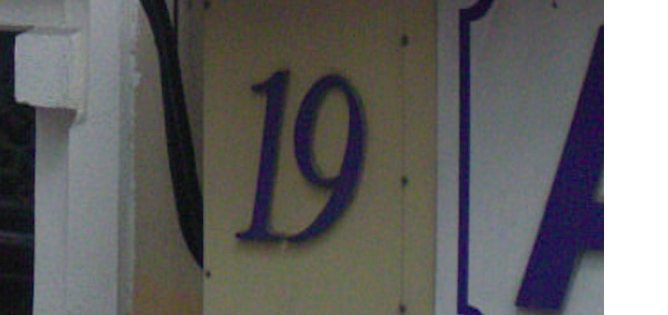


Dataset
Using Street View House Number (SVHN) dataset from Stanford
Use provided ground truth labels and positioning data (.json format)
80-20 train-test split

Slide 3
Preprocessing
Pull ROI using MSER (opencv) and resize to 32x32
MSER is blob detection algorithm – maximally stable regions from thresholding
Convert every ROI to grayscale
Calculate ROI overlap with ground truth coordinates
> 80% overlap = positive label
< 5% overlap = negative label
Training set – grayscale and subtract per pixel mean to normalize (good practice to maintain stable gradients)
End dimensions – 32x32x1

Slide 4
Approach
Two models – classifier and recognizer
Classifier model – 280462 training size including negative ROIs
Valid size – 69078
Recognizer model – 105200 training size without negative ROIs (useless for recognizer)
Valid size – 26053
Why classifier?
Could combine classification and recognition
Separate classifier model gave more reliable performance to detecting presence of digits – better performance at not much worse speeds

Slide 5
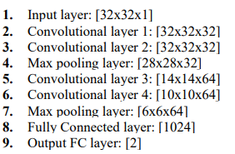
Classifier model
CNN architecture
Use max pooling to downsample input

Slide 6
Recognizer model
Same CNN architecture
Include extra third FC layer to improve representational capacity with dropout in between to reduce overfitting
Output FC layer has 10 outputs for digits

Slide 7
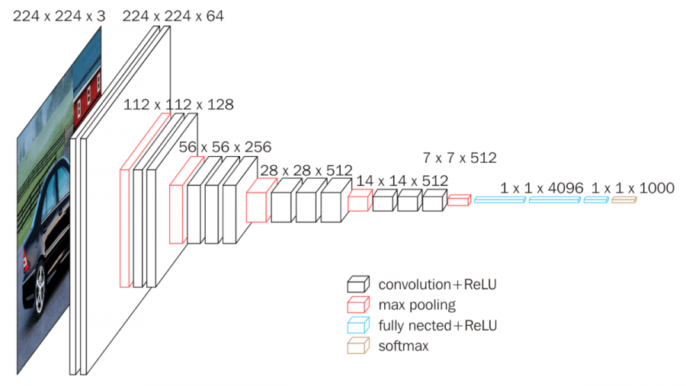
Pretrained VGG16 model
Using keras implementation with imagenet weights
Different approach (required)
Combined classifier and recognizer (11 outputs, extra for no digit)
Use color ROI (32x32x3)
Long time to train and slightly worse performance
Validation accuracy = 0.9320, F1 = 0.92

Slide 8
Model complexity
Custom models designed to resemble VGG16 (with lesser complexity)
Considered more complex models, but training time became longer with worse performance – likely overfitting to training data
Efficiency was important since using two models, so elected to minimize model complexity instead of keeping more complex models

Slide 9
Training
10 epochs for recognizer and 5 epochs for classifier – computational limits
Used ADAM optimizer for classifier – SGD optimizer that uses first and second order moments (mean and variance respectively)
Mainly used for better performance and because it is widely used in industry
Lr = 0.001
Used SGD for recognizer – ADAM didn’t generalize well
SGD typically generalizes better – much better performance than ADAM and AdaDelta
Lr = 0.01

Slide 10
Training cont.
Batch size = 200
Smaller sizes -> inaccurate results
Training results
Classifier accuracy – 0.9505
Recognizer accuracy – 0.9396
Negative labels outnumbered positive – important to consider other metrics like confusion matrix and F1 score
Classifier F1 score – 0.95

Slide 11
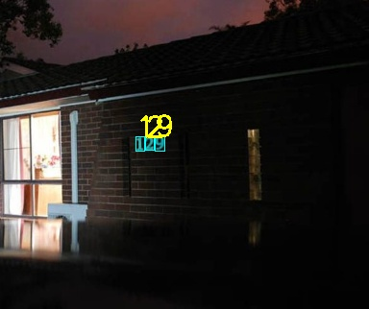
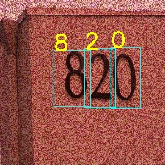
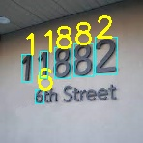
Final performance
Previously unseen real life images
Respectable performance, but very dependent on how thresholding is handled and image is preprocessed
Use non max suppression – candidate region M is selected and those with overlap >= than predetermined threshold with M are removed

Slide 12
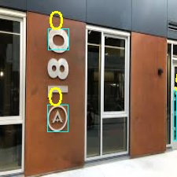
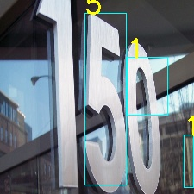
Potential improvements
Moving windows for large images with small digits
Consider different localization methods than MSER
Improve robustness during training, specifically flipping images and skewing
Final model was unable to recognize reliably the following images
Consider other thresholding approaches – soft NMS (decay instead of removal those regions that overlap with M)

Slide 13
Further considerations
Combined approach with better efficiency might be considered
YOLO, Region-based CNN
These models combine localization and detection
Localization network instead of MSER (picks up every blob and difficult to be correct when don’t have ground truths)
Use CNN as feature extractor and Fully Connected regressor for localization coordinates
Multiple digits per image makes this approach difficult

