Slide 1
Interface Shift Register with Atmega
74HC595 (8Bits)

Slide 2
Preface
When there more devices to drive than available MCU pins, this shift register comes handy
Essentially a serial to parallel converter
Typical applications include driving 7 Segment display, Bargraph display etc.
One or more shift registers can be cascaded with the existing one (daisy chaining) to get 16 or 32 or more separate output lines without having to increase MCU pins
These work as output devices. There are devices available for input as well

Slide 3
Refference
Datasheet: E:\educational\datasheets\74HC_HCT595.pdf
Extreme-Electronics: http://extremeelectronics.co.in/avr-tutorials/using-shift-registers-with-avr-micro-avr-tutorial/
Youtube : https://www.youtube.com/watch?v=d7Au3I4ZdZc

Slide 4
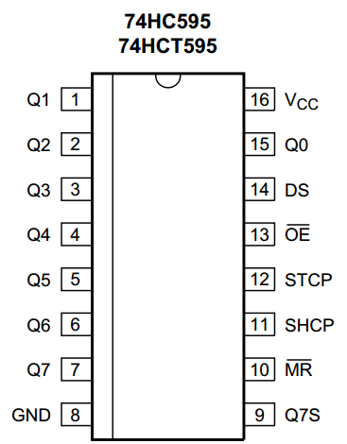
Pin out

Slide 5
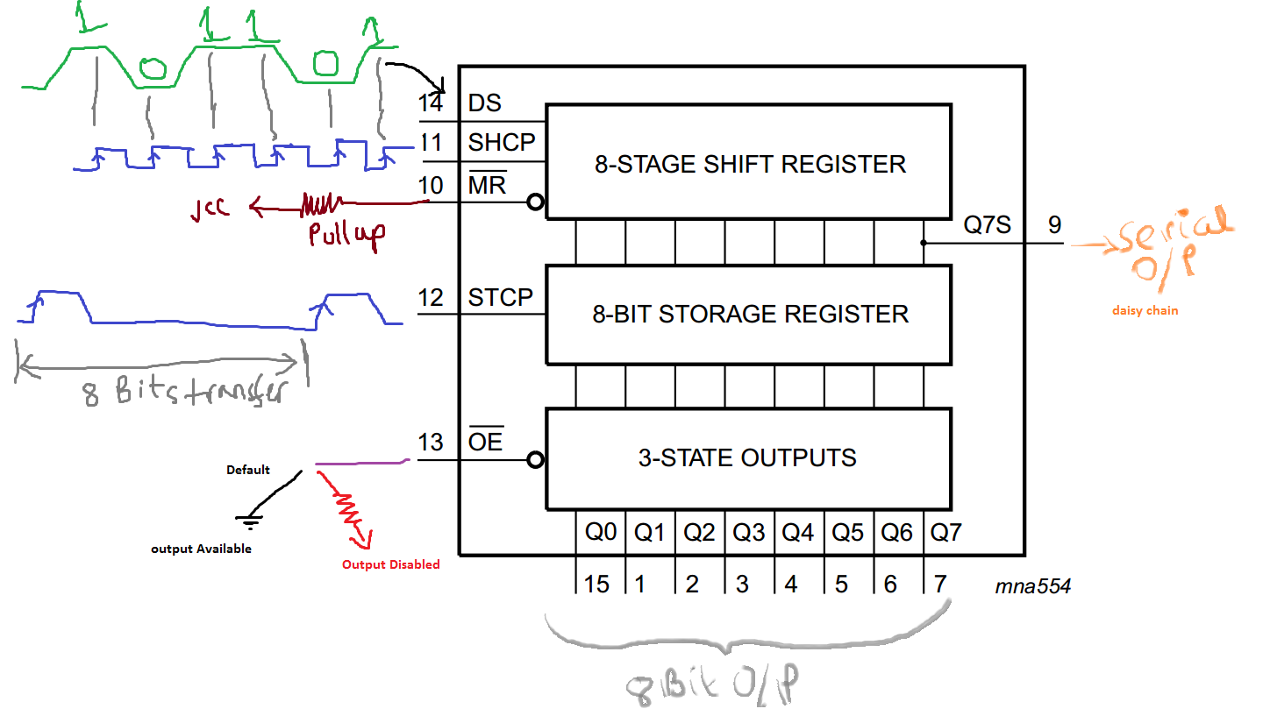
Working mechanism

Slide 6
Working Principle DS and SHCP
DS (serial data pin-14) takes in serial data.
At every rising edge of shift clk on pin 11, the register left-shifts its previous byte present in 8 STAGE SHIFT REGISTER.
samples and captures DS (high or low) and places it on newly vacant LSB position
This way 8 rising edge on SHCP will load a new byte in 8 STAGE SHIFT REGISTER.

Slide 7
Working Principle STCP
Unless STCP receive a rising edge the content of 8 STAGE SHIFT REGISTER will not be available at 8 BIT STORAGE REGISTER
Once STCP receives a rising edge the content of 8 STAGE SHIFT REGISTER gets copied into 8 BIT STORAGE REGISTER
So its usually done once after 8 new bits have shifted in 8 STAGE SHIFT REGISTER
When OE is connected to GND (default) the 8 bits in 8 BIT STORAGE REGISTER is available in 3 STATE OUTPUTS for external use

Slide 8
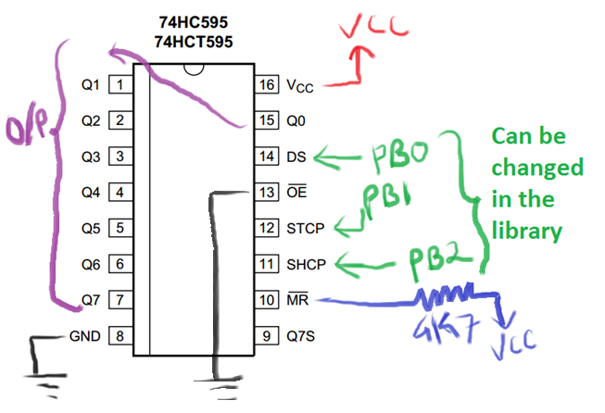
MCU connection (Basic mode) just 5 pins (3MCU pins)

Slide 9
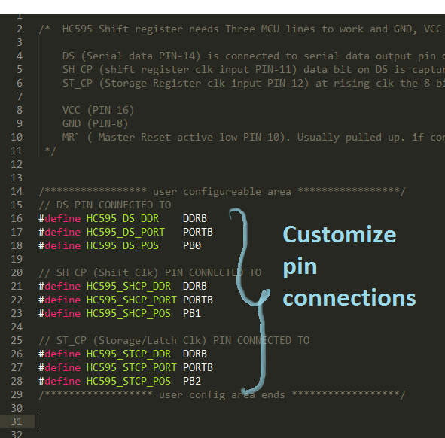
Library (ShiftRegHC595.h)

Slide 10
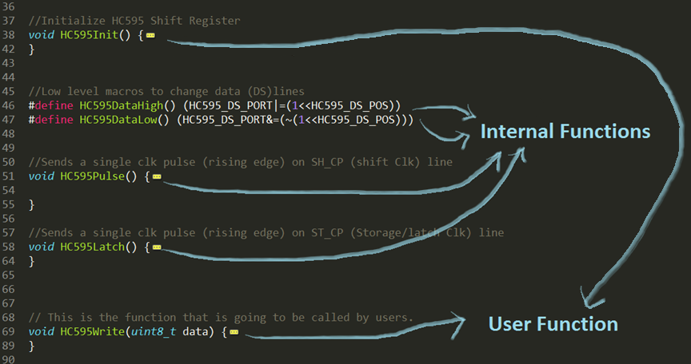
Library (ShiftRegHC595.h)

Slide 11
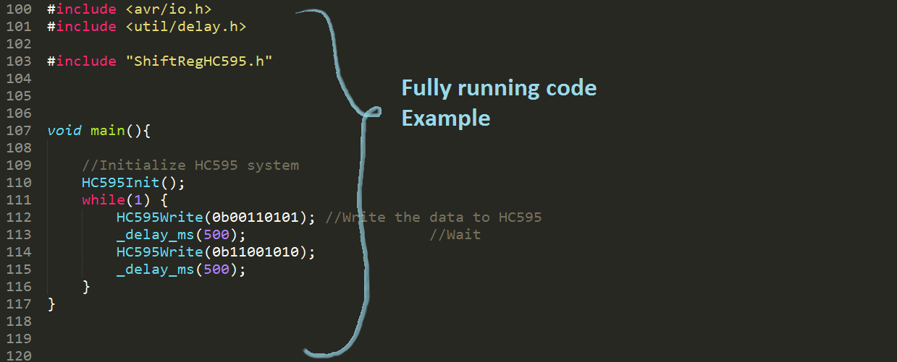
Library (ShiftRegHC595.h)

Slide 12
Extended & Advanced Features
Sometimes one shift register is not enough.
So there are four different ways to connect multiple shift registers with MCU
Daisy Chain
Common clocks( SHCP & STCP common and different DS lines)
Common latch (STCP common and different SHCP and DS lines)
Totally separate modules

Slide 13
1. Daisy Chain
Cascade

Slide 14
1. Daisy Chain
Shift registers are cascaded.
Number of MCU lines doesn't increase( stays 3).
2 SR gives 16 o/p lines, 3 gives 24 etc.
But total number of bits avail able have to be updated together
Best suited for display devices (7 segments, bargraphs etc.)

Slide 15
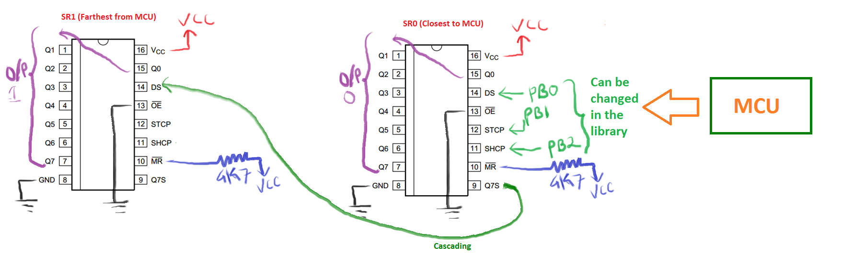
1.Daisy chain Connections

Slide 16
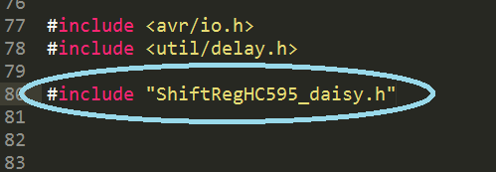
1.Daisy chain Library (shiftreghc595_daisy.h)
Include “ShiftRegHC595_daisy.h” and this will automatically include “ShiftRegHC595.h”

Slide 17
1.Daisy chain Library (shiftreghc595_daisy.h)
Then configure the connection for SR0 (Closest to MCU) in ShiftRegHC595.h

Slide 18
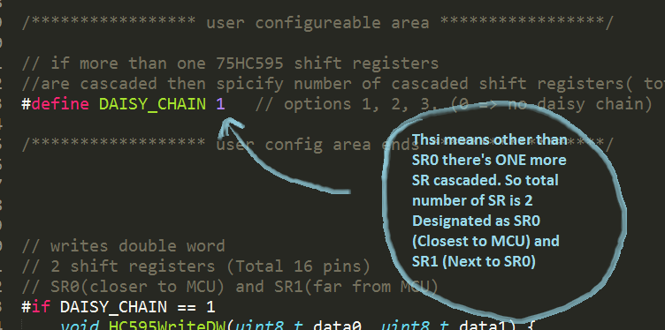
1.Daisy chain Library (shiftreghc595_daisy.h)
Then specify number of SR(s) cascaded, i.e. total number of SR(s) excluding SR0, in ShiftRegHC595_daisy.h

Slide 19
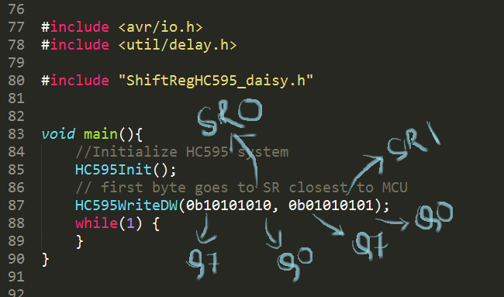
1.Daisy chain Library (shiftreghc595_daisy.h)
That’s it, Now just call the functions. Here’s a sample program.

Slide 20
2. Common Clocks
SHCP(shift Clk) & STCP(latch Clk)

Slide 21
2. Common Clocks (SHCP & STCP)
Shift registers are not cascaded.
All the SR(s) share the same clock line (SHCP & STCP)
But each SR have their own an different DS lines
Since they share clocks. If one SR is updated then this will cause shifts in all the SR(s). To overcome this all shift registers will have to be updated all at once.
First SR (SR0) requires 3 MCU lines and then after one more MCU lines (DS) each for each SR(s) added.

Slide 22
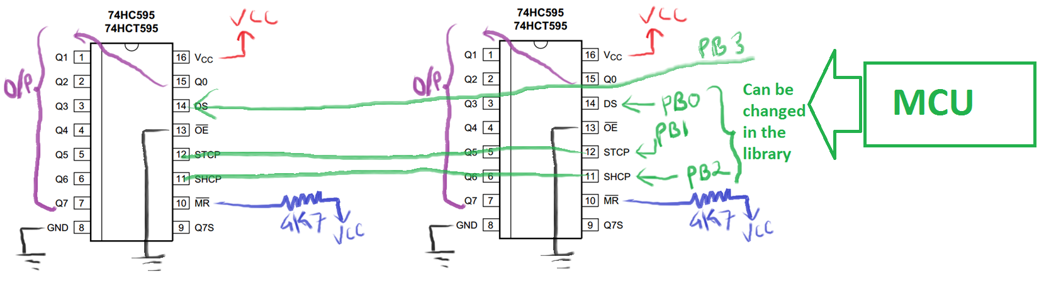
2. Common Clocks Connections

Slide 23
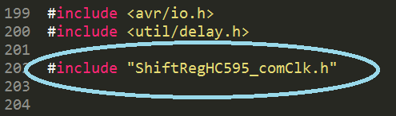
2. Common Clocks Library (shiftreghc595_comClk.h)
Include “ShiftRegHC595_comClk.h” and this will automatically include “ShiftRegHC595.h”

Slide 24
2. Common Clocks Library (shiftreghc595_comClk.h)
Then configure the connection for SR0 (Closest to MCU) in ShiftRegHC595.h

Slide 25
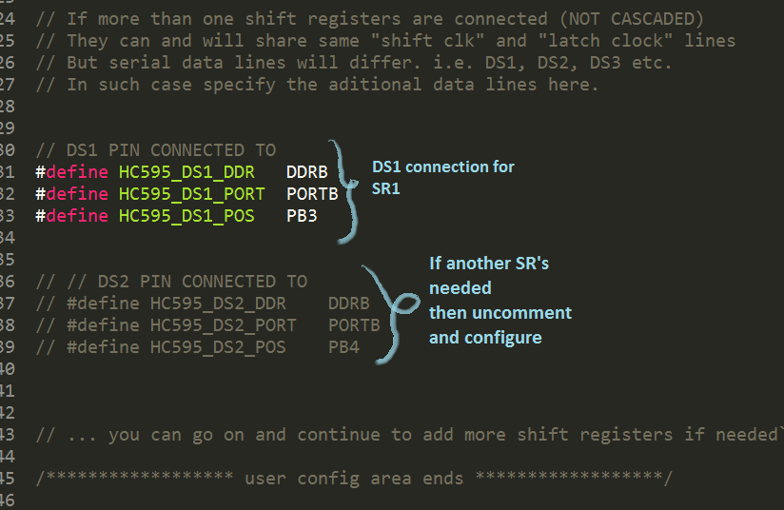
2. Common Clocks Library (shiftreghc595_comClk.h)
Then configure DSx line connections for SR1 and SR2 in ShiftRegHC595_comClk.h

Slide 26
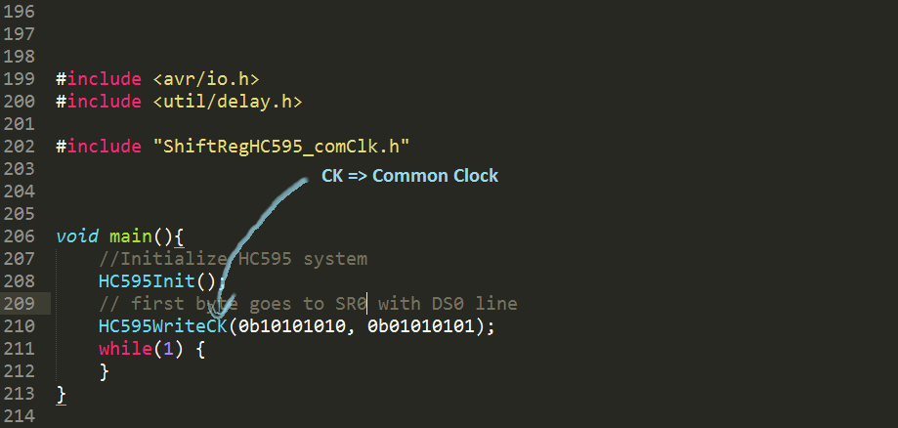
2. Common Clocks Library (shiftreghc595_comClk.h)
That’s it, Now just call the functions. Here’s a sample program.

Slide 27
3. Common latch
STCP(latch Clk is common)

Slide 28
3. Common Latch
The latch Clk(STCP) is shared between all the SR(s)
Each SR has its own Shift Clk(SHCP) and Serial data(DS)
This mode can be achieved by Configuring the same PORT, DDR, POS for STCP pic in Totally separate mode

Slide 29
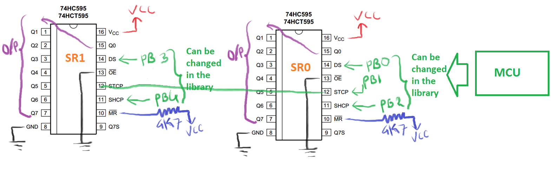
3. Common Latch Connections

Slide 30
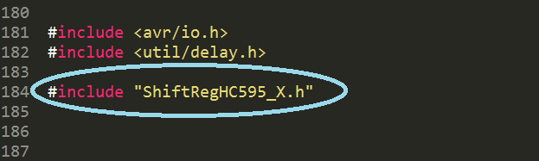
3. Common Latch Library (ShiftRegHC595_X.h)
Include “ShiftRegHC595_X.h” and this will automatically include “ShiftRegHC595.h”

Slide 31
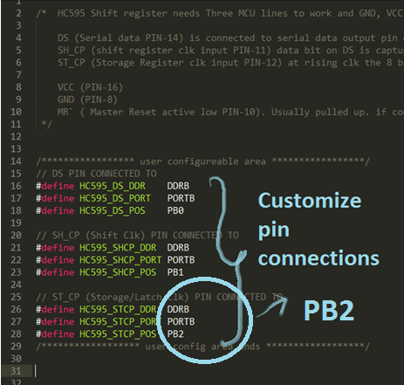
3. Common Latch Library (ShiftRegHC595_X.h)
Then configure the connection for SR0 (Closest to MCU) in ShiftRegHC595.h

Slide 32
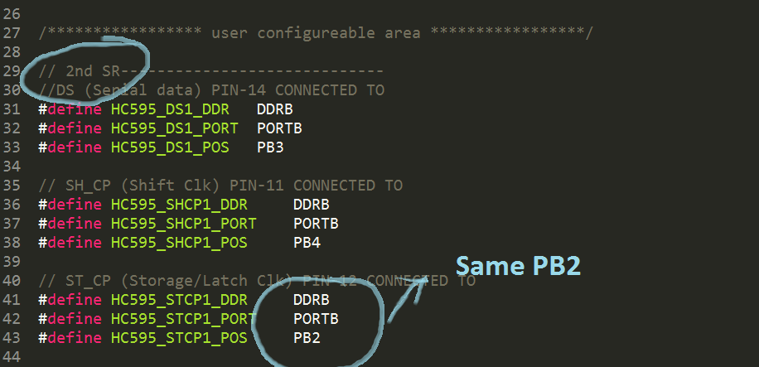
3. Common Latch Library (ShiftRegHC595_X.h)
Then configure the connection for SR1 in ShiftRegHC595_X.h

Slide 33
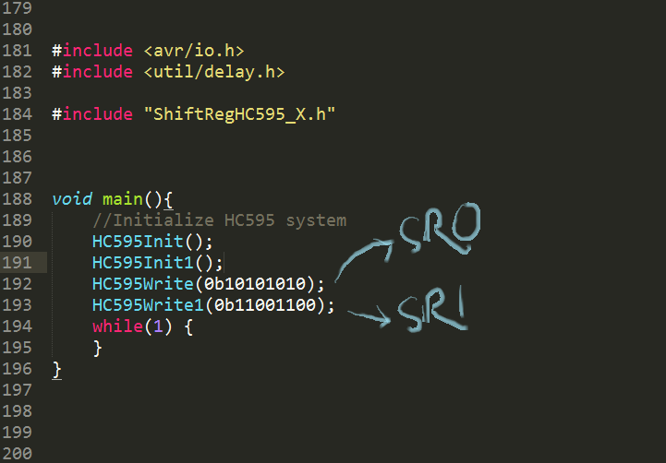
3. Common Latch Library (ShiftRegHC595_X.h)
Sample Program

Slide 34
4. Totally Separate

Slide 35
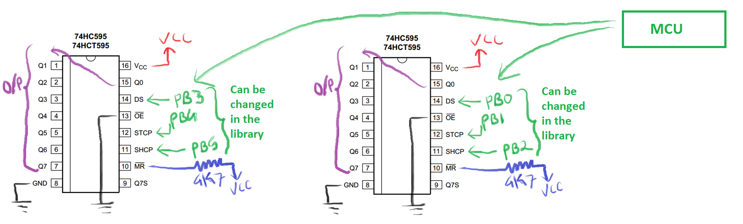
4. Totally separate Connections
SR1
SR0

Slide 36
4. Totally separate Connections
Include “ShiftRegHC595_X.h” and this will automatically include “ShiftRegHC595.h”

Slide 37
4. Totally separate Connections
Then configure the connection for SR0 (Closest to MCU) in ShiftRegHC595.h

Slide 38
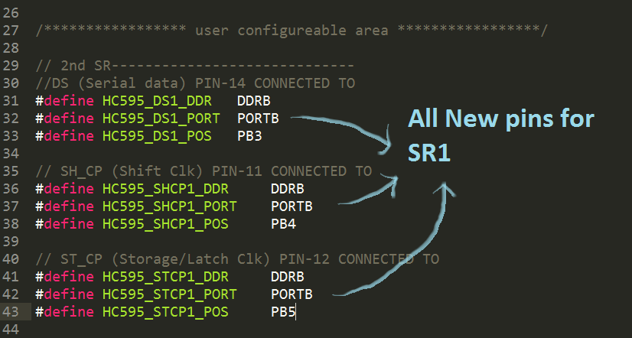
4. Totally separate Connections
Then configure the connection for SR1 in ShiftRegHC595_X.h

Slide 39
4. Totally separate Connections
Sample Program

