Slide 1






Presentation
Cultural Heritage and Festivals of Bangladesh
Batch:B-27
SL:20

Slide 2

Introduction
The culture and tradition of Bangladesh are drawn from people’s faith, ethnic root, thoughts and aspirations and creativity, and the passion for life and nature. Unique geographic location, abundance in resources and natural splendour of the country have throughout the history attracted traders, travellers, religion preachers from outside to visit and settle in this land. Such continued interactions with people of diverse race, civilization and cultural background have helped Bangladesh further enrich its culture and civilization, still maintaining the distinctive indigenous elements.

Slide 3


Important Archaeological Sites
The cultural heritage of Bangladesh is substantiated in numerous vestiges of ancient periods as well as in remnants of pre-historic urban settlements and other magnificent monuments of different era spread all over the country. So far, 448 sites have been enlisted as national heritage. Notable heritage sites in Bangladesh include among other the following:

Slide 4
Pre-historic city in Wari-Batashar:
The twin village Wari-Batashar in the district of Narsingdi dates back to 450 BC. According to archaeologists, Wari-Batashar was a commercial city represents the most ancient civilization in the region. Before the discovery of Wari-Batashar, it was widely held view that urbanization started much later in Bengal region. Excavation of the site has so far unearthed a road, a water reservoirs, small rooms, punched marked silver coins, earthen pots, iron artifacts, hand axes, semi-precious stone beads of early historic period.

Slide 5
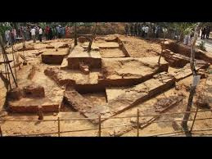
Pre-historic city in Wari-Batashar:

Slide 6
Mahastangarh in Bogra:
Earliest relics of the historic age are Mahasthangarh in northern district of Bogra district. Mahasthangarh was built as provincial capital in 3rd century BC by Pundra dynasty and the city continued flourishing during the successive ruling dynasties. The wide range of relics recovered from this site has been put on display at a museum in the site.

Slide 7
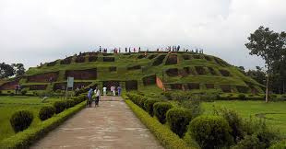
Mahastangarh in Bogra:

Slide 8
Sompur Bhuddhist Mahavihara at Paharpur:
The most striking Buddhist monument is the colossal monastery at Paharpur known as Sompur Mahavihara in the northern district of Naogaon. This is the second largest single monastery in the south of the Himalayas. The Monastery was built the second king of Pala dynasty Dharmapala in the 8th century AD. According to Tibetan sources, Sompur Mahavihara in Paharpur was one of the five greatest Buddhist monasteries of ancient time. Sompur Mahavihara has been designated as a World Heritage Site by UNESCO in 1985. Many other smaller monasteries and stupas have been exposed at in Dinajpur, Savar, and in the Lalmai-Mainamati hill range in Comilla

Slide 9
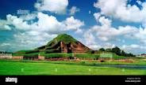
Sompur Bhuddhist Mahavihara at Paharpur:

Slide 10
Sixty-domed Mosque in Bagerhat:
The majestic Sixty-domed mosque, popularly known as Shait-Gumbuj Masjid, is the southern district of Bagerhat is the largest mosque of the Sultanate period in the country of Sultanate period. The same is surrounded by many other mosques and tombs of same period (Bibi Begni Mosque, Khan Jahan’s tomb, Nine-domed Mosque, etc). The mosque, built by saint ruler Khan Jahan Ali in mid 15th century AD, has been designated as a World Heritage Site by UNESCO.

Slide 11
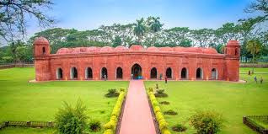
Sixty-domed Mosque in Bagerhat:

Slide 12
Soto Sona Mosjid in Chapai Nawabganj
Soto Sona Mosjid (small golden mosque,) in the northern district of Chapai Nawabganj is another landmark monument of Sultanate period (built by Sultan Hussain Shah between 1493 to 1519). Stone carving, brick-setting, terracotta, gilding and glazed tiles were used in decorating the building.

Slide 13
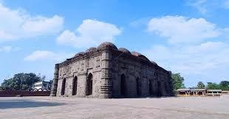
Soto Sona Mosjid in Chapai Nawabganj

Slide 14
Lalbagh Fort:
The impressive Lalbagh Fort is a 17th century Mughal fort complex that still stands proudly in the bank of river Buriganga in Dhaka. Mughal Prince Muhammad Azam Shah, the third son of Mughal Emperor Aurangzeb, started the work of the fort in 1678 during this vice-royalty in Bengal and stayed in the fort for 15 months. The famous tomb of Pari Bibi, daughter of Shaista Khan who succeeded Prince Azam Khan, constitutes one of the three major components of the fort complex.

Slide 15
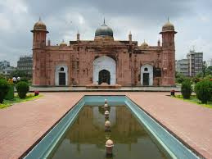
Lalbagh Fort:

Slide 16
Ahsan Manjil Palace:
It is one of the most significant architectural monuments of Bangladesh. The majestic palace was the residential palace and the seat of Dhaka Nawab family. It was built in the banks of the Buriganga river during the period from 1859 to 1872. Some portions of the palace complex were built earlier in the 18thcentury by the landlord of Jamalpur.

Slide 17
Kantajew Mandir in Dinajpur:
It is a late-medieval Hindu temple, built by Maharaja Pran Nath in the northern district of Dinajpur. Its construction started in 1704 and completed in 1722. It boasts one of the greatest examples of terracotta architecture in Bangladesh.

Slide 18
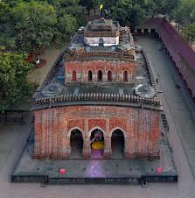
Kantajew Mandir in Dinajpur:

Slide 19
CONCLUTION
The culture of Bangladesh refers to the ways of life of the people of Bangladesh. We have a rich culture, and it has its own uniqueness. Its deeply rooted heritage is thoroughly reflected in its architecture, dance, literature, music, painting and clothing. People of different religions live here in peace. These religions here their influence on our culture. People of Bangladesh are traditionally religious, simple, kind and hospitable. The music in Bangladesh can be divided into three main categories; classical, modern and folk. Both vocal and instrumental classical music is enjoyed in Bangladesh. Various types of folk songs are popular here, such as jari, sari, Bhatiali, Bhawaiya etc. Modern music is becoming more popular and is practiced widely. Contemporary, pop songs and bands are also enjoying widespread fame. But they are mainly popular in Dhaka and other big cities. Tribal dances are very popular among the people here. Dancing with the rhythm of popular folk music is very popular among young boys and girls. They often perform in different festivals and cultural programmes of their communities. . The main food is rice and fish. Bangladesh cuisine is diverse in its own way. People from all over the world love Bangladesh foods. So Bangladesh has an impressive culture, and proud of it.

