Slide 1
Law of Total Probability and Independence

Slide 2
Example
If an aircraft is present in a certain area, a radar detects it and generates an alarm signal with probability 0.99. If an aircraft is not present, the radar generates a (false) alarm with probability 0.1. We assume that an aircraft is present with probability 0.05.
What is the probability of no aircraft presence and a false alarm ?
What is the probability of aircraft presence and no detection ?
What is the probability that the radar detects the aircraft ?
(Example 1.9 Bertsekas)

Slide 3
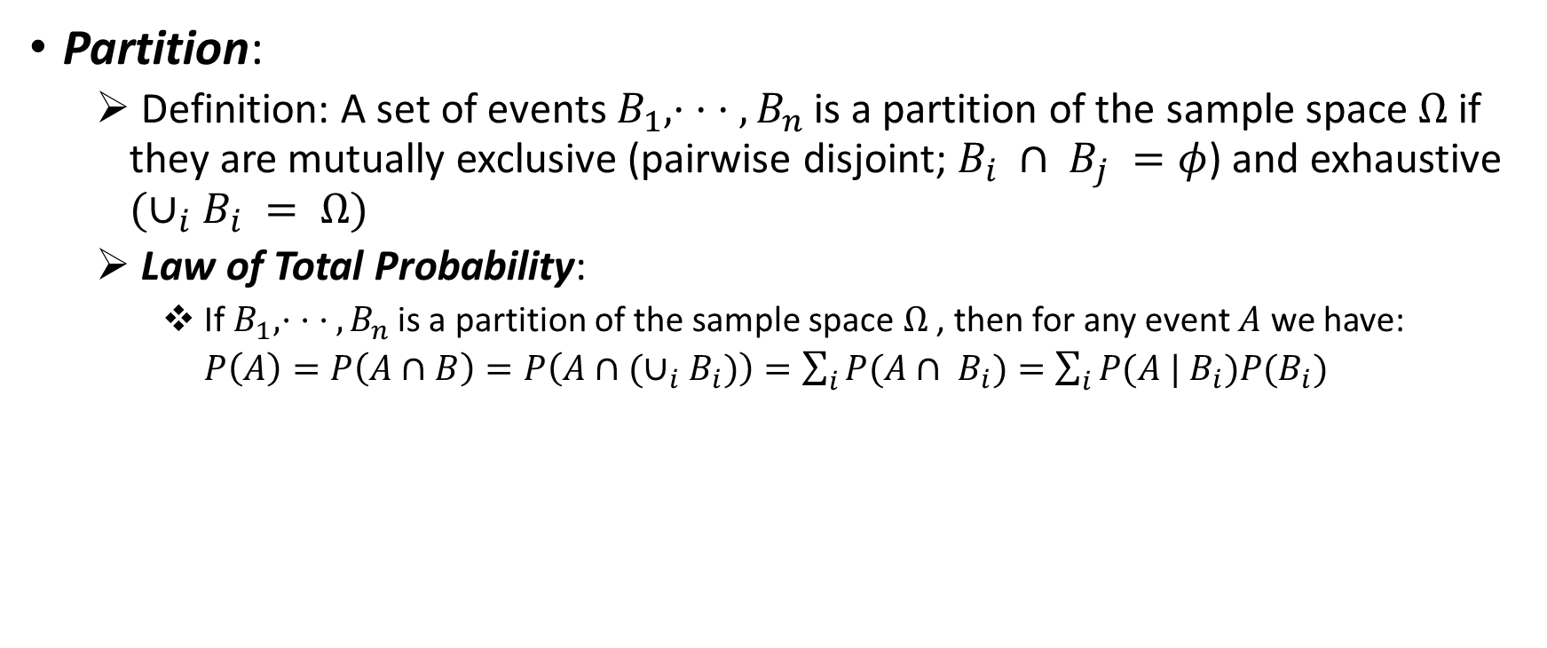
Law of Total Probability
Partition:
Definition: A set of events $B_{1}, · · · , B_{n}$is a partition of the sample space $Ω$ if they are mutually exclusive (pairwise disjoint; $B_{i} ∩ B_{j} =φ$) and exhaustive $(∪_{i}B_{i} = Ω)$
Law of Total Probability:
If $B_{1}, · · · , B_{n}$is a partition of the sample space $Ω$ , then for any event $A$ we have:
$P\left(A\right)=P\left(A∩B\right)=P\left(A∩(∪_{i}B_{i})\right)=\sum_{i}{P(A∩ B_{i})}=\sum_{i}{P(A | B_{i})P(B_{i})}$

Slide 4
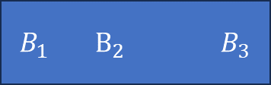
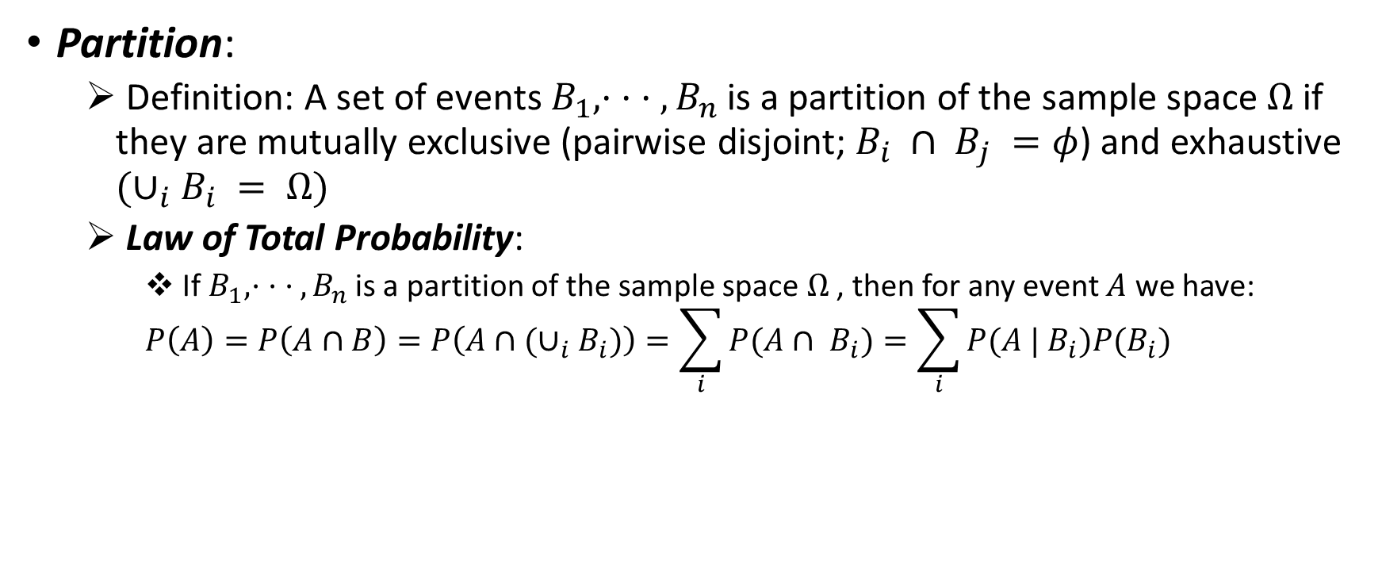

Law of Total Probability
Partition:
Definition: A set of events $B_{1}, · · · , B_{n}$is a partition of the sample space $Ω$ if they are mutually exclusive (pairwise disjoint; $B_{i} ∩ B_{j} =φ$) and exhaustive $(∪_{i}B_{i} = Ω)$
Law of Total Probability:
If $B_{1}, · · · , B_{n}$is a partition of the sample space $Ω$ , then for any event $A$ we have:
$$P\left(A\right)=P\left(A∩B\right)=P\left(A∩(∪_{i}B_{i})\right)=\sum_{i}{P(A∩ B_{i})}=\sum_{i}{P(A | B_{i})P(B_{i})}$$
$B_{1}$ $B_{2} B_{3}$
A
$A_{1}$ $A_{2} A_{3}$

Slide 5
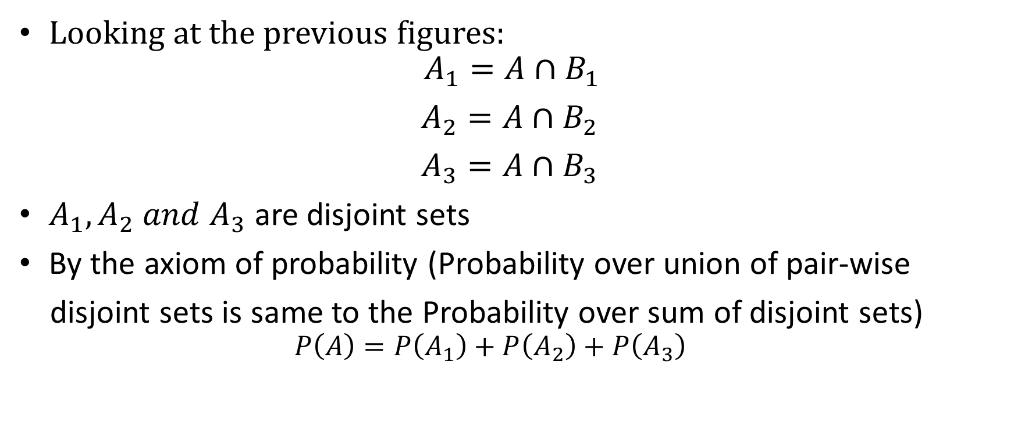
Law of Total Probability
Looking at the previous figures:
$$A_{1}=A∩B_{1}$$
$A_{2}=A∩B_{2}$
$A_{3}=A∩B_{3}$
$A_{1}, A_{2} and A_{3}$ are disjoint sets
By the axiom of probability (Probability over union of pair-wise
disjoint sets is same to the Probability over sum of disjoint sets)
$$P\left(A\right)=P\left(A_{1}\right)+P\left(A_{2}\right)+P\left(A_{3}\right)$$

Slide 6
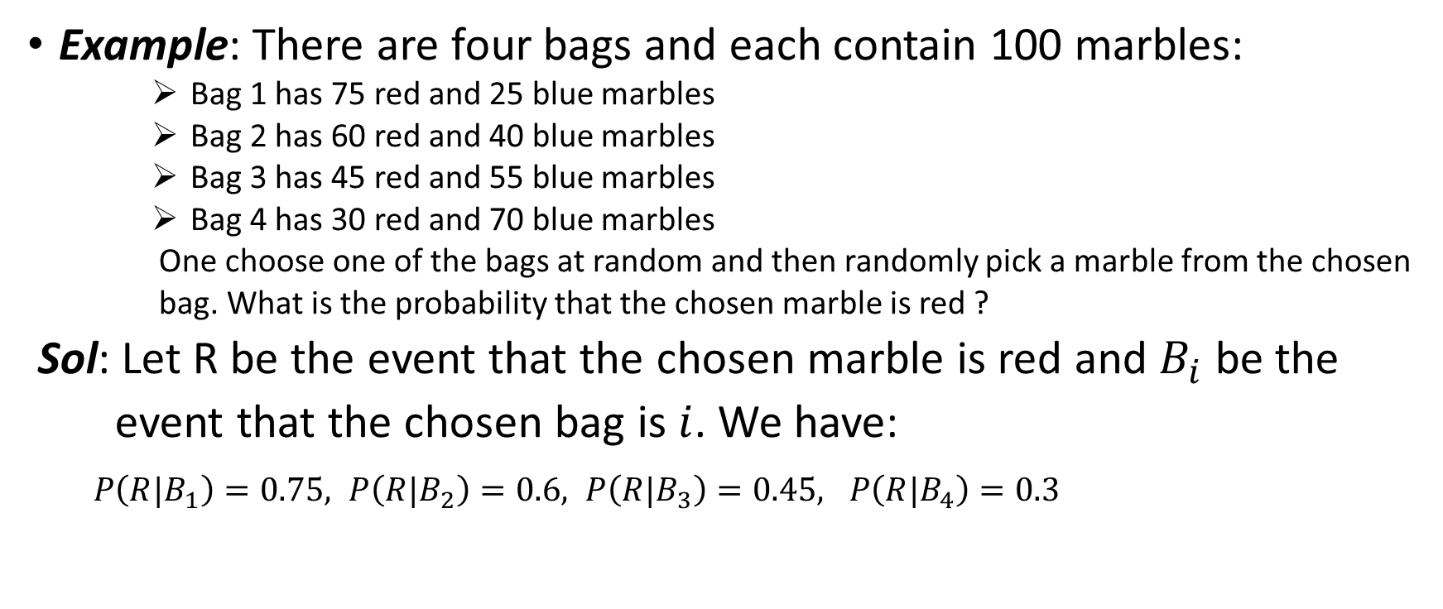
Law of Total Probability
Example: There are four bags and each contain 100 marbles:
Bag 1 has 75 red and 25 blue marbles
Bag 2 has 60 red and 40 blue marbles
Bag 3 has 45 red and 55 blue marbles
Bag 4 has 30 red and 70 blue marbles
One choose one of the bags at random and then randomly pick a marble from the chosen
bag. What is the probability that the chosen marble is red ?
Sol: Let R be the event that the chosen marble is red and $B_{i}$ be the
event that the chosen bag is $i$. We have:
$P\left(R|B_{1}\right)=0.75, P\left(R|B_{2}\right)=0.6, P\left(R|B_{3}\right)=0.45, P\left(R|B_{4}\right)=0.3$

Slide 7
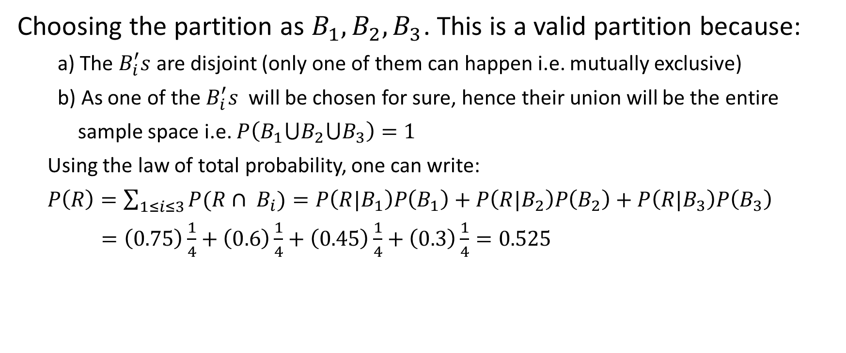
Law of Total Probability
Choosing the partition as $B_{1},B_{2},B_{3}$. This is a valid partition because:
a) The $B_{i}^{′}s$ are disjoint (only one of them can happen i.e. mutually exclusive)
b) As one of the $B_{i}^{′}s$ will be chosen for sure, hence their union will be the entire
sample space i.e. $P\left(B_{1}⋃B_{2}⋃B_{3}\right)=1$
Using the law of total probability, one can write:
$P\left(R\right)=\sum_{1≤i≤3}{P(R∩ B_{i})}=P\left(R|B_{1}\right)P\left(B_{1}\right)+P\left(R|B_{2}\right)P\left(B_{2}\right)+P\left(R|B_{3}\right)P\left(B_{3}\right)$
$=\left(0.75\right)\frac{1}{4}+\left(0.6\right)\frac{1}{4}+\left(0.45\right)\frac{1}{4}+\left(0.3\right)\frac{1}{4}=0.525$

Slide 8

Independence
Two events $A, B$are independent if the occurrence of one event does not affect the probability of occurrence of the other event i.e.
$P(A | B)=P(A)$ and $P(B|A)=P(B)$

Slide 9
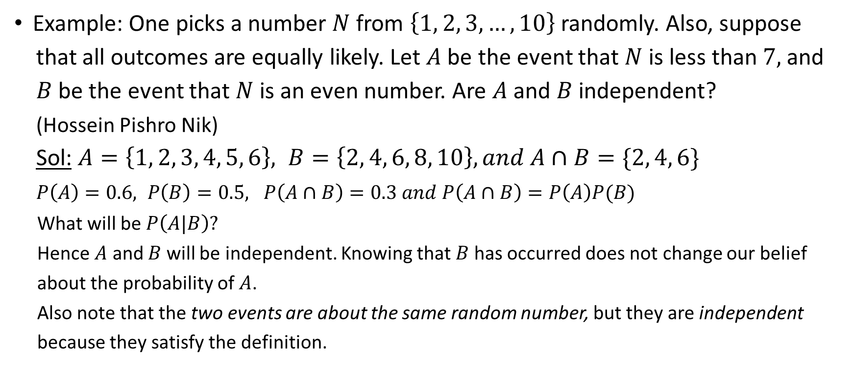
Independence
Example: One picks a number $N$ from $\left\{1, 2, 3, …, 10\right\}$ randomly. Also, suppose
that all outcomes are equally likely. Let $A$ be the event that $N$ is less than $7,$ and
$B$ be the event that $N$ is an even number. Are $A$ and $B$ independent?
(Hossein Pishro Nik)
Sol: $A=\left\{1, 2, 3, 4, 5, 6\right\}, B=\left\{2, 4, 6, 8, 10\right\}, and A∩B=\{2, 4, 6\}$
$P\left(A\right)=0.6, P\left(B\right)=0.5, P\left(A∩B\right)=0.3 and P\left(A∩B\right)=P\left(A\right)P(B)$
What will be $P\left(A|B\right)?$
Hence $A$ and $B$ will be independent. Knowing that $B$ has occurred does not change our belief
about the probability of $A$.
Also note that the two events are about the same random number, but they are independent
because they satisfy the definition.

Slide 10
Example 1 Professor Perception
A professor thinks students who live on campus are more likely to get A grade in the probability course. To check this theory, the professor combines the data from the past few years:
600 students have taken the course
120 students have got As
200 students lived on the campus
80 students lived off campus & got As
Does this data suggest that “getting an A” and “living on campus” are dependent or independent ? (Hossein Pishro Nik)

Slide 11
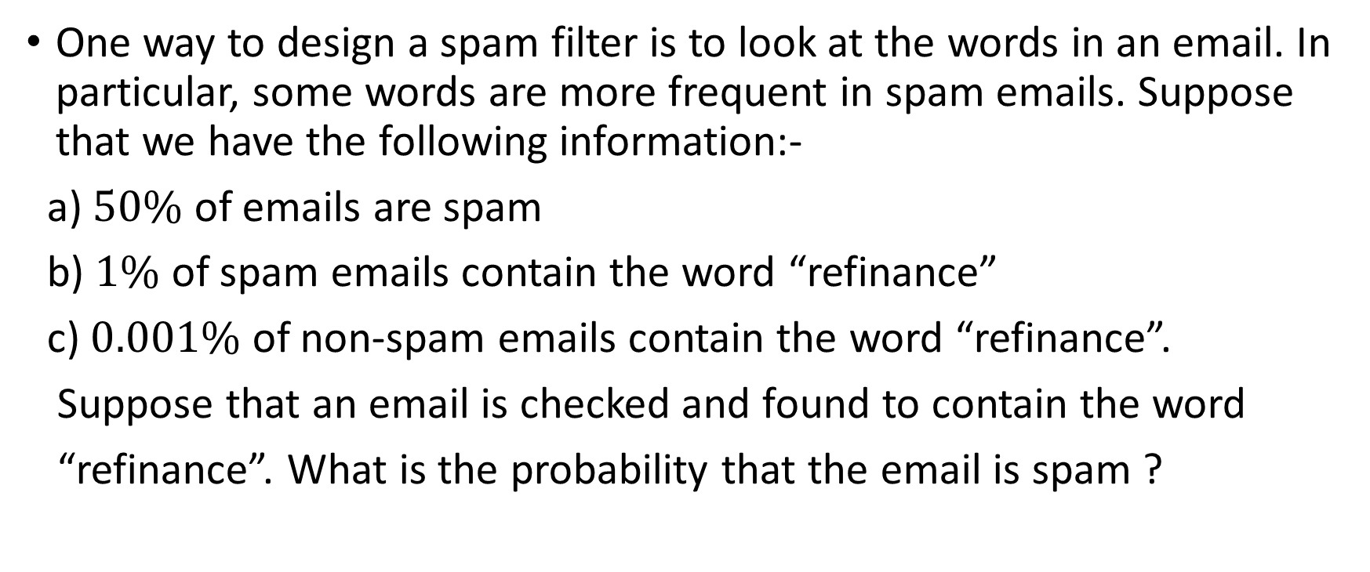
Example 2 Spam Filter
One way to design a spam filter is to look at the words in an email. In particular, some words are more frequent in spam emails. Suppose that we have the following information:-
a) $50\%$ of emails are spam
b) $1\%$ of spam emails contain the word “refinance”
c) $0.001\%$ of non-spam emails contain the word “refinance”.
Suppose that an email is checked and found to contain the word
“refinance”. What is the probability that the email is spam ?

Slide 12
References
Pishro-Nik, Hossein. Introduction to probability, statistics, and random processes. Blue Bell, PA, USA: Kappa Research, LLC, 2014.
Harchol-Balter, Mor. Introduction to probability for computing. Cambridge University Press, 2023.
Bertsekas, Dimitri, and John N. Tsitsiklis. Introduction to probability. Vol. 1. Athena Scientific, 2008.

