Slide 1
Lam Research TechnologyAgent
Project: Lam Research TechnologyAgent
  Team members: [List team names]
  Faculty advisor: Michele Samorani
  Sponsor: Lam Research
Notes:
Hello — we’re presenting Lam Research TechnologyAgent, a prototype platform to accelerate identification of academic partners. I’m [name] and our team includes [names]. Michele Samorani advised this work and Lam Research sponsored it. Over the next ten minutes I’ll outline the scope, approach, architecture, results, and business impact.

Slide 2
Project Scope
Make partnership discovery fast, consistent, and scalable
  Target users: technology scouts and research partnerships teams
  Manual search is slow, subjective, and misses emerging researchers
Notes:
Lam needed a repeatable way to find academic partners aligned to future technology directions. Analysts today rely on manual Google Scholar searches which are slow and subjective. Our aim: surface relevant researchers quickly while preserving signals for impact and recency.

Slide 3
Key Use Cases
Find candidates for sponsored research and collaborations
  Identify rising researchers and cross-disciplinary matches
  Produce concise summaries for outreach and evaluation
Notes:
We focused on three practical use cases: building candidate shortlists for sponsored projects, discovering rising talent and cross-disciplinary fits, and generating distilled summaries to speed outreach.

Slide 4
Work Steps / Analysis
Requirements: stakeholder interviews and success criteria
  Data-source evaluation: selected OpenAlex for coverage
  Pipeline design: ingestion, identity resolution, KB construction
Notes:
Our approach began with requirements and stakeholder interviews, followed by data-source evaluation. We chose OpenAlex for breadth. We designed a pipeline to ingest metadata, resolve identities, and create a normalized researcher knowledge base.

Slide 5
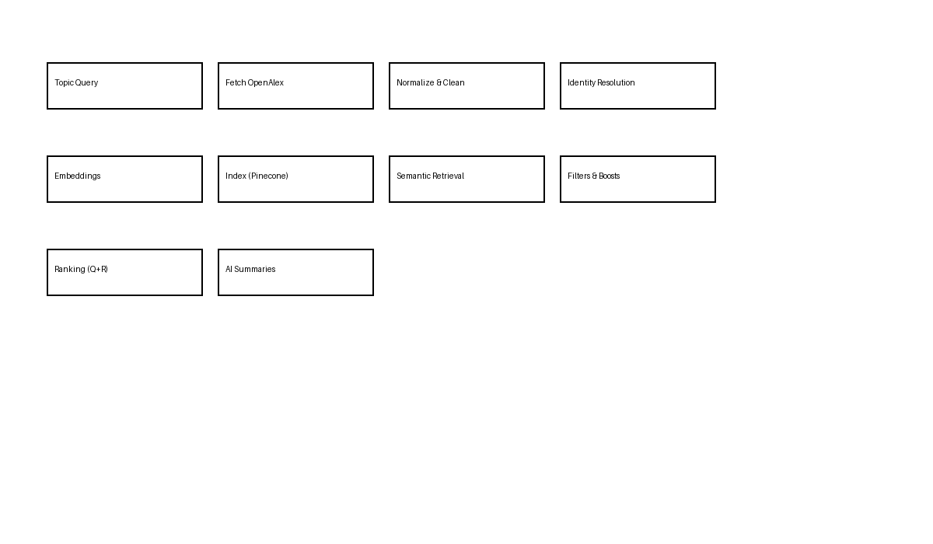
Ingestion & Retrieval Flow
Ingestion → normalization → identity resolution → embeddings → index
  Semantic retrieval + structured metadata boosting
  Ranking and AI summarization produce actionable lists
Notes:
This flowchart shows how OpenAlex records are fetched, cleaned, and mapped to canonical researcher profiles. We generate embeddings for semantic retrieval, index them in Pinecone, then apply structured filters and ranking to produce actionable candidate lists.

Slide 6
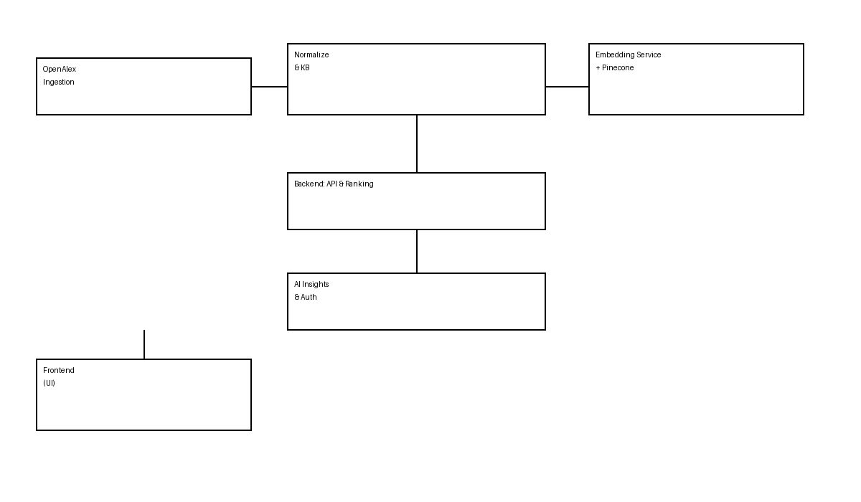
System Architecture
OpenAlex ingestion, Researcher KB, Embedding service, Pinecone
  Backend services for ranking, AI insights, and auth
  Frontend for search, saved lists, and exports; deployed on GCP
Notes:
The architecture is modular: ingestion feeds a researcher KB and embedding pipeline; embeddings live in Pinecone; backend services handle ranking, APIs, and AI summarization; the frontend lets users search, save lists, and export. We deploy on Google Cloud for scale and security.

Slide 7
Researcher Ranking & Retrieval
Q: query relevance via semantic similarity and topical match
  R: impact/recency metric — citations, recent activity, venue strength
  Hybrid blend (tunable) surfaces relevant, credible researchers
Notes:
Our ranking merges Q (how well the researcher’s work matches the query) and R (impact and momentum). This hybrid gives results that are topically relevant and credible. We tune weights per use case so the product surfaces either exploratory or conservative matches.

Slide 8
Key Deliverables
Researcher discovery platform with search, filters, save/export
  Semantic search backed by Pinecone vector DB
  Ranking engine exposing Q/R tuning and AI summaries
Notes:
The deliverables include a searchable discovery UI, the semantic retrieval backend, a hybrid ranking engine with tunable parameters, and AI summaries that save analyst time and jumpstart outreach.

Slide 9
Benefits to Lam Research
Faster identification of academic experts
  Improved discovery of emerging and cross-disciplinary researchers
  Reduced manual research effort; better strategic scouting
Notes:
For Lam Research this means faster partner identification, discovery of promising emerging researchers, reduced analyst time, and stronger, more strategic partnership pipelines — enabling quicker decisions on sponsored research and collaborations.

Slide 10
Results, Next Steps & Close
Current: ranked lists, saved candidates, AI summaries, APIs
  Future: add grants/patents, collaboration graphs, automated alerts
  Closing: TechnologyAgent enables scalable, data-driven partnerships
Notes:
Today we can generate ranked candidate lists with summaries and saved shortlists. Next steps include adding additional data sources, improving ranking with funding and network signals, and automating alerts for emerging researchers.

