Slide 1
Design and Implementation a Communication Site for NSTU
A Project
Submitted by
Md. Saiduzzaman Tohin
Roll No: ASH1201033M
Session: 2011-2012
Under the guidance of
Md. Javed Hossain
Associate Professor
Department of Computer Science and Telecommunication Engineering
NOAKHALI SCIENCE AND TECHNOLOGY UNIVERSITY

Slide 2
Outlines
Abstract
Objectives
Introduction
System Development Tools
E-R Diagram
Data Flow Diagram
User Interface
Future Works

Slide 3
Abstract
This social communication site is an web application where teachers and students can check each others personal information.
This system provides user to posted images and thoughts publicly.
Using this system users can send messages to each other.
The system is designed to be secure by providing login features which authenticates the user by means of email and password.

Slide 4
Objectives
This system provides users to register their social personal profiles and users can update their profile as required.
One user can follow and send messages to other user and can maintain the records of the messages
Users can maintain their follower and following lists.
To upload various images and others can like and comment on these.
User can mentions other users in a post by using @ sign.
User can hashtag any kind of topics on their post.

Slide 5
Introduction
Existing System: Now in NSTU all teachers and students are communicating to each other and their social activities are done by using social website Facebook which is a third party software. Using of third party software, makes our university social life and virtual life more critical.
If NSTU will create an ‘Alumni Association’ and users of this association used third party media for communicating to each others then it seems too much time killing and will face lacking of security issue and trust.

Slide 6
Project Overview:
The main features of this web application are-
This system provides users to register their various types of profile like social, personal, general and professional.
This system provides users to send a message, images and data files to their friends.
This system provides users to follow others and they can maintain their friend list.
This system provides users to upload the photos so that user can maintain own album
This system provides user to recover their account by using Gmail
This system provides user to mentions other and hashtag any kind of social topics.
This system provides user to meet new people and find jobs.

Slide 7
System Development Tools
HTML (Hyper Text Markup Language) version 5, CSS (Cascading Style Sheets) version 3
JavaScript and JQuery
Server-side language: Object Oriented PHP
Database: MySQL
Software: Sublime text 3

Slide 8
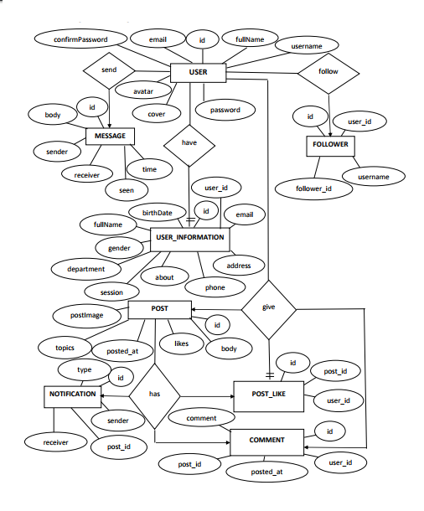
E-R Diagram

Slide 9
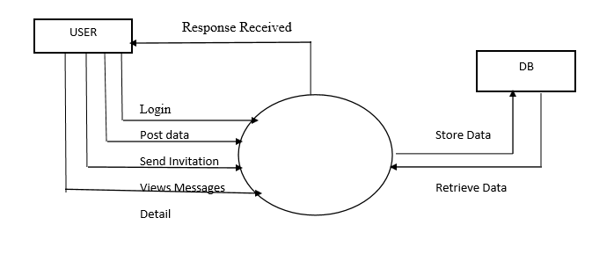
Data Flow Diagram
0 Level Data Flow Diagram:

Slide 10
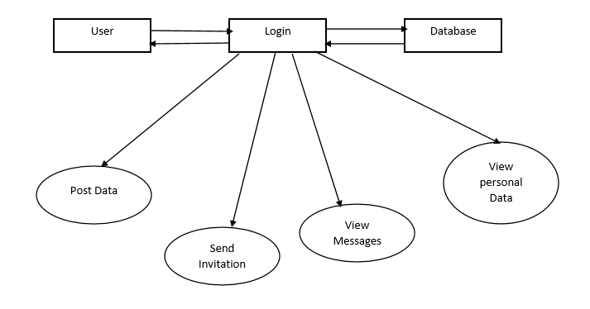
1 Level Data Flow Diagram:

Slide 11
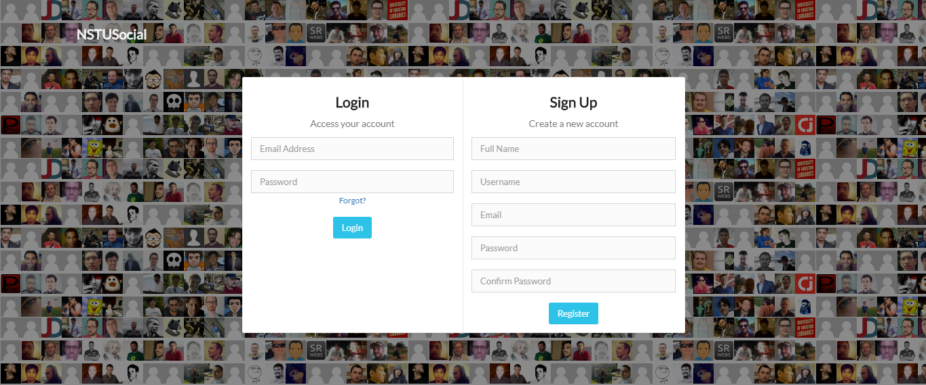
User Interface
User Registration and Login Page:

Slide 12
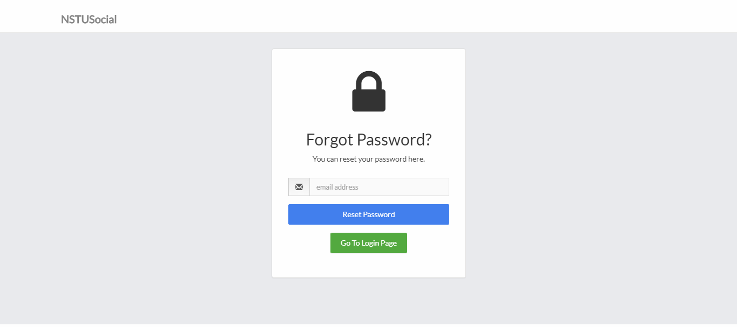
Forget Password Page:

Slide 13
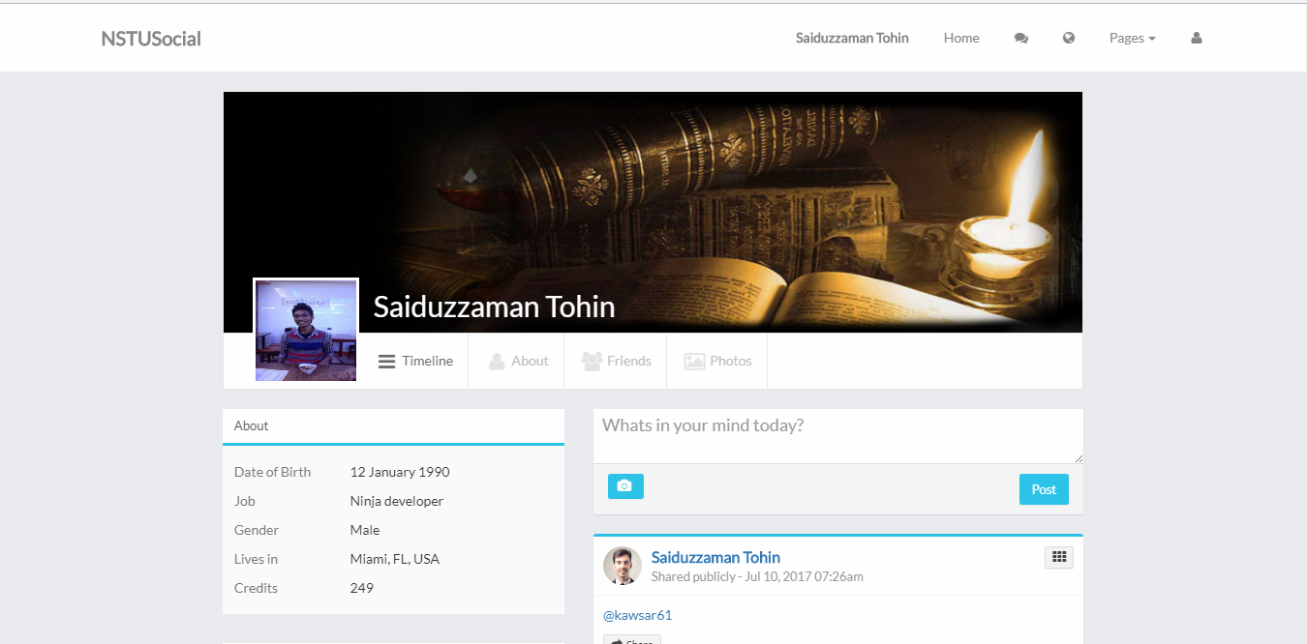
User Profile Timeline:

Slide 14
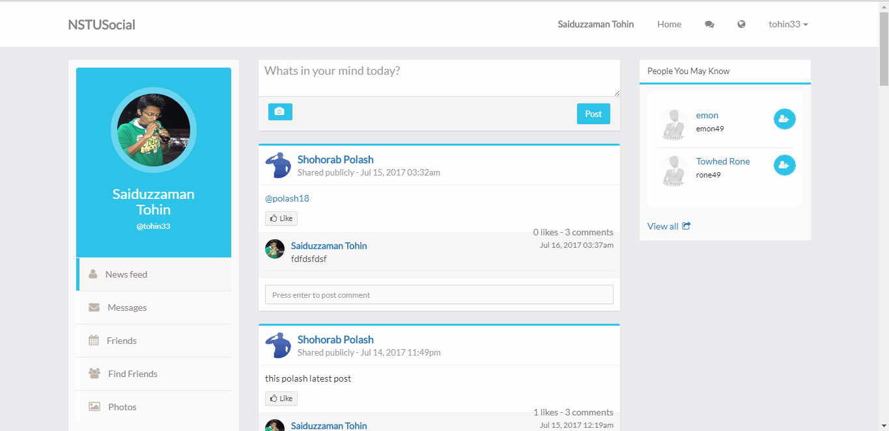
News Feed Page:

Slide 15
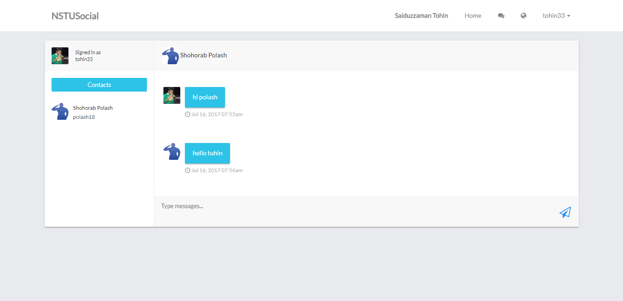
Message System Page:

Slide 16
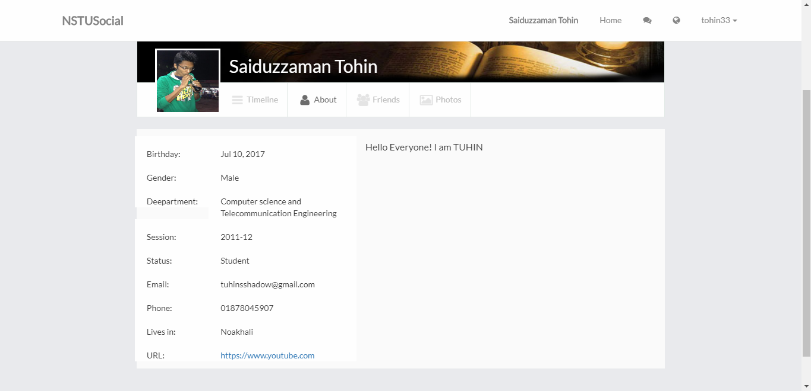
User Personal Detail Page:

Slide 17
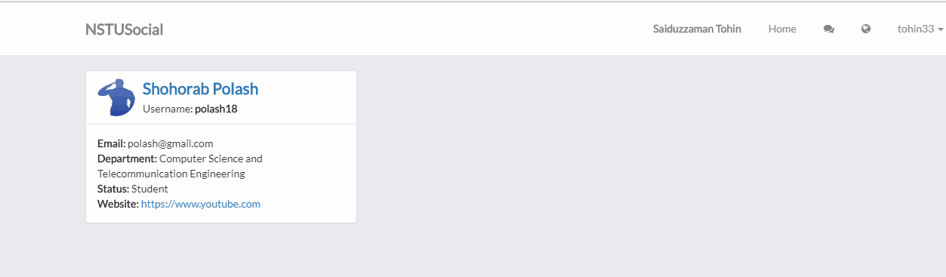
Friend List Page:

Slide 18
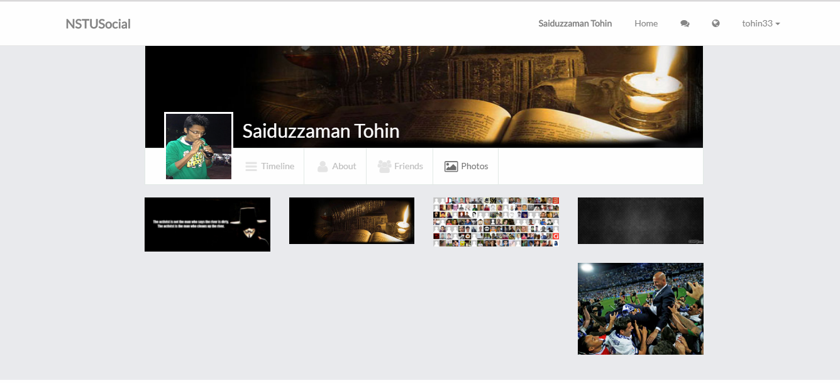
User Photo Gallery Page:

Slide 19
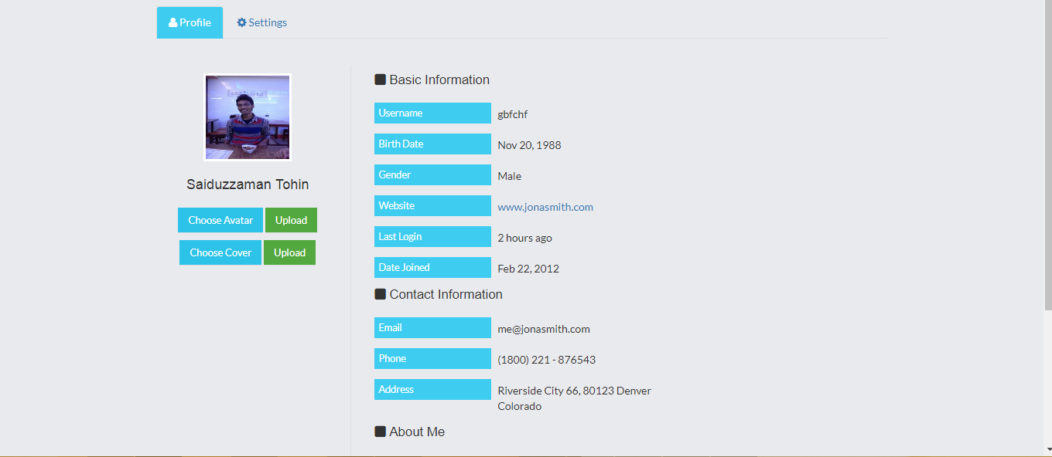
Account Setting Pages:

Slide 20
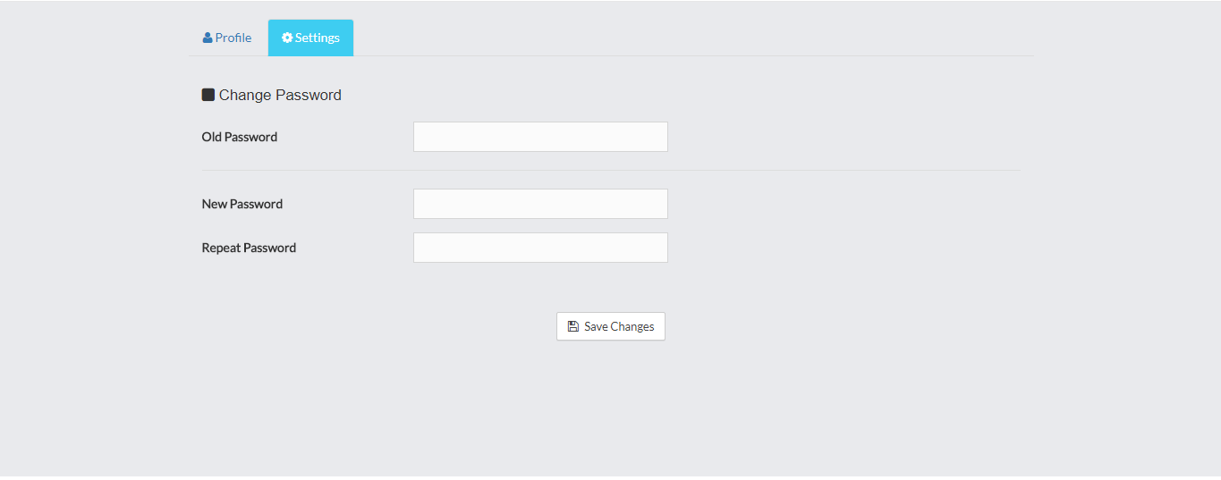

Slide 21
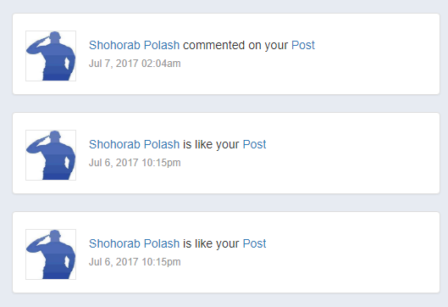
Notification Page:

Slide 22
Future Works
AJAX will be added to remove synchronous system.
The android version of this application will be fully completed and it will be completely functional.
The mobile version of this project will be compatible with other mobile platforms.
In future release, all the limitations of the application will be fulfilled.

Slide 23
Thank You
Any Question?

