Slide 1
INVESTMENT ASSIGNMENT SUBMISSION
Name: Tuhin Kumar Dutta

Slide 2
Abstract
Planning before investment is crucial. The major objective is to present a general trend of market and formulate an efficient way to Spark Funds to let them invest and thus assisting them in gaining optimum profits. Data provided by Spark Funds is in form of three data sets. One contains company names, primary sectors they are working in and their origin country. The other data set contains funding type and the funding amount in USD. The third data set contains names of eight main sectors mapped with the list of primary sectors.
In order to achieve the goal, the programming language, Python has extensively been used as the prime tool during the entire process of analysis along with an IDE called Jupyter Notebook and other some external python libraries like numpy, pandas, matplotlib and seaborn.
The approach begins with merging the three data sets into one which would contain all the necessary information. This merged data set then undergoes various processes to attain a clean and sane state. Various analysis based on funding types, countries, sectors at various stages are performed to figure out the overall tendency of funding. Bar plot, stacked bar plot, line plot, box plot, pie chart and heat-map have been used as part of data visualization which ultimately helped in presenting the gist and concluding that how investment on some sectors and countries could fetch profit whereas others may cause to face loss.

Slide 3
Problem solving methodology
Extracting primary sectors
Mapping the main sectors
Extracting the entries with the funding amount ranging between 5-15 USD
END
A data frame with the top 3 english-speaking countries and top 3 invested main sectors
START
Sector analysis
Formatting and cleaning the jupyter notebook
Answering the questions in Investment excel sheet
Preparing the PPT
Load all available datasets
Country analysis to sort out the top 9 countries based on investment amount
Plotting the required graphs
Includes dealing with null values
Renaming columns
Removing duplicates
Handling upper and lower cases of texts
Cleaning of individual datasets
Median is the representative value
Identify the most representative value of the investment amount(Funding type analysis)
The representative amount of investment in each funding type
Top 9 countries against the total amount of investments of private equity type
Number of investments in the top 3 sectors of the top 3 countries
Merging companies and rounds2 dataset into one: master_frame

Slide 4
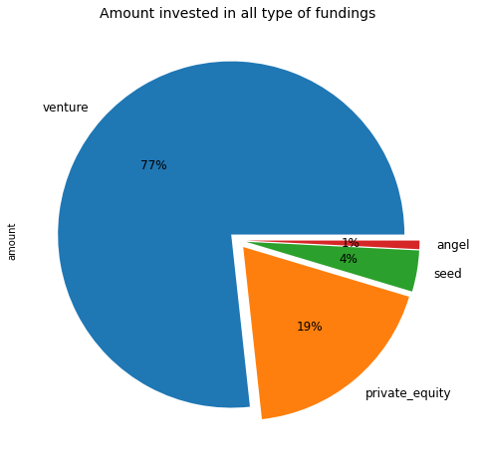
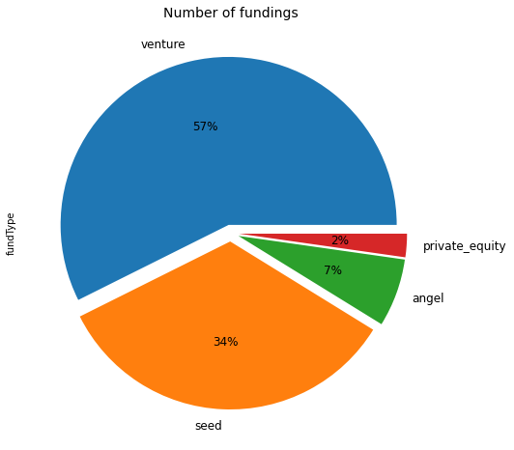
Funding Type Analysis
In this analysis, the aim is to find the most representative value of the investment amount for each of venture, angel, seed, and private equity funding types and hence determine the most suitable funding type for Spark Funds to invest between 5 to 15 million USD per investment round.

Slide 5
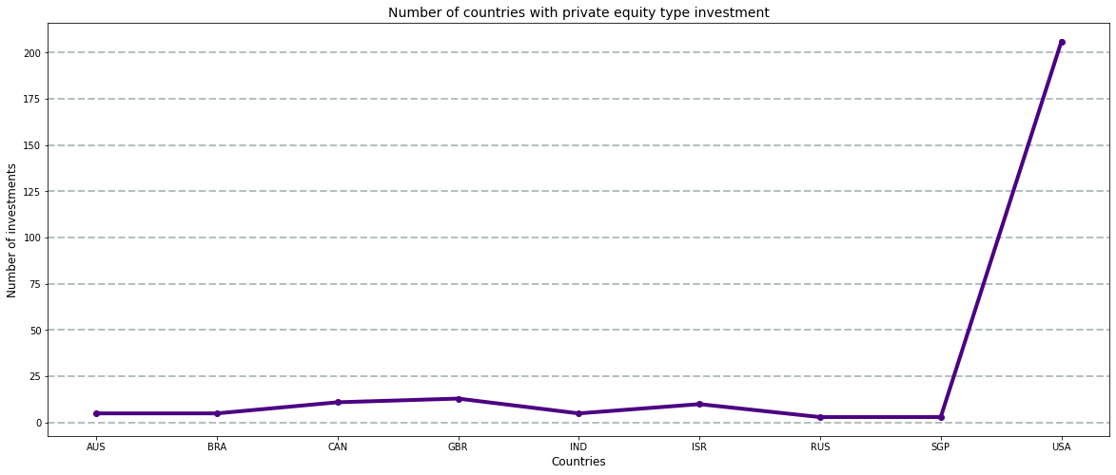
Country Analysis
In this analysis, the aim is to see the top nine countries which have received the highest total funding. Then to create a data frame for the chosen investment type with the top 9 countries (based on the total investment amount each country has received).
Note: The below graph does not show the top 9 countries based on the total amount of investments rather based on total number of investments. This has been provided for illustration purpose only.

Slide 6
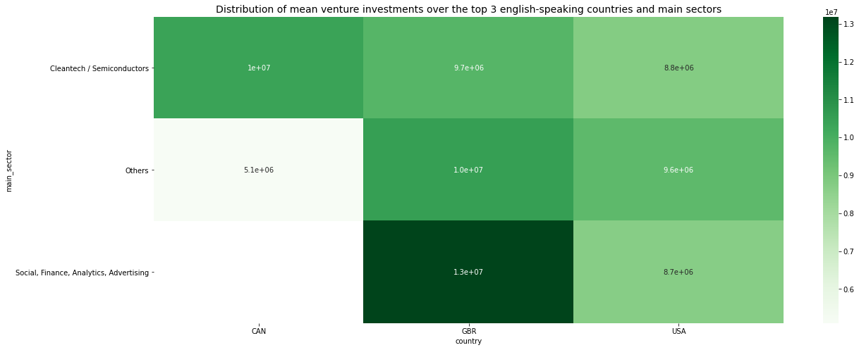
Sector Analysis
In this analysis, the main sectors are mapped with the primary sector of the main data frame. The data frame is sorted to have only the top three English speaking countries (USA, GBR, CAN), and the most suitable funding type for Spark Funds (Private Equity).
Three data frames are created for each of the three countries containing the observations of venture funding type falling within the 5-15 million USD range.

Slide 7
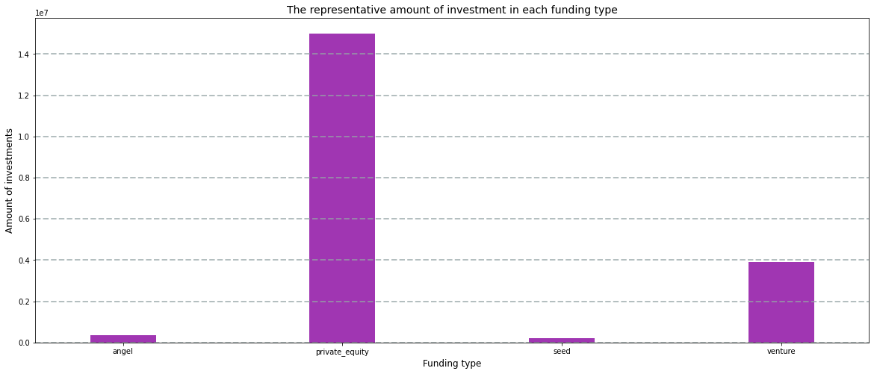
Results of Funding type Analysis
Median is the most representative value of the investment amount
Private equity investment count comprises of 1286 nos., i.e, around 2 % of all round types
Private Equity funding total amount comprises of 45 billion USD, i.e., around 19 % of all round type
Median of investment amount of private equity furnding is 15 million USD, which is therefore most suitable for Spark Funds (considering that Spark Funds wants to invest between 5 to 15 million USD per investment round)

Slide 8
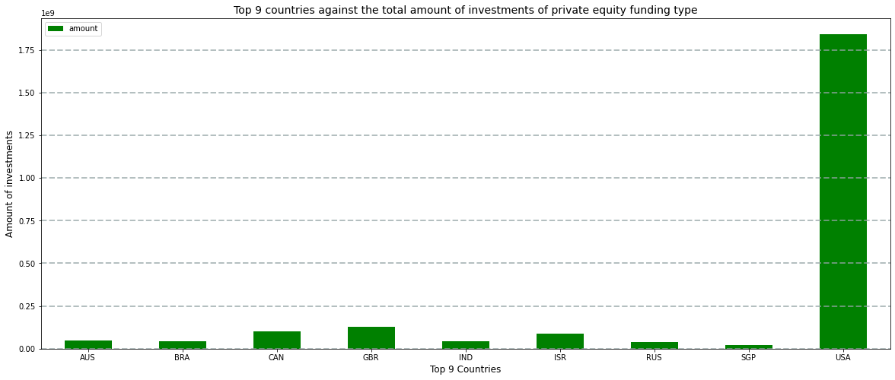
Results of Country Analysis
Country codes of the top 9 countries where the maximum private equity investment occurs in decreasing order are :-
USA , GBR , CAN , ISR , AUS , BRA , IND , RUS , SGP
Among the top 9 countries, following are the top 3 english-apeaking countries based on the amount of investment :-
USA , GBR , CAN

Slide 9
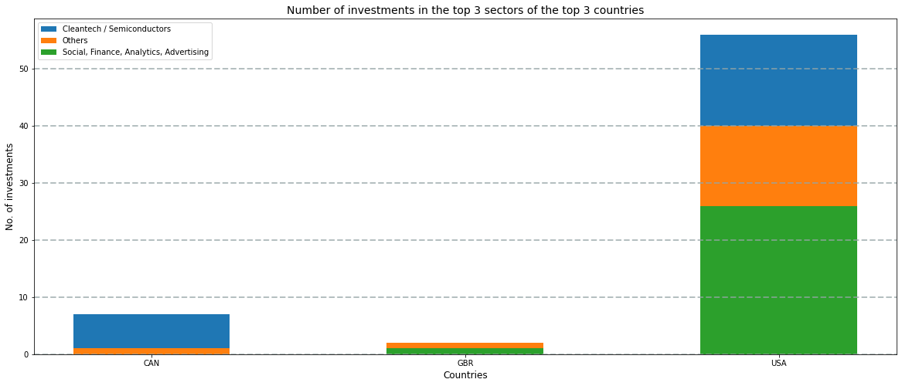
Results of Sectors Analysis
The top 3 biggest sectors with the largest amounts of investments in the top 3 eglish speaking countries are :-
Cleantech / Semiconductors , Others , Social, Finance, Analytics, Advertising
USA has the highest number of investments in all sectors followed by CAN and GBR
Investment is done more on followed by ‘Cleantech / Semiconductors’ sector followed by ’Others’ and ‘Social, Finance, Analytics, Advertising’

Slide 10
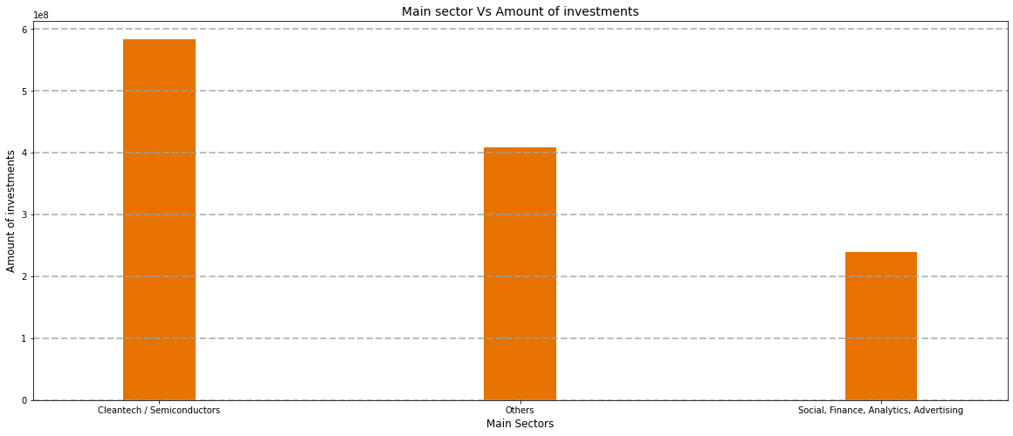
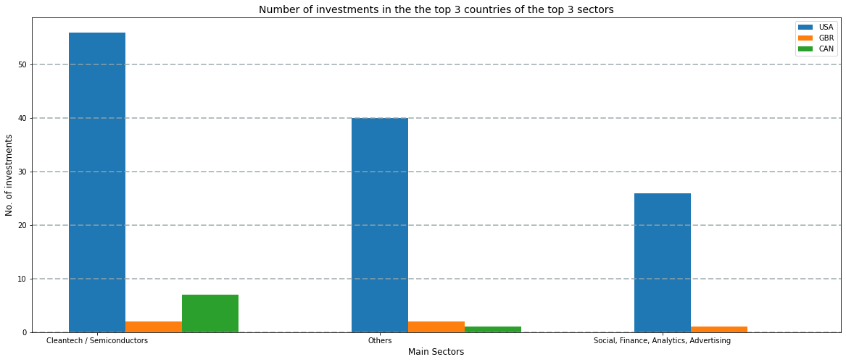
Conclusion
For Spark Funds to invest between 5 to 15 million USD per investment round, Spark fund should focus on investing on ‘Cleantech / Semiconductors’ main sector through private equity type funding, if any of the top 3 English-speaking country is chosen at random since ‘Cleantech / Semiconductors’ main sector has got the maximum amount of investments.
USA has got the maximum number and amount of investments.
‘Cleantech / Semiconductors’ sector has got maximum investments.
To specifically invest in USA since USA has got maximum investments, Spark Funds should invest in ‘Cleantech / Semiconductors’ sector and vice versa.

