Slide 1
Food.AI BOT
A natural way to find food using watson conversation and foursquare
Tuhin Mahmud
Conginitive Builder Faire
Austin,TX
May 21st,2017

Slide 2
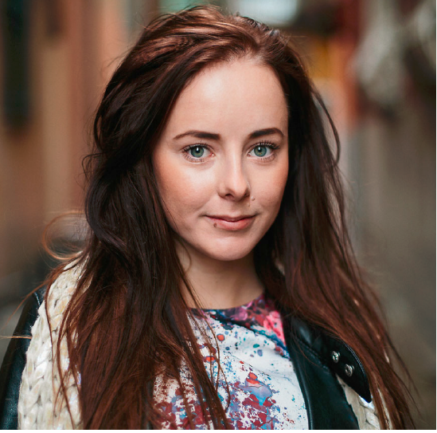
Persona
Kathy,a working Mom with kids Active social life with friends,familiy and work related travels.
“With only a limited time to explore, I’m
worried that I’ll miss something while
searching…”
Food, places to visit while traveling
Taking kids to fun places
Pain Points: Limited time, wants unique and authentic experience

Slide 3
Alignment statement
Food.AI bot receives [place,people,perosal choice] finds available places and recommends them all the while interacting naturally.

Slide 4
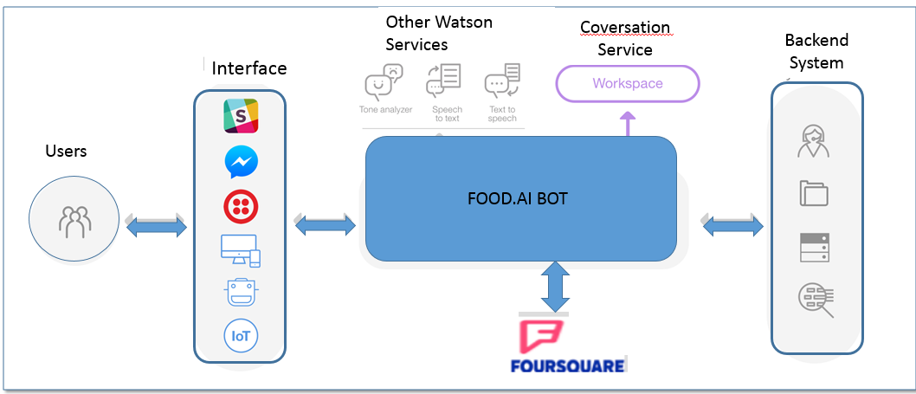



System Map
FOODIE APP
Referene:watson api documnets

Slide 5

Services and integration
Integration natural conversation using IBM Watson Conversation service to find customer needs.
Use Foursquare Api to get relavant information and recommend experience.

Slide 6
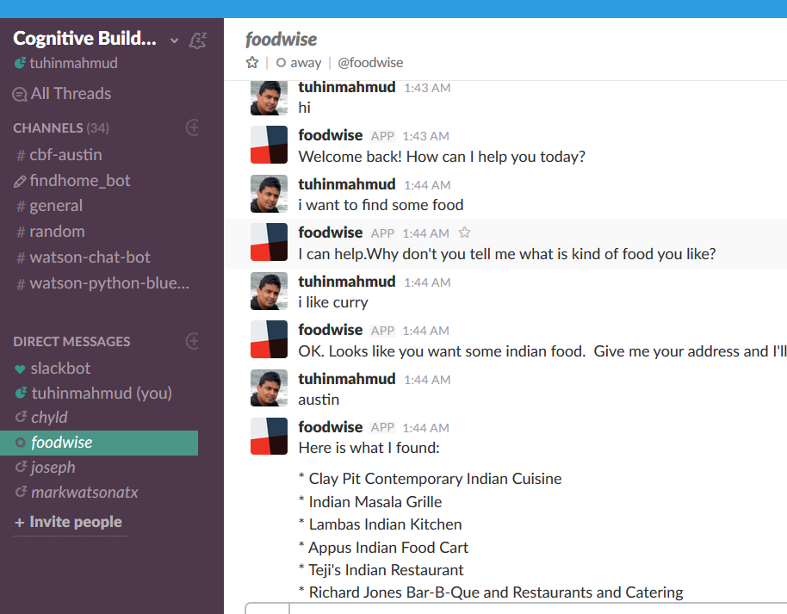
Food.AI Bot Live DEMO
Food.AI Bot in Congnitive builder slack channel

Slide 7
Next Steps
Use of watson Speech to Text and Text to speech
Use Tone Analyzer to understand user mood and suggest his personal choice
Save user choices to build recommender model for users in DSX and deploy it in backend system.
Provide SMS and mobile app interface

Slide 8


Thank you.

