Slide 1

Q-GPU: A Recipe of Optimizations for Quantum Circuit Simulation Using GPUs
Yilun Zhao, Yanan Guo, Yuan Yao, Amanda Dumi, Devin M Mulvey, Shiv Upadhyay, Youtao Zhang, Kenneth D Jordan, Jun Yang, and Xulong Tang
University of Pittsburgh

Slide 2
Quantum Circuit Simulation (QCS)
QCS is important
The public has limited access to reliable quantum machines.
Schrödinger-style QCS
Widely used as the mainstream simulation method.
Represents a quantum state by a vector of complex-valued amplitudes (state vector).
Modifies the state vector in place by applying quantum transformations.
Challenge in QCS
The memory cost for storing all the quantum state amplitudes grows exponentially as the # of qubits.
Applying a gate requires a traversal of all the stored state amplitudes.

Slide 3
QISKit-Aer With GPU
Step 1: State Vector Partitioning
GPU memory
0000000~0001111
0000000~0001111
0010000~0011111
0010000~0011111
0100000~0101111
0100000~0101111
State Vector
0110000~0111111
1000000~1001111
1010000~1011111
0110000~0111111
1100000~1101111
1000000~1001111
1110000~1111111
1010000~1011111
1100000~1101111
1110000~1111111
CPU memory

Slide 4











QISKit-Aer With GPU
Step 2: Static Chunk Allocation
GPU memory
0000000~0001111
$$chunk_{0}$$
$$chunk_{0}$$
0000000~0001111
$$chunk_{1}$$
0010000~0011111
$$chunk_{1}$$
0010000~0011111
$$chunk_{2}$$
0100000~0101111
0100000~0101111
0110000~0111111
…
1000000~1001111
0110000~0111111
$$chunk_{3}$$
1010000~1011111
$$chunk_{4}$$
1100000~1101111
1000000~1001111
1010000~1011111
$$chunk_{5}$$
$$chunk_{7}$$
1110000~1111111
$$chunk_{6}$$
1100000~1101111
1110000~1111111
$$chunk_{7}$$
CPU memory

Slide 5
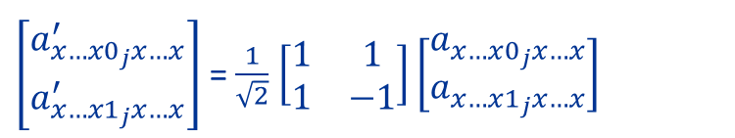
QISKit-Aer With GPU
Step 3: Reactive Chunk Exchange
When apply an H gate on qubit j:
$\left[\begin{aligned}a_{x…x0_{j}x…x}^{′} \\ a_{x…x1_{j}x…x}^{′}\end{aligned}\right]$ = $\frac{1}{\sqrt{2}}$ $\left[\begin{matrix}1 & 1 \\ 1 & −1\end{matrix}\right]\left[\begin{aligned}a_{x…x0_{j}x…x}^{ } \\ a_{x…x1_{j}x…x}^{ }\end{aligned}\right]$
On-demand data exchange
Case 1: The amplitudes in a pair are in the same chunk. No data exchange
Case 2: The amplitudes in a pair are in different chunks. Potential data exchange

Slide 6
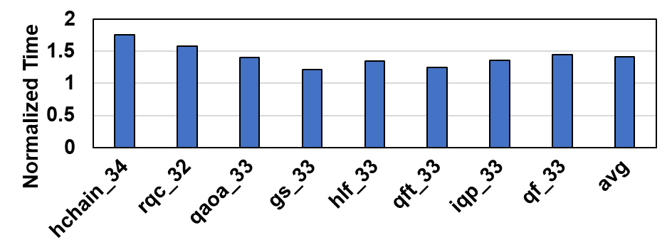
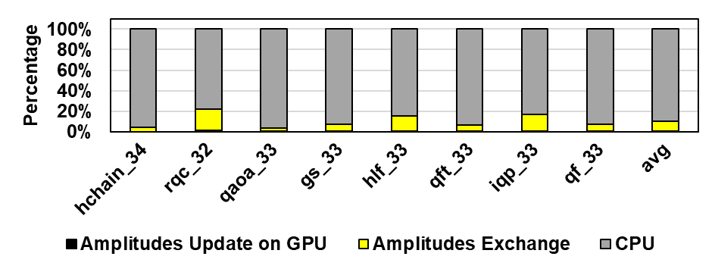
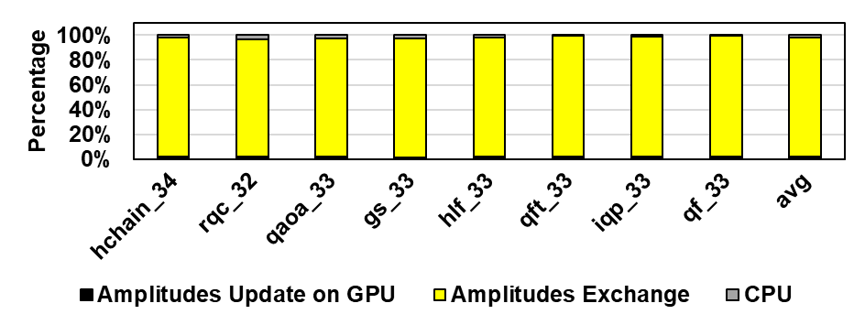
GPU Under-Utilization
Observation 1: GPU-based simulation is slower than the CPU-based one, with ≥ 32 qubits.
Naïve Optim.: Dynamically allocate chunks and transfer them to GPU for updates
Runtime
Breakdown
Normalized Result
Worse Performance!
Data Exchange!
Observation 2: CPU dominates the runtime

Slide 7
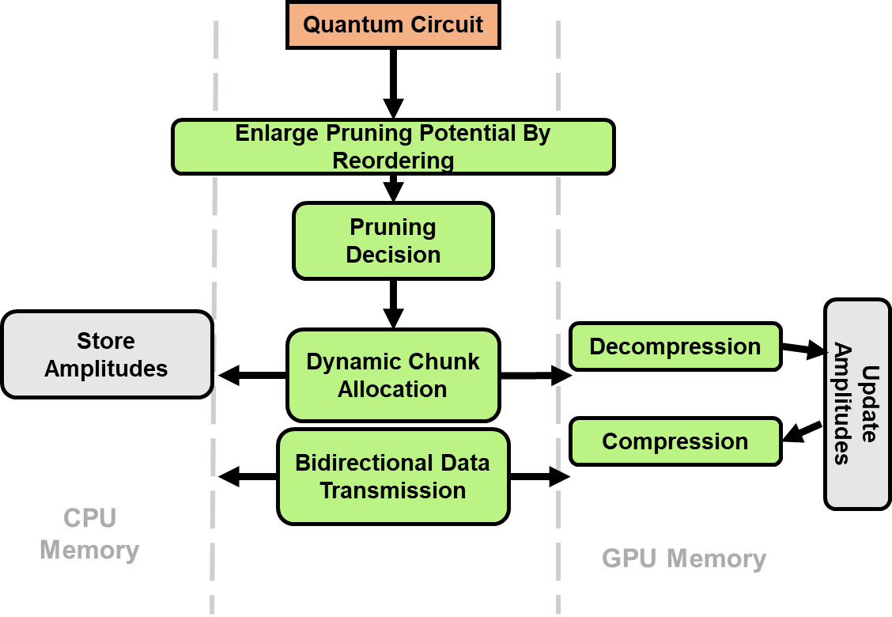
Q-GPU Overview
Q-GPU: Increase the GPU utilization from 3 perspectives.
Reducing moving zero amplitudes
Reducing moving non-zero amplitudes
Improving GPU utilization

Slide 8
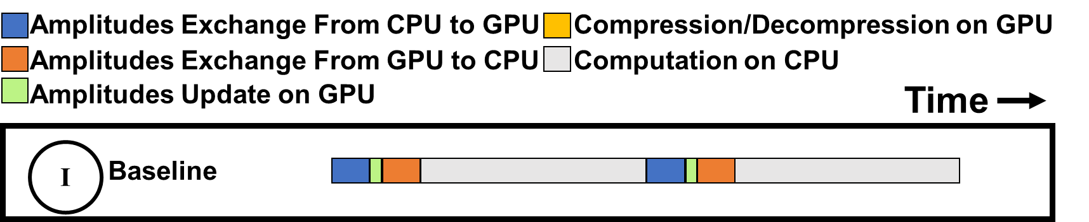
Proactive Data Transfer
Main idea: Fully utilize the bi-directional data transfer between CPU and GPU.
Currently are not overlapped to avoid data overwriting

Slide 9
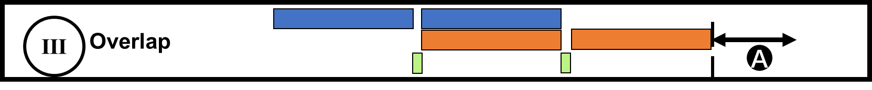
Proactive Data Transfer
Cuda Stream + Circular Buffers

Slide 10
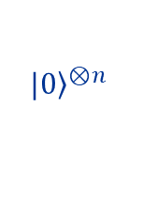



Pruning Zero State Amplitudes
$q_{k}^{ }$is not involved
$a_{0……0}^{ }$ = 1
$${\left.|0\right\rangle }^{⊗n}$$
$a_{x…x1_{k}x…x}^{ }$= 0
Initial state:
$Others$ = 0
One qubit not involved means half of the state amplitudes are zero!
Pruning potential
Circuit | #of operations | # of operations before all qubit involvement | Percentage
hchain | 1786 | 272 | 15.23%
rqc | 124 | 54 | 43.55%
qaoa | 754 | 19 | 2.51%
gs | 37 | 16 | 43.24%
iqp | 146 | 132 | 90.41%

Slide 11
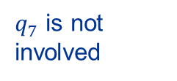
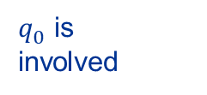
Pruning Algorithm
Bit vector for qubit involvement
00100011
Chunks size = 4
$q_{7}^{ }$ is not involved
$q_{0}^{ }$ is
involved
Dynamic chunk size (depends on the lowest qubit index that is not involved)
Determine the data movement by comparing the chunk index and bit vector
E.g. skip all the following chunks when chunk id > MSBs of the bit vector
00000011 bit vector
000001 chunk index
000001 > 000000

Slide 12
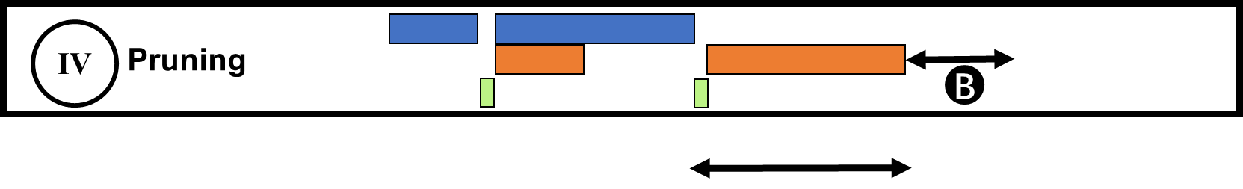
Pruning Zero State Amplitudes

Slide 13
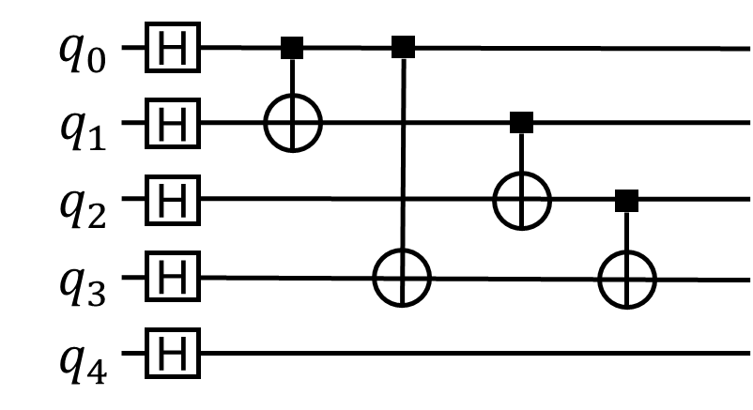
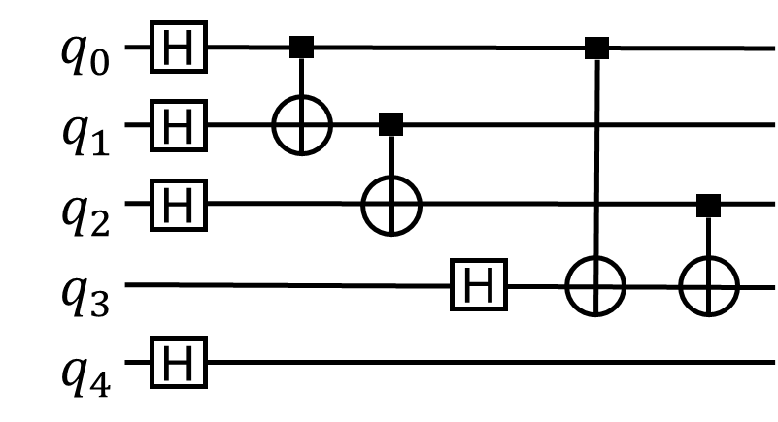
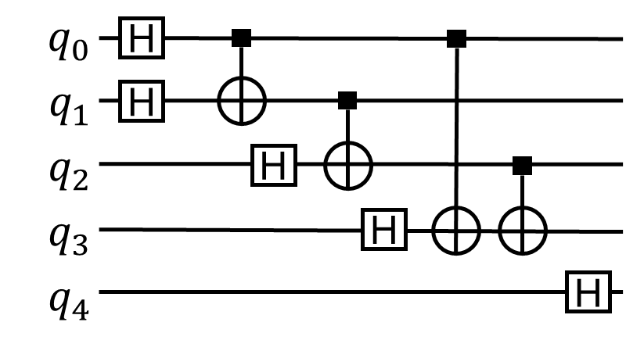
Increasing Pruning Potential
Main idea: Reorder to delay qubit involvement.
1
6
7
1
5
8
1
3
7
2
8
4
6
2
5
3
9
2
9
4
8
4
7
6
3
9
5
No Reorder
Reorder Option 1
Reorder Option 2

Slide 14
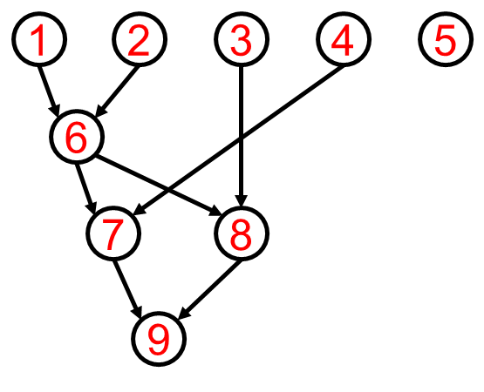
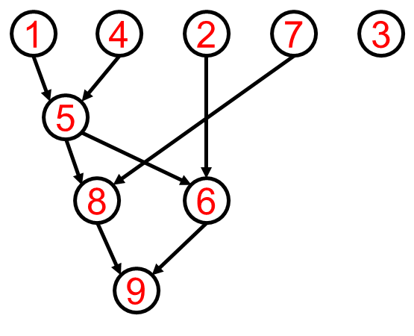
Reordering Algorithm I
1
6
7
1
5
8
2
8
4
6
3
9
2
9
4
7
5
3
Greedy
Reordering
Step 1: Generate the DAG.
Step 2: Greedy reordering based on the DAG.

Slide 15
Reordering Algorithm I
1
6
7
1
5
8
2
8
4
6
3
9
2
9
4
7
5
3
Greedy
Reordering
But we miss the optimal solution
# of involved qubits: Original: 1 →2 →3 →4 →5 →5 →5 →5 →5
After Reordering: 1 →2 →3 →4 →4 →4 →5 →5 →5

Slide 16
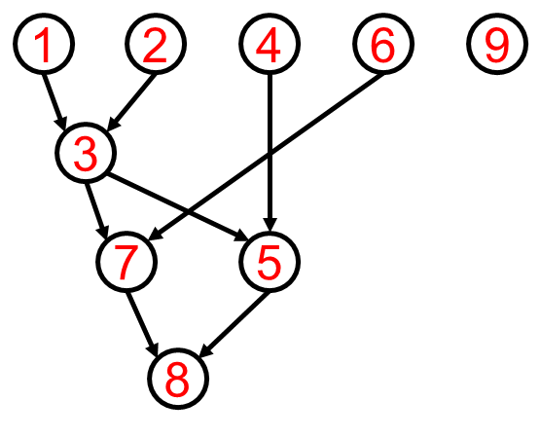
Reordering Algorithm II
1
6
7
1
3
7
2
8
2
5
3
9
4
8
4
6
9
5
Forward-looking
Reordering
Cost = Cost_Current + Cost_Ahead

Slide 17
Reordering Algorithm II
1
6
7
1
3
7
2
8
2
5
3
9
4
8
4
6
9
5
Forward-looking
Reordering
# of involved qubits: Original: 1 →2 →3 →4 →5 →5 →5 →5 →5
After Reordering: 1 →2 →2 →3 →3 →4 →4 →4 →5

Slide 18
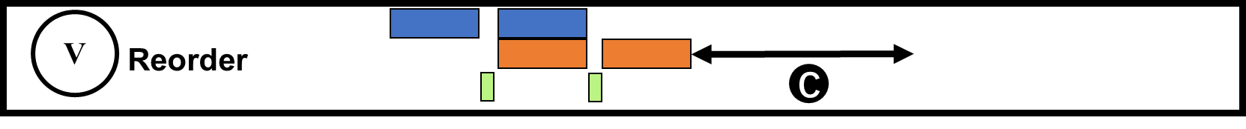
Gate Reordering

Slide 19
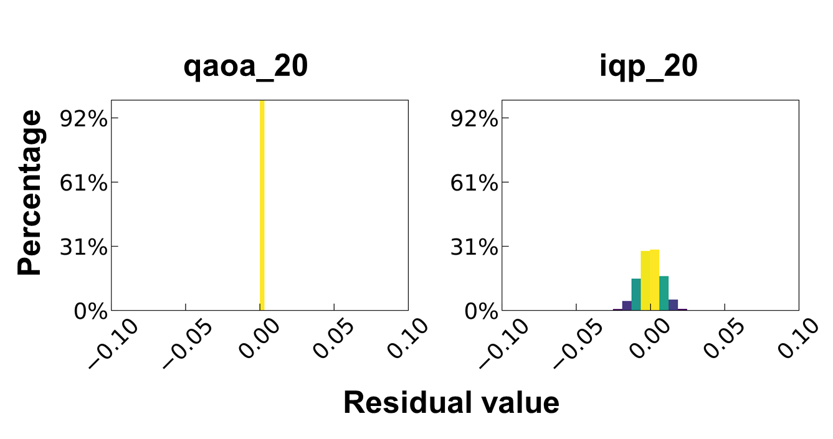
Data Compression
Main idea: Reduce the non-zero data movement via data compression.
Residual distributions for qaoa_20 and idp_20

Slide 20
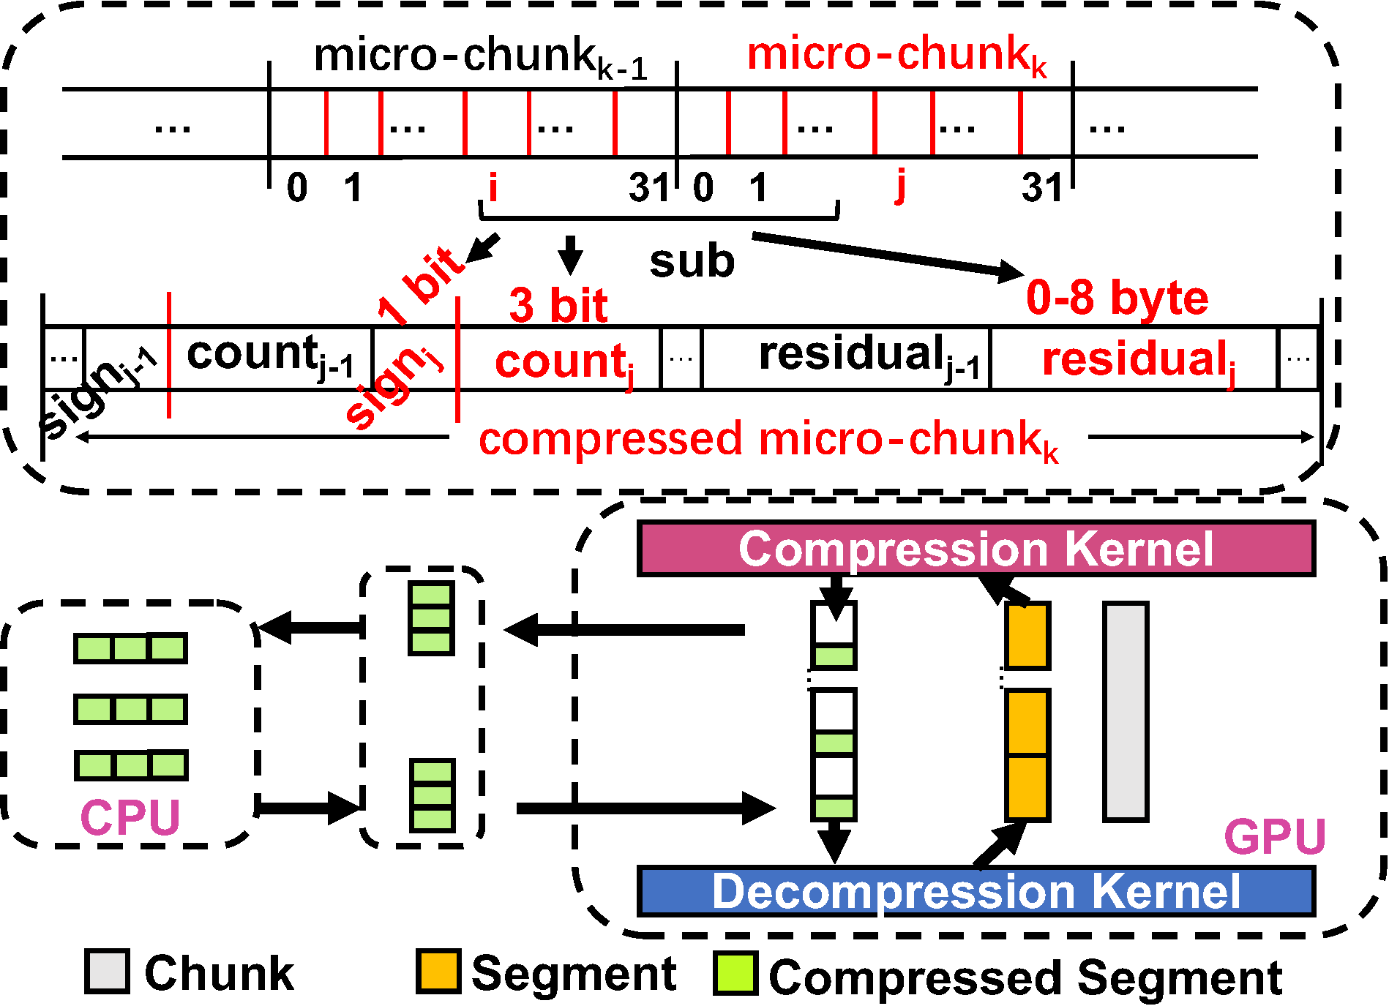
Compression Algorithm
GFC algorithm.
Chunk → Segment (handled by a warp) → Micro-chunk.

Slide 21
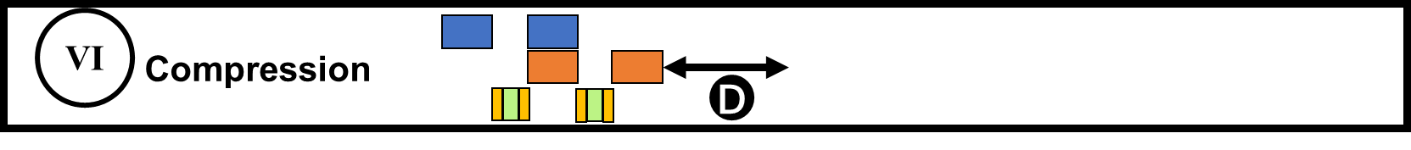
Data Compression

Slide 22
Evaluation Configuration
Implementation
Q-GPU is implemented on top of IBM QISKit-Aer.
Platform
Dual 10-core Intel Xeon Silver 4114 CPU with 384 GB memory + an NVIDIA P100 GPU with 16 GB memory.
Evaluated Simulation Setups
Baseline: Qiskit-Aer baseline (the GPU version).
CPU+OpenMP: Qiskit-Aer baseline (the CPU version).
Overlap: Q-GPU design, part 1.
Pruning: Q-GPU design, part 1 + part 2.
Reorder: Q-GPU design, part 1+ part 2 + part 3.
Compression: Q-GPU design, part 1+ part 2 + part 3 + part 4.

Slide 23
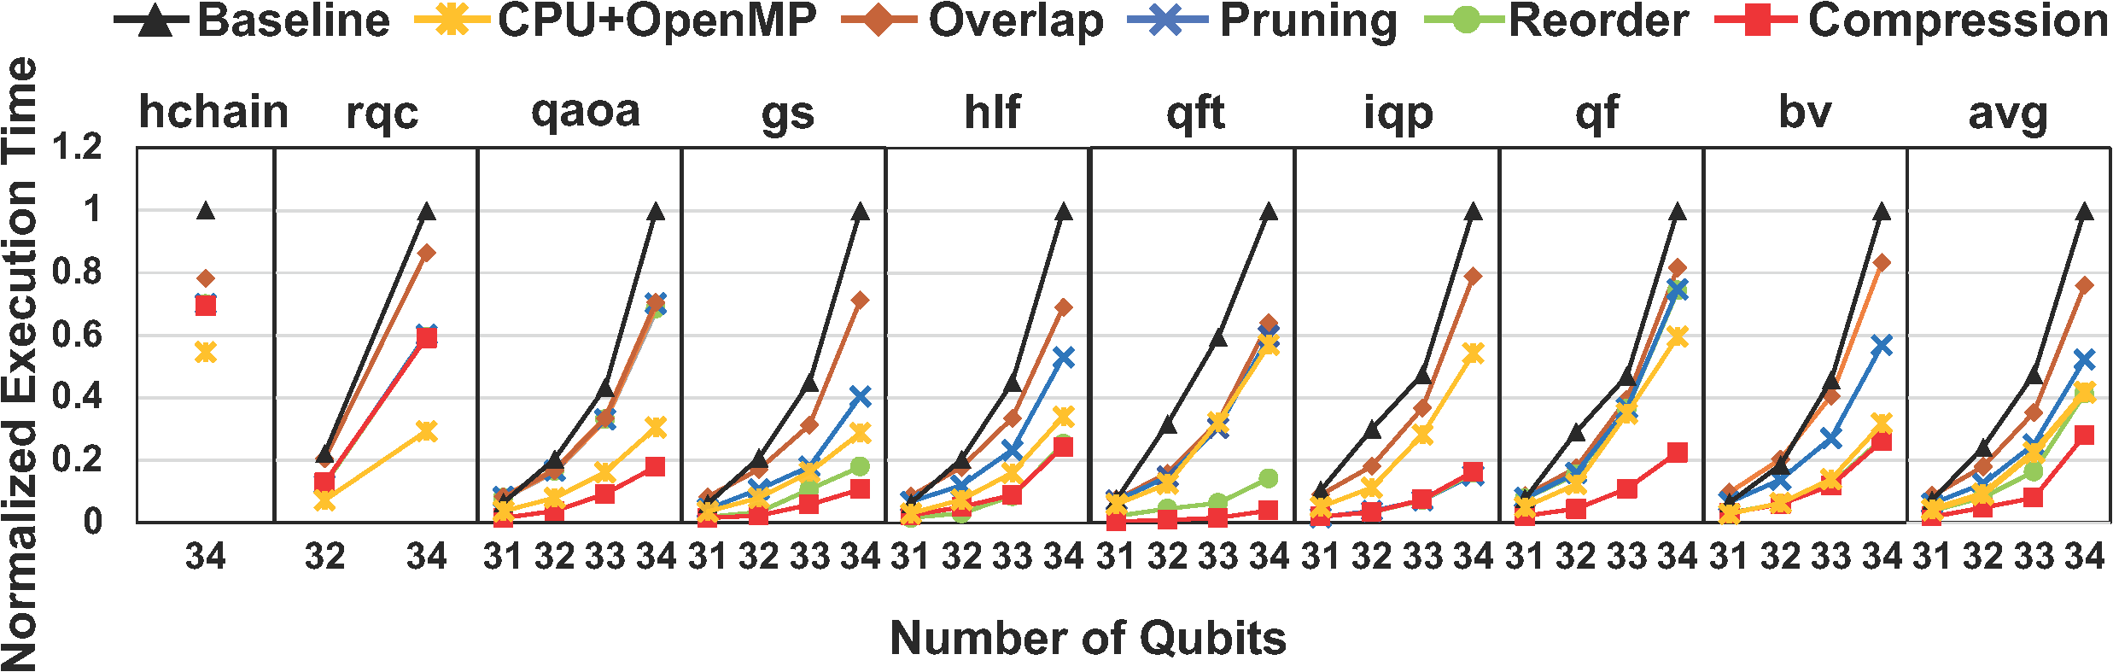
Experimental Results
Major Result: Execution time normalized to Baseline.

Slide 24
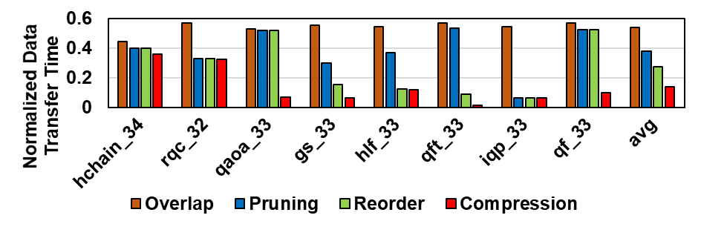
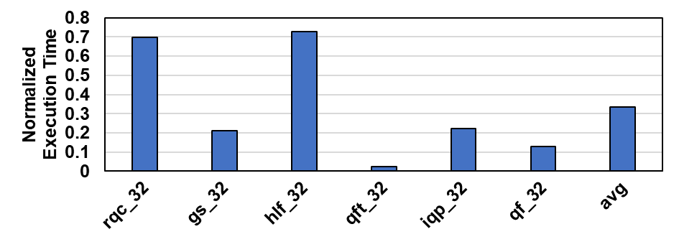
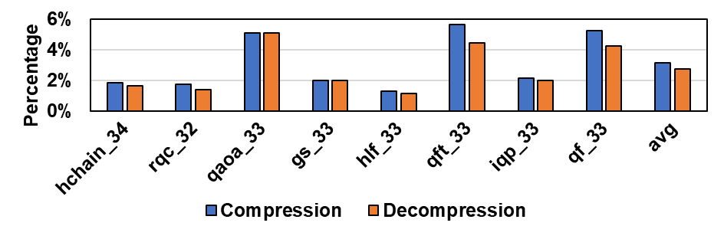
Experimental Results
Detailed results
Normalized Data Transfer Time
Normalized Execution Time on Multi-GPU Platforms
More results can be found in the paper.
Compared to other quantum simulators.
Performance on V100 and A100 GPUs.
Evaluation for deep circuits.
Compression and Decompression Overhead

Slide 25
Summary
Motivation
Quantum circuit simulation (QCS) is important especially in the NISQ era.
Existing quantum simulators such as QISKit cannot utilize the computing resource on GPUs efficiently.
Proposal
Q-GPU: a high-performance and scalable QCS framework with modern GPUs.
Overlap the data movement in different directions.
Prune the zero-valued state amplitudes.
Reorder the gates to enlarge the potential of pruning.
Use compression to reduce the amount of non-zero data movement.
Result
Q-GPU outperforms QISKit-Aer by 3.55*.
Artifacts: https://github.com/Zhaoyilunnn/q-gpu

Slide 26
Thanks for your attention!
For any questions, please contact Dr. Xulong Tang (xulongtang@pitt.edu)
This presentation and recording belong to the authors. No distribution is allowed without the authors' permission.

