Slide 1

Performance-Enhanced Integrity Verification for Large Memories
Yanan Guo¹, Andrew Zigerelli¹, Yueqiang Cheng², Youtao Zhang¹, Jun Yang¹
¹University of Pittsburgh ²NIO Security Group

Slide 2

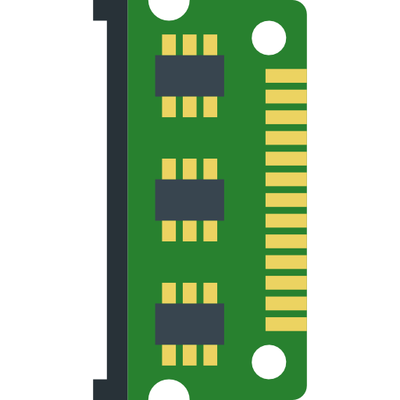
Threat Model
Trusted
Untrusted

Slide 3

Threat Model
Trusted
Untrusted
Bus manipulation
Cold boot attack

Slide 4
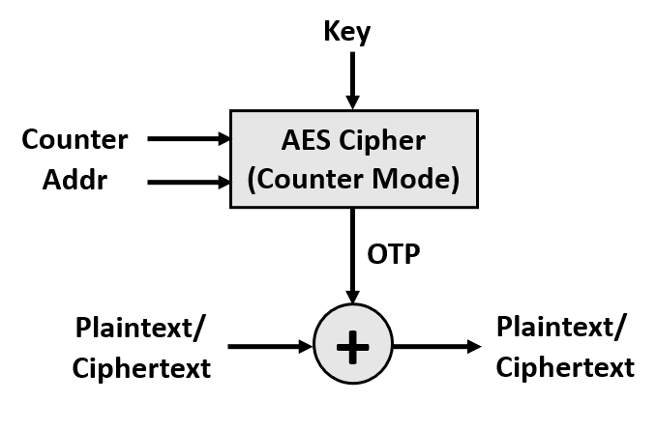
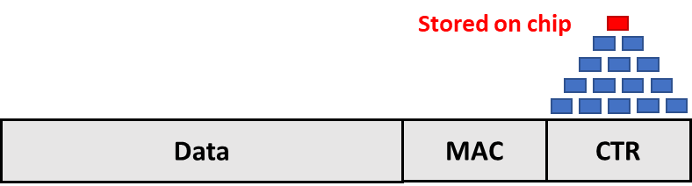

Secure Memory
Memory data confidentiality
Memory data integrity
Replay Attack?

Slide 5
Secure Memory
Memory data confidentiality
Memory data integrity
Replay Attack?

Slide 6
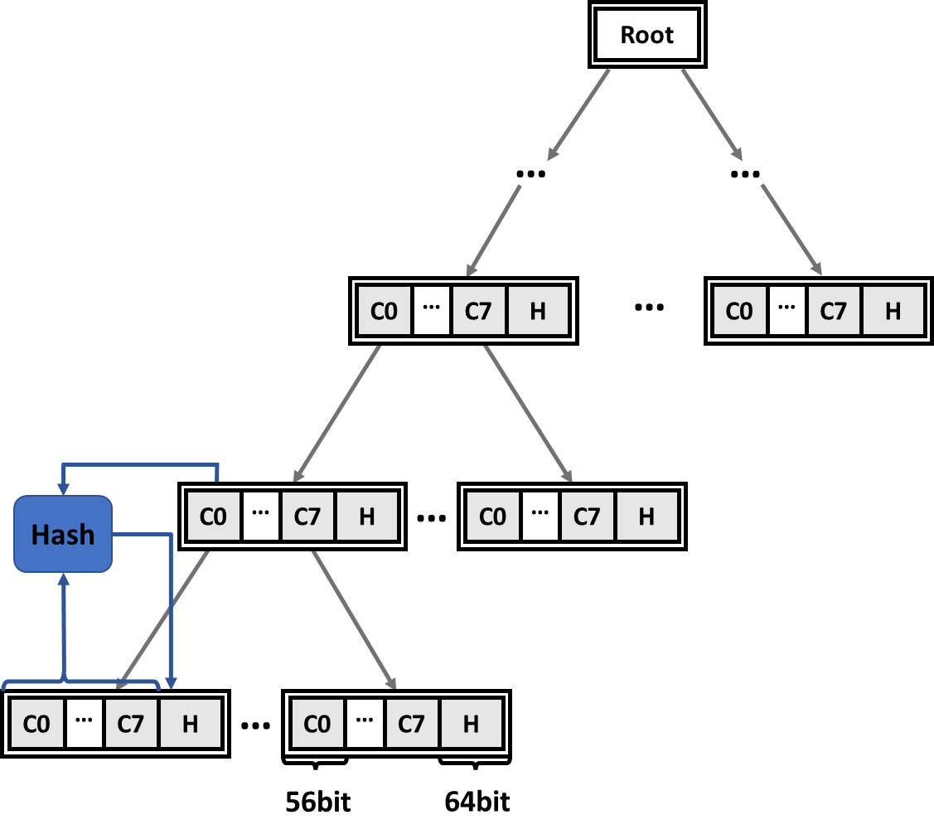
Secure Memory
Memory data confidentiality
Memory data integrity
Replay Attack?

Slide 7
Secure Memory
Memory data confidentiality
Memory data integrity
Replay Attack?
Counters for data

Slide 8
Secure Memory
Memory data confidentiality
Memory data integrity
Counters for counters
Replay Attack?

Slide 9
Secure Memory
Memory data confidentiality
Memory data integrity
Counters for counters
Replay Attack?

Slide 10
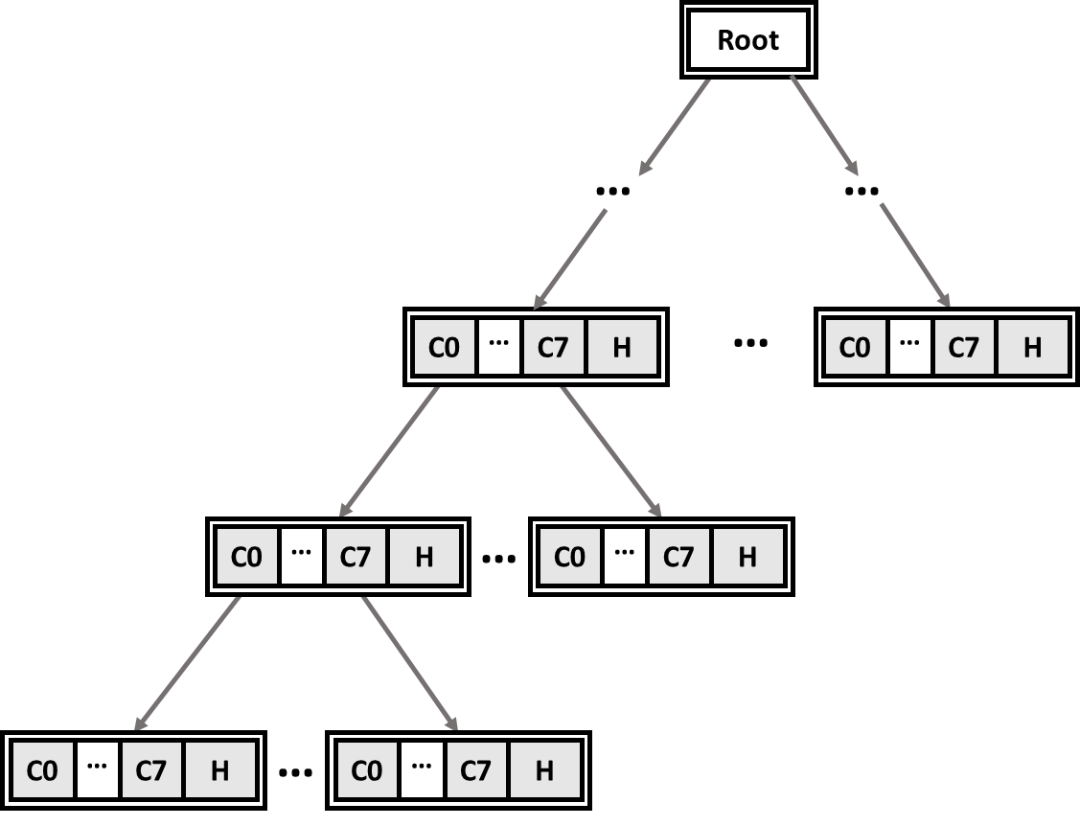
Integrity Tree Overhead
Overhead 1: Longer critical path.
Overhead 2: Extra memory bandwidth consumption.

Slide 11
Integrity Tree Overhead
Overhead 1: Longer critical path.
Overhead 2: Extra memory bandwidth consumption.
For a 32-core, 512GB-mem system, the overhead of using SGX tree can be up to 4× .
Cached

Slide 12
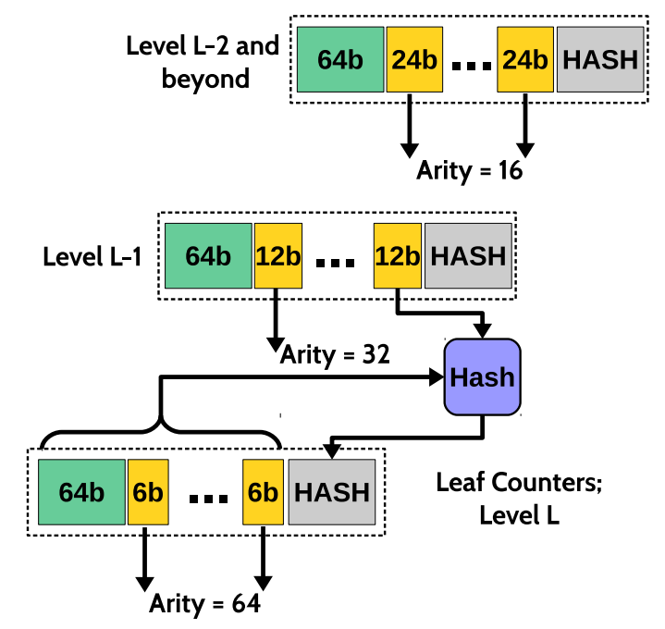
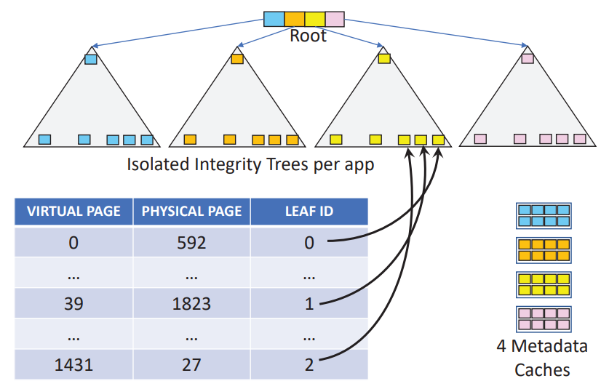
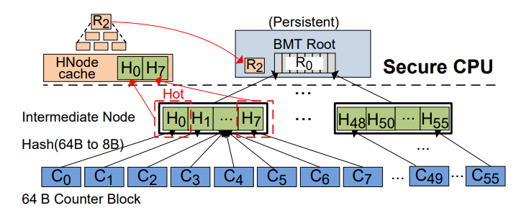
Optimized Trees

Slide 13
Overview
Motivation
Most prior proposals assume a standalone tree.
Considering architecture features of cloud computing processors
can give us more opportunities for optimization.
Proposed Design: PCPT
Design 1: Parallelizing tree path fetching.
Design 2: Curtailing tree node fetches.
Design 3: Adaptive prefetch.
Average performance improvement
PCPT has 55% less overhead compared to SGX integrity tree.

Slide 14
Parallelizing Tree Path Fetching
Observation 1: On average over 70% mem data reads only require ≤ 2 additional mem fetches for tree nodes.
Cached

Slide 15
Parallelizing Tree Path Fetching
Observation 2: Current cloud computing processors have ≥ 4 mem channels.

Slide 16
Parallelizing Tree Path Fetching
Question: what if nodes and data can be fetched in parallel?
Case 1
Case 2
Core 0
Core 1
Core 0
Core 1
Core 0
Core 1
Fetch, D0, C0
Fetch, D1, C1
Fetch, D0, C0
Fetch, D1, C1
Fetch, D0, C0
Fetch, D1, C1
C0
C1
C1
D1
D0
D1
D0
C0
MC0
MC1
MC0
MC1
MC0
MC1
If a memory access takes 1 cycle,
Core 0 finishes at Cycle 2,
Core 1 finishes at Cycle 2.
If a memory access takes 1 cycle,
Core 0 finishes at Cycle 1,
Core 1 finishes at Cycle 2.

Slide 17
Parallelizing Tree Path Fetching
Can nodes and data be fetched in parallel?

Slide 18
Parallelizing Tree Path Fetching
Our solution: reorganize the tree.

Slide 19
Parallelizing Tree Path Fetching
Our solution: reorganize the tree.

Slide 20
Parallelizing Tree Path Fetching
Our design: reorganize the tree.
Step 1: remap the tree nodes in memory.

Slide 21
Parallelizing Tree Path Fetching
Our design: reorganize the tree.
Step 1: remap the tree nodes in memory.

Slide 22
Parallelizing Tree Path Fetching
Our design: reorganize the tree.
Step 2: change how data are associated with the tree.

Slide 23
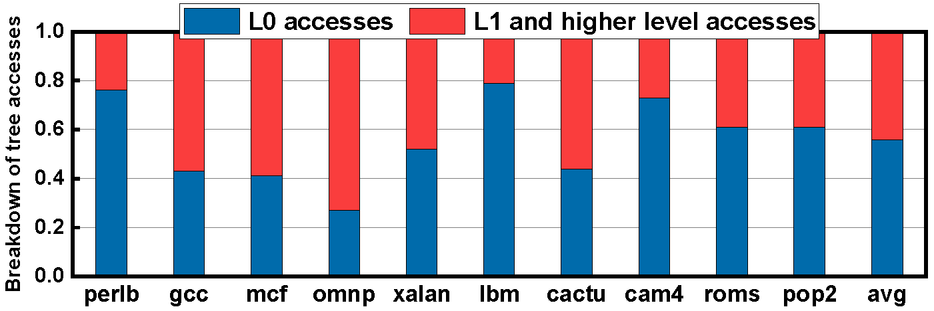
Curtailing Tree Node Fetches
Problem: fetching counters increases memory bus pressure.
Solution: compress data block to place a copy of L0 counter in it.

Slide 24
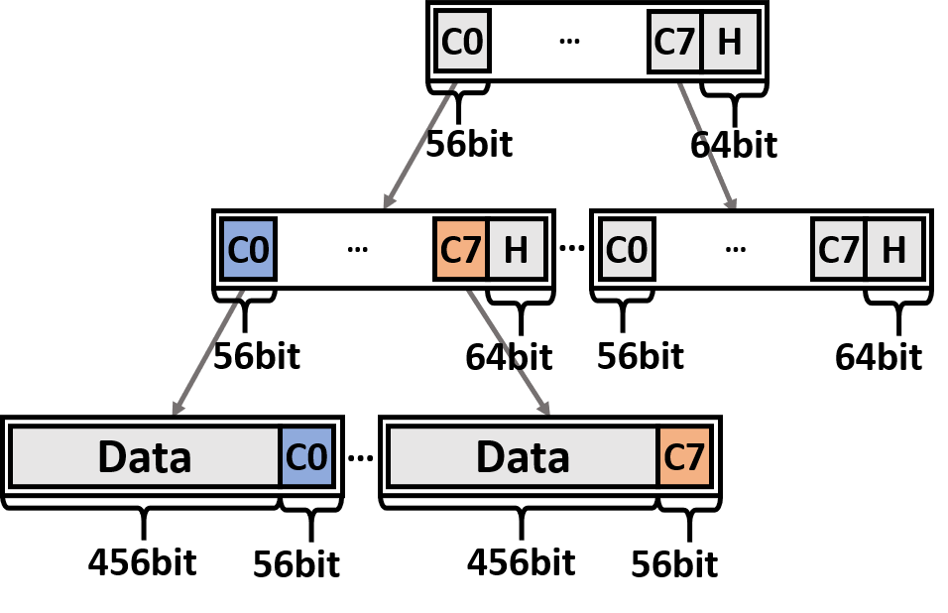
Curtailing Tree Node Fetches
Solution: compress data block to place a copy of L0 counter in it.
How do we verify the freshness of the counter?

Slide 25
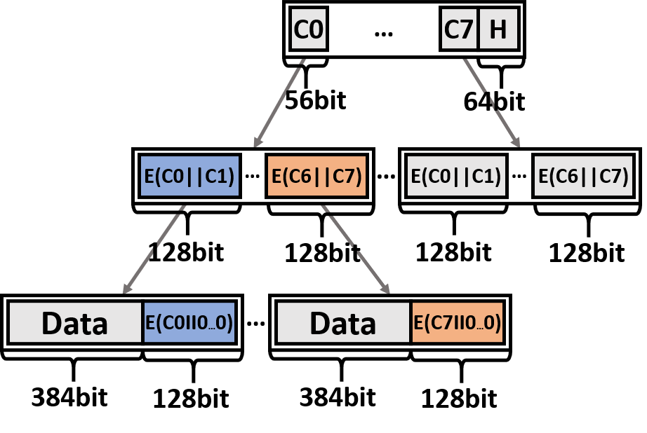
Curtailing Tree Node Fetches
Solution: compress data block to place a copy of L0 counter in it.
(ASPLOS’18) Meysam Taassori et al.: encrypt L0 counters to build the linkage.

Slide 26
Adaptive Prefetch
Problem: mis-prefetches can introduce high overhead.

Slide 27
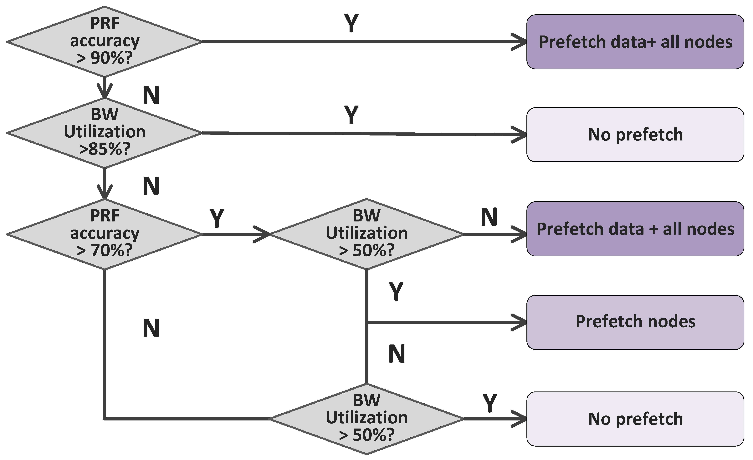
Adaptive Prefetch
Problem: mis-prefetches can introduce high overhead

Slide 28
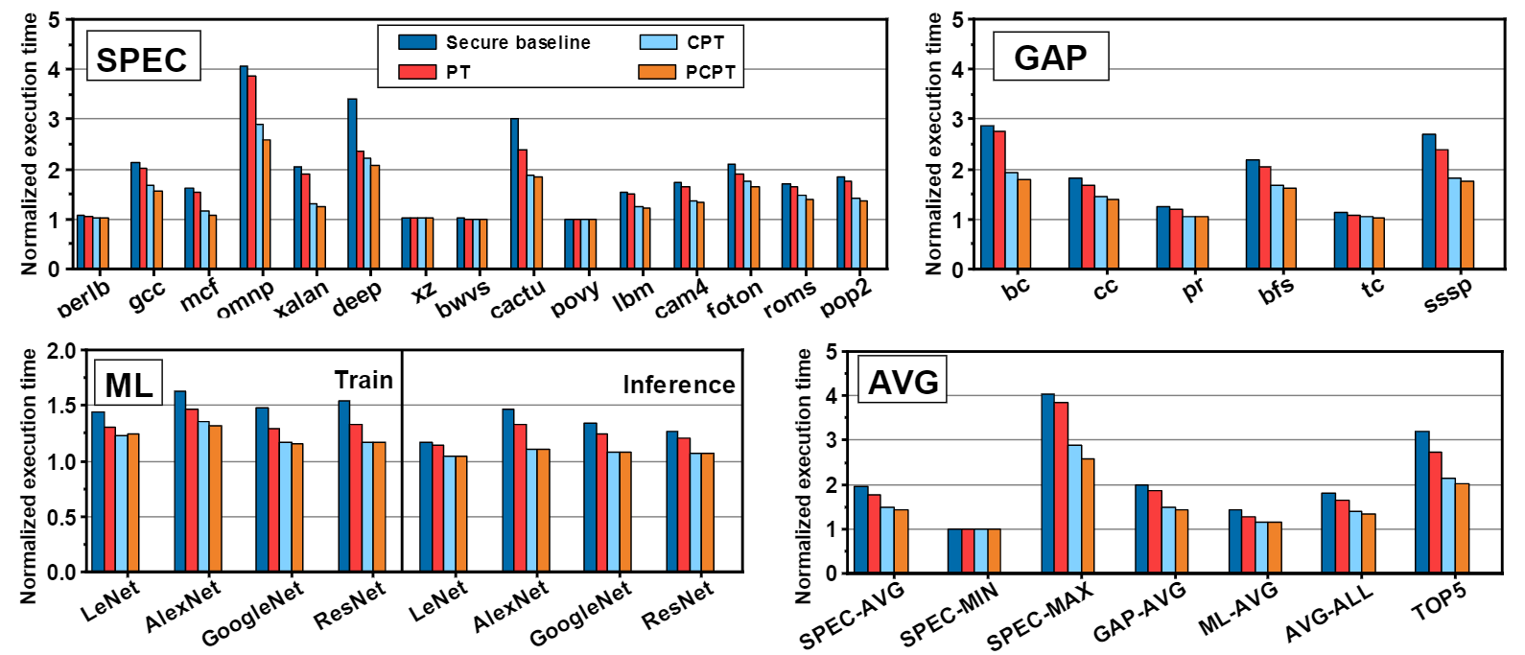
Evaluation
Platform: QEMU+USIMM

Slide 29
Summary
Key Insight
Architecture features of cloud computing servers can be used to improve tree performance.
Proposed Design: PCPT
Design 1: Parallelizing tree path fetching.
Design 2: Curtailing tree node fetches.
Design 3: Adaptive prefetch.
Average performance improvement
PCPT has 55% less overhead compared to SGX integrity tree.

